Slide 1
Plantwide Control Fundamentals Recyle Loop Issues: Snowball Effect
Module # 7.2
Process Dynamics and Control
Supplementary Material
Indian Institute of Technology Kanpur

Slide 2
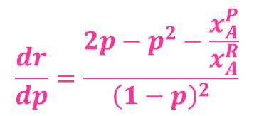
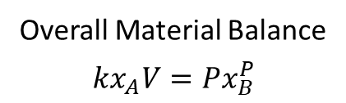
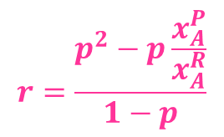
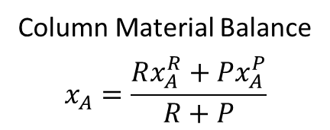
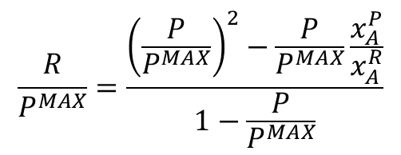
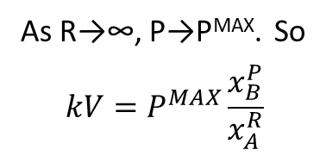
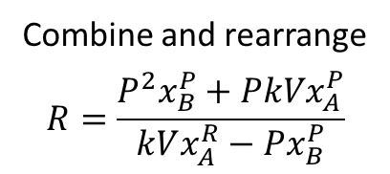
Snowball Effect Analysis
F_{A}
R, x_{A}^{R}
Column Material Balance
$$x_{A}=\frac{Rx_{A}^{R}+Px_{A}^{P}}{R+P}$$
Overall Material Balance
$$kx_{A}V=Px_{B}^{P}$$
Combine and rearrange
$$R=\frac{P^{2}x_{B}^{P}+PkVx_{A}^{P}}{kVx_{A}^{R}−Px_{B}^{P}}$$
As R→∞, P→P^{MAX}. So
$$kV=P^{MAX}\frac{x_{B}^{P}}{x_{A}^{R}}$$
REACTOR
C
O
L
U
M
N
A → B
Q_{rxr}
r = k x_{A}
$$\frac{R}{P^{MAX}}=\frac{{\left(\frac{P}{P^{MAX}}\right)}^{2}−\frac{P}{P^{MAX}}\frac{x_{A}^{P}}{x_{A}^{R}}}{1−\frac{P}{P^{MAX}}}$$
$$r=\frac{p^{2}−p\frac{x_{A}^{P}}{x_{A}^{R}}}{1−p}$$
$$\frac{dr}{dp}=\frac{2p−p^{2}−\frac{x_{A}^{P}}{x_{A}^{R}}}{{\left(1−p\right)}^{2}}$$
P, x_{B}^{P}

Slide 3


Snowball Effect Analysis _{Continued}
$$r=\frac{p^{2}−p\frac{x_{A}^{P}}{x_{A}^{R}}}{1−p}$$
For pure P and R (x_{A}^{P}=x_{B}^{R}=0)
p | r | dr/dp
0.1 | 0.0111 | 0.2346
0.2 | 0.0500 | 0.5625
0.3 | 0.1186 | 1.041
0.4 | 0.2667 | 1.778
0.5 | 0.5000 | 3.000
0.6 | 0.9000 | 5.250
0.7 | 1.633 | 10.11
0.8 | 3.200 | 24.00
0.9 | 8.100 | 99.00
Blows up as p → 1 (ie P → P^{MAX})
$$\frac{dr}{dp}=\frac{2p−p^{2}−\frac{x_{A}^{P}}{x_{A}^{R}}}{{\left(1−p\right)}^{2}}$$
Blows up faster as p → 1 (ie P → P^{MAX})

Slide 4
Nonlinearity
NO FEASIBLE STEADY STATES
Recycle Rate
Snowballing
Fresh Feed Rate
Fixing the fresh feed rate of a recycled component is NOT a good idea
Possibility of overfeeding induced instability

Slide 5
Control Implication of Snowballing
TPM
FC
Recycle A
Fresh A
PC
RC
LC
TC
REACTOR
C
O
L
U
M
N
Cooling
Water
A → B
LC
Recycle loop shows large swings
Large Throughput De-rating
R
TC
%
F_{A}
LC
Time
Product B

Slide 6
Control Implication of Snowballing _{continued}
TPM
FC
Recycle A
Fresh A
PC
RC
LC
TC
REACTOR
C
O
L
U
M
N
Cooling
Water
A → B
LC
No large swings in recycle rate
Lower Throughput De-rating
TC
LC
Product B

Slide 7
TPM Location Flexibility
IC
FC
IC
P
Transforms variability into recycle loop
F
Recycle
FC
IC
IC
Transforms variability out of recycle loop
F
P
Recycle

Slide 8
Summary
Recycle rate typically highly sensitive to production rate changes (snowball effect)
TPM at fresh feed will likely result in large swings in recycle rate, thus disturbing the entire plant.
May also result in overfeeding induced instability
When TPM location is flexible, fix a flow inside the recycle loop (Luyben’s rule) and bring in fresh feed(s) as make-up stream(s) under inventory control.
The fixed flow rate inside the recycle loop may be used as TPM.

