Slide 1
Plantwide Control Fundamentals Economic Operation
Module # 7.4
Process Dynamics and Control
Supplementary Material
Indian Institute of Technology Kanpur

Slide 2
PWC Basics
Regulatory Control System
Drives all inventory accumulation terms to zero
Ensures plant operation around a steady state
What steady state to operate at
Economic Optimum
Minimize expensive utility consumption
Maximize production

Slide 3
Plantwide Control Hierarchy
PLANTWIDE CONTROL SYSTEM
Optimization Layer
(updates every few hrs)
Economic Operation
SETPOINT
Supervisory Control Layer
(updates every few mins)
Measurements
SETPOINT
Safe & Stable Operation
Regulatory Control Layer
(updates every few secs)
SIGNAL TO VALVE
PLANT

Slide 4
Regulatory PWCS Design
What to Control
Throughput or Production Rate (TPM selection)
All independent inventories (DOF)
Material – Liquid level or gas pressure
Energy – Temperature or vapor pressure
Component – Composition, tray temperature (inferential)
Degree of tightness of control
Energy inventories should be tightly controlled.
Surge level inventories should be loosely controlled.
What to manipulate
The largest term on the RHS of the inventory balance
Richardson’s Rule
Pair close
Fast dynamics
Tight closed loop control

Slide 5
PWC Basics: TPM Selection
When is TPM choice flexible
Large storage tanks supply the fresh feed(s)
Variability in storage tank level is acceptable
Allows structures that bring in fresh feed(s) as make-up
Usually plant designs have large recycle rates
Design in the snowballing region
Capacity bottleneck then is likely inside the loop
Where to locate the TPM
Inside the recycle loop
If multiple recycle loops, on a common branch
If bottleneck is known, AT the bottleneck

Slide 6
Key PWC Guidelines
Configure control structure to transform recycle rate variability out of the recycle loop
Provide control DOFs for fast “local” control
“Pair” locally for fast control
Choose TPM at bottleneck constraint to transform variability away from bottleneck
Almost always, bottleneck is inside the recycle loop

Slide 7
Economic Operation Considerations
ECONOMIC OBJECTIVE
MINIMIZE J over dofs u
subject to process contraints
J
J
J
Loss
u^{opt}
u^{MIN}
u
u^{MAX}
u^{MIN}
u
u^{MAX}
u^{MIN}
u
u^{MAX}
Operate at u^{MAX} always
Operate at u^{MIN} always
Operate at u^{opt}
u^{opt} changes

Slide 8
The “What to Control” Paradigm
J
u^{MIN}
u
u^{MAX}
Optimum remains “nearly” the same
Find those “magic” process variables with invariant optimum
WHAT TO CONTROL
All active constraints
Economic CVs

Slide 9

Optimal Operating Policy Example
40 km Marathon
100 m Sprint
J = min_{u} Race Completion Time
J = min_{u} Race Completion Time
Constant Effort
BRC
BR SP
Constant Speed
100%
SC
Speed SP
Constant Breathing Rate
Running Effort
Running Effort
The Skogestad Example
NEED PROCESS INSIGHT FOR DEVELOPING OPTIMAL OPERATING POLICY
Image taken from: https://www.vectorstock.com

Slide 10
PWCS Design Steps
DOF analysis and control objectives
Production rate
Product quality
Safety limits (eg UFL < gas loop composition < LFL)
Economic
Choose TPM
Feed set by an upstream process
On demand operation (utility plants)
Flexible
Inside the recycle loop at the feed of the most non-linear/fragile unit
If bottleneck is known, at the bottleneck inside the recycle loop
Design “local” loops for closing all independent material and energy balances around the TPM
Radiate outwards from the TPM
Check consistency of material / energy balance closure (Downs’ Drill)
Choose loop setpoints “wisely”
Usually governed by economic considerations

Slide 11




Reactor-Separator-Recycle Process
R, x_{C}^{R}
DOF ANALYSIS
Control DOFs 9
Surge levels 2
Given Column P 1
Steady State DOF 6
FA
FB
A + B → C
Production rate P
Product purity x_{C}^{P MIN}
Max reactor Temperature T_{rxr}^{MAX}
Max reactor Holdup V_{rxr}^{MAX}
Max recycle impurity x_{C}^{R} ^{MAX}
Unconstrained DOF 1
KM I $r=k{ x}_{A}{ x}_{B}$
E
KM II: $r=k x_{A}^{a} x_{B}^{b}$
KM III: $r=k\frac{x_{A}{ x}_{B}}{1+K_{A}x_{A}+K_{B}x_{B}}$
KM IV: $r=k\frac{x_{A}^{a}{ x}_{B}^{b}}{1+K_{A}x_{A}+K_{B}x_{B}}$
P, x_{C}^{P}

Slide 12
Mode I Economic Operation
At given production rate, P
Find the globally optimal control law for 1 unconstrained DOF that
minimizes recycle rate, R
R is surrogate for column boilup

Slide 13
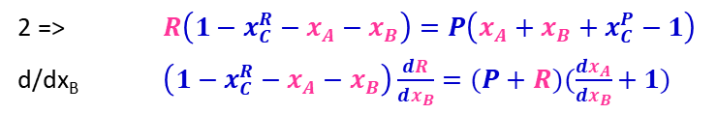

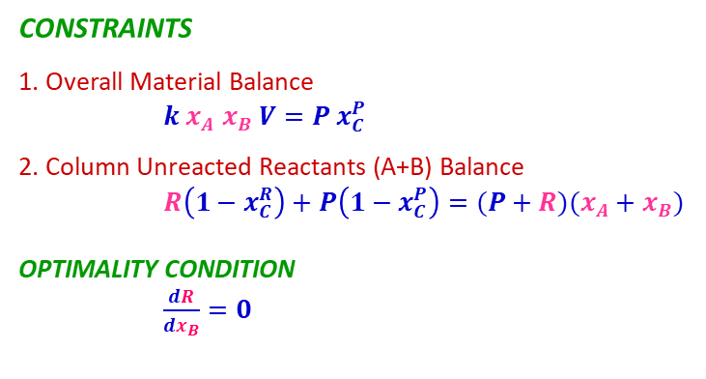

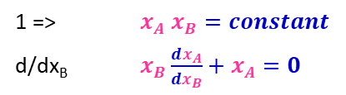
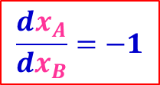
Mode I Optimal Invariant: KM I
FA
R, x_{C}^{R}
MINIMIZE R at given production, P
CONSTRAINTS
1. Overall Material Balance
$k x_{A} x_{B} V=P x_{C}^{P}$
2. Column Unreacted Reactants (A+B) Balance
$R\left(1−x_{C}^{R}\right)+P\left(1−x_{C}^{P}\right)=(P+R)(x_{A}+x_{B})$
OPTIMALITY CONDITION
$\frac{dR}{dx_{B}}=0$
FB
A + B → C
E
KM I: $r=k{ x}_{A}{ x}_{B}$
2 => $R\left(1−x_{C}^{R}−x_{A}−x_{B}\right)=P\left(x_{A}+x_{B}+x_{C}^{P}−1\right)$
d/dx_{B} $\left(1−x_{C}^{R}−x_{A}−x_{B}\right)\frac{dR}{dx_{B}}=(P+R)(\frac{dx_{A}}{dx_{B}}+1)$
$$\frac{dx_{A}}{dx_{B}}=−1$$
0
1 => $x_{A} x_{B}=constant$
d/dx_{B} $x_{B}\frac{dx_{A}}{dx_{B}}+x_{A}=0$
P, x_{C}^{P}
$$x_{A}=x_{B}$$

Slide 14
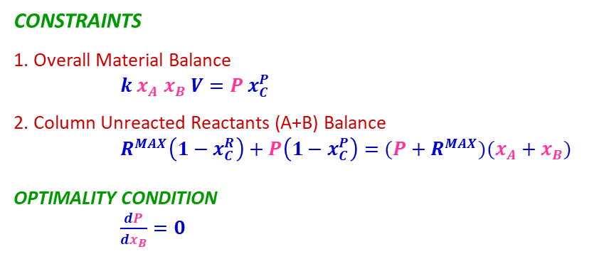


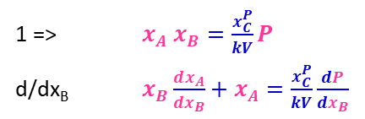
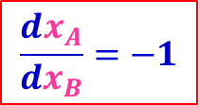
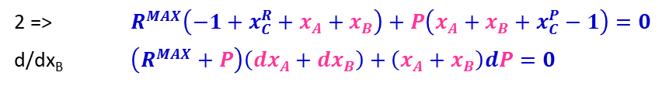
Mode II Optimal Invariant: KM I
R, x_{C}^{R}
Maximize P subject to bottleneck R^{MAX}
FA
CONSTRAINTS
1. Overall Material Balance
$k x_{A} x_{B} V=P x_{C}^{P}$
2. Column Unreacted Reactants (A+B) Balance
$R^{MAX}\left(1−x_{C}^{R}\right)+P\left(1−x_{C}^{P}\right)=(P+R^{MAX})(x_{A}+x_{B})$
OPTIMALITY CONDITION
$\frac{dP}{dx_{B}}=0$
FB
A + B → C
E
KM I: $r=k{ x}_{A}{ x}_{B}$
2 => $R^{MAX}\left(−1+x_{C}^{R}+x_{A}+x_{B}\right)+P\left(x_{A}+x_{B}+x_{C}^{P}−1\right)=0$
d/dx_{B} $\left(R^{MAX}+P\right)\left(dx_{A}+dx_{B}\right)+\left(x_{A}+x_{B}\right)dP=0$
$$\frac{dx_{A}}{dx_{B}}=−1$$
0
1 => $x_{A} x_{B}=\frac{x_{C}^{P}}{kV}P$
d/dx_{B} $x_{B}\frac{dx_{A}}{dx_{B}}+x_{A}=\frac{x_{C}^{P}}{kV}\frac{dP}{dx_{B}}$
P, x_{C}^{P}
$$x_{A}=x_{B}$$
0

Slide 15
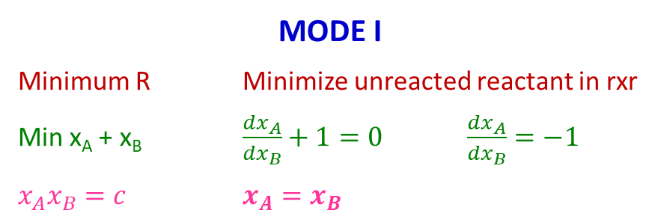
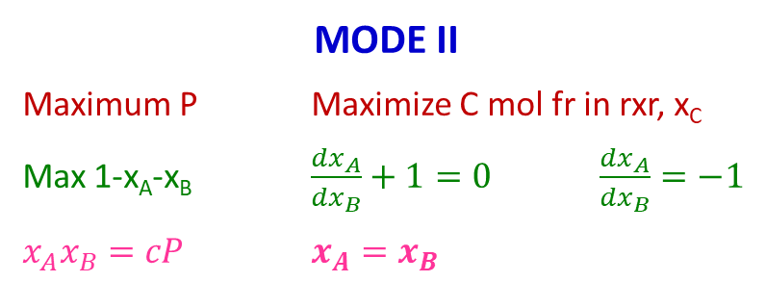
Interpretation
FA
R, x_{C}^{R}
MODE I
Minimum R Minimize unreacted reactant in rxr
Min x_{A} + x_{B} $\frac{dx_{A}}{dx_{B}}+1=0$ $\frac{dx_{A}}{dx_{B}}=−1$
$x_{A}x_{B}=c$ $x_{A}=x_{B}$
FB
A + B → C
E
MODE II
Maximum P Maximize C mol fr in rxr, x_{C}
Max 1-x_{A}-x_{B} $\frac{dx_{A}}{dx_{B}}+1=0$ $\frac{dx_{A}}{dx_{B}}=−1$
$x_{A}x_{B}=cP$ $x_{A}=x_{B}$
KM I: $r=k{ x}_{A}{ x}_{B}$
P, x_{C}^{P}

Slide 16
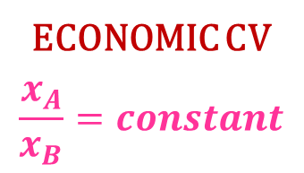
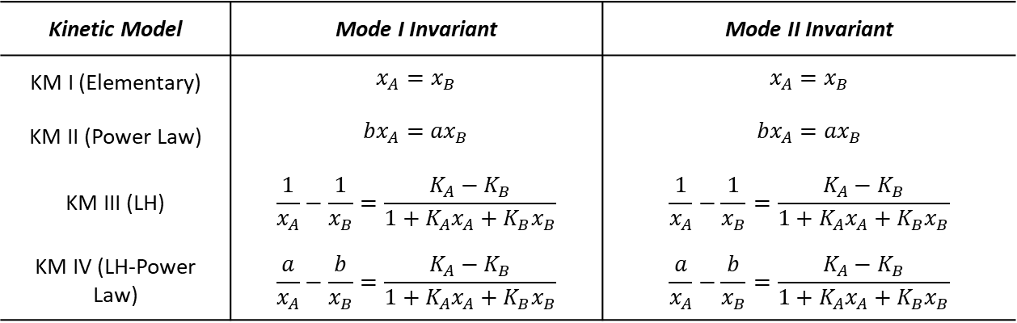
Optimal Invariants
Kinetic Model | Mode I Invariant | Mode II Invariant
KM I (Elementary) | $$x_{A}=x_{B}$$ | $$x_{A}=x_{B}$$
KM II (Power Law) | $${bx}_{A}={ax}_{B}$$ | $${bx}_{A}={ax}_{B}$$
KM III (LH) | $$\frac{1}{x_{A}}−\frac{1}{x_{B}}=\frac{K_{A}−K_{B}}{1+K_{A}x_{A}+K_{B}x_{B}}$$ | $$\frac{1}{x_{A}}−\frac{1}{x_{B}}=\frac{K_{A}−K_{B}}{1+K_{A}x_{A}+K_{B}x_{B}}$$
KM IV (LH-Power Law) | $$\frac{a}{x_{A}}−\frac{b}{x_{B}}=\frac{K_{A}−K_{B}}{1+K_{A}x_{A}+K_{B}x_{B}}$$ | $$\frac{a}{x_{A}}−\frac{b}{x_{B}}=\frac{K_{A}−K_{B}}{1+K_{A}x_{A}+K_{B}x_{B}}$$
ECONOMIC CV
$$\frac{x_{A}}{x_{B}}=constant$$

Slide 17
Practical Case
Mode I
Minimize boilup or reboiler duty at given production
Recycle rate and boilup correlated but not linearly related
Mode II
Maximize production subject to maximum boilup as bottleneck
Bottleneck corresponds to column flooding
Candidate economic CVs
Reactor B mol fr, x_{B}
Reactor A/B ratio, x_{A}/x_{B}
Global invariant (RHS – LHS = 0)

Slide 18
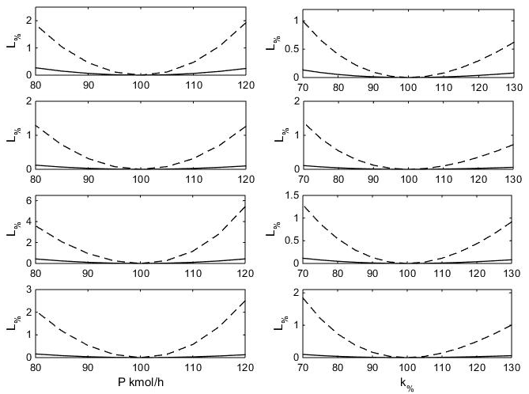
Economic Performance Quantification
Mode I
Mode II
── : [A/B] at nominal optimum
- - - : x_{rxrB} at nominal optimum
KM I
KM II
KM III
KM IV

Slide 19
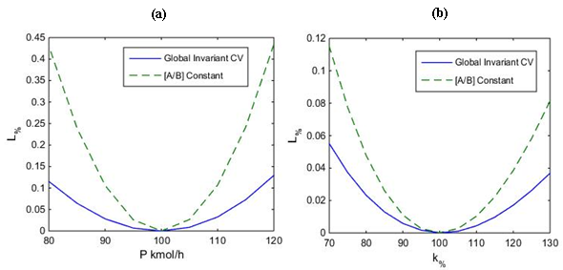
Economic Performance Quantification
Mode I
Mode II
Constant reactor A/B ratio a good economic CV for all reaction kinetic types

Slide 20
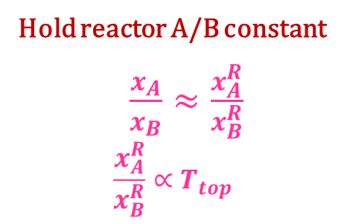
Inferring Reactor A/B Ratio
R, x_{C}^{R}
Hold reactor A/B constant
$\frac{x_{A}}{x_{B}}≈\frac{x_{A}^{R}}{x_{B}^{R}}$
$$\frac{x_{A}^{R}}{x_{B}^{R}}∝T_{top}$$
FA
FB
T_{top}
A + B → C
E
T_{top} infers reactor A/B ratio
P, x_{C}^{P}

Slide 21
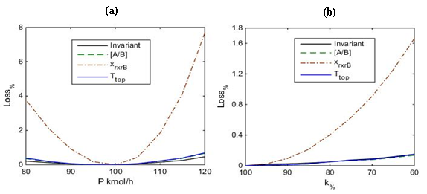
T_{top} as Economic CV
Mode I
Mode II
T_{top} is a good economic CV

Slide 22
Plantwide Control Structure, CS1
FC
X
CC
x_{B}
R, x_{C}^{R}
FA
LVL_{rxr} ^{MAX}
LC
PC
FB
CC
T_{rxr} ^{MAX}
x_{C}^{R MAX}
FC
LC
TC
A + B → C
Economic CV: x_{B}
E
x_{C}^{P MIN}
V^{MAX}
CC
TC
LS
TPM
FC
LC
P, x_{C}^{P}

Slide 23
Plantwide Control Structure, CS 2
FC
X
TC
T_{top}
R, x_{C}^{R}
FA
LVL_{rxr} ^{MAX}
LC
PC
FB
CC
T_{rxr} ^{MAX}
x_{C}^{R MAX}
FC
LC
TC
A + B → C
Economic CV: T_{top}
E
x_{C}^{P MIN}
V^{MAX}
CC
TC
LS
TPM
FC
LC
P, x_{C}^{P}

Slide 24
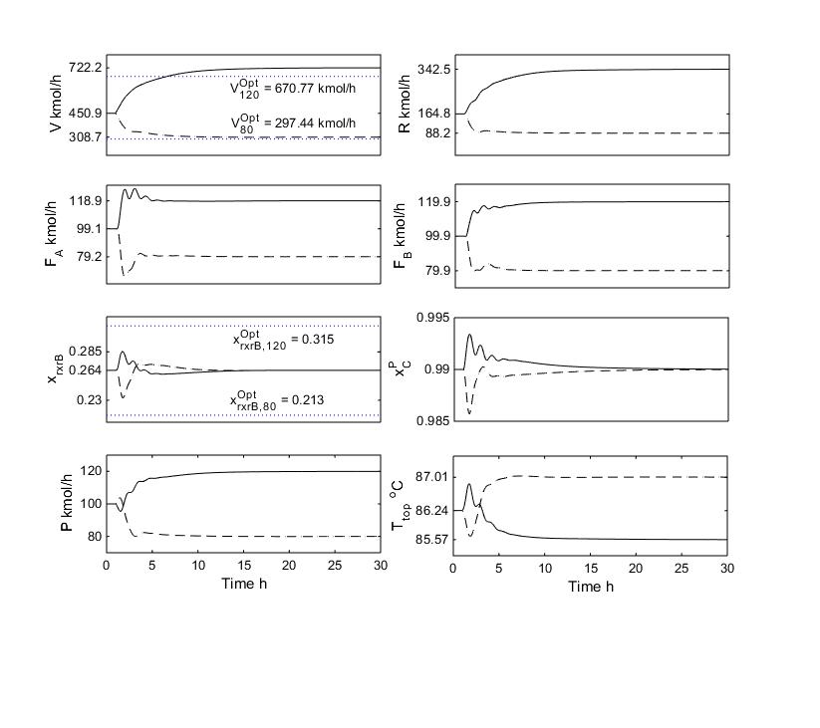
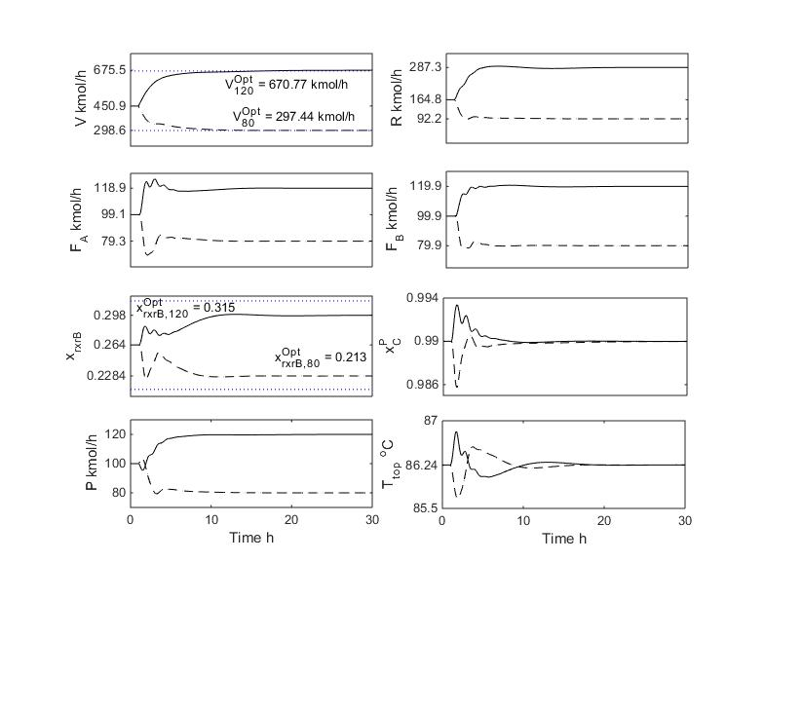
Mode I Throughput Change Response
CS1: x_{B} constant
CS2: T_{top} constant
+20% Throughput: CS1 boilup ~7.0% higher -20% Throughput: CS1 boilup ~3.6% higher

Slide 25
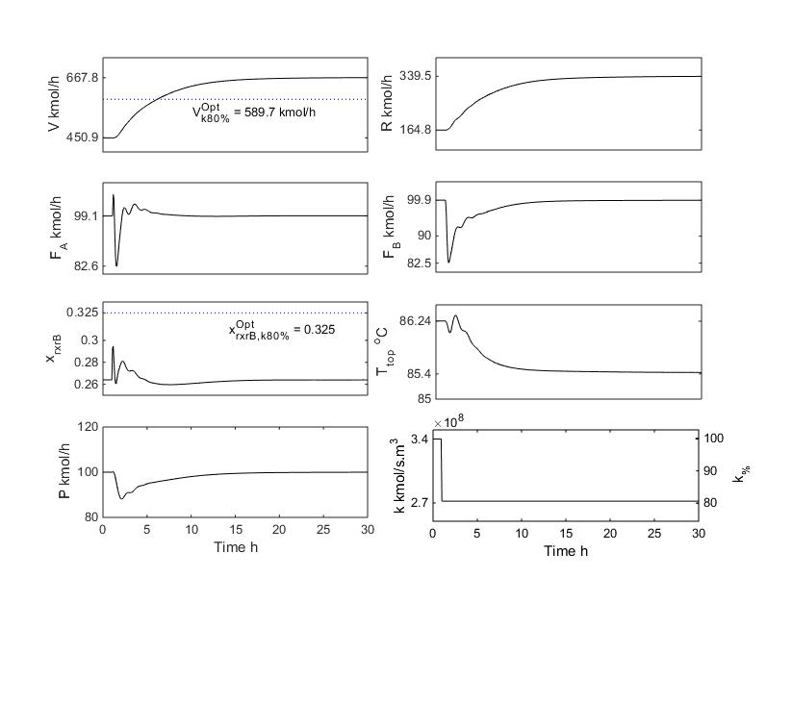
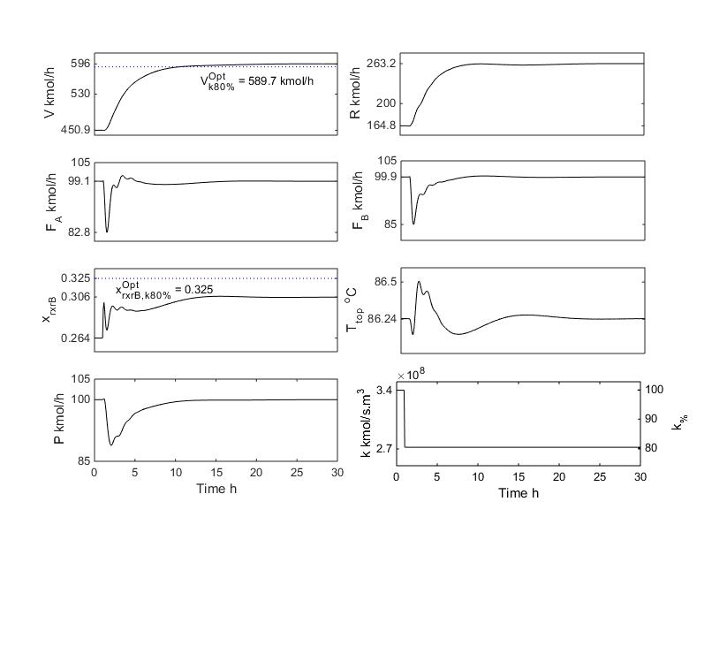
Mode I Catalyst Deactivation Response
CS1: x_{B} constant
CS2: T_{top} constant
20% Deactivation: CS1 boilup ~12% higher

Slide 26
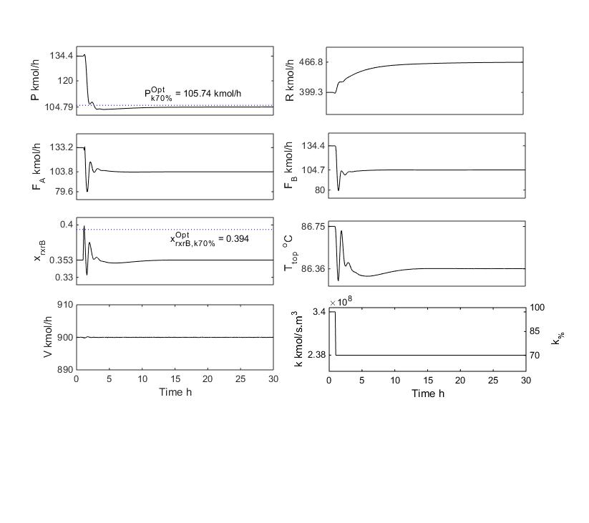
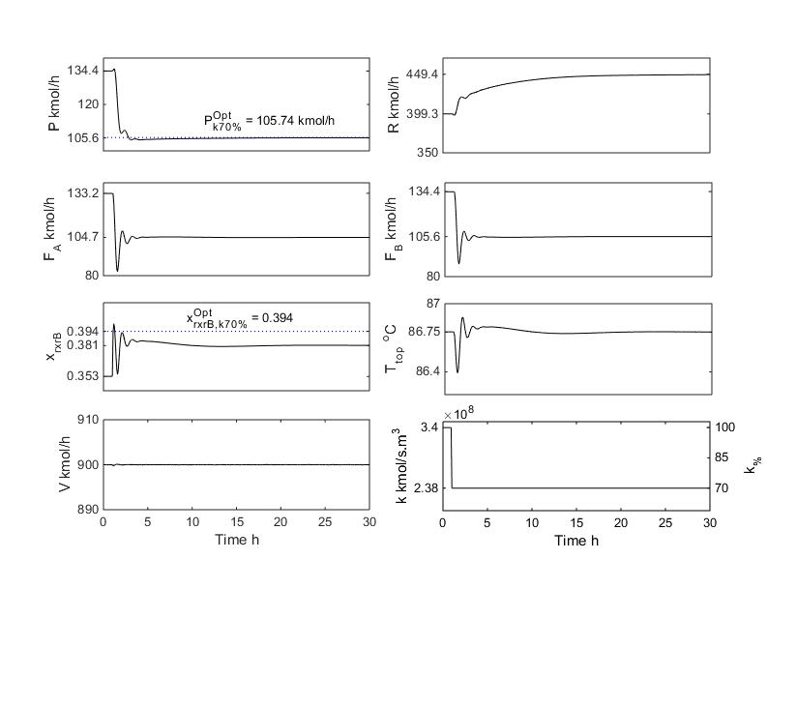
Mode II Catalyst Deactivation Response
CS1: x_{B} constant
CS2: T_{top} constant
30% Deactivation: CS1 production ~0.8% lower

Slide 27
Summary
What to control holds the key to effective plantwide control
Control all active constraints
Control SOCVs for unconstrained dofs
Proper choice of TPM (inside the recycle loop) ensures robust regulation
Significant max throughput benefit (up to 25% in ester process example)
Self-optimizing CVs for unconstrained variables can result in significant energy savings
7-12% energy savings in example reactor-separator recycle process
Presented approach provides method to the madness that plantwide control can be

