Slide 1
Plantwide Control Fundamentals Cumene Process PWCS Design
Lecture # 7.5
Process Dynamics and Control
Supplementary Material
Indian Institute of Technology Kanpur

Slide 2
Cumene Process
Transalkylation
C₁₂ + C₆ ↔ 2C₉
Transalkylator
Recycle C₆
C₉
Recycle
Product
C₁₂
C₆
Vent
C₃
Furnace
Alkylation
C₃ + C₆ → C₉
C₉ + C₃ → C₁₂
FEHE
Alkylator
Purge
Vaporizer

Slide 3
DOF Analysis
Transalkylator
Recycle C₆
C₉
# of Control Valves 25
# of LCs 8
Given Column Ps 3
Given Reactor P 1
STEADY STATE DOF 13
Recycle
Product
C₁₂
C₆
Vent
C₃
Furnace
FEHE
Alkylator
Purge
Vaporizer

Slide 4
Steady State Specifications
Specified Variable | Comment 1 | Comment 2
Throughput (Production Rate) | Specified by business side | First fresh feed DoF
Main reactor C₆ to C₃₌ ratio | Excess C₆ to suppress C₁₂ formation | Second fresh feed DoF
C₆ Impurity in Product | Fixed by product quality requirement | Recycle column DoF 1 (bottom LK impurity)
C₁₂ Impurity in Product | Fixed by product quality requirement | Product column DoF 1 (top HK impurity)
Reactor Feed Temperature | Set by furnace duty | Furnace DoF
Reactor Temperature | Set by reactor cooling duty | Reactor DoF
Purge Column Top Temperature | ~ 50 °C. Set by condenser cooling water | Purge column DoF 1
Purge Column Bottom C₃ Impurity | Set to a small value (say 0.1 mol%) | Purge column DoF 2
Recycle Column Top C₉ Impurity | Set to a small value (say 0.1 mol%) | Recycle column DoF 2 (top HK impurity)
Product Column Bottom C₉ Impurity | Set to a small value (say 1 mol%) | Product column DoF 2 (bottom LK impurity)
TA reactor inlet temperature | Set by TA preheater | TA preheater DoF
TA effluent cooler outlet temperature | Set by TA effluent cooling duty | TA effluent cooler DoF
TA C₆ to C₁₂ ratio | High value (shifts equilibrium to right) | C₆ recycle splitter DoF
Production Rate (Throughput)
C₆ Impurity in Product
C₉ Impurity in Product
Reactor Feed Temperature
Reactor Temperature
Purge Column Top Temperature
C₃ Impurity in Purge Column Bottoms
Flash Drum Cooler Sets Reactor Pressure

Slide 5
Conventional PWCS: TPM at C₃ Feed
TC
Transalkylator
TC
Transalkylation
C₉ + C₆ ↔ C₉
Recycle C₆
PC
CC
PC
FC
X
FC
LC
X
FC
LC
C₉
X
Recycle
CC
Product
TC
TC
X
LC
LC
C₁₂
C₆
FC
TC
PC
Vent
TPM
C₃
FC
LC
Furnace
TC
Alkylation
C₃ + C₆ → C₉
C₉ + C₃ → C₁₂
FEHE
TC
Alkylator
Purge
Vaporizer
LC
PC
LC
TC
LC

Slide 6
Bottleneck: Recycle Column Flooding
TC
Transalkylator
TC
Transalkylation
C₉ + C₆ ↔ C₉
Recycle C₆
PC
CC
PC
FC
Alkylation
C₃ + C₆ → C₉
C₉ + C₃ → C₁₂
X
FC
LC
X
FC
LC
C₉
X
Recycle
CC
Product
TC
TPM
TC
X
FC
LC
LC
C₁₂
C₆
FC
TC
PC
Vent
C₃
FC
LC
Furnace
TC
FEHE
TC
Alkylator
Purge
Vaporizer
PC
LC
TC
LC
LC

Slide 7
Bottleneck: Furnace Duty
TC
Transalkylator
TC
Transalkylation
C₉ + C₆ ↔ C₉
Recycle C₆
PC
CC
PC
FC
Alkylation
C₃ + C₆ → C₉
C₉ + C₃ → C₁₂
X
FC
LC
X
FC
LC
C₉
X
Recycle
CC
Product
TC
TC
X
LC
LC
C₁₂
C₆
FC
TC
PC
Vent
C₃
FC
LC
Furnace
TC
FEHE
TPM
Alkylator
Purge
Vaporizer
PC
LC
LC
TC
TC
LC

Slide 8
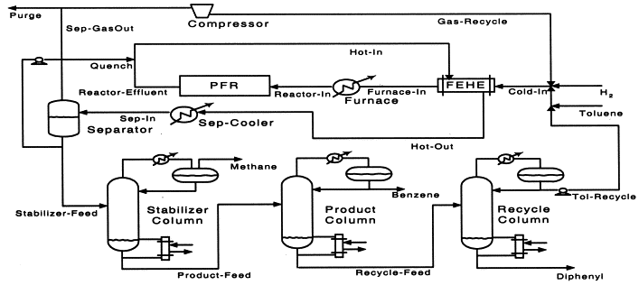
Exercise: HDA Process
C₇H₈ + H₂ → C₆H₆ + CH₄
2C₆H₆ ↔ C₁₂H₁₀ + H₂

