Slide 1
Process for Separating Ethanol‐Water Mixture with Benzene as Entrainer
The ethanol‐water binary system has a minimum boiling azeotrope that makes obtaining pure ethanol and pure water using simple distillation, infeasible. One of the common routes for breaking the azeotrope is to use benzene as a light entrainer. The separation process consists of three columns, namely, the prefractionator, the azeotropic column and the recycle column. The prefractionator processes the dilute ethanol‐water feed to recover the ethanol rich azeotrope as the distillate and pure water as the bottoms. The distillate (azeotrope) is fed to the azeotropic column, in which the benzene (entrainer) preferentially carries the water and some ethanol as the overhead vapour, which is condensed. The condensate is collected in a surge drum. It phase separates into a benzene rich organic layer (contains some ethanol and water) and a water rich aqueous layer (contains some ethanol and benzene). The organic layer is refluxed back into the column and the aqueous layer leaves as the distillate product. Since the entrainer preferentially carries the water overhead, pure ethanol is recovered as the bottoms product. The aqueous layer distillate from the azeotropic column is sent to the recycle column which recovers pure water as the bottoms product and recycles the distillate (contains all three components) to the azeotropic column after mixing it with the distillate from the prefractionator.
Trace amounts of the entrainer is lost in the pure ethanol and pure water product streams. To make up for this loss, a small make‐up entrainer stream is fed to the azeotropic column decanter.

Slide 2
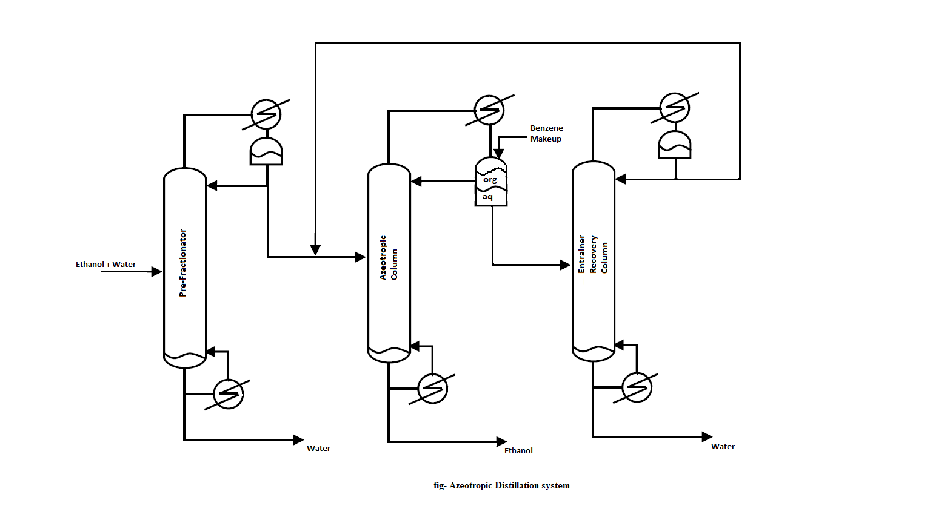

Slide 3
Process for Separating Isopropyl Alcohol (IPA)‐Water Mixture with Cyclohexane as Entrainer
IPA‐water mixture forms a minimum boiling azeotrope so that simple distillation cannot be used to separate it into its pure components. Cyclohexane is commonly used as an entrainer to break the azeotrope and separate an IPA‐water mixture into pure IPA and pure water. The three‐column separation process consists of the prefractionator, the azeotropic column and the recycle column. The prefractionator separates the dilute IPA‐water feed into an IPA rich distillate whose composition is very close to the azeotrope and a pure water bottoms product. The prefractionator distillate is sent to the azeotropic column. In this column, the entrainer (cyclohexane) preferentially carries the water and some IPA in the overhead vapour, which is condensed and collected in a surge drum. The condensate phase separates into an organic layer (mostly entrainer with some water and IPA) and an aqueous layer (mostly water with some entrainer and IPA). The organic layer is refluxed and the aqueous layer leaves as distillate. With the entrainer preferentially carrying the water overhead, pure IPA is recovered as the bottoms product from the azeotropic column. The aqueous layer distillate is separated in the recycle column to recover pure water as the bottoms product and IPA‐entrainer rich distillate, which is recycled back to the azeotropic column after mixing it with prefractionator distillate.
Trace amounts of the entrainer is lost in the pure IPA and pure water product streams. To make up for this loss, a small make‐up entrainer stream is fed to the azeotropic column decanter

Slide 4
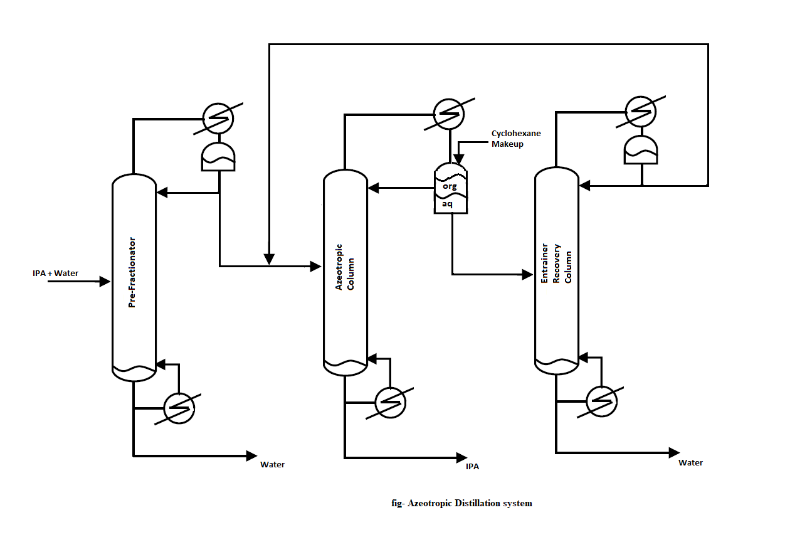

Slide 5
Process for Separating Ethanol‐Water Mixture with Ethyl Ether as Entrainer
The ethanol‐water binary system has a minimum boiling azeotrope that makes obtaining pure ethanol and pure water using simple distillation, infeasible. One of the common routes for breaking the azeotrope is to use ethyl ether as a light entrainer. The separation process consists of three columns, namely, the prefractionator, the azeotropic column and the stripping column. The prefractionator processes the dilute ethanol‐water feed to recover the ethanol rich azeotrope as the distillate and pure water as the bottoms. The distillate (azeotrope) is fed to the azeotropic column, in which the ethyl ether (entrainer) preferentially carries the water and very little ethanol as the overhead vapour, which is condensed. The condensate is collected in a surge drum. It phase separates into an ether rich organic layer (contains some ethanol, negligible water) and a water rich aqueous layer (contains some ether, negligible ethanol). The organic layer is refluxed back into the column and the aqueous layer leaves the column as the distillate product. Since the entrainer preferentially carries the water overhead, pure ethanol is recovered as the bottoms product from the azeotropic column. The water rich distillate from the azeotropic column is sent to the stripping column which recovers pure water as the bottoms product. The overhead vapour (mostly ethyl ether with some water) is condensed and sent to the azeotropic column decanter.
Trace amounts of the entrainer is lost in the pure ethanol and pure water product streams. To make
up for this loss, a small make‐up entrainer stream is fed to the azeotropic column decanter.

Slide 6
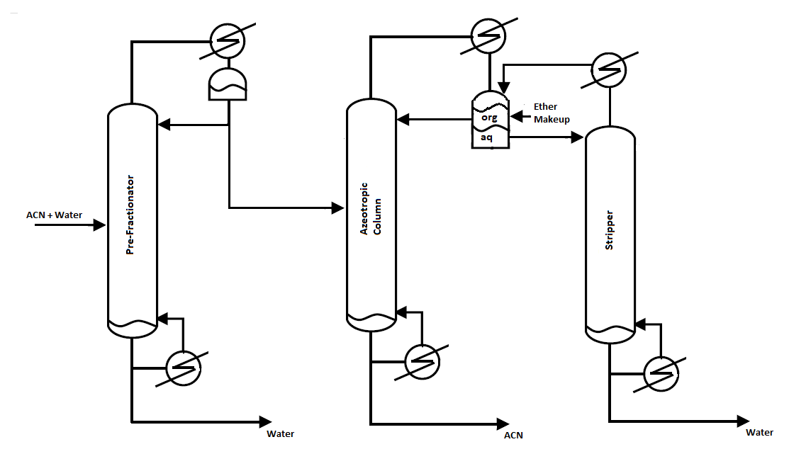

Slide 7
Process for Separating Acetonitrile‐Water Mixture with Acrylonitrile as Entrainer
The acetonitrile (AcN)‐water binary system has a minimum boiling azeotrope that makes obtaining pure AcN and pure water using simple distillation, infeasible. One of the common routes for breaking the azeotrope is to use acrylonitrile as a light entrainer. The separation process consists of three columns, namely, the prefractionator, the azeotropic column and the stripping column. The prefractionator processes the dilute AcN‐water feed to recover the AcN rich azeotrope as the distillate and pure water as the bottoms. The distillate (azeotrope) is fed to the azeotropic column, in which the acrylonitrile (entrainer) preferentially carries the water and negligible AcN as the overhead vapour, which is condensed. The condensate phase separates in a decanter into an organic layer (mostly entrainer, some water, negligible AcN) and an aqueous layer (mostly water, some entrainer, negligible AcN). The organic layer is refluxed back into the column and the aqueous layer leaves as the distillate product. With the entrainer preferentially carrying the water overhead, pure AcN is recovered as the bottoms product from the azeotropic column. The aqueous layer distillate is sent to the stripping column which recovers pure water as the bottoms product. The overhead vapour (mostly entrainer with some water) is condensed and recycled to the azeotropic column decanter.
Trace amounts of the entrainer is lost in the pure AcN and pure water product streams. To make up for this loss, a small make‐up entrainer stream is fed to the decanter.

Slide 8


