Slide 1
BANG! AI Using a Bayesian Belief Network
Barbara Martin
Elizabeth Phippen

Slide 2
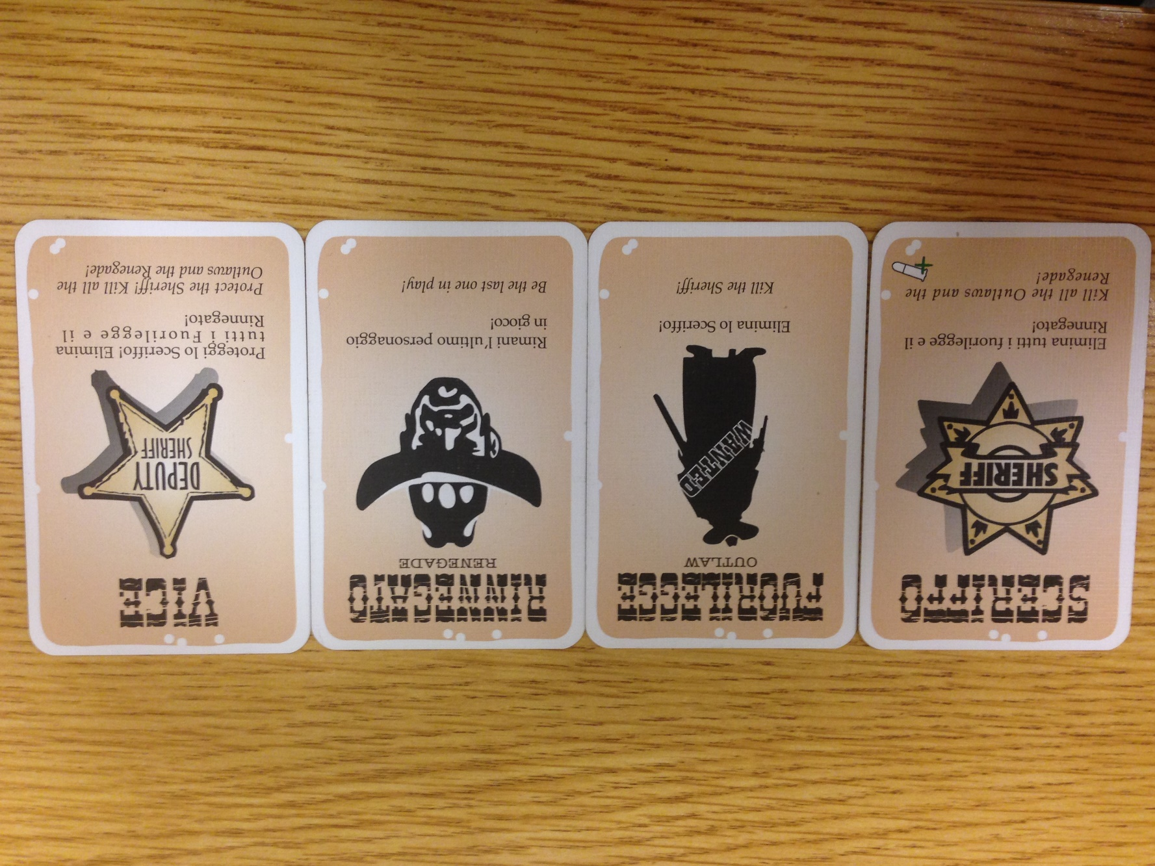
BANG!
Roles
Sheriff, Outlaw(x3), Renegade, Deputy(x2)
To win
Sheriff/Deputies have to kill the Outlaws and Renegade
Outlaws have to kill the Sheriff
Renegade has to kill everyone, saving the Sheriff for last
Turn
Draw 2 cards
Play/discard as many from hand as you want
Must end turn with hand <= health

Slide 3
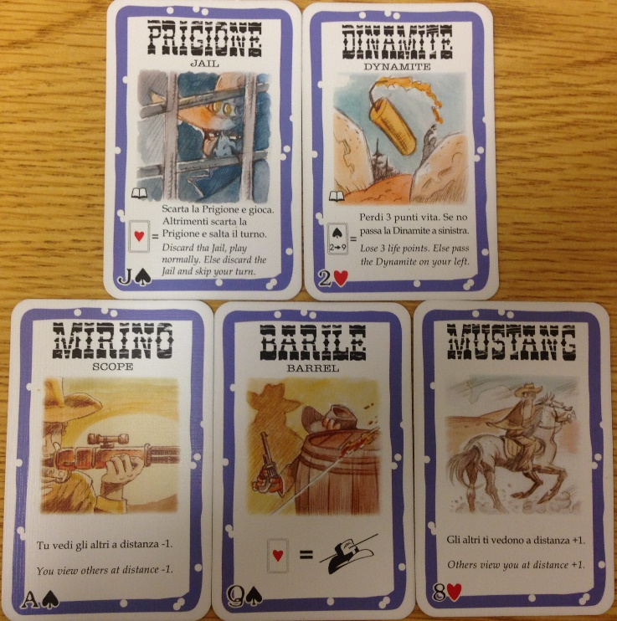
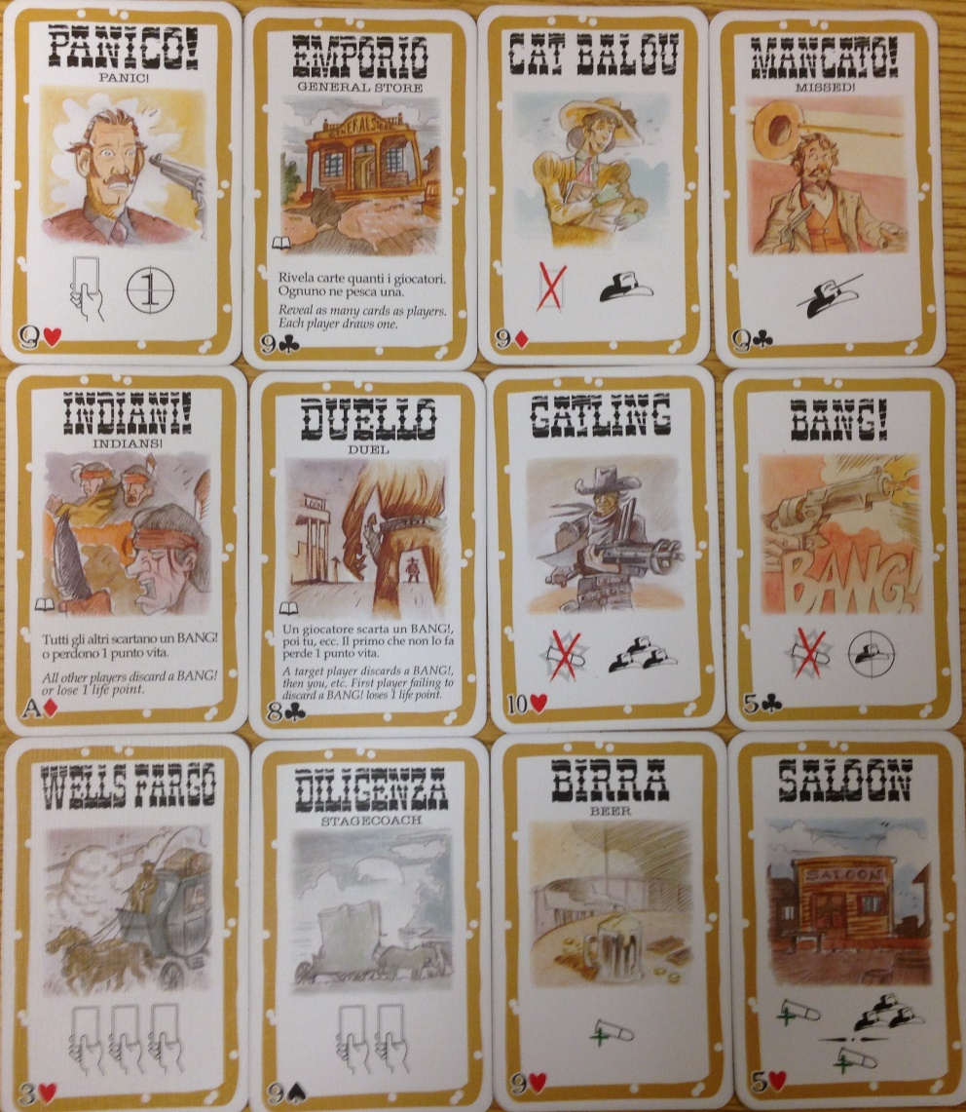
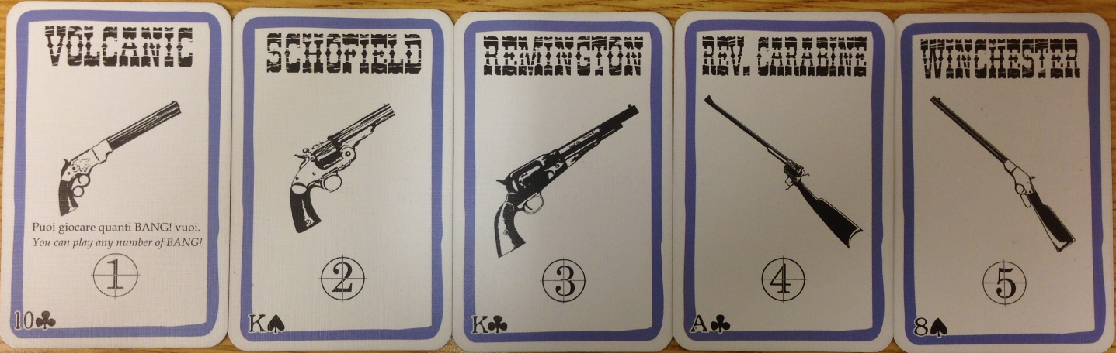
It gets Complicated…

Slide 4
Our Goal / Methodology
Construct a AI for BANG!
Based on Bayesian Belief Network (BN)
Choose BN because Bang is a game of incomplete information
Roles remain hidden until a player is killed
E.g. Sheriff doesn’t want to shoot a deputy
BN handles probabilities well
Language: Python
Flexible and has BN module
bayespy

Slide 5
Methodology
Game Construction
Complicated rule logic
Slight language barrier
Dumb AI for Comparison
plays every card possible on self and person to the left
BN construction
Drew model
Split in to manageable steps

Slide 6
Methodology
Ran 20 Games for each game size (4-7)
BN AI set to one character group
Sheriff
Outlaws
Renegade
Deputies
All others set to Dumb AI
Recorded winning group/player

Slide 7
Results

Slide 8
Results

Slide 9
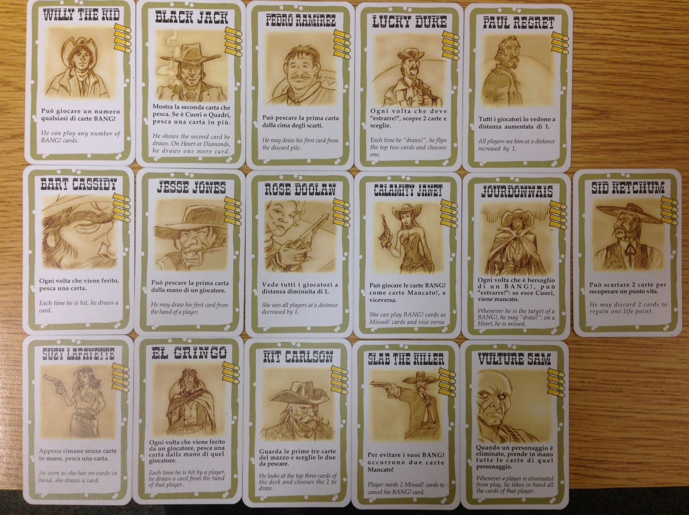
Areas of Future Inquiry
Addition of Characters to Game
Addition of Characters to Bayesian Network
Comparison of Bayesian Network to other AI algorithms

