Slide 1
Letting Turing handle the BUGS
Where we are,
and where we want to go

Slide 2
Current state
Turing.jl: Evaluator function with contexts
...no graphical information!
GraphPPL (in progress): hand-build graphical models
...no front-end; semantics & interface unclear
Some half-baked ideas on a type system
...me inventing semantics from nothing

Slide 3
End goal
Graphical representation for models
→ Manipulation, analysis & inference
Connected to a front-end (DSL) with specified semantics
Eventually: subsume both styles under common abstraction

Slide 4
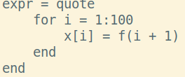
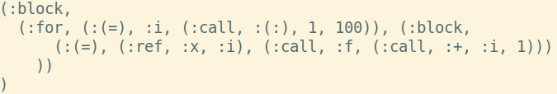
Julia AST
LISP-like: everything an S-expression
Extensible and transformable (macros)
Pre-semantic: no types et al.

Slide 5
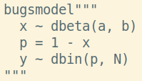
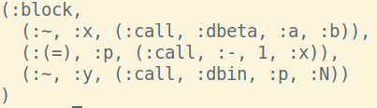
BUGS fragment of Julia syntax
“Raw”, implicit graph
Still ordered, unnormalized
No metadata attached

Slide 6
Where to go
Transformation to evaluator functions: easy, but uninteresting/insufficient
Want: graphical model, node (meta)data, dependencies, …
Correctness: validity, typing, domain constraints, ...

Slide 7
What’s the BUGS way?
How do graph construction and checking phases interact?
Role of the data?
Specified semantics?
“Lowering”: normalization, treatment of loops, ...

Slide 8
Concrete discussion points
Phases of model construction/checking
Usage of data structures
Relation between “raw model” and data
Semantics of “raw model” and “instantiated model”

