Slide 1
TimSort
Instructional Slides
Aidan Tan, Sarah Warren, Philip Yao

Slide 2
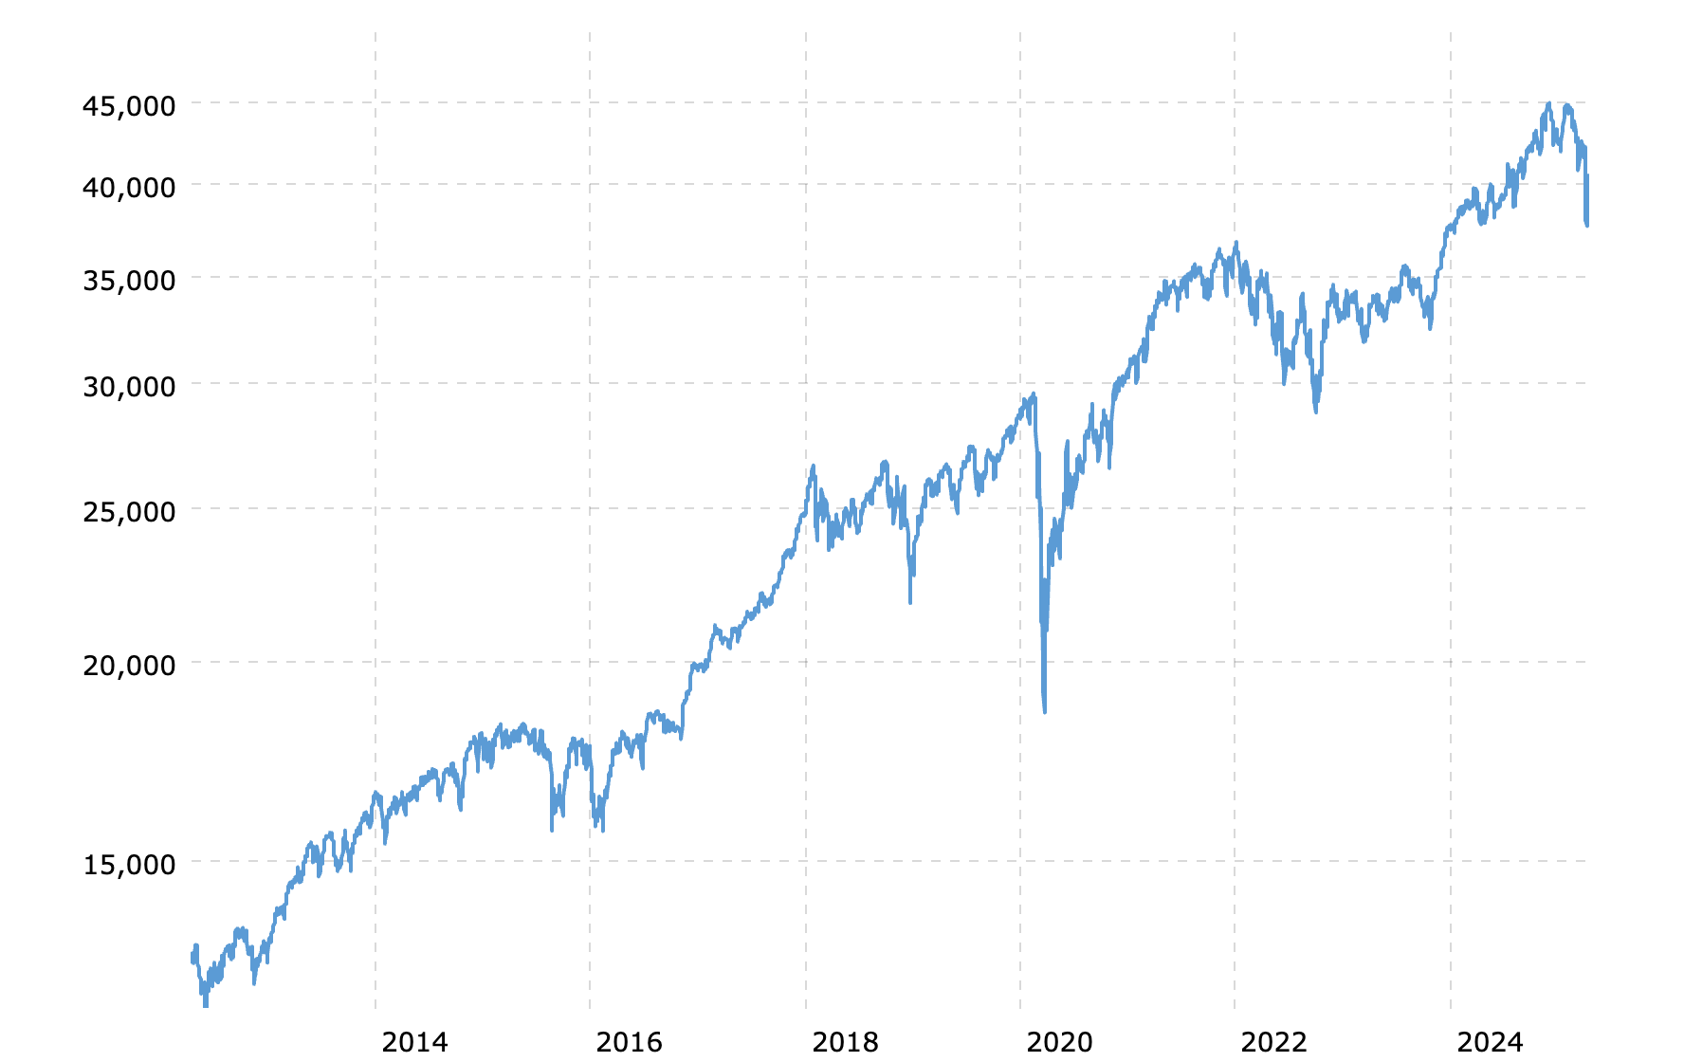
Motivation
Optimize sorting for real world datasets
Patterns/ trends
Strictly decreasing segments
Ex. Dow Jones Industrial Average over 10 years
Notes:
Notes: patterns in dataset, som

Slide 3
Motivation
Fast sorting in cases that are more likely to occur
 | Average Time | Best Time | Worst Time
Quicksort | O(n log n) | O(n log n) | O(n*n)
Mergesort | O(n log n) | O(n log n) | O(n log n)
Insertionsort | O(n*n) | O(n) | O(n*n)
Timsort | O(n log n) | O(n) | O(n log n)
Notes:
https://en.wikipedia.org/wiki/Samplesort

Slide 4
Definitions
N: Size of the input
Runs: weakly increasing or strictly decreasing subarrays in the input
MinRun: Minimum length of runs
Notes:
https://en.wikipedia.org/wiki/Samplesort

Slide 5
Overview
Calculate MinRun
Split into runs, Insertion sort
Merge
Notes:
https://en.wikipedia.org/wiki/Samplesort

Slide 6
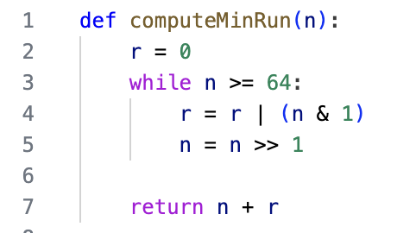
Calculating MinRun
Based on size of the input
Merging is most efficient when the number of runs is equal to or slightly less than a power of two
Maintain (|input| / minrun) ≤ X^2
32 to 64 inclusive
Note: if the n < 32, Tim Sort defaults to using Insertion Sort only.

Slide 7
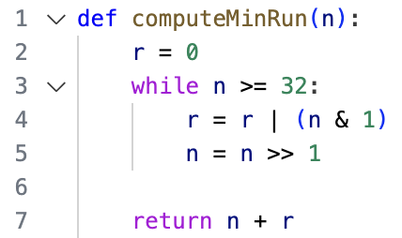
Calculating MinRun: Example
n = 130
First pass:
r = 0 | (130 & 1) = 0 (even/odd)
n = 130 >> 1 = 65 (floor(n/2))
Second pass:
r = 0 | (65 & 1) = 1
n = 65 >> 1 = 32
Return 32 + 1 = 33
Number of runs = 130 / 33 = 3.939
Equal or slightly less than a power of 2!

Slide 8
First Pass: Scan List for Runs
Identify a Run
Run Detection: Look from the current position to find an ascending (or descending) sequence.
Reverse: if the run is descending, reverse it to become ascending.
Local InsertionSort()
Works very well for small and partially sorted inputs

Slide 9
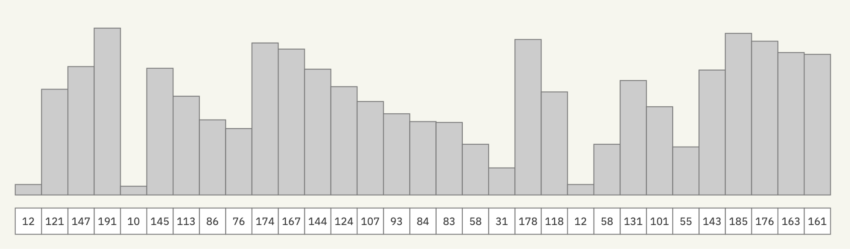
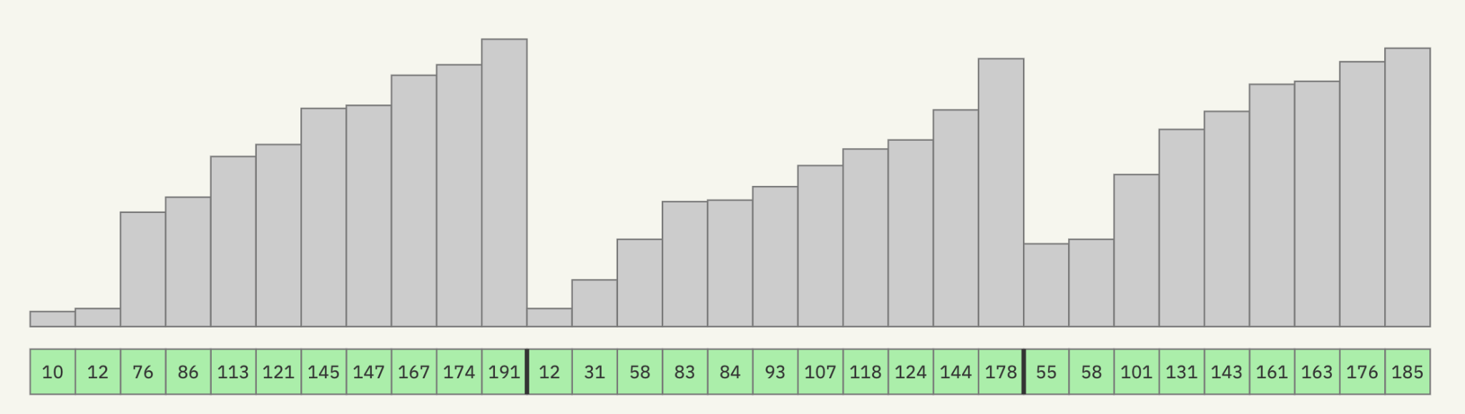
Scan
Reversed in place
MinRun = 11

Slide 10
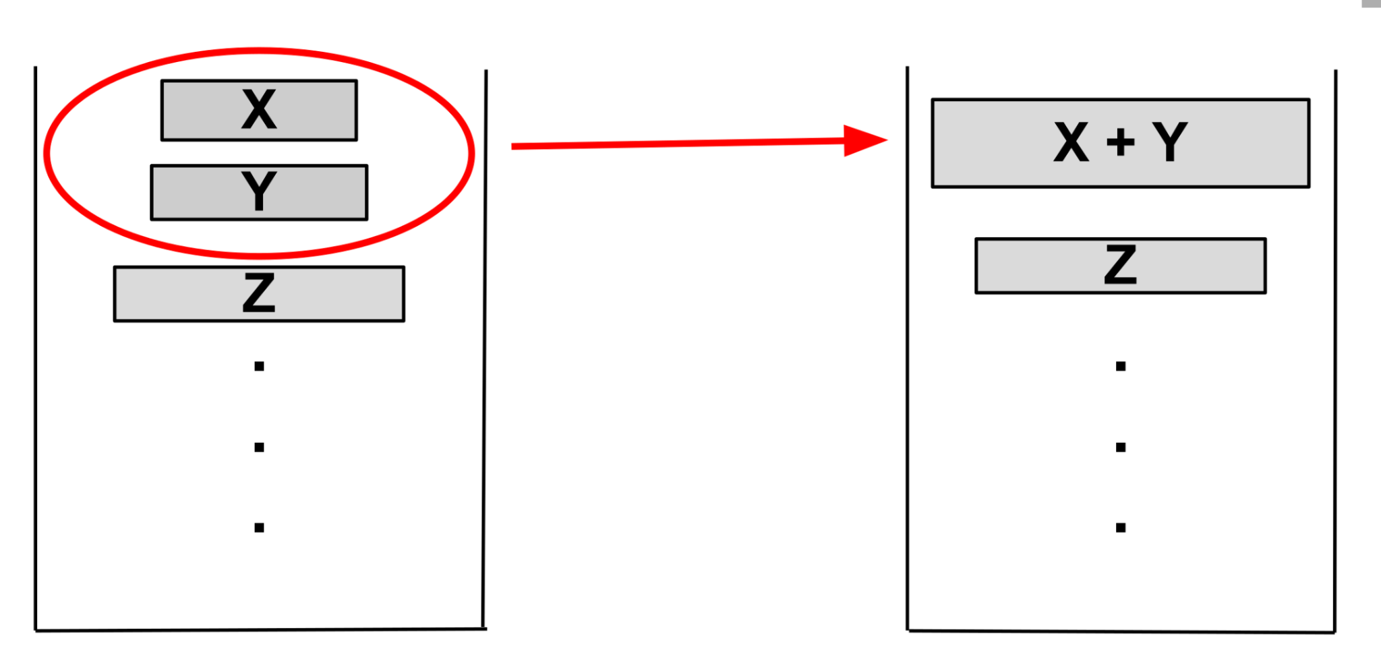
Merge Policy
Deciding when to merge runs
Maintain:
|Z| > |Y| + |X|
|Y| > |X|
If |Z| ≤ |Y| + |X|, merge X and Y
Notes:
https://en.wikipedia.org/wiki/Samplesort

Slide 11
Optimization: Galloping Mode
Cuts down on number of comparisons made during merge
If run RunA[i] > RunB[j] more than minGallop times, switch to galloping mode
How it works:
Exponential search in the losing run to find the next element that exceeds the current maximum
Copy the entire “gallop” of elements in one go

Slide 12
Example
MinRun = 5

Slide 13
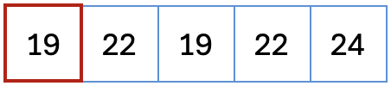
3. Call InsertionSort() in each run

Slide 14
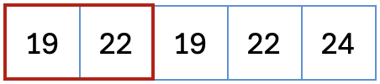
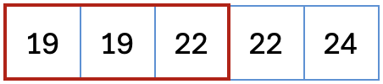
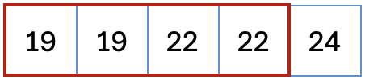
Insertion Sort Refresher

Slide 15
Example
Call InsertionSort() in each run

Slide 16
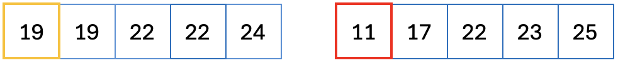
Example
** Note that each half is already sorted, so there is no need for a recursive splitting of the list, merge can be applied immediately.
Merge the runs

Slide 17
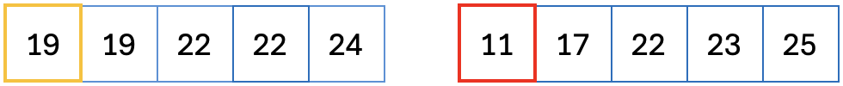

Merge Sort

Slide 18
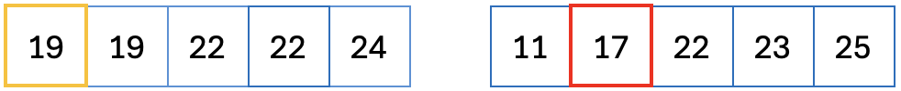
Merge Sort

Slide 19

Merge Sort

Slide 20


Merge Sort
…

Slide 21
Merge Sort

Slide 22
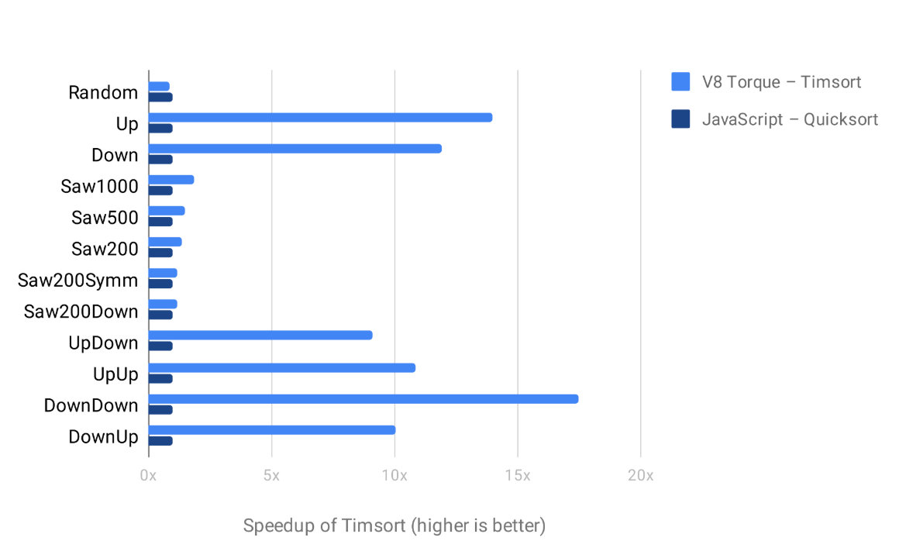
Conclusion
Strengths
Adaptive based on dataset
Stable
Fast lower and upper bounds
Weaknesses
Complex implementation
Notes:
https://en.wikipedia.org/wiki/Samplesort

