Slide 1
TimSort
Presentation Slides
Aidan Tan, Sarah Warren, Philip Yao

Slide 2
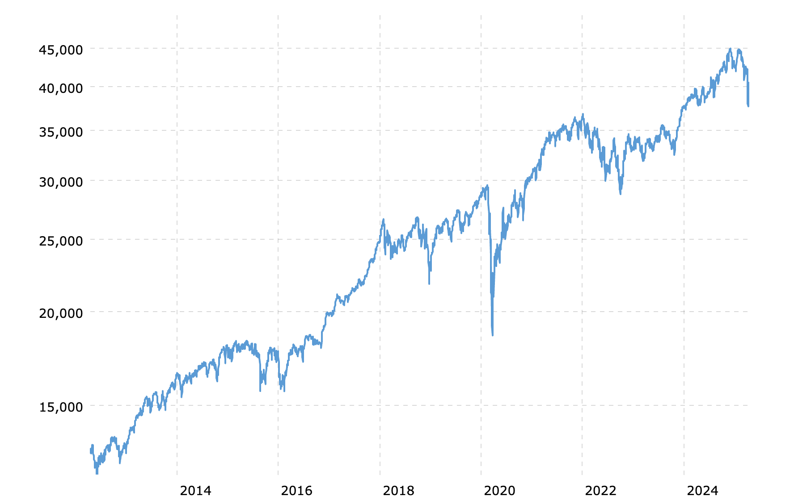
Motivation
Optimize sorting for real world datasets
Patterns/ trends
Strictly decreasing segments
Ex. Data collected over time
Notes:
Hybrid sorting algorithm that is designed to work well on real world data, which is often is partially sorted and has trends. for example data that is collected over time. This has a positive trend and some decreasing segments. Timsort will be able to address these patterns very fast.

Slide 3
Motivation
 | Average Time | Best Time | Worst Time
Quicksort | O(n log n) | O(n log n) | O(n*n)
Mergesort | O(n log n) | O(n log n) | O(n log n)
Insertionsort | O(n*n) | O(n) | O(n*n)
Notes:
Hybrid sorting algorithm that takes strategies from insertionsort and mergesort. The target worst case is O(nlogn), but the best case will be O(n)

Slide 4
Overview
Split data into smaller “chunks” of subarrays
Insertion sort
Merge
Notes:
It uses insertionsort when breaking the data int these chunks, and then uses mergesort as the last step.

Slide 5
Definitions
n : Size of the input
Runs: weakly increasing or strictly decreasing subarrays in the input
MinRun: Minimum length of said runs
Adaptive, based on n
Notes:
Timsort is an adaptive sorting algorithm, so the size of the chunks is dependent on the size of the input.

Slide 6
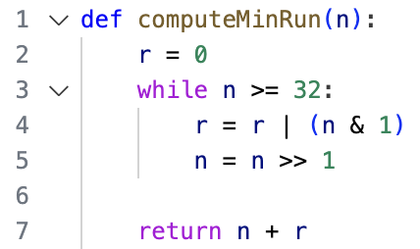
Calculating MinRun
Based on size of the input
Merging is most efficient when the number of runs is equal to or slightly less than a power of two
Maintain (|input| / minrun) ≤ X^2
32 to 64 inclusive
Notes:
r= 1 because remainder for odd numbers, round up so it can capture less runs to be more efficient

Slide 7
First Pass: scan list for runs
Identify a Run
Run Detection: Look from the current position to find an ascending (or descending) sequence.
Reverse: if the run is descending, reverse it to become ascending.
Local InsertionSort()
Works very well for small and partially sorted inputs

Slide 8
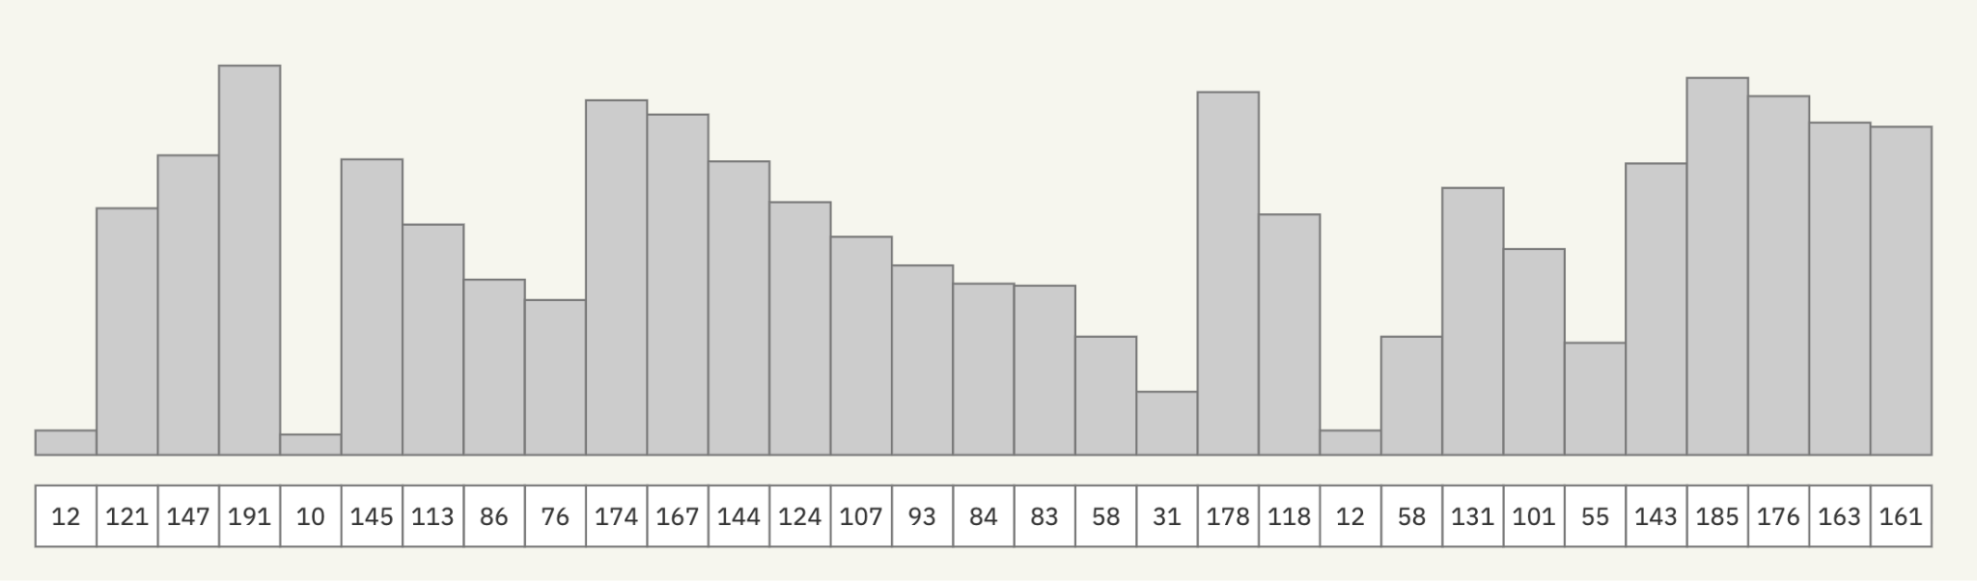
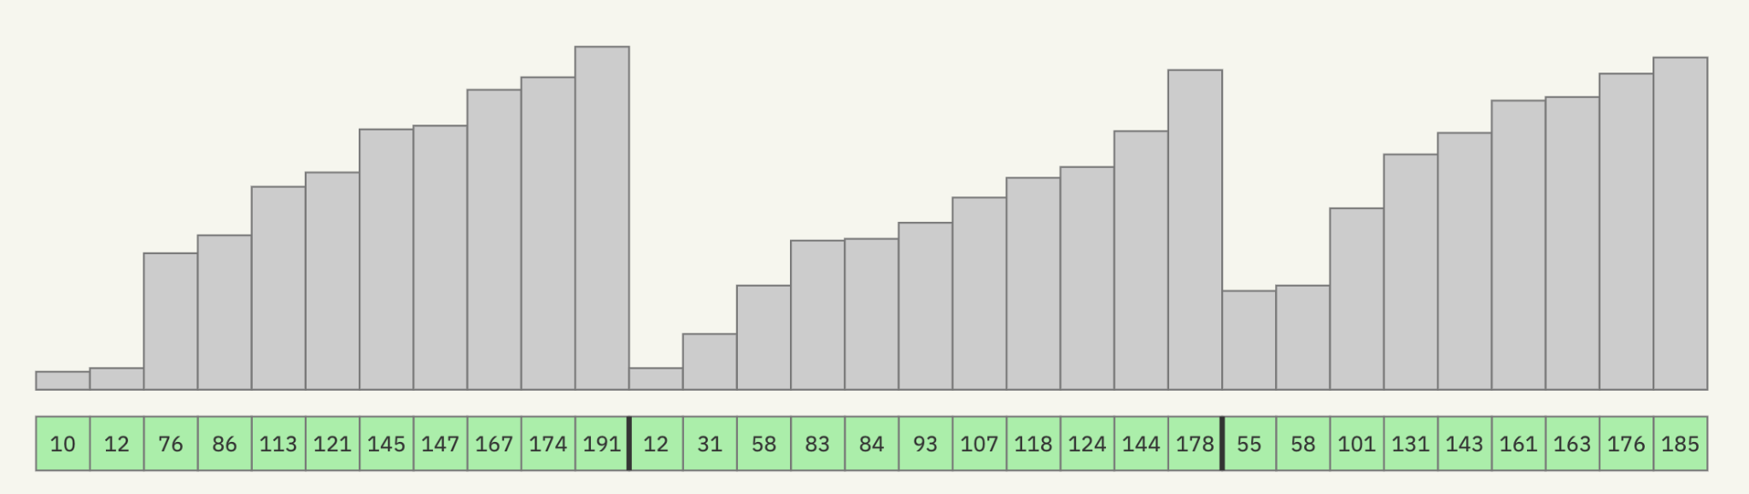
Scan
Reversed in place
MinRun = 11
Notes:
While looking at runs and doing insertion, If decreasing, look at next until one is not decreasing and then reverse

Slide 9
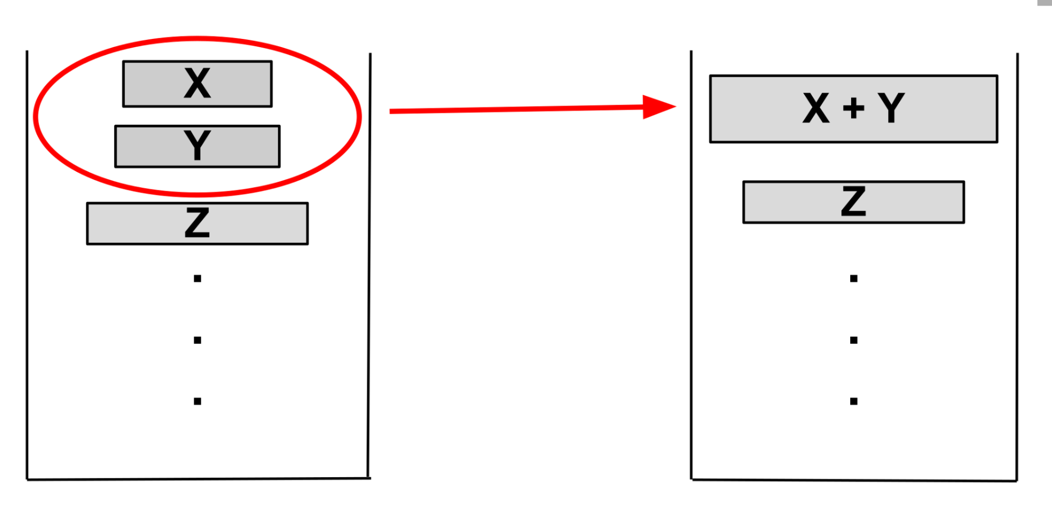
Merge Policy
Deciding when to merge runs
Maintain:
1. |Z| > |Y| + |X|
2. |Y| > |X|
If |Z| ≤ |Y| + |X|, merge X and Y
Notes:
https://en.wikipedia.org/wiki/Samplesort
"When merging is required, we pick between merging Y + X or Z + Y.
Where x, y, and z are the sizes of the runs.
We merge the pair with the smaller total size to minimize data movement.
If sizes are equal, we merge lower on the stack first to maintain balance merges."

Slide 10
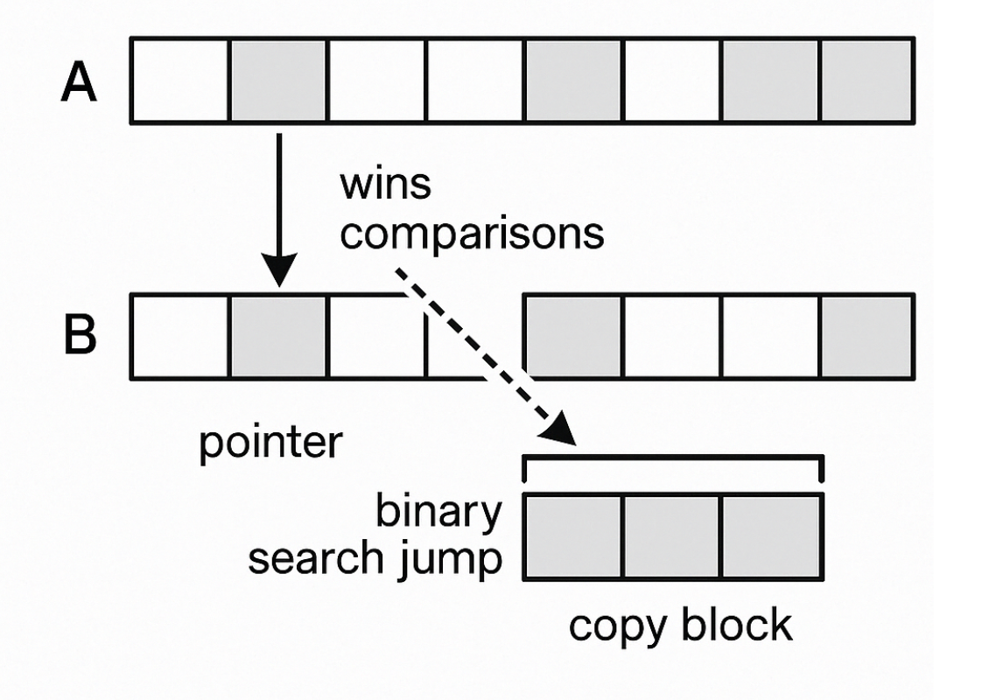
Optimization: Galloping Mode
Cuts down on number of comparisons made during merge
If run RunA[i] > RunB[j] more than minGallop times, switch to galloping mode
How it works:
Exponential search in the losing run to find the next element that exceeds the current maximum
Copy the entire “gallop” of elements in one go
Notes:
"In Timsort, galloping mode is an optimization that significantly reduces the number of comparisons during the merging phase.
It's especially useful when one run continuously wins during comparisons.
Galloping mode kicks in when a run wins more than a predefined number of times, known as minGallop."
"Here’s how galloping mode works:
When we detect that RunA[i] (the current element in the upper run) is greater than RunB[j] (the current element in the lower run) more than minGallop times, we switch to galloping mode."
"In galloping mode, instead of comparing one element at a time, we perform an exponential search in the losing run — the run that’s losing the comparison.
The idea is to skip ahead and find the next element that exceeds the current maximum, skipping over the elements that are definitely smaller."
"Once Timsort finds a chunk of elements that exceed the current maximum, it copies the entire chunk in one go, greatly reducing the number of comparisons and speeding up the merge."

Slide 11
Time Complexity
 | Average Time | Best Time | Worst Time
Quicksort | O(n log n) | O(n log n) | O(n*n)
Mergesort | O(n log n) | O(n log n) | O(n log n)
Insertionsort | O(n*n) | O(n) | O(n*n)
Timsort | O(n log n) | O(n) | O(n log n)
Notes:
Here we have the final runtimes of mergesort,
Here we can see that it improves on the best time of merge sort of nlog(n) by taking the best time of insertion sort, which is O(n).
It also has an average runtime of nlog(n) and a worst case runtime of nlog(n).

Slide 12
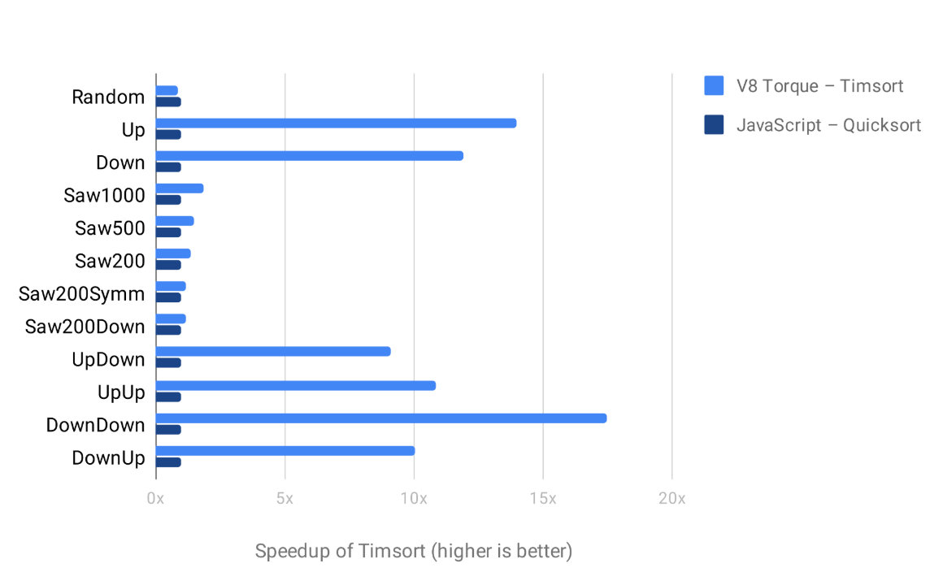
Conclusion
Strengths
Adaptive based on dataset
Stable
Fast upper and lower bounds
Weaknesses
Uses O(n) Memory
Other sorting algorithms use less memory
Quicksort is O(log(n))
Notes:
https://en.wikipedia.org/wiki/Samplesort
In conclusion,
"Timsort is adaptive to different datasets, performing efficiently on both sorted and random data.
It is also stable, preserving the relative order of equal elements.
Timsort has fast upper and lower bounds, meaning it performs well in both best and worst-case scenarios, making it a reliable choice in many cases."
"However, Timsort has some drawbacks:
It uses O(n) memory, which is more than some other algorithms like QuickSort, which only needs O(log n) memory.
For situations where memory usage is a concern, Timsort might not be the best option compared to algorithms that require less space."

