Slide 1

Unemployment and Mental Health
By Philip Yao, Joseph Choe, Eunice Kim,
Tu-Yen Dang, and Herin Seo

Slide 2

Research Questions
Exploring The Intersection Between
Unemployment and Mental Health
How much does unemployment have an effect on
the prevalence of stress, anxiety, and depression?
2. How does household income among those who are unemployed affect their mental health?
3. How does education level among those who are unemployed affect their mental health?

Slide 3

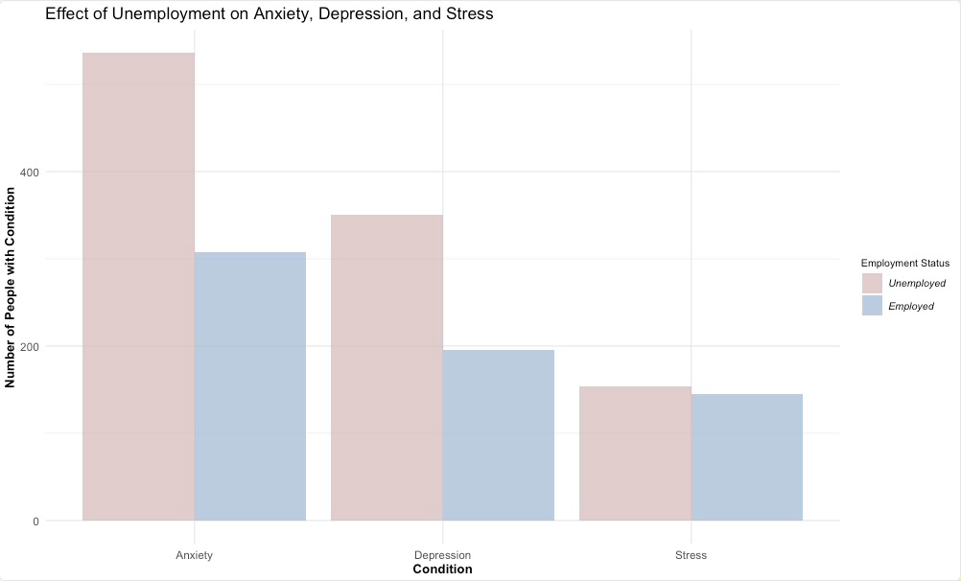
Question 1 :
How much does unemployment have an effect on
the prevalence of stress, anxiety, and depression?

Slide 4
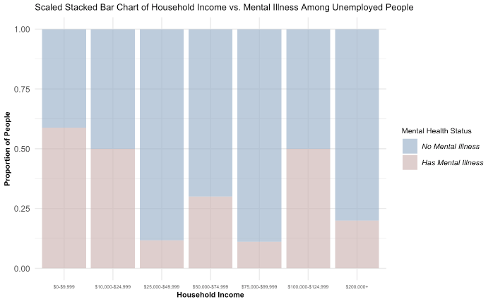
Question 2 :
How does household income among those who are unemployed affect their mental health?

Slide 5
Question 3 :
How does education level among those who are unemployed affect their mental health?

Slide 6
Conclusions
Unemployment had an obvious negative effect on factors related to mental health, as shown by the increased rates of anxiety, stress, and depression
Household income had no obvious correlation with mental health illness.
Having higher education did not appear to have a strong correlation between being unemployed and having a mental illness.

Slide 7
Citations
The Devastator, "Medical Student Mental Health," Kaggle, 2002, https://www.kaggle.com/datasets/thedevastator/medical-student-mental-health?select=Data+Carrard+et+al.+2022+MedTeach.csv
Michaela Corley, “Unemployment and Mental Illness Survey,” Kaggle, 2018,https://www.kaggle.com/datasets/michaelacorley/unemployment-and-mental-illness-survey/data

