Slide 1
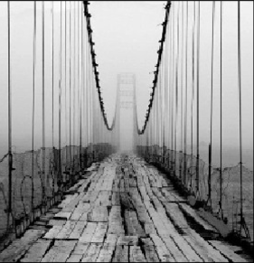
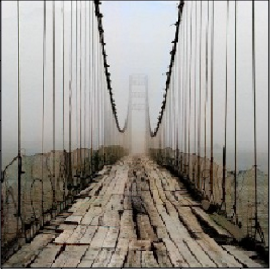
Colorizing Grayscale Images
Chandler, Poorwa, Prathyusha, Rakesh, Taruni
Notes:
Don’t change the alignment of the title, while downloading as pdf it moves down.

Slide 2
Our Project’s Aim
Description:
Our project aims to reclaim the original colors of an image from grayscale. We want to create a machine learning model that functions as a tool for converting black and white images to color automatically. We will build and analyze several models for this purpose.
Motivation:
Black and white photos and movies. Subreddit: /r/colorization
Storage of grayscale images and their use in image processing.
MRI scans, satellite imagery, CCTV cameras, astronomical photography, or electron microscopy.

Slide 3
Approach
Data:
Berkeley Segmentation Dataset
ImageNet
Computational Visual Cognition Laboratory
Initial Thoughts:
Our plan is to create an initial baseline and then an advanced model.
Algorithms we will experiment with are K-means clustering, Regression, SVM and CNN
Compare results by testing accuracy
Number of accurate predicted pixels/number of actual pixels

