Slide 1
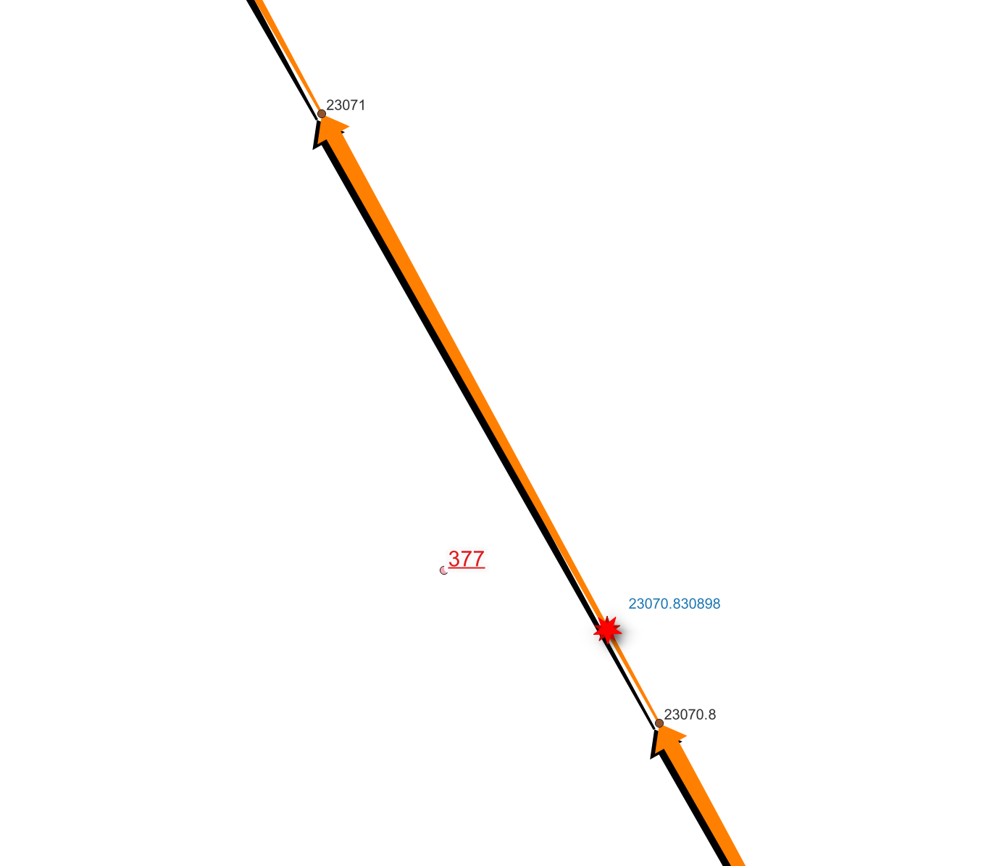
EOP Interpolation from GNSS Trajectory

