Slide 1
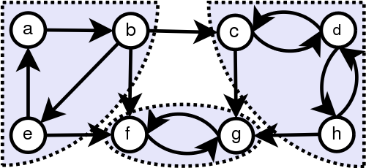
Advanced Algorithms project
A comparison of three variations of the same algorithm to find strongly connected components in graphs
Philippe Scorsolini
Emanuele Ricciardelli

Slide 2
Index
Context
Applications of SCC algorithms
Algorithms with examples
Tarjan’s Algorithm
Nuutila’s Algorithm
Pearce’s Algorithm
Differences
A practical usage of Nuutila’s - Transitive Closure
Our implementations
Algorithms
Modifications
Timing results
Memory analysis
Conclusions

Slide 3
Context
The aim of all the algorithms is to find Strongly Connected Components (SCC) in directed graphs, they all achieve it by performing a Depth-First Search (DFS) over the graphs.
SCC : A directed graph in which there is a path between all pairs of vertices. A strongly connected component of a directed graph is a maximal strongly connected subgraph.
Trivial SCC: a SCC composed only by one vertex

Slide 4
The seminal work is presented by Tarjan in his “Depth-first search and linear graph algorithms” paper where the main approach is illustrated:
“Corollary 10 : Let C be a strongly connected component in G. Then the vertices of C define a subtree of a tree in F, the spanning forest of G. The root of this subtree is called the root of the strongly connected component C.”
Spanning forest generated by DFS
The problem of finding the strongly connected components of a graph G thus reduces to the problem of finding the roots of the strongly connected components.
The following works by Nuutila and Pearce adopt the same DFS approach but achieve better memory usages by optimizing the usage of data structures (or removing some of them) and avoiding useless operations such as stacking “trivial” components.

Slide 5
Applications of SCC algorithms
“...can help find the cyclic dependencies in a program. Given a dependency graph G(directed graph), the Strongly Connected Components which contains more than one node of G (if any), gives the cycles in the graph.”
“Finding Strongly Connected Components in a social network graph can give you information about the communities of people that have formed on those networks. Social Networks can study the evolution of those communities and getting to know what community a person belongs to may help getting better ads for him.”
“... may be used to solve 2-satisfiability problems (systems of Boolean variables with constraints on the values of pairs of variables): as Aspvall, Plass & Tarjan (1979) showed, a 2-satisfiability instance is unsatisfiable if and only if there is a variable v such that v and its complement are both contained in the same strongly connected component of the implication graph of the instance”

Slide 6
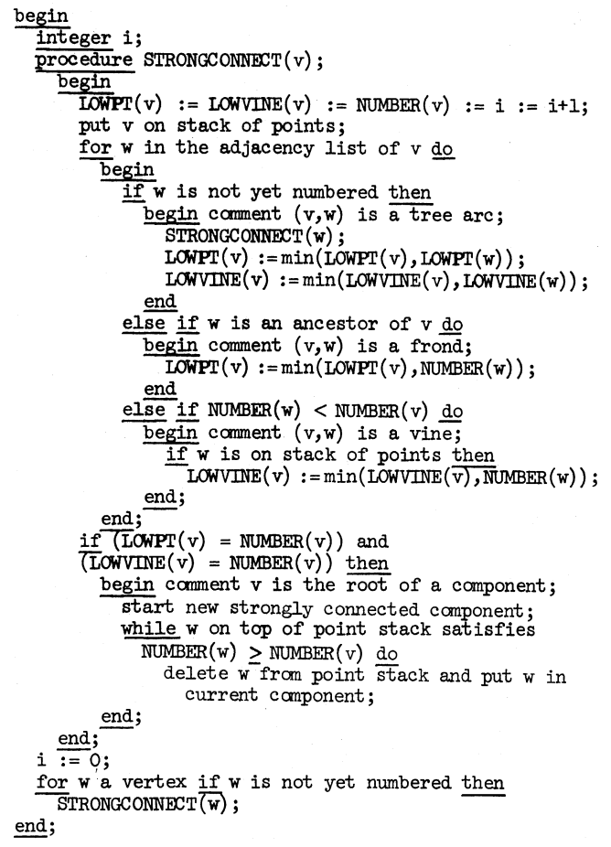
Tarjan’s Algorithm
Vine : edges running from one subtree to another in the tree.
Frond : edges running from descendants to ancestors in the tree.
Needed structures:
Number (int[V]) : store vertices visit order
Lowpt (int[V]) : store value of lowest parent reached through a frond
Lowvine (int[V]) : store value of lowest node reached through a vine
Stack : store vertices already visited but not yet in a component

Slide 7
Tarjan’s Algorithm complexity
Time complexity : O( V + E )
Space complexity :
O( V ) from Tarjan’s paper
v * ( 2 + 5w ) ( specified in Pearce’s paper )

Slide 8
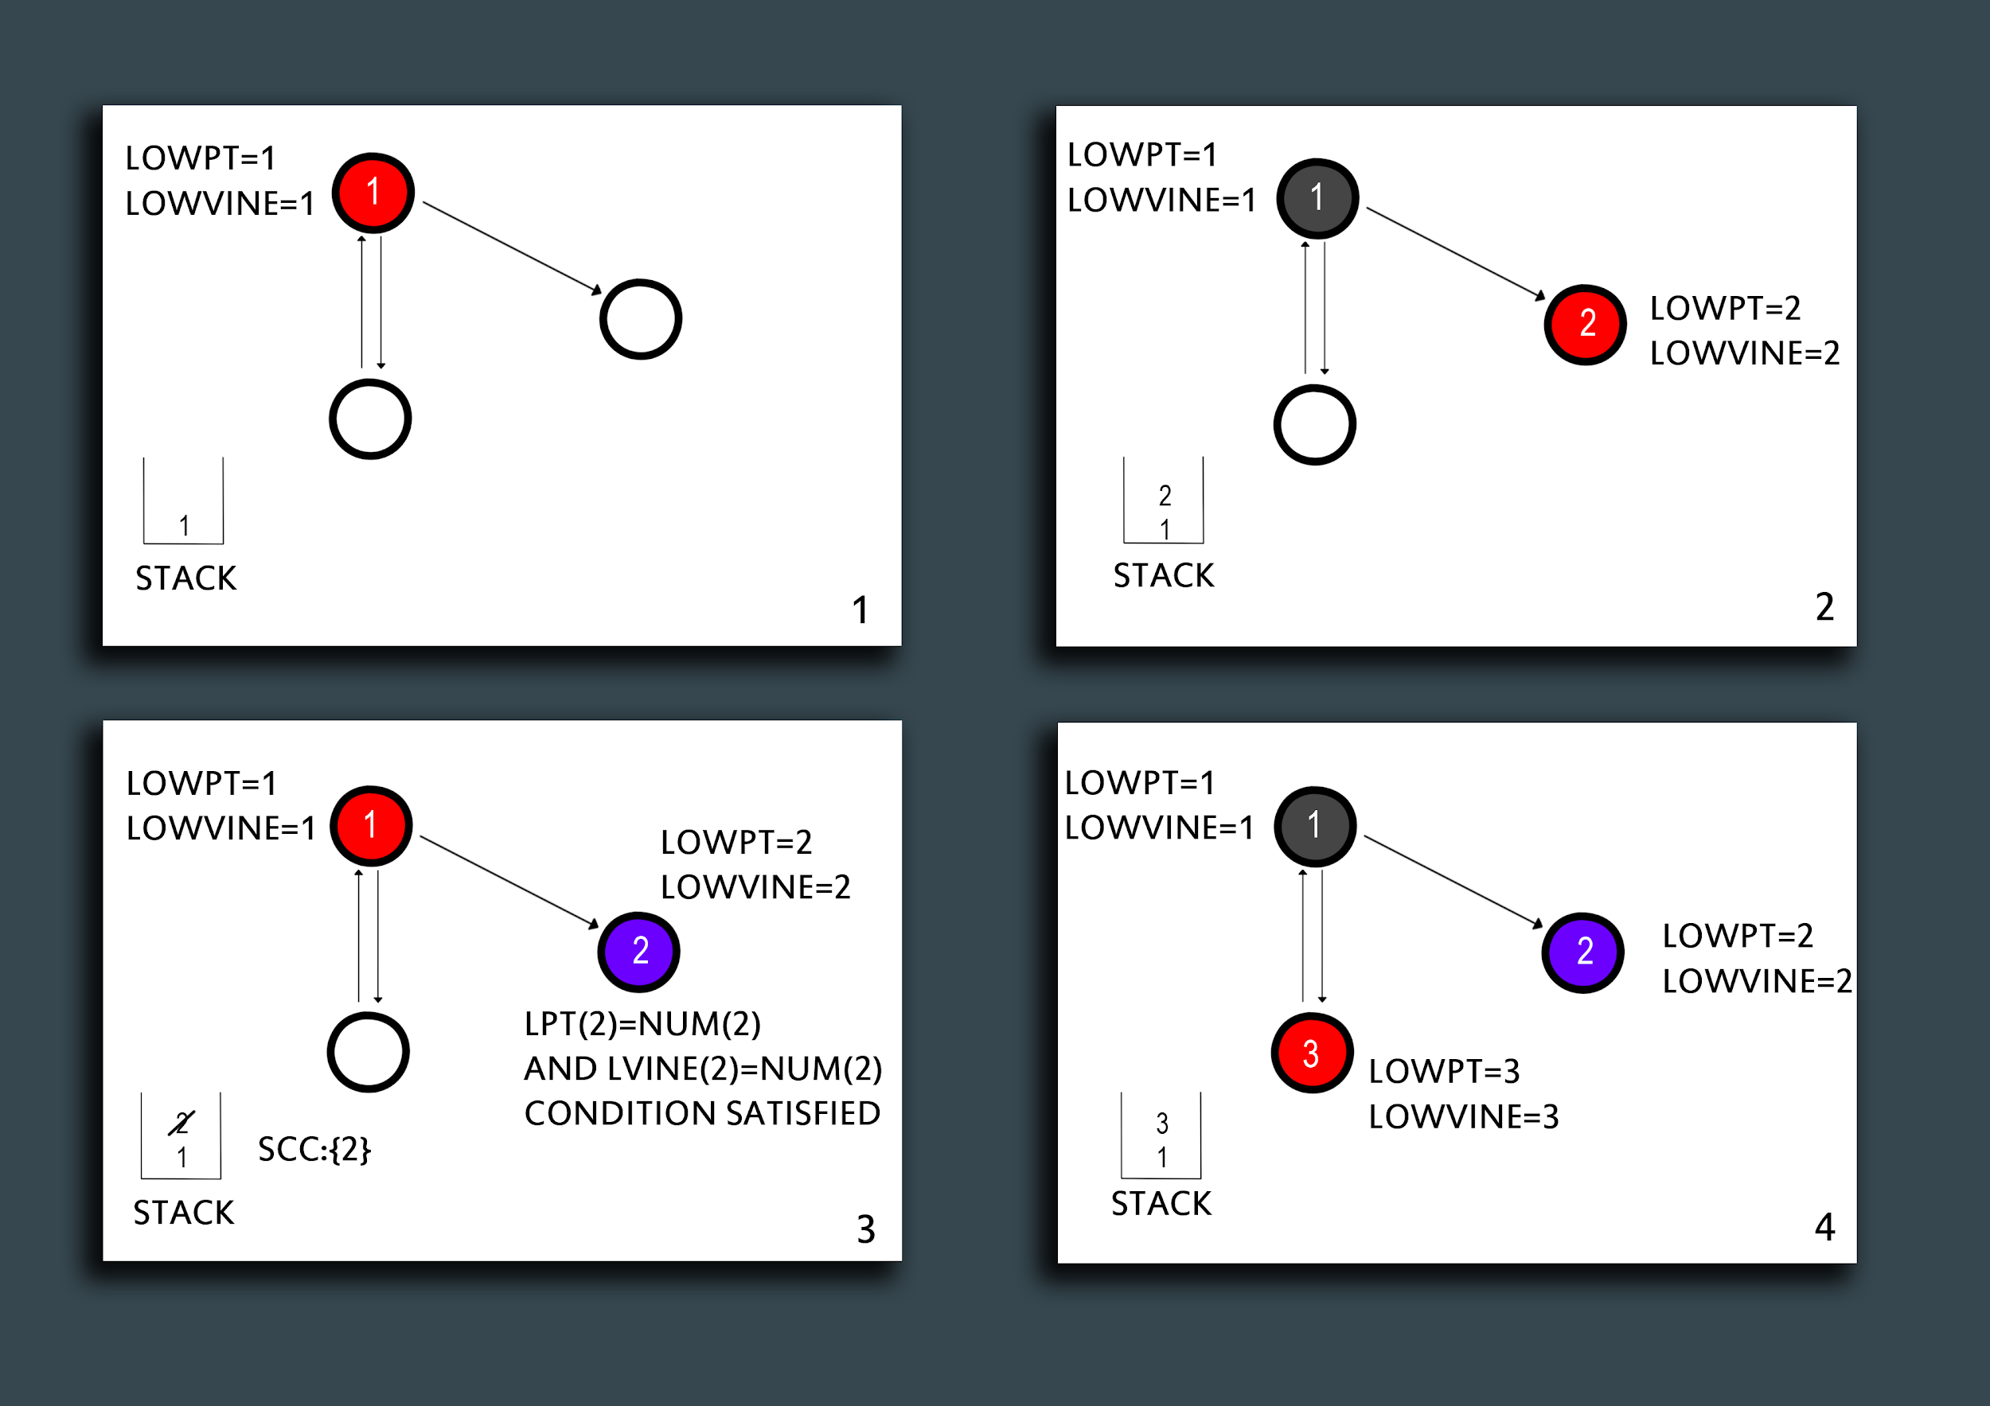
Tarjan Example 1/2

Slide 9
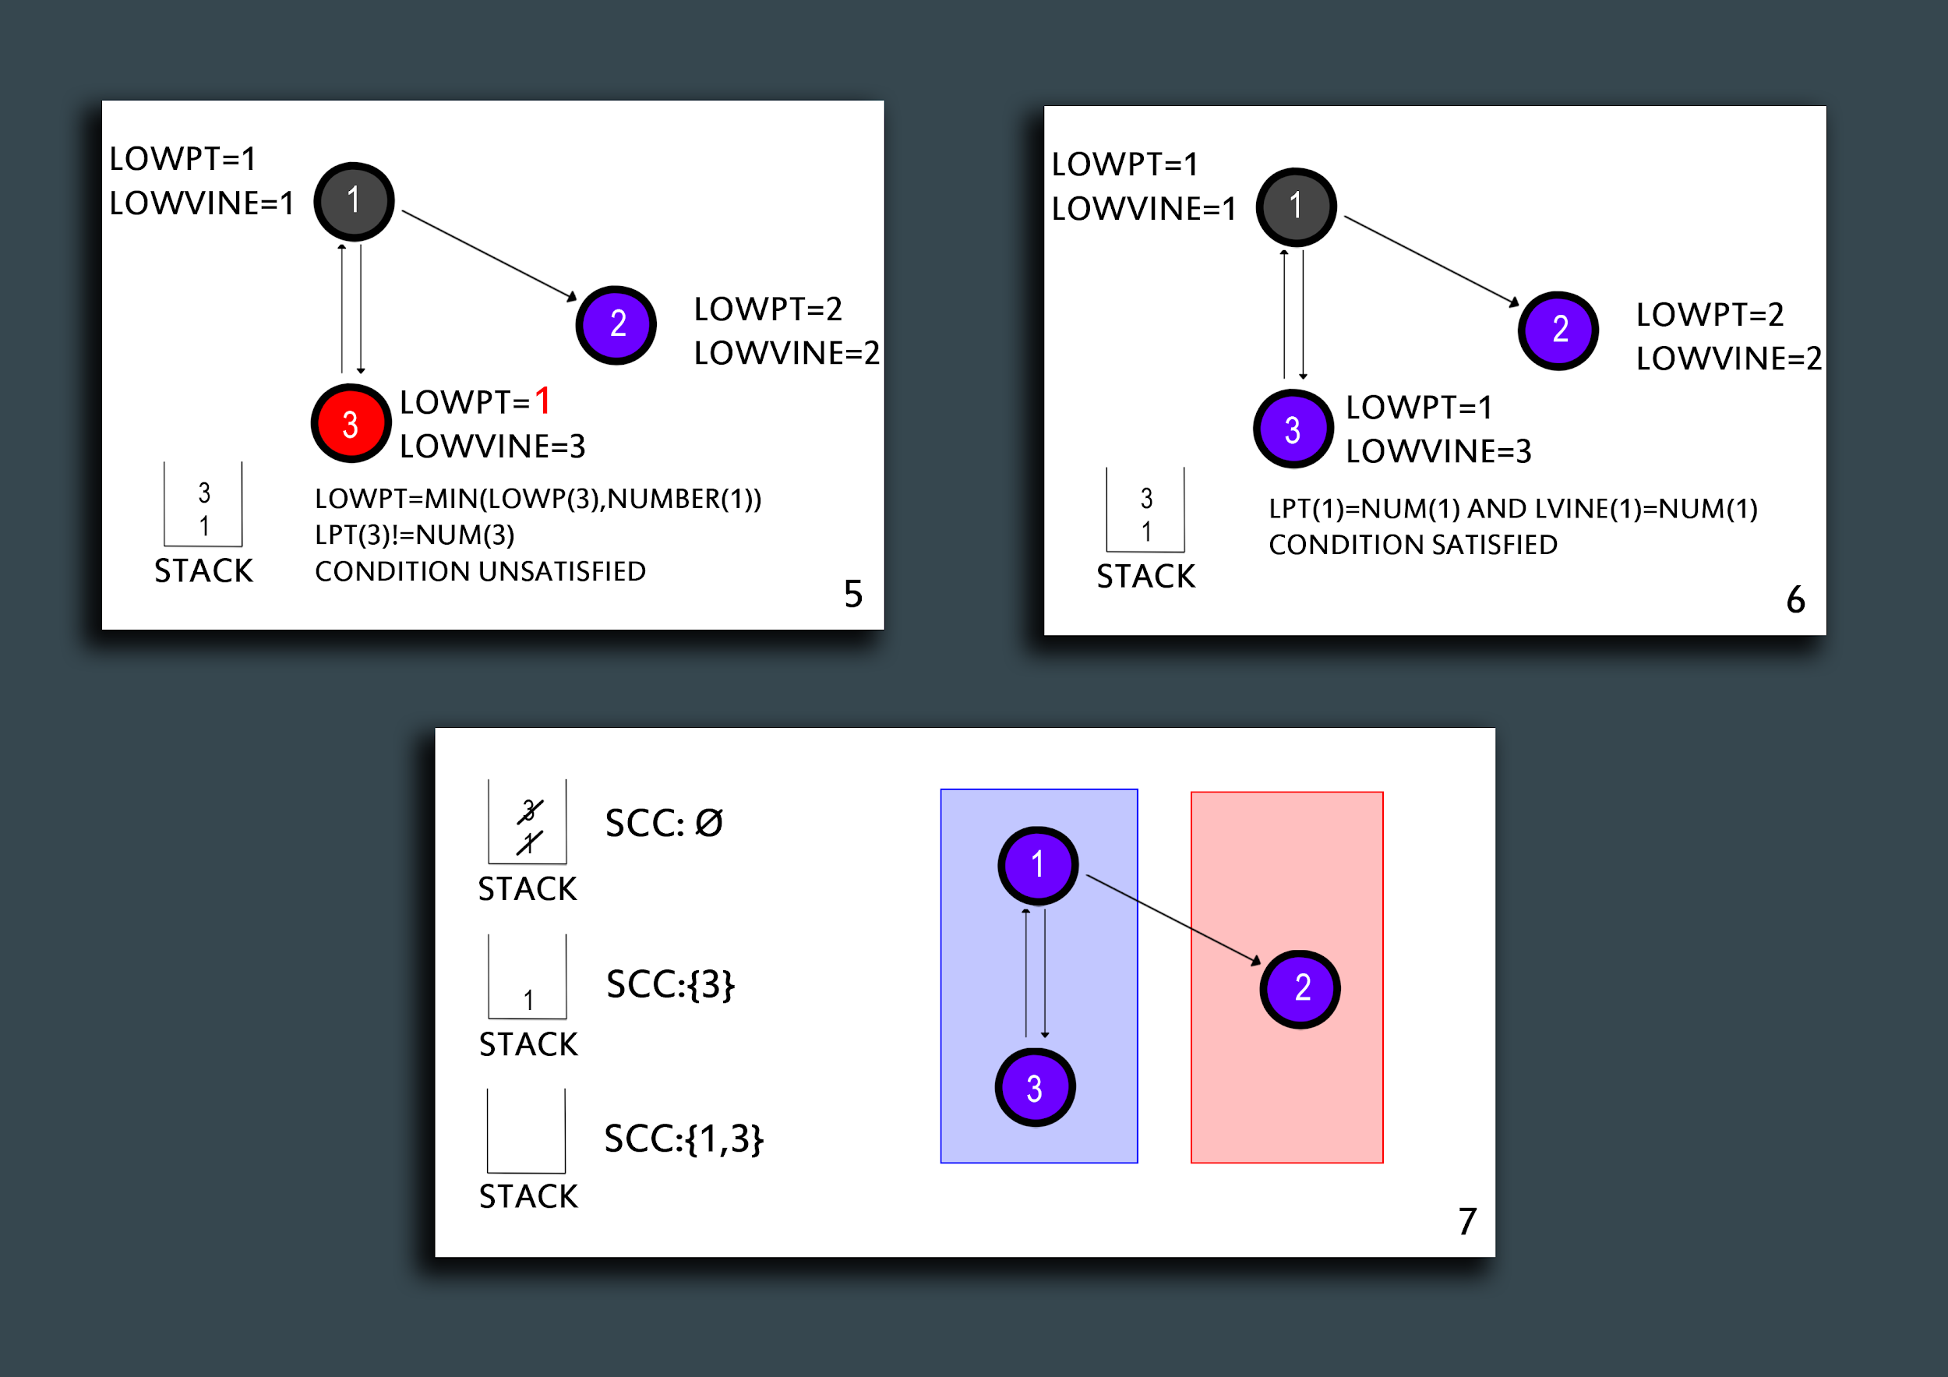
Tarjan Example 2/2

Slide 10
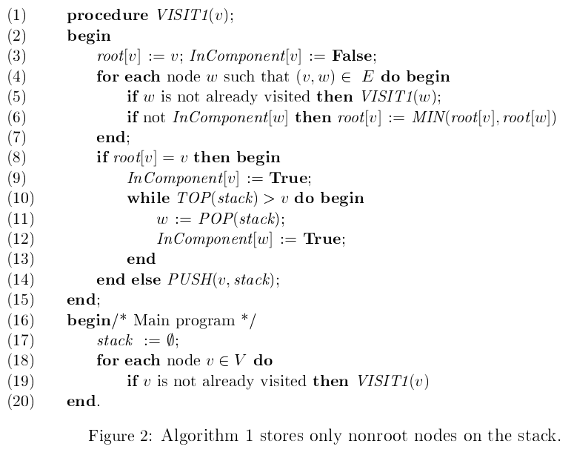
Nuutila
Needed structures:
Number int[V] : the visiting order
InComponent bool[V] : store if vertex is already in a component or not
Root int[V] : store the root of the component where the vertex is
Stack : store vertices until they are not assigned to a component, avoid pushing if knows it will be popped immediately
Time complexity : O( V + E )
Space complexity :
O( V )
v * ( 1 + 4w ) ( specified in Pearce’s paper )

Slide 11
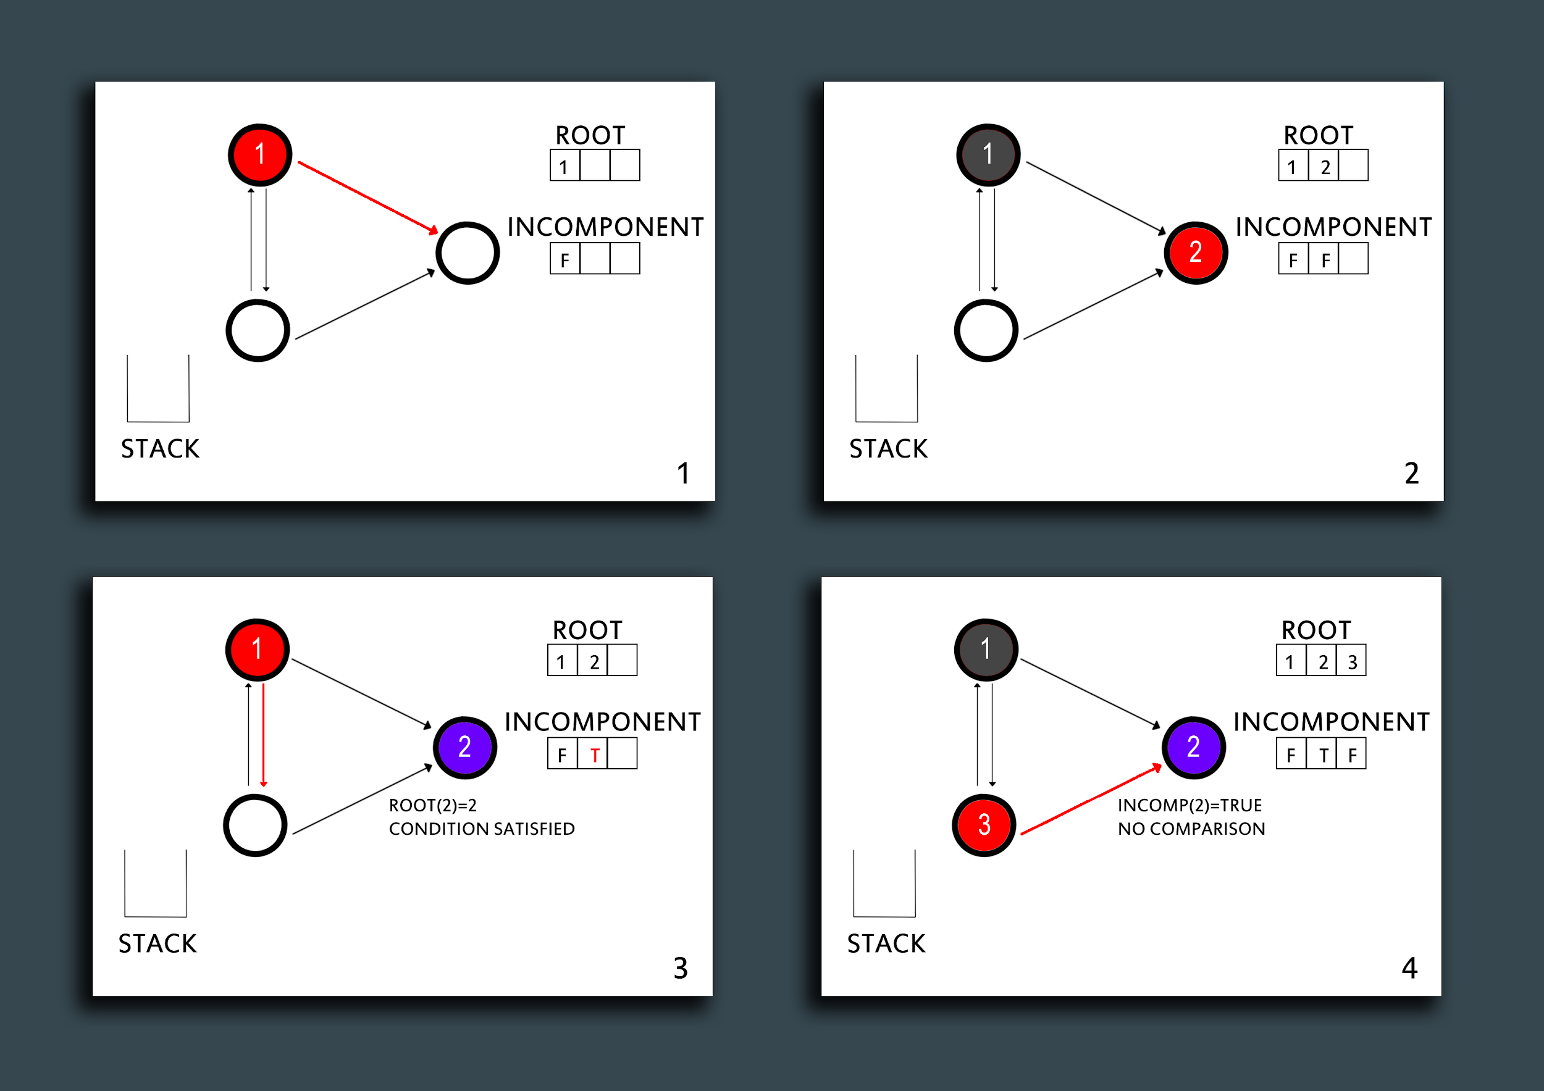
Nuutila Example 1/2

Slide 12
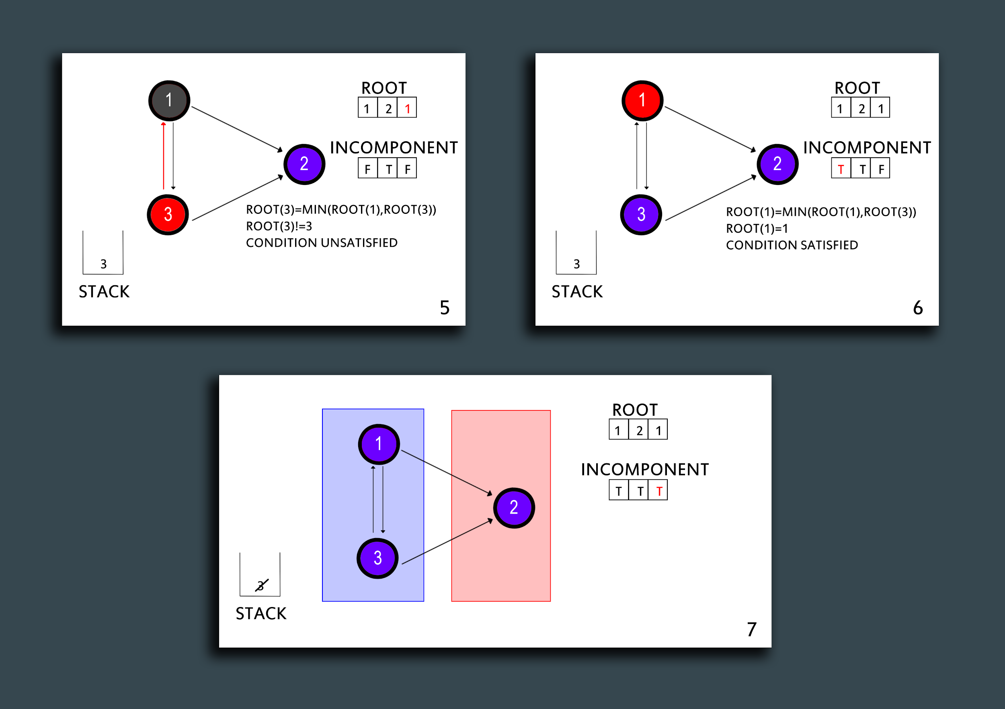
Nuutila Example 2/2

Slide 13
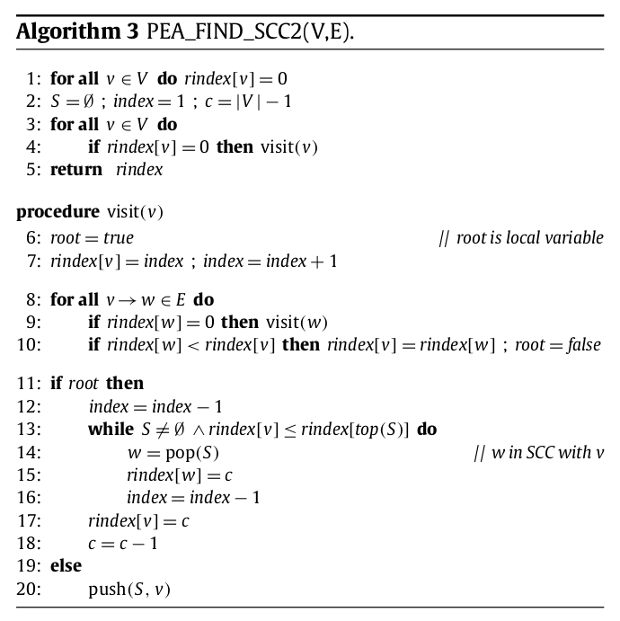
Pearce
Needed structures :
Rindex int[V] : used to check if not visited yet (0) and also the component the vertex belongs to.
Stack : store vertices until not popped to be assigned to a component. Last one not assigned
Time Complexity : O ( V + E )
Space Complexity (worst case) :
Non-recursive version : v * ( 1 + 3w)

Slide 14
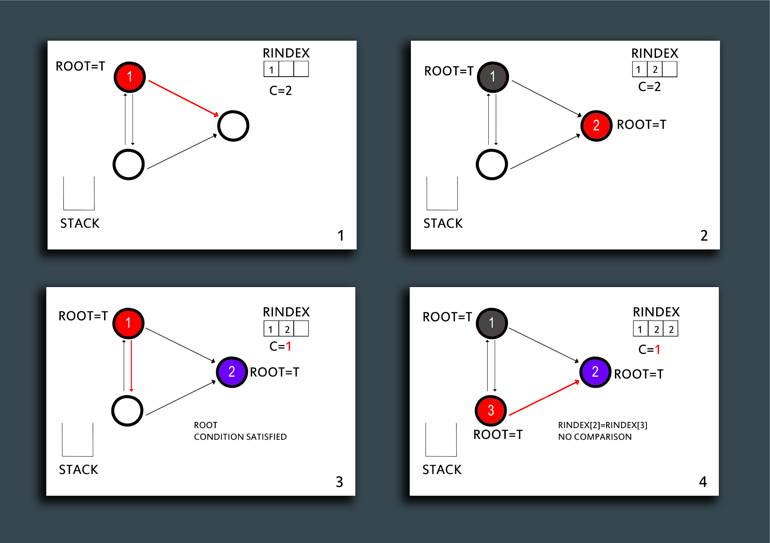
Pearce Example 1/2

Slide 15
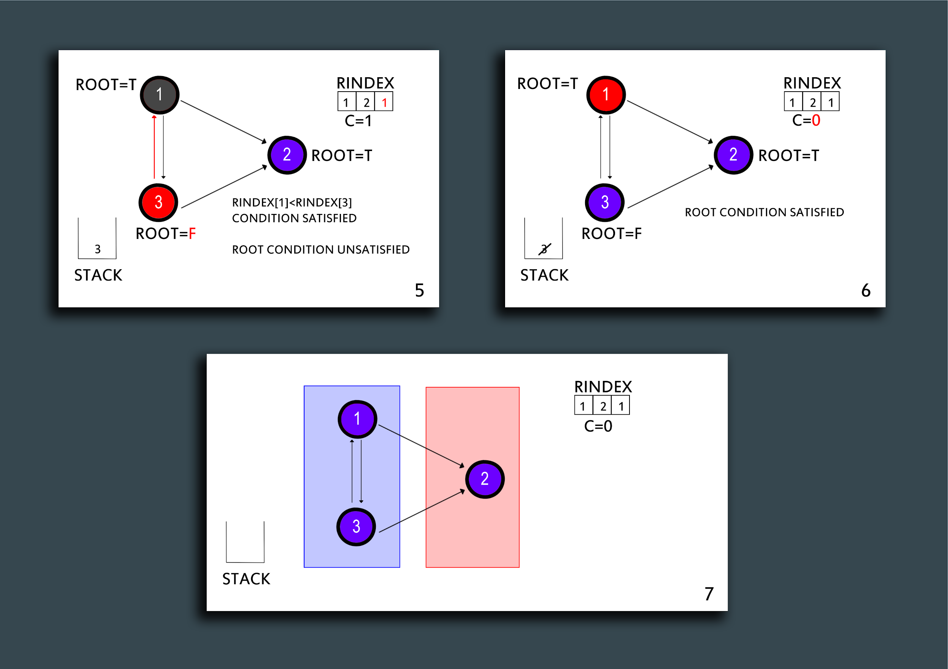
Pearce Example 2/2

Slide 16
Differences
Space efficiency :
Stack usage :
Tarjan’s pushes on the stack the vertices before checking if it’s necessary or not, pushing in the worst case all the vertices on the stack (long chain of vertices).
Nuutila’s avoids pushing on the stack nodes belonging to trivial components (single node components), achieving better performance when the graphs are sparse and pushes on the stack only during the backtracking phase, when it’s sure it’s not part of a trivial component. This way in case of a long chain no vertices at all are pushed on the stack.
Pearce’s further improves Nuutila’s approach using fewer auxiliary structures, rindex is used for multiple purposes (“already visited?”, “in component?”)..
Time complexity remains the same due to the Depth First Search all three the algorithms perform.

Slide 17
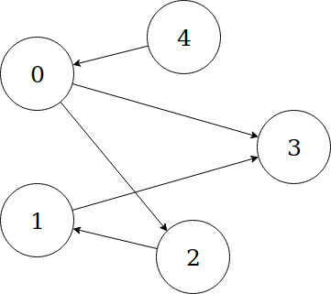
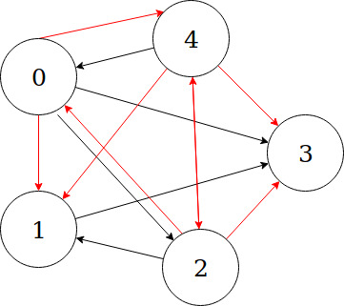
A practical usage of Nuutila’s - Transitive Closure
Original Graph Transitive closure of the original
A transitive closure of a graph is the one in which there exists an edge starting from vertex i to vertex j if and only if vertex j “is reachable” from vertex i in the original graph, that is there is a (single or multi) hop path from vertex i to j.

Slide 18
Transitive Closure
The main idea of Nuutila is to compute the successor nodes,, that is the ones reachable via a path, only for the final candidate roots.
Taken a SCC called C, the set of successors succ[C] contains all the vertices in C and the candidate roots’ successors of SCC adjacent to C, that is reachable from a vertex v in C.
These are the benefits respect to other algorithms for transitive closure based on SCC:
All the outgoing edges are scanned only once (during the Depth-First Search) thanks to usage of suitable data structures
The successors set is computed only for the final roots and not for all the vertices in the graph

Slide 19
Our implementations
Languages :
Algorithms implementations : C++ (Boost Graph Library)
Visualization and results manipulation : Python ( jupyter notebooks, pandas, matplotlib, plotly)
Testing automation and benchmarking : Bash scripts and some C++ helper functions
Tools :
Time measures : boost::timer::auto_cpu_timer
Memory profiling :
Valgrind (massif)
Heaptrack
We have implemented :
Tarjan’s STRONGCONNECT
Nuutila’s :
Visit1
Transitive Closure example
Pearce’s :
PEA_FIND_SCC2 (recursive)
PEA_FIND_SCC3 (non-recursive)

Slide 20
Our implementations
TarjanClass, NuutilaClass, PearceClass (recursive) that wrap all the needed structures and expose a method (tarjan_scc(), nuutila_scc(), pearce_scc()) returning a pointer to the structure used to associate components and vertices (components / root / rindex)
To check the correctness of our implementation we have compared them against the results given by the boost::strong_components function.
We have also implemented in the PearceNR class, the non recursive version of the algorithm proposed by Pearce, and in the TransitiveClosure class, the example given as an application of Nuutila’s algorithm for computing the transitive closure of a given graph.

Slide 21
Modifications to the proposed algorithms
In order to effectively implement them, we had to add some data structures:
Tarjan :
sm (std::vector<bool>(V)) : used to check if a vertex is in the stack or not in linear time
std::vector<bool>(V) uses 1 bit per element, instead bool[V] uses 1 Byte per element, wasting 8 times more space than a vector
ancestor (std::vector<bool>(V)) : used to check if a vertex is an ancestor of the current one in linear time
comp (std::vector<int>(V)) : used to store the component each vertex belongs to (not strictly specified)
Nuutila:
No additions
Pearce:
No additions

Slide 22
Timing results
Generated graphs with 0 to 1000 vertices and 0 to 1000 edges using boost::erdos_renyi_iterator (setS as outgoing edge container in order to avoid repeated edges)
We then have :
run the executable over the generated graphs (multiple runs)
collected the results of boost::timer::auto_cpu_time
averaged them
Plotted both in (V+E,t) space and in (V,E,t)
And as can be seen from the plots we have achieved a behaviour according to the specified theoretical complexity.

Slide 23
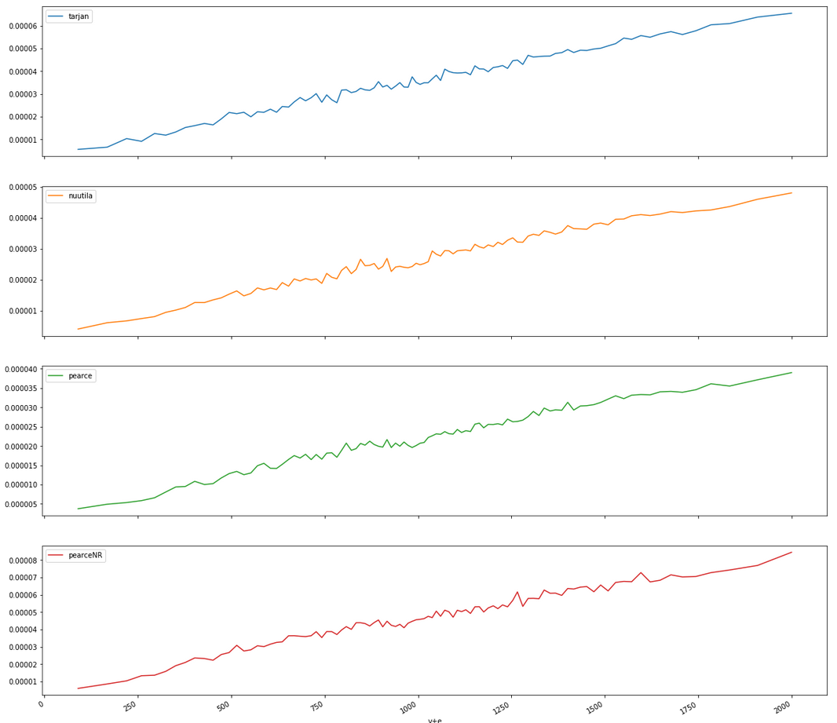
μs
Tarjan
μs
Nuutila
μs
Pearce
μs
Pearce non recursive
v+e

Slide 24
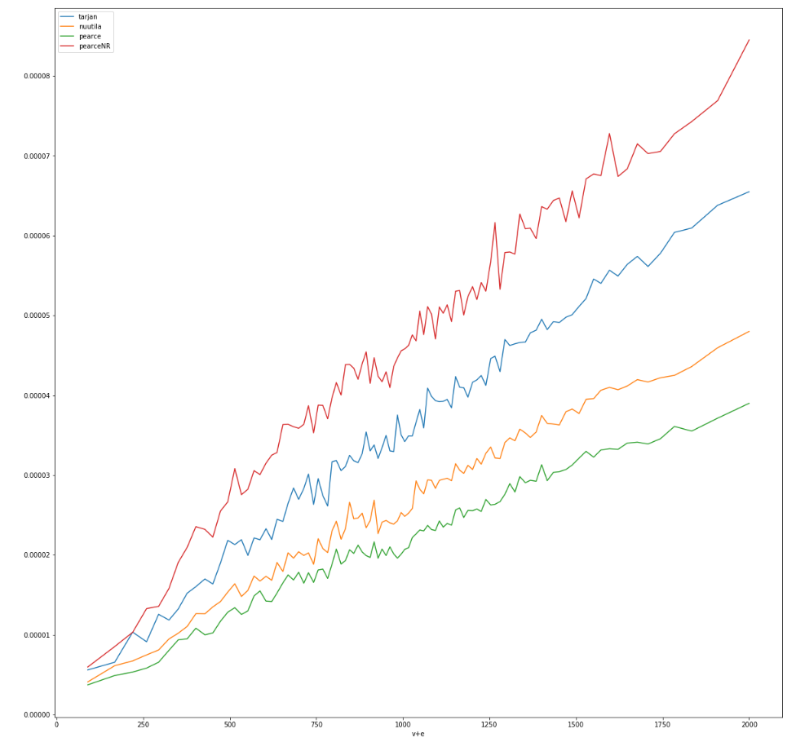
μs
PearceNR
Tarjan
Nuutila
Pearce
v+e

Slide 25
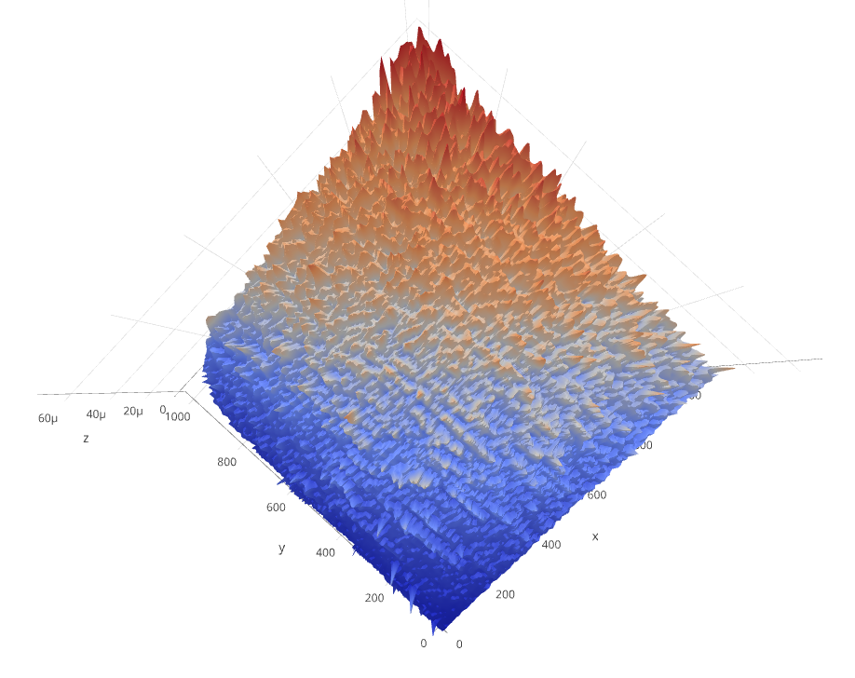
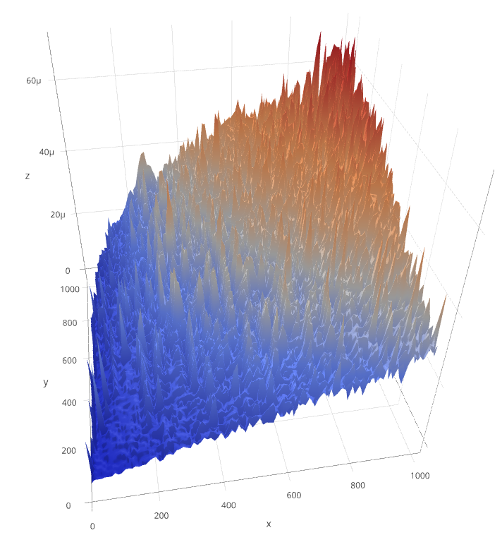
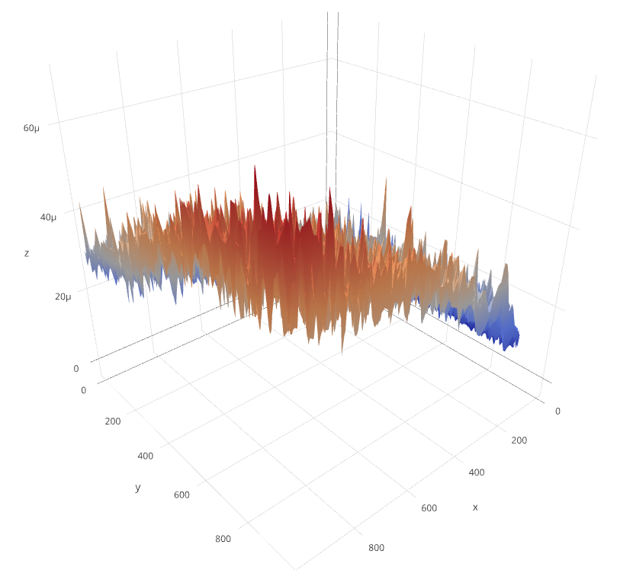
(V,E,t) space
Tarjan
Nuutila
Pearce
Non recursive Pearce
μs
e
v

Slide 26
Memory Analysis
Our aim was to confirm, generally speaking, what’s reported by the papers, so that Tarjan’s algorithm is less efficient than Nuutila’s and, in turn, the latter is less efficient than Pearce’s.
Despite the similar characteristics, Nuutila’s is less efficient because it uses more data structures to achieve the same results of Pearce’s.
At last, we tested how the iterative approach of Pearce impacts on the memory allocation w.r.t. to the other algorithms, expecting that, when a huge amount of recursive calls occur, it saves a lot of memory in terms of stack occupancy, nullifying the overhead introduced by the usage of more data structures.
What we did:
We used Valgrind’s Massif tool to measure heap and stack allocations’ peak for all the four algorithms, feeding the same test graphs. In order to have a general result, we have tested with graphs that differ by an increasing (step fashion) number of vertex and different number of edges, for the same number of vertex.

Slide 27
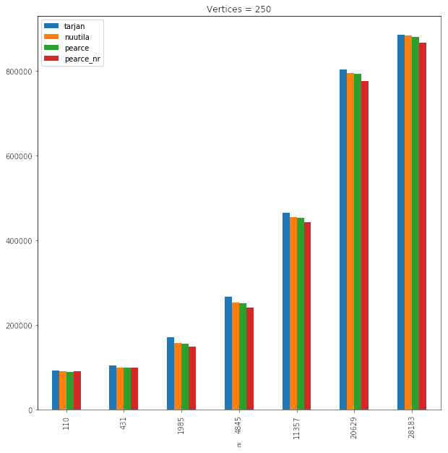
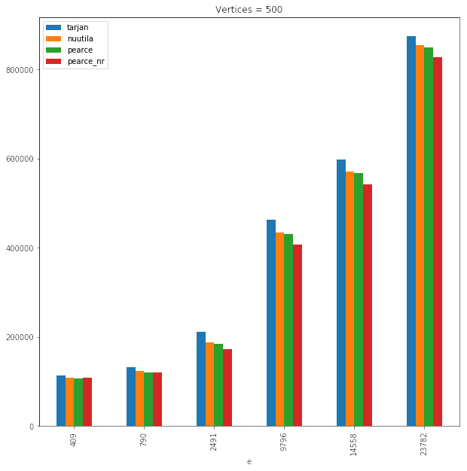
Vertex Number:
250 (Above)
500 (Side)

Slide 28
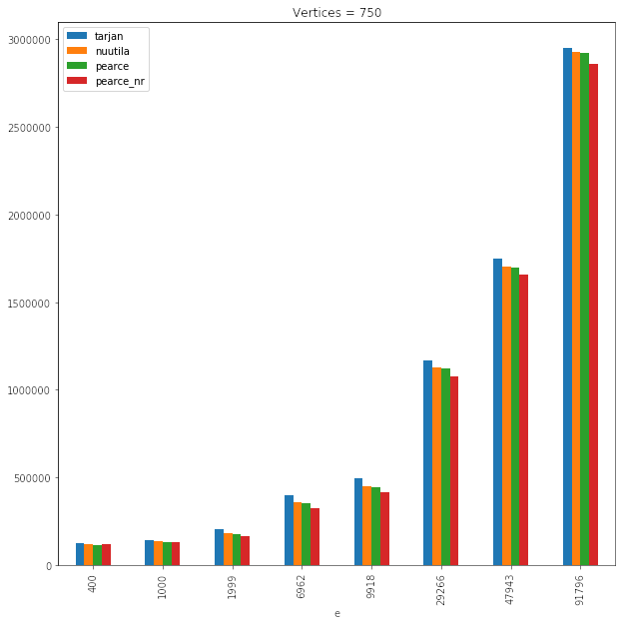
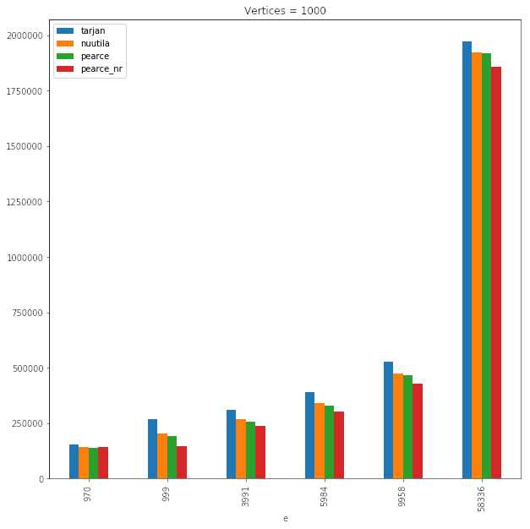
Vertex Number:
750 (Above)
1000 (Side)

Slide 29
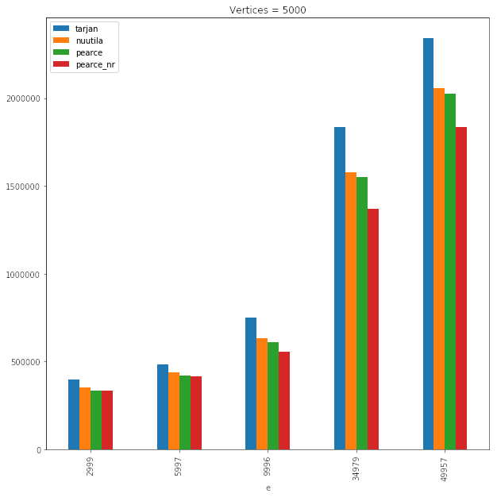
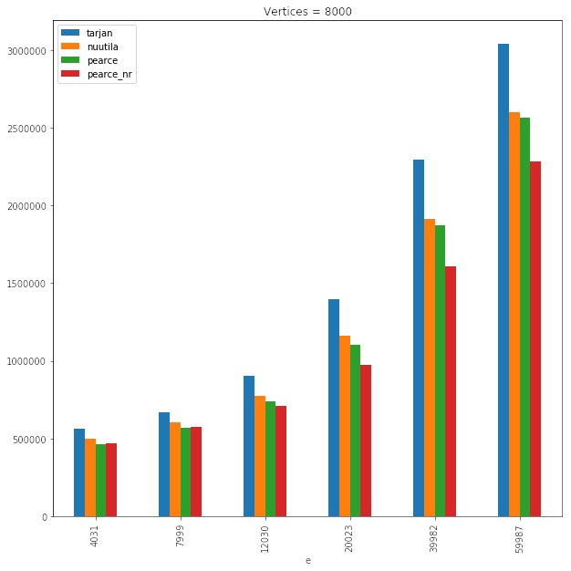
Vertex Number:
5000 (Above)
8000 (Side)

Slide 30
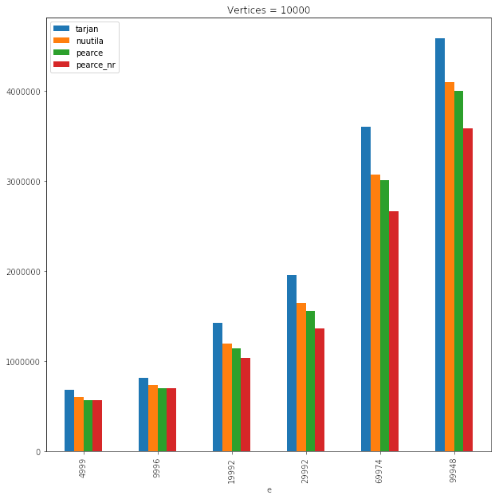

Slide 31
Further Memory Analysis
In order to assess if our implementations showed the same benefits described in Nuutila’s and Pearce’s paper, s.t. no “trivial” SCC’s vertex is pushed on the stack, we evaluated the heap peaks to measure the gap between Tarjan and the others in two special test cases, at the two ends of the spectrum:
Chain DAG : where all SCC are trivial
Single Component Graph : all vertex in the same SCC

Slide 32
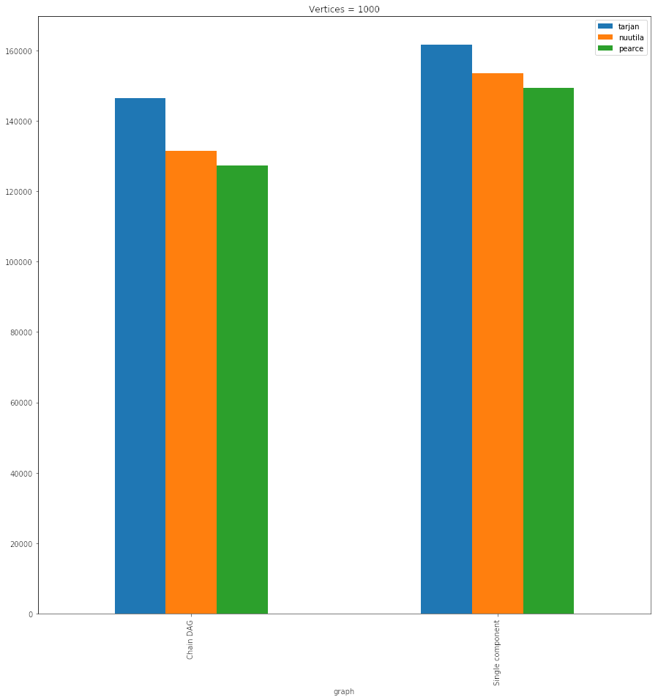
B

Slide 33
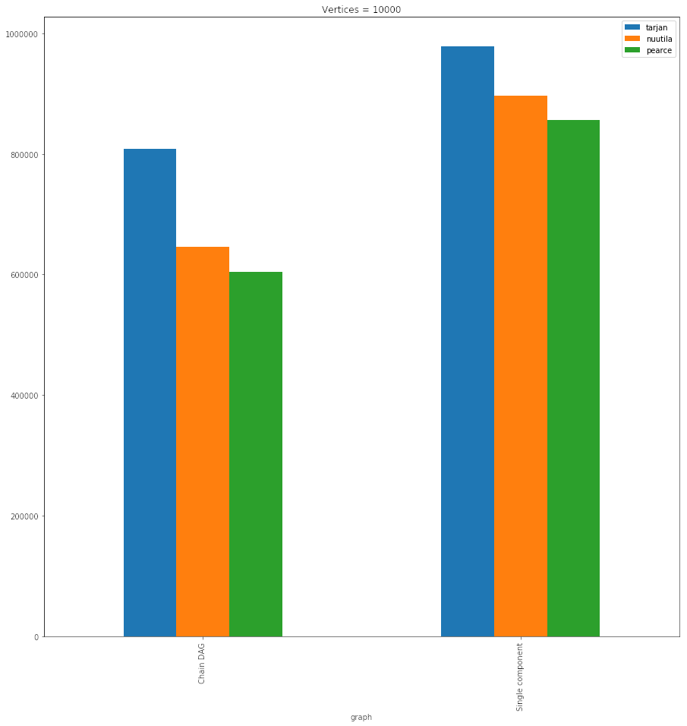

Slide 34
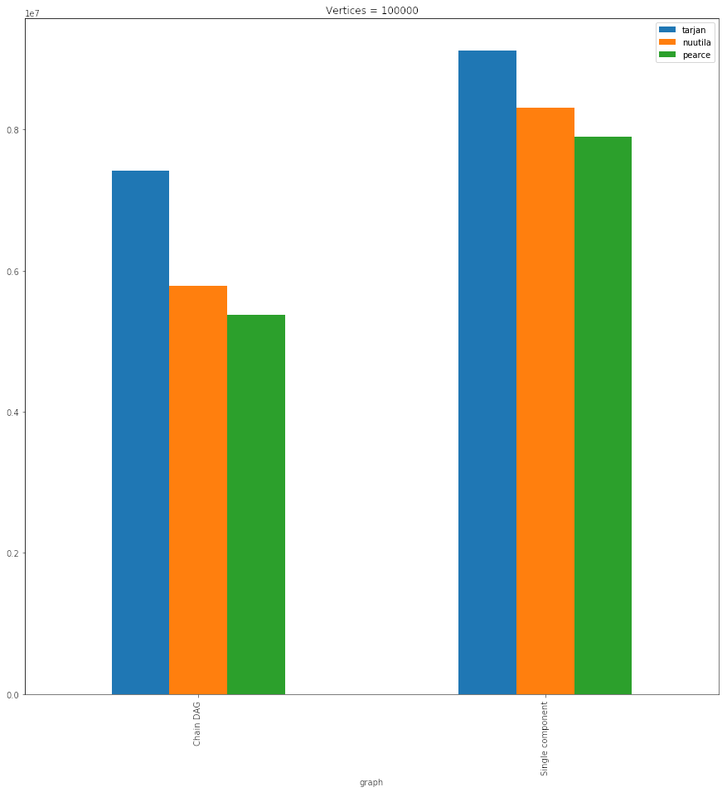

Slide 35
Conclusions
We have :
Implemented the algorithms
Verified that our implementation respects time and space complexity
Shown empirically the benefits between the 3 iteration of the algorithm

Slide 36
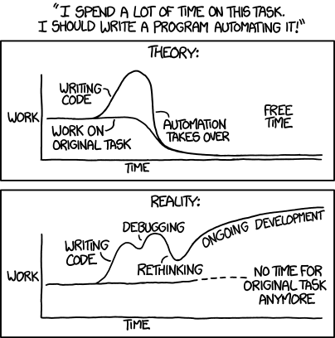
THANK YOU FOR YOUR ATTENTION!

