Slide 1
CSE7101- Capstone Project
Review-1
PhishGuard AI: An Interactive Phishing Awareness and Detection App
Batch Number: CCS_14
Roll Number | Student Name
20231CCS3001 | ANKIREDDY BHARATH KUMAR REDDY
20221CCS0083 | PATHAKOTA VENKATA RAMA MUNI REDDY
20221CCS0047 | PADARTHI REVANTH
Under the Supervision of,
Dr.Shanthi S
Professor
School of Computer Science and Engineering
Presidency University
Name of the Program: Computer Science And Engineering-CYBER SECURITY
Name of the HoD: Dr.Anandaraj
Name of the Program Project Coordinator: Dr.Jayavadivel Ravi
Name of the School Project Coordinators: Dr. Sampath A K , Dr. Geetha A

Slide 2
Problem Statement Number:PSCS_252
Organization: AICTE.
Category: Software
Problem Description:
Phishing is still one of the biggest cybersecurity threats today. Attackers use fake emails, websites, and messages to trick people into giving away personal or sensitive information. While there are many technical security tools available, many users still aren’t fully aware of how to spot these attacks. This project aims to create an AI-powered mobile app that helps users in two ways: by teaching them through interactive simulations and by detecting phishing attempts in real time. The goal is to give users the knowledge and tools they need to stay safe online.

Slide 3
Content
Problem Statement
Objectives
Background and Related work for title Selection
Analysis of Problem Statement

Slide 4
Content (continuation)..
Innovation or Novel Contributions
Git-hub Link
Timeline of the Project
References

Slide 5
Develop a mobile application for phishing awareness training.
Objectives
Develop a mobile application for phishing awareness training.
Integrate AI-based phishing detection using Natural Language Processing (NLP) and URL analysis.
Create gamified phishing recognition challenges.
Provide built-in tools to screen links, emails, and files (e.g., attachments) for malicious indicators and reputation.
Deliver realistic phishing simulations (email/SMS/in-app) with instant feedback.
Offer structured quizzes and a progress dashboard to measure and improve user awareness over time.

Slide 6
Background and Related work
Background:
Phishing is a major social engineering threat that continues to grow in volume and sophistication.
Attackers trick users through fake emails, websites, and messages to steal credentials or sensitive data. Research shows that even trained users can fall victim without continuous awareness programs. Mobile-first training solutions are limited, creating a gap for easily accessible education tools.
Related Work :
Email filters and browser security plugins exist, but they focus primarily on blocking phishing rather than educating users.
Email filters and browser security plugins exist, but they focus primarily on blocking phishing rather than educating users.
Academic studies demonstrate that interactive training and simulations can reduce phishing susceptibility by over 40%, supporting the need for gamified, engaging awareness solutions.

Slide 7
Analysis of Problem Statement
Phishing remains one of the most persistent and damaging forms of cybercrime. Attackers exploit human psychology by crafting emails, SMS messages, and fake websites that closely mimic trusted organizations. Despite advancements in spam filters and anti-virus solutions, phishing continues to succeed because the human factor remains the weakest link in cybersecurity.
Current Gaps
Most existing solutions (e.g., spam filters, browser warnings) focus on technical prevention, not user education.
Many users cannot differentiate between legitimate and fraudulent messages.
2. Challenges
Designing realistic phishing simulations without exposing users to actual risks.
Ensuring AI models are accurate and regularly updated to detect evolving phishing tactics.
3. Target Audience
Students – often inexperienced and vulnerable to scholarship/education-related scams.
Working Professionals – targeted with credential-stealing corporate phishing attacks.
General Mobile Users – exposed to SMS-based (“smishing”) and WhatsApp/social phishing links.

Slide 8
Analysis of Problem Statement (contd...)
Software & Hardware Requirements
Software:
Frontend: Flutter(cross-platform mobile)
Backend: Firebase(Authentication)
Database: SQLite
APIs:Virustotal,PhishTank API
Hardware:
Smartphone(Android/IOS),Internet access

Slide 9
Innovation or Novel Contributions
AI-driven phishing detection (URL reputation).
Gamified learning modules with real-world phishing examples.
Tools for malicious content detection (files, emails, URLs).
Interactive phishing simulations and quizzes.
Awareness score tracking for users.

Slide 10
Github Link
The GitHub link provided should have public access permission.
GitHub Link
https://github.com/phishguardai252-png/phishguard-ai

Slide 11
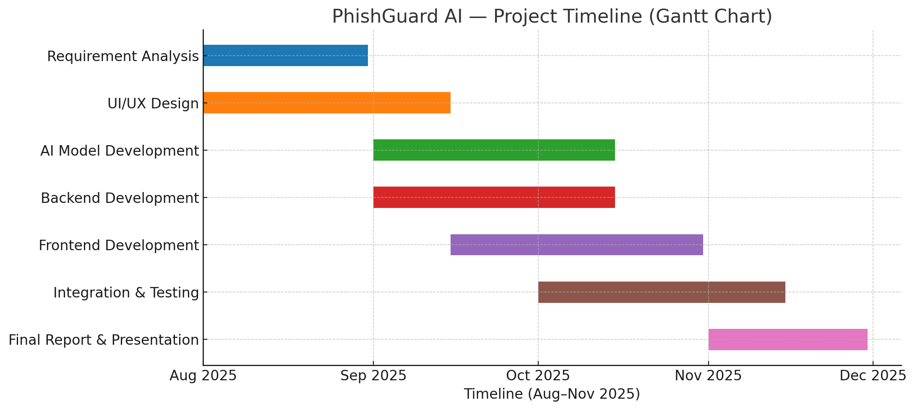
Timeline of the Project (Gantt Chart)
20-Aug

Slide 12
References (IEEE Paper format)
[1] M. F. Ansari, P. K. Sharma, and B. Dash, “Prevention of Phishing Attacks Using AI-Based Cybersecurity Awareness Training,” Int. J. Smart Sensor and Adhoc Network, vol. 3, no. 3, Article 6, Mar. 2022.
[2] O. Ogundairo and P. Broklyn, “AI-Driven Phishing Detection Systems,” J. Cyber Security, Aug. 2024.
[3] A. Arun, “Next Generation of Phishing Attacks using AI-powered Browsers,” IEEE, arXiv preprint, 2024.
[4] A. Rahartomo, A. T. A. Ghaleb, and M. Ghafari, “Phishing Awareness via Game-Based Learning,” arXiv preprint, Jan. 2025.
[5] R. Meguro and S. T. Chong, “AdaPhish: AI-Powered Adaptive Defense and Education Resource Against Deceptive Emails,” arXiv preprint, Feb. 2025.
[6] L. Huang, S. Jia, E. Balcetis, and Q. Zhu, “ADVERT: An Adaptive and Data-Driven Attention Enhancement Mechanism for Phishing Prevention,” arXiv preprint, Jun. 2021.
[7] N. A. G. Arachchilage, “User-Centred Security Education: A Game Design to Thwart Phishing Attacks,” arXiv preprint, Nov. 2015.

Slide 13


