Slide 1
CSE7101- Capstone Project
Review-2
PhishGuard AI: An Interactive Phishing Awareness and Detection App
Batch Number: CCS_14
Roll Number | Student Name
20231CCS3001 | ANKIREDDY BHARATH KUMAR REDDY
20221CCS0083 | PATHAKOTA VENKATA RAMA MUNI REDDY
20221CCS0047 | PADARTHI REVANTH
Under the Supervision of,
Dr.Shanthi S
Associate Professor
School of Computer Science and Engineering
Presidency University
Name of the Program: Computer Science And Engineering-CYBER SECURITY
Name of the HoD: Dr.Anandaraj
Name of the Program Project Coordinator: Dr.Jayavadivel Ravi
Name of the School Project Coordinators: Dr. Sampath A K , Dr. Geetha A

Slide 2
Content
Abstract
Objectives
Existing Methods and Drawbacks
Proposed Methods & Feasibility Study

Slide 3
Content (continuation)..
Architecture Diagram
Modules
Hardware and Software Details
Timeline(Gantt Chart)

Slide 4
Abstract:
Content:
Problem: Phishing is one of the most common cyber threats today, targeting users through emails, files, fake Wi-Fi, and malicious links.
Objective: To develop a mobile application that combines detection and awareness training against phishing.
Approach: The app integrates modules such as Safe Link Checker, File Threat Detector, Email Detector, Wi-Fi Security Checker, AI-powered Chatbot, Quizzes, and Daily Tips. These features provide both real-time protection and awareness through interactive learning.
Outcome: A user-friendly, multi-feature platform that educates users and helps prevent falling victim to phishing attacks.

Slide 5
Develop a mobile application for phishing awareness training.
Objectives
Develop a cross-platform mobile app for phishing awareness and detection (Flutter).
Integrate AI-based detection for URLs and message content using NLP and URL analysis.
Provide interactive training: quizzes, gamified challenges, and phishing simulations.
Offer practical security tools: Safe Link Checker, File Threat Detector, Email Analyzer, Wi-Fi Security Checker.
Add a helpdesk & dashboard with progress tracking and certificates for completed training.
Keep system feasible: use free-tier APIs where possible (VirusTotal, Hugging Face / OpenAI for prototype).

Slide 6
Existing Methods & Drawbacks
Awareness Campaigns: Posters, emails, and online training used by organizations.
Drawback: Passive learning → users forget easily.
Phishing Simulations: Companies send fake phishing emails to test employees.
Drawback: Fear-based, limited interactivity, no personalized feedback.
Anti-virus / Security Software: Detects malicious links/files.
Drawback: Focuses on detection only, does not educate users.
Browser-based Warnings (e.g., Google Safe Browsing): Warn users of unsafe websites.
Drawback: Limited to browsing; cannot cover emails, Wi-Fi, or files.
Existing Apps (awareness or quizzes): Provide general tips & multiple-choice questions.
Drawback: Lack gamification, real-time scanning, and explainable AI feedback.

Slide 7
Proposed Methods & Feasibility Study
Phishing Awareness Mobile App combining education + real-time protection.
Key Modules:
🤖 AI Chatbot (Gemini) → answers user queries on phishing & security.
🔗 Safe Link Checker → scans suspicious URLs (VirusTotal API).
📧 Email Threat Analyzer → detects phishing patterns in email text.
📡 Wi-Fi Security Checker → flags insecure / fake hotspots.
🔐 Password Strength Analyzer → checks and suggests strong passwords.
📲 Daily Cybersecurity Tips (Notifications/Widget) → awareness through reminders.
📁 File Threat Detector → scans uploaded files for malware.
🧩 Phishing Quiz Module – tests user awareness with MCQs & scenarios.
🎮 Phishing Simulation Module – sends fake phishing samples (emails/links) to test user response.

Slide 8
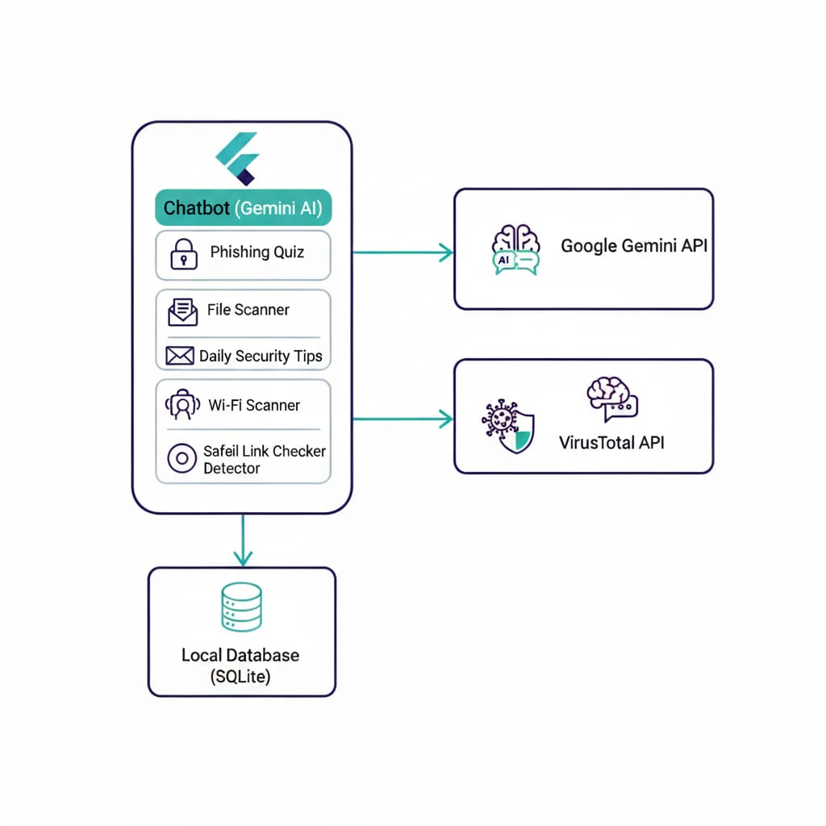
Architecture Diagram

Slide 9
Modules
✅ Awareness & Learning Modules
Quizzes & Simulations
Awareness Games
Daily Security Tips
✅ Detection & Security Modules
Safe Link Checker (VirusTotal API)
File Scanner (VirusTotal API)
Wi-Fi Security Checker
Email Threat Detector
Password Strength Analyzer
✅ Engagement Modules
Gamified Learning
✅ AI Modules
Chatbot (Gemini API)
AI Threat Prediction(Virus Total)

Slide 10
Hardware & Software Details
Software & Hardware Requirements
Software:
Frontend: Flutter(cross-platform mobile)
Backend: Firebase(Authentication)
Database: SQLite
APIs:Virustotal,PhishTank API
Hardware:
Smartphone(Android/IOS),Internet access

Slide 11
Github Link
The GitHub link provided should have public access permission.
GitHub Link
https://github.com/phishguardai252-png/phishguard-ai

Slide 12
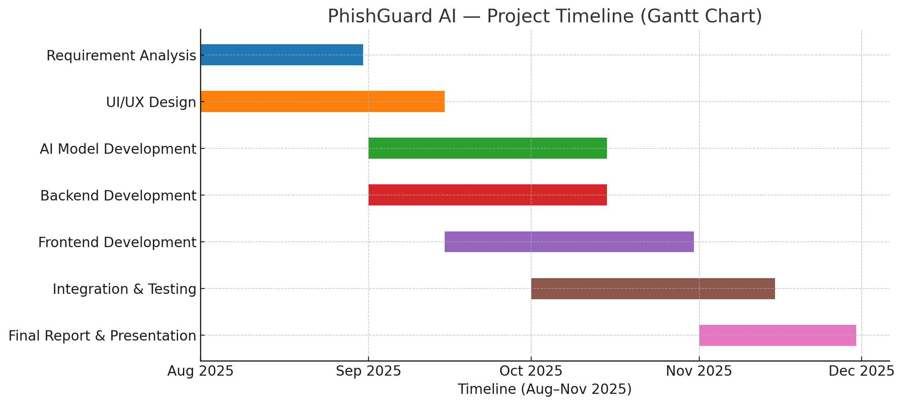
Timeline of the Project (Gantt Chart)
20-Aug

Slide 13
References (IEEE Paper format)
[1] M. F. Ansari, P. K. Sharma, and B. Dash, “Prevention of Phishing Attacks Using AI-Based Cybersecurity Awareness Training,” Int. J. Smart Sensor and Adhoc Network, vol. 3, no. 3, Article 6, Mar. 2022.
[2] O. Ogundairo and P. Broklyn, “AI-Driven Phishing Detection Systems,” J. Cyber Security, Aug. 2024.
[3] A. Arun, “Next Generation of Phishing Attacks using AI-powered Browsers,” IEEE, arXiv preprint, 2024.
[4] A. Rahartomo, A. T. A. Ghaleb, and M. Ghafari, “Phishing Awareness via Game-Based Learning,” arXiv preprint, Jan. 2025.
[5] R. Meguro and S. T. Chong, “AdaPhish: AI-Powered Adaptive Defense and Education Resource Against Deceptive Emails,” arXiv preprint, Feb. 2025.
[6] L. Huang, S. Jia, E. Balcetis, and Q. Zhu, “ADVERT: An Adaptive and Data-Driven Attention Enhancement Mechanism for Phishing Prevention,” arXiv preprint, Jun. 2021.
[7] N. A. G. Arachchilage, “User-Centred Security Education: A Game Design to Thwart Phishing Attacks,” arXiv preprint, Nov. 2015.

Slide 14


