Slide 1
DFL Roadmap : AI Chatbot

Slide 2

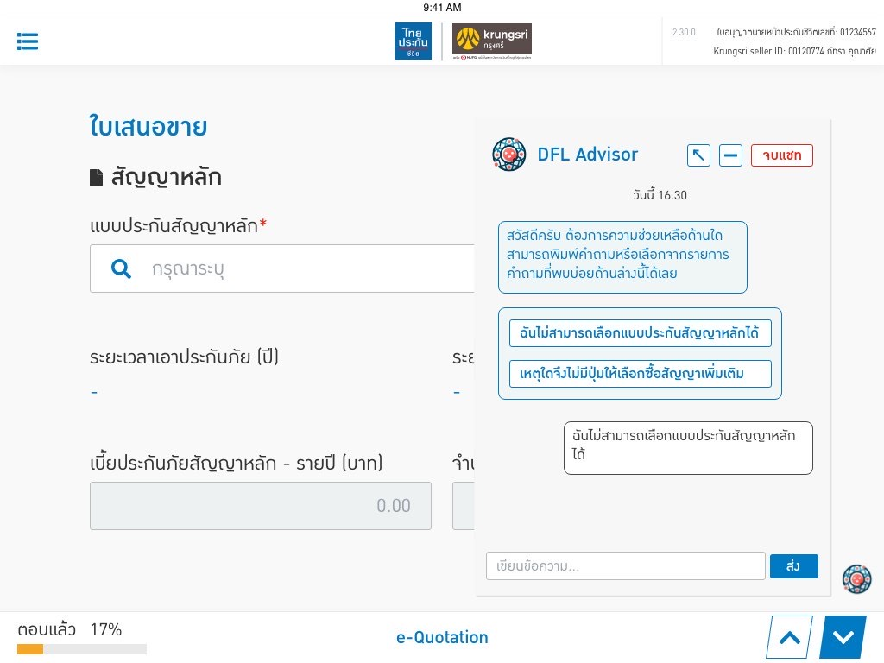
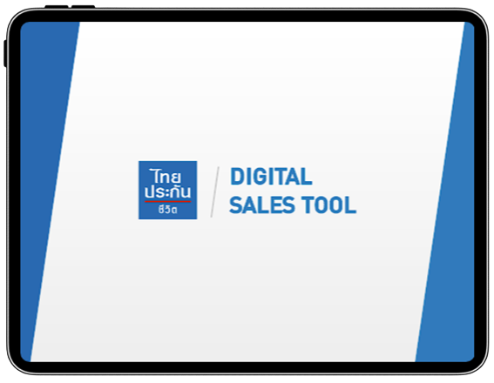
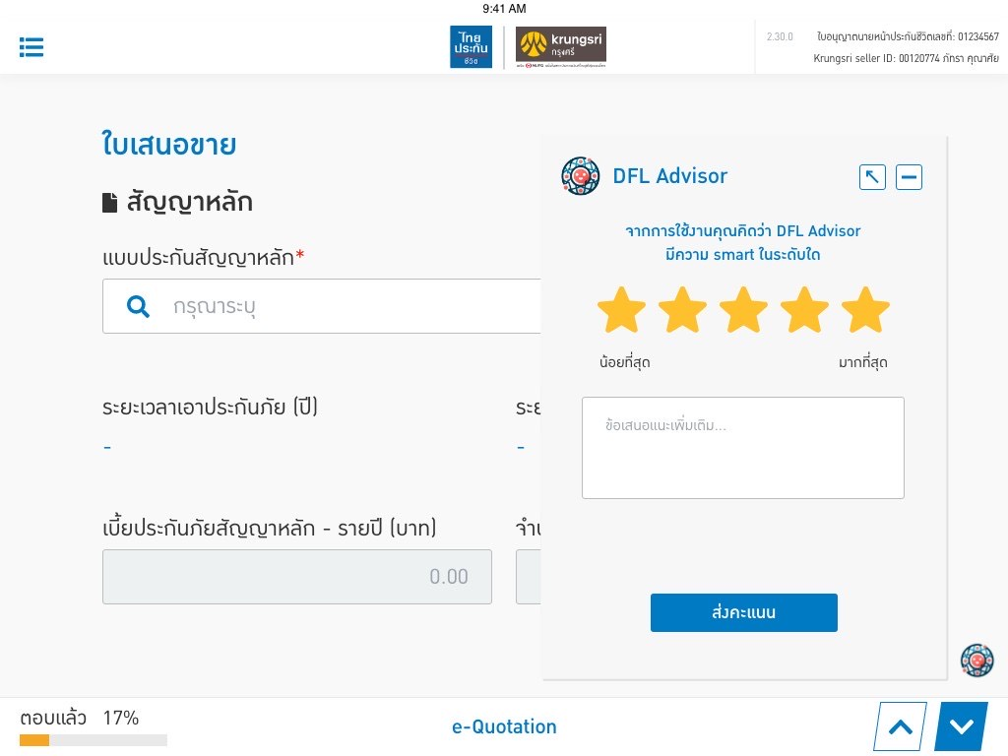
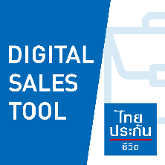
AI Chatbot
1.Function in
DFL Digital Sales Tool Application
Krungsri Seller
Expert User
History log
for review
 | GIO | NGIO | CL
Top | XX | XX | XX
Low | XX | XX | XX
AI Chatbot
New User
Send the result as daily report
2.Smart Score

Slide 3
AI Chatbot
Usage Forecast
Scope of AI
Period, Sum assured, Benefit, Product Comparison.
1.Product Feature
Sales process, UW guideline, Non-med limit rate.
2.New Business Sales Process
Freelook Right & Process.
Answer Accuracy 80-95%
3.Policy Condition
AI Chatbot
Appropriate Question
Changing Beneficiary.
Register DD, CC.
4.After Sales Service
Inappropriate Question
5.Bank’s Requirement
Bank’s Information such as bank counter payment.
7. Business Answer
6.Sales Tool Guideline
How to do e-KYC, e-Submission process, e-CTF & e-Reject Process.
Timeline
AI Chatbot Phase I
AI Chatbot Phase II
May
2024
December
2024
June
2025
Go Live Plan
Improvement Plan

Slide 4
AI Chatbot : Input & Output Example

Slide 5
Thank You

