Slide 1
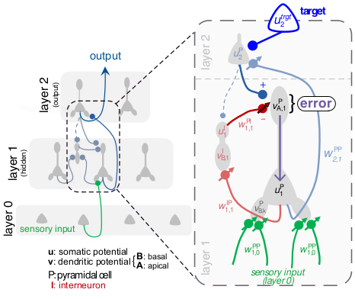
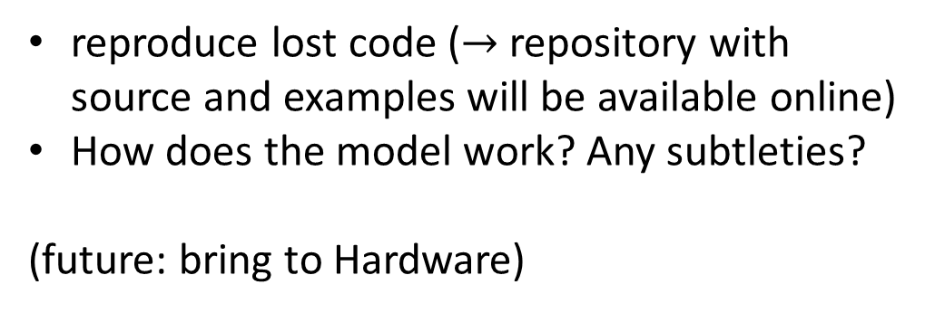
Dendritic cortical microcircuits approximate the backprob algorithm (Sacramento 2017)
reproduce lost code ($→$ repository with source and examples will be available online)
How does the model work? Any subtleties?
(future: bring to Hardware)

Slide 2
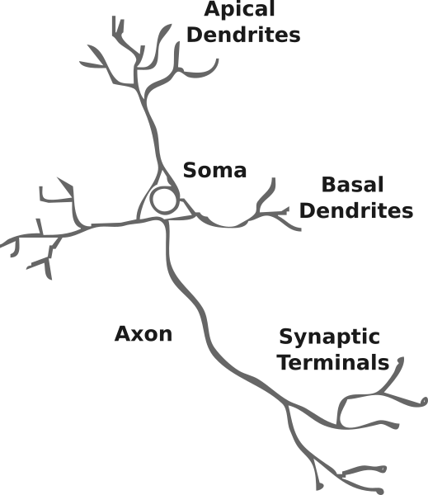











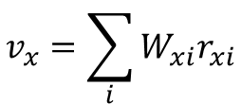
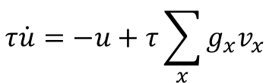

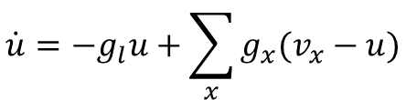

From point neurons to multi-compartment neurons
$$g_{l}$$
$$u$$
soma
$$g_{x}$$
$$u$$
$$v_{x}$$
…
$$W$$
$$W_{x}$$
$$r_{x}$$
presynaptic input $r$
$$v_{x}=\sum_{i}{W_{xi}r_{xi}}$$
$$\dot{u}=−g_{l}u+\sum_{x}{g_{x}(v_{x}−u)}$$
$$r=φ(u)$$
$$τ\dot{u}=−u+τ\sum_{x}{g_{x}v_{x}}$$
$$T≫τ$$
$$\tilde{u}=τ\sum_{x}{g_{x}v_{x}}$$
1/$τ=g_{tot}$
$$=g_{l}+∑g_{x}$$
steady-state solution

Slide 3
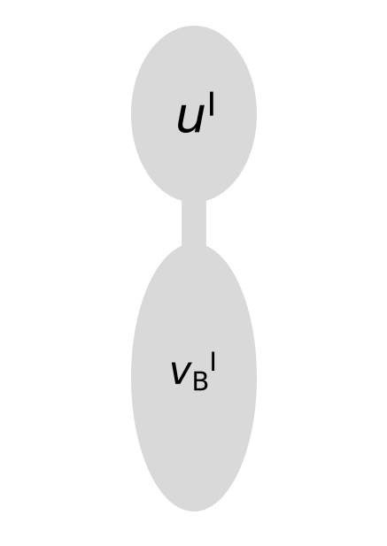












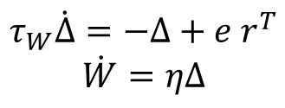
Learning by dendritic prediction of somatic spiking
$${\hat{v}}_{B}≡\tilde{u}= \frac{g_{D}}{g_{l}+g_{D}} v_{D}= \frac{g_{D}}{g_{l}+g_{D}}W⋅r$$
$$g_{l}$$
$$u^{target}$$
$$g_{som}$$
$$u$$
with nudging $\tilde{u}=\left(1−λ\right){\hat{v}}_{B}+λu^{target}$, $λ= \frac{g_{som}}{g_{l}+g_{D}+g_{som}}$
$$g_{D}$$
dendritic prediction error: $e≡φ\left(u\right)−φ\left({\hat{v}}_{B}\right)$
$$v_{B}$$
$$W$$
$$r$$
$$\dot{W}=η e r^{T}$$
until ${\hat{v}}_{B}=u^{target}$
in praxis:
$$τ_{W}\dot{Δ}=−Δ+e r^{T}$$
$$\dot{W}=ηΔ$$
Supplements; Urbanczik 2014

Slide 4
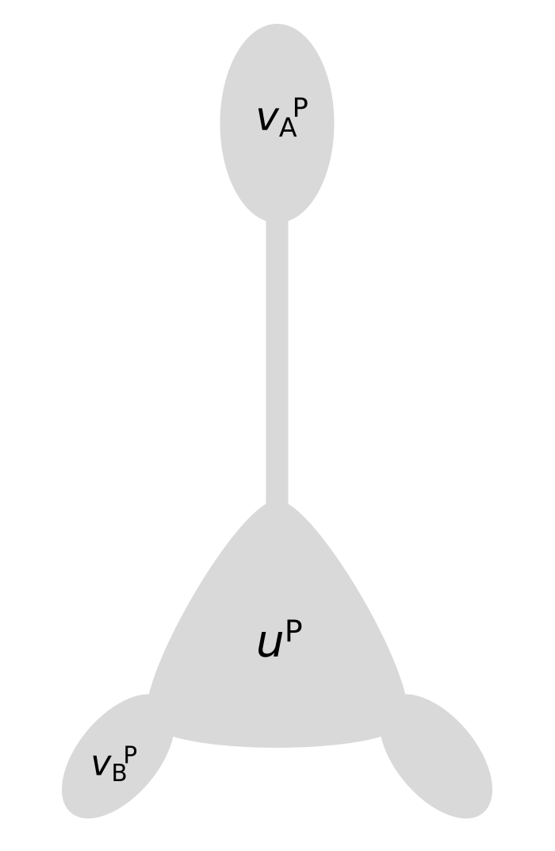















Pyramidal neurons
$$v_{A}$$
$$g_{A}$$
$${ \hat{v}}_{B}≡\tilde{u}= \frac{g_{B}}{g_{l}+g_{B}+g_{A}} v_{B}= \frac{g_{B}}{g_{l}+g_{B}+g_{A}}W⋅r$$
$$=0$$
$$g_{l}$$
$$v_{A}$$
$$u$$
$$≠0$$
$\tilde{u}={\hat{v}}_{B}+λ v_{A}$ , $λ= \frac{g_{A}}{g_{l}+g_{B}+g_{A}}$
$$g_{B}$$
dendritic prediction error: $e≡φ\left(u\right)−φ\left({\hat{v}}_{B}\right)$
$$v_{B}$$
$$W$$
$$r$$
$$\dot{W}=η e r^{T}$$
until forever?

Slide 5


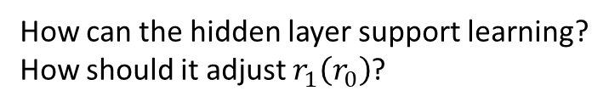


Deep cortical microcircuits (naïve)
output
apply the learning rule in the output layer
learns mapping $r_{1}\left(r_{0}\right)→u^{target}$
$$r_{1}$$
How can the hidden layer support learning?
How should it adjust $r_{1}\left(r_{0}\right)$?
propagate output error back to hidden layer via $r_{1}\left(r_{0}\right)$
Implement a feedback-loop
sensory input, $r_{0}$

Slide 6






Deep cortical microcircuits
lateral plasticity $→$ self-predicting state:
$$w_{1,2}^{PP}$$
$$W_{2,1}^{PP}=W_{1,1}^{IP}$$
$$v_{A}^{P}≈0$$
$$W_{1,1}^{PI}={−W}_{1,2}^{PP}$$
$u_{1}^{I}≈u_{2}^{P}$

Slide 7
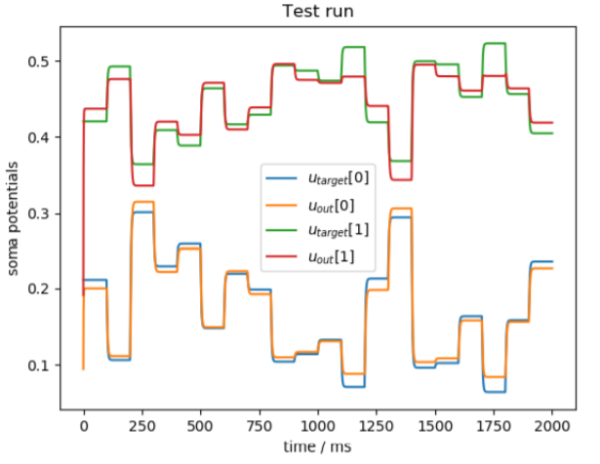
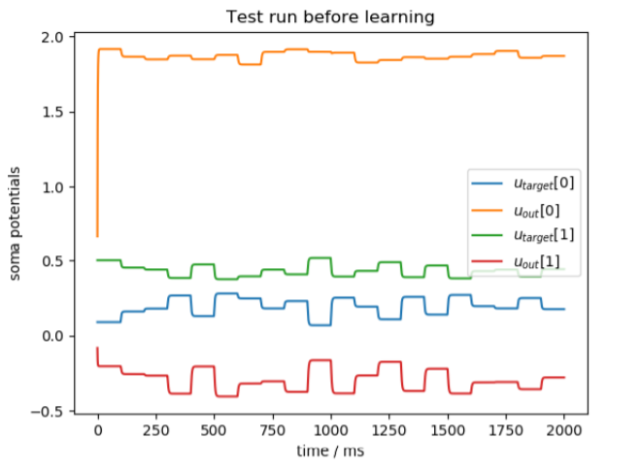
Mimic-regression-task
task: 2x3x2 network learns to
mimic the output of a randomly
initialized network of same size

Slide 8
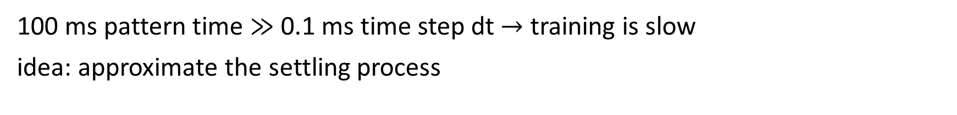
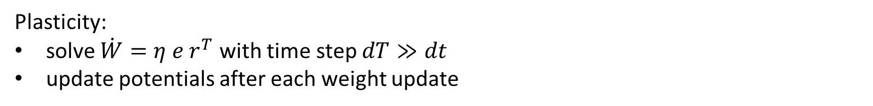
Steady-State Approximation
100 ms pattern time $≫$ 0.1 ms time step dt $→$ training is slow
idea: approximate the settling process
1. propagate the input upwards, layer by layer with dendritic prediction / steady-state solution:
2. propagate corrections downwards with full steady-state solution:
3. repeat $n_{passes}$ times $→$ (hopefully) converge to steady-state of entire network
Plasticity:
solve $\dot{W}=η e r^{T}$ with time step $dT≫dt$
update potentials after each weight update
What do we hope to gain? Approximation might not be accurate, but good approach for hyperparameter search!

Slide 9
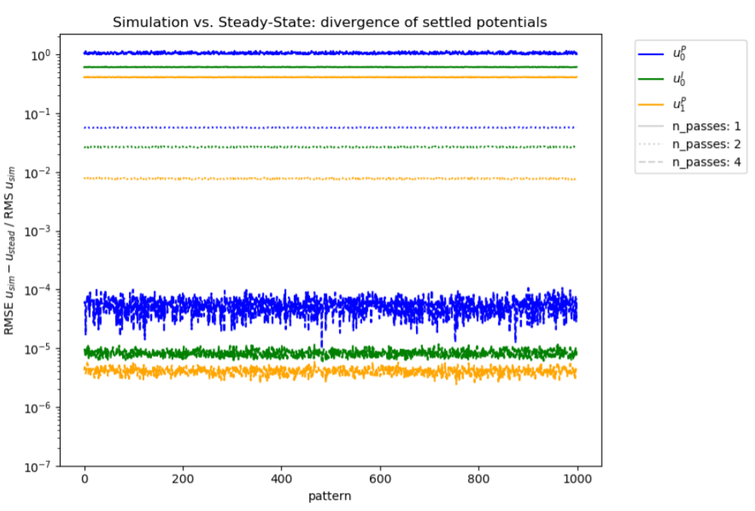
Steady-State Approximation: Validity
relative rms deviation of soma potentials, when plasticity is switched off

Slide 10
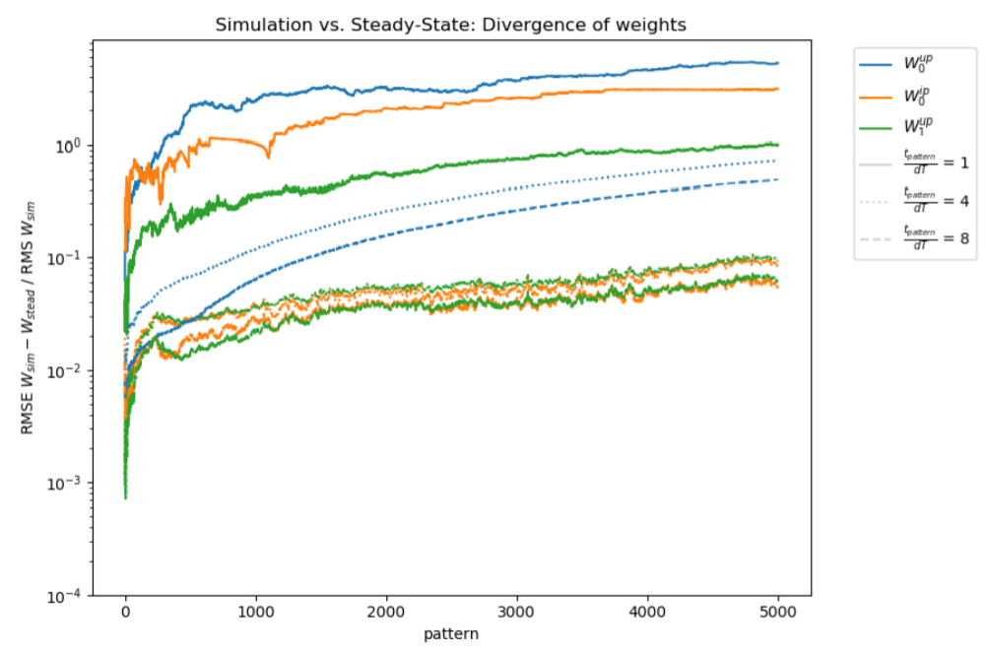
Steady-State Approximation: Validity
relative rms deviation of weights

Slide 11
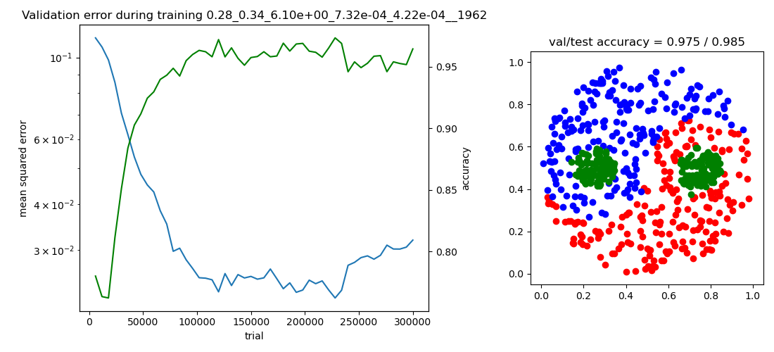
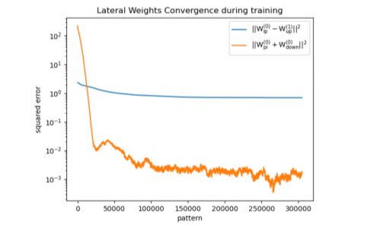
Yin-Yang results
trained on 55 epochs a 6000 samples: $\left(97.2±1.1\right)\%$accuracy

Slide 12
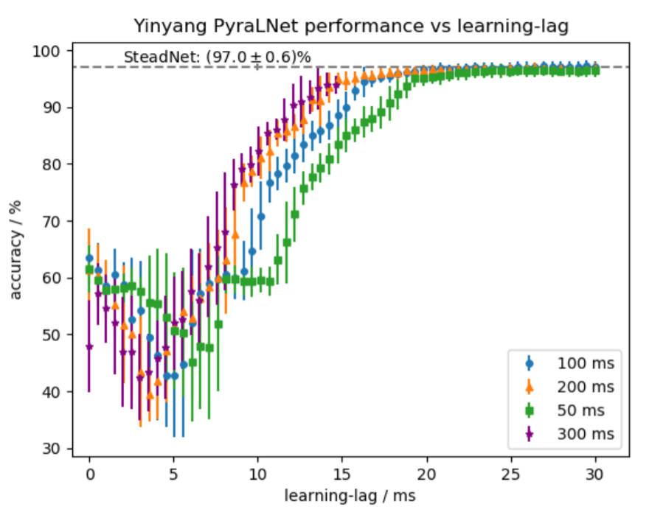
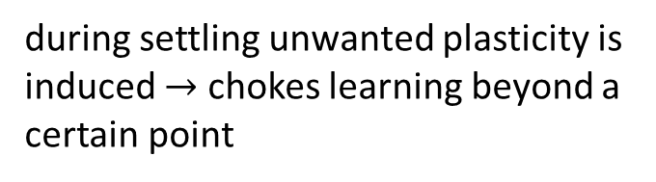
Yin-Yang results: learning-lag
during settling unwanted plasticity is induced $→$ chokes learning beyond a certain point
introduce learning-lag: no plasticity for fixed time after each new pattern
*the network is initialized in the self-predicting state and PI-plasticity is switched of
*trained on 6000 samples for 45 epochs

Slide 13
Summary
Code for simulation (PyraLNet) and steady-state approximation (SteadNet) is available
model is able to solve the Yin-Yang problem effectively once learning-lag is introduced
SteadNet is able to solve MNIST
However:
SteadNet results cannot directly be generalized to full simulation (since unwanted plasticity during settling might cause problems)

Slide 14








Deep cortical microcircuits
$$u_{2}^{P}=−g_{tot}u_{2}^{P}+g_{B}W_{2,1}^{PP}φ\left(u_{1}^{P}\right)+g_{som}u^{target}$$
$$u_{1}^{I}=−g_{tot}u_{1}^{I}+g_{D}W_{1,1}^{IP}φ\left(u_{1}^{P}\right)+g_{som}u_{2}^{P}$$
$$u_{1}^{P}=−g_{tot}u_{1}^{P}+g_{B}W_{1,0}^{PP}r_{0}+g_{A}v_{A,1}^{P}$$
$$w_{1,2}^{PP}$$
$$v_{A,1}^{P}=W_{1,1}^{PI}φ\left(u_{1}^{I}\right)+W_{1,2}^{PP}φ(u_{2}^{P})$$
${\dot{W}}_{1,1}^{PI}={−η}^{PI}v_{A,1 }^{P}$, ${\dot{W}}_{1,2}^{PP}=0$
lateral plasticity $→$ self-predicting state:
$$W_{2,1}^{PP}=W_{1,1}^{IP}$$
$$v_{A}^{P}≈0$$
$$W_{1,1}^{PI}=W_{1,2}^{PP}$$
$u_{1}^{I}≈u_{2}^{P}$

Slide 15
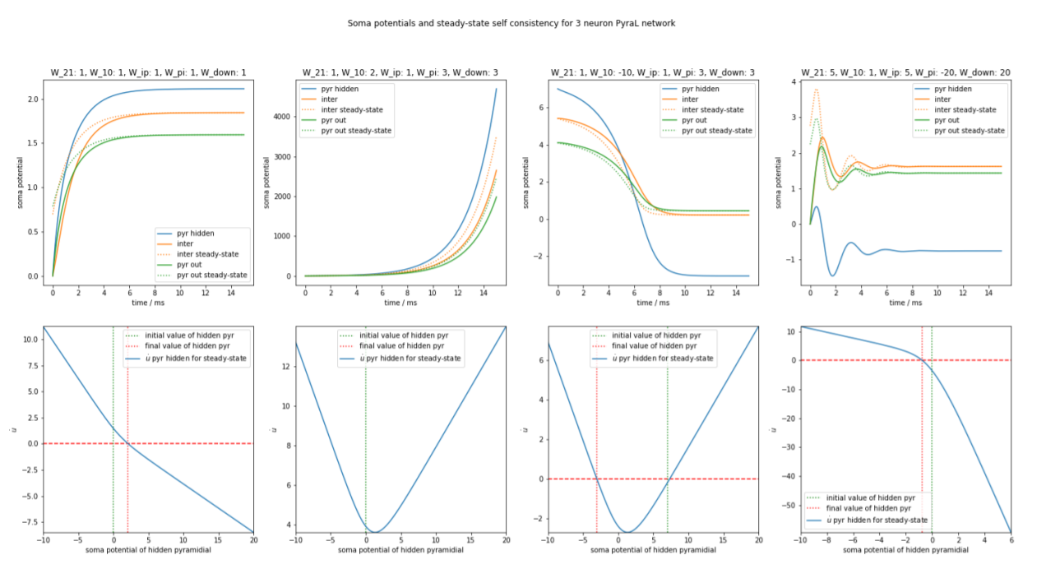
Stability

Slide 16
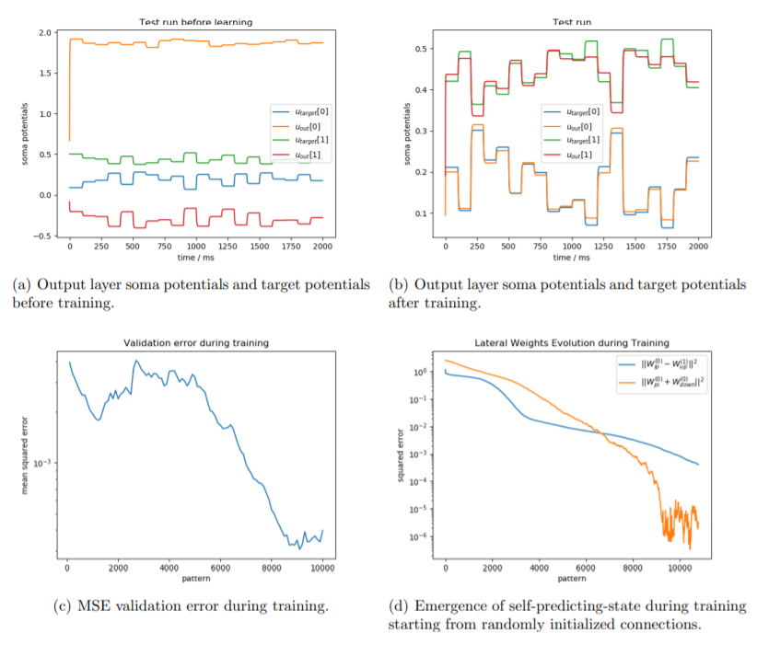
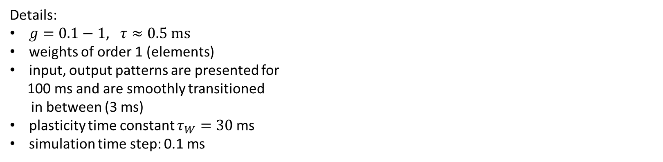
Mimic-regression-task
task: 2x3x2 network learns to
mimic the output of a randomly
initialized network of same size
Details:
$g=0.1−1$, $τ≈0.5 ms$
weights of order 1 (elements)
input, output patterns are presented for
100 ms and are smoothly transitioned
in between (3 ms)
plasticity time constant $τ_{W}=30$ms
simulation time step: 0.1 ms

Slide 17
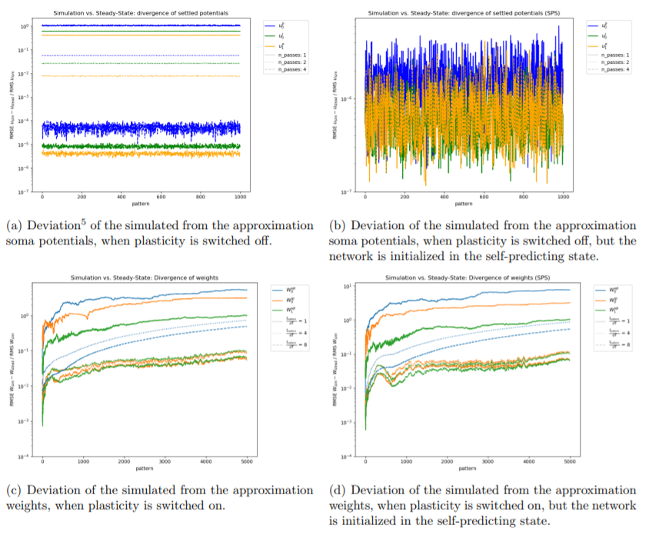
Steady-State Approximation: Validity

Slide 18
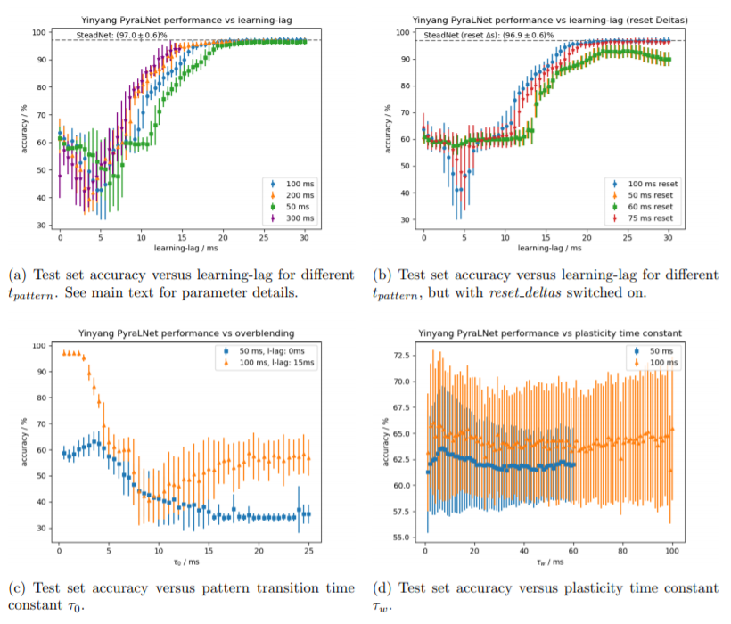
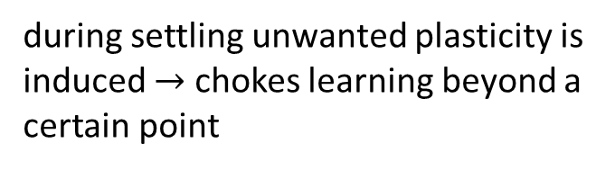
Yin-Yang results: learning-lag
during settling unwanted plasticity is induced $→$ chokes learning beyond a certain point
introduce learning-lag: no plasticity for fixed time after each new pattern
*the network is initialized in the self-predicting state and PI-plasticity is switched of
*trained on 6000 samples for 45 epochs

