Slide 1
BUSINESS ANALYSIS PORTFOLIO CASE
Shipment exceptions, handled before the customer calls
From three conflicting requests to rules that run as tests, a working demo and a controlled pilot — for a fictional short-sea and door-to-door operator.
Philippe Godfroy · fictional organisation, simulated delivery, real automated tests
Notes:
Open with the one-sentence version: customers heard about delays at the gate; I turned three requested solutions into one problem and worked it out end to end. Say upfront that the organisation is fictional and the delivery simulated — and that the tests and demo are real.

Slide 2
1 · THE PROBLEM
Customers learned about delays at the gate
22%
38%
±55 / week
of late deliveries announced before the window
of all contacts are “where is my load?”
missed delivery slots at ±€140
Three managers, three solutions:
“A tracking page like the parcel carriers” — Head of Customer Service
“Proactive e-mails to key accounts” — Commercial director
“Nothing that creates more work” — Road planning lead
Root cause: no shared definition of late, no severity, no owner for telling the customer.
Fictional organisation · portfolio case · 2/10
Notes:
Illustrative figures. The point of the slide: the request came in as three solutions. My first job was to describe the problem without choosing one of them. The 5 whys ended at 'missing rules', not 'missing screen'.

Slide 3
2 · APPROACH
From opportunity to production readiness
1
Frame & business case
2
Discover & event storm
3
Model AS-IS / TO-BE
4
Rules & examples
5
Prioritise with the PO
6
Design & demo
7
BAT & go/no-go
8
Measure
BA prepares, owners decide. Scope and priority: Product Owner. Thresholds: PO with the planning lead. Go-live: PO. Funding and stage gate: sponsor.
Evidence: documents with IDs that trace from pain point to KPI; a script checks every reference in CI.
Fictional organisation · portfolio case · 3/10
Notes:
Walk the journey in 30 seconds. Emphasise the split between preparing and deciding — it comes back in every step and answers 'aren't you doing the PO's job?' before it is asked.

Slide 4
3 · FRAMING
Four options, one honest business case
Option | Score | Verdict
O1 Add a CS agent | 2.45 | treats the symptom
O2 Standard TMS e-mails | 3.10 | ±9 changes per order, ±0.3 relevant
O3 Exception management | 3.95 | recommended — as a pilot
O4 Visibility platform | 2.85 | later, for consignees
Riskiest assumption
The case pays back in ±13.5 months if a third of WISMO contacts disappear. Nobody knew that number.
Pessimistic case: ±31 months.
So the sponsor funded a six-week pilot with a control group, and release 2 only if WISMO falls ≥ 20%.
Weights were agreed before scoring, with the PO, the Head of CS and the planning lead. Proposed figures — not measured.
Fictional organisation · portfolio case · 4/10
Notes:
Why not O2: I tested it on paper with a week of status events for 20 orders. More messages is not better information. The strongest move here is 'buy the information first': name the riskiest assumption and test it before the full investment.

Slide 5
4 · WORKSHOP
One disagreement, one missing concept: severity
Account manager
Senior planner
Decision (PO, D-02)
“Key accounts must hear everything.”
Need: never surprised by something serious.
“No notification storm.”
Need: no message that doesn't change the customer's day.
By severity: minor < 2 h, major 2–6 h, critical ≥ 6 h or next day; reefer +1; critical key account also gets a call.
How: ask each side for the last load that went wrong → reflect the need back → put both needs on the wall → let the room find the concept → three options → the owner decides.
Honest note: the workshop is simulated. The facilitation plan and choices are real; I have not yet run event storming with a real group.
Fictional organisation · portfolio case · 5/10
Notes:
This is the stakeholder-conflict story. Tell it with the dialogue in docs/03-workshops/workshop-dialogue.md. Severity resolved three hotspots at once. Keep the honest note — interviewers respect it.

Slide 6
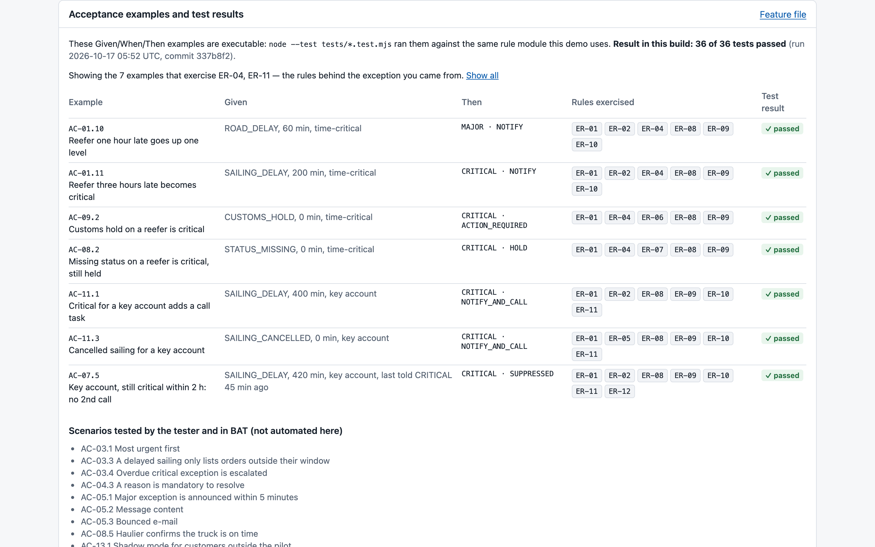
5 · REQUIREMENTS
Rules precise enough to run as tests
13 rules, one decision table, 30 Given/When/Then examples
The examples are the specification and the test: the prototype, the demo and CI all use the same rule module.
When the PO changes a threshold, the failing examples show exactly which decisions change meaning.
Traceability: P5 → BR-1 → FR-06/10 → ER-10/12 → US-05/07 → AC-07.1 → K1, K3
Fictional organisation · portfolio case · 6/10
Notes:
Boundaries matter: 119 minutes is minor, 120 is major. Explain why the window check is the first row of the table: a delayed sailing must not alarm customers whose delivery is still on time. The analyst does not write production code — the module proves the rules are precise enough to build and test.

Slide 7
6 · PRODUCT DELIVERY
Prioritised with the Product Owner
Backlog item | WSJF
EN-2 Window mandatory for pilot customers | 15.0
US-07 No message storm | 9.0
US-13 Pilot toggle + measurement | 8.0
US-05 Proactive customer message | 5.8
US-06 EDI/API status messages → R2 | 1.8
Trade-offs the PO made
Missing-status hold before EDI messages: false alarms in week 1 would kill trust.
Key-account call task kept: cheap, and it wins the account managers.
Workbench scope cut: filters to R2.
Release 1 = 36 points, two sprints, five pilot customers.
WSJF ranks; dependencies sequence. MoSCoW says what is in the release; WSJF orders the work inside it.
Fictional organisation · portfolio case · 7/10
Notes:
When everything is 'Must', WSJF made the 1-point window fix rise to the top: 28% of orders had no window, and nothing works without it. Business scores value, the team scores size, the PO decides.

Slide 8
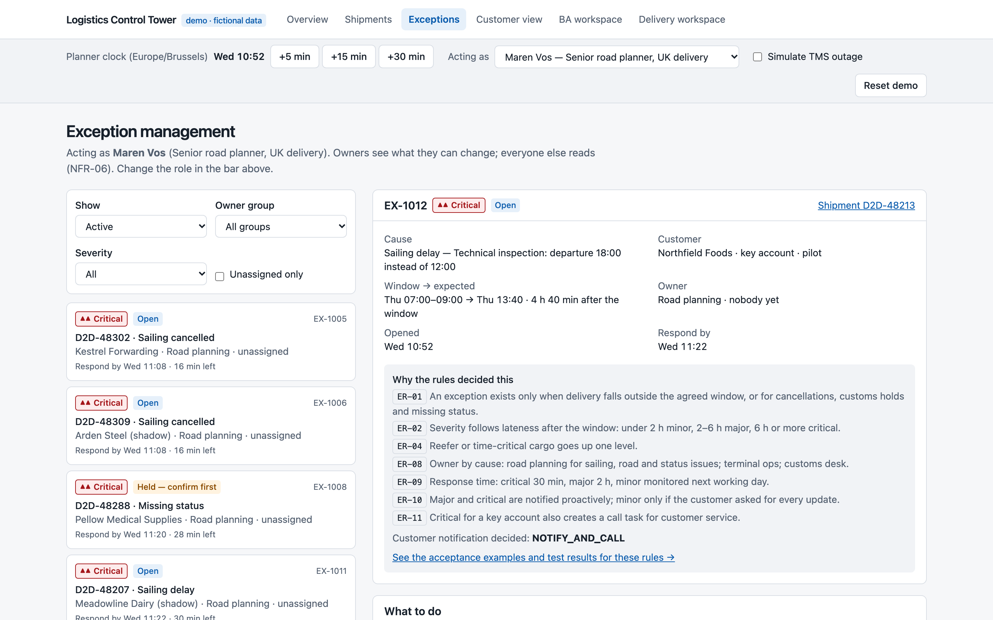
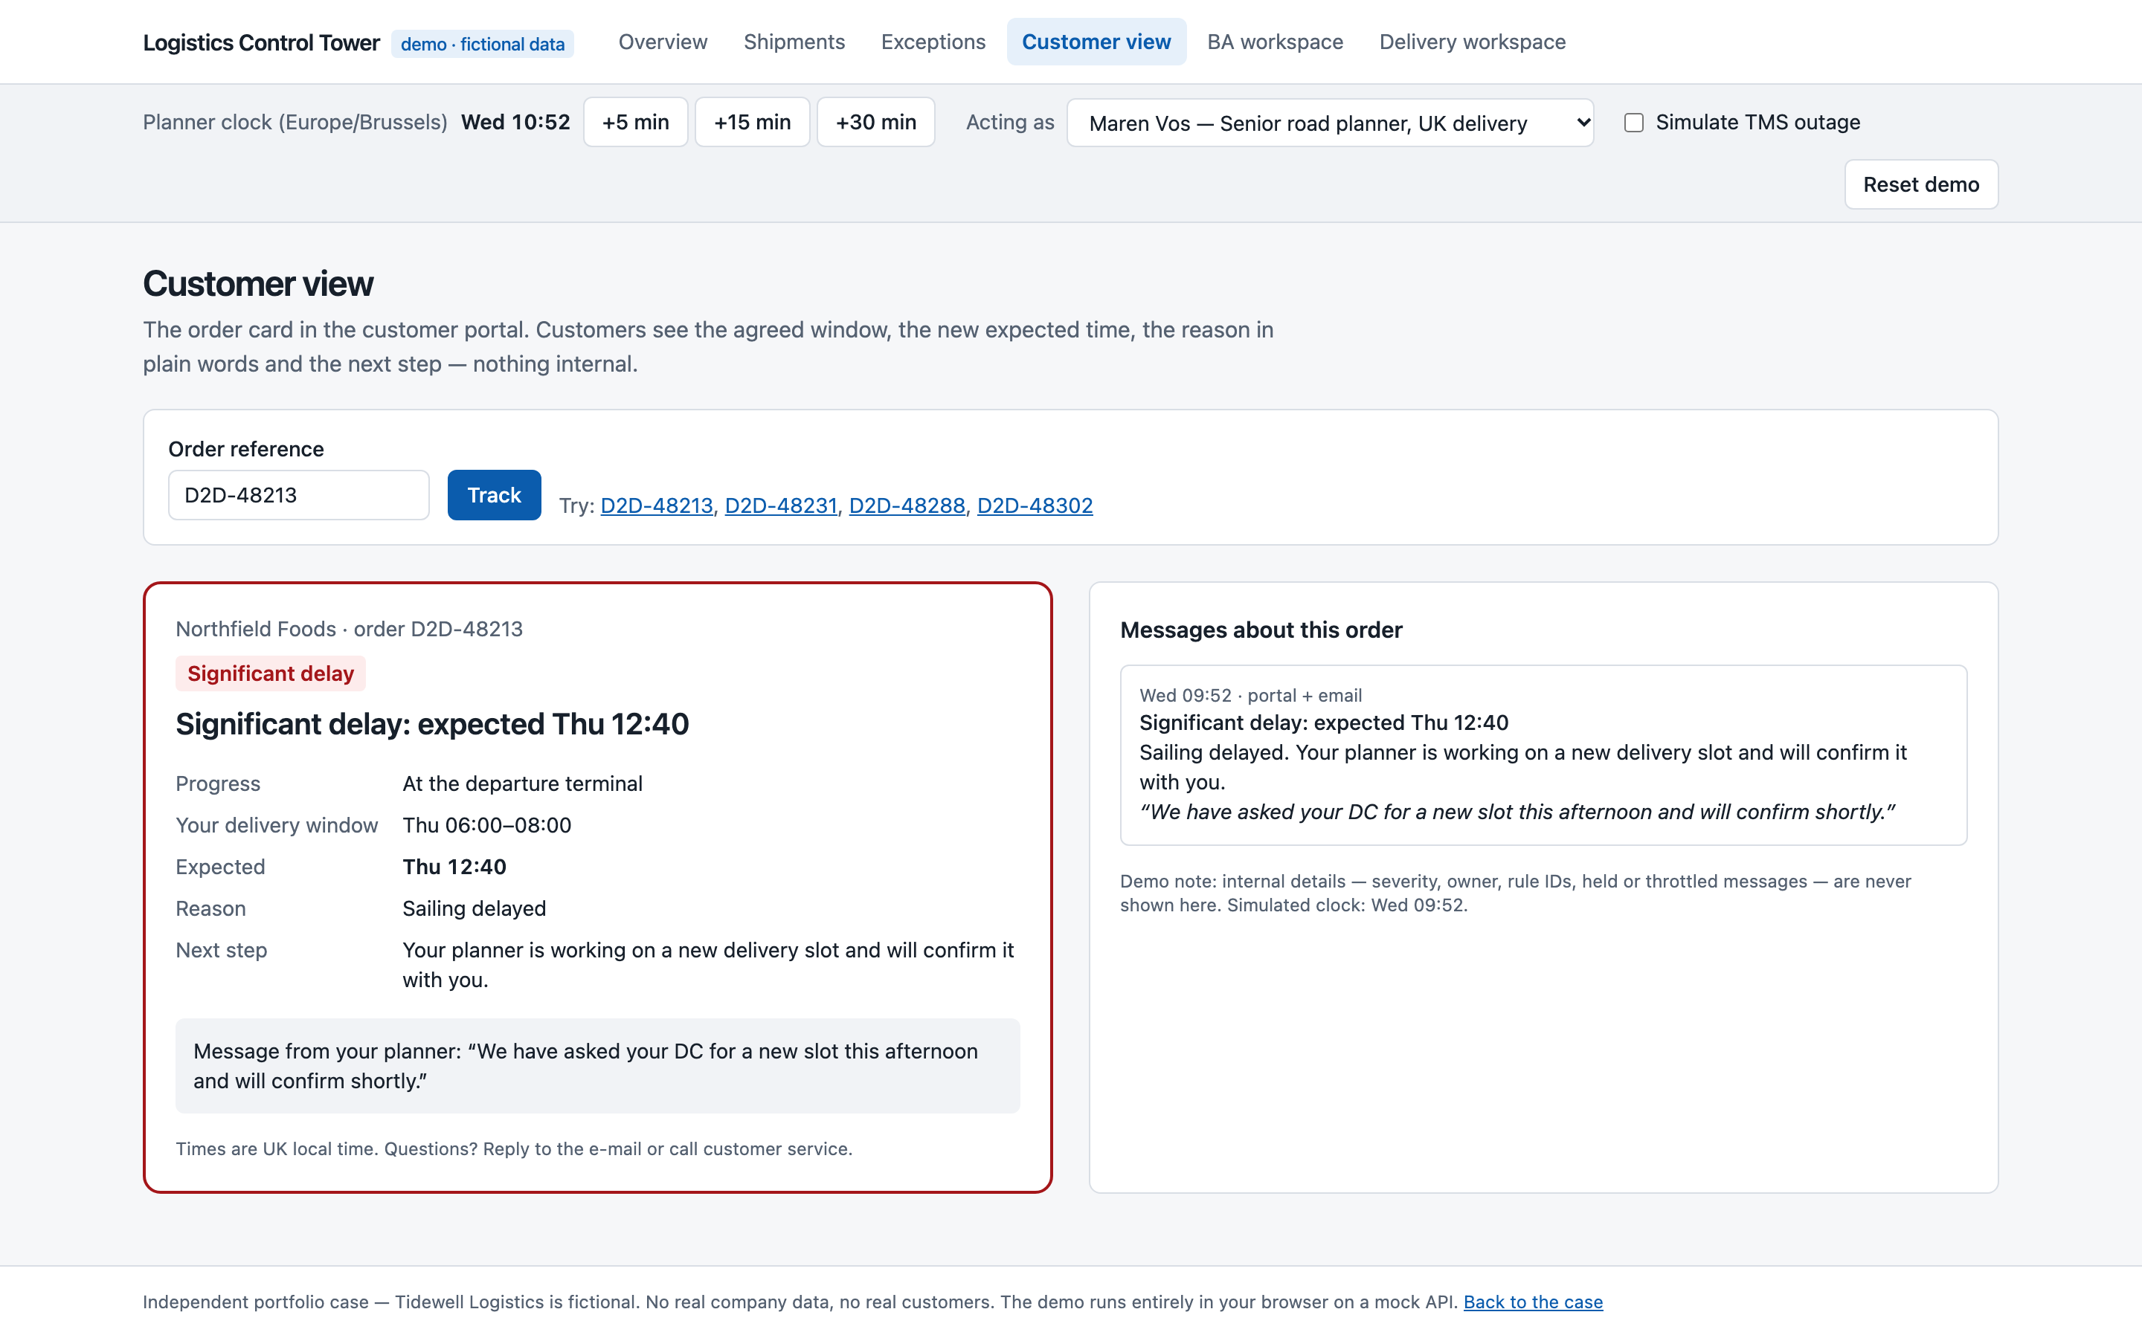
7 · DESIGN & DEMO
The control tower: the release, working
Planner: most urgent first; every exception explains which rules decided it. Customer: one clear message — nothing internal.
Building it was a review: five open questions the spec had missed, and a privacy leak in the first customer API — found and fixed with a test.
Fictional organisation · portfolio case · 8/10
Notes:
If there is time, open the live demo and run the guided scenario (±3 minutes): publish the sailing delay, show that 4 of 11 orders become exceptions, the critical classification, assign, act, customer view, new window, audit trail, test results.

Slide 9
8 · ACCEPTANCE & GO-LIVE
Accepted by the business — and my own mistake
BAT (simulated)
My mistake (DEF-04)
Ready for production
Key users incl. the sceptical senior planner.
3 of 4 majors came from real readers in their own context — the team's tests had passed.
Signed off with 2 known issues, each with workaround, owner and date.
In refinement I answered: throttle per exception.
In BAT a customer got two e-mails in ten minutes about one order.
Fix: per order. Retro action: customer-facing questions go to the PO the same day.
13 go/no-go criteria, an owner each.
Shadow mode, staged switch-on on a Monday, rollback in 4 minutes.
Support article: “rule or bug?”.
Fictional organisation · portfolio case · 9/10
Notes:
DEF-04 is the best story in the case: my own analysis decision, found by a real reader, fixed, and turned into a team practice. Tell it plainly.

Slide 10
9 · WHAT THIS SHOWS
Shown here — and not claimed
Shown
Not claimed
How I frame a problem, prepare decisions and specify precisely.
Artefacts a team can use: BPMN, rules, stories, API contract, BAT, go/no-go.
Real automated tests and a working demo.
A learning lab to defend every artefact.
Real stakeholders, sprints or BAT — all simulated.
Years in a professional Scrum team.
That the case was built without help: it was built with AI assistance; what I reviewed is tracked openly.
My questions for you: How does refinement work in your team, and who writes the acceptance criteria? Where do business analysts add the most value here today?
Fictional organisation · portfolio case · 10/10
Notes:
Close by being precise about evidence. Then switch to their world with the two questions. Only claim AI-assisted work at the level recorded in your private provenance table.

