Slide 1
STEERING COMMITTEE · CUSTOMER VISIBILITY
Shipment exceptions, handled before the customer calls
Problem, options, business case and the release 1 pilot — decision requested: go for a 6-week pilot
Independent portfolio case · fictional organisation · illustrative figures, not real company data · Philippe Godfroy

Slide 2
THE PROBLEM
Customers hear about delays at the gate — so they call
38%
22%
3 h 10
±55
of customer-service contacts are "where is my load?" (±1,250 a week)
of late deliveries are announced before the window starts
median time from "delay known" to "customer told"
missed delivery slots a week, ±€140 each
Since the TMS go-live customers see statuses — not whether their delivery window is at risk.
Three requests reached the PO: a tracking page (customer service), e-mails to key accounts (commercial), "nothing that adds work" (planning).
Root cause after 5 whys and a 60-order sample: no rule for what matters, no owner for telling the customer.
Independent portfolio case · fictional organisation · illustrative figures, not real company data · Philippe Godfroy

Slide 3
OPTIONS
Four options — exception management scores highest
Option | What it means | Upfront | Yearly | Score
O1 Do nothing, add an agent | Absorb the calls | — | €55k | 2.45
O2 Standard TMS e-mails | A message per status change: ±9 per order, 0.3 relevant | €10k | €4k | 3.10
O3 Exception management | Rules decide what matters, who owns it, who is told | €195k | €34k | 3.95
O4 External visibility platform | Real-time tracking subscription + integration | €80k | €150–250k | 2.85
Criteria and weights agreed before scoring: root cause 30% · customer experience 25% · 3-year cost 20% · delivery risk 15% · fit with the TMS 10%.
O4 is worth re-assessing later for consignee tracking (release 3).
Independent portfolio case · fictional organisation · illustrative figures, not real company data · Philippe Godfroy

Slide 4
BUSINESS CASE
Pays back in ±13.5 months — if a third of the calls disappear
Item | Per year
Customer-service time freed (35% fewer WISMO) | €91.9k
Fewer missed slots (30%) | €115.5k
Running cost | −€34k
Net benefit | €173k
One-off cost (4 sprints + set-up) | €195k
Scenario | WISMO | Payback
Pessimistic | −20% | ±31 months
Expected | −35% | ±13.5 months
Optimistic | −50% | ±9 months
The riskiest assumption is measurable in 6 weeks.
Recommendation: fund release 1 as a pilot (±€114k), 5 customers + control group; fund release 2 (±€81k) only if WISMO drops ≥ 20%.
Independent portfolio case · fictional organisation · illustrative figures, not real company data · Philippe Godfroy

Slide 5
EVENT STORMING
The disagreements became decisions — by their owners
Hotspot | Decided by | Decision
Late compared to what? | PO + CS + planning | After the end of the agreed window (D-01)
Key accounts: tell everything? | Product Owner | By severity; critical key-account cases also get a call (D-02)
Missing status: alarm or no app? | Road planning lead | Planner confirms before the customer is told (D-04)
Planner's own call vs. a system message | PO + planning lead | One message, optional planner note, calls still possible (D-08)
Nobody records why | Product Owner | Reason code mandatory on close
Customs is everyone's problem | Customs desk lead | Customs desk owns it; release 2
Severity — minor, major, critical — was the concept that made "tell key accounts everything" and "no notification storm" compatible.
Independent portfolio case · fictional organisation · illustrative figures, not real company data · Philippe Godfroy

Slide 6
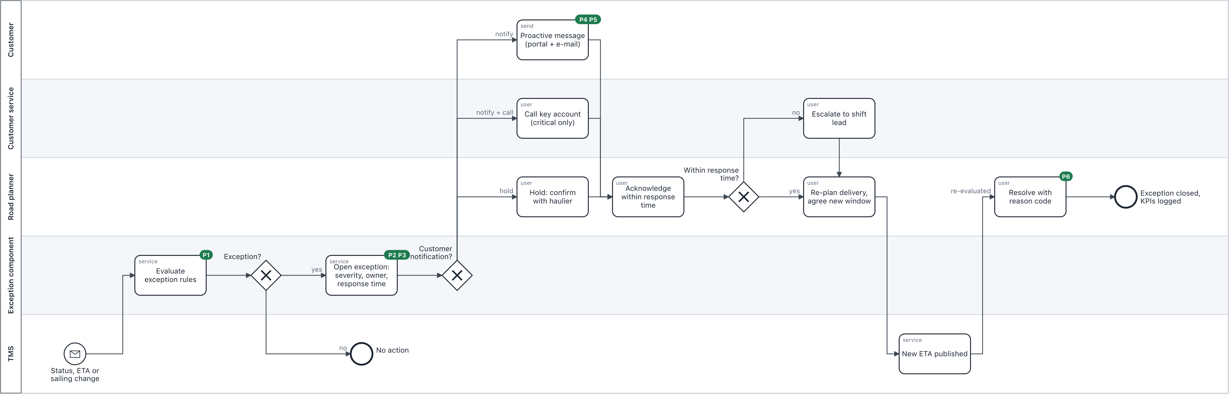
PROCESS
TO-BE: every change is checked against the delivery window
Minor < 2 h · major 2–6 h · critical ≥ 6 h or next day · reefer +1 level · max. one message per order per 2 h unless worse · 30 decision examples run as tests
Independent portfolio case · fictional organisation · illustrative figures, not real company data · Philippe Godfroy

Slide 7
BACKLOG
Release 1: a two-sprint pilot, prioritised with WSJF
Top of the backlog | WSJF | Release
Delivery window mandatory (pilot customers) | 15.0 | R1
No message storm (throttling) | 9.0 | R1
Pilot toggle + measurement | 8.0 | R1
Receive TMS changes reliably | 7.3 | R1
Proactive customer message | 5.8 | R1
EDI/API status messages | 1.8 | R2
Consignee notifications | 0.8 | R3
Week | Milestone
1–2 | Sprint 1: planner sees the right exceptions
3–4 | Sprint 2: customer hears it first
5 | BAT + go/no-go
6 | Pilot live (Monday)
6–11 | Pilot measurement
12 | Stage gate R2
Independent portfolio case · fictional organisation · illustrative figures, not real company data · Philippe Godfroy

Slide 8
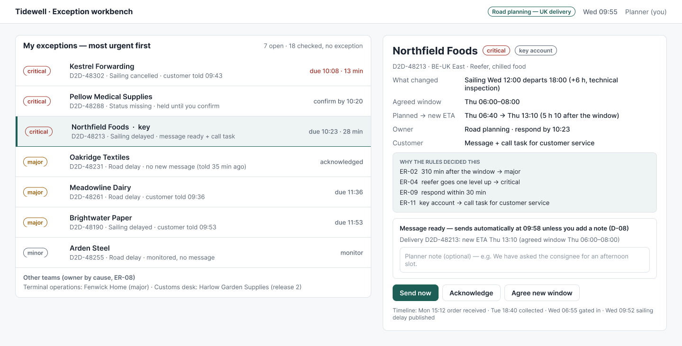
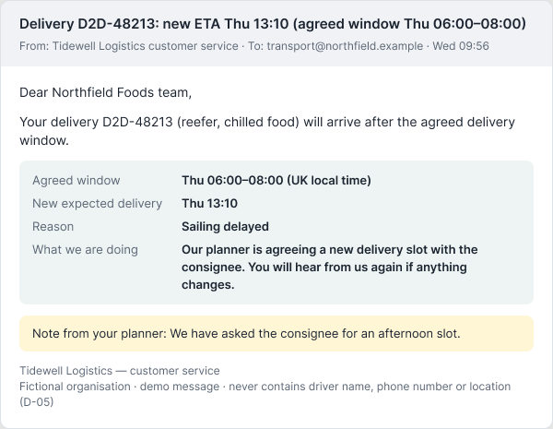
DESIGN
Designed with planners and pilot customers
Only exceptions, most urgent first · the decision explains itself · critical messages wait 5 min for an optional planner note · no driver data to customers
Independent portfolio case · fictional organisation · illustrative figures, not real company data · Philippe Godfroy

Slide 9
BAT AND GO-LIVE
Accepted by the business, ready for production
12 / 4 / 2
13
4 min
BAT scenarios · major findings fixed and retested · minor known issues with a date
go/no-go criteria, each with an owner and evidence
rehearsed rollback — feature toggle per customer
Shadow mode for two days before customers get messages; pilot customers switched on one by one, Monday 07:00.
Hypercare 2 weeks with thresholds: > 1 false alarm a day or > 2 messages per exception → action.
Communication per audience: planners, CS, account managers, pilot customers (letter from their AM), support (KB article).
Independent portfolio case · fictional organisation · illustrative figures, not real company data · Philippe Godfroy

Slide 10
ASK
Decision requested today
1. Approve release 1 as a 6-week pilot: 2 sprints + set-up, ±€114k.
2. Approve the stage gate: release 2 (±€81k) only if WISMO contacts for pilot customers fall ≥ 20% against the control group.
3. Nominate key users for BAT in week 5: senior road planner, 2 customer-service agents, 1 account manager.
4. Account managers to brief the five pilot customers in week 5.
What we will report: proactive notification rate, time to inform, WISMO vs. control, missed slots, false alarms, messages per exception.
Independent portfolio case · fictional organisation · illustrative figures, not real company data · Philippe Godfroy

