Slide 1




Smart Trade
Best Price && Smart Life

Slide 2





Solana Clobs.
The two exchanges, OpenBook and Phoenix, play a significant role in pricing and liquidity within Solana.
These exchanges have demonstrated numerous advantages: hight speed, trading volume, and efficiency.
Many Solana AMMs have integrated with these two exchanges.
Smart Trade
01

Slide 3

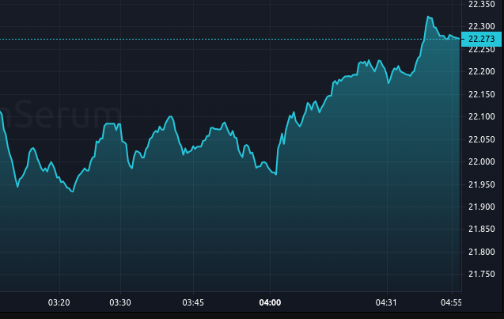

What price should I trade at?
When you need to execute buy or sell orders, determining the best price becomes challenging.
Typically, you would have to choose to swap orders on various AMMs to get the best price
Smart Trade
01

