Slide 1
Spyware
Konstantin Vetrov
Voronezh State University

Slide 2
Types of spyware
Spyware spread methods
Antispyware techniques

Slide 3

Adware

Slide 4
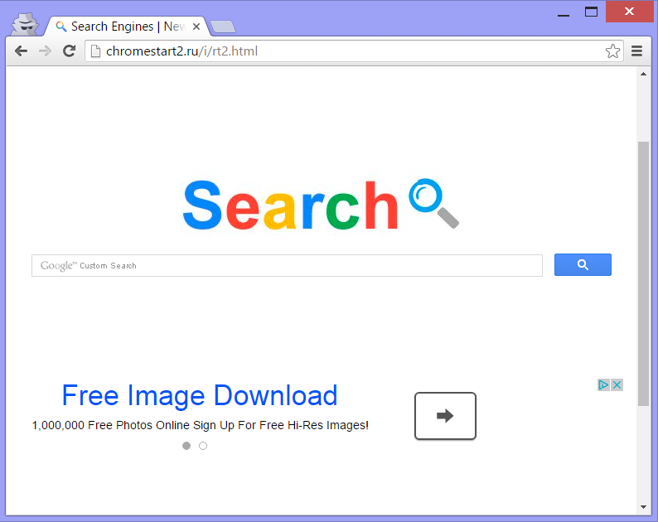
Browser Hijackers

Slide 5

Key Loggers

Slide 6
Spread Methods
Shareware software
Useful software
Drive by download
Fake antispyware

Slide 7
Antispyware techniques
Manual identification
Signature based identification
Behavior based identification

