Slide 1
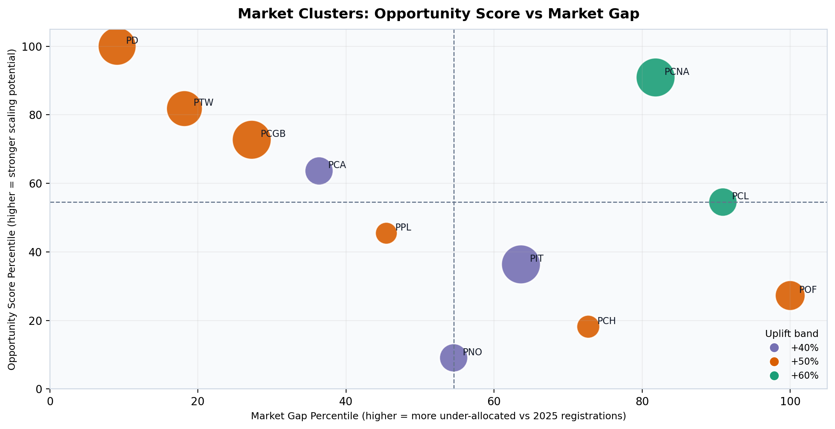
Recommendation: Market Clusters for 2026 Paid Media Aggressiveness
We assign +40% / +50% / +60% bands by market based on target pressure and scalability headroom.
Budget guidance bands
+60% | 2 markets | €365,000
+50% | 6 markets | €1,067,000
+40% | 3 markets | €285,000
Recommendation
Prioritize aggressive funding in: PCNA, PCL.
Keep +40% markets on disciplined baseline until efficiency improves.
Method used: Markets are clustered on two dimensions — target pressure (DCFS gap vs 2026 target) and scalability (curve-based incremental response). Uplift bands (+40%, +50%, +60%) are directional aggressiveness signals.
Note: CTG data is used as a directional proxy for paid-media responsiveness. Bands are guidance on urgency/importance, not deterministic allocation outputs.

