Slide 1
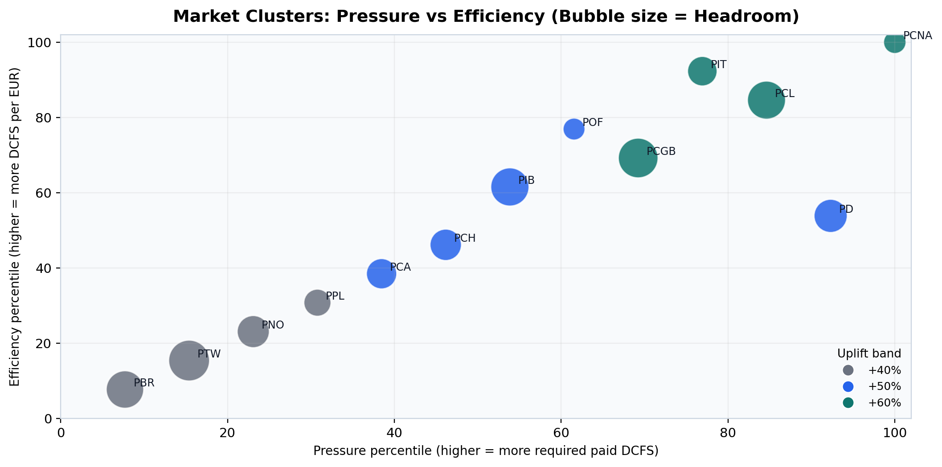
Recommendation: 2026 Market Budget Aggressiveness
Uplift bands
+60% | 4 markets
Budget: EUR 116,800,000 | Paid DCFS: 100,399
+50% | 5 markets
Budget: EUR 71,100,000 | Paid DCFS: 12,897
+40% | 4 markets
Budget: EUR 21,100,000 | Paid DCFS: 1,010
Recommendation
Prioritise +60% markets first: PCGB, PCL, PCNA, PIT.
Use +50% as controlled scale
+40% as baseline optimisation.
Method: (1) Delivery pressure = required paid-media DCFS from Reverse Funnel (from RFL). (2) Cost efficiency = 2026 budget / required paid-media DCFS (RFL). (3) Headroom = registrations share gap + registrations momentum (Porsche Reg. data 2025/2024). Bands are assigned rule based.

Slide 2
Recommendation: 2026 Market Budget Aggressiveness
Uplift bands
+60% | 4 markets
Budget: EUR 116,800,000 | Paid DCFS: 100,399
+50% | 5 markets
Budget: EUR 71,100,000 | Paid DCFS: 12,897
+40% | 4 markets
Budget: EUR 21,100,000 | Paid DCFS: 1,010
Recommendation
Prioritise +60% markets first: PCGB, PCL, PCNA, PIT.
Use +50% as controlled scale
+40% as baseline optimisation.
Method: (1) Delivery pressure = required paid-media DCFS from Reverse Funnel (from RFL). (2) Cost efficiency = 2026 budget / required paid-media DCFS (RFL). (3) Headroom = registrations share gap + registrations momentum (Porsche Reg. data 2025/2024). Bands are assigned rule based.

Slide 3
Recommendation: 2026 Market Budget Aggressiveness
Pressure: How big is the gap between target and current performance
Efficiency: How much it costs to deliver
Headroom: How much room we have to grow
+60%
Budget: EUR 116,800,000
Paid DCFS: 100,399
+50%
Budget: EUR 71,100,000
Paid DCFS: 12,897
UK
US
Canada
Italy
Germany
France
Portugal
Spain
Switzerland
Australia
+40%
Budget: EUR 21,100,000
Paid DCFS: 1,010
Brazil
Taiwan
Norway
Poland
High pressure
strong efficiency
high headroom
🟢 Clear scale opportunity
Medium pressure
Mixed efficiency
Moderate headroom
🟡 Scale but monitor performance
Lower pressure
Weaker efficiency
Limited headroom
🔵 Fix performance before scaling

