Slide 1
Internet of Things (2022)
Webserver & DB
Soo Young Shin / Philipp Mayer&Denis Maric
Notes:
Websites:
https://phmayer.github.io/IoT23_webserver/
https://raw.githubusercontent.com/phmayer/IoT23_webserver/main/server.py
https://raw.githubusercontent.com/phmayer/IoT23_webserver/main/nginx.conf
https://petstore.swagger.io/

Slide 2
Contents
Web server
Web server introduction
Nginx, HTML, CGI, Python, etc.
Demo web server
Nginx, Python, Flask
REST API
Database Installation
MySQL
SQLite

Slide 3
Web Server
Web server
An Internet service program that uses the HTTP protocol to provide data requested by the client through the browser
Lightweight web server features
Need to limit and optimize the functionality of your web server for use on systems with limited resources
Function
Efficient use of limited system resources - Improved process / memory handling
Easy integration and portability with raspberry Pi
Support dynamic creation of web pages - CGI and server-side script programs
Configurable security model (removable) - SSL, DAA
Restricting general-purpose Web server functionality such as other log files, virtual servers, and authentication servers
Applications
Remote system monitoring - Check status information or data of Raspberry Pi
Remote control - dynamically change settings of Raspberry Pi

Slide 4
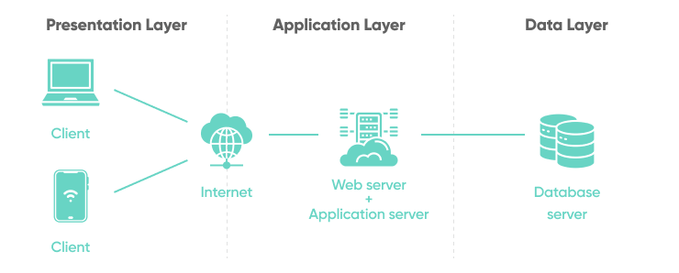
Webserver
Image: https://www.softkraft.co/web-application-architecture/

Slide 5
Web Server Introdution
Web server and client interfaces
Web browser(Client)
Web Server system
정적
웹
문서
DB
Graphical user interface
정적
웹
문서
Static
Web
Doc.
Java Virtual
Machine
Web Application Prog.
HTML
Parser
Script Parser
Form
Generator
Web Server
HTML
Parser
Form
Parser
HTTP Engine
HTTP Engine
TCP/IP stack
TCP/IP Stack
Internet

Slide 6
Web Server
Web Server System Configuration
Usually configured as an HTTP server + web application framework + database
LAMP (Linux + Apache + MySQL + PHP), MAMP, WAMP
HTTP server
Common HTTP server available
Name | Platform | Licence | Description
Apache | Unix, Linux, Windows, Mac | GPL | - An HTTP server running in a single thread. - CGI programs, automatic directory creation, self-extracting. - http://www.boa.org
lighttpd | Unix, Linux, Windows, Mac | BSD | - FastCGI, SCGI, HTTP proxy, WebDAV support - SSL, TLS support via OpenSSL - http://www.lighttpd.net
nginx | Unix, Linux, Windows, Mac | BSD | An HTTP server that provides dynamic web pages. - Handles low memory (~ 2.5MB) even at high load (10000 concurrent connections). - http://nginx.org/

Slide 7
Web Server
Web server system configuration
Web applications
CGI and script programs that generate dynamic web content
Install web application framework to run web application
Database (DB)
Using SQL database etc.
MySQL - Open Source SQL DB
SQLite - SQL DB to put a database in one file or memory
Language | Types
Java | Struts, Wicket, Eclipse RAP, Google Web Toolkit, JSF, JBoss Seam, Spring
Javascript | node.js, SproutCore
Perl | Catalyst, Dancer
PHP | Zend Framework
Python | Bottle, CherryPy, Django, Flask, Grok, Pylons, web2py
Ruby | Camping, Ruby On Rails, Sinatra

Slide 8

Nginx
Opensource
Proxy/Reverse Proxy
Load Balancing
44% of heavy traffic websites worldwide
We have chosen Nginx, because:
Easy to use and set up
Powerful
Resourceful

Slide 9
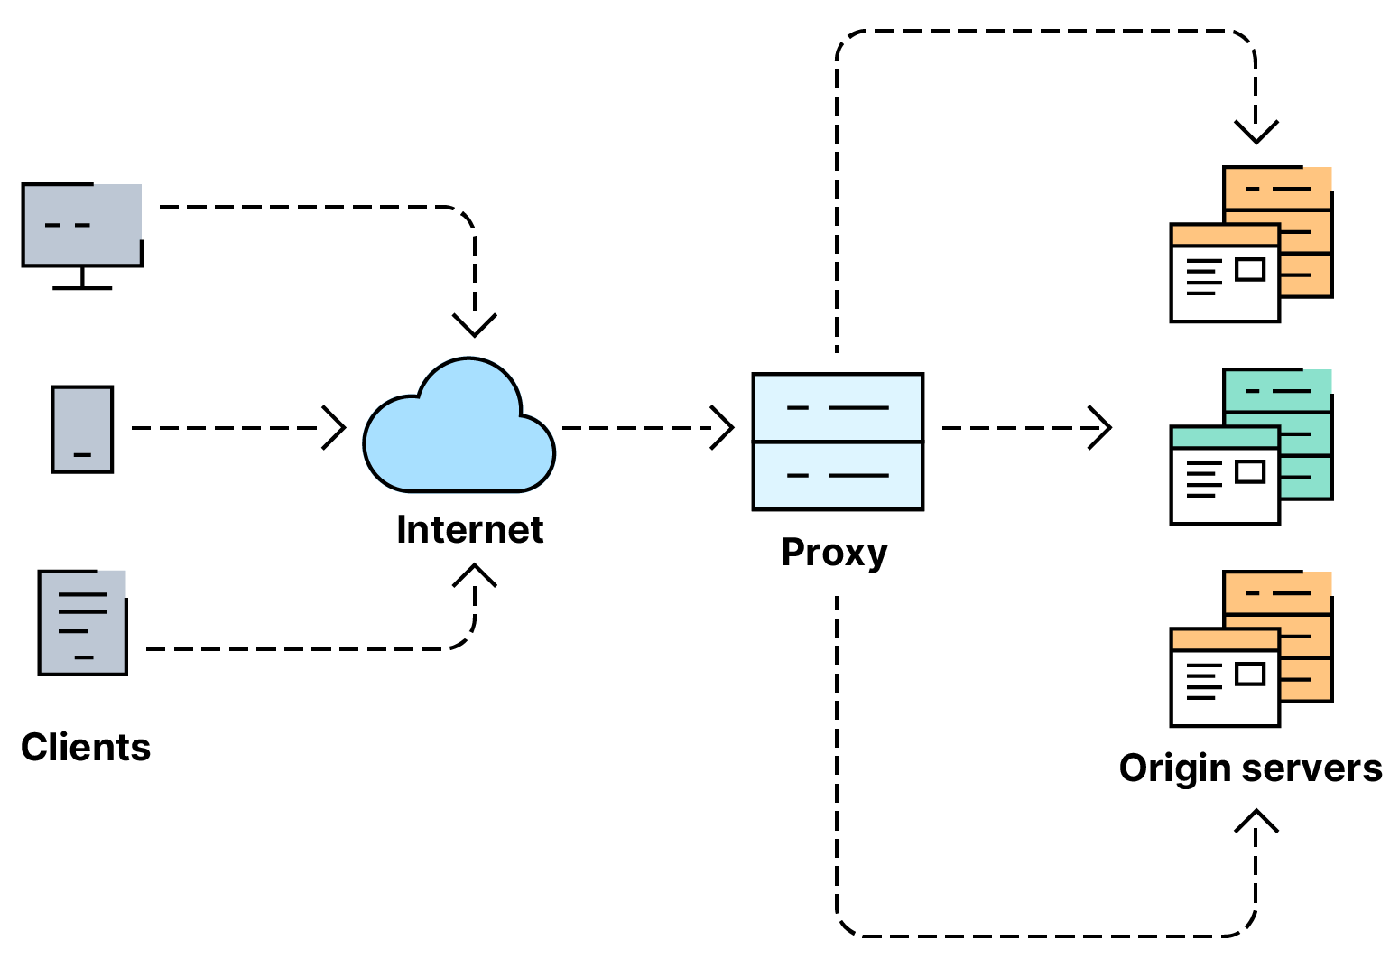
Nginx
Image: https://www.netscaler.com/articles/what-is-load-balancing

Slide 10
Python Web Programming
HTML (HyperText Markup Language)
Language for creating html documents with hypertext capability
HTML document
Often composed of tags
The tag is usually a format consisting of the beginning <tag> and end </ tag>
All documents start with <html> and end with </ html>, and the inside of the document consists of two parts: head and body
<html>
<head>
<title>Embedded Webserver</title>
</head>
<body>
<H1>Embedded Webserver</H1><br />
Welcome to Embedded Linux World!
</body>
</html>

Slide 11
HTTP
HTTP Status Codes
코드 | 상태 | 설 명
200 | OK | 클라이언트의 요청을 정상적으로 수행하였을 때 사용한다. 응답 바디(body)엔 요청과 관련된 내용을 넣어준다.
201 | Created | 클라이언트가 요청한 리소스 생성이 성공적으로 수행되었을때 사용한다.
202 | Accepted | 클라이언트 요청이 비동기적으로 처리될 때 사용한다. 응답 바디에 처리 시간 등의 정보를 넣어준다.
204 | No Content | 클라이언트의 요청을 정상적으로 수행하였을 때 사용한다. 200과 다르게 204는 응답 바디가 없을 때 사용한다. 예를 들어 DELETE와 같은 요청 시
400 | Bad Request | 클라이언트의 요청이 부적절할 때 사용한다. 요청 실패 시 가장 많이 사용될 상태코드로서 응답 바디에 요청이 실패한 이유를 넣어준다.
401 | Unauthorized | 접근 권한을 가지지 않은 리소스를 요청했을 때 사용한다. 예를들어 로그인(login)하지 않은 사용자가 로그인시에만 요청가능한 리소스를 요청했을때
403 | Forbidden | 사용자 인증상태와 관계없이 응답하고 싶지 않은 리소스를 클라이언트가 요청했을 때 사용한다. 그러나 해당 응답코드 대신 400을 사용할 것을 권고
404 | Not Found | 클라이언트가 요청한 리소스가 존재하지 않을 때 사용하는 응답이다.
405 | Method Not Allowed | 클라이언트가 요청한 리소스에서는 사용 불가능한 Method를 이용했을 때 사용하는 응답이다. 읽기전용 리소스에 DELETE Method를 사용했을 때
301 | Moved Permanantly | 클라이언트가 요청한 리소스에 대한 URI가 변경되었을 때 사용한다. 응답시 Location header에 변경된 URI를 적어준다.
500 | Internal Server Error | 서버에 뭔가 문제가 있을 때 사용한다.
504 | Service Not Available | 현재 서버에 과부하가 걸려있거나 유지보수를 위해 접근이 거부될 때 사용

Slide 12
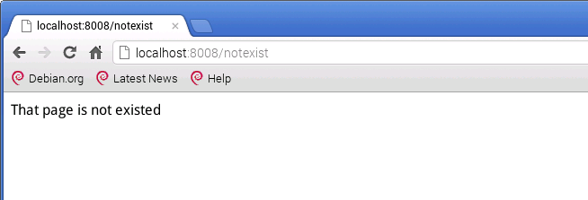
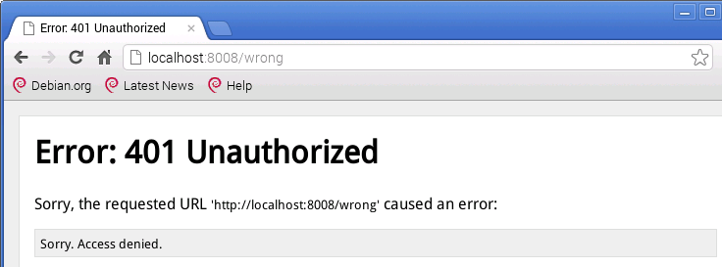
HTTP
재접속과 오류처리
웹 서버의 오류 메시지 출력 화면
웹 서버의 사용자 설정 오류 페이지 화면

Slide 13

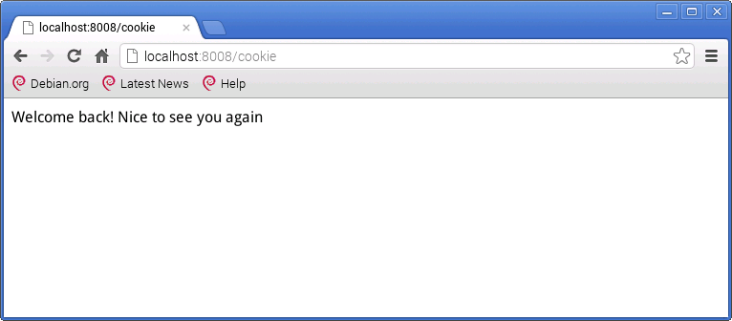
Cookie
쿠키 (Cookie)
웹 서버 의 쿠키 활용 화면

Slide 14
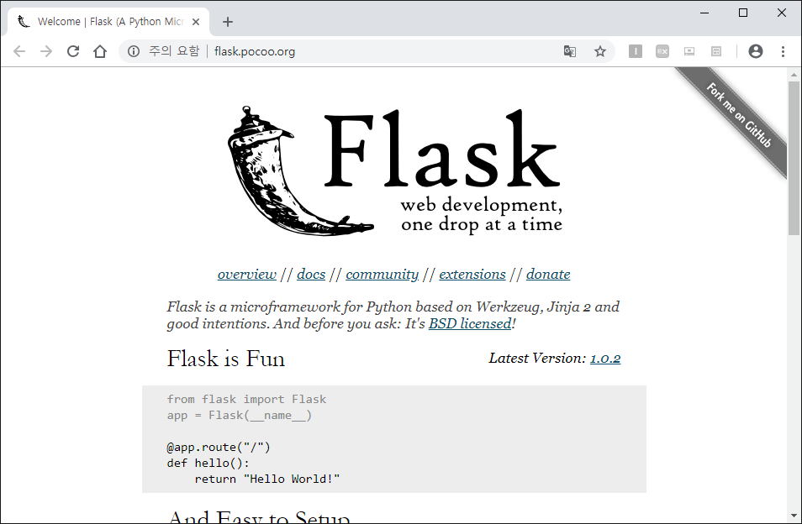
Flask
Fast and lightweight Python lightweight web application framework
Dynamic URL and WSGI program support
Homepage : http://flask.pocoo.org/

Slide 15
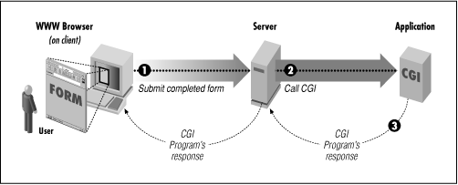
CGI
CGI (Common Gateway Interface)
A standard protocol for connecting between Web servers and external applications
Supplementing the functionality of HTML
http text is static, while CGI can dynamically change text information.
Languages with CGI programs
C / C ++, Fortran, PERL, TCL, Any Unix Shell, Java / JavaScript, etc.

Slide 16
CGI
Was a very popular and important interface specification, for dynamic websites.
CGI has downsides:
can be slow
creates for every request a new process
Because of this its vulnurable against denial of service attacks

Slide 17
CGI
Today it is not as important anymore. Since there exist many better alternatives. → Many modern scripting languages used for web can be embedded directly into webservers, without the need of CGI!
Newer and better alternatives are:
FastCGI (compatible with CGI)
Django
Perl
Etc…

Slide 18
Web Server Demo
Tool Stack:
Nginx (→ Webserver / Proxy)
Python (→ Application)
Flask (→ Framework)
WSGI

Slide 19
Web Server Demo
We will be following a tutorial from: https://www.piawesome.com
We prepared a Handout with all the Links and Tips, for trying it out yourself: https://phmayer.github.io/IoT23_webserver/

Slide 20
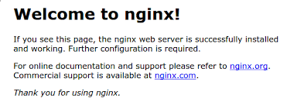
Nginx
Update packages:
sudo apt update –y
Install Nginx:
sudo apt install nginx –y
Browse to ‘localhost’ to check if install was successful:

Slide 21
Flask & Python
We will install Python and Flask in an virtual environment, as this is very common in Webdevelopment.
Install it:
sudo apt update
sudo apt install python3-venv -y
Make Folder:
cd ~/
mkdir app
cd app
Create Environment:
python3 -m venv .

Slide 22
Flask & Python
Acitivate Environment:
source bin/activate
Install Flask:
pip install flask
Create a small Application:
vi server.py

Slide 23
Flask & Python
File should contain the following:
You can also download it like this:
wget https://raw.githubusercontent.com/phmayer/IoT23_webserver/main/server.py
from flask import Flask
app = Flask(__name__)
@app.route('/')
def hello_world():
return 'Hello, World!'
if __name__ == "__main__":
app.run(host=‘localhost', port=8123)

Slide 24
Flask & Python
Run our App:
python ./server.py
Check if its running:
curl localhost:8123
or open ‘localhost:8123’ in browser.
→ It should say ‘Hello World’

Slide 25
Use Nginx as Proxy
Now our App is only available on localhost, and also Flask on its own is not suited to serve our Application to clients.
So for accepting and serving Requests/Responses to Clients, we will use Nginx as a proxy.
For this we have to create our Nginx configuration:
vi nginx.conf

Slide 26
Use Nginx as Proxy
The config file should contain this:
You can also download it like this:
wget https://raw.githubusercontent.com/phmayer/IoT23_webserver/main/nginx.conf
upstream flaskapp {
server localhost:8123;
}
server {
listen 80 default_server;
listen [::]:80 default_server;
root /var/www/html;
index index.html index.htm index.nginx-debian.html;
location / {
proxy_pass http://flaskapp;
proxy_redirect off;
}
}

Slide 27
Use Nginx as Proxy
We now have to copy the config into the right place:
sudo cp ./nginx.conf /etc/nginx/sites-enabled/default
Now we only have to reload Nginx:
sudo systemctl reload nginx
And run the app:
python ./server.py
And to check if it works, now you can open the website in your browser. It is now available not only on ‘localhost’, but for others in the same network as well! (enter IP into the browser)
Credit for this Tutorial goes to: https://www.piawesome.com

Slide 28
REST API 설계
RESTful 웹 서비스
REST (Representational State Transfer) – 웹 서비스 방식의 일종
Roy Fielding 이 2000년에 고안한 웹 서비스 구조
복잡한 세션 처리 대신 단순하고 일관된 인터페이스를 통해 특정 자원(Resource) 에 대한 URI 주소 지정 및 데이터 전송
REST API 설계 원칙
인터넷 상의 리소스를 인터넷 주소 URI (Uniform Resource Identifier) 로 표현
소문자 사용
확장자 대신 Accept 헤더 이용
나쁜 예
http://www.myhome.net/sensor/1
GET /tasks/1 HTTP/1.1
Host: myhome.net
Accept: application/xml
http://www.myhome.net/Tasks.xml

Slide 29
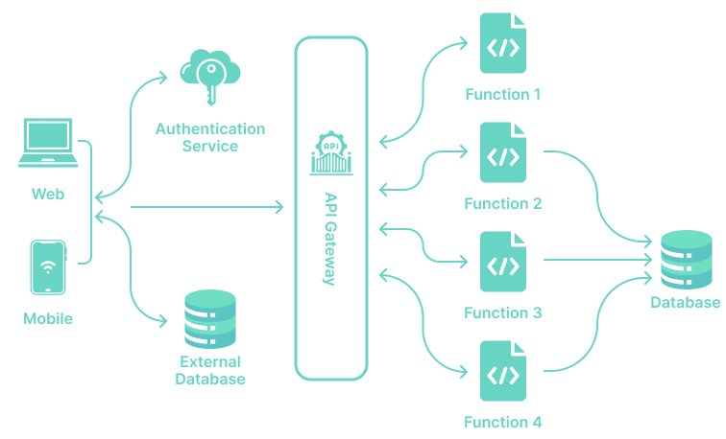
REST API
Image: https://www.softkraft.co/web-application-architecture/

Slide 30
REST API 설계
REST API 설계 원칙
URI 에 동사를 사용하지 않음
리소스 요청은 CRUD(Create, Read, Update, Delete) HTTP 요청 사용
GET : 리소스에 대한 정보를 획득한다.
POST : 리소스를 생성하거나
PUT : 리소스를 수정하거나 갱신한다.
DELETE : 리소스를 삭제한다.
동사(술어) 를 URI 에 사용하면 리소스/행위 요청 혼동
나쁜 예
쿼리문은 리소스의 검색 범위를 제한하는 용도로만 사용
GET /tasks/13/delete HTTP/1.1
POST /recipes/write HTTP/1.1
GET /delete?id=55 HTTP/1.1
GET /motor?action=GoForward HTTP/1.1
GET /family/address?name=John HTTP/1.1

Slide 31
REST API 설계
스케줄 관리 프로그램 실습
자신의 스케줄을 DB 에 입력, 조회, 수정하는 파이썬 웹 프로그램
출력 형식 – json 형식으로 지정
REST API 설계
리소스 URL | 메소드 | 인자 | 설명
/schedule | GET |  | 모든 스케줄 조회
/schedule | POST | 이름,설명,데드라인 | 새로운 스케줄 생성
/schedule/<idnum> | GET |  | 특정 스케줄 조회
/schedule/<idnum> | DELETE |  | 특정 스케줄 삭제
/schedule/<idnum>/name | PUT | 이름 | 특정 스케줄 이름 수정
/schedule/<idnum>/description | PUT | 설명 | 특정 스케줄 설명 수정
/schedule/<idnum>/deadline | PUT | 데드라인 | 특정 스케줄 데드라인 수정
/schedule/<idnum>/complete | PUT | 상태 | 특정 스케줄 상태 수정
/schedule/done | GET |  | 스케줄 완료 수 및 비율

Slide 32
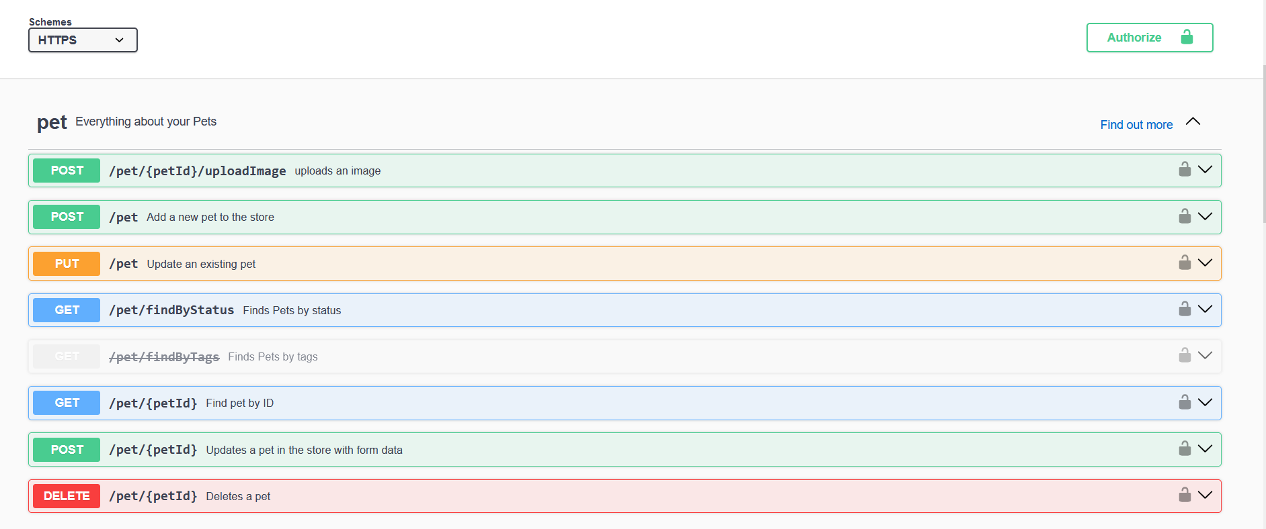
REST API
‘Swagger.ui’ is a popular tool to document REST APIs
Example: https://petstore.swagger.io/

Slide 33
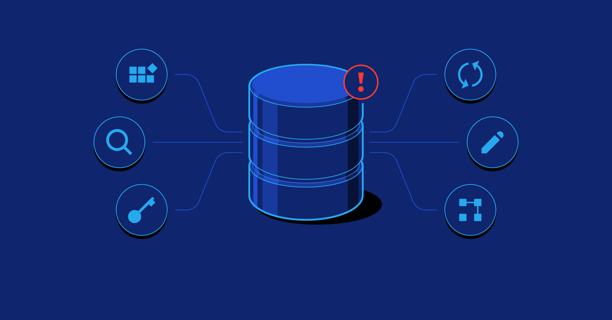
Database
What is database?
A database is a structured collection of data that is organized and stored for efficient data management and retrieval.
It's like a digital filing cabinet for your data.
Databases can store a wide range of information, from customer records to product inventory.
They are essential for managing and analyzing data in today's digital world.

Slide 34
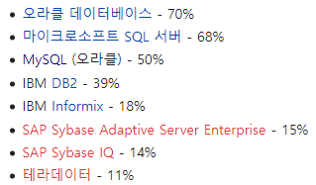
Database Overview
Data Model: Relational data model – Describing data in the form of table relationships.
SQL Language: Relational Database Management System (RDBMS).
Examples include Oracle, MySQL, PostgreSQL, MSSQL, SQLite, and more.

Slide 35
Why Databases Matter
Efficient Data Storage: Databases provide a systematic way to store and organize data, making it easily accessible.
Data Integrity: Databases enforce data consistency and integrity, ensuring accurate and reliable information.
Data Retrieval: Databases allow for quick and precise data retrieval, enabling better decision-making.
Scalability: Databases can grow with your needs, making them suitable for businesses of all sizes.

Slide 36
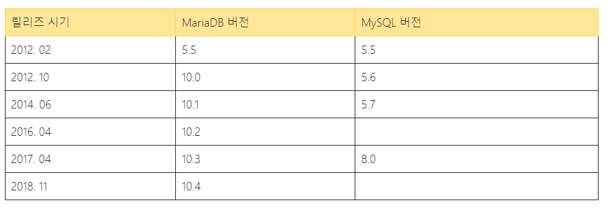
MySQL feat.MariaDB
MariaDB
MySQL, created by MySQL AB in 1995, is an open-source DBMS that is free and has gained a high position with its large capacity, high stability, and performance.
In 2008, it was acquired by Sun Microsystems (later acquired by Oracle in 2010). As of 2018, MySQL version 8.0 was released, along with the introduction of a paid license.
One of the co-founders of MySQL, Michael "Monty" Widenius, established MariaDB. MariaDB is based on the MySQL source code and offers mostly similar features, ensuring compatibility.

Slide 37
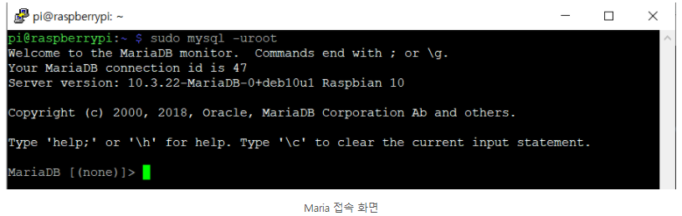
MySQL feat.MariaDB
MariaDB , installation code
MySQL, access
sudo apt-get update
sudo apt-get install mariadb-server mariadb-client
sudo mysql –u root

Slide 38
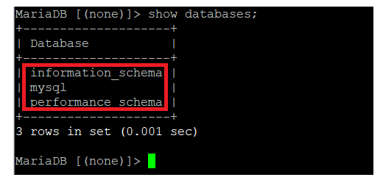
MySQL feat.MariaDB
database check
show databases;

Slide 39
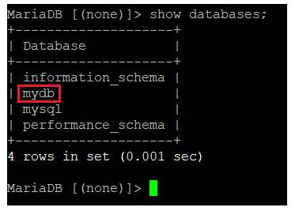
MySQL feat.MariaDB
create database
create database mydb;

Slide 40
MySQL feat.MariaDB
Table creation and attribute setting
Table creation, attribute verification
create table tbl(
id VARCHAR(20),
pwd VARCHAR(20));
show tables;

Slide 41
MySQL feat.MariaDB
Commands – Add, Delete, Change Data Types
Data Input Command
Data modification
Alter TABLE tbl add PRIMARY KEY(ID);
Select * from tbl;
INSERT INTO
tbl(id,pwd)
VALUES(‘kit’,’1234’);
Update tbl SET pwd=‘5678’
Where id = ‘kit’;

Slide 42
MySQL feat.MariaDB
Data deletion:
delete database:
DELETE FROM tbl WHERE ID = 'kit';
drop database mydb;

Slide 43
MySQL feat.MariaDB
MySQL practical training
python.py composition - python3 execution
$sudo pip3 install pymysql
Import pymysql
db=pymysql.connect(host=‘localhost’,user=‘root’,password=‘1234’,db=‘mydb’)
Cur = db.curcor()
Cur.execute(“SELECT * from cities”)
Rows = cur.fetchall() / cur.fetchone() – 전부 출력 or 하나만 출력
Print(rows) – for row in rows: print(row) – 한줄로 / 한줄씩 출력
db.close()

Slide 44
SQLite Database
SQLite
Store a lightweight database in a file or memory, allowing direct access through a program.
It's not a server-based approach like MySQL.
Pre-installed on Google Android systems.
Supports languages such as C, C++, Java, C#, PHP, Python, Perl, Ruby, Delphi.
The license is PUBLIC DOMAIN.
Install the sqlite3 client package for management
pi@raspberrypi ~ $ sudo apt-get install sqlite3
Reading package lists... Done
Building dependency tree
Reading state information... Done
Suggested packages:
sqlite3-doc
The following NEW packages will be installed:
sqlite3

Slide 45
Thanks

