Slide 1
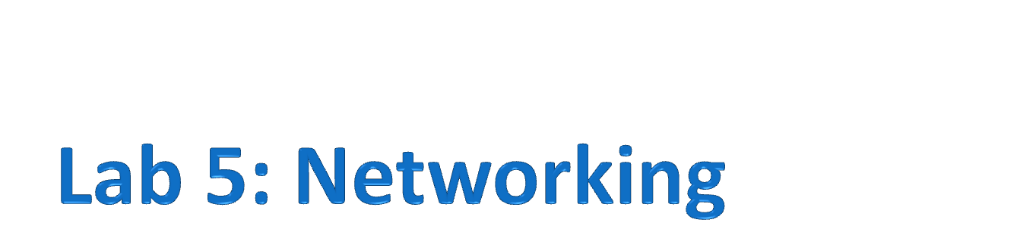

Slide 2
Administration
Application survey report due on 11/26 (next week)
  Submit instruction was on web
Schedule modified
Week 11 (11/26): Localization | Week 11 (11/26): Localization
Week 12 (12/03): Lab-6: Localization Labs | Week 12 (12/03): TinyOS and C
Week 13 (12/10): How to made you own hardware | Week 12 (12/03): Lab-6: Localization Labs
Week 14 (12/17): Term project workshop | Week 13 (12/10): How to made you own hardware
Week 15 (12/24): Survey presentation | Week 15 (12/24): Survey presentation

Slide 3
Wireless Communication
PHY and MAC layers
Node ←→ Node
Routing layers
Multi-hops
A node transmit a packet
Every node within radio range can hear the packet
Routing: how packet travel in a network
How the node sends packet to the other nodes within one hop is defined by Physical and MAC layer

Slide 4
Typical Data Transmit
Somebody wants to send something
Data Frame start
Length of the data
Receive data
Synchronization header
Synchronization header
Synchronization header
Synchronization header
Data
Length
SYNC
Preamble
Data
Length
Data
SYNC
Length
Preamble
Data
Length
SYNC
Preamble
SYNC
Preamble
listen
Transmitter
Receiver

Slide 5
Constraints in WSN
Limited Power
  If it is battery powered
Computation power
  Usually less then 30 MHz
  Higher the frequency, higher the power consumption
Memory
  > 100 KB code size
  > 10 KB RAM size
  Cost is proportional to the memory size
Time constraints
  Many applications has time constraints (Real-time)
You must turn off radio for some time. Otherwise it wouldn’t last for too long
You cannot do complicated algorithm on one node
Cost is very important for the success of wireless sensor network
You must finish something within some time

Slide 6
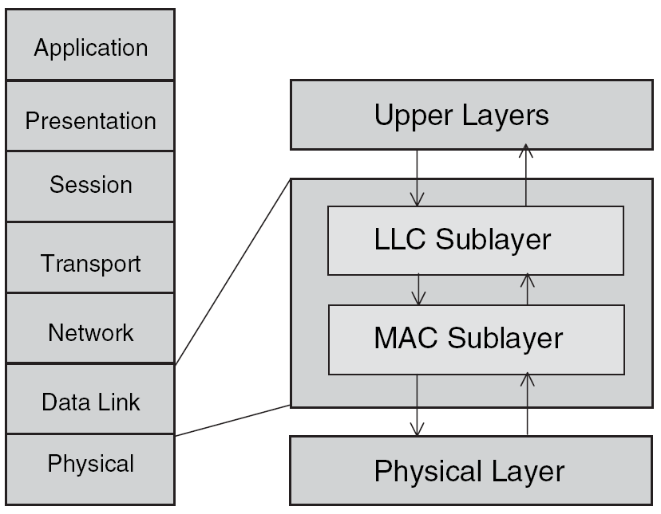
OSI Model
In WSN
  Due to the constraints, usually we have only three layers for data transmission
  Application specific
    Use the protocols that fits your need
  Consider routing and MAC together to achieve better performance
In computer network
Routing
MAC
Physical

Slide 7
Physical Layer
How the bits transmit in real physical world
For wireless communication, it defines
  Operating frequency
    2.4 GHz, programmable channel for Taroko
  Modulation/demodulation method
  Physical data rate
    250 kbps for Taroko
  Transmission power
    Programmable for Taroko
  How the radio chip detect a valid data packet
    Synchronization header
    User controllable for Taroko
Synchronization header
Data
Length
SYNC
Preamble

Slide 8
MAC
Medium Access Control
  Control the access of a shared channel
Wireless channel are shared among different nodes
  One node access the shared channel at a time
  Two nodes send packet at the same time, both packet will drop (usually)
Need a mechanism to control the usage of the channel

Slide 9
Types of MAC Protocols
Contention Based
  CSMA/CA (802.11)
  S-MAC, B-MAC, T-MAC (WSN)
Scheduled Based
  TDMA
Hybrid (Scheduled and Contention)
  Z-MAC

Slide 10
Contention Based
No specific schedule, a node will try to send packet when it needs to send
CSMA: Carrier Sense Multiple Access
  C wants to send to D
  But A is sending packets to B
  C listen to the channel
  It can hear A is sending
  So C backoff and wait
  When the channel is clear
  C sends packets to D
A
B
C
D

Slide 11
RTS/CTS/Data/ACK
Basic theme (802.11)
  A wants to send data to B
Request to Send (RTS)
Clear to Send (CTS)
I want to send something
Ok, you can send (if B is not receiving data from other node)
RTS
CTS
B
A
Data
This is the data packet
ACK
Ok, I receive this data packet

Slide 12
Collision Avoidance
E wants to send to B, and A is sending data to B
E is not in the radio range of A, so it cannot hear A is sending (CSMA is useless)
Without RTS/CTS, E will keep trying to send data to B, results in a high collision
With RTS/CTS, E knows B is receiving data from other node
A
B
E
C
D

Slide 13
Turn-off Radio
Power consumption while listening
  IEEE 802.15.4: approximate 19 mA
For two AAA batteries with 1600 mAh capacity
  Out of power in 84 hours if radio is always on
If these are you requirements
  Battery powered
  Long time operation without replace/recharge battery
Then, you MUST turn-off radio periodically

Slide 14
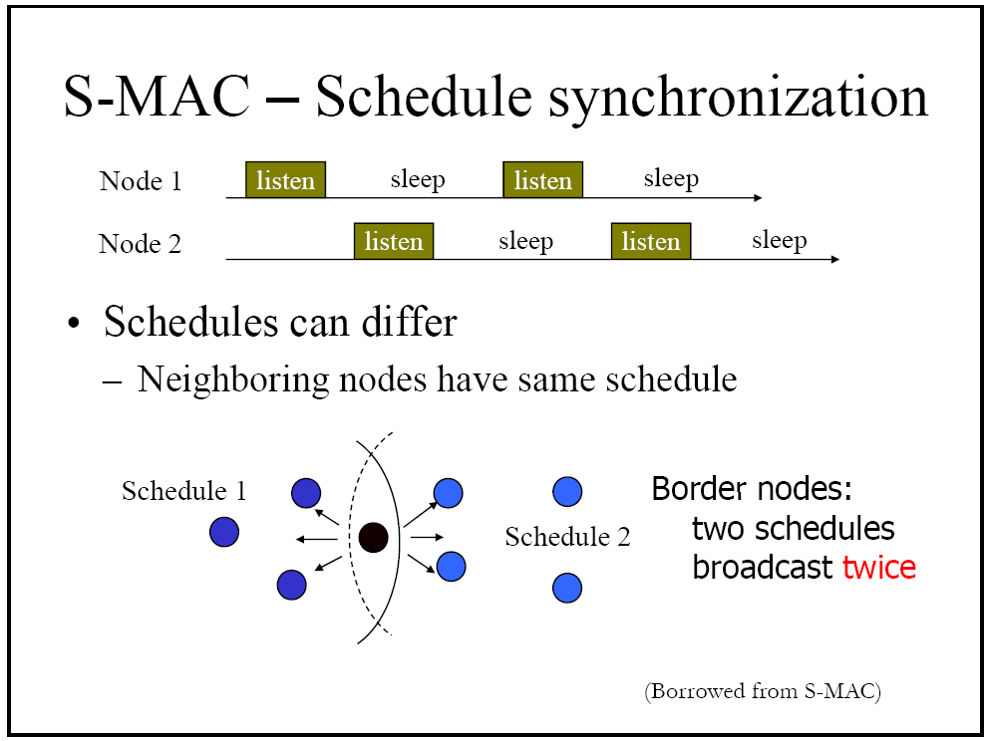
S-MAC
Just to give you an idea here
  Polly has talk about it last week, check her slides
S-MAC
  listen – sleep – listen – sleep
  Use RTS-CTS-DATA-ACK
Trade throughput and latency for energy

Slide 15
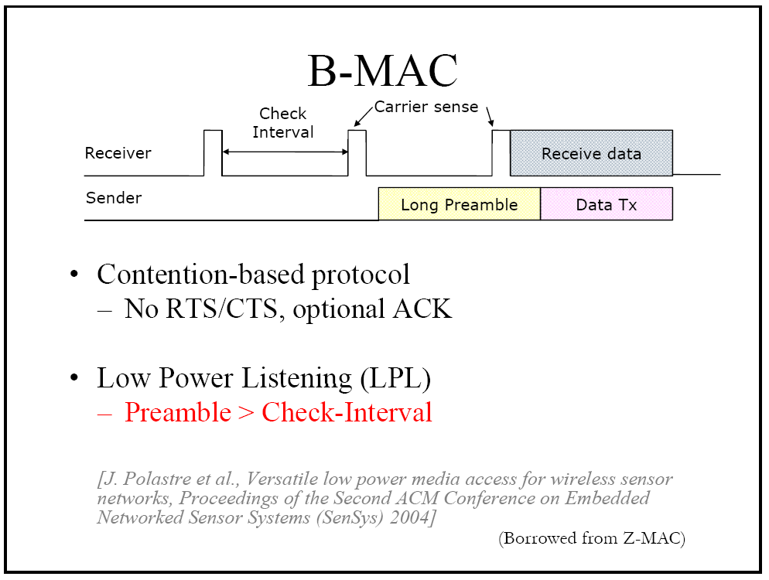
B-MAC
Key: Low Power Listening (LPL)

Slide 16
B-MAC
CSMA (no RTS-CTS)
Improves over S-MAC
  Higher Throughput
  Lower Latency
  Less energy consumption

Slide 17
TDMA
F
Time divided multiple access
  Divided into time slots
TDMA require Time synchronization
I
J
G
A
B
H
E
C
K
L
D
M
A sends; B, C, F listen
C sends; A, G, M listen
E sends; J, B, L, K listen
Time
Nodes that do not listen or send, go to sleep

Slide 18
Clock Synchronization
Every node in the network agree on the same clock (or period)
2007/11/19 10:12:2345
A
B
H
agree on the same clock
C
(when it counts to 65535, reset to zero)
26584
A
B
H
agree on the same period
C

Slide 19
Why the Time Is Different
65535
65535
Different start up time
One time synchronization is enough?
  No
Clock drift
  The crystal is not prefect
  For 32768 Hz watch crystal we used, the error is 20 ppm (0.002%)
  Error over a day: 86400 * 0.002% = 1.73 seconds per day
  DCO is even worst
  You need re-sync
65535
0
A
Counter_B is 0,
Counter_C is 10000
0
B
0
C

Slide 20
Synchronization
In an ideal simplest case
My time is 34567
B,C, F set their counter to 34567
My time is 34789
L sets its counter to 34789
F
I
J
G
My time is 34678
A
G, M set their counter to 34678
B
H
E
C
K
L
D
M
The synchronization message propagate through the network

Slide 21
Synchronization Delays
Non-deterministic. Even if you install same program on two identical nodes, they can still be different. (interrupts)
The uncertainties
Application: send sync message, embedded current clock value into message
Application: receive sync message, set clock value to the value in the message
Send Message processing time
Receive message processing time
Routing
Routing
MAC
MAC
Transmit time
Radio (Physical)
Radio (Physical)
Receive time
Propagation time
Deterministic values

Slide 22
Flooding Time Sync Protocol (FTSP)
Periodic flooding
  robust to failures and topology changes
MAC-layer timestamp
Implemented on Mica platform
~1 Microsec accuracy
Scaleble

Slide 23
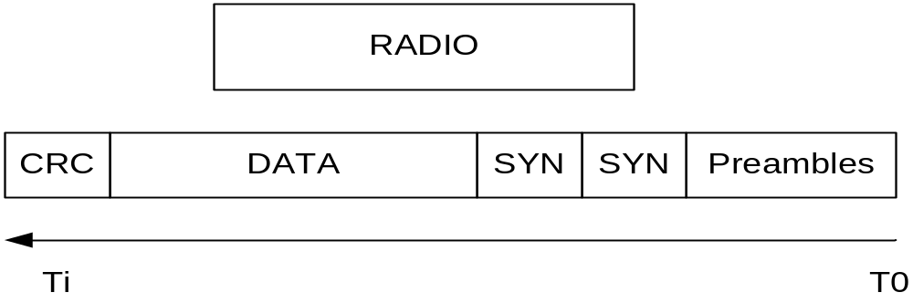
MAC Layer Timestamp
When to time stamp the message
  Radio layer, after the second SYN sent out, 6 timestamps in row, take the average and send only 1 timestamp
Insert the timestamp into the end of the data
Normalize and then take Average of these timestamps for 6 bytes of data

Slide 24
Synchronization Delays
Non-deterministic. Even if you install same program on two identical nodes, they can still be different. (interrupts)
With MAC layer timestamp
Application: send sync message, embedded current clock value into message
Application: receive sync message, set clock value to the value in the message
Send Message processing time
Receive message processing time
Routing
Routing
MAC
MAC
set clock value to the value in the message
Transmit time
Radio (Physical)
Radio (Physical)
Receive time
embedded current clock value into message
Propagation time
Deterministic values

Slide 25
Radio Irregularity
Lets take a look at the other professor’s slides

Slide 26
CC2420 Features
IEEE 802.15.4 compliant
250 kbps effective data rate
Hardware MAC encryption (AES-128)
Programmable output power
2400 – 2483.5 MHz

Slide 27
MAC Hardware Support
802.15.4 MAC hardware support:
  Automatic preamble generator
  Synchronization word insertion/detection
  CRC-16 computation and checking over the MAC payload
  Clear Channel Assessment
  Energy detection / digital RSSI
  Link Quality Indication
  Full automatic MAC security(CTR, CBC-MAC, CCM)
  Stand-alone AES encryption

Slide 28
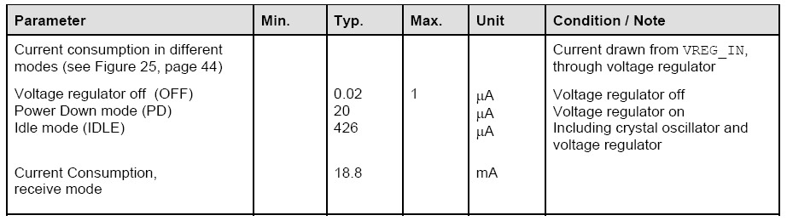
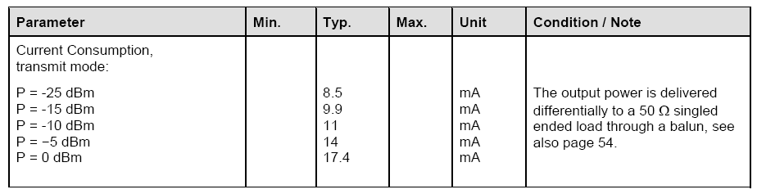
Power Consumption
Mode | Current Consumption
Idle | 426 μA
Receive (including listen) | 18.8 mA
Transmit | 17.4 mA (max power)

Slide 29
IEEE 802.15.4 and Zigbee
OSI 7-Layer
IEEE 802.15.4
  Wireless MAC and PHY specifications for low-rate wireless personal area networks (LR-WPANs)
Layer 7: Application
Layer 6: Presentation
Layer 5: Session
ZigBee…
Layer 4: Transport
Layer 3: Network
Layer 2: Data Link
    (MAC)
802.15.4
IEEE 802.15.4 MAC
Layer 1: Physical (PHY)
IEEE 802.15.4
IEEE 802.15.4
868/915 MHz
PHY
2400 MHz
PHY

Slide 30
IEEE 802.15.4 PHY
Channel 0
Channels 1-10
868MHz / 915MHz
PHY
2 MHz
868.3 MHz
902 MHz
928 MHz
2.4 GHz
PHY
Channels 11-26
5 MHz
2.4 GHz
2.4835 GHz

Slide 31
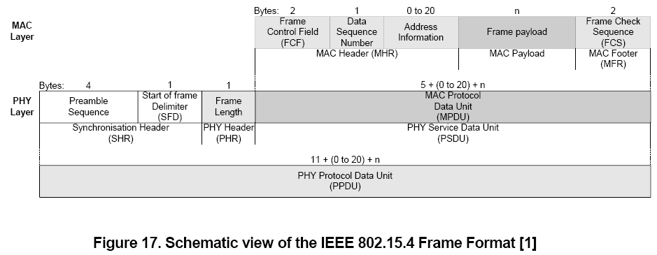
IEEE 802.15.4 Packet
PHY Packet Fields
Preamble (32 bits)
Start of Packet Delimiter (8 bits)
PHY Header (8 bits) – PSDU length
PSDU (0 to 1016 bits) – Data field

Slide 32
IEEE 802.15.4 MAC
IEEE 802.15.4 Addressing:
MAC address: 64-bit
Network address: 16-bit
PAN identifier: 16-bit
Star Topology
Peer-Peer Topology
Full function device: can do routing
Reduced function device: end device, cannot do routing
PAN Coordinator: (1) every network should have at least one coordinator
(2) Other devices joint the coordinator they found
(3) PAN Coordinator assign a 16 bit network to the device

Slide 33
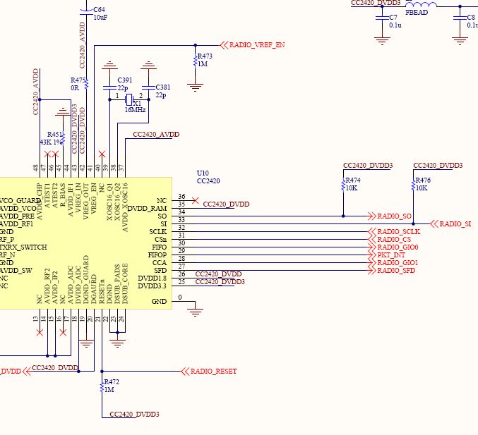
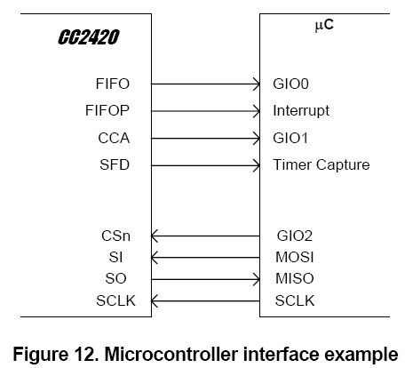
CC2420 ←→MSP430F1611
Power control
SPI interface: send/receive data to/from radio chip
Status indication pins
Reset

Slide 34

General View
Initialization:
  Turn on CC2420, setting the register and memory
  Now CC2420 is in idle mode
Transmit
  Do your MAC layer operations
  Write the packet into the transmit buffer
  Send a transmit command to CC2420
  Do your MAC layer operations
Receive
  Turn on receiver to listen
  If a packet arrive, after receive the last byte of the packet, FIFOP interrupt will generate
  Go to the FIFOP ISR, fetch the received packet from receive buffer
  Do your MAC layer operations
Power and reset control
CC2420
MSP430F1611
SPI interface:
Status indication pins

Slide 35
CC2420: Registers
Communication: CC2420 ←→MSP430F1611
  SPI interface
33 16-bit configuration and status registers
  Configuration registers
    Initialization: make the device operate in the way you want
  Status registers
    Get the status of the device
15 command strobe registers
  Single byte instructions: ask the device to do something
  Eg. “send packet”, “start encryption”
Two 8-bit FIFO(buffer) access registers
  Access receive and transmit buffer

Slide 36
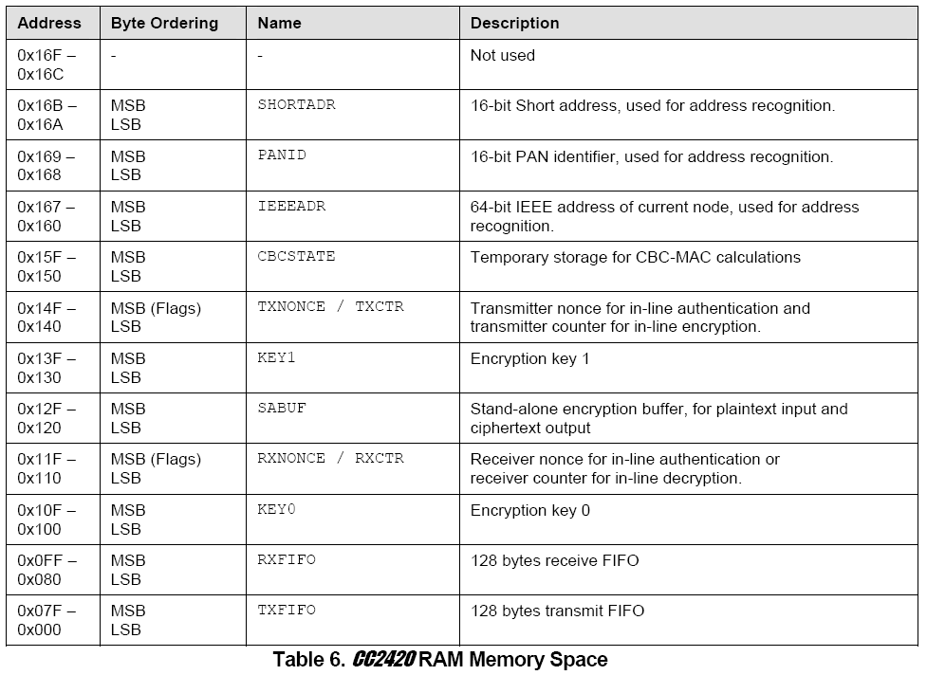
CC2420: RAM
Internal 368 bytes RAM
  4 bytes blank (not used)
  16 bytes IEEE802.15.4 addressing
  112 bytes security bank
  128 bytes receive FIFO
  128 bytes transmit FIFO
IEEE802.15.4 addressing
security bank
receive buffer
Transmit buffer

Slide 37
MSP430 SPI
It is similar to UART
  Initial SPI module by setting proper registers
  Check User guide for further detail
Send a byte to CC2420
  Write to U0TXBUF
Receive a byte from CC2420
  Write a byte to U0TXBUF
  Wait for U0RXBUF ready, read the byte from U0RXBUF
  You must send a byte to CC2420 in order to read a byte
    In SPI protocol, master must send something to push slave send data back
    You don’t need receive interrupt (unlike UART)
When will CC2420 know MSP430 wants to send something to it?
  Pull the CSn pin low

Slide 38
Access Registers
Registers
Read/write registers
BIT 7
BIT 6
BIT 5:0
RAM (1)/ Reg (0) | Read(1)/ Write(0) | Address
send
0 | 0 | Address
Register Value
Setting Register
Receive
Status
Status
send
0 | 1 | Address
Read Register value
Receive
Status
Register Value
send
0 | 0 | Address
Send Command Strobe
Receive
Status
Register Value

Slide 39
Access RAM
RAM access:
  Crystal oscillator must be running and stable for RAM access
  DO NOT use RAM access for FIFO
FIFO access: use FIFO access register (Tx: 0x3E, Rx: 0x3F)
Luckily, you don’t need to write these hardware access routines
BIT 7
BIT 6:0
BIT 7:6
BIT 5
BIT 4:0
RAM (1)/ Reg (0) | Address
Bank | Read(1)/ Read+Write (0) | X | X | X | X | X
send
0 | 0 | 111110
DATA
Transmit FIFO
Receive
Status
Status
send
0 | 1 | 111111
Receive FIFO
Receive
Status
FIFO DATA

Slide 40
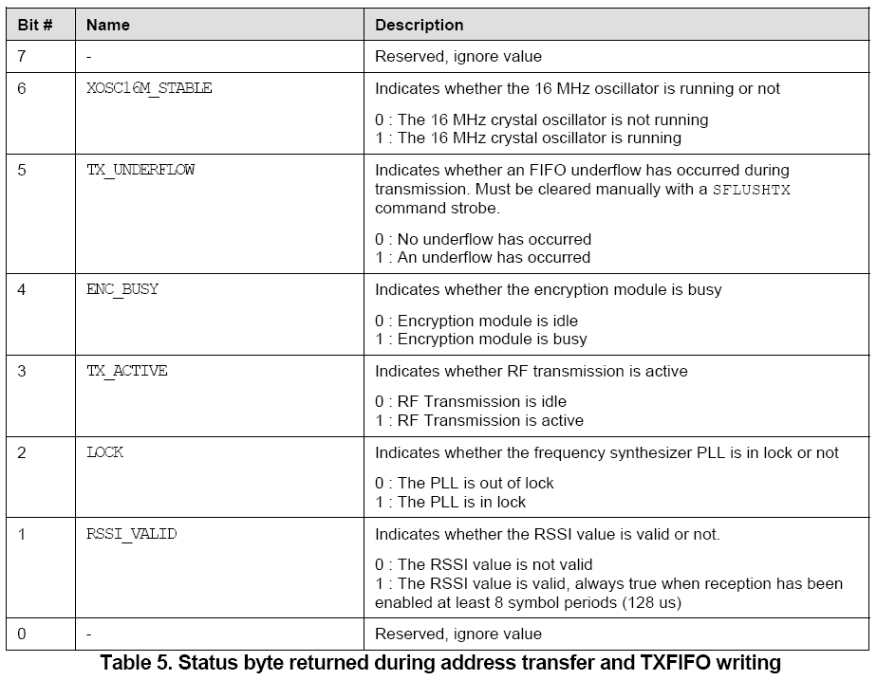
Status Byte
Status byte is returned
  When MSP430 write something to CC2420
  Issue a SNOP command (do nothing, just to get the status byte

Slide 41
Preamble And SFD
Preamble
  IEEE802.15.4 standard: 4 bytes (0x00)
  Length of preamble is controlled by register: MDMCTRL0
  Programmable length from 1 to 16 bytes
    For IEEE 802.15.4, it is set to 3 bytes long
    Don’t set it to less than 3 bytes
  Each byte is 2 zero-symbols
    Each symbol is 16μs
SFD
  IEEE 802.15.4 standard: 1 byte (0xA7)
  Programmable by register: SYNCWORD
  SYNCWORD is two bytes long
    When used in IEEE 802.15.4: one byte for preamble, another for SFD

Slide 42
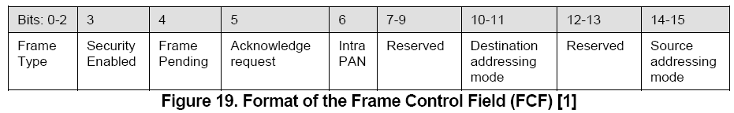
Frame Length And FCF
Frame length field: 7-bit
Frame Control Field (FCF)
  Compliant to IEEE 802.15.4
BIT 7
BIT 6:0
Frame length
Reserved | Frame length

Slide 43
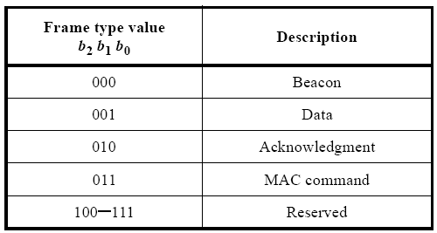
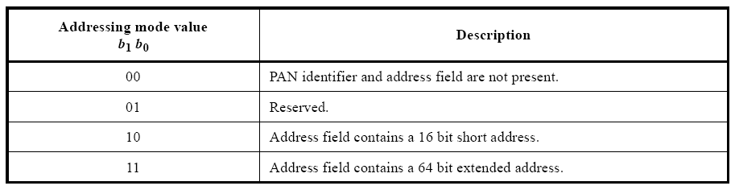
Frame Control Field
If set to 1 means: I have another packet to send to you after this packet

Slide 44
Frame Check Sequence
CC2420 can do auto CRC check
  Always enable this function
Frame Check Sequence: 2 bytes
  In transmit mode
    CRC is auto calculated and append to the transmit packet
  In receive mode
    CRC is verified by hardware
    Frame check sequence contain
BIT 7:0
BIT 7
BIT 6:0
RSSI
CRC OK(1)/ CRC not OK (0) | LQI
RSSI - Receive Signal Strength Indicator
LQI - Link Quality Indication

Slide 45
Address Recognition And ACK
Hardware address recognition
  Enable/disable by ADR_DECODE bit in MDMCTRL0 register
  CC2420 will perform a sequence of address checking when it is enable
  If address recognition fail, CC2420 will reject the frame
  Check datasheet for further detail
Acknowledge frames
  Hardware support auto acknowledge
  Enable/disable by AUTOACK bit in MDMCTRL0 register
  If
    Auto ack enabled
    Incoming frames pass address recognition and CRC checking
    Acknowledge requested in FCF
  CC2420 will automatically send an acknowledge back to the sender

Slide 46

RSSI
Receive Signal Strength Indicator
  Indicate how strong the RF signal is
Averaged over 8 symbol periods (128 μs)
  RSSI_VALID status bit indicates when the RSSI value is valid
  Receiver has been enabled for at least 8 symbol periods
power P at the RF Pins
  RSSI_OFFSET is found empirically during system development
  RSSI_OFFSET is approximately –45

Slide 47
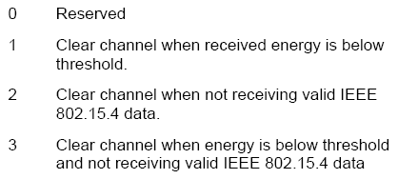
CCA
Clear channel assessment
  Check if the channel is clear
  Based on the measured RSSI value and a programmable threshold
Threshold level
  Programmed by registers: RSSI
3 CCA modes
    Programmed by registers: MDMCTRL0
CCA output pin indicates the channel is cleal or not
  High: channel is clear
  Low: channel is not clear

Slide 48

Frequency and Channel Programming
Operating frequency is set by FSCTRL register
  Last 10 bit
Operating frequency Fc
IEEE 802.15.4
  16 channels within the 2.4 GHz band, in 5 MHz steps
  numbered 11 through 26
There for

Slide 49
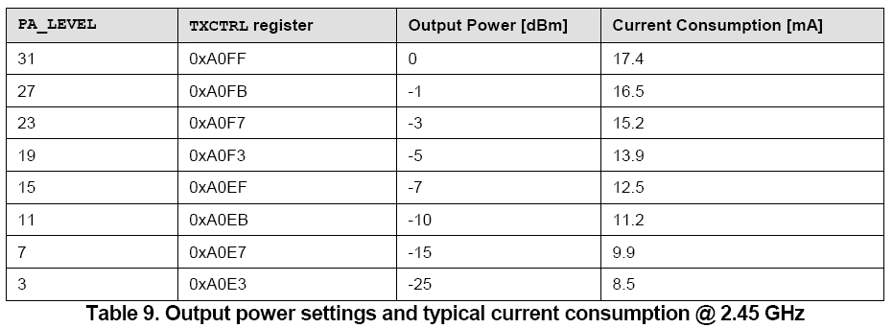
Output Power Programming
Controlled by the TXCTRL register

Slide 50
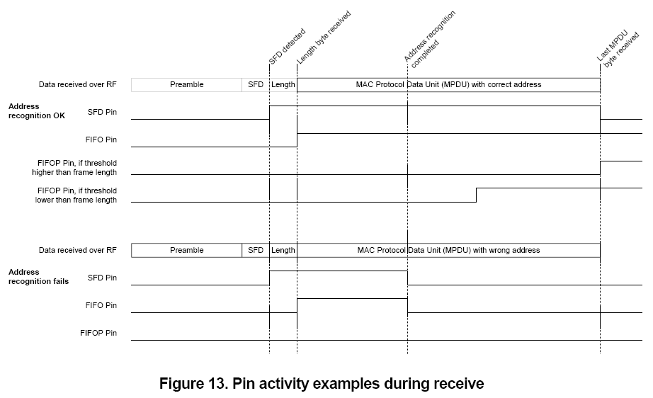
Receive Mode
We use FIFOP to indicate the receive of valid packet
  Enable FIFOP interrupt
RXFIFO overflow
  FIFO pin goes low and FIFOP pin goes high indicate a RXFIFO overflow
  You must send a SFLUSHRX command to CC2420 if RXFIFO overflow occurred

Slide 51
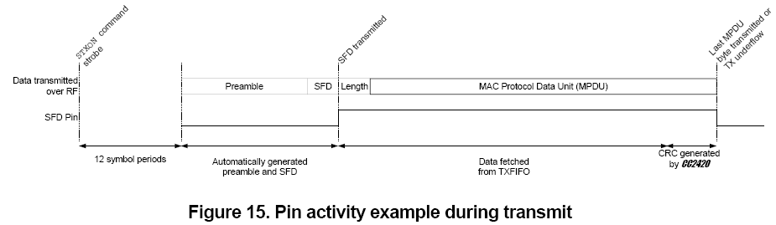
Transmit Mode
Timer capture
Timestamp value
MAC layer timestamp
  SFD is connected to a timer capture pin on MSP430
TXFIFO underflow
  Not enough bytes write to the TXFIFO
  Indicate in TX_UNDERFLOW bit in status byte

Slide 52
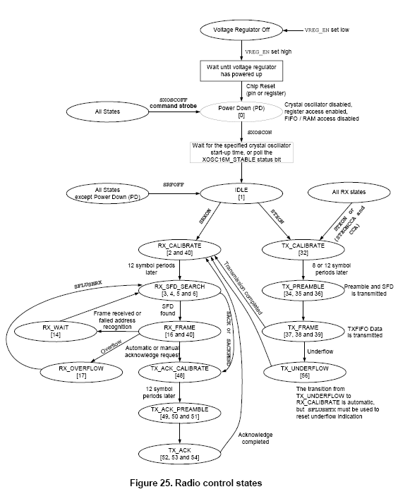

Slide 53
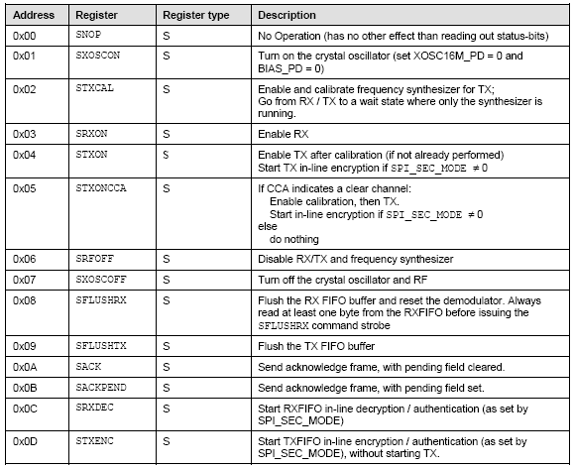
Strode command

Slide 54
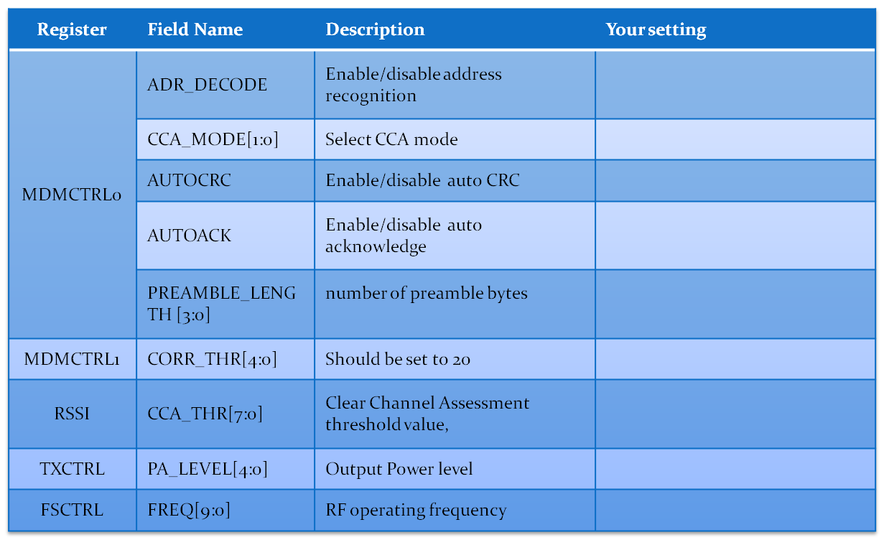
Summary

Slide 55
Low Level SPI Routines
There are defined in hal_cc2420.h
Send command strobe
  FASTSPI_STROBE(command)
  Example: FASTSPI_STROBE(CC2420_STXON)
Setting registers
  FASTSPI_SETREG(address, value)
  Example: FASTSPI_SETREG(CC2420_MDMCTRL0, 0x1234)
RAM access (write address)
  FASTSPI_WRITE_RAM_LE(p,a,c)
    p = pointer to the variable to be written
    a = the CC2420 RAM address
    c = the number of bytes to write
  Example: FASTSPI_WRITE_RAM_LE(&myAddr, CC2420RAM_SHORTADDR, 2)
Write to TXFIFO
  FASTSPI_WRITE_FIFO(p,c)
    p = pointer to the byte array to be read/written
    c = the number of bytes to read/write
  Example: FASTSPI_WRITE_FIFO((BYTE*)&frameControlField, 2);
Read RXFIFO
  FASTSPI_READ_FIFO_NO_WAIT(p,c)
    p = pointer to the byte array to be read/written
    c = the number of bytes to read/write
  FASTSPI_READ_FIFO_NO_WAIT((BYTE*) &frameControlField, 2);

Slide 56
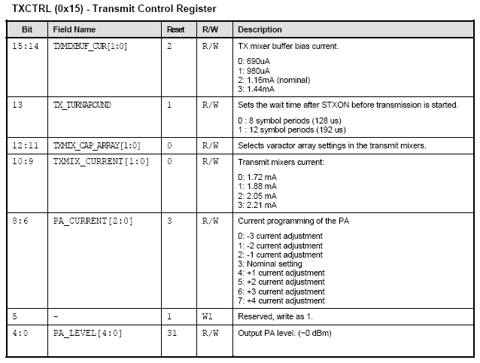
Setting Registers
BE CAREFUL!!
  When setting registers
    FASTSPI_SETREG(address, value)
  This is not “|=“
  For example, you want to reduce the output power level
    Reset default is 31, you want to change to 15
  You cannot use: FASTSPI_SETREG(CC2420_TXCTRL, 0x000F)
    You will override the other fields
  You must retain the reset default value for other fields
    You should do:
    FASTSPI_SETREG(CC2420_TXCTRL, 0xA0EF)
Check CC2420 datasheet for the reset default value

Slide 57
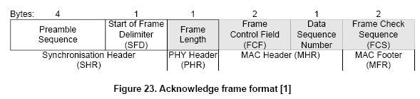
Packet Type
Acknowledge packet
Data Packet
5 bytes
4~17
Minimum: 11 bytes
Bytes:
4~17
1
1
2
1
2
2
2
0~116
2
Preamble | SFD | Frame Length | FCF | Seq. number | PAN ID | Destination address | Source address | Payload | FCS

Slide 58
Channel Assignment
Group | Channel
1 | 11
2 | 12
3 | 13
4 | 14
5 | 15
6 | 16
7 | 17
8 | 18
9 | 19
10 | 20
11 | 21
12 | 22

Slide 59
Today’s Lab
Lab 1: simple MAC
  Download the files from website
  Include these files into your project
  Modify three files:
    rf_init.c, rf_receive.c, rf_transmit.c
  You should use the packet format in previous slide
  Make a Taroko as sender, another Taroko as receiver
  Sender send following byte sequence
    0x01 0x02 0x03 0x04 0x05 0x06
  Receiver should be able to receive this byte sequence
  Use 0x2420 as PAN ID
  Set your CPU clock rate at 5 MHz

Slide 60
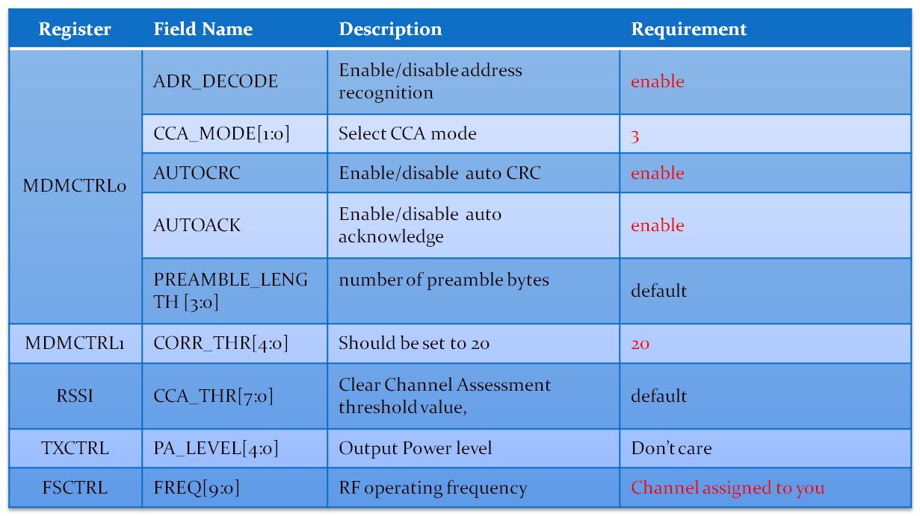
Lab 1 MAC Spec
Your MAC must have

Slide 61
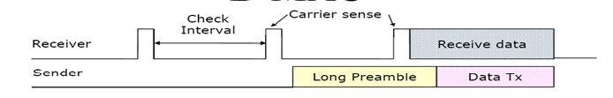

Low Power Listen
Use a timer to turn on/off receiver periodically
When the receiver is on, it sense the channel (check CCA pin).
If channel is clear (CCA is high), go back to sleep
If channel is busy (CCA is low), that means
1. some one wants to send something, or
2. some one is sending, or
3. the channel has many noise
it stay awake for a period of time (preamble length)
if (a valid SFD received) {
receive the packet
}
else {
go to sleep again
}
Change you preamble length, make it longer

Slide 62
Lab 2
Implement Low Power Listen in your MAC in lab 1

