Slide 2

MILESTONE PREVIEW
Quan Phan | 24/08/2025

Slide 3

Agenda
Top-down approach, Database Analysis & Design
Critical Thinking & Writing SQL Query
Writing unit test & Learn Clean Code Principle
Time Management & Outdoor assignment
Summary

Slide 4
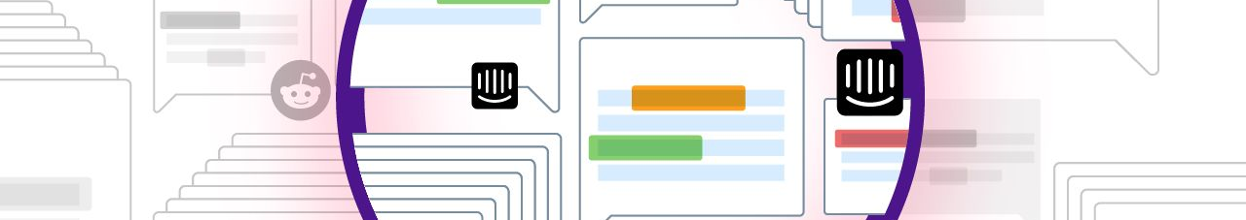
MILESTONE 1: TOP-DOWN APPROACH, DATABASE ANALYSIS & DESIGN

Slide 5
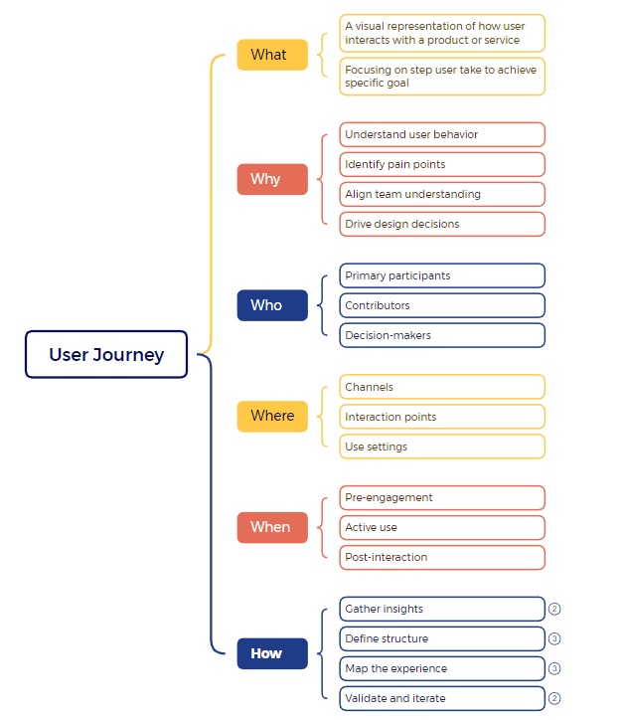
LEARN TOP-DOWN APPROACH
Learn how to use mind map to learn new concept by 5W 1H
Learn how to break a big concept to many smaller concepts

Slide 6
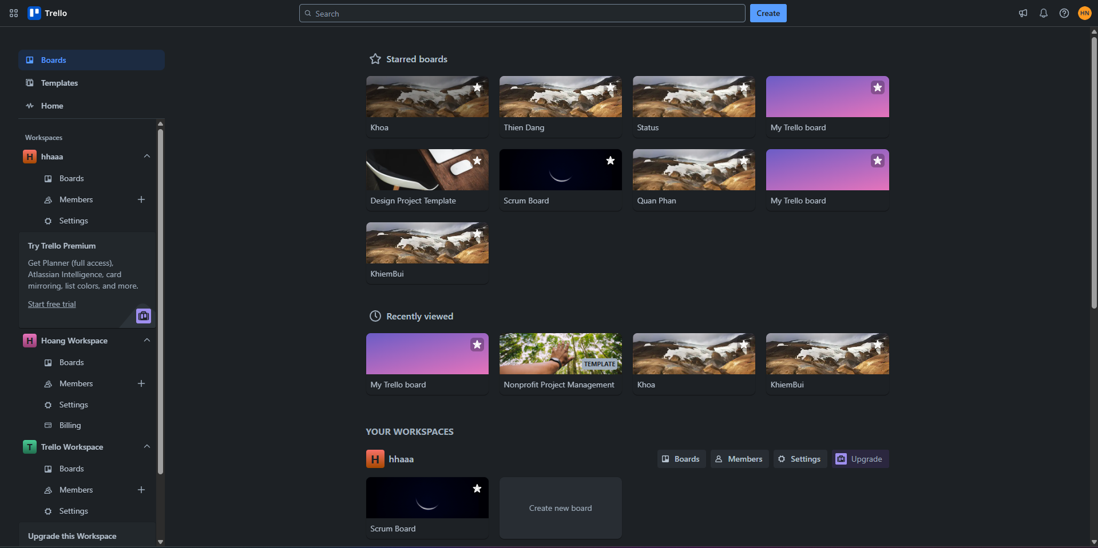
DESIGN DATABASE FOR TRELLO

Slide 7
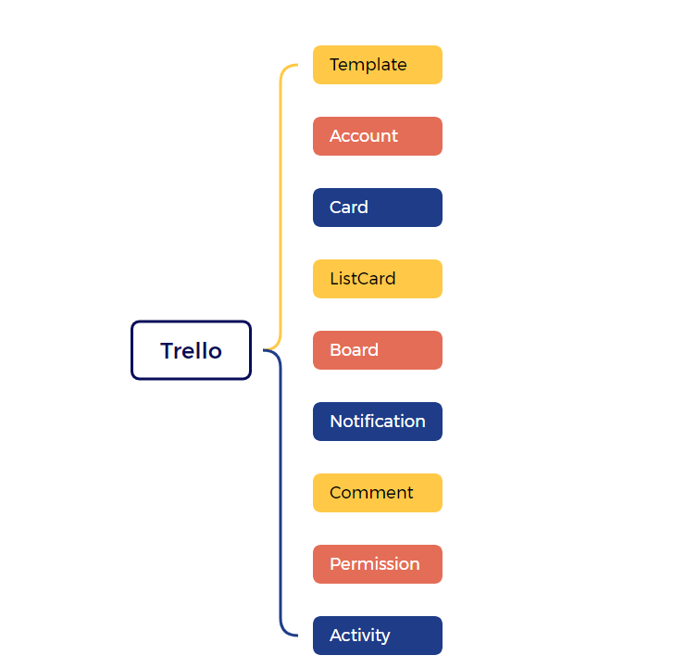
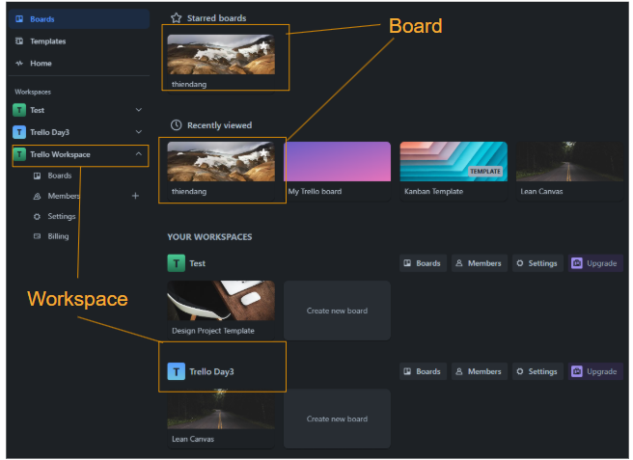
FIRST VERSION OF LIST ENTITY FOR TRELLO

Slide 8
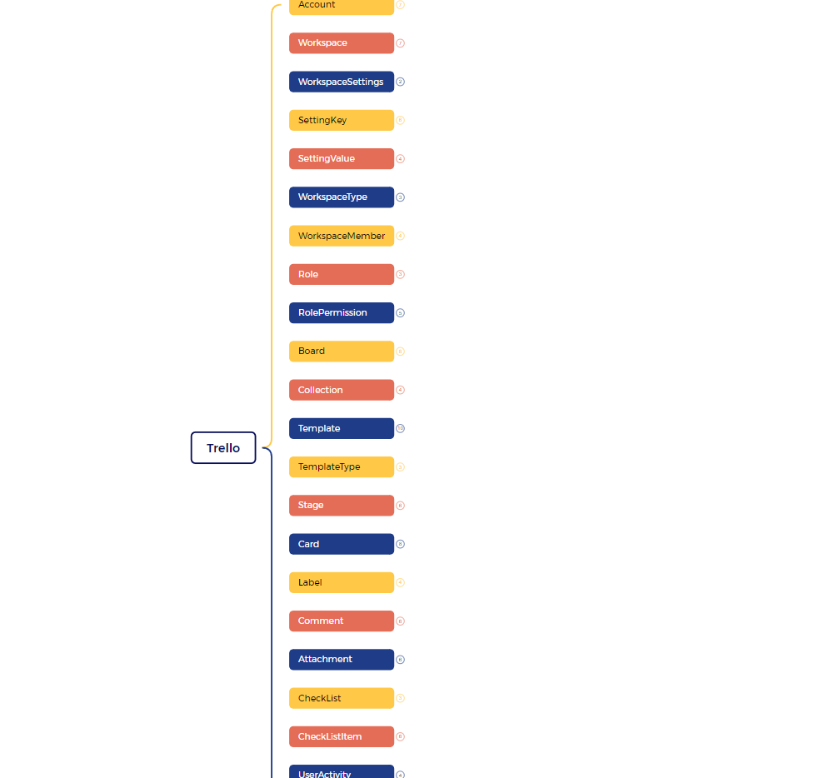
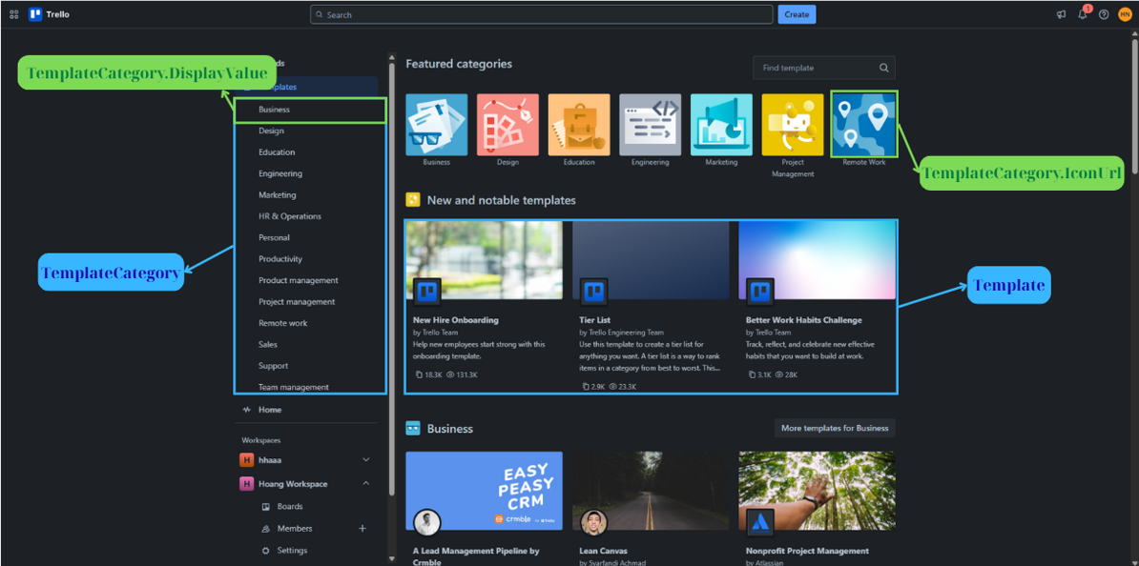
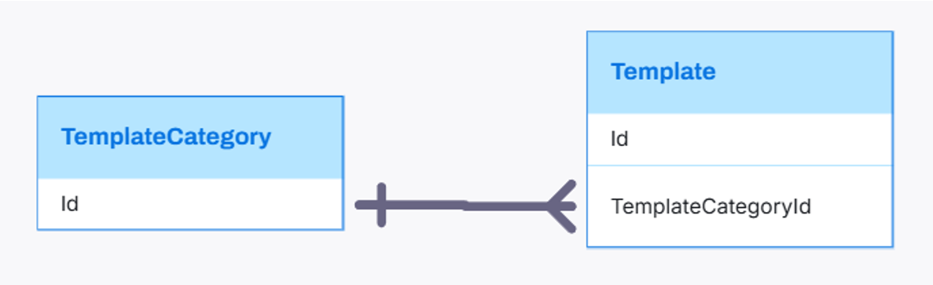
VERSION AFTER RECEIVING FEEDBACK

Slide 9

MILESTONE 2: Learn Critical Thinking & Write SQL Query

Slide 10


Critical Thinking
Ask questions: Always ask "Why?", "How?", "What's the evidence?".
Seek diverse information: Don't rely on a single source.
Challenge your own beliefs: Be willing to change your mind if presented with convincing evidence.
Understand fallacies and biases: Recognize them in others and in yourself.
Focus on data and evidence: Don't let emotions or prejudices dictate your judgment.

Slide 11
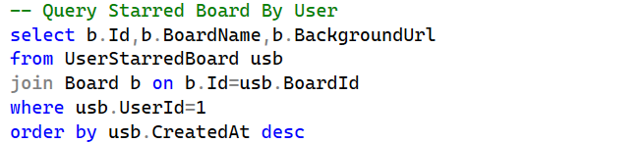
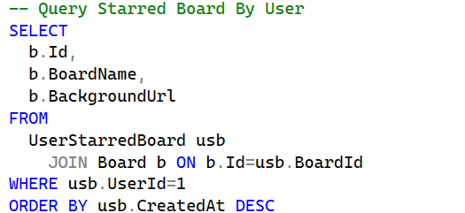

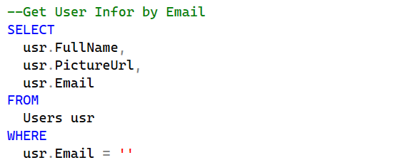
WRITE SQL QUERY - BEFORE AND AFTER RECEIVING FEEDBACK

Slide 12
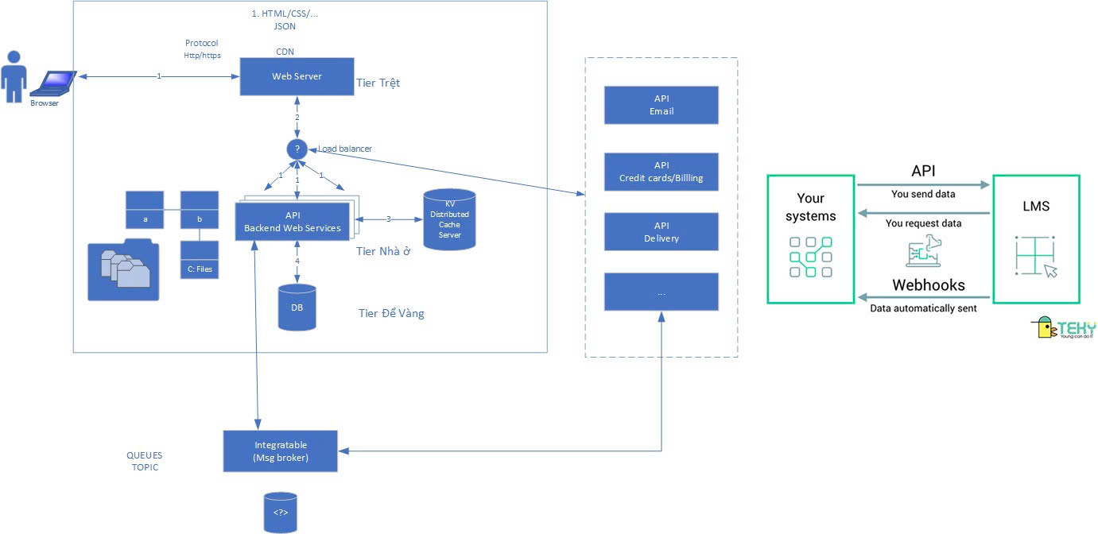
LEARN THREE-TIER ARCHITECTURE

Slide 13

MILESTONE 3: Writing Unit Test & Learn Clean Code Principle

Slide 14



WRITING UNIT TEST – LEARN CLEAN CODE
At first: just write code to run, without focusing on performance or readability -> write from scratch for 3 time
Later: after learning SOLID principles and design patterns → care more about performance, maintainability, and readability

Slide 15
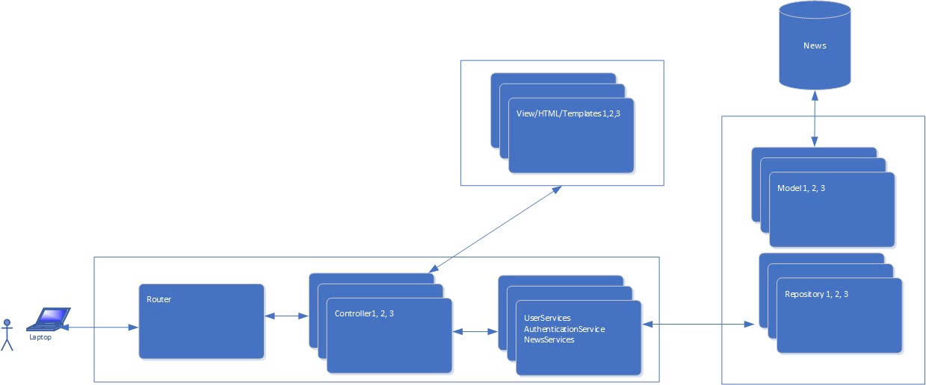
LEARN MVC MODEL

Slide 16

MILESTONE 4: OUTDOOR ASSIGNMENT & LEARN TIME MANAGEMENT

Slide 17
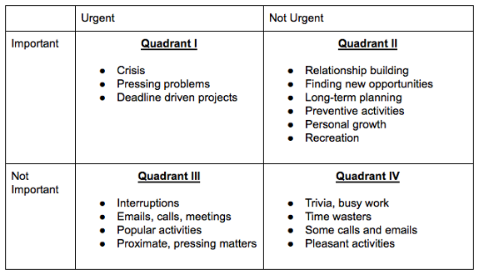
LEARN TIME MANAGEMENT

Slide 18



TALKING WITH FOREIGNER

Slide 19
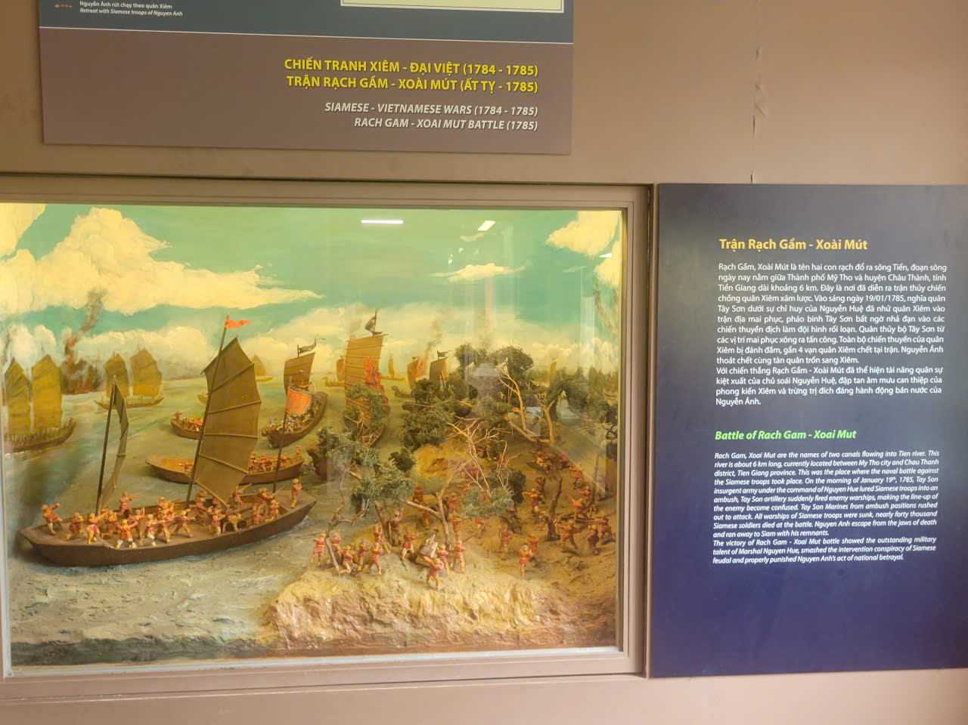

MAKE PRESENTATION ABOUT VIETNAM HISTORY AND CULTURE

Slide 20

SUMMARY

Slide 21
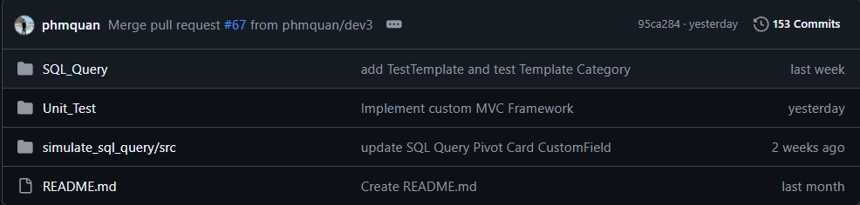
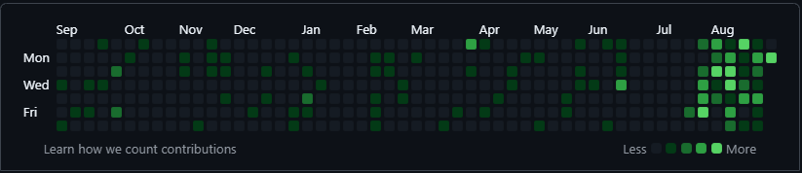
SUMMARY
Learn from feedback and solving problem
Learn both technical and soft skills
Better everyday by daily progress

Slide 22

Q&A

