Slide 2




Presentation on Trello Functionalities
bbv Software Services AG | Date: 08/05/2025

Slide 3

Agenda
Introduction
Key Functionalities
Screens in Trello
Q&A

Slide 4

INTRODUCTION
What is Trello?

Slide 5
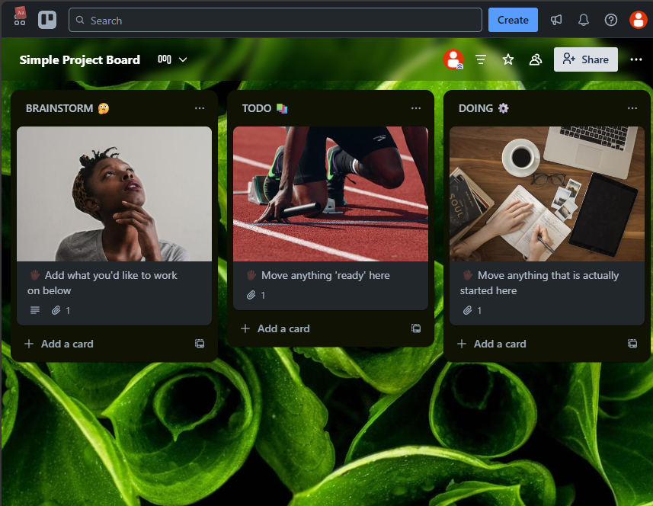
INTRODUCTION
Trello is a visual project management tool
Workspace → Board → Stage → Card to organize tasks
Collaborate with teams.
Intuitive drag-and-drop interface
Ideal for task management, kanban boards, and collaboration
Works for teams of any size

Slide 6

Key Functionalities

Slide 7
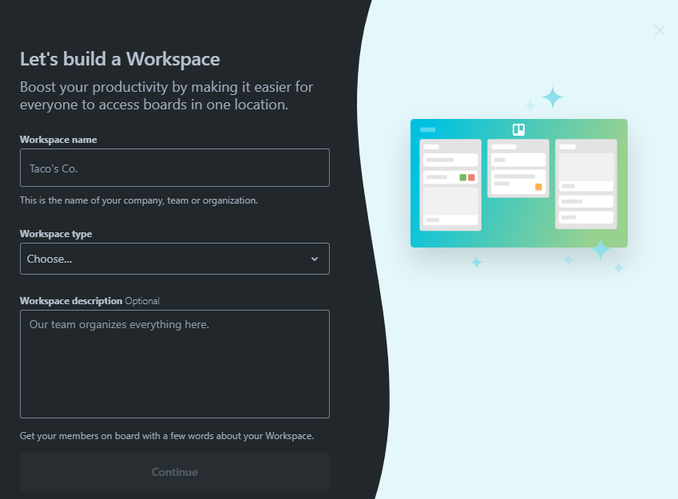
Key Functionalities of Trello
Create Workspaces and Boards
Create Stages within Boards
Create Cards (task items) inside Stages
Add custom fields to Cards
Assign Members to Cards
Add Labels, Due Dates, Checklists, and Attachments
Comment and track Activity on Cards
Manage Permissions and Sharing
Use Templates for quick project setup

Slide 8
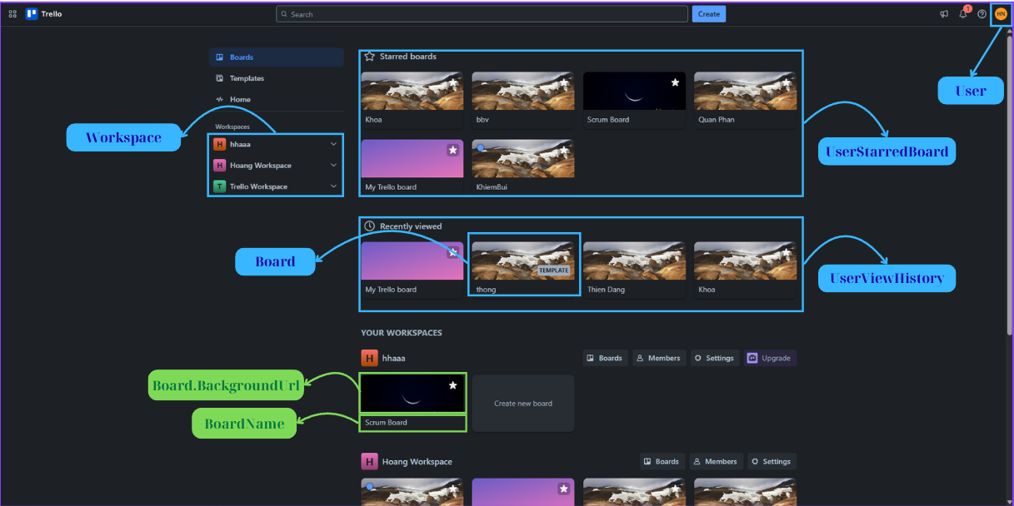
BOARDS TAB
Notes:
-- Query Starred Board By User
select
b.Id,
b.BoardName,
b.BackgroundUrl
from
UserStarredBoard usb
join Board b on b.Id = usb.BoardId
where
usb.UserId = 1
order by
usb.CreatedAt desc
-- Query Recently viewed by user
SELECT TOP 4
b.Id as BoardId,
b.BoardName,
b.BackgroundUrl
FROM Board b
JOIN UserViewHistory uvh ON uvh.OwnerId = b.Id
JOIN OwnerType owt on owt.Id=uvh.OwnerTypeId and owt.OwnerTypeValue='board'
JOIN Users u ON u.Id = uvh.UserId
WHERE u.Id = 1 -- userId
ORDER BY uvh.AccessedAt DESC;
-- Query all Workspace where User is a Member. For each workspace, get all Board where User is also a Member
SELECT
w.Id AS WorkspaceId,
w.WorkspaceName,
w.LogoUrl AS WorkspaceIcon,
b.Id AS BoardId,
b.BoardName AS BoardName,
b.BoardDescription,
b.BackgroundUrl,
b.CreatedAt
FROM Workspace w
-- Find Workspace where User is a Member
JOIN Members mw ON mw.OwnerId = w.Id
JOIN OwnerType otw ON otw.Id = mw.OwnerTypeId
AND otw.OwnerTypeValue = 'workspace'
-- Find Board corresponding to Workspace where User is also a Member
JOIN Board b ON b.WorkspaceId = w.Id
JOIN Members mb ON mb.OwnerId = b.Id
JOIN OwnerType otb ON otb.Id = mb.OwnerTypeId
AND otb.OwnerTypeValue = 'board'
WHERE mb.UserId = 1

Slide 9
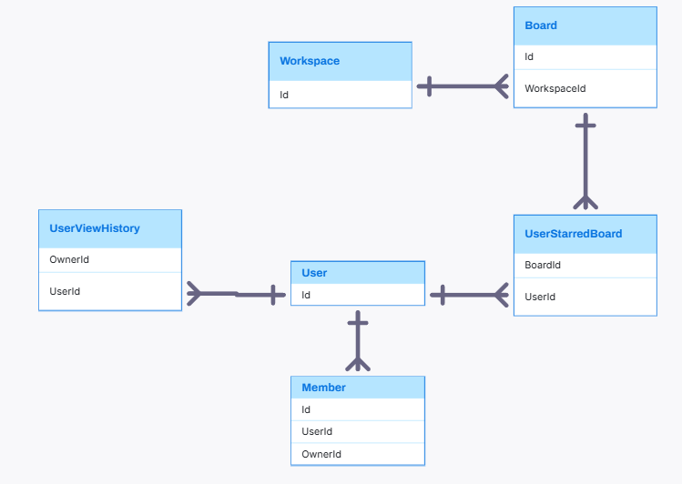
BOARDS TAB RELATIONSHIP

Slide 10
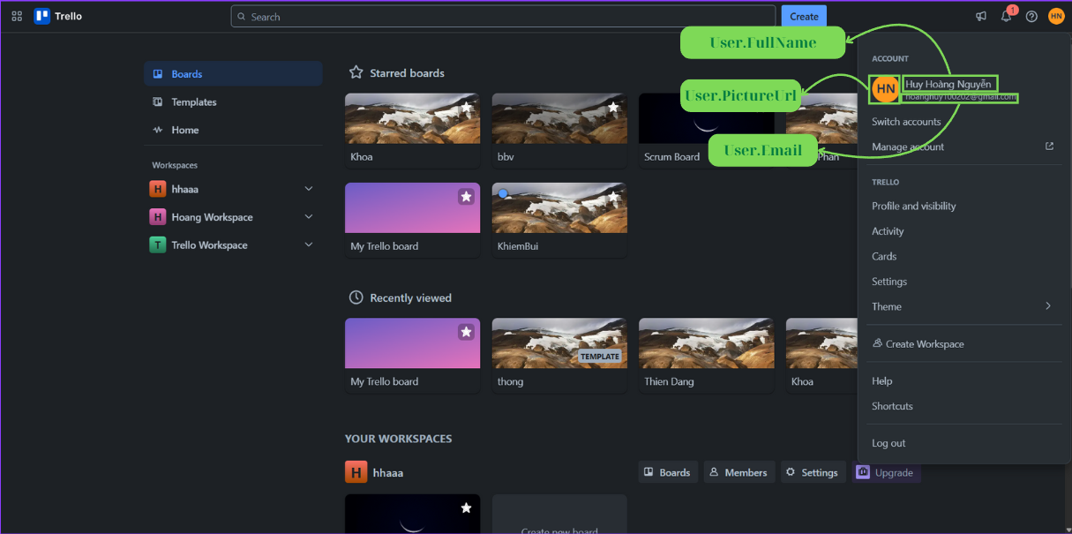
USER INFOR
Notes:
--Get User Infor by Email
select
usr.FullName,
usr.PictureUrl,
usr.Email
from
Users usr
where
usr.Email = ''

Slide 11
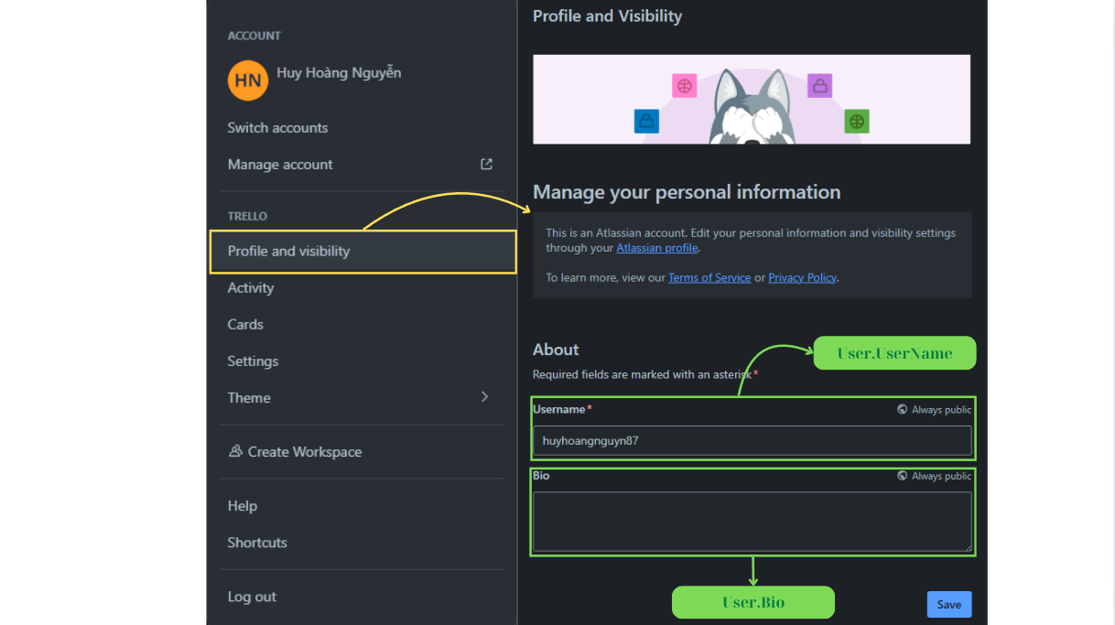
EDIT USER INFOR
Notes:
--Update Username and Bio by Id
update
Users
set
Username = '',
Bio = ''
where
Email = ''

Slide 12
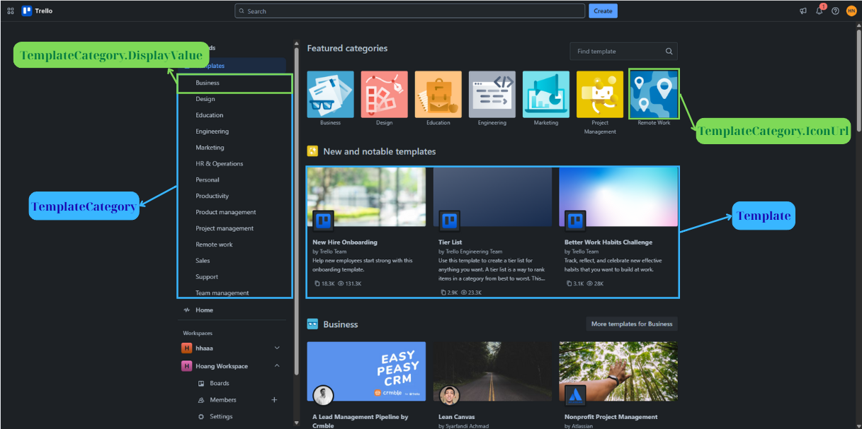
TEMPLATES TAB
Notes:
-- 7. Get top 7 template categories
select
Top 7 tpc.Id,
tpc.DisplayValue,
tpc.IconUrl
from
TemplateCategory tpc
-- 8. Get New and notable templates
SELECT
t.Id as TemplateId,
t.Title,
t.BackgroundUrl,
t.CreatedAt,
t.CreatedBy,
t.Copied,
t.Viewed,
t.TemplateDescription
FROM Template t
ORDER BY
t.CreatedAt DESC,
t.Viewed DESC,
t.Copied DESC;

Slide 13
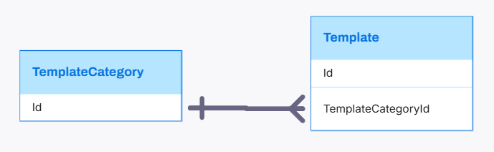
TEMPLATES TAB RELATIONSHIP

Slide 14
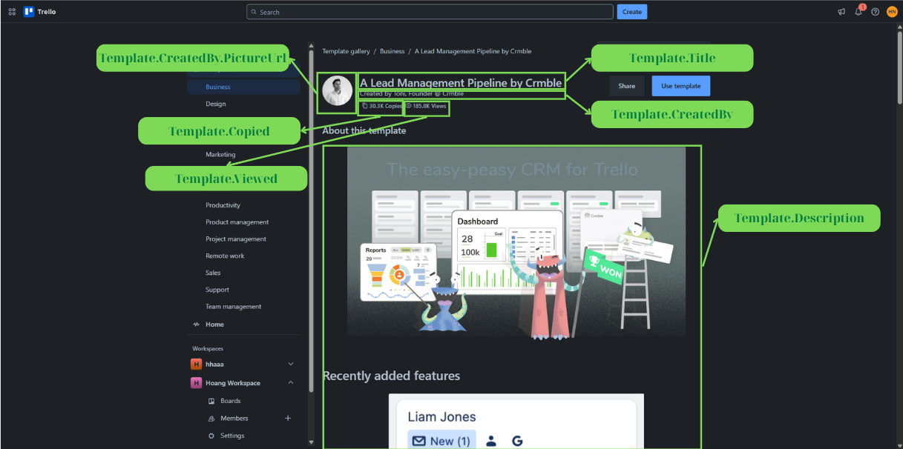
TEMPLATE DETAIL
Notes:
-- Get template details and the Board associated with that template
-- Get All Template Detail
SELECT
t.Id as TemplateId,
t.Title,
u.Username,
t.Copied,
t.Viewed,
t.TemplateDescription,
b.Id as BoardId,
b.BoardName,
b.BoardStatus
FROM Template t
JOIN Board b ON b.Id = t.BoardId
JOIN Users u ON t.CreatedBy = u.Id
WHERE t.Id = 1; -- templateId
GO
--Get all Stage, Card belong to Board in Template (Store Procedure)
CREATE OR ALTER PROCEDURE GetBoardDetail
@BoardTemplateId INT
AS
BEGIN
--Get BoardDetail
SELECT
b.Id as BoardId,
b.BoardName,
b.BackgroundUrl,
b.BoardStatus
FROM Board b
WHERE b.Id=@BoardTemplateId
--Get Stage in Board
SELECT s.Id as StageId, s.Title as StageTitle,s.Position as StagePosition,c.ColorName as BackgroundColor
FROM Stage s
JOIN Color c on c.Id=s.ColorId
where s.BoardId=@BoardTemplateId
--Get Card in Stage
SELECT
crd.Id AS CardId,
crd.Title AS CardTitle,
crd.StageId,
crd.CoverValue,
color.ColorName,
a.AttachmentPath,
crd.Position,
crd.CardDescription
FROM CARDS crd
JOIN Stage s
ON s.Id = crd.StageId
JOIN CardCoverType cct
ON cct.Id = crd.CardCoverTypeId
LEFT JOIN Color color
ON cct.TypeValue = 'color'
AND TRY_CAST(crd.CoverValue AS INT) = color.Id
LEFT JOIN Attachment a
ON cct.TypeValue = 'attachment'
AND TRY_CAST(crd.CoverValue AS INT) = a.Id
WHERE s.BoardId = @BoardTemplateId
ORDER BY StageId;
END
GO
EXEC GetBoardDetail @BoardTemplateId=20

Slide 15
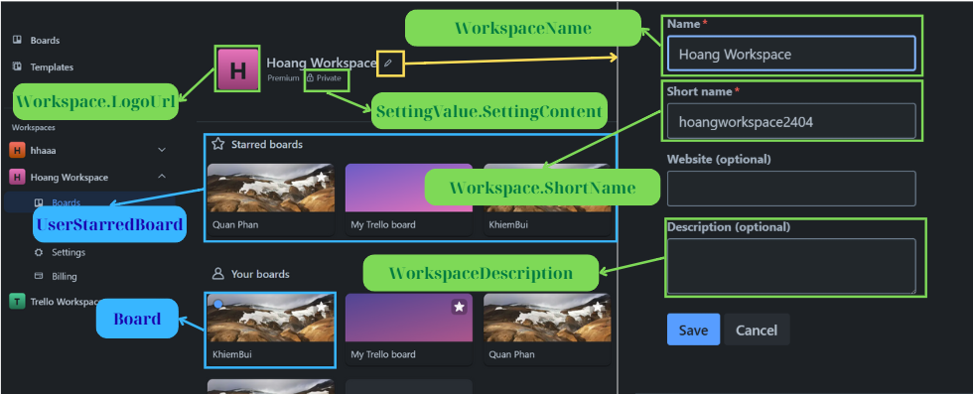
WORKSPACE DASHBOARD
Notes:
-- Get Workspace Name, SettingKey=‘workspacevisibility' and SettingValue
-- related to SettingKey of Workspace
WITH SettingValueForWorkspace AS (
SELECT
sv.Id as SettingValueId,
sv.OwnerId,
sk.Id,
sk.OwnerTypeId,
sk.KeyName,
so.DisplayValue
FROM SettingValue sv
JOIN SettingKey sk ON sk.Id = sv.SettingKeyId
LEFT JOIN SettingOption so ON sv.SettingContent= so.Id
AND sk.IsBoolean=0
JOIN OwnerType owt ON owt.Id = sk.OwnerTypeId
AND owt.OwnerTypeValue = 'workspace'
WHERE sk.KeyName = 'workspacevisibility'
)
SELECT
w.Id as WorkspaceId,
w.WorkspaceName,
svfw.DisplayValue as Visibility
FROM Workspace w
JOIN SettingValueForWorkspace svfw ON svfw.OwnerId = w.Id
WHERE w.Id = 2;
-- Get Starred Board of User from a specific Workspace
select
brd.Id,
brd.BoardName,
brd.BackgroundUrl
from
UserStarredBoard usb
join Board brd on brd.Id = usb.BoardId
and usb.UserId = 1
join Workspace wrs on wrs.Id = brd.WorkspaceId
and wrs.Id = 1
order by
usb.CreatedAt desc
-- Get "Your boards" section: Get Board belonging to Workspace
-- where User is also a Member of the Board
SELECT
w.Id as WorkspaceId,
b.Id as BoardId,
b.BoardName,
b.BackgroundUrl
FROM Board b
JOIN Members m ON m.OwnerId = b.Id
JOIN Workspace w ON w.Id = b.WorkspaceId
JOIN OwnerType owt ON owt.Id = m.OwnerTypeId
AND owt.OwnerTypeValue = 'board'
WHERE w.Id = 1 AND m.UserId=2

Slide 16
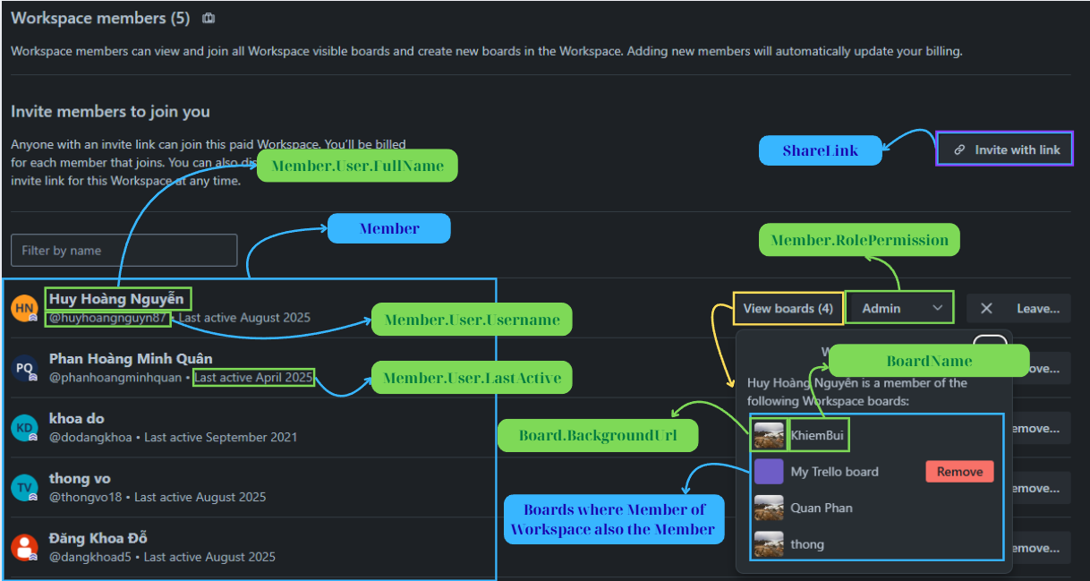
WORKSPACE MEMBER TAB
Notes:
-- Get all Members in Workspace, number of Board in Workspace that Member
-- participates in and corresponding RolePermissions in Workspace
WITH WorkspaceMembers AS (
SELECT
m.UserId,
m.RolePermissonId
FROM Members m
JOIN OwnerType owt ON owt.Id = m.OwnerTypeId
WHERE owt.OwnerTypeValue = 'workspace'
AND m.OwnerId = 1
),
BoardInWorkspace AS (
SELECT
b.Id AS BoardId,
b.BoardName as BoardName,
b.BackgroundUrl
FROM Board b
WHERE b.WorkspaceId = 2
),
BoardMembers AS (
SELECT
m.UserId,
m.OwnerId AS BoardId
FROM Members m
JOIN OwnerType owt ON owt.Id = m.OwnerTypeId
WHERE owt.OwnerTypeValue = 'board'
)
SELECT
u.Id as UserId,
u.Username,
u.Email as UserEmail,
u.LastActive,
p.PermissionName as Permission,
COUNT(bm.BoardId) AS NumBoardsJoined,
STRING_AGG(biw.BoardName, ', ') AS JoinedBoardNames,
STRING_AGG(biw.BackgroundUrl, ', ') AS JoinedBoardBackground
FROM WorkspaceMembers wm
LEFT JOIN BoardMembers bm ON bm.UserId = wm.UserId
JOIN BoardInWorkspace biw ON bm.BoardId = biw.BoardId
JOIN Users u ON wm.UserId = u.Id
JOIN RolePermission p ON wm.RolePermissonId = p.Id
GROUP BY
u.Id,
u.Username,
u.Email,
u.LastActive,
p.PermissionName;
-- Get sharelink of workspace and status of sharelink
SELECT
sl.Id as ShareLinkId,
sl.ShareLinkToken,
sl.ShareLinkStatus,
p.PermissionName
FROM ShareLink sl
JOIN Workspace w ON w.Id = sl.OwnerId
JOIN OwnerType owt on owt.Id=sl.OwnerTypeId AND owt.OwnerTypeValue='workspace'
JOIN RolePermission p ON sl.RolePermissonId = p.Id
WHERE w.Id = 1;

Slide 17
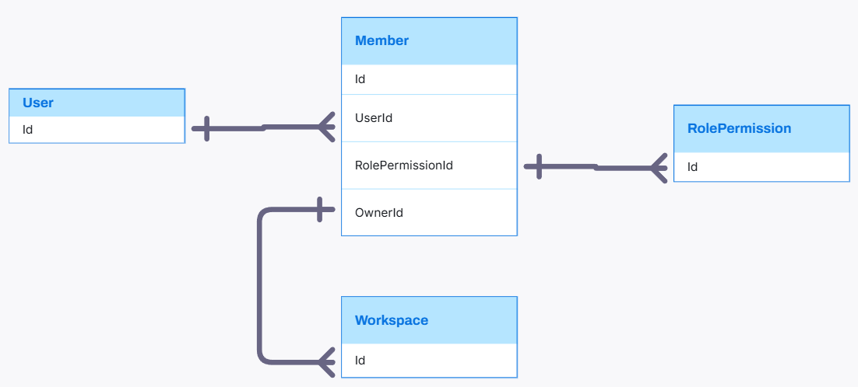
WORKSPACE MEMBER TAB RELATIONSHIP

Slide 18
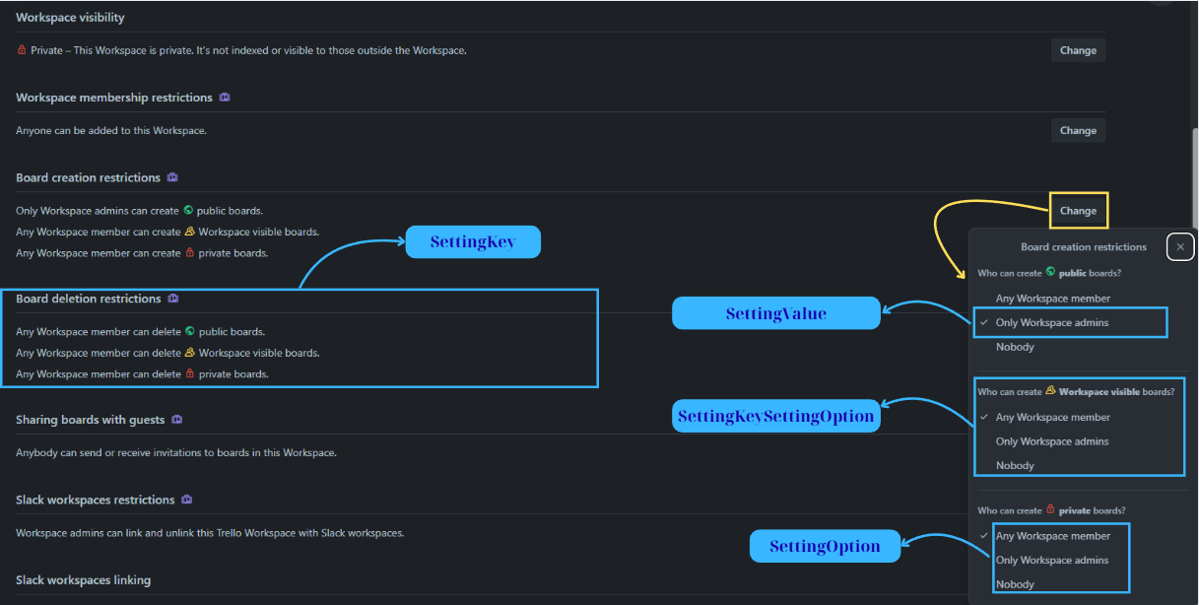
WORKSPACE SETTING TAB
Notes:
-- SettingKey and corresponding SettingOption for Workspace
SELECT
sk.KeyName,
so.DisplayValue
FROM SettingKey sk
JOIN SettingKeySettingOption skso ON skso.SettingKeyId = sk.Id
JOIN SettingOption so ON so.Id = skso.SettingOptionId
JOIN OwnerType owt ON owt.Id = sk.OwnerTypeId
AND owt.OwnerTypeValue = 'workspace';
-- SettingValue of specific Workspace
SELECT
sk.KeyName,
sk.OwnerTypeId,
sv.SettingContent,
so.DisplayValue
FROM SettingValue sv
JOIN SettingKey sk ON sk.Id = sv.SettingKeyId
JOIN OwnerType owt on owt.Id=sk.OwnerTypeId
LEFT JOIN SettingOption so ON so.Id = sv.SettingContent AND sk.IsBoolean=0
WHERE sv.OwnerId = 1 AND owt.OwnerTypeValue='workspace';

Slide 19
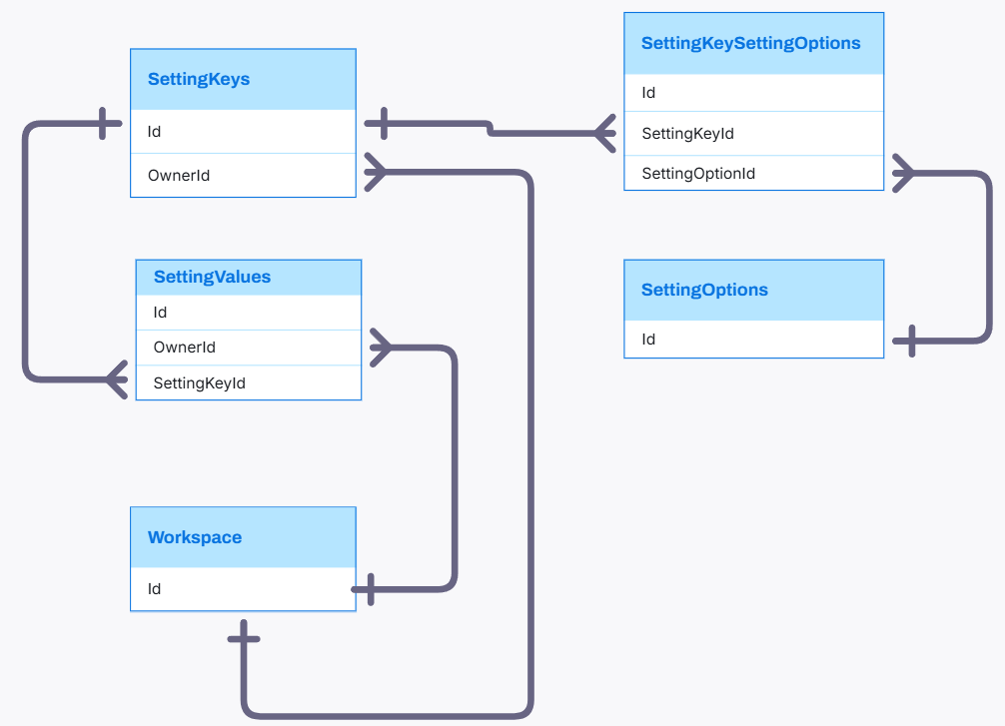
WORKSPACE SETTING TAB RELATIONSHIP

Slide 20
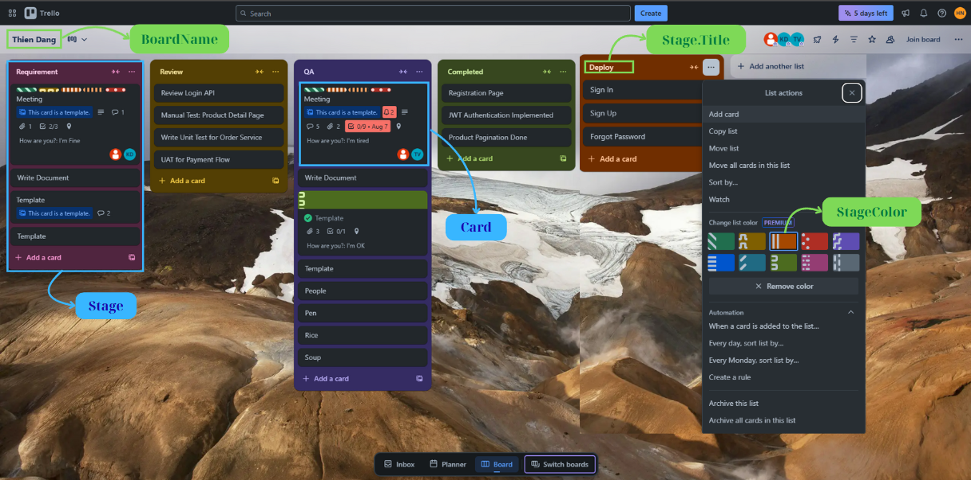
BOARD DETAIL
Notes:
-- Get All Stage and Card relate to board
CREATE OR ALTER PROCEDURE GetBoardStagesAndCards
@BoardId INT
AS
BEGIN
SET NOCOUNT ON;
WITH MemberAgg AS (
SELECT
m.OwnerId AS CardId,
STRING_AGG(CAST(u.Id AS VARCHAR(20)), ', ') AS AssignedMemberId,
STRING_AGG(u.Username, ', ') WITHIN GROUP (ORDER BY u.Username) AS AssignedMembers
FROM Members m
JOIN OwnerType owt ON owt.Id = m.OwnerTypeId
AND owt.OwnerTypeValue = 'CARD'
JOIN Users u ON u.Id = m.UserId
GROUP BY m.OwnerId
),
AttachmentAgg AS (
SELECT
tch.CardId,
COUNT(tch.Id) AS AttachmentCount
FROM Attachment tch
GROUP BY tch.CardId
),
CommentAgg AS (
SELECT
cmm.CardId,
COUNT(cmm.Id) AS CommentCount
FROM Comment cmm
GROUP BY cmm.CardId
),
LabelAgg AS (
SELECT
cl.CardId,
STRING_AGG(CAST(l.Id AS VARCHAR(20)), ', ') WITHIN GROUP (ORDER BY l.Id) AS LabelId,
STRING_AGG(l.Title, ', ') AS LabelTitle
FROM CardLabel cl
JOIN Labels l ON l.Id = cl.LabelId
GROUP BY cl.CardId
)
SELECT
s.Id AS StageId,
s.Title AS StageTitle,
s.StageStatus,
s.Position,
c.Id AS CardId,
c.Title AS CardTitle,
c.CardDescription,
c.StartDate,
c.DueDate,
c.CardLocation,
la.LabelId,
la.LabelTitle,
ma.AssignedMemberId,
ma.AssignedMembers,
aa.AttachmentCount,
ca.CommentCount
FROM Stage s
LEFT JOIN Cards c ON c.StageId = s.Id
LEFT JOIN MemberAgg ma ON c.Id = ma.CardId
LEFT JOIN LabelAgg la ON c.Id = la.CardId
LEFT JOIN AttachmentAgg aa ON c.Id = aa.CardId
LEFT JOIN CommentAgg ca ON c.Id = ca.CardId
WHERE s.BoardId = @BoardId
ORDER BY s.Position, c.Id;
END;
GO
EXEC GetBoardStagesAndCards @BoardId = 1;

Slide 21
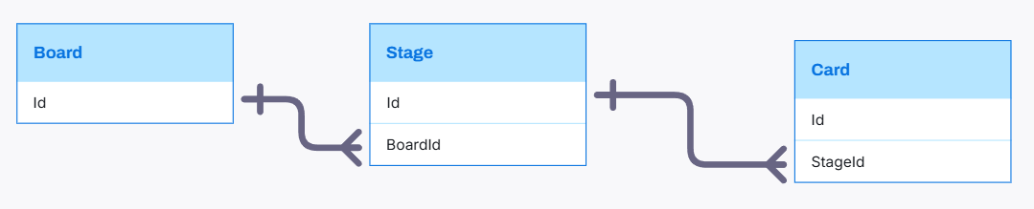
BOARD DETAIL RELATIONSHIP

Slide 22

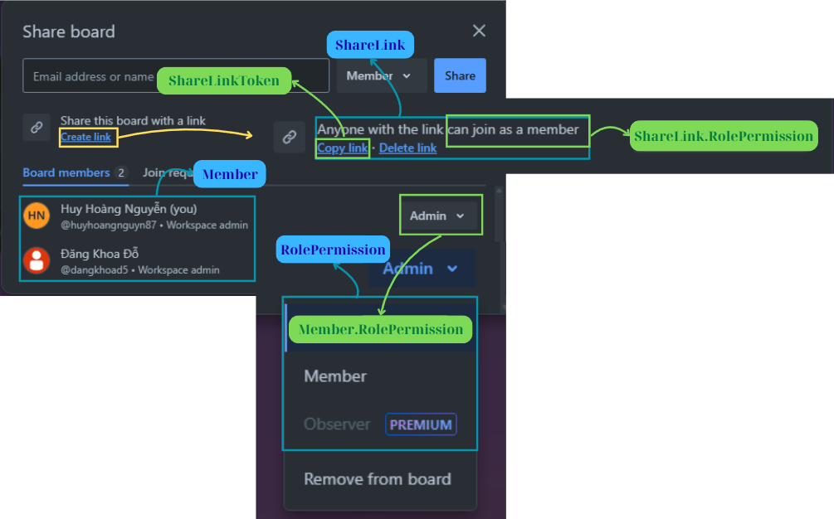
BOARD SHARE
Notes:
--Get all Members of Board and their RolePermissions
SELECT
m.Id,
u.Username,
p.PermissionName
FROM Members m
JOIN Board b ON b.Id = m.OwnerId
JOIN RolePermission p ON p.Id = m.RolePermissonId
JOIN Users u ON u.Id = m.UserId
WHERE b.Id = 1;
-- Get ShareLink relate to Board select srl.Id as ShareLinkId, srl.ShareLinkStatus as ShareToken, srl.ShareLinkStatus
from ShareLink srl
JOIN OwnerType owt on owt.Id=srl.OwnerTypeId AND owt.OwnerTypeValue='board'
where srl.OwnerId=1 and srl.ShareLinkStatus=1

Slide 23
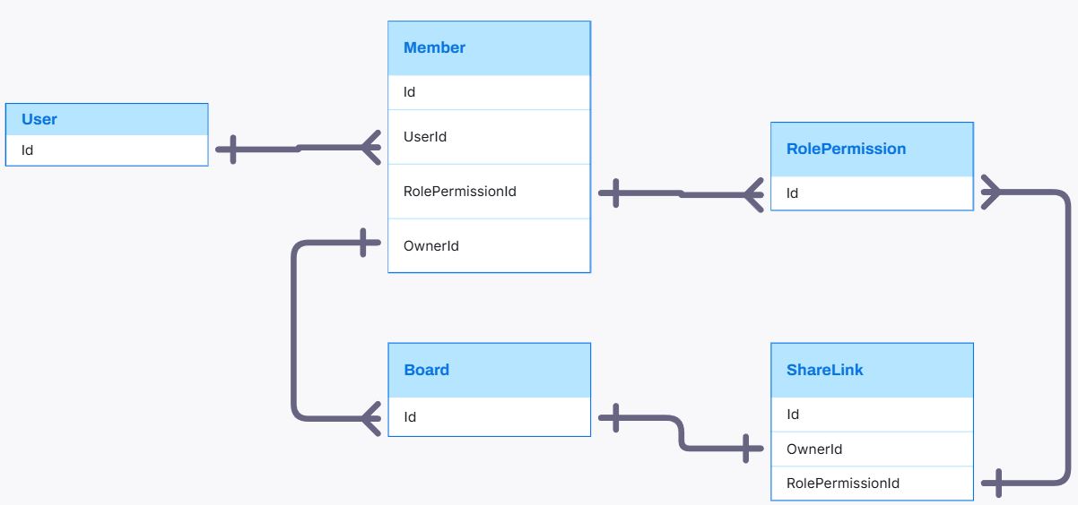
BOARD SHARE RELATIONSHIP

Slide 24
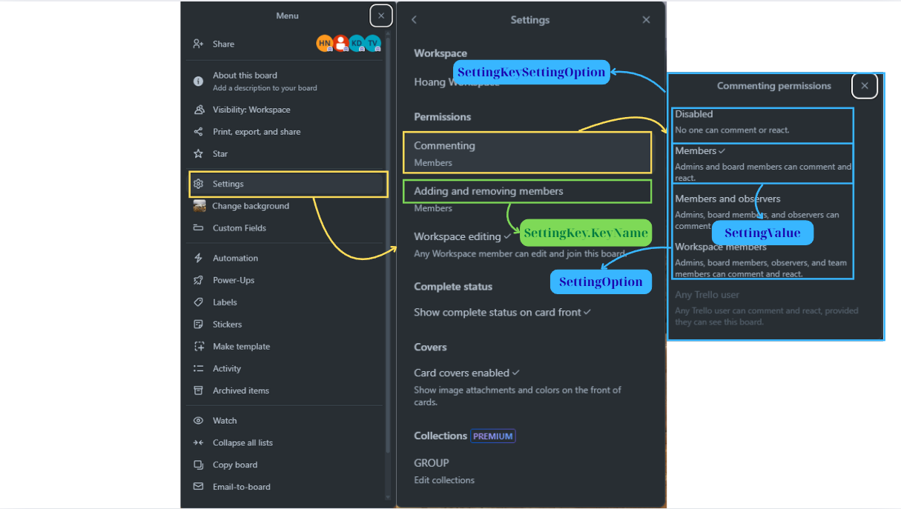
BOARD SETTING
Notes:
-- SettingKey and corresponding SettingOption for Board
SELECT
sk.Id as SettingKeyId,
sk.KeyName,
sk.OwnerTypeId,
so.DisplayValue
FROM SettingKey sk
JOIN SettingKeySettingOption skso ON skso.SettingKeyId = sk.Id
JOIN OwnerType owt ON owt.Id = sk.OwnerTypeId
AND owt.OwnerTypeValue = 'board'
LEFT JOIN SettingOption so ON so.Id = skso.SettingOptionId
-- SettingValue corresponding to Board
SELECT
sv.Id as SettingValueId,
sv.OwnerId,
sk.KeyName,
sk.IsBoolean,
owt.OwnerTypeValue,
sv.SettingContent as SettingValue,
so.DisplayValue
FROM SettingValue sv
JOIN SettingKey sk ON sk.Id = sv.SettingKeyId
JOIN OwnerType owt ON owt.Id = sk.OwnerTypeId
AND owt.OwnerTypeValue = 'board'
LEFT JOIN SettingOption so ON so.Id = sv.SettingContent and sk.IsBoolean=0
WHERE sv.OwnerId = 1;

Slide 25
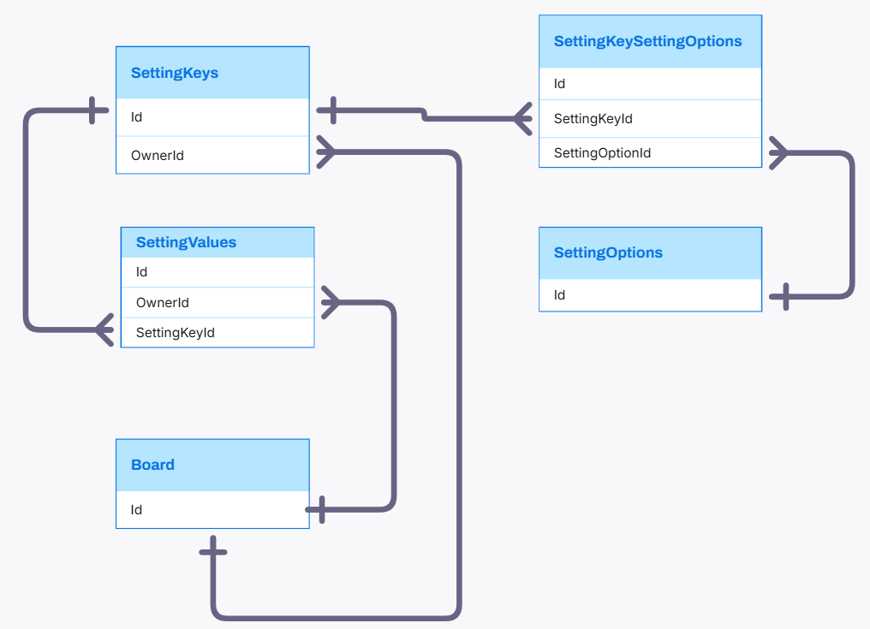
BOARD SETTING RELATIONSHIP

Slide 26
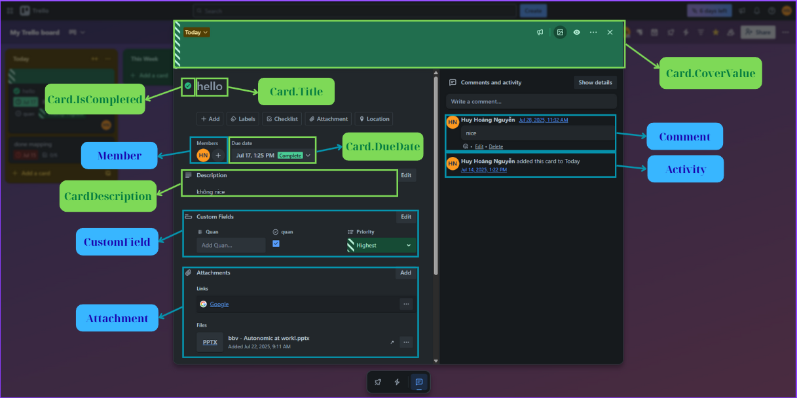
CARD DETAIL
Notes:
-- Get Card Detail and Related Information
CREATE OR ALTER PROCEDURE GetCardDetail
@CardId INT
AS
BEGIN
SET NOCOUNT ON;
-- 1. Card cơ bản
SELECT
c.Id AS CardId,
c.Title,
c.CardDescription,
c.StartDate,
c.DueDate,
c.CardLocation,
c.CreatedAt,
c.CreatedBy,
c.UpdatedAt,
c.UpdatedBy
FROM Cards c
WHERE c.Id = @CardId;
-- 2. Members
SELECT
u.Id AS UserId,
u.Username
FROM Members m
JOIN OwnerType owt ON owt.Id = m.OwnerTypeId
AND owt.OwnerTypeValue = 'CARD'
JOIN Users u ON u.Id = m.UserId
WHERE m.OwnerId = @CardId;
-- 3. Labels
SELECT
l.Id AS LabelId,
l.Title AS LabelTitle
FROM CardLabel cl
JOIN Labels l ON l.Id = cl.LabelId
WHERE cl.CardId = @CardId;
-- 4. Attachments
SELECT
a.Id AS AttachmentId,
a.AttachmentName,
a.AttachmentPath,
a.CreatedAt,
a.CreatedBy
FROM Attachment a
WHERE a.CardId = @CardId;
-- 5. Custom fields + values
SELECT
cf.Id AS CustomFieldId,
cf.Title,
cf.Position,
fv.FieldValue
FROM CustomField cf
JOIN FieldValue fv ON fv.CustomFieldId = cf.Id
WHERE fv.CardId = @CardId;
-- 6. Comments + reactions
SELECT
cm.Id AS CommentId,
cm.Content,
cm.CreatedAt,
cm.CreatedBy
FROM Comment cm
WHERE cm.CardId = @CardId;
SELECT
cmr.ReactionId AS ReactionId,
cmr.CreatedBy,
COUNT(*) as ReactionCount
FROM CommentReaction cmr
JOIN Comment cm ON cm.Id = cmr.CommentId
JOIN Reaction rct on rct.Id=cmr.ReactionId
WHERE cm.CardId = @CardId
GROUP BY cmr.ReactionId,cmr.CreatedBy
-- 7. Activities
SELECT
act.Id AS ActivityId,
act.ActivityDescription,
act.CreatedAt,
usr.FullName,
usr.PictureUrl
FROM Activity act
JOIN OwnerType owt on owt.Id=act.OwnerTypeId
JOIN Users usr on usr.Id=act.UserId
WHERE act.OwnerId = @CardId;
END;
GO
EXEC GetCardDetail @CardId=1

Slide 27
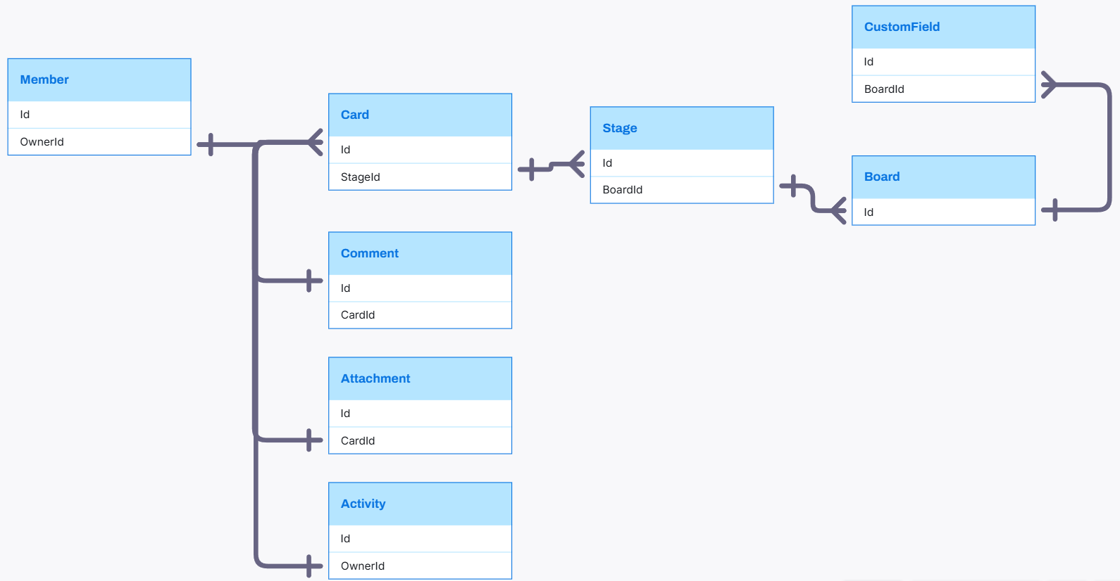
CARD DETAIL RELATIONSHIP

Slide 28
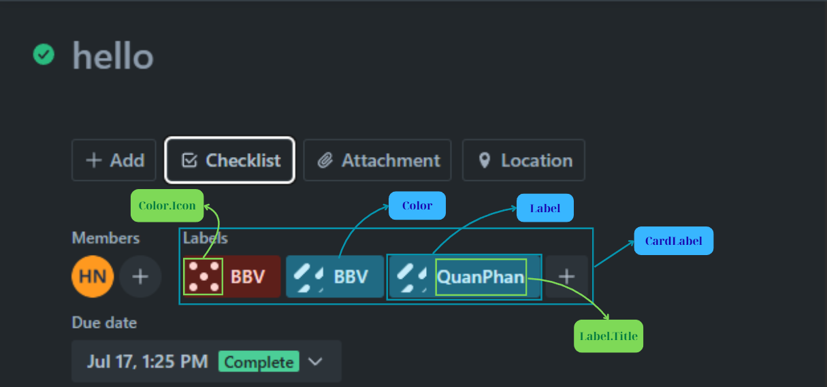
CARD LABEL
Notes:
-- Get Label and Color of specific Card
SELECT
l.Id AS LabelId,
l.Title AS LabelTitle,
clr.ColorHex as Color
FROM CardLabel cl
JOIN Labels l ON l.Id = cl.LabelId
JOIN Color clr ON clr.Id=l.ColorId
WHERE cl.CardId = 1;

Slide 29
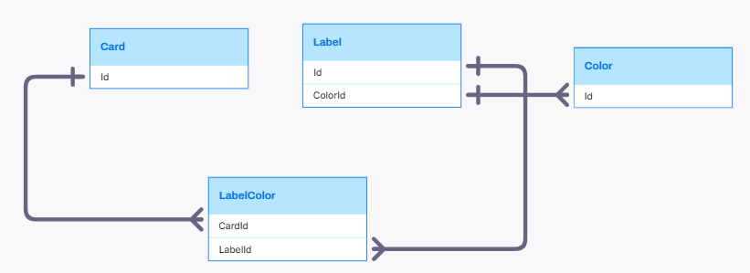
LABEL RELATIONSHIP

Slide 30
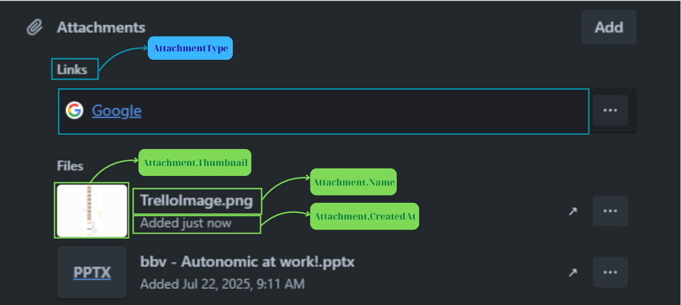
CARD ATTACHMENT
Notes:
-- Get Attachment of specific Card
SELECT
atm.Id AS AttachmentId,
atm.AttachmentName,
atm.AttachmentPath,
atm.CreatedAt,
atm.CreatedBy,
atm.Thumbnail,
att.DisplayValue
FROM Attachment atm
JOIN AttachmentType att on att.Id=atm.AttachmentTypeId
WHERE atm.CardId = 1;

Slide 31
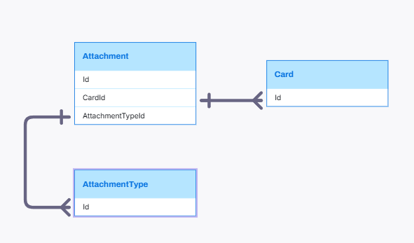
CARD ATTACHMENT RELATIONSHIP

Slide 32
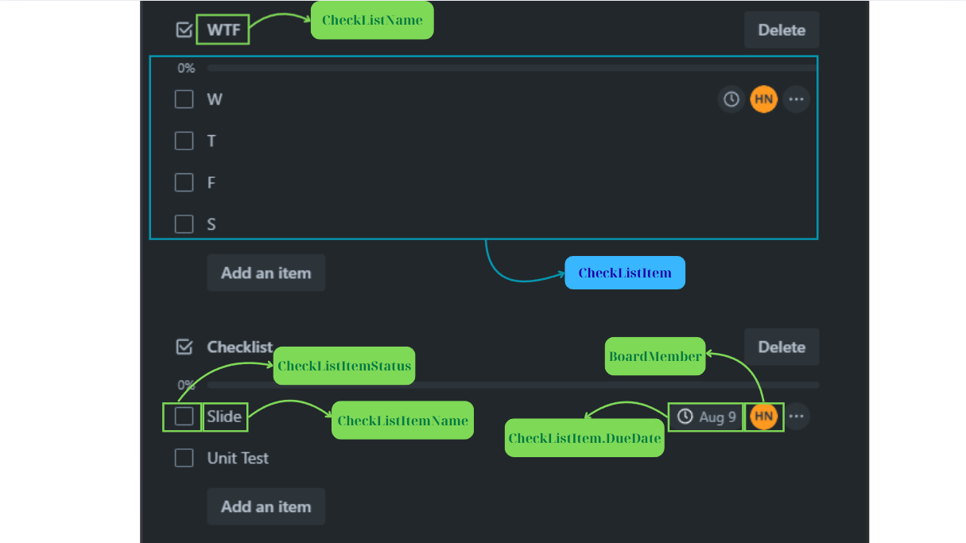
CARD CHECKLIST
Notes:
-- Query all CheckListItem in CheckList of specific Card
SELECT
cli.CheckListItemName AS ItemName,
cli.DueDate AS DueDate,
m.Id AS MemberId,
u.Username AS Username,
cli.CheckListItemStatus AS IsCompleteItem,
cli.CheckListId AS CheckListID
FROM CheckListItem cli
JOIN CheckList cl ON cl.Id = cli.CheckListId
LEFT JOIN Members m ON m.Id = cli.MemberId
LEFT JOIN Users u ON u.Id = m.UserId
WHERE cl.CardId = 1;

Slide 33
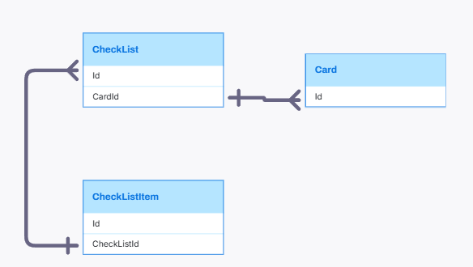
CARD CHECKLIST RELATIONSHIP

Slide 34
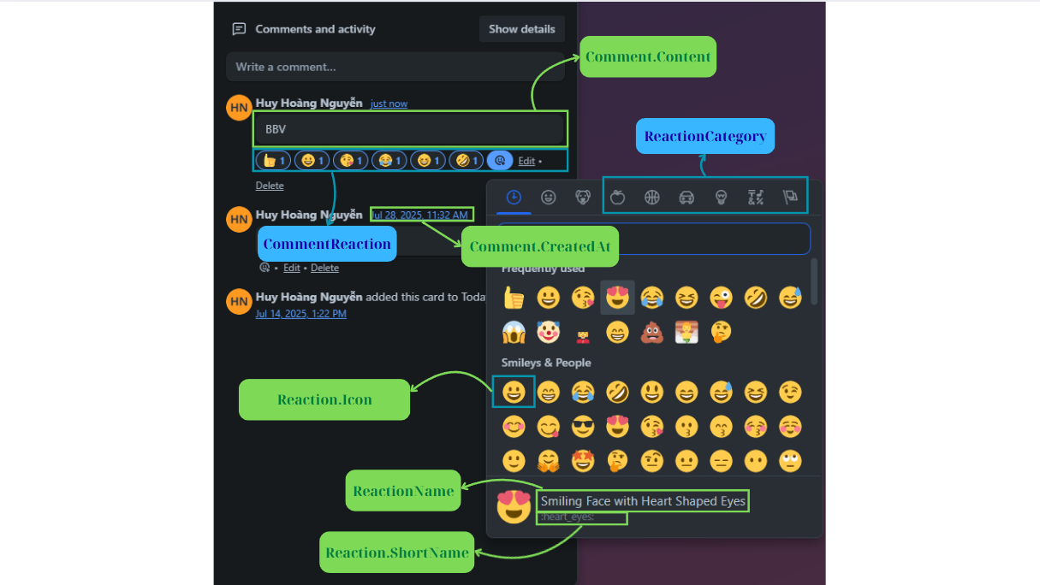
CARD COMMENT
Notes:
-- Query Comment realate to Card
SELECT
comment.Content,
comment.CreatedAt
FROM Comment comment
JOIN Cards c ON c.Id = comment.CardId
WHERE c.Id = 1;
-- Get all Reaction of Comment in specific Card
SELECT
cm.Id AS CommentId,
cmr.ReactionId,
rct.Icon,
COUNT(*) AS ReactionCount,
STRING_AGG(u.Username, ', ') WITHIN GROUP (ORDER BY u.Username) AS ReactedUsers
FROM CommentReaction cmr
JOIN Comment cm ON cm.Id = cmr.CommentId
JOIN Reaction rct ON rct.Id = cmr.ReactionId
JOIN Users u ON u.Id = cmr.CreatedBy
WHERE cm.CardId = 1
GROUP BY cm.Id, cmr.ReactionId, rct.Icon
ORDER BY cm.Id, rct.Icon;

Slide 35
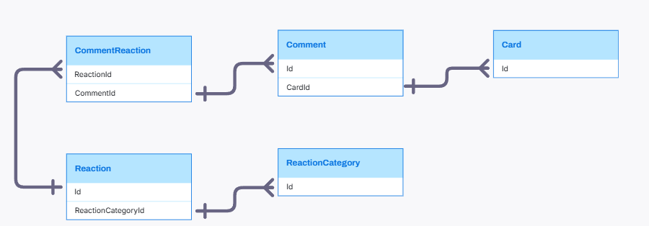
CARD COMMENT RELATIONSHIP

Slide 36
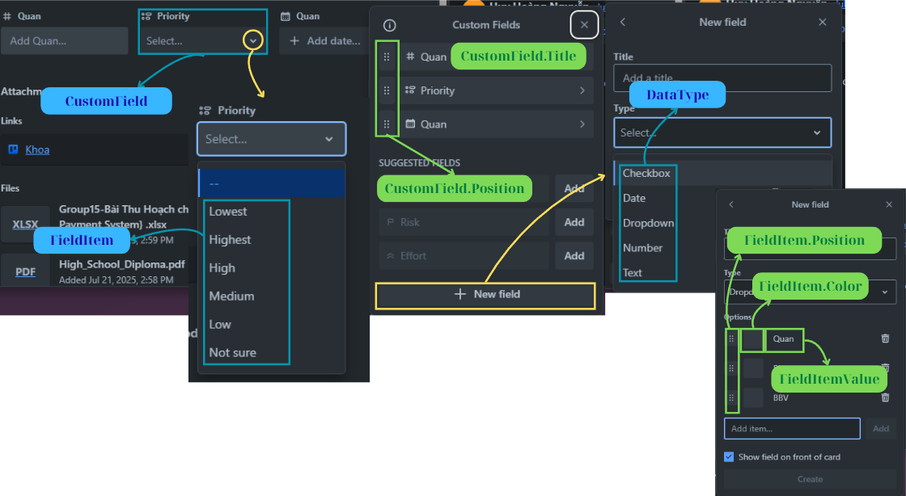
CUSTOM FIELD
Notes:
-- Query All CustomField, FieldItem of Board (store procedure)
CREATE OR ALTER PROCEDURE sp_GetAllCustomFieldAndFieldValue
@BoardId INT
AS
BEGIN
-- Query all CustomField and FieldItem if have dropdown CustomField been add to Board
SELECT
cf.Id,
cf.Title,
cf.Position,
dtt.DataTypeValue
FROM CustomField cf
JOIN DataType dtt ON dtt.Id=cf.DataTypeId
WHERE cf.BoardId = @BoardId;
SELECT
cf.Id as CustomFieldId,
fi.Id as FieldItemId,
fi.FieldItemValue AS FieldItemValue,
fi.Position AS FieldItemPriority,
c.ColorName AS Color,
c.Icon AS ColorIcon
FROM FieldItem fi
JOIN CustomField cf ON cf.Id = fi.CustomFieldId
JOIN DataType dtt on dtt.Id=cf.DataTypeId and dtt.DataTypeValue='dropdown'
LEFT JOIN Color c ON fi.ColorId=c.Id
WHERE cf.BoardId = @BoardId;
END;
GO
EXEC sp_GetAllCustomFieldAndFieldValue @BoardId = 4;
-- Query CustomField and value of all Cards in Board
DECLARE @cols NVARCHAR(MAX)
DECLARE @query NVARCHAR(MAX)
-- Lấy danh sách cột pivot theo Position
SELECT @cols = STUFF((
SELECT ',' + QUOTENAME(Title)
FROM (
SELECT cf.Title, cf.Position
FROM CustomField cf
WHERE cf.BoardId = 1
GROUP BY cf.Title, cf.Position
) AS x
ORDER BY x.Position
FOR XML PATH(''), TYPE).value('.', 'NVARCHAR(MAX)'), 1, 1, '')
SET @query = '
SELECT
CardId,
CardTitle,
' + @cols + '
FROM (
SELECT
c.Id AS CardId,
c.Title AS CardTitle,
cf.Title AS CustomFieldTitle,
CASE
WHEN cf.DataTypeId = 2 THEN fi.FieldItemValue
ELSE fv.FieldValue
END AS FieldDisplayValue
FROM Cards c
INNER JOIN Stage s ON c.StageId = s.Id
INNER JOIN Board b ON s.BoardId = b.Id
LEFT JOIN FieldValue fv ON c.Id = fv.CardId
LEFT JOIN CustomField cf ON fv.CustomFieldId = cf.Id AND cf.BoardId = 1
LEFT JOIN FieldItem fi ON TRY_CAST(fv.FieldValue AS INT) = fi.Id AND cf.DataTypeId=2
WHERE b.Id = 1
) AS SourceTable
PIVOT (
MAX(FieldDisplayValue)
FOR CustomFieldTitle IN (' + @cols + ')
) AS PivotTable
ORDER BY CardId;
'
EXEC(@query)

Slide 37
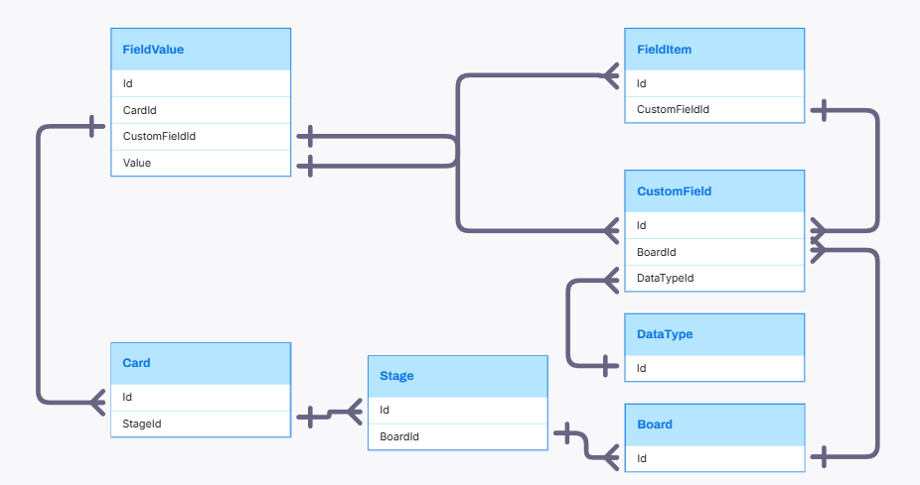
CUSTOM FIELD RELATIONSHIP

Slide 38
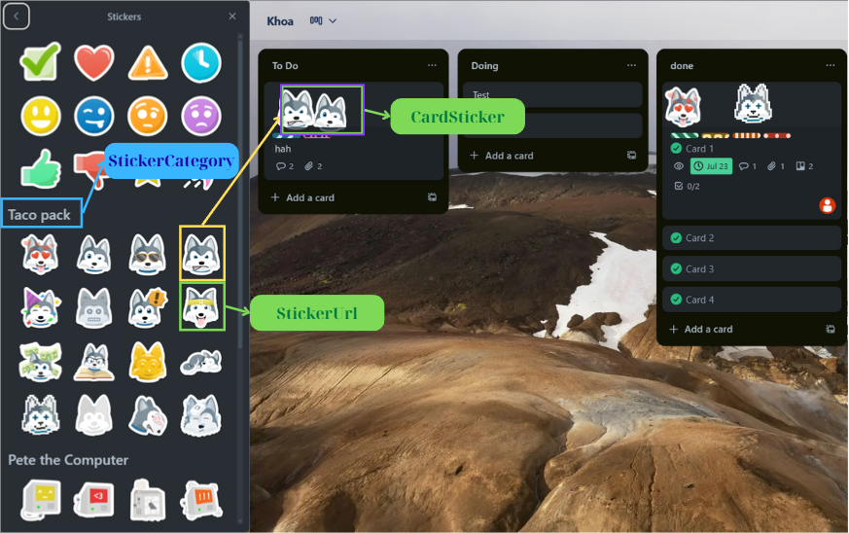
CARD STICKER
Notes:
-- Query Sticker of all Card in specific Board
SELECT
sta.BoardId AS BoardId,
s.StickerName AS StickerName,
s.StickerUrl,
cs.CardId,
cs.PositionX AS StickerPositionXAxis,
cs.PositionY AS StickerPositionYAxis,
cs.IndexZ AS StickerPositionZIndex
FROM Sticker s
JOIN CardSticker cs ON cs.StickerId = s.Id
JOIN Cards c ON c.Id = cs.CardId
JOIN Stage sta ON sta.Id = c.StageId
WHERE sta.BoardId = 1;

Slide 39
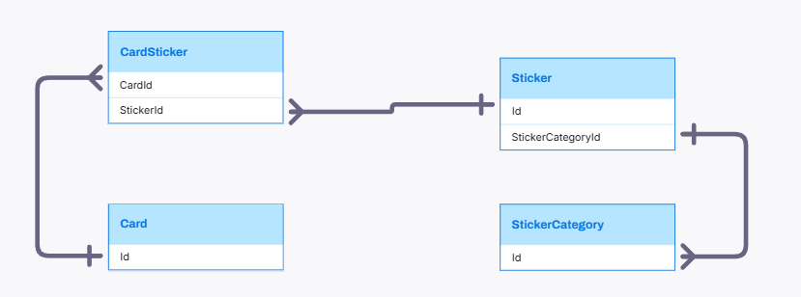
CARD STICKER RELATIONSHIP

Slide 40

Q&A

