Slide 2
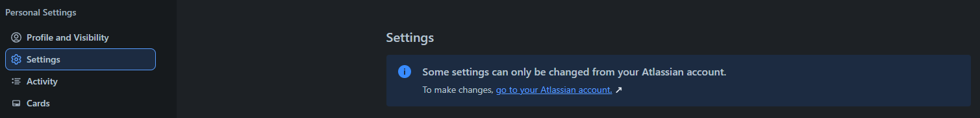



Key Functionalities of Trello
bbv Software Services AG | 21/07/2025

Slide 3
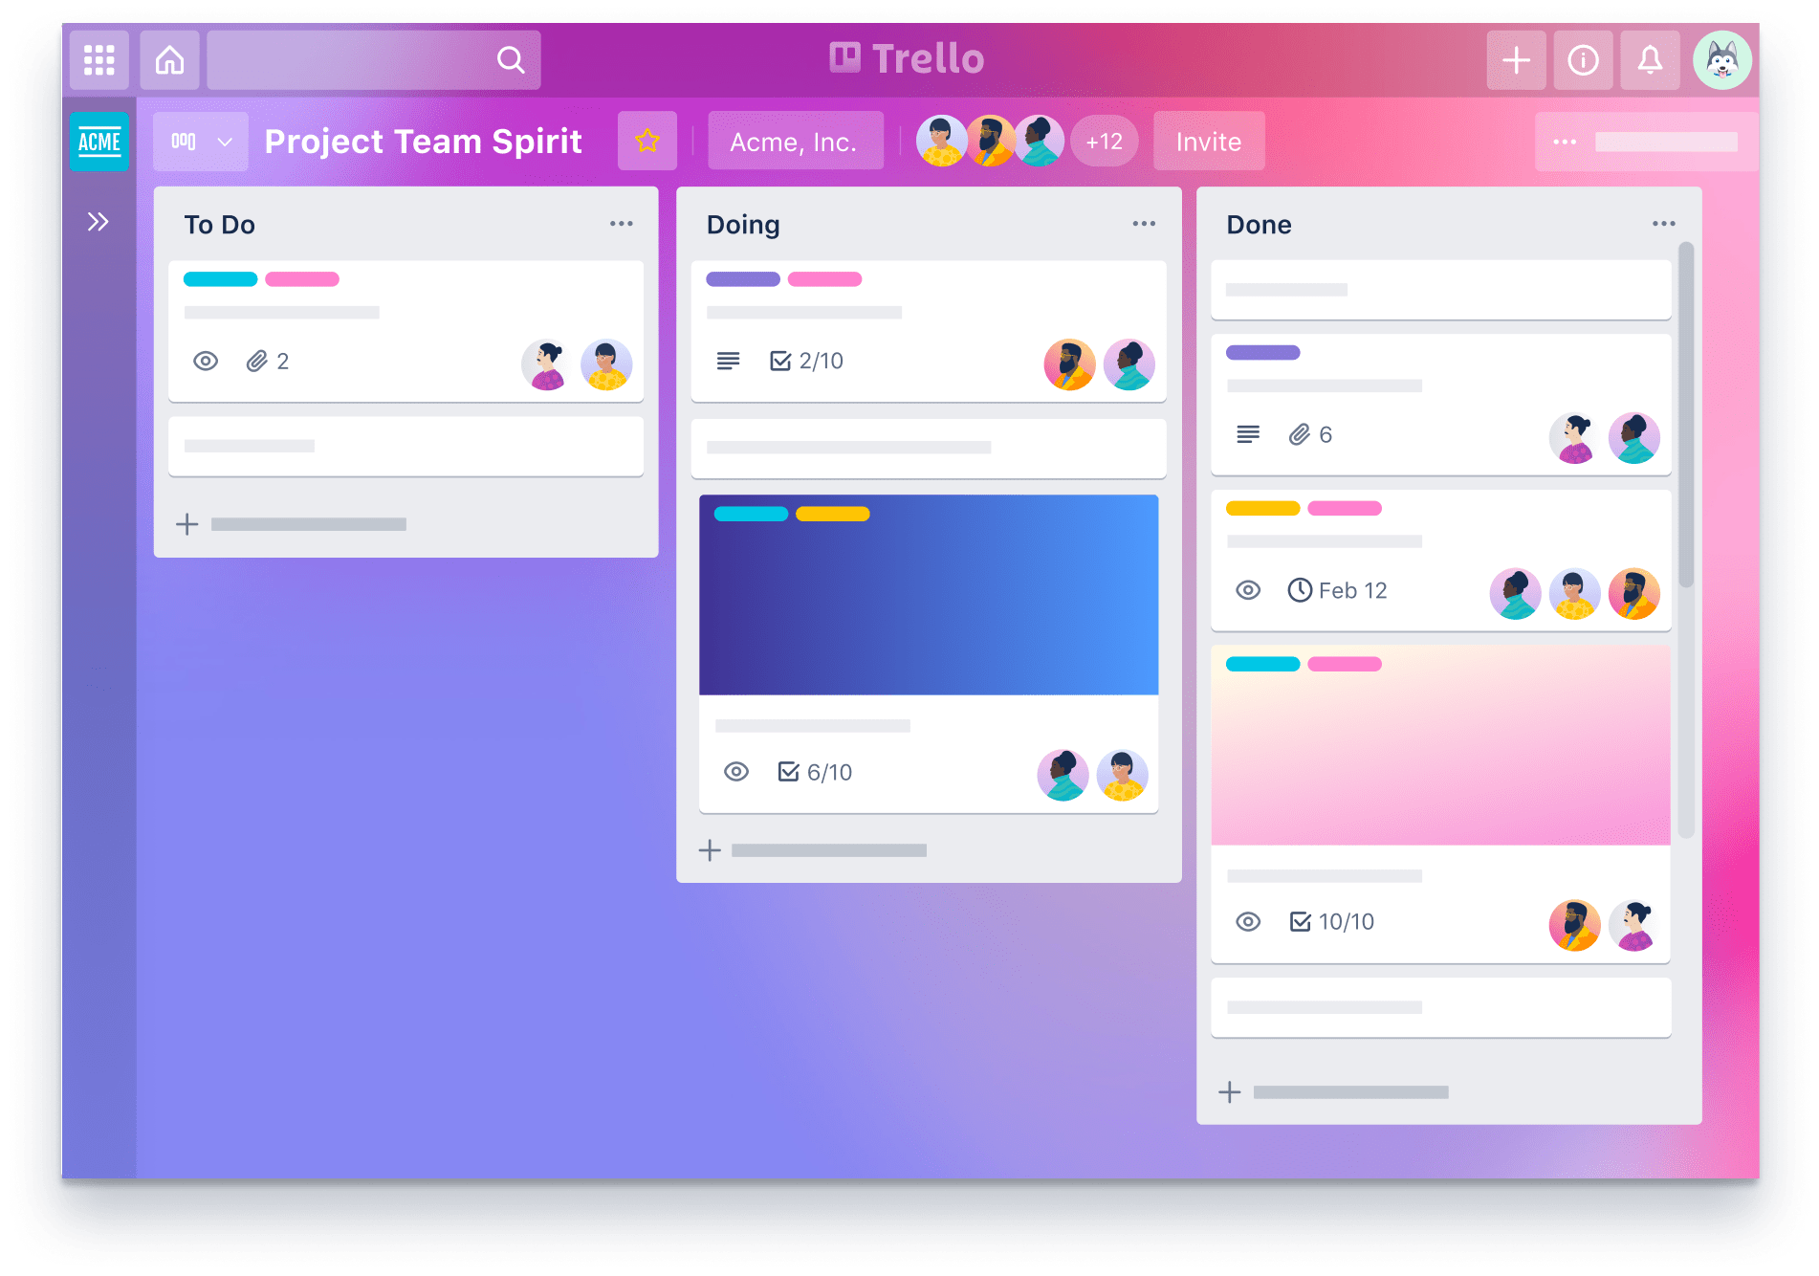
KEY FUNCTION
Create and manage Workspace and Board
Manage Template and Template Category
Manage Member Workspace, Boards, Cards
Manage Setting of Workspaces, Boards, User
Manage Board Custom Field and Custom Field Item
Comment and Activity for Card
Card Label
Card Sticker

Slide 4
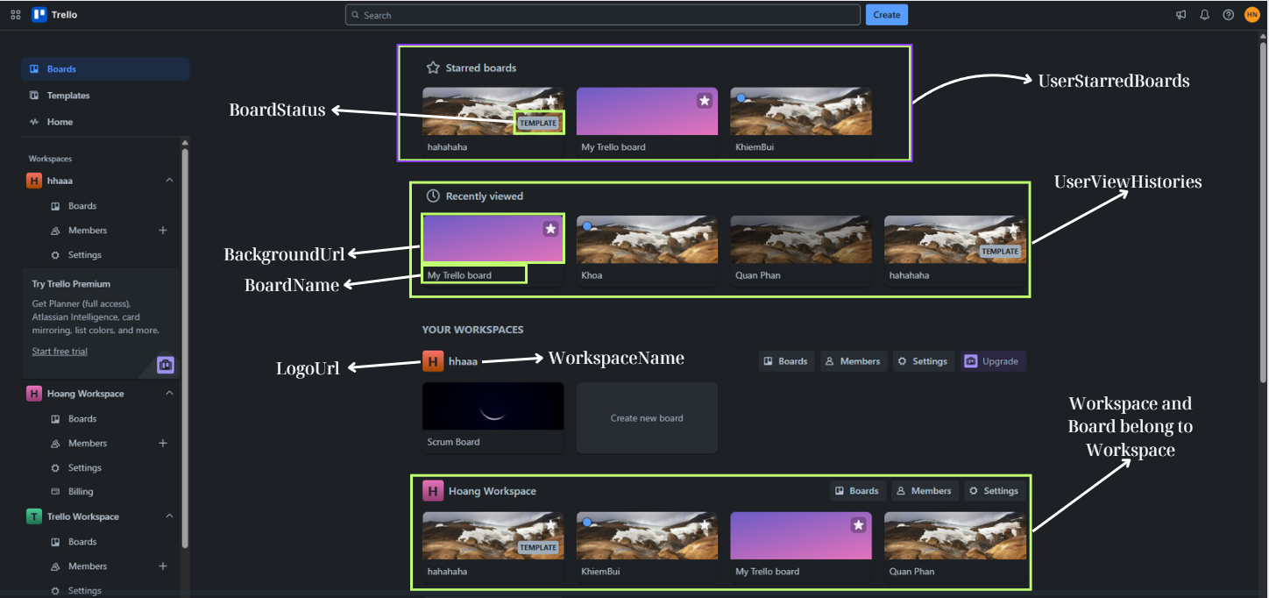
BOARDS TAB SCREEN
Notes:
--Query Starred Board by User
select b.Id,b.BoardName,b.BackgroundUrl
from UserStarredBoards usb
join Boards b on b.Id=usb.BoardId
where usb.UserId=1
order by CreatedAt desc
--Query 4 recently accessed Boards by user
SELECT TOP 4
b.Id as BoardId,
b.BoardName,
b.BackgroundUrl
FROM Boards b
JOIN UserViewHistories uvh ON uvh.OwnerId = b.Id
JOIN Categories c on c.Id=uvh.CategoryId and c.CategoryName='Board'
JOIN Users u ON u.Id = uvh.UserId
WHERE u.Id = 1 -- userId
ORDER BY uvh.AccessedAt DESC;
--Query all Workspaces where User is a Member
SELECT
w.Id,
w.WorkspaceName
FROM Workspaces w
JOIN Members m ON m.OwnerId = w.Id
JOIN Categories ot ON m.CategoryId = ot.Id
WHERE ot.CategoryName = 'WORKSPACE'
AND m.UserId = 1;
Query all Workspaces where User is a Member. For each workspace, get all Boards where User is also a Member
SELECT
w.Id AS WorkspaceId,
w.WorkspaceName,
w.LogoUrl AS WorkspaceIcon,
b.Id AS BoardId,
b.BoardName AS BoardName,
b.BoardDescription,
b.BackgroundUrl,
b.CreatedAt
FROM Workspaces w
-- Find Workspaces where User is a Member
JOIN Members mw ON mw.OwnerId = w.Id
JOIN Categories otw ON otw.Id = mw.CategoryId
AND otw.CategoryName = 'WORKSPACE'
-- Find Boards corresponding to Workspace where User is also a Member
JOIN Boards b ON b.WorkspaceId = w.Id
JOIN Members mb ON mb.OwnerId = b.Id
JOIN Categories otb ON otb.Id = mb.CategoryId
AND otb.CategoryName = 'BOARD'
WHERE mb.UserId = 1

Slide 5
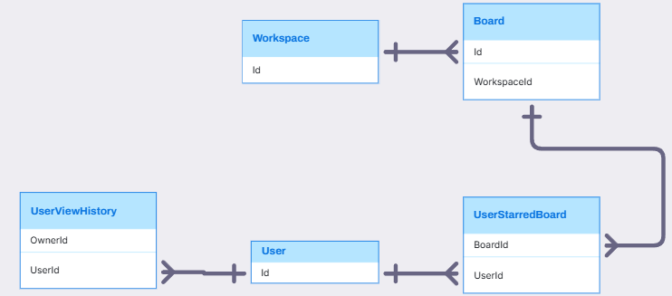
BOARDS TAB SCREEN RELATIONSHIP

Slide 6
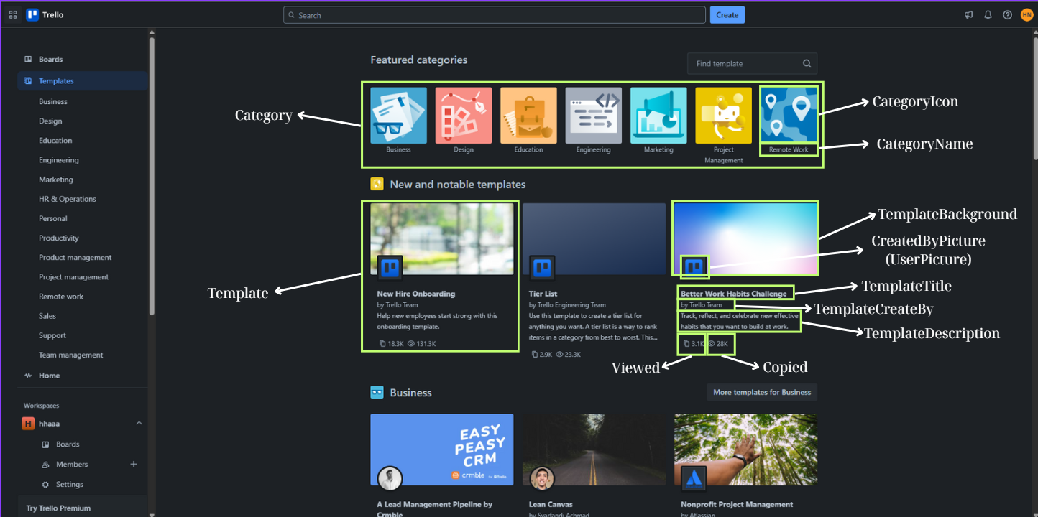
TEMPLATES TAB SCREEN
Notes:
-- Get top 7 template categories
SELECT TOP 7
c.Id,c.CategoryName,c.Icon
FROM Categories c
JOIN CategoryTypes ct ON ct.Id=c.CategoryTypeId AND ct.Id=6
-- Get New and notable templates
SELECT
t.Id as TemplateId,
t.Title,
t.BackgroundUrl,
t.CreatedAt,
t.CreatedBy,
t.Copied,
t.Viewed,
t.TemplateDescription
FROM Templates t
ORDER BY
t.CreatedAt DESC,
t.Viewed DESC,
t.Copied DESC;

Slide 7
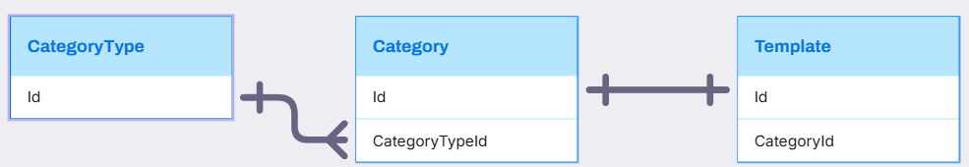
TEMPLATES TAB SCREEN REALTIONSHIP

Slide 8
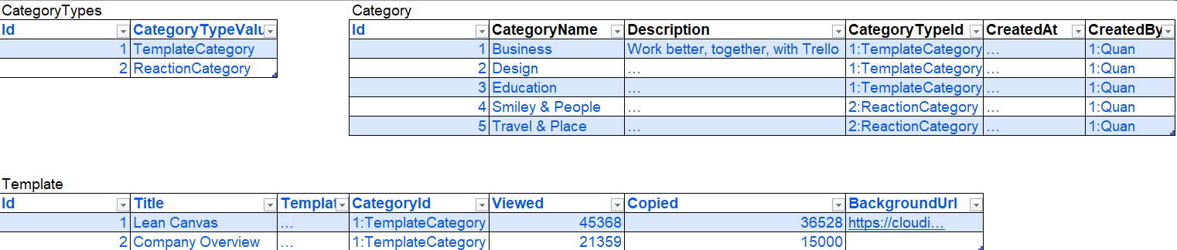
TEMPLATES TAB SCREEN SAMPLE DATA

Slide 9
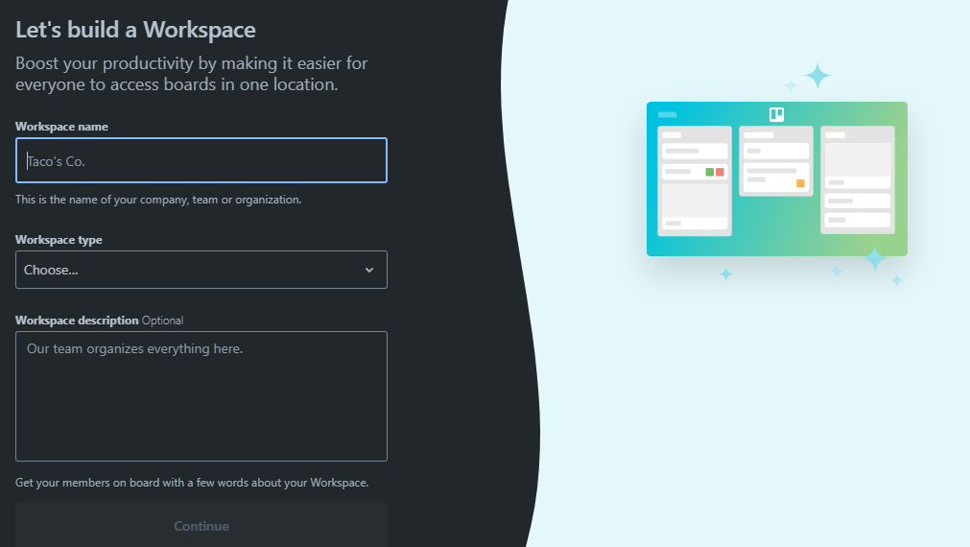
CREATE WORKSPACE IN TRELLO SYSTEM
Workspace Information
Notes:
9. Insert data into Workspaces

Slide 10
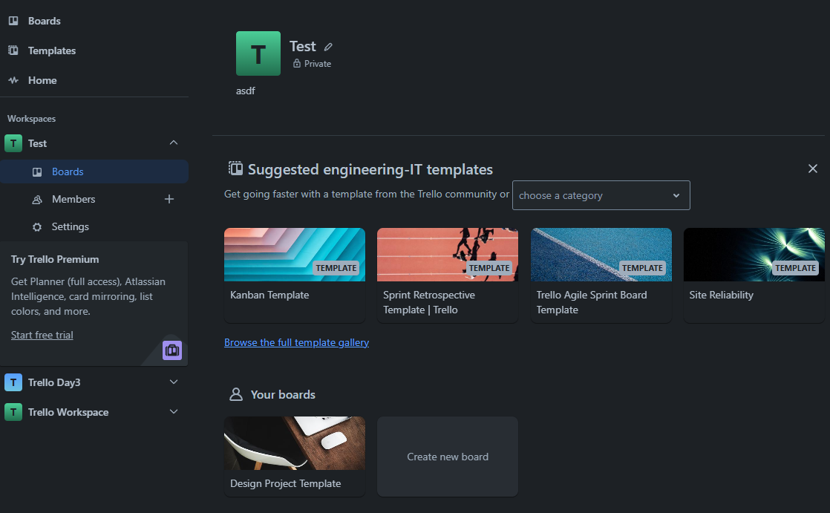
WORKSPACE IN TRELLO SYSTEM
Click here
Template
Board
Notes:
10. Get Workspace Name, SettingKey='visibility' and SettingValue related to SettingKeys of Workspace
11. Get 4 suggested Boards by Template Category Type with status as Template
12. Get "Your boards" section: Get Boards belonging to Workspace where User is also a Member of the Board

Slide 11
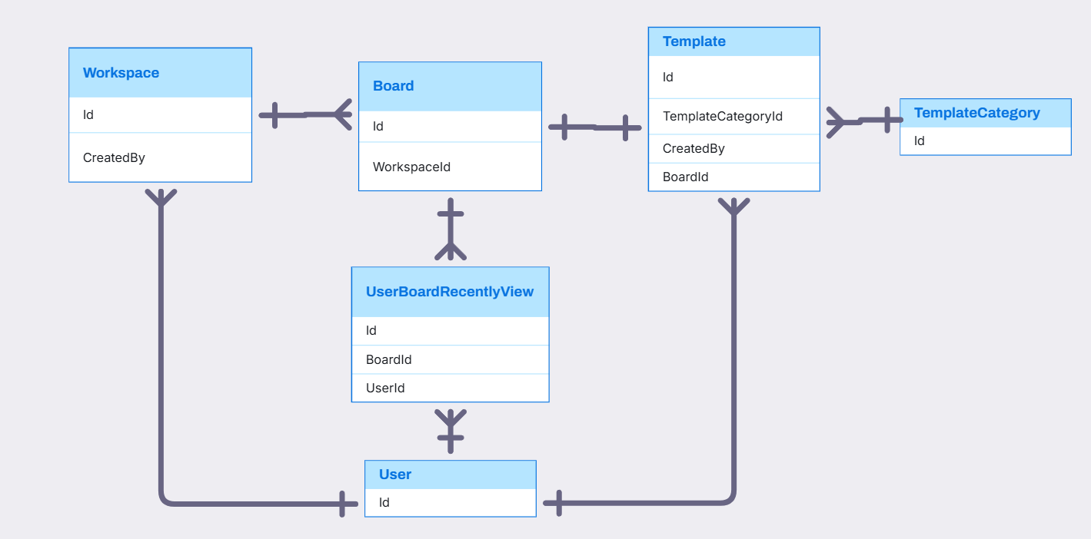
USER, WORKSPACE, BOARD, TEMPLATE, TEMPLATECATEGORY, USERBOARD RELATIONSHIP

Slide 12
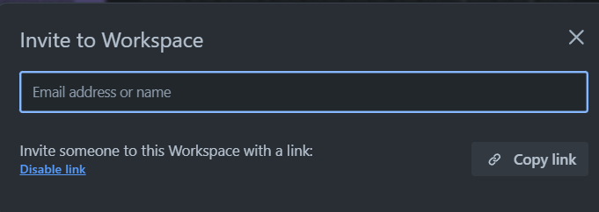
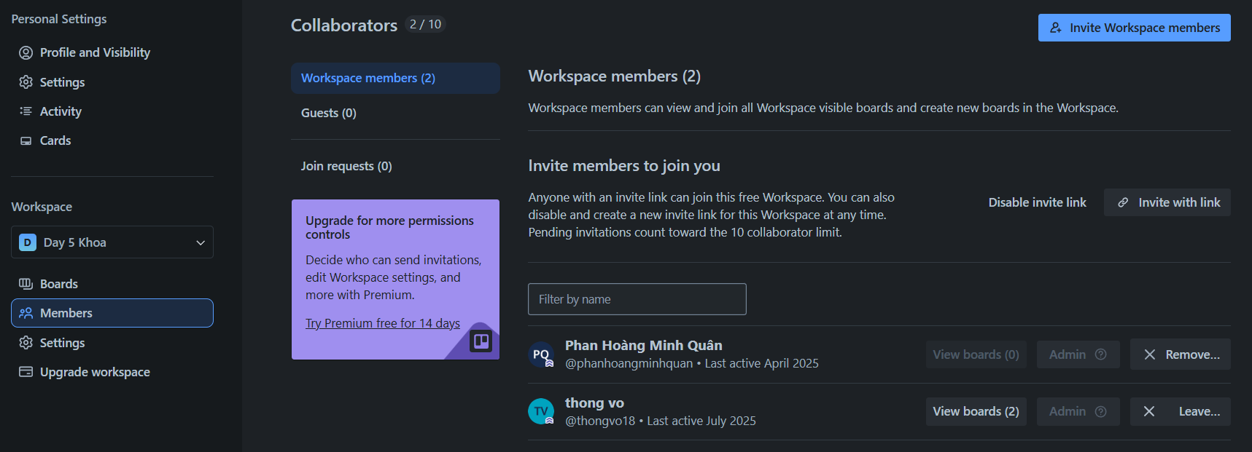
WORKSPACE IN TRELLO SYSTEM
ShareLink
Member
Permission
Notes:
13. Get all Members in Workspace, number of Boards in Workspace that Member participates in and corresponding permissions in Workspace 14. Get Sharelink of workspace and status of Sharelink 15. Update ShareLink Status of Workspace

Slide 13
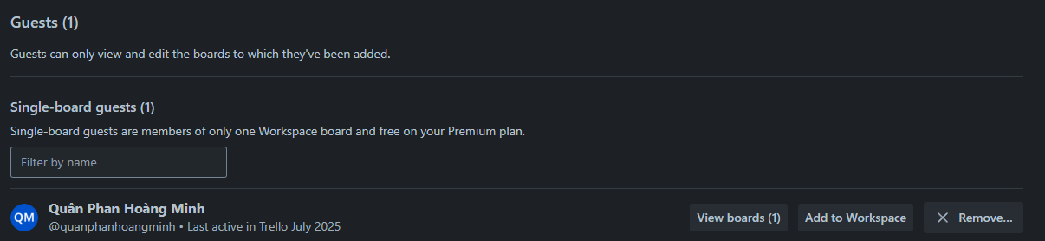
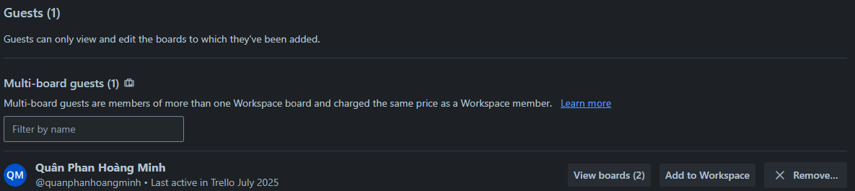
WORKSPACE IN TRELLO SYSTEM
Notes:
16. Query Members of Boards belonging to Workspace, but Members who are not part of the Workspace

Slide 14
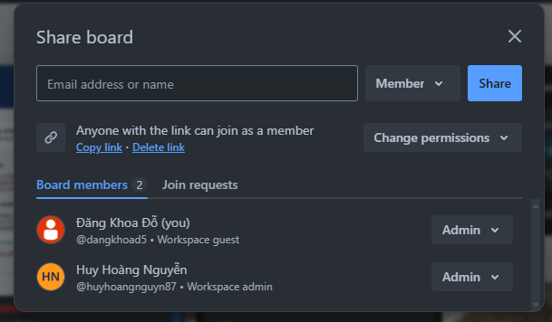
WORKSPACE IN TRELLO SYSTEM
ShareLink
Member
Permission
Notes:
17. Add Member to Board with Permission
18. Create ShareLink for Board with Permission (Each Board has only 1 ShareLink)
19. Update Status and Permission of ShareLink
20. Get all Members of Board and their Permissions

Slide 15
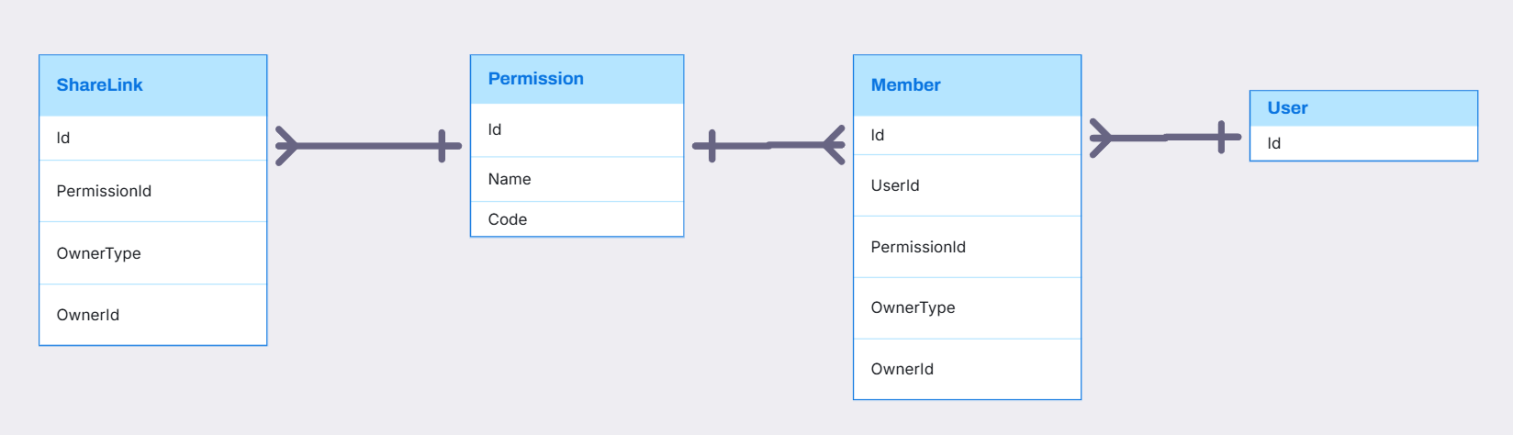
SHARELINK, PERMISSION, MEMBER RELATIONSHIP

Slide 16
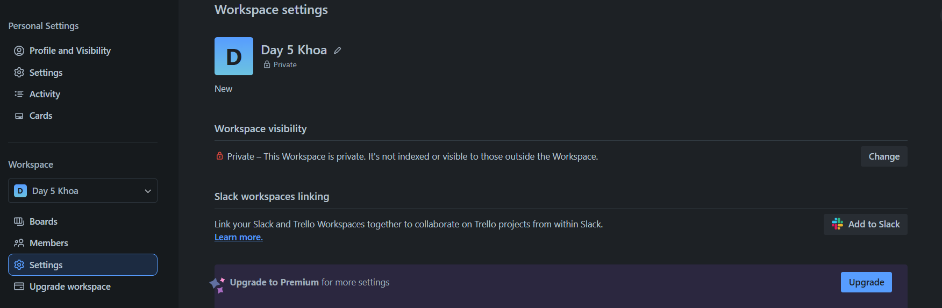
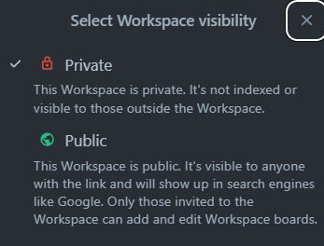
WORKSPACE SETTING IN TRELLO SYSTEM
SettingKey
SettingOption
SettingValue
Notes:
21. SettingKeys and corresponding SettingOptions for Workspace
22. SettingValues of specific Workspace

Slide 17
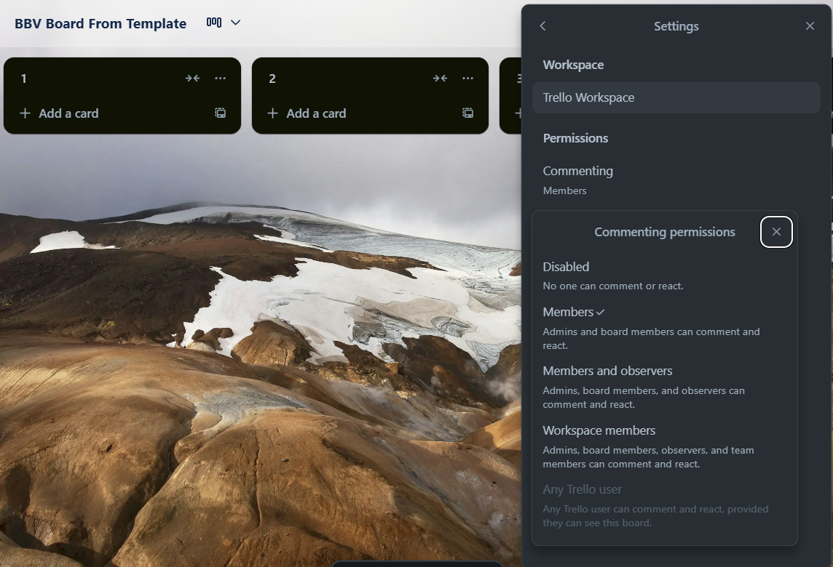
BOARD SETTING IN TRELLO SYSTEM
SettingKey
SettingValue
SettingOption
Notes:
23. SettingKeys with KeyName='permission.*' and corresponding SettingOptions for Board
24. SettingKeys and corresponding SettingOptions for Board
25. SettingValues corresponding to Board

Slide 18
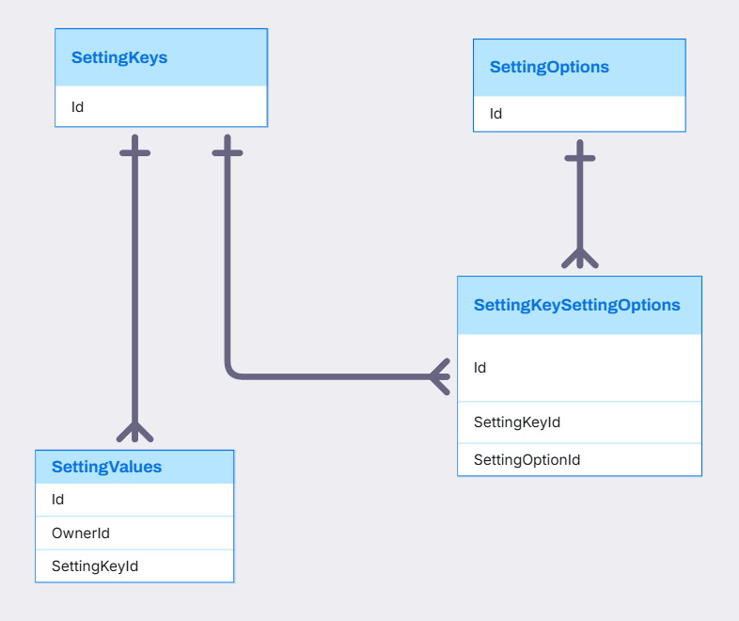
SETTINGKEY, SETTINGOPTION, SETTINGVALUE, SETTINGKEYSETTINGOPTION RELATIONSHIP

Slide 19
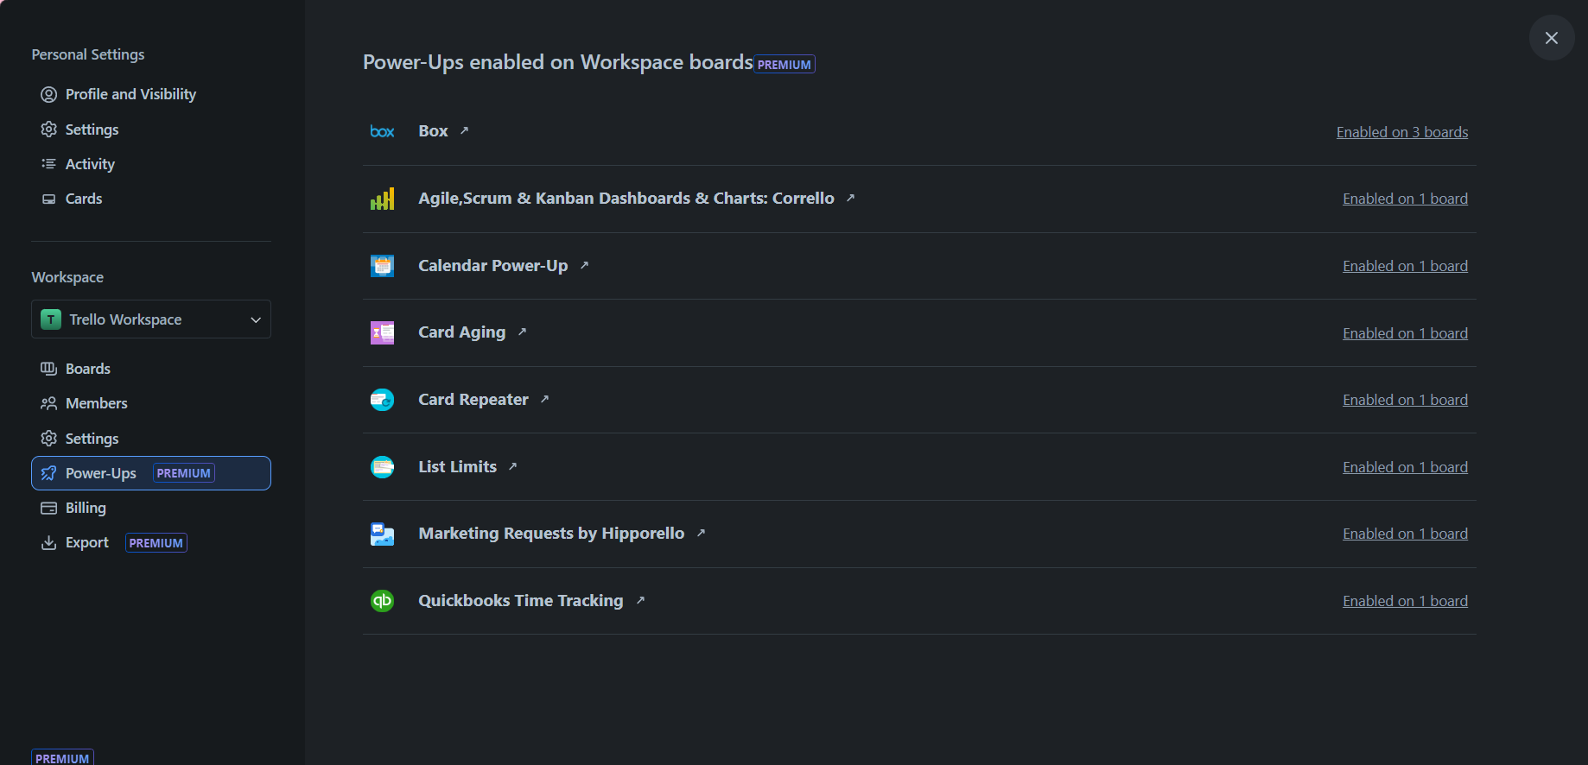
WORKSPACE IN TRELLO SYSTEM
Power-up
Notes:
26. Query how many Boards in Workspace have Power-Ups added

Slide 20
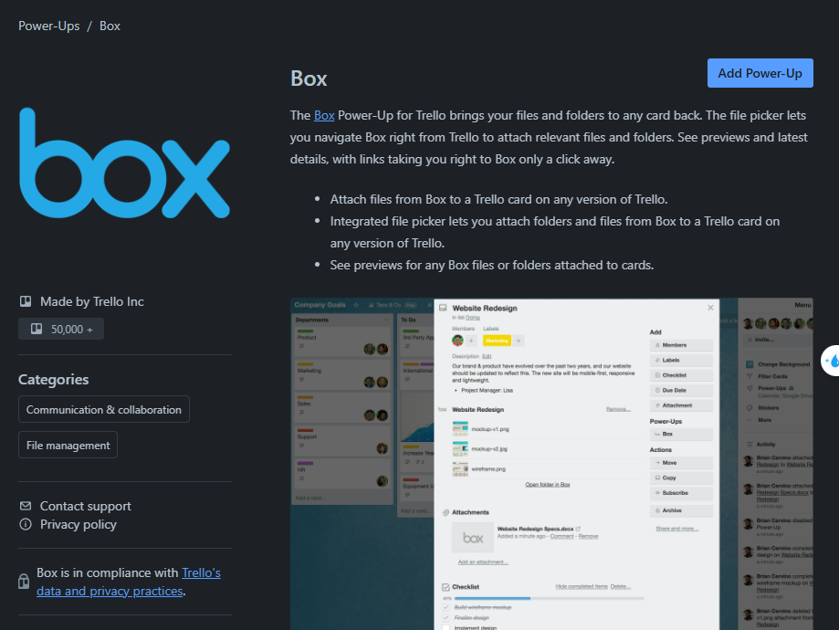
WORKSPACE IN TRELLO SYSTEM
Title
Description
AuthorName
PowerUpsCategory
Notes:
Query Power-Up details

Slide 21
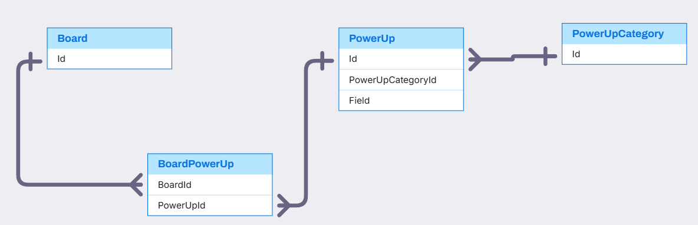
BOARD, POWERUP,POWERUPCATEGORY RELATIONSHIP
PowerUp,PowerUpCategory,Board(Quan)

Slide 22
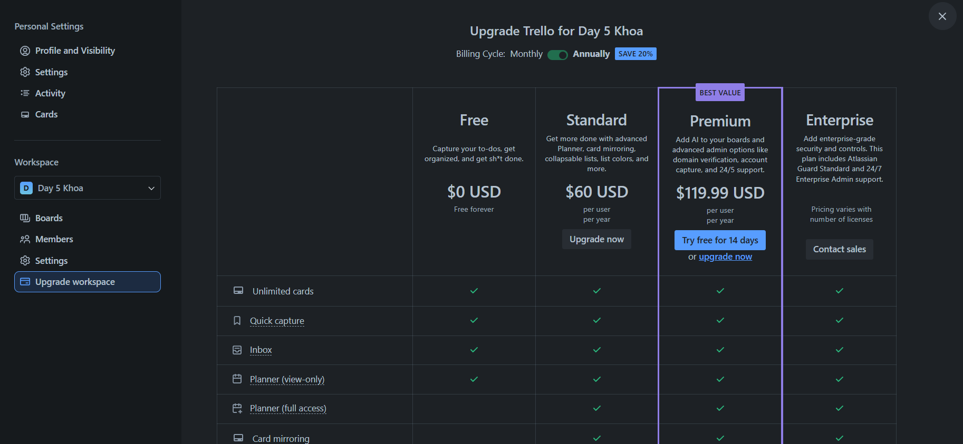
WORKSPACE IN TRELLO SYSTEM
BillingPlan
Notes:
28. Get Billing Plan

Slide 23
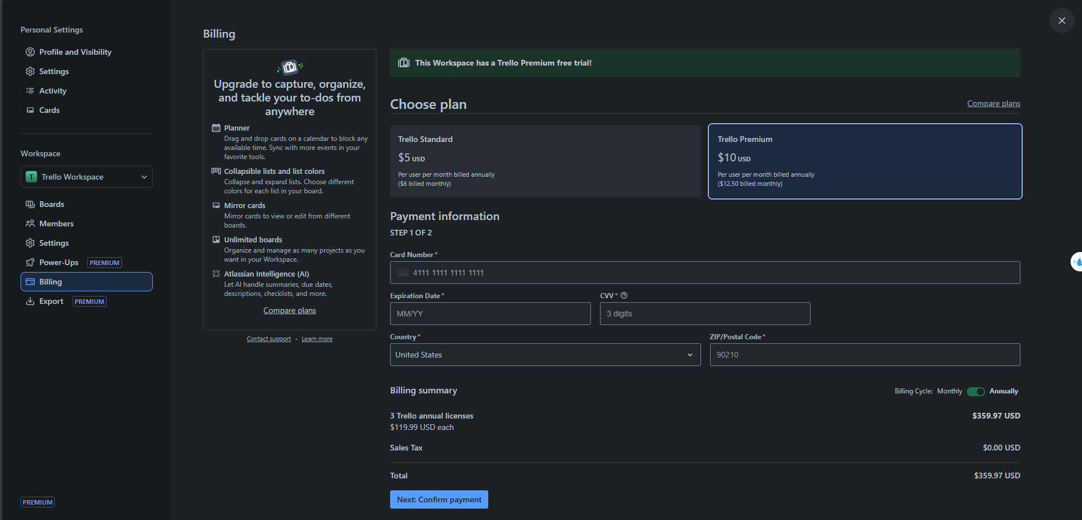
WORKSPACE IN TRELLO SYSTEM
BillingPlan
PaymentInformation
Notes:
29. Get Subscription of specific Workspace
30. Change PaymentInformation
31. Change BillingContact Information

Slide 24
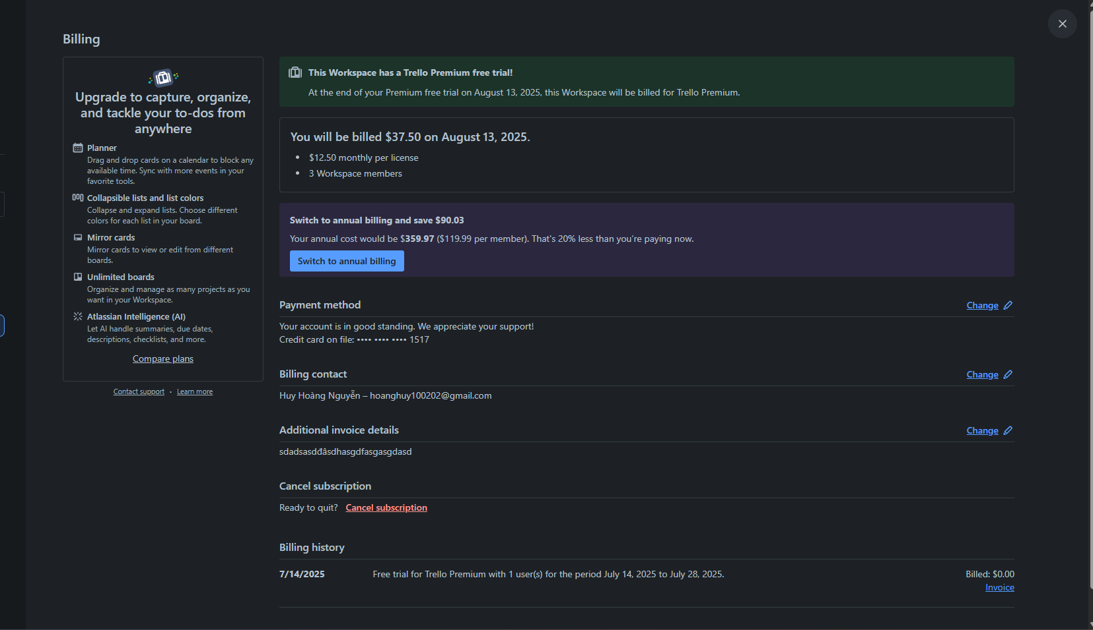
BILLING IN TRELLO SYSTEM
Subscription
Billing.AdditionalInvoiceDetail
Query from subscription
Notes:
32. Change Additional invoice details
33. Query Billing history from Subscription

Slide 25
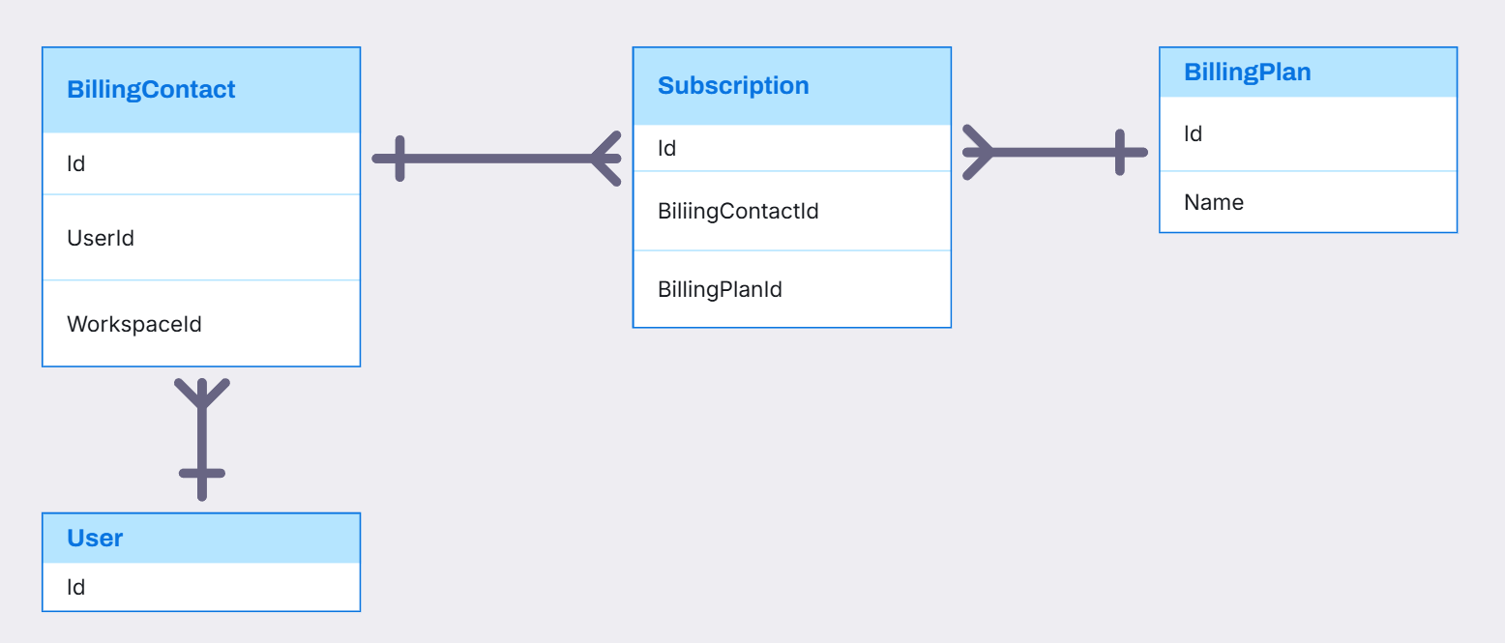
BILLINGCONTACT, BILLINGPLAN, SUBSCRIPTION RELATIONSHIP

Slide 26
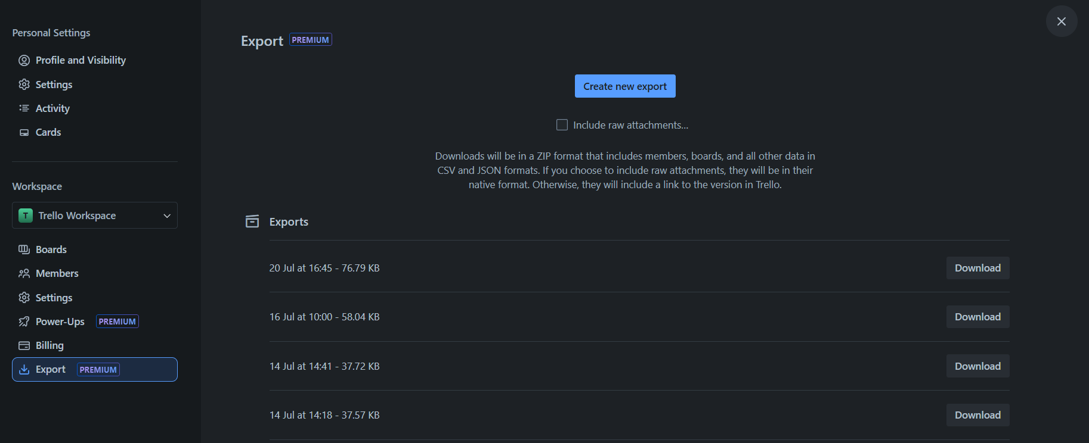
WORKSPACE IN TRELLO SYSTEM
Export
Notes:
34. Create Export for Workspace
35. Query Export from specific Workspace

Slide 27
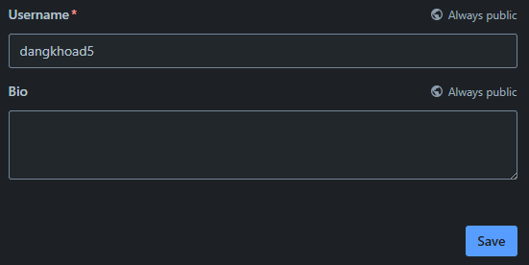
USER IN TRELLO SYSTEM
Username
UserBio
Notes:
36. Query Username and Bio
37. Update Username and Bio

Slide 28
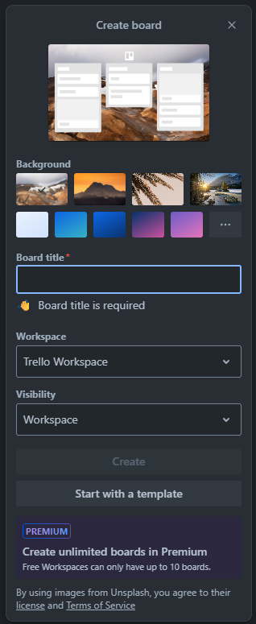
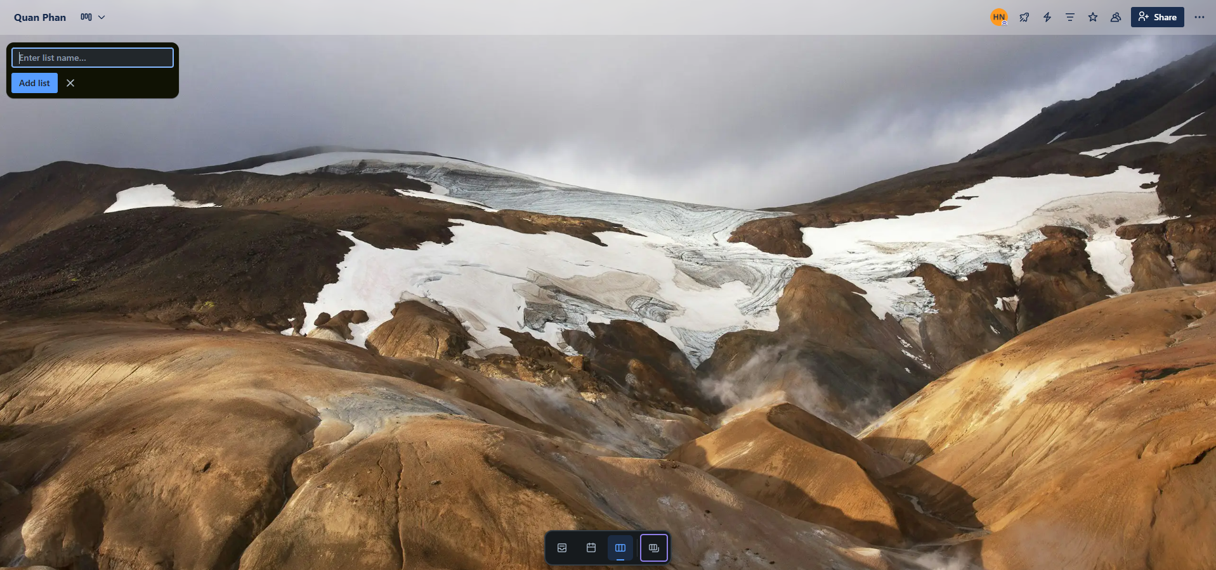
BOARD IN TRELLO SYSTEM
Stage
Board
Notes:
38. Create Board
39. Create Stage in Board

Slide 29
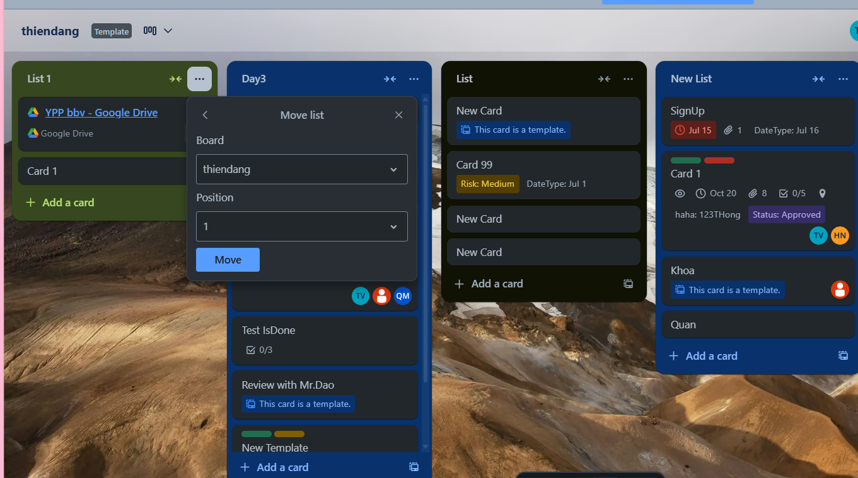
STAGE IN TRELLO SYSTEM
Stage Position
Notes:
40. Update Stage Position

Slide 30
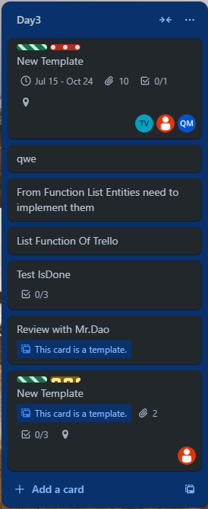
STAGE IN TRELLO SYSTEM
Stage
Card
Notes:
41. Query all card in Stage

Slide 31
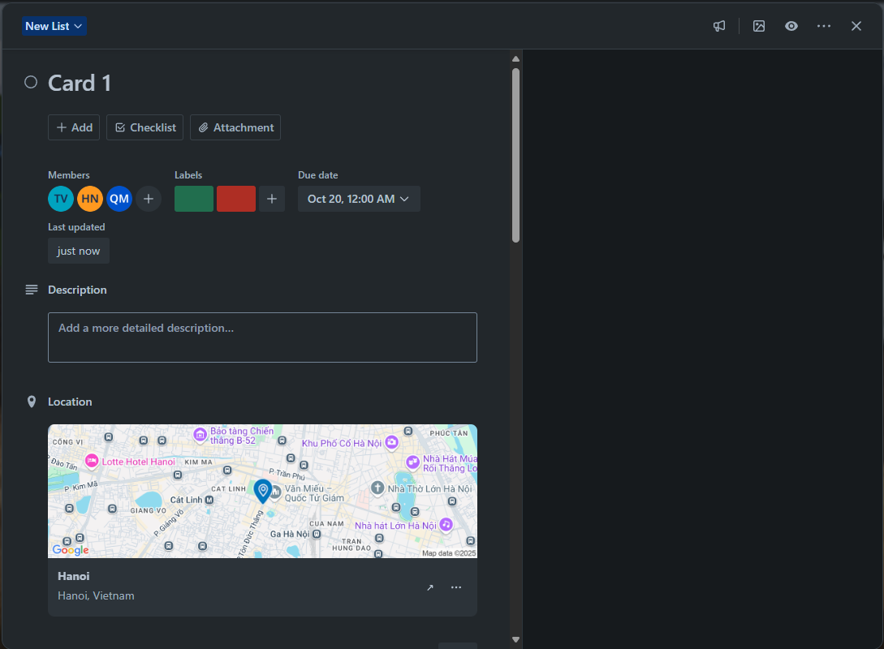
CARDS IN TRELLO SYSTEM
CardAssignMember
CardDate
Label
CardDescription
CardLocation
Notes:
42. Query Card Detail

Slide 32
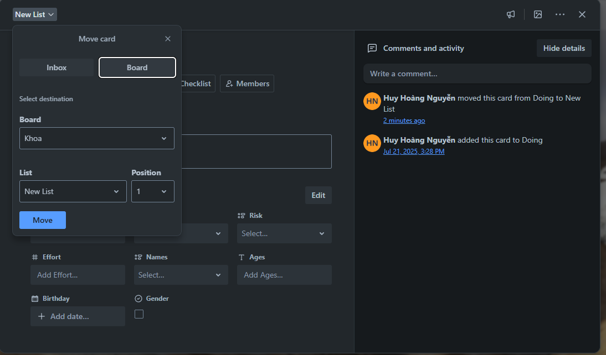
CARDS IN TRELLO SYSTEM
Card Comment
Card Position
Notes:
43. Query Comment
44. Query Activities related to Card
45. Get Moved Card Data (Store Procedure)
46. Query current position of Card
47. Move card to a different list

Slide 33
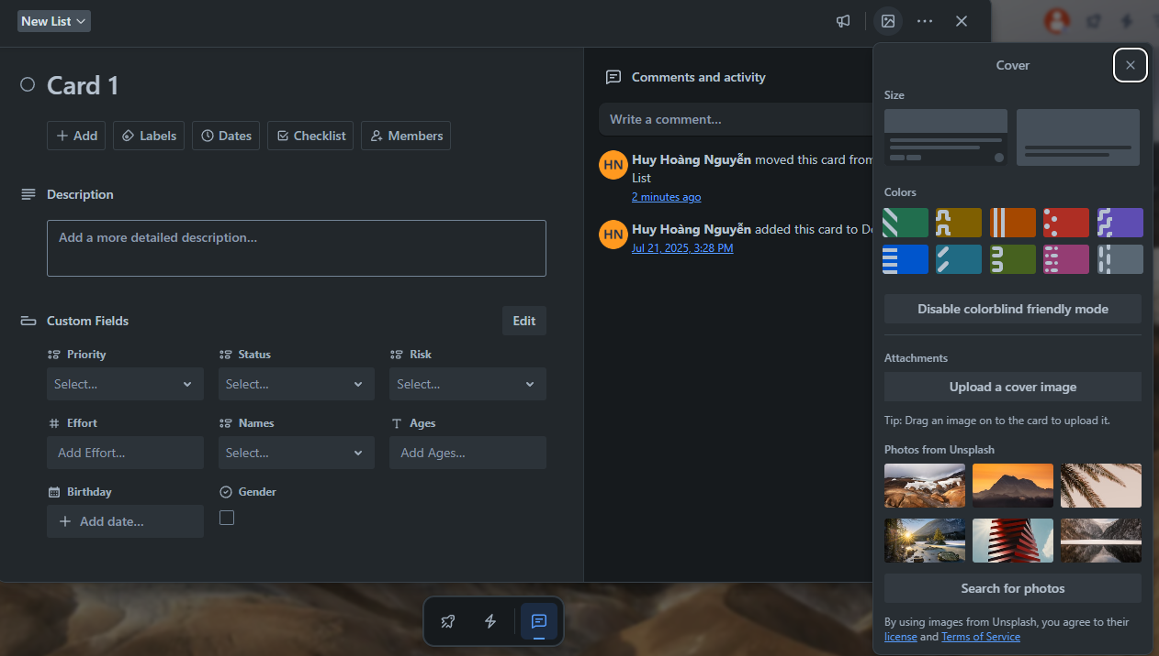
CARDS IN TRELLO SYSTEM
Color
Attachment
Card Cover
UnsplashImg
Notes:
48. Update Card Cover (Color, Unsplash, Attachment)

Slide 34
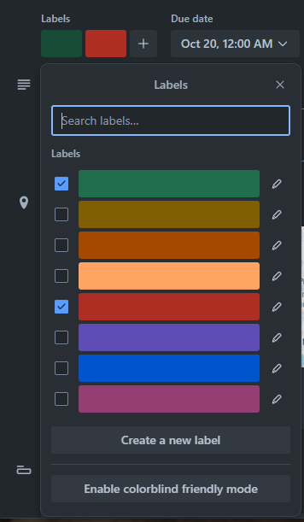
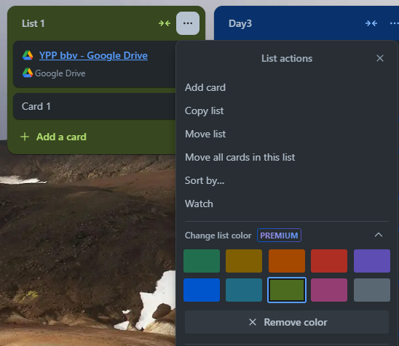
LABEL AND COLOR IN TRELLO SYSTEM
Label
Color
Notes:
49. Get all Label and check Label added to Card
50. Get all Color

Slide 35
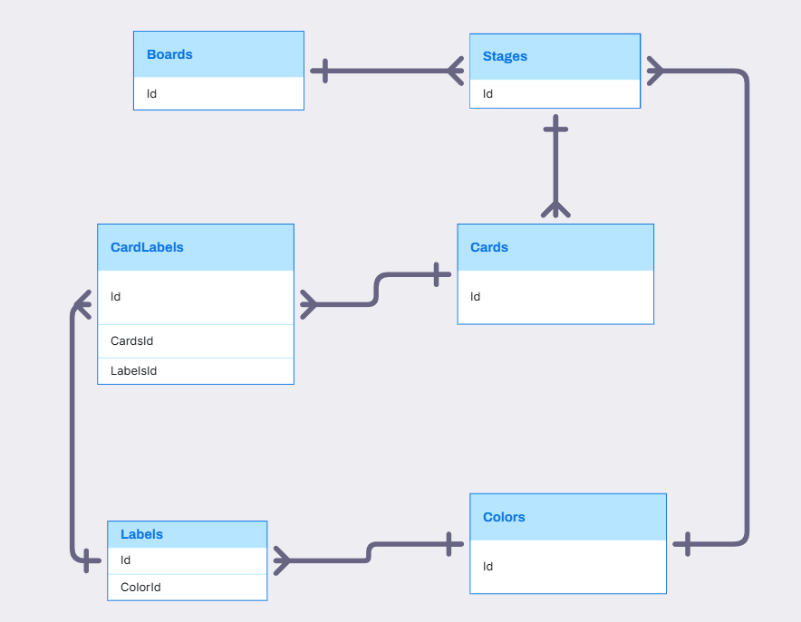
BOARD, STAGE, CARD, LABEL, COLOR RELATIONSHIP

Slide 36
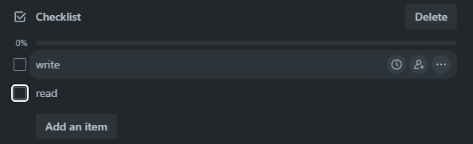
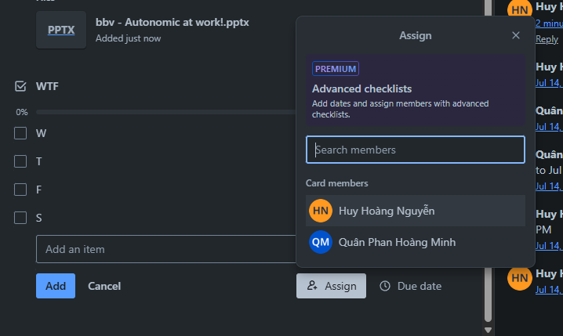
CHECKLIST IN TRELLO SYSTEM
CheckListItem
CheckList
Assign Member Into CheckListItem
Notes:
51. Query all CheckList in specific Card
52. Query all CheckListItem in CheckList of specific Card

Slide 37
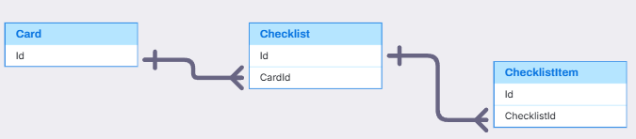
CARD, CHECKLIST, CHECKLISTITEM
Card, CheckList, CheckListItem(Quân)
,
,

Slide 38
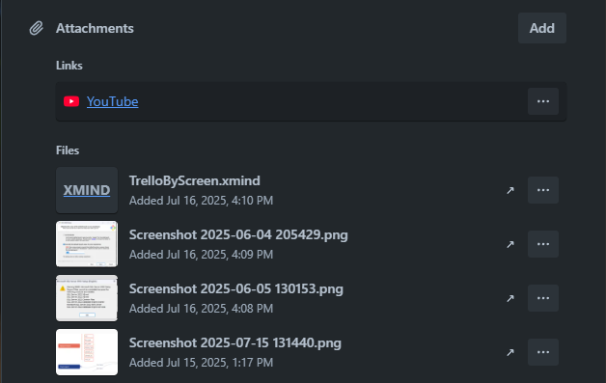
ATTACHMENT IN TRELLO SYSTEM
Attachment
Notes:
52. Get all Attachment of a specific Card

Slide 39
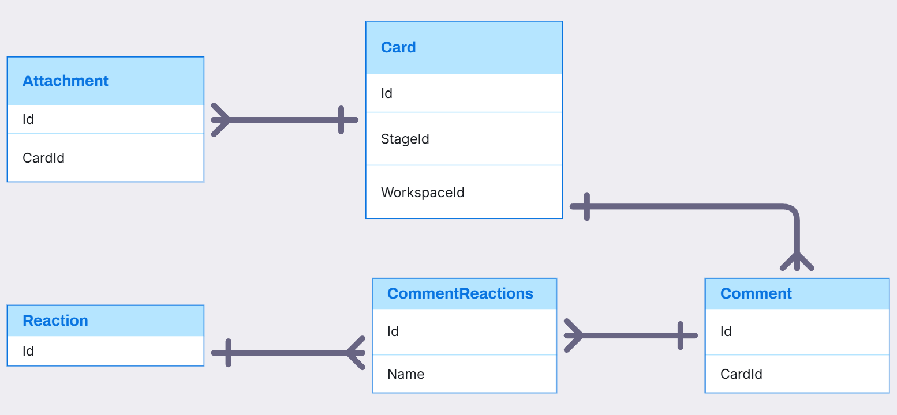
CARD, ATTACHMENT, COMMENT, REACTION RELATIONSHIP

Slide 40
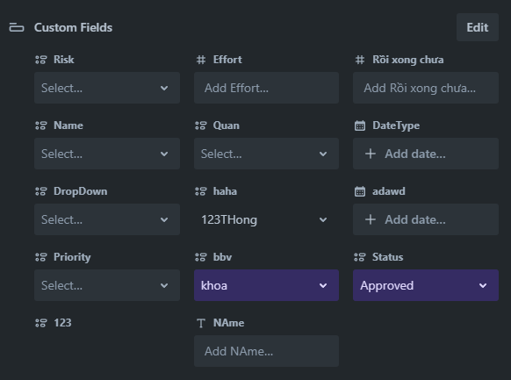
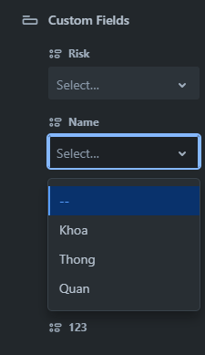
CARDS IN TRELLO SYSTEM
FieldItem
CustomField
FieldValue
FieldItem
Notes:
53. Query All CustomField, FieldItem of Board (store procedure)
54. Query FieldValue of CustomField in specific Card.

Slide 41
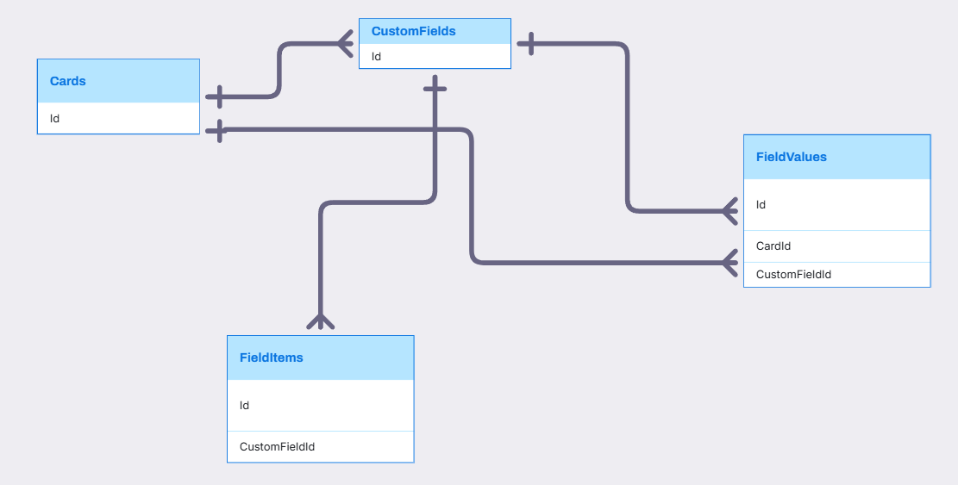
Visily
Card, CustomField, FieldValue, FieldItem(Thông)
,
,

Slide 42

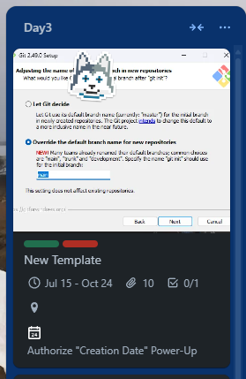
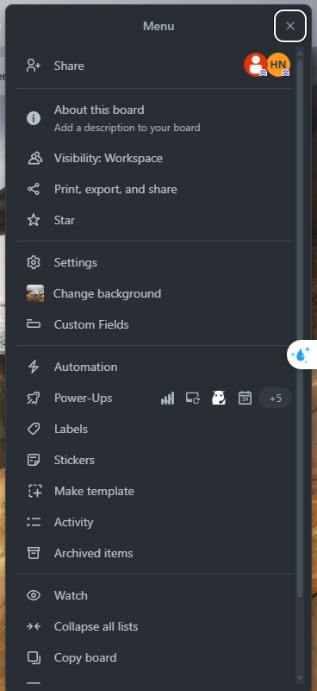
STICKERS IN TRELLO SYSTEM
Click Here
Drag To Here
Sticker
Notes:
55. Query all Stickers
56. Add Sticker to Card
57. Query Sticker of all Card in specific Board

Slide 43
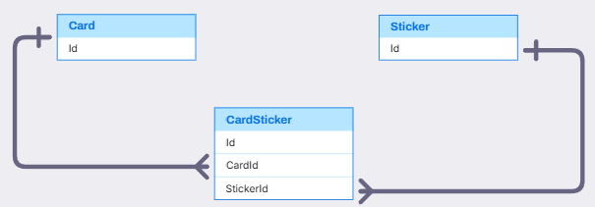
STICKERS IN TRELLO SYSTEM

Slide 44

HOME TAB IN TRELLO SYSTEM
CheckListItem:MemberId,Username, CardName, BoardName
Comment, CommentReaction
Notes:
58.1.Get “Your Items”: Get CheckListItem where User is assigned
58. Get user's recent activities across all accessible boards/workspaces
59. Get recently viewed Board which user is a member

Slide 45

NOTIFICATION IN TRELLO SYSTEM
Notification
Notes:
60. Get all notification of specific User

Slide 46

ACTIVITY, NOTIFICATION RELATIONSHIP

Slide 47

COLLECTION IN TRELLO SYSTEM
Collection
Board
Notes:
62. Add Board to Collection

Slide 48

COLLECTION, BOARD, BOARDCOLLECTION RELATIONSHIP

Slide 49

Q&A
Thank you
Intern | Trello Team

Slide 51
bbv template EN
How-to guides

Slide 52


bbv Master layouts & slide library
Insert new slide
1
Click on «New Slide»
1
2
Select layout
Choose the desired layout from the pre-programmed master layouts.
2
🡪
Or select layout from slide library

Slide 53




Transfer of existing slides into the new Master
1
2
3
4
Insert original slide
Copy slide in original presentation with Ctrl+C.
In the target presentation, select the slide after which the original slide is to be inserted.
Select in the tab «Home / Paste / Use Destination Theme».
Assign slide layout
Select the inserted slide
Select the desired layout in the tab «Home / Layout».
Adjust slide manually
Check all slide contents such as text blocks, images, etc. for position and size and manually adjust them to the new layout grid.
Check design
Independently check:
Font type, sizes and font colours
Colours of graphic elements
Text alignment
Coherence of the overall picture
Important:
When transferring existing slides, always carry out all four steps.

Slide 54


Change icon colour
Approach
Notes
Select icon
In the tab «Graphics Format» under «Graphics Styles», use «Graphics Fill» to change the colour
For some icons, the colour can be changed by using «Graphics Outline» instead of «Graphics Fill».
The colour cannot be changed if an icon is inserted as a picture. In this case, after selecting the icon, the tab «Picture Format» appears instead of «Graphics Format».
Best vector file format for icons: *.svg

Slide 55






Insert image into placeholder
Insert image from external source
Click on the image icon, select image from Sharepoint or other source
The bbv image library is here locally located: C:\Users\Public\bbv_templates\Marketing\PPT-Bibliotheken\Bilder-Bibliothek
Or: copy image from external source with Ctrl+C, select the placeholder, then paste with Ctrl+V
Adjust
Select the image
Click in the tab «Picture Format» on «Crop»
Adjust the image composition by moving the image
Resize the image by clicking and dragging the outer circles.
Click again on «Crop» to finish the adjustments

Slide 56






Insert image into mock-up screen (mobile/laptop)
Mock-up
Paste image
Copy image from external source with Ctrl+C and paste with Ctrl+V
Image mask
Adjust size & determine image area:
Place image behind image mask
Adjust image size and determine image area
Image mask
Crop image to image mask
Select image
Select image mask
Click in the tab «Shape Format / Merge Shapes» on «Intersect»
Combine image with mock-up
Place image behind mock-up
Activate image and mock-up and align both horizontally (Align Center) and vertically (Align Middle)
Group image and mock-up with Ctrl+G

Slide 57
bbv template EN
Style guide

Slide 58



Working area, guides & ruler
Working area
Depending on the slide, a single-column layout, a 2-column or 3-column layout is used.
Display the ruler and guides in the «View» tab.

Slide 59


bbv colour theme
Always OK!
Never, please!
Default text colours
Main accent
Colours for diagrams, charts, graphs etc.
Use selectively and sparingly
Never, please!
Colours for diagrams, charts, graphs etc.
Colours for diagrams, charts, graphs etc.

