Slide 1
PREDICTION OF COVID-19 CONTAGION INTENSITY IN CHICAGO, IL.
By Mutuyimana Manzi

Slide 2
INTRODUCTION
Prediction of the continuous values of COVID-19 contagion intensity in Chicago, IL
Utilization of preexisting data that is not specific to pathogenic properties of COVID-19
Utilization of swish, softplus, ReLU and leaky ReLU as activation functions
Solving the issue of vanishing gradient descent and local minima or maxima

Slide 3
Data
Data collection with:
Economy, society, health, and environment properties as features
Web scraping
API requests
wget() download
Data processing with:
String editing
Geographical location assignment
Datapoint rescaling
Data organization with:
Chicago’s Zip code area
Zip code area reassignment from community area
Calculation to the percent scale

Slide 4
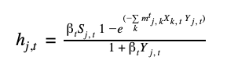

Methodology : The Target Variable
From SIR Model to the continuous values of the COVID-19 contagion intensity
Calculation of the COVID-19 contagion intensity per Chicago’s zip code area

Slide 5
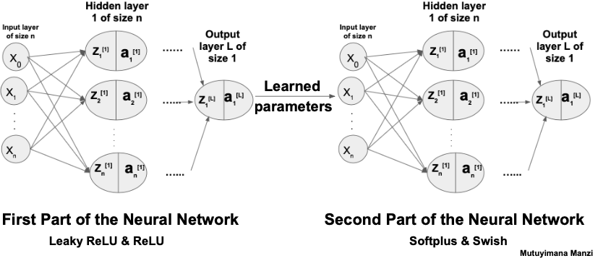




Methodology: Neural Network Model
Two-part deep neural network
Activation functions in Part I:
ReLU and leaky ReLU
Activation functions in Part II
Swish and Softplus

Slide 6
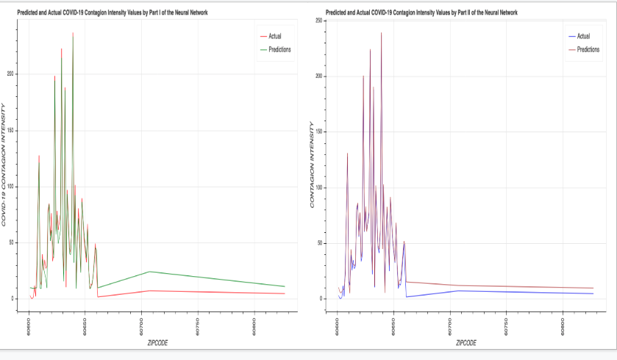
Results : Prediction
Part I:
R-Squared from the first part of the neural network is 0.973
Part II
Coefficient of determination from the second part of the neural network is 0.993

Slide 7
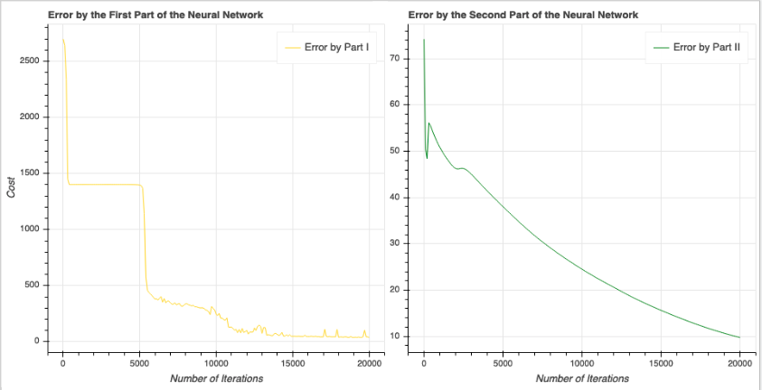
Results: Mean Squared Error
Part I:
At the beginning of training MSE is 2698.535
At the end of training MSE is 37.443
Part II
At the beginning of training MSE is 74.250
At the end of training MSE is 9.747

Slide 8
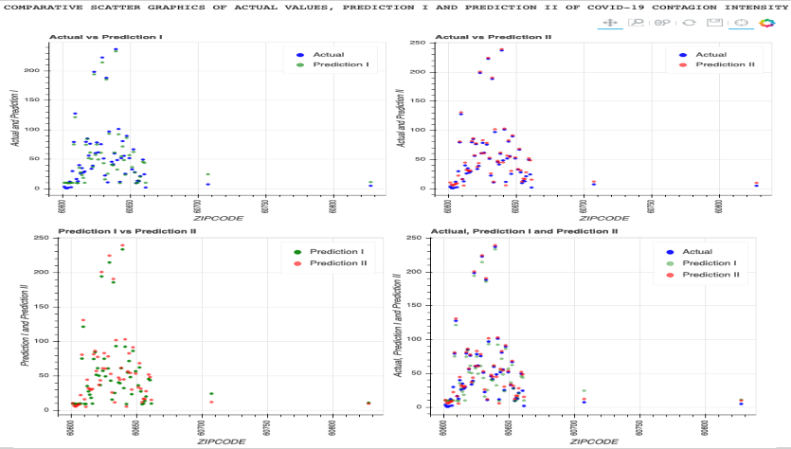
Results : Vanishing Gradient Descent & Local Minima/Maxima
Part I:
Local minimum encountered at MSE value 1409.12
4,600 iterations to overcome the local minimum
Part II:
Vanishing gradient descent encountered at at iteration 200,
MSE increases from 49.2 to 56.07

Slide 9
Conclusion
The neural network model with activation functions of ReLU and leaky ReLU, Swish and Softplus efficiently predicts continuous values and overcomes the issue of vanishing gradient descent and local minima or maxima. With this project only limited on the level of zip code areas of the City of Chicago, the identical technique could extrapolated on a much larger scale, such as the national level to make predictions of contagion intensity.

Slide 10
