Slide 1
Deconvolutional Networks 学习报告
汇报人：胡如明

Slide 2
01
基本介绍
content
02
模型解析
03
图像重构

Slide 3
基本介绍
/01

Slide 4
Abstract
Building robust low and mid-level image representations, beyond edge primitives, is a long-standing goal in vision. Many existing feature detectors spatially pool edge information which destroys cues such as edge intersections, parallelism and symmetry. We present a learning framework where features that capture these mid-level cues spontaneously emerge from image data. Our approach is based on the convolutional decomposition of images under a sparsity constraint and is totally unsupervised. By building a hierarchy of such decompositions we can learn rich feature sets that are a robust image representation for both the analysis and synthesis of images.

Slide 5
Deconvolutional Networks的出发点
从图像中提取特征，从这一点而言，Deconvolutional network和Convolutional network的出发点是一致的，只不过，为了实现这一目的使用的策略是不同的

Slide 6
Deconvolutional Networks的应用
Deconvolutional network被提出时，是为了从图像中提取特征，从而，可以应用到object recognition中，但后来并没有朝这个方向发展，因为Convolutional network已经很强大了，而且，深层的Deconvolutional network做optimizing还是很困难的；现在的deconvolutional network主要朝着feature visualization方向发展

Slide 7
Convolutional network和Deconvolutional Network异同
既然Deconvolutional network和convolutional network的出发点是一致的，那么，他们到底有什么区别呢？它们的具体实现机制是不同的。
CNN：给定一组图像及其相应的labels，学习一系列的filters（多层），将这些学习到的filters对输入图像进行卷积可以将输入的图像映射成不同的feature maps
DCNN：给定一组图像（不需要labels），去学习一系列的filters和feature maps，使得这些filters对feature maps做卷积后等于输入的图像

Slide 8
模型解析
/02

Slide 9
considering a single Deconvolutional Network layer

Slide 11
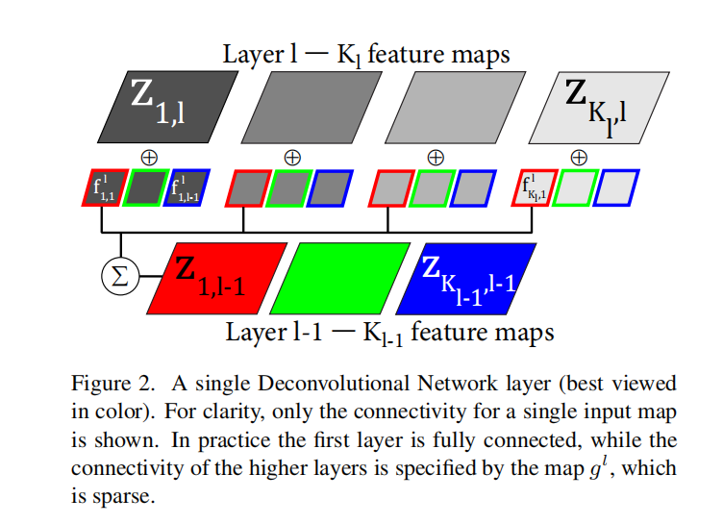

Slide 12
Forming a hierarchy

Slide 13
Learning filters

Slide 15
z sub-problem

Slide 17
x sub-problem

Slide 20
图像重构
/03

Slide 22
THANKS

