Slide 1
Capstone
File created on: 1/12/24 17:19:59 EST

Slide 2
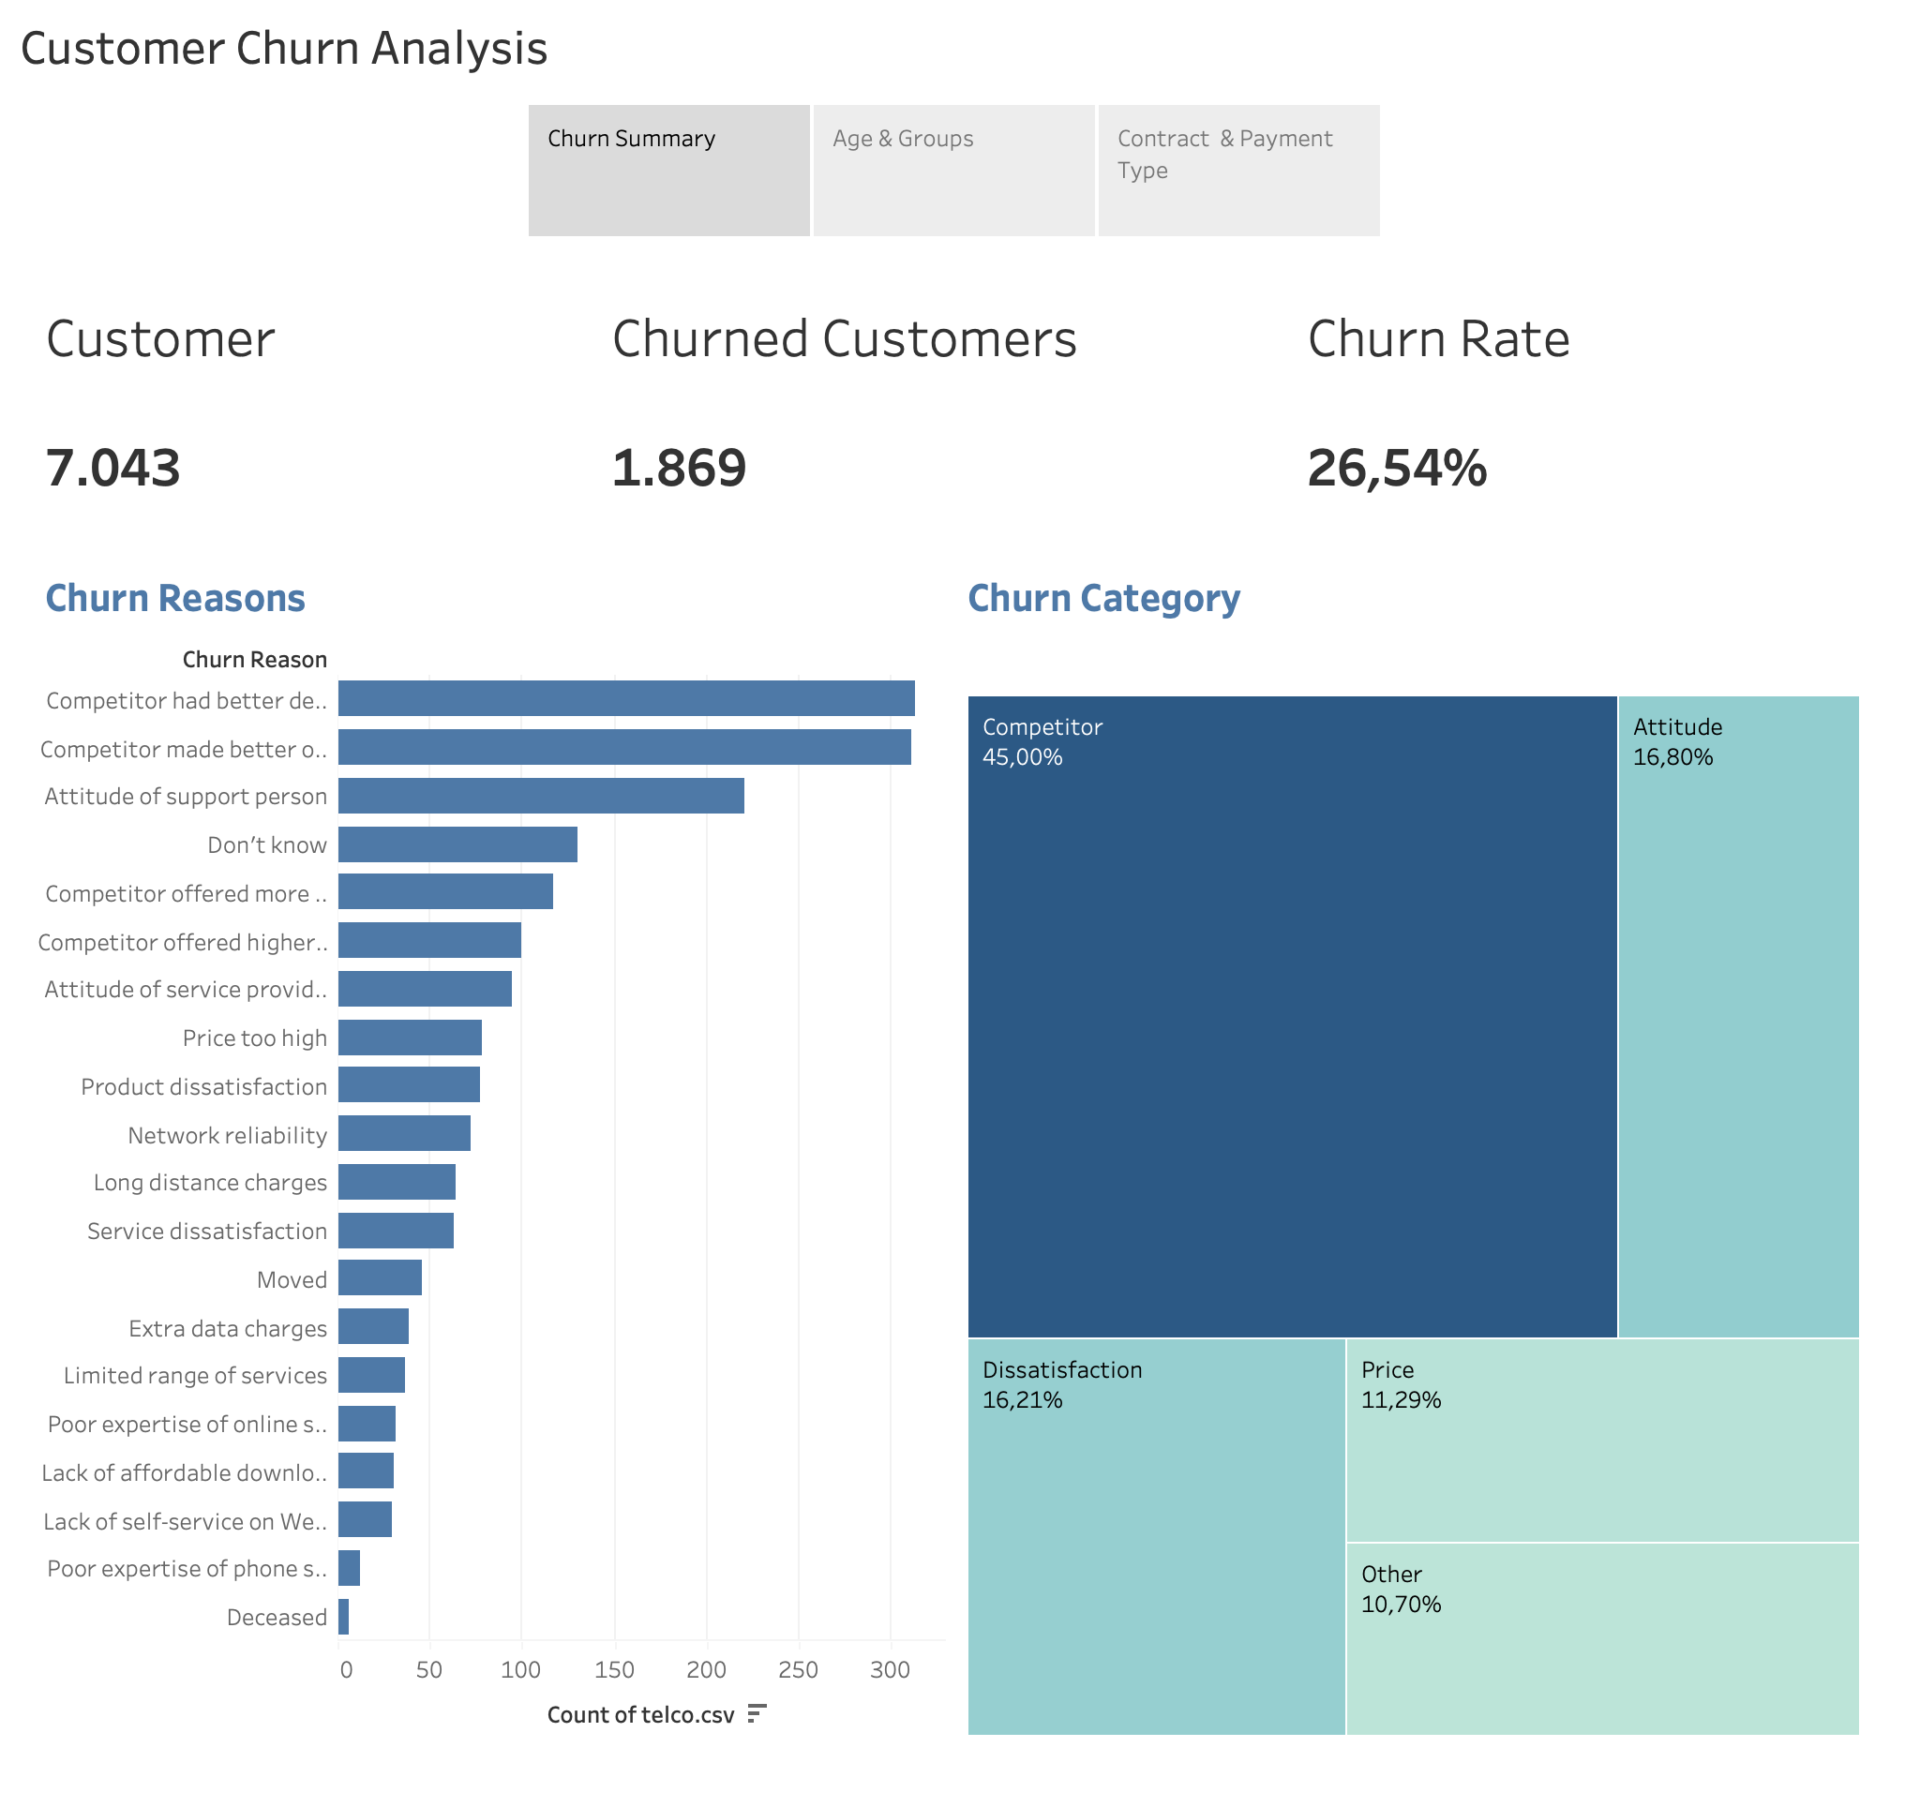

Slide 3
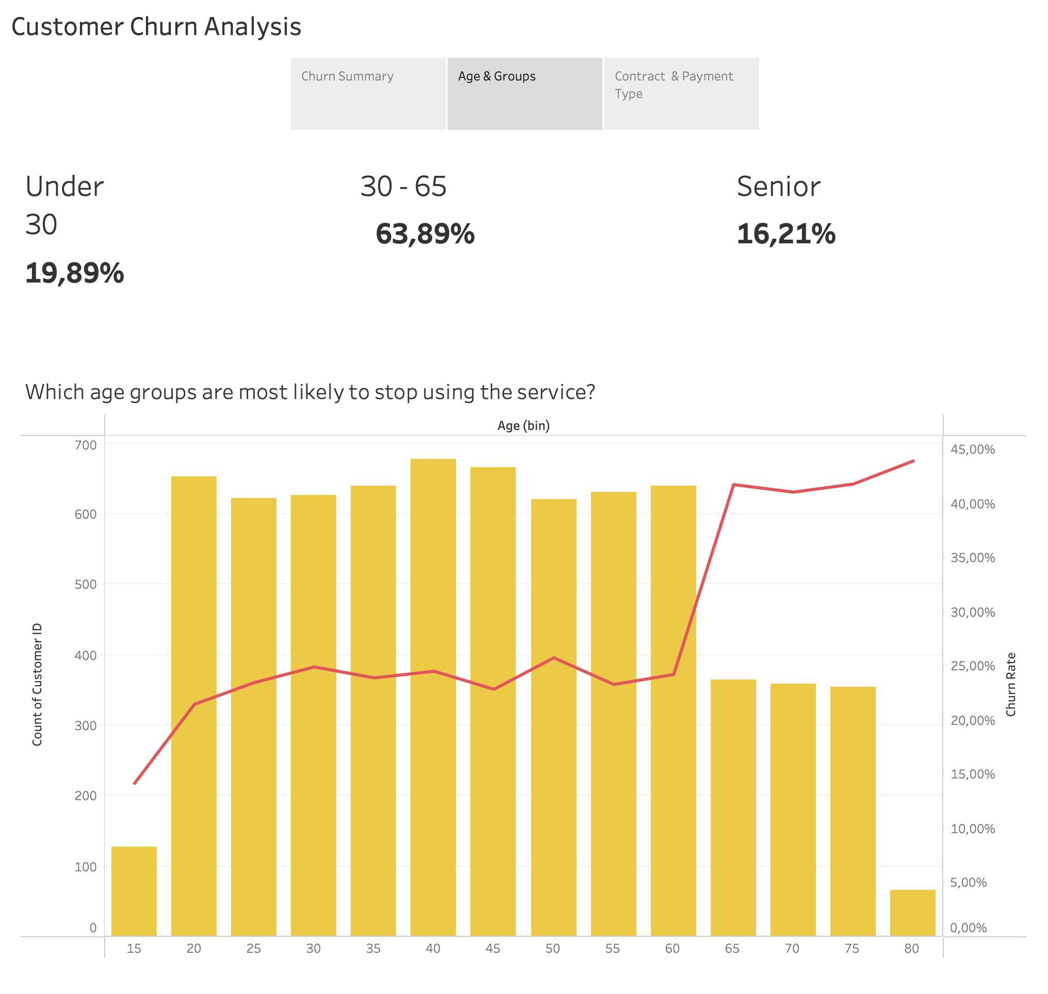

Slide 4
