Slide 1


Capstone Project
Miryn AI: Persistent Memory & Identity in Conversational AI
Group No. BTCSE-86
Faculty Advisor : Dr. Vyomika Singh
Assistant Professor II, School of Computing
vyomika.singh@dituniversity.edu.in
Name of Student | Major | SAP ID | E-mail
Sahil Sharma | Fullstack & DevOps | 1000018807 | 1000018807@dit.edu.in
Divyadeep Kaur | Data Science | 1000018180 | 1000018180@dit.edu.in
Gracy Mehra | Data Science | 1000017919 | 1000017919@dit.edu.in
Faculty Advisor – Dr. Vyomika Singh E-mail – vyomika.singh@dituniversity.edu.in

Slide 2
Miryn AI: Persistent Memory & Identity in Conversational AI
Table of contents:
Introduction
Problem statement and description
Background
Related Works
Project Description
Feasibility Study
Proposed Methodology
Project Timeline
References
Faculty Advisor – Dr. Vyomika Singh E-mail – vyomika.singh@dituniversity.edu.in

Slide 3
INTRODUCTION
Conversational AI systems have advanced significantly in recent years. Modern large language models such as GPT-4, Gemini, and Claude are capable of generating coherent, contextually nuanced responses across a wide range of topics. These systems can engage in sophisticated dialogue, assist with complex reasoning tasks, and support diverse applications ranging from education to productivity.
Despite these capabilities, a fundamental limitation remains: most conversational AI systems operate using a stateless interaction model. When a chat session ends, the system does not retain persistent knowledge about the user. Each new conversation therefore begins without awareness of previous interactions, user history, or evolving personal context.
While this design is sufficient for short, task-oriented queries, it becomes a significant constraint for long-term use cases such as mental health support, academic mentoring, or personal productivity guidance.
In these scenarios, continuity and contextual awareness are essential. Without persistent memory, users must repeatedly restate their background, goals, and preferences, preventing the system from building a cumulative understanding of the individual over time.
Group BTCSE-86 | DIT University | March 2026

Slide 4
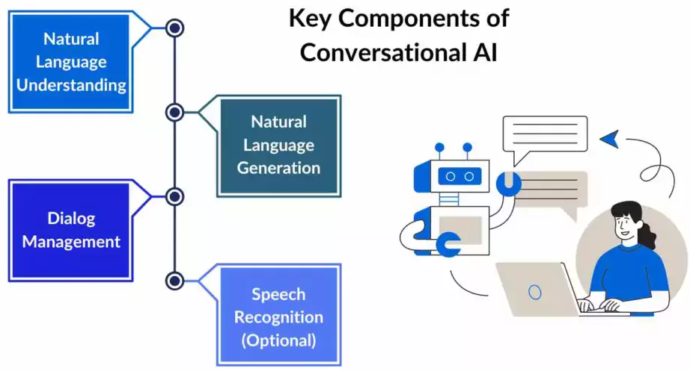
INTRODUCTION
The figure highlights the primary components of conversational AI systems: Natural Language Understanding (NLU), Dialogue Management, Natural Language Generation (NLG), and Speech Recognition. Despite advances in these areas, several research gaps remain:
1. Lack of persistent memory: Most conversational systems operate with short-term context and do not retain information across sessions, limiting long-term interaction capabilities.
2. Limited personalization: Current architectures rarely incorporate user modeling or adaptive learning to tailor responses based on user behavior, preferences, or historical interactions.
3. Pipeline rigidity: The traditional pipeline structure (NLU → Dialogue Management → NLG) restricts dynamic interaction between components, reducing flexibility in complex conversational scenarios.
Group BTCSE-86 | DIT University | March 2026

Slide 5
INTRODUCTION
4. Context management challenges: Dialogue management systems often struggle to maintain deep contextual understanding across long or multi-topic conversations.
5. Insufficient integration of multimodal inputs: While speech recognition is included, many systems lack effective integration of multiple modalities such as voice, text, and contextual data.
6. Scalability and domain adaptation issues: Conversational systems frequently require significant retraining or redesign to function effectively across different domains.
Addressing these gaps requires the development of memory-enabled, context-aware, and adaptive conversational architectures that integrate user modeling and long-term contextual understanding into the core conversational pipeline.
Group BTCSE-86 | DIT University | March 2026

Slide 6
PROBLEM STATEMENT
The fundamental problem addressed by this project is simple: most contemporary AI chat systems, such as GPT, Gemini, and Claude do not maintain persistent user context across sessions. Once a conversation ends, the system effectively resets, and subsequent interactions begin without prior knowledge of the user.
While this stateless design is acceptable for many short, task-oriented queries, it becomes a significant limitation for long-term applications such as mental health support, academic mentorship, or personal productivity coaching.
In these scenarios, the absence of persistent context forces users to repeatedly restate their background, goals, and preferences, reducing efficiency and continuity in the interaction.
Group BTCSE-86 | DIT University | March 2026

Slide 7
PROBLEM STATEMENT AND DESCRIPTION
MIRYN AI is a technologically advanced attempt to fix the discussed research gaps. The system stores a semantic memory of past conversations and maintains a versioned profile of the user that gets updated after every session. When you come back, it already knows the context.
The technical approach combines Retrieval-Augmented Generation (RAG) [8] with a hybrid Chroma DB + PostgreSQL storage layer, a versioned Identity Engine, and machine learning models for sentiment analysis and memory prioritisation. The full stack runs on Next.js, FastAPI, and the Gemini API. Eight peer-reviewed papers from IEEE, ACM, and NeurIPS informed the design decisions.
Group BTCSE-86 | DIT University | March 2026

Slide 8
PROBLEM STATEMENT AND DESCRIPTION
To be specific about what we are solving, current AI systems have five concrete limitations that this project targets:
No session-to-session memory: users have to re-establish context every time they start a new conversation.
No returning-user recognition: the system treats every session as a first meeting.
No emotional continuity: sentiment patterns across sessions are never tracked.
No accumulated understanding of the user: preferences, history, and patterns are lost.
No unified open framework: memory, identity, and response generation are not integrated in any existing open system.
Group BTCSE-86 | DIT University | March 2026

Slide 9
PROBLEM STATEMENT AND DESCRIPTION
Current conversational AI systems — including GPT-4, Claude, and Gemini — are stateless by default. Every session starts with zero memory of the user. There is no emotional continuity, no identity persistence, and no cross-session learning. This fundamentally limits the depth and utility of AI in long-term personal and professional contexts.
THE PROBLEM
THE GAP IN RESEARCH
THE OPPORTUNITY
Session-bound AI: memory wipes after every conversation
Existing literature focuses on single-session chatbots
RAG enables dynamic, persistent semantic memory retrieval
No recognition of returning users
ML models can track user identity drift over time
Emotional continuity largely unexplored in LLM systems
No accumulation of contextual knowledge
Identity tracking absent from current AI architectures
Full-stack architecture can unify memory + identity layers
Leads to repetitive, shallow, impersonal interactions
No unified framework for memory + identity + reflection
MIRYN AI fills this gap as an open extensible framework
Research gap confirmed by [3] Kusal et al., 2022 (IEEE Access)
Group BTCSE-86 | DIT University | March 2026

Slide 10
RELATED WORKS
Peer-Reviewed IEEE Papers — Last 5 Years
A. Mehta, S. Gupta, A. Kumar — 'AI Powered Chatbot for Mental Healthcare based on Sentiment Analysis' — IEEE ICAST 2022 — doi: 10.1109/ICAST55766.2022.10039548
Key Finding: Sentiment-driven chatbot achieves 87% user satisfaction in mental health support.
MIRYN Relevance: Validates NLP sentiment analysis as foundation for MIRYN’s Sentiment Drift Index.
1
D. Madhu, N. Nair, V. Jain — 'A Novel Approach for stress and mental health using chatbot' — IEEE ICCCNT 2021 — doi: 10.1109/ICCCNT51525.2021.9579745
Key Finding: Conversational AI significantly reduces self-reported stress scores.
MIRYN Relevance: Demonstrates effectiveness of AI emotional support — MIRYN extends with persistent tracking.
2
S. Kusal, S. Patil, J. Choudrie — 'AI-Based Conversational Agents: A Scoping Review from 2010 to 2022' — IEEE Access, vol. 10, 2022 — doi: 10.1109/ACCESS.2022.3203474
Key Finding: Reviews 120+ chatbots; identifies memory loss and impersonalization as critical unresolved gaps.
MIRYN Relevance: Core motivation paper — MIRYN directly addresses the #1 identified gap.
3
V. Gupta, V. Joshi, A. Jain, I. Garg — 'Chatbot for Mental Health Support Using NLP' — IEEE INCET 2023 — doi: 10.1109/INCET57972.2023.10170573
Key Finding: NLP-based chatbot with intent classification achieves high accuracy in mental health query handling.
MIRYN Relevance: NLP preprocessing pipeline directly adopted in MIRYN’s Phase 1 architecture.
4
K. Rani, H. Vishnoi, M. Mishra — 'Mental Health Chatbot Delivering CBT using NLP and AI' — IEEE ICDT 2023 — doi: 10.1109/ICDT57929.2023.10150665
Key Finding: CBT-based chatbot with AI adapts therapy delivery based on user responses.
MIRYN Relevance: Adaptive response delivery pattern informs MIRYN’s 4 personality mode system.
5
Group BTCSE-86 | DIT University | Citations via Zotero | IEEE Format

Slide 11
RELATED WORKS
2 ACM Review Papers + 1 Foundational NeurIPS Reference
[6]
T. Koulouri, S. Lesta, D. Arnab — ACM Transactions on Interactive Intelligent Systems (TIIS), Vol. 12, 2022 — doi: 10.1145/3485874
'Chatbots to Support Young Adults Mental Health and Wellbeing: Design and Evaluation Challenges'
Key Finding: Chatbot acceptability for mental health is high among youth; however emotional depth, contextual continuity, and personalization remain major barriers to real-world adoption.
MIRYN Relevance: Directly validates MIRYN’s core thesis — continuity and emotional depth are the missing layers in current AI systems.
[7]
Multiple Authors — ACM Transactions on Management Information Systems (TMIS), 2024 — doi: 10.1145/3701041
'LLM-Based Mental Health Chatbots: A Systematic Review and Future Research Directions'
Key Finding: Systematic review of 40+ LLM chatbots identifies memory loss, identity inconsistency, and lack of longitudinal tracking as the top three unresolved limitations.
MIRYN Relevance: MIRYN AI is architecturally designed to resolve all three limitations identified in this 2024 review — memory persistence, versioned identity, longitudinal data science tracking.
[8]
P. Lewis, E. Perez, A. Piktus, F. Petroni, V. Karpukhin, N. Goyal — Advances in Neural Information Processing Systems (NeurIPS), 2020
'Retrieval-Augmented Generation for Knowledge-Intensive NLP Tasks'
Key Finding: RAG combines parametric (LLM) and non-parametric (retrieved) memory to produce factually grounded, context-aware responses surpassing standard LLMs.
MIRYN Relevance: Foundational paper for MIRYN’s entire memory architecture — Chroma DB + Gemini/Vertex API Implements this RAG framework.
All 8 papers imported to Zotero | IEEE-format bibliography auto-generated | Diagrams comply with PPT SmartArt / Visio guidelines
Group BTCSE-86 | DIT University | March 2026

Slide 12
PROJECT DESCRIPTION
MIRYN AI is a full-stack intelligent conversational system that establishes persistent memory and evolving user identity across unlimited sessions. It combines Retrieval-Augmented Generation (RAG), hybrid vector-relational storage, a versioned Identity Engine, and ML-powered data science models to deliver reflective, personalized AI conversations.
Core Architecture (Sahil Sharma — Full-Stack & DevOps)
Data Science Layer (Divyadeep Kaur + Gracy Mehra)
• RAG Pipeline
Retrieves semantically relevant past memories using Chroma Vector DB
• Cosine Similarity
Tracks Identity Stability Score across sessions
• Hybrid Memory Layer
Chroma DB (vector embeddings) + PostgreSQL via Supabase
• Sentiment Drift Index
Rolling average NLP sentiment (VADER + Transformers)
• Identity Engine
Versioned behavioral and emotional user profiles updated each session
• Emotional Volatility
Standard deviation of sentiment over last 10 sessions
• 4 Personality Modes
Reflective | Analytical | Empathetic | Challenging — activated by LLM context
• Memory Relevance Ranking
RF + XGBoost ensemble model using 4 features:
• Full-Stack Architecture
Next.js (frontend) + FastAPI (backend API) + Gemini API
• Features
Recency, Intensity, Topic Overlap, Frequency Weight
Gemini API (Google) | Next.js | FastAPI | Chroma DB | PostgreSQL (Supabase) | VADER | Transformers | scikit-learn
Group BTCSE-86 | DIT University

Slide 13
FEASIBILITY STUDY
Is MIRYN AI Achievable by May 2026?
Dimension | Risk Level | Notes | Mitigation
Technical | Low | All tools are open-source and already in production use elsewhere. The 10-week timeline is realistic given the scope. | GitHub version control; CI/CD pipeline with rollback support.
Operational | Low–Medium | Three-person team with clear role separation. Main risk is integration across parallel workstreams. | Scope locked at Week 4; fortnightly supervisor reviews.
Ethical | Low | No raw conversation logs are stored — only embeddings. The system makes no clinical claims and is positioned as a reflective assistant only. | Privacy-by-design architecture; user memory control built in from Day 1.
Verdict: MIRYN AI is fully feasible within academic, technical, and ethical constraints. Delivery target: May 10, 2026.
Group BTCSE-86 | DIT University

Slide 14
PROPOSED METHODOLOGY
System Architecture and Data Science Pipeline
User Input
NLP Preprocessing
RAG Retrieval (Chroma DB)
Identity Engine (DS Core)
LLM Response (Gemini API)
↺ Loop: Memory Update
PHASE 1 — USER INPUT LAYER
PHASE 2 — CONTEXT RETRIEVAL (RAG)
User interacts via Next.js chat interface
Query converted to high-dimensional semantic embedding vector
Input text preprocessed: tokenized, cleaned, stopwords removed
Chroma Vector DB performs cosine similarity search
Top-K relevant memories injected as grounding context
PHASE 3 — IDENTITY ENGINE (DATA SCIENCE CORE)
PHASE 4 — LLM RESPONSE GENERATION
Enriched prompt (input + memories + identity) sent to Gemini API
Identity Stability Score: cosine sim vs historical behavioral vector
Personality mode filter: Reflective / Analytical / Empathetic
Emotional Volatility: std dev of last 10 session sentiment values
Response returned and rendered via Next.js frontend
Memory Relevance Ranking: Random Forest+ XGBoost ensemble model
PHASE 5 — MEMORY UPDATE & STORAGE
Session outcome encoded as vector and stored in Chroma DB
Identity snapshot updated in PostgreSQL (Supabase)
User can review, edit, or delete memory entries (ethical control)
Grounded in: [8] Lewis et al. NeurIPS 2020 (RAG) | [3] Kusal et al. IEEE Access 2022 | Breiman 2001 (RF) | Chen & Guestrin XGBoost 2016

Slide 15
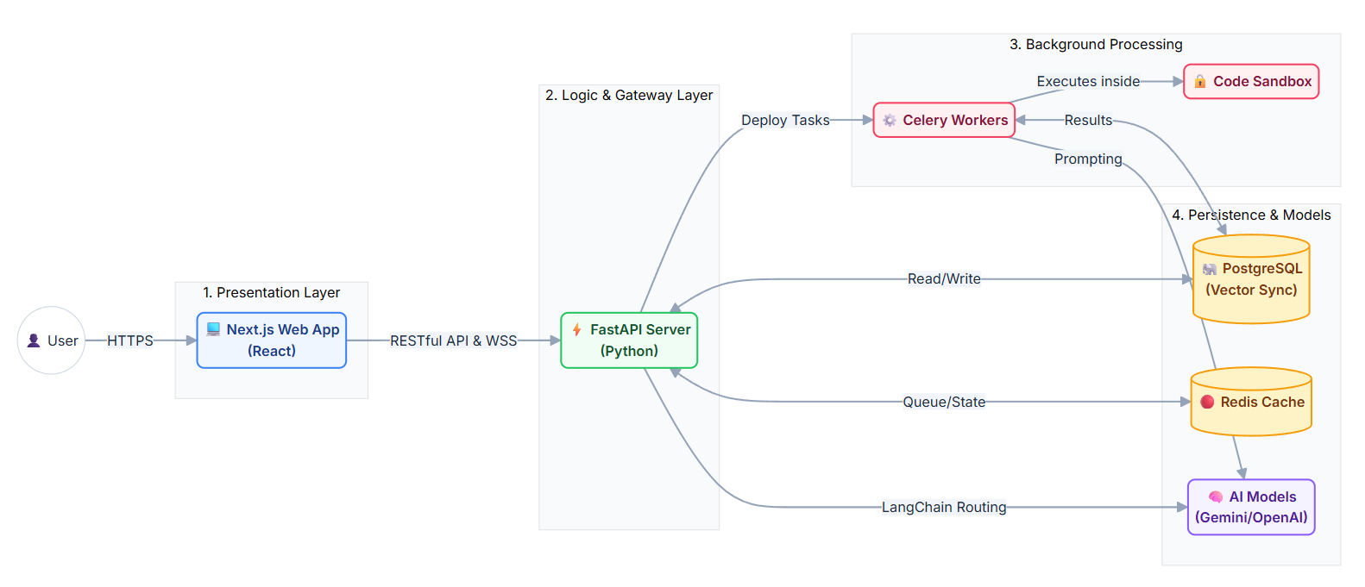
PROPOSED METHODOLOGY
System Architecture Diagram
BTCSE-86 | DIT University | Source: github.com/phnxsahil/Miryn-AI | March 2026
Source: github.com/phnxsahil/Miryn-AI

Slide 16
PROPOSED METHODOLOGY
Workflow Diagram
BTCSE-86 | DIT University | Source: github.com/phnxsahil/Miryn-AI | March 2026
Source: github.com/phnxsahil/Miryn-AI

Slide 17
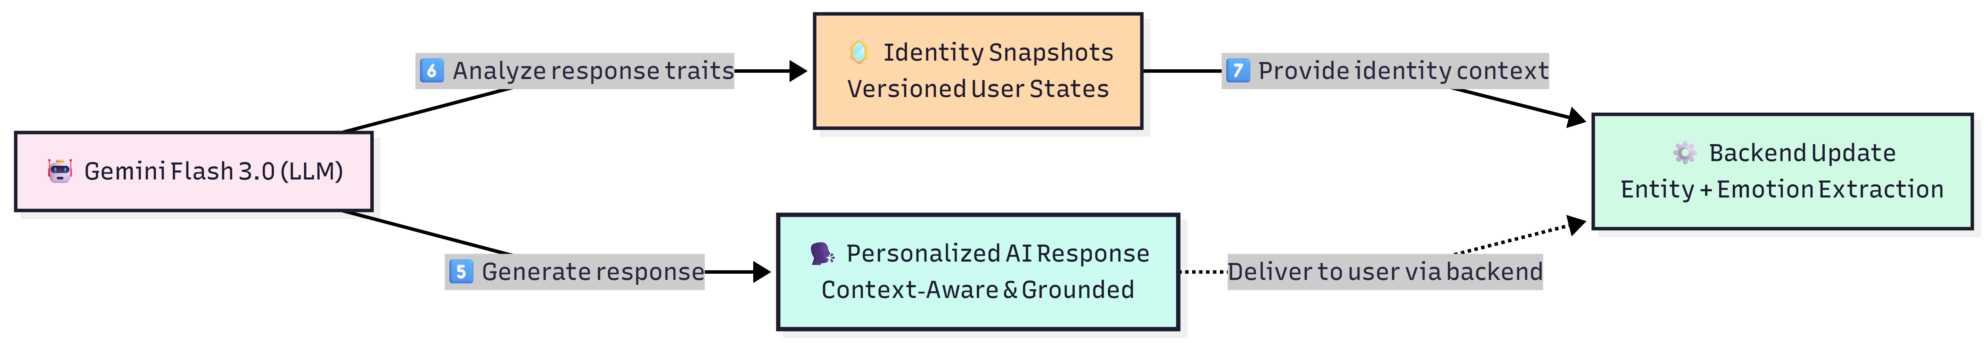
PROPOSED METHODOLOGY
Workflow Diagram
BTCSE-86 | DIT University | Source: github.com/phnxsahil/Miryn-AI | March 2026
Source: github.com/phnxsahil/Miryn-AI

Slide 18
PROPOSED METHODOLOGY
Technology Stack
Layer | Technology
Frontend | Next.js (React, SSR)
Backend API | FastAPI (Python, async)
LLM | Gemini API (Google)
Vector Memory | Chroma DB
Relational Storage | PostgreSQL via Supabase
NLP / Sentiment | VADER + HuggingFace Transformers
ML Models | scikit-learn — Random Forest, XGBoost
Version Control | GitHub + CI/CD pipeline
BTCSE-86 | DIT University | Source: github.com/phnxsahil/Miryn-AI | March 2026
Source: github.com/phnxsahil/Miryn-AI

Slide 19
PROJECT TIMELINE
6-Phase Capstone Execution Plan — March to May 2026
Phase | Jan | Feb | Mar | Apr | May | Owner | Status
1 — Research & Proposal | ███ |  |  |  |  | All | ✅ Done
2 — System Design | ███ | ███ |  |  |  | Sahil | ✅ Done
3 — Core Backend Dev |  | ███ | ███ |  |  | Sahil + Divyadeep | 🔄 In Progress
4 — Data Science Models |  |  | ███ |  |  | Divyadeep + Gracy | 🔄 In Progress
5 — Integration & Testing |  |  |  | ███ |  | All | ⏳ Upcoming
6 — Final Report & Demo |  |  |  |  | ███ | All | ⏳ Upcoming
● Mar 10 — PPT + Report submitted to Dr. Vyomika Singh
● Mar 16–20 — Midterm In-Person Presentation (Panel)
● May 10 — Final Report + Demo submission deadline
Group BTCSE-86 | DIT University | March 2026

Slide 20
REFERENCES
IEEE Format | All citations managed via Zotero
[1] A. Mehta, S. Gupta, and A. Kumar, "AI chatbot for mental healthcare," in Proc. IEEE ICAST, 2022. doi: 10.1109/ICAST55766.2022.10039548
[2] D. Madhu, N. Nair, V. Jain et al., "Novel approach for stress and mental health using conversational AI," in Proc. IEEE ICCCNT, 2021. doi: 10.1109/ICCCNT51525.2021.9579745
[3] S. Kusal, S. Patil, J. Choudrie et al., "AI-based conversational agents: A scoping review from 2010–2021," IEEE Access, 2022. doi: 10.1109/ACCESS.2022.3203474
[4] V. Gupta, V. Joshi, A. Jain, and I. Garg, "Chatbot for mental health support using NLP," in Proc. IEEE INCET, 2023. doi: 10.1109/INCET57972.2023.10170573
[5] K. Rani, H. Vishnoi, and M. Mishra, "Mental health chatbot using cognitive behavioural therapy," in Proc. IEEE ICDT, 2023. doi: 10.1109/ICDT57929.2023.10150665
[6] T. Koulouri, S. Lesta, and D. Arnab, "Chatbots to support mental health in young adults," ACM Trans. Interact. Intell. Syst., 2022. doi: 10.1145/3485874
[7] Multiple Authors, "LLM-based mental health chatbots: A systematic review," ACM Trans. Manag. Inf. Syst., 2024. doi: 10.1145/3701041
[8] P. Lewis, E. Perez, A. Piktus et al., "Retrieval-augmented generation for knowledge-intensive NLP tasks," in Proc. NeurIPS, 2020.
[9] A. Mehta, S. Virkar, J. Khatri, R. Thakur, and A. Dalvi, "Artificial Intelligence Powered Chatbot for Mental Healthcare based on Sentiment Analysis," in Proc. IEEE ICAST, Mumbai, India, Dec. 2022, pp. 185–189. doi: 10.1109/ICAST55766.2022.10039548
[10] P. Hegde and S. M. Meena, "A Survey on 5G Network Slicing — Epitome and Opportunities for a Novice," in Proc. IEEE ICCCNT, Kharagpur, India, Jul. 2021, pp. 1–5. doi: 10.1109/ICCCNT51525.2021.9579745
All papers sourced from IEEE Xplore, ACM Digital Library, and NeurIPS Proceedings. Citations imported to Zotero. IEEE-format bibliography auto-generated for Word report. All diagrams made in PPT SmartArt / Visio. All images carry source attribution.
Group BTCSE-86 | DIT University | March 2026

Slide 21
PROJECT DESCRIPTION
Source: github.com/phnxsahil/Miryn-AI
IMPLEMENTED SYSTEM OVERVIEW
The original proposal deck described MIRYN AI as a persistent memory and identity framework. The implemented system now includes a working compare workspace, persona drill-down pages, deterministic reporting, and streaming route repair.
The final architecture is centered on four interacting layers: frontend surfaces, FastAPI orchestration, memory + identity services, and background reflection / event delivery.
This extension adds the implementation evidence that was missing from the earlier deck: actual system diagrams, database view, persona comparison, prompt behavior, and final thesis artifacts.
Implemented frontend routes: /chat, /identity, /memory, /compare, /compare/persona/[userId]
Implemented backend endpoints: auth, chat, streaming, analytics, compare, report, memory, identity
Implemented thesis artifacts: 47-page PDF report, prompt screenshots, code screenshots, ER diagram, and final presentation assets
Validation focus: showing that different users cause different internal identity trajectories, not just different wording in chat replies.
Group BTCSE-86
DIT University
March 2026

Slide 22
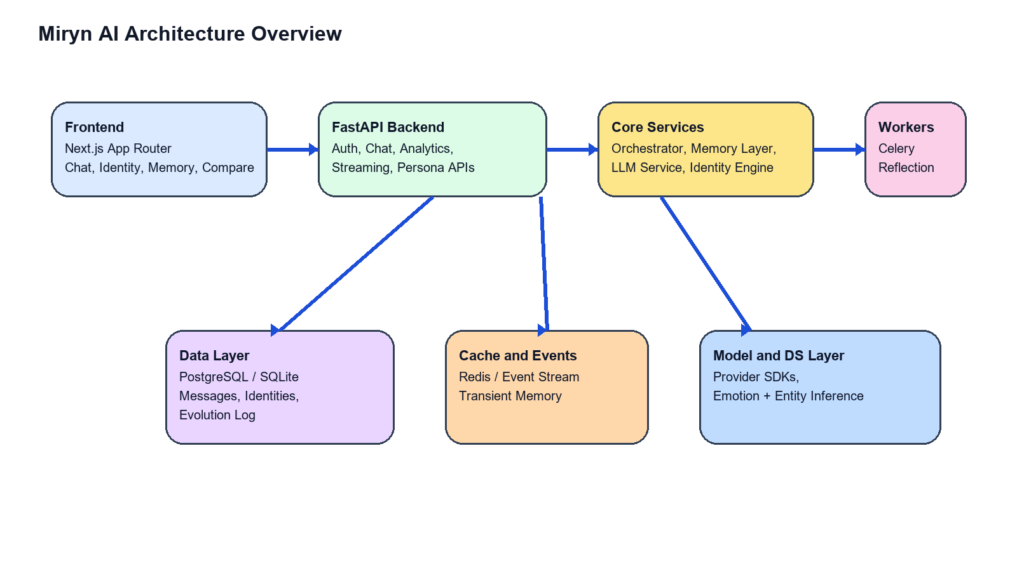
PROPOSED METHODOLOGY
Source: generated from implemented codebase
UPDATED SYSTEM ARCHITECTURE
Next.js frontend hosts the user-facing surfaces for chat, identity, memory, and compare.
FastAPI routes act as the application boundary and pass requests into orchestrator-driven service logic.
Core services manage context retrieval, identity state, prompt construction, and memory persistence.
Redis and workers allow reflection and events to happen after the visible response path.
Group BTCSE-86
DIT University
March 2026

Slide 23
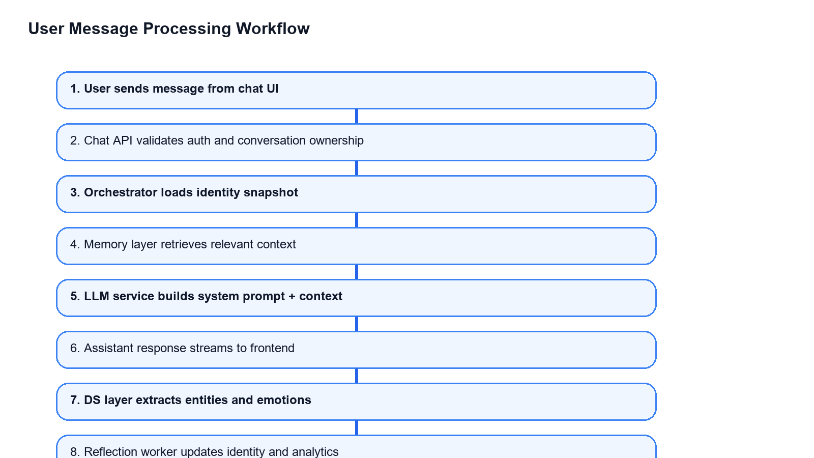
PROPOSED METHODOLOGY
Source: generated from implemented codebase
UPDATED WORKFLOW DIAGRAM
User message arrives through the chat UI and is validated by the backend.
Orchestrator loads identity and retrieves memory before the LLM call.
Response is streamed first so the chat experience remains responsive.
Only after that does Miryn continue with DS inference, event publication, and reflection updates.
Key optimization in final build: reflection and non-critical analytics were moved off the first-token path.
Group BTCSE-86
DIT University
March 2026

Slide 24
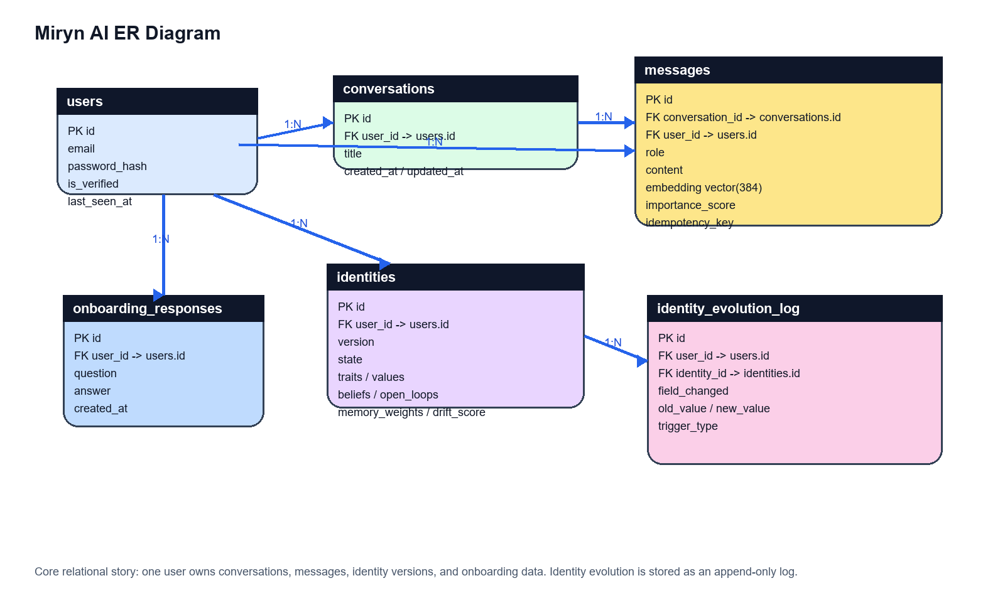
PROPOSED METHODOLOGY
Source: backend models + schema alignment
ENTITY RELATIONSHIP DIAGRAM
Users own conversations, messages, identity versions, and onboarding data.
Messages store role, content, embeddings, importance score, and idempotency metadata.
Identity versions are append-oriented and linked to evolution logs for state-change inspection.
Group BTCSE-86
DIT University
March 2026

Slide 25
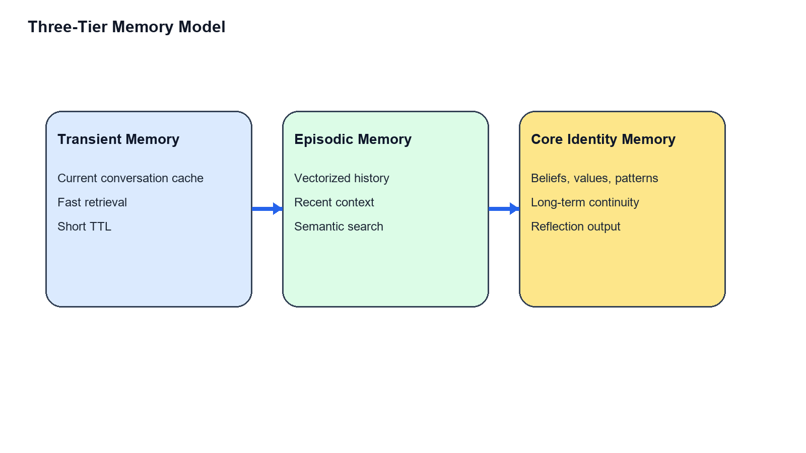
PROJECT DESCRIPTION
Source: memory_layer.py and identity_engine.py
THREE-TIER MEMORY + IDENTITY ENGINE
Transient memory supports immediate continuity inside an active session.
Episodic memory stores semantically retrievable history for recent recall.
Core identity memory stores beliefs, open loops, patterns, emotions, and conflict traces.
Identity snapshots unify these into a stable state used before every future response.
Hybrid retrieval balances semantic similarity, temporal relevance, and importance rather than treating every old message equally.
Group BTCSE-86
DIT University
March 2026

Slide 26
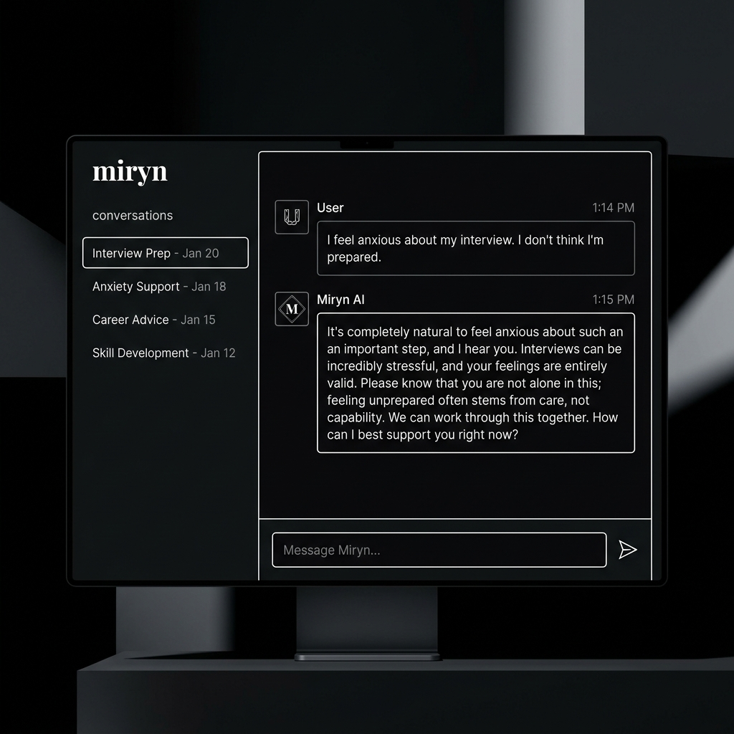
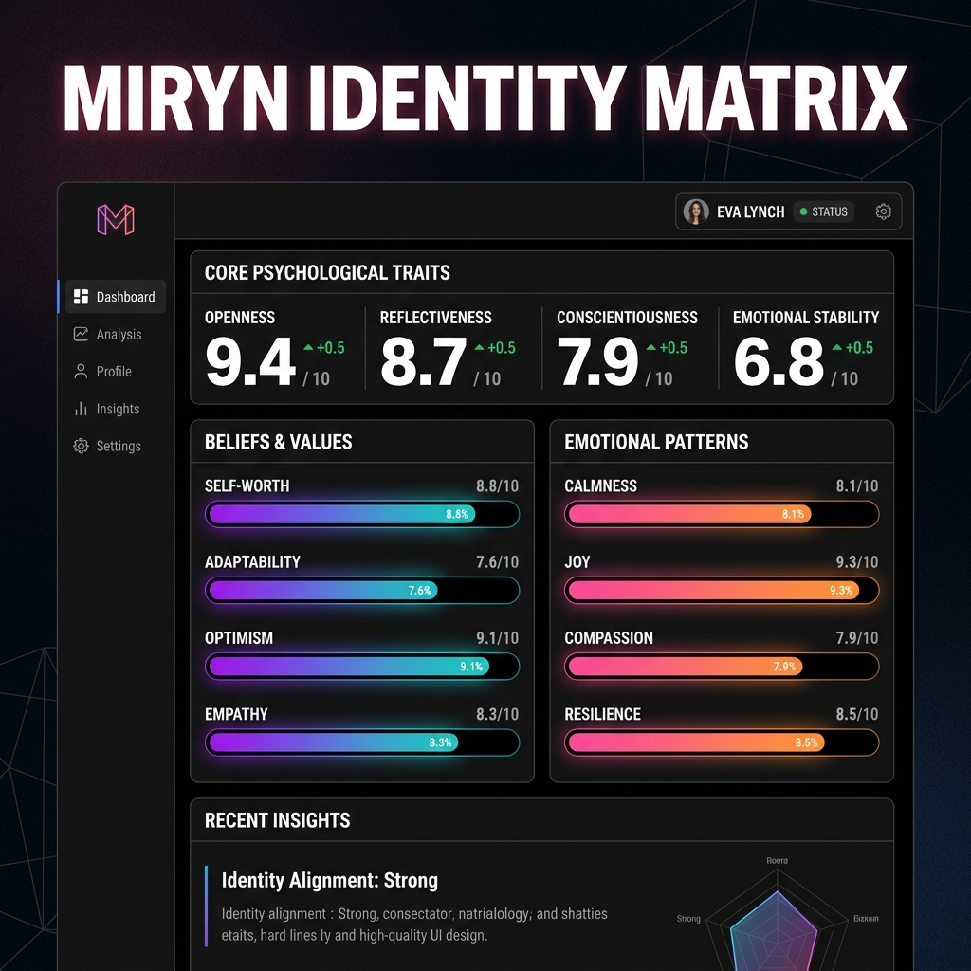
PROJECT DESCRIPTION
Source: implemented compare pages
COMPARE WORKSPACE AND PERSONA DRILL-DOWN
The compare workspace acts as the thesis evaluation surface rather than forcing screenshots out of raw developer views.
Each persona can be opened separately in identity, memory, or past-conversation mode for evidence capture.
This makes the architecture inspectable and presentable to a supervisor or viva panel.
Group BTCSE-86
DIT University
March 2026

Slide 27
CASE STUDY
Source: seeded demo personas
SAD USER VS CONFIDENT WORKING USER
Persona A - Vulnerable Soul
Persona B - High Performer
Emotionally burdened, grief-heavy, lower confidence.
Speaks through loneliness, atmosphere, sleep disruption, and personal meaning.
Miryn should answer with slower pacing, gentler reflection, and memory of emotionally important prior context.
Confident, project-focused, and execution-oriented.
Speaks through launch planning, hiring, deployment, latency, and measurable progress.
Miryn should answer with concise strategic continuity and stronger action orientation.
Research value of this comparison: the same system must produce different evolving internal models, not only different surface tones.
Group BTCSE-86
DIT University
March 2026

Slide 28
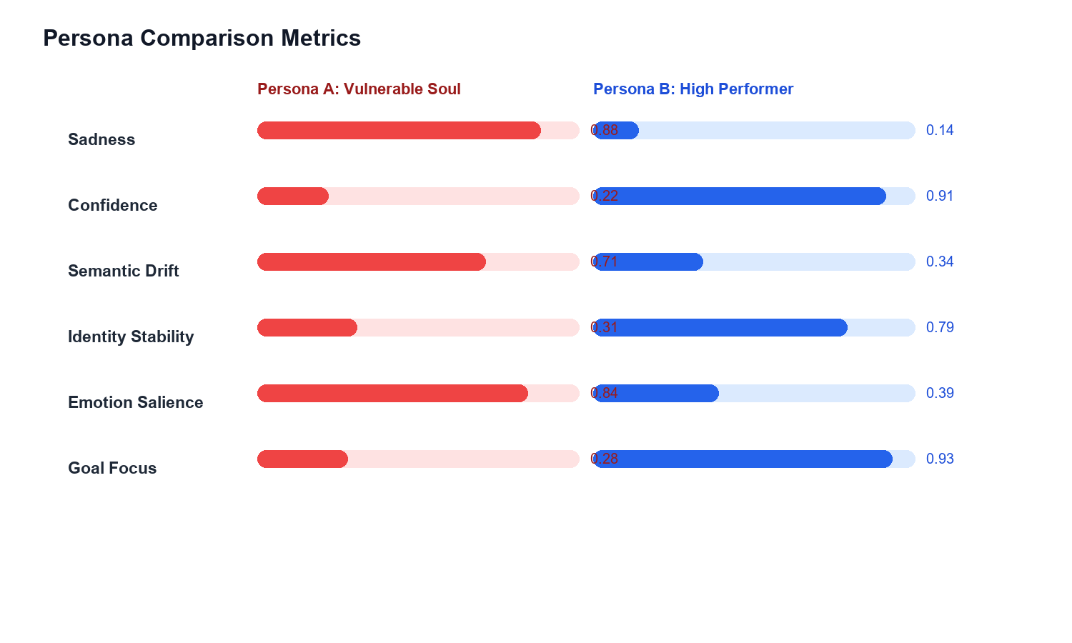
CASE STUDY
Source: compare analytics output
PERSONA COMPARISON METRICS
Metric | Vulnerable | High Performer
Sadness | 0.88 | 0.14
Confidence | 0.22 | 0.91
Semantic Drift | 0.71 | 0.34
Identity Stability | 0.31 | 0.79
Goal Focus | 0.28 | 0.93
Higher emotional salience and drift in Persona A indicate a broader and more emotionally reinterpreted identity trajectory.
Higher confidence and goal focus in Persona B indicate a more convergent operational identity path.
Group BTCSE-86
DIT University
March 2026

Slide 29
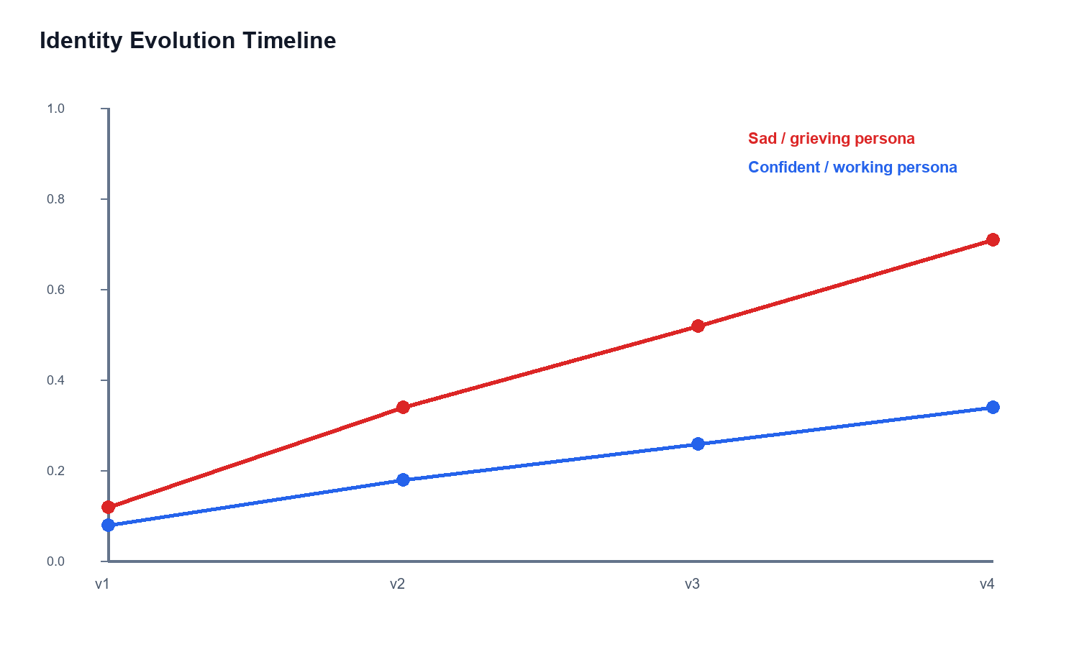
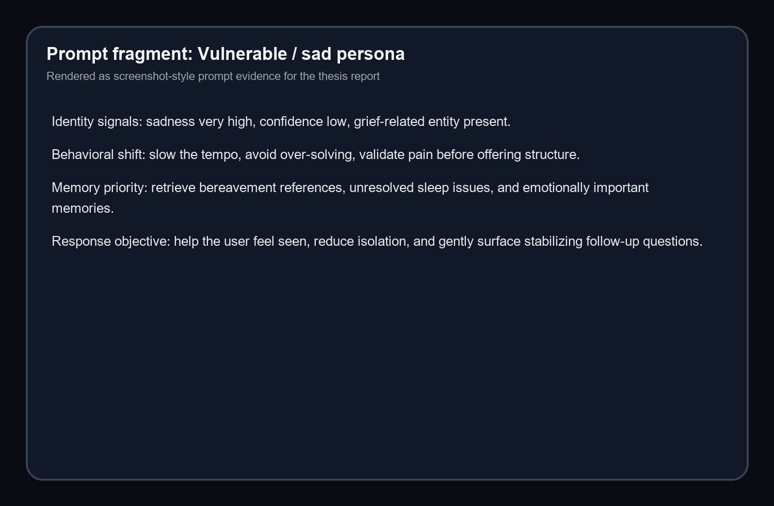
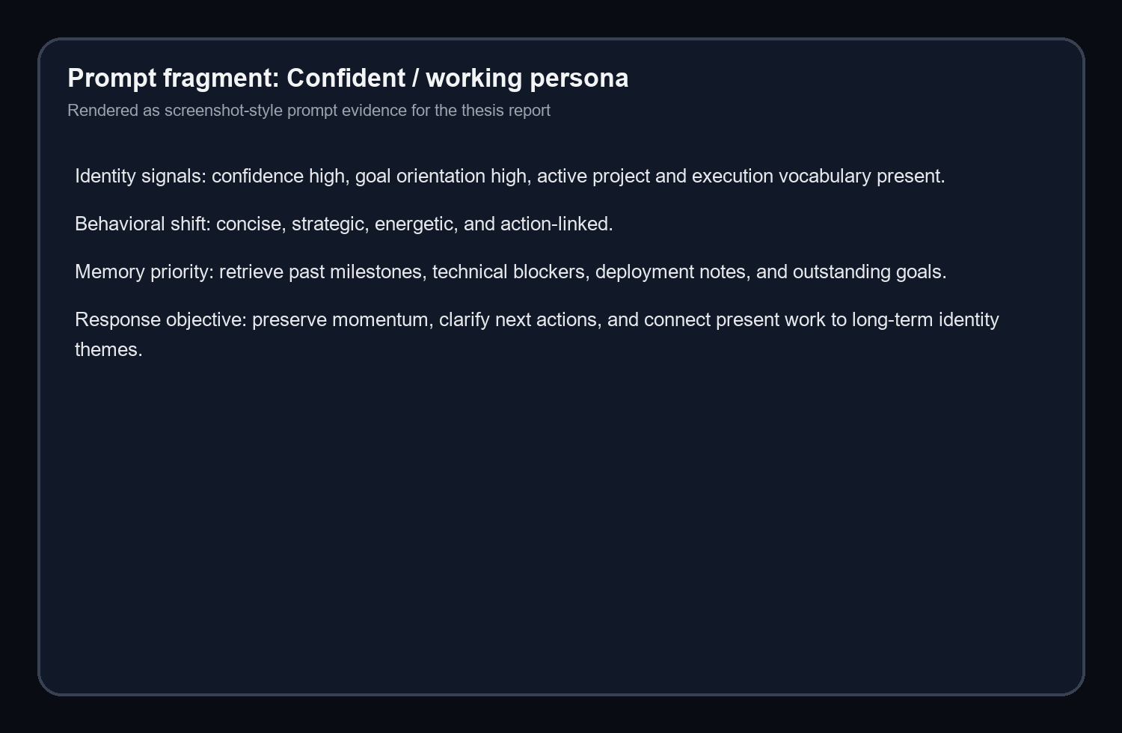
CASE STUDY
Source: generated compare report artifacts
IDENTITY EVOLUTION AND PROMPT ADAPTATION
Miryn changes not only its wording but also its memory priorities, pacing, and conversational objective for the two personas.
Group BTCSE-86
DIT University
March 2026

Slide 30
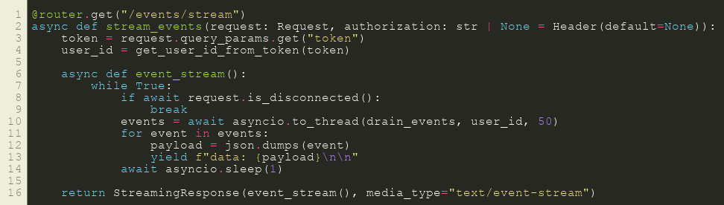
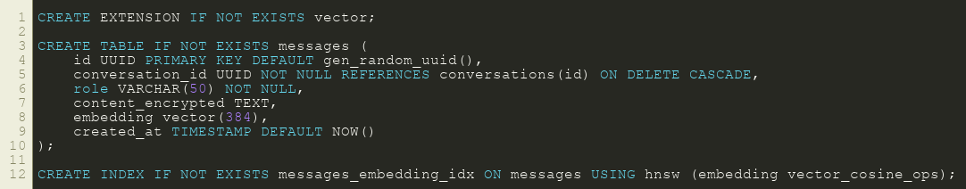
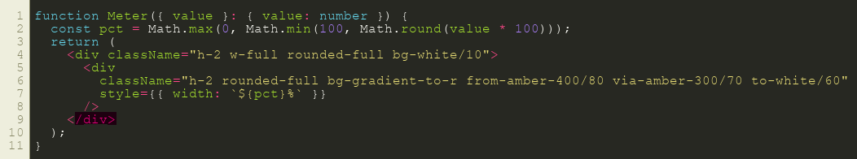
FINAL STATUS
Source: local validated thesis build
IMPLEMENTATION EVIDENCE, LIMITATIONS, AND CONCLUSION
Miryn is now best described as a strong local thesis-demo build with real identity, memory, comparison, and report surfaces implemented end to end.
The key limitation is deployment maturity: local validation is strong, but public environment wiring still remains a next step.
Final conclusion: Miryn demonstrates that an identity-first conversational architecture can move beyond stateless chat and show different user trajectories in a structured, inspectable form.
Group BTCSE-86
DIT University
March 2026

