Slide 1
PROJECT DESCRIPTION
Source: github.com/phnxsahil/Miryn-AI
IMPLEMENTED SYSTEM OVERVIEW
The original proposal deck described MIRYN AI as a persistent memory and identity framework. The implemented system now includes a working compare workspace, persona drill-down pages, deterministic reporting, and streaming route repair.
The final architecture is centered on four interacting layers: frontend surfaces, FastAPI orchestration, memory + identity services, and background reflection / event delivery.
This extension adds the implementation evidence that was missing from the earlier deck: actual system diagrams, database view, persona comparison, prompt behavior, and final thesis artifacts.
Implemented frontend routes: /chat, /identity, /memory, /compare, /compare/persona/[userId]
Implemented backend endpoints: auth, chat, streaming, analytics, compare, report, memory, identity
Implemented thesis artifacts: 47-page PDF report, prompt screenshots, code screenshots, ER diagram, and final presentation assets
Validation focus: showing that different users cause different internal identity trajectories, not just different wording in chat replies.
Group BTCSE-86
DIT University
March 2026

Slide 2
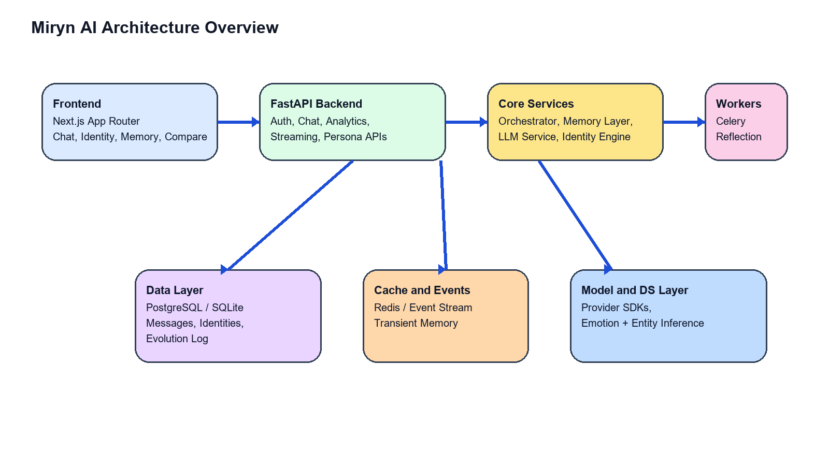
PROPOSED METHODOLOGY
Source: generated from implemented codebase
UPDATED SYSTEM ARCHITECTURE
Next.js frontend hosts the user-facing surfaces for chat, identity, memory, and compare.
FastAPI routes act as the application boundary and pass requests into orchestrator-driven service logic.
Core services manage context retrieval, identity state, prompt construction, and memory persistence.
Redis and workers allow reflection and events to happen after the visible response path.
Group BTCSE-86
DIT University
March 2026

Slide 3
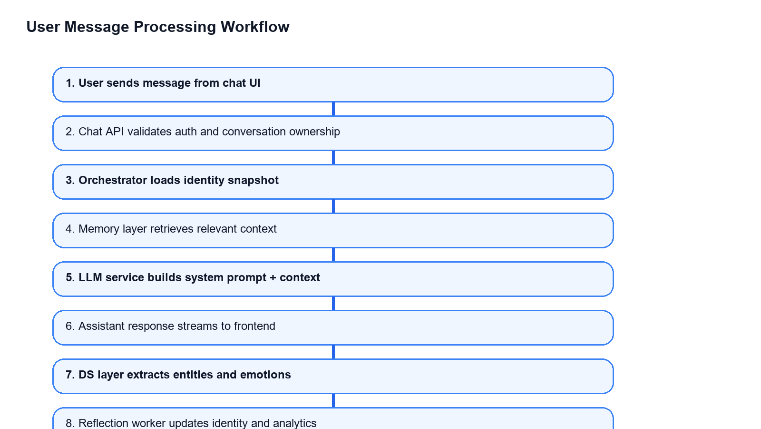
PROPOSED METHODOLOGY
Source: generated from implemented codebase
UPDATED WORKFLOW DIAGRAM
User message arrives through the chat UI and is validated by the backend.
Orchestrator loads identity and retrieves memory before the LLM call.
Response is streamed first so the chat experience remains responsive.
Only after that does Miryn continue with DS inference, event publication, and reflection updates.
Key optimization in final build: reflection and non-critical analytics were moved off the first-token path.
Group BTCSE-86
DIT University
March 2026

Slide 4
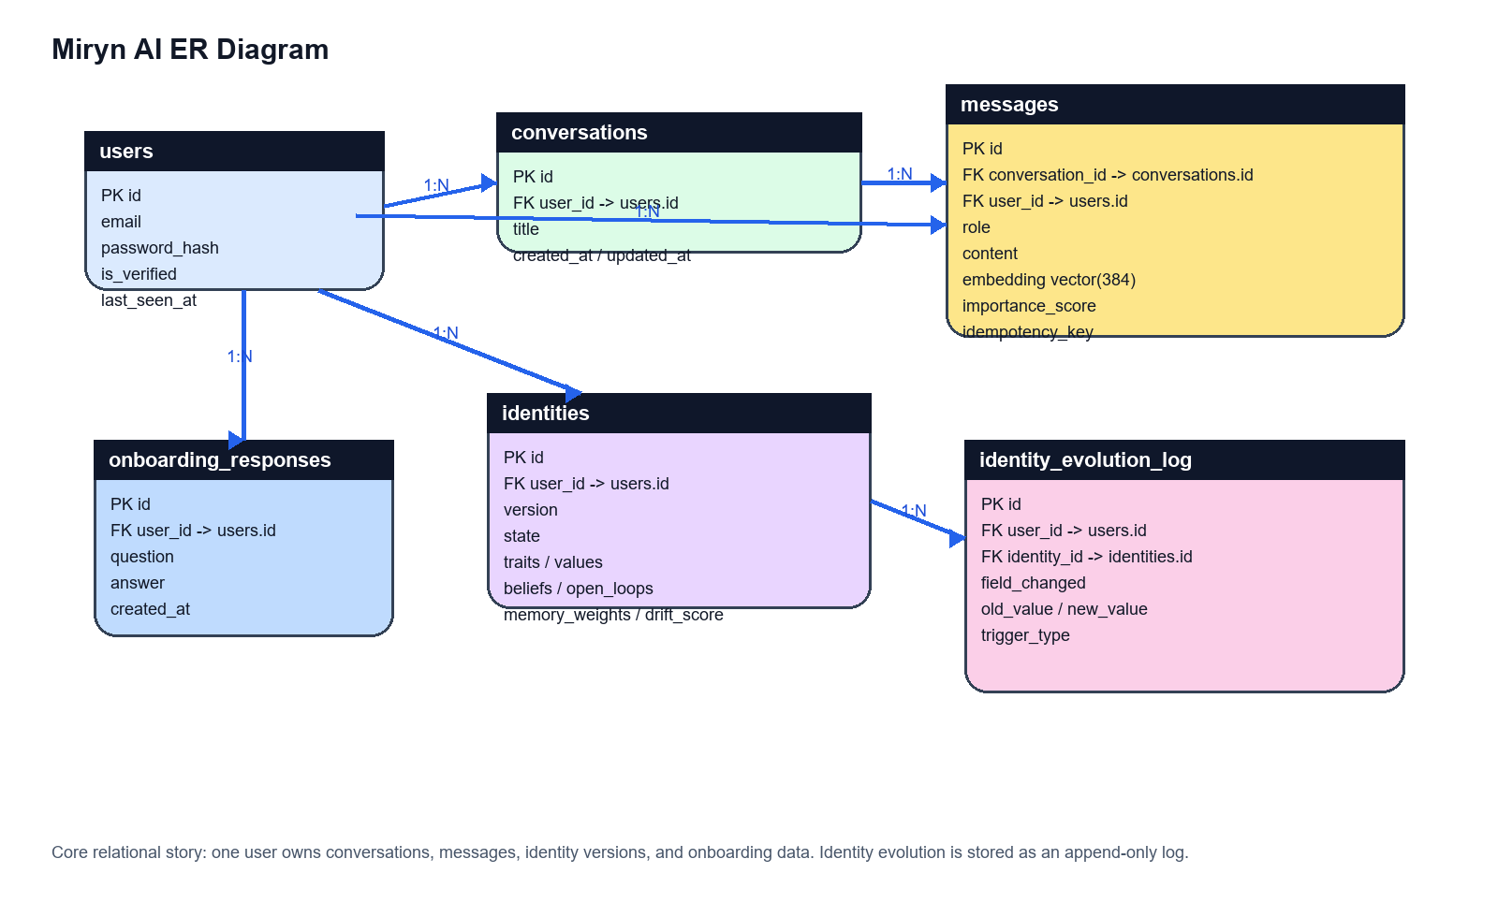
PROPOSED METHODOLOGY
Source: backend models + schema alignment
ENTITY RELATIONSHIP DIAGRAM
Users own conversations, messages, identity versions, and onboarding data.
Messages store role, content, embeddings, importance score, and idempotency metadata.
Identity versions are append-oriented and linked to evolution logs for state-change inspection.
Group BTCSE-86
DIT University
March 2026

Slide 5
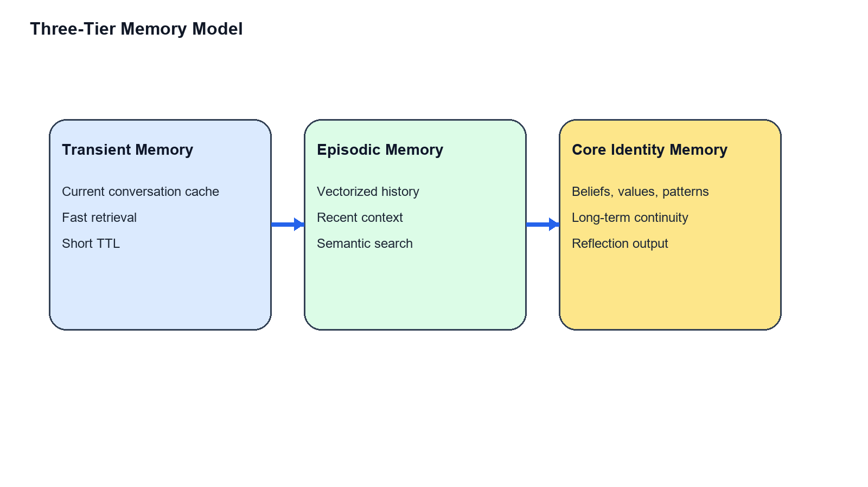
PROJECT DESCRIPTION
Source: memory_layer.py and identity_engine.py
THREE-TIER MEMORY + IDENTITY ENGINE
Transient memory supports immediate continuity inside an active session.
Episodic memory stores semantically retrievable history for recent recall.
Core identity memory stores beliefs, open loops, patterns, emotions, and conflict traces.
Identity snapshots unify these into a stable state used before every future response.
Hybrid retrieval balances semantic similarity, temporal relevance, and importance rather than treating every old message equally.
Group BTCSE-86
DIT University
March 2026

Slide 6
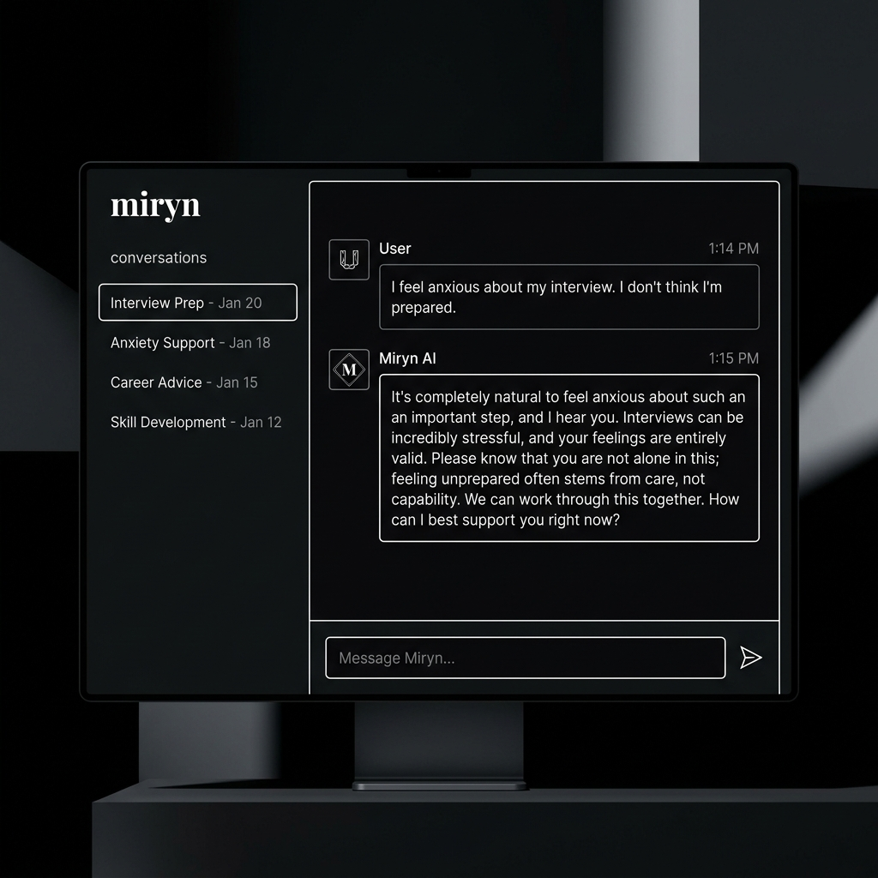
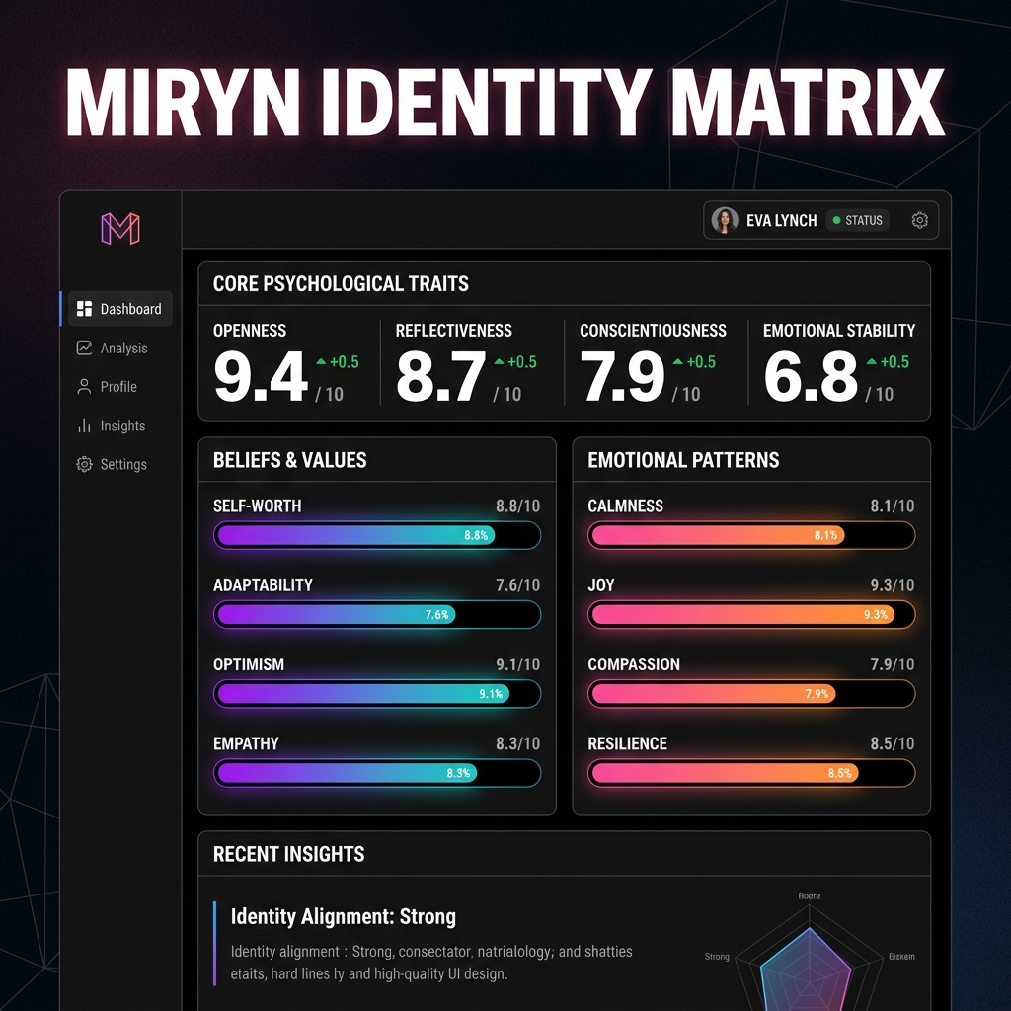
PROJECT DESCRIPTION
Source: implemented compare pages
COMPARE WORKSPACE AND PERSONA DRILL-DOWN
The compare workspace acts as the thesis evaluation surface rather than forcing screenshots out of raw developer views.
Each persona can be opened separately in identity, memory, or past-conversation mode for evidence capture.
This makes the architecture inspectable and presentable to a supervisor or viva panel.
Group BTCSE-86
DIT University
March 2026

Slide 7
CASE STUDY
Source: seeded demo personas
SAD USER VS CONFIDENT WORKING USER
Persona A - Vulnerable Soul
Persona B - High Performer
Emotionally burdened, grief-heavy, lower confidence.
Speaks through loneliness, atmosphere, sleep disruption, and personal meaning.
Miryn should answer with slower pacing, gentler reflection, and memory of emotionally important prior context.
Confident, project-focused, and execution-oriented.
Speaks through launch planning, hiring, deployment, latency, and measurable progress.
Miryn should answer with concise strategic continuity and stronger action orientation.
Research value of this comparison: the same system must produce different evolving internal models, not only different surface tones.
Group BTCSE-86
DIT University
March 2026

Slide 8
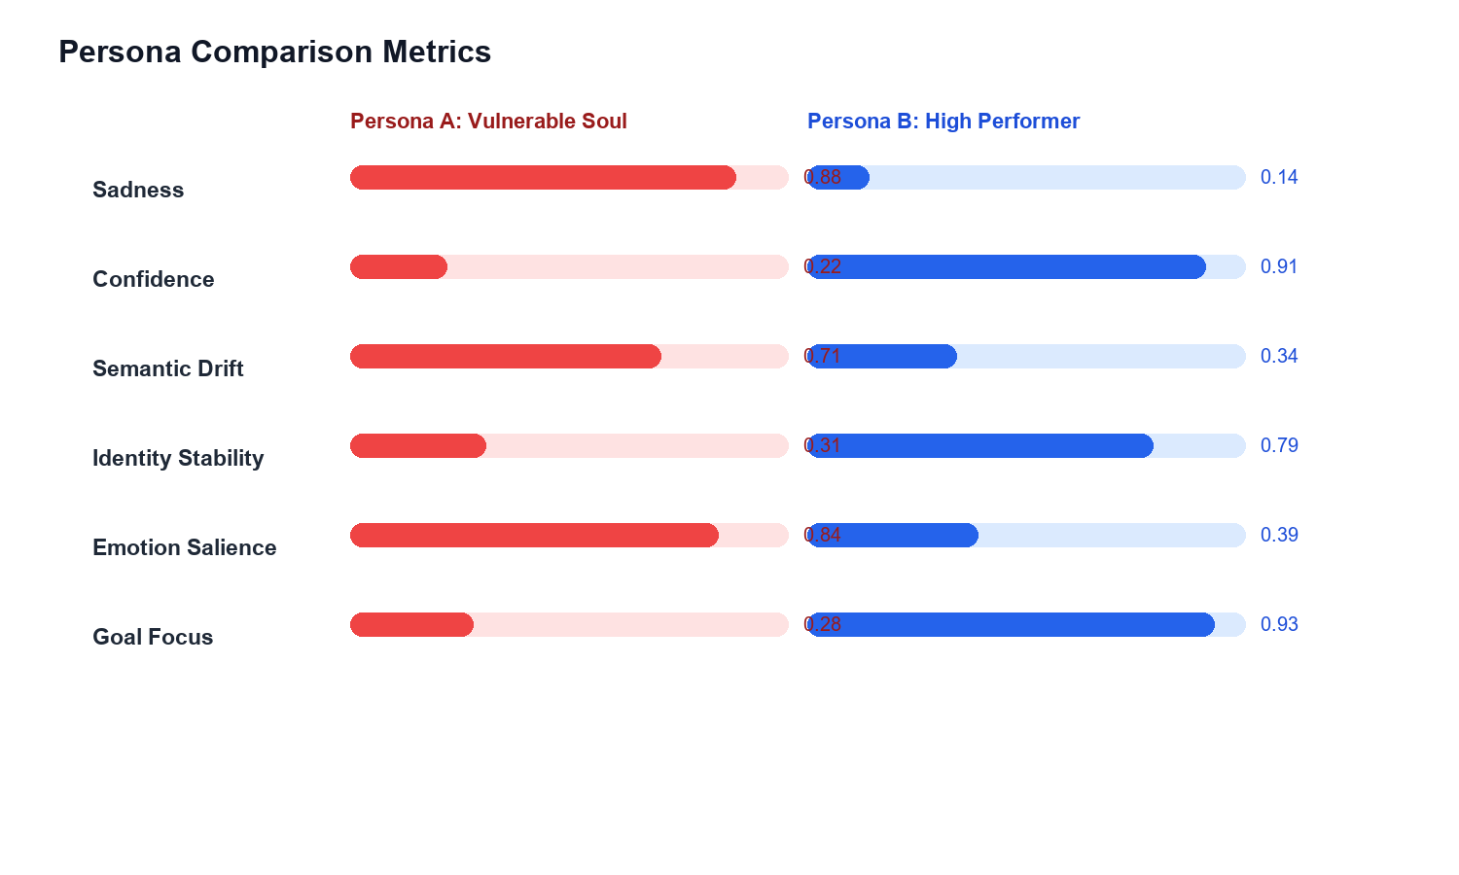
CASE STUDY
Source: compare analytics output
PERSONA COMPARISON METRICS
Metric | Vulnerable | High Performer
Sadness | 0.88 | 0.14
Confidence | 0.22 | 0.91
Semantic Drift | 0.71 | 0.34
Identity Stability | 0.31 | 0.79
Goal Focus | 0.28 | 0.93
Higher emotional salience and drift in Persona A indicate a broader and more emotionally reinterpreted identity trajectory.
Higher confidence and goal focus in Persona B indicate a more convergent operational identity path.
Group BTCSE-86
DIT University
March 2026

Slide 9
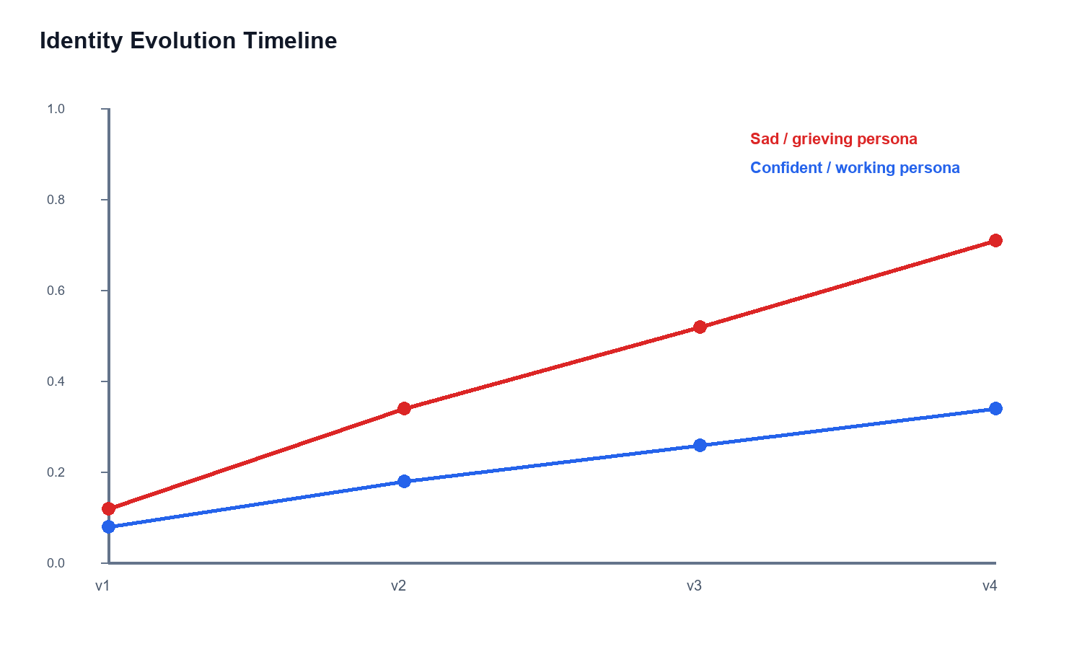
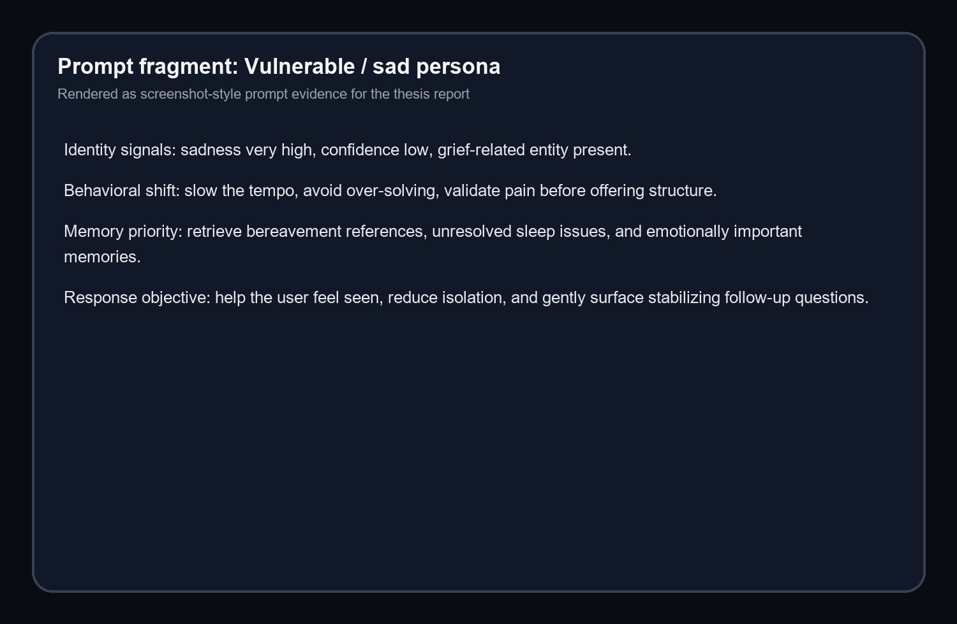
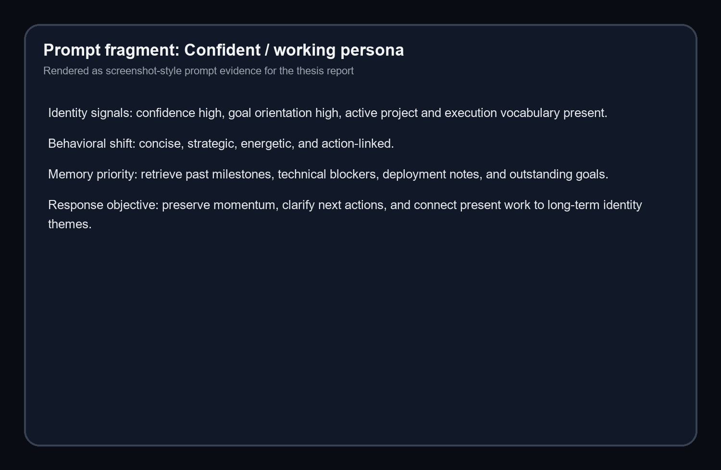
CASE STUDY
Source: generated compare report artifacts
IDENTITY EVOLUTION AND PROMPT ADAPTATION
Miryn changes not only its wording but also its memory priorities, pacing, and conversational objective for the two personas.
Group BTCSE-86
DIT University
March 2026

Slide 10
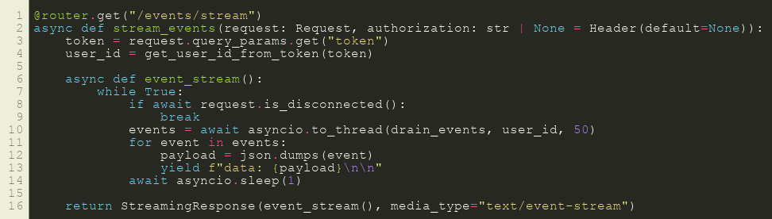
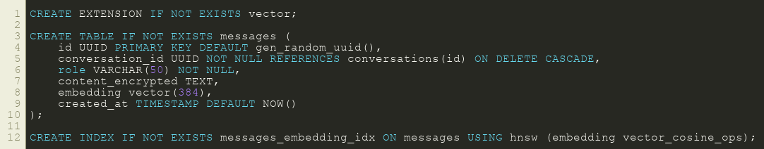
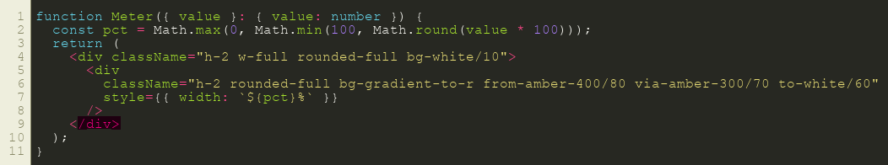
FINAL STATUS
Source: local validated thesis build
IMPLEMENTATION EVIDENCE, LIMITATIONS, AND CONCLUSION
Miryn is now best described as a strong local thesis-demo build with real identity, memory, comparison, and report surfaces implemented end to end.
The key limitation is deployment maturity: local validation is strong, but public environment wiring still remains a next step.
Final conclusion: Miryn demonstrates that an identity-first conversational architecture can move beyond stateless chat and show different user trajectories in a structured, inspectable form.
Group BTCSE-86
DIT University
March 2026

