Slide 1
Storage Media
Life Expectancies
John Van Bogart
National Media Laboratory
Digital Archive Directions (DADs) Workshop
June 22, 1998
Notes:
Dr. John Van Bogart
Data Preservation Scientist
National Media Laboratory
Building 235-1N-17, 3M Center
St. Paul, MN 55144-1000
Voice: (612) 733-1918
FAX: (612) 575-1644
E-mail: jwvanbogart@nml.org

Slide 2


National Media Laboratory
Mission: To ensure that the U.S. Government leads the world in information superiority by working with commercial industry to catalyze, influence, and exploit emerging information technology and products that satisfy government needs.
NML Home Page address:
http://www.nml.org
Notes:
The National Media Laboratory (NML) Strategic Alliance was created to bring commercial information technology expertise to the U.S. Government. Commercial expertise available to the U.S. Government through the NML Alliance includes:
Storage and Dissemination Technology
Information Management and Access
Communications Technology
Materials and Environment
Networks
Printing and Imaging
The NML Strategic Alliance is a member of the National Technology Alliance, which has been funded by Congress since 1992 and is and currently sponsored by the National Imagery and Mapping Agency (NIMA).
The National Media Laboratory hosted at 3M has taken a leadership role in helping the U.S. Government gain access to commercial technology since 1987. When the lab was first established, it was a unique approach to assist government reinvent the way it works with the commercial world. A streamlined approach has become more and more critical as commercially developed technology capabilities begin to surpass those of expensive, stand-alone systems developed and produced specifically by or for government.
Initially focused on supporting advanced government requirements for data storage (specifically, magnetic tape in those days), it became apparent to the Lab that a single focus on media was not the most beneficial to its government customer. Media, after all, is only one part of the information system.
Today, as part of the National Technology Alliance, the National Media Lab represents a strategic alliance of leading commercial companies to bring industry's best technology to each aspect of the government information system. Current NML alliance members include 3M, Ampex, General Dynamics, Imation, Lucent Technologies, Motorola, and Space Imaging.

Slide 3
NML Media Stability Studies
Since 1989
To provide solutions to U.S. Government data storage system issues.
  Technology assessment
  System reliability studies
  Media stability studies
To answer the question: “How long will my data files be accessible?”
Notes:
The National Media Laboratory (NML) is an industry resource supporting the U.S. Government in the evaluation, development, and deployment of advanced storage media and systems. NML endeavors to provide a broad perspective of current progress in information technology issues, both from a commercial and a government perspective.
NML accomplishes its mission by functioning as a:
CONSULTANT to the U.S. Government specializing in data storage and access requirements, assessing evolving technologies, determining applicability of currently available technologies to recording programs, and influencing commercial recording systems standards to accommodate Government requirements.
RESEARCH AND DEVELOPMENT FACILITY, which includes technology assessment and evaluation capabilities, measurements and testing laboratories, and prototype product development capabilities. This research facility is distributed across industry, university, and Government laboratories.
TECHNICAL SERVICE ORGANIZATION providing user support at operational sites, field monitoring, rapid crisis response; and the transfer of technology and information.
ADMINISTRATIVE AGENT in programs that require both broadly based industrial and academic resources and coordination across Government /industry boundaries.

Slide 4
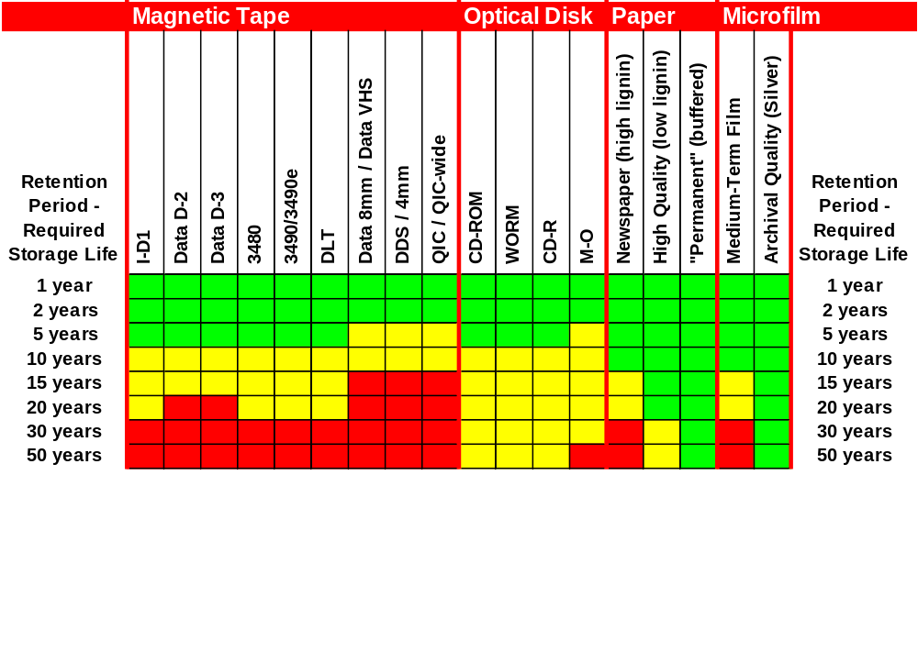
Disposition/LE Chart
For storage at 20°C (68°F) & 40% RH
Notes:
Disposition charts were developed by the National Media Laboratory in 1994 to support a request from the Department of Defense. The chart above was designed to be used in conjunction with document retention (disposition) schedules to determine which media types were acceptable for storing documents for the required length of time.
The chart above considers magnetic tape, optical disk, paper, and film media types. In determining the LE numbers, all of the most likely modes of failure have been considered. For magnetic tape, binder hydrolysis, pigment deterioration, and backing instabilities have all been considered.
Media quality can vary appreciably from vendor to vendor. Also vendors have good manufacturing days and bad ones. Therefore, a range of life expectancies is provided (shown in yellow) to consider these variation in media quality.
On the chart above, areas in green indicate that ALL media should be able to survive reliably under the storage conditions indicated. Areas in yellow indicate that only the “best” vendors will survive for the times indicated. Areas in red indicate that even the “best” media may be unable to survive for the times indicated.
For example, under storage conditions of 20 C and 40% relative humidity, any brand of 3480 tape should reliably store information for 5 years. However, only the highest quality 3480 tapes can be trusted to store information for 20 years.

Slide 5



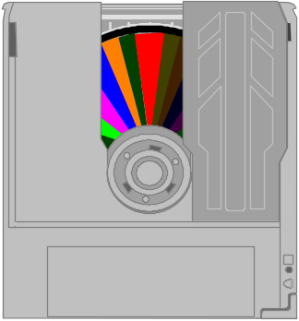
Media Stability Studies
Aging
Failure Analysis
Modeling
Extrapolation
Notes:
At the National Media Laboratory, a variety of magnetic tape and optical disk media types have been aged in accelerated environments. Subsequent failure analysis and modeling of deteriorating media properties allow the longevity of these media to be estimated.
A basic accelerated methodology includes:
Use of several accelerated temperature/humidity/pollutant environments to artificially age the media
The measurement of media physical properties and error/dropout rates at regular intervals.
The modeling of properties versus time using appropriate kinetic models.
Determination of the Life Expectancy, commonly referred to the LE value for a particular medium involves:
Extrapolation of models determined from accelerated aging studies using standard methods.
Application of an appropriate set of End-of-Life criteria—consisting of a material property and a value at which failure of the tape system occurs. An example of an end of life criteria is a Block Error Rate of 220 commonly used to evaluate the longevity of CD-ROM media.

Slide 6
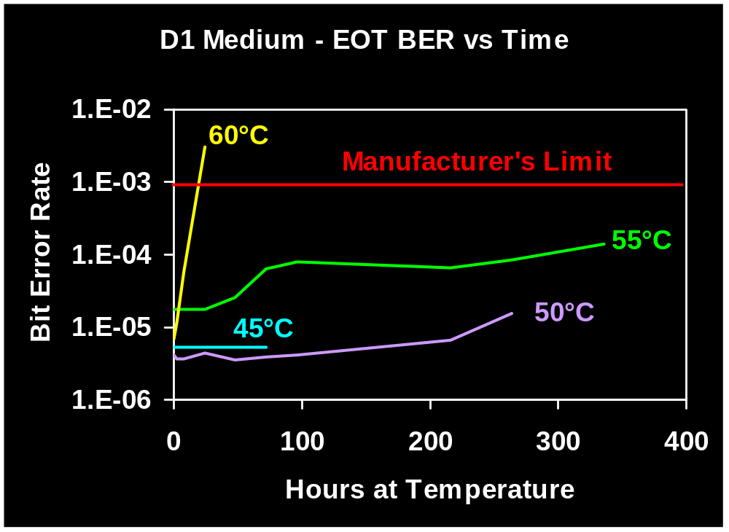
Accelerated Aging - Tape
Notes:
The above chart indicates that a permanent data loss occurred as the result of mis-tracking after a D1 (digital video) tape was stored at 60 C (140 F) for 24 hours. Storage at this temperature allowed the tape backing to undergo dimensional changes which allowed stresses in the backing to relax (stress relaxation). The dimensional changes were great enough to distort the data tracks and raise the uncorrected bit error rate above the manufacturer’s limit resulting in hard errors.
No tape or disc is ever error free. Error-free media would be too expensive to produce. Instead, tape and disc systems use error correction code (ECC) schemes that allow bit errors to be corrected when the tape or disc is read. (A tape with an uncorrected bit error rate (BER) of 1 in 10,000 read can have a corrected BER of 0.) If data is missing on one portion of the media, it may be able to be re-constructed from the redundant information written in the ECC table.
However, there is a limit to how many errors the ECC schemes can handle before the system is unable to correct the error and the user actually experiences a read error. In the example above, the maximum uncorrected bit error rate is 1 bad bit in 1,000 bits read. For CD-ROM discs, the maximum allowed block error rate is 220 (average).

Slide 7

Media Lifetimes
35
?
?
20
?
?
?
10
How long will
my tapes last?
27 years
Notes:
Dependable storage strategy requires a knowledge of media longevities.
The prevalence of media vendors, hardware suppliers, and tape formulations make it impossible to come up with a single LE number that is valid for a given media at a specified storage condition. Furthermore, media may fail for reasons other than those considered when determining the indicated LE values.
It is best to use the LE’s as “guidelines” rather than numbers “carved in stone.” Currently, there are no accepted standards for determining the LE (life expectancy) of magnetic tape media. Standard methods for determining the life expectancy of optical disks have been developed by ANSI, but not all manufacturers perform the necessary product testing.
With moderate care, most magnetic tapes used for digital data storage will last for 10 years. With special storage and handling, digital magnetic tape formats can reliably store information for 30 years or more. The longevity of magnetic tapes can be significantly increased by storing the tapes at lower temperatures and humidities.
Optical disc media can last for several decades. Testing by Imation/3M indicates that their CD-ROM media will last for over 100 years. Research by Kodak shows that their CD-Recordable media is also estimated to last for over 100 years. On the other hand, magneto-optical (M-O) and phase change (PD) media have a life expectancy comparable to magnetic tape of 10 - 30 years.

Slide 8
…your LE may vary...
The quality with which the media was manufactured -- manufacturers and lots vary in quality
The storage temperature and humidity
The cleanliness of the storage environment
The care with which the media is handled
The number of times the media is accessed over its lifetime
The quality of the recorder used to read/write to the media
Technological obsolescence
Notes:
Keep in mind that LE values are similar to “mile per gallon” ratings for automobiles -- “your actual mileage may vary” depending on the number of times the tape or disc is accessed during its life, the quality of the conditions in which it is stored, and the care with which it is handled/shipped.
With regard to technological obsolescence, digital tape and disk media require special hardware in order to be read. Even if the media survives for 50 years or more, the technology needed to read the data may not survive for more than 10 or 20 years. Thus, the life of a digital archive may be limited by obsolescence of the drive hardware rather than the stability of the media.
Technology WILL change -- Migration to new recording systems and transcription of records to new media is inevitable to preserve the records. Some US government agencies transcribe all of their data to a proven “state-of-the-art” format every ten years. The old records are maintained until the next transcription occurs. In this way, the media/system is only required to last 20 years. Furthermore, there are always two copies of the information available.

Slide 9
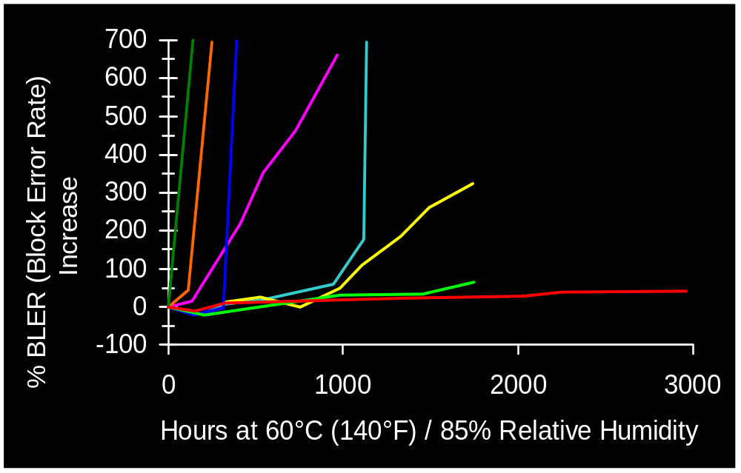
CD-ROM: Durability
Source: Bill Murray, “CD-ROM Archivability,” NML Bits, 2(2), 4 (1992)
Notes:
The chart shows that there is also a wide variability in the stability of CD-ROM disks produced by various manufacturers.
On this chart, the percent increase in block error rates (BLER’s) is plotted as a function of time. The CD-ROMs were aged in an environment of 60 C and 85% RH. Some disks were unplayable after less than 100 hours in this environment. Other manufacturers products lasted over 3000 hours.

Slide 10

LE - Qualifying
To completely qualify a LE value:
  Temperature
  Humidity
  Failure Criterion
    Property & Value
  Percent Surviving
  Confidence Interval
The same set of data can give many different LE values ! !
Notes:
Several criteria are required to fully qualify a Life Expectancy value.
The same set of experimental data can provide different LE values depending on the end-of-life criteria used. In his book, Optical Recording: A Technical Overview, Alan Marchant states that “one company has variously quoted lifetimes of thirty, fifty, and one hundred years for a write-once optical disk product, basing these different estimates on exactly the same test data.” When reviewing manufacturers’ media archival life values, it is important to understand the method and criteria by which the LE values were determined.
The “weak link” in a data storage product will determine its lifetime. A tape with a 80 year expected life based on magnetic property performance may have an actual life of only 30 years by reason of poor binder stability.

Slide 11
AES/ANSI IT9-5 JTC
Write standards for estimates of media longevity
Write standards for storage, handling, and transfer
Meets twice a year (June & Dec.)
Representatives from industry, government, and academia
    IBM Imation Kodak Quantegy
    NARA NIST Library of Congress
Notes:
Belfer Audio Archive, Syracuse University
CD-Info Company
Digital Audio Disc Corporation
Eastman School of Music
FBI
IBM
Image Permanence Institute
Imation
Kodak
Library of Congress
Media Machines International
National Archives
National Association of Photographic Manufacturers
National Film Board of Canada
National Media Laboratory
NIST
Optical Science Center, University of Arizona
Quantegy
Sony
Specs Bros
Tape Archival and Restoration Service
University of Missouri
Some of the organizations represented on the Audio Engineering Society/American National Standards Institute Joint Technical Commission (AES/ANSI IT 9-5) on media longevities are listed below.

Slide 12
ANSI LE (Existing)
Life Expectancy of Compact Discs (CD-ROM) (IT 9.21)
Polyester Base Magnetic Tape - Storage (IT 9.23)
Life Expectancy of Magneto-Optic (MO) Disks (IT 9.26)

Slide 13
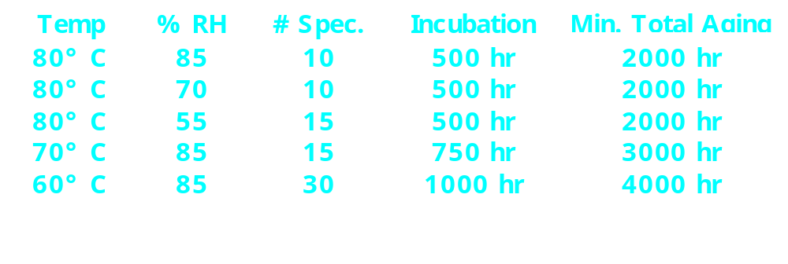
ANSI: LE of CD-ROM
    Failure: 10 second average of the block error rate (BLER, ISO/IEC 10149) >= 220
    Eyring acceleration model
    Weibull failure distribution model
    Report LE: “At a storage condition of 25° C and 50% RH, 95% of the product evaluated will last __ years, with 95% confidence.”
Notes:
The ANSI/NAPM IT9.21-1996 American National Standard for “Life Expectancy of Compact Discs (CD-ROM)--Method for Estimating, Based on Effects of Temperature and Relative Humidity” outlines a method for estimating the longevity of a CD-ROM disc by aging discs to failure. The point of failure is an average block error rate (BLER) of 220. An Eyring kinetic model is used to determine acceleration factors at each of five aging conditions. The distribution of failure times is then analyzed as a Weibull failure distribution. Results are extrapolated to 25° C and 50% RH to estimate a life expectancy for the sample population at those conditions.
The test requires a minimum of 80 test samples and five temperature-humidity conditions. Discs are aged for a period of time, removed from the test chambers, BLER rates are measured, and any unfailed discs are returned to the chambers for another incubation period. The test requires a minimum of 6-months to complete.
The life expectancy of the CD-ROM media is reported using the following language: “At a storage condition of 25° C and 50% RH, 95% of the product evaluated will last X years, with 95% confidence.”

Slide 14
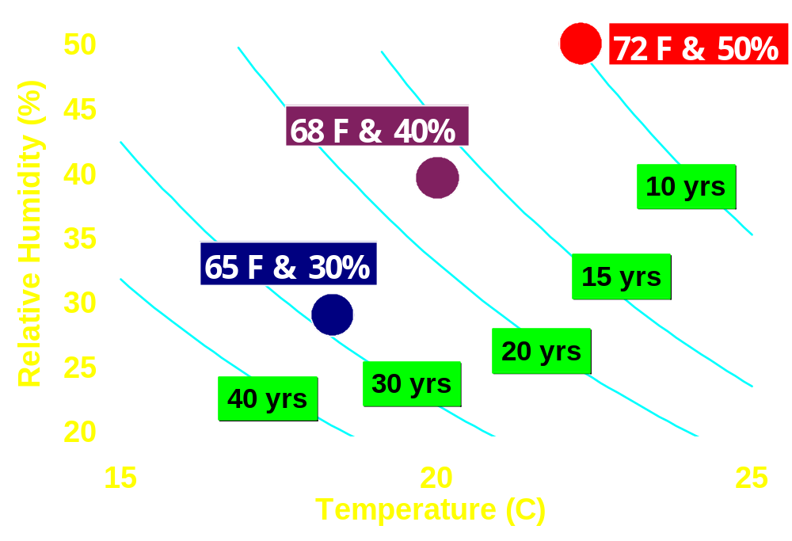
LE: High Grade VHS Tape
Notes:
Modeling the hydrolysis of tape binder and application of an appropriate set of failure criteria allow the LE’s for a high grade VHS to be estimated at various storage conditions and temperatures in the chart above. For the sake of discussion, it is assumed that the LE of this particular tape is 10 years when stored at 72 F & 50% RH. Furthermore, only the detrimental effects associated with hydrolysis of the binder are considered in determining LE values.
Cooling tape results in the slowing of the chemical processes which are degrading the tape. Drier conditions reduce the amount of water absorbed by the tape and also reduce the rate and ultimate extent of binder hydrolysis.
One point that this chart makes is that slightly higher humidities can be tolerated at lower storage temperatures for the same level of binder degradation. It also shows the benefits of lower temperature and humidity storage.
The chart also demonstrates that the life expectancy of magnetic tape can be significantly increased by slightly lowering the temperature and humidity of storage. Life expectancies of 10, 17, and 28 years are estimated for storage conditions of 72 F & 50% RH, 68 F and 40% RH, and 65 F & 30% RH, respectively. In these examples, both the humidity and temperature have been reduced simultaneously. However, it is not necessary to reduce both to see a benefit in media longevity. Either the temperature or humidity can be reduced with benefit to the media.

Slide 15
Storage Conditions
Past
  70° F (21° C) & 50% RH (SMPTE - 1982)
  65° F (18° C) & 40% RH (NARA-1990)
Future (ANSI, SMPTE, . . . )
  For easy access:
    60 - 74° F (15 - 23° C)
    30 - 55% RH
  Extended term storage:
    As low as 50° F (10° C)
    As low as 20% RH
Notes:
Current industry standards recommend that materials be stored around 20 C and 40 - 50% relative humidity. They may not be the best conditions for the long-term storage of magnetic tape and optical disk media.
In the case of short-lived information, storage conditions can be at or near the room ambient conditions. No special storage facilities would be required, assuming that temperatures stayed between 20 - 24 C year round and the humidity never exceeded 55% RH.
For the indefinite storage of information, special storage facilities would be required to maximize the lifetime of the media. Storage temperatures as low as 40 F and humidities as low at 20% RH are being considered.
No medium lasts forever, so transcription of information from old, deteriorating media to new media would eventually be required; however, storage conditions can be optimized to preserve the current media copy of the information for as long as possible.

Slide 16
ANSI (In Draft)
In Draft
  LE of CD-R
  LE of Magnetic Tape
  Handling of Magnetic Tape
  Storage of Optical Disc (IT 9.25)
Proposed
  LE of DVD
  Light Stability of CD-R

Slide 17
Conclusions
To preserve digital information
  Knowledge of media longevity is essential
  Transcription is inevitable
ANSI/AES JTC
  Standard LE methods
  Storage/Handling guidelines
Future needs
  Use of ANSI test methods -- publish LE ratings for media
  Systems that monitor bit errors and warn of imminent media/drive failures
Notes:
In order to preserver information stored on digital media in perpetuity, a knowledge of digital media longevities is essential for proper archive maintenance. However, because of rapid advances in digital data storage technologies and the fragility of digital media, transcription of information from older to newer media at regular intervals is inevitable.
The AES/ANSI joint technical commission has developed and is continuing to develop standard test methods for estimating the life expectancies (LE’s) of optical disc and magnetic tape. This committee has also developed guidelines for the storage and handling of media that will ensure the media can be preserved for as long as possible.
In the future, manufacturers need to use these standard test methods and provide users with reliable LE estimates for media. There is also a great need for systems that monitor error rates on media and alert the user when the media is close to failure. This would allow sufficient time to copy the information to newer media before documents were permanently lost. An example of this is SMART (Self-Monitoring And Reporting Technology) which is built into some newer hard drives. This technology monitors disk drive performance and can predict drive failure before they occur.

