Slide 1

FISHERIES STOCK ASSESSMENT · SPECIAL SESSION
Getting Started
with ELEFAN
Reading fish growth from length-frequency data
Matsuishi Takashi Fritz
Notes:
Hello. Today's topic is ELEFAN.
ELEFAN is a method for estimating how fast fish grow, using only their lengths, even when their ages are unknown.
We will go through how it works, how to use it, and its pitfalls.

Slide 2
INTRODUCTION
Why do we need ELEFAN?
Ages are hard to read
Lengths are easy
ELEFAN
Measured at markets and landing sites: cheaply, in large numbers, every month
Estimates growth parameters from length-frequency data alone (Pauly & David 1981)
In tropical fishes and invertebrates, otolith rings are often unclear
ELEFAN = Electronic LEngth Frequency ANalysis
Getting Started with ELEFAN | 2
Notes:
Stock assessment needs information on growth: how fast fish grow.
Usually, we read age from the rings in otoliths. But in tropical fishes, and in invertebrates such as shrimps and clams, the rings are often unclear.
Lengths, on the other hand, can be measured at markets and landing sites, cheaply, in large numbers, every month.
So, in 1981, Pauly and David developed ELEFAN. The name stands for Electronic Length Frequency Analysis.
It is still widely used in stock assessments in Southeast Asia and Africa.

Slide 3
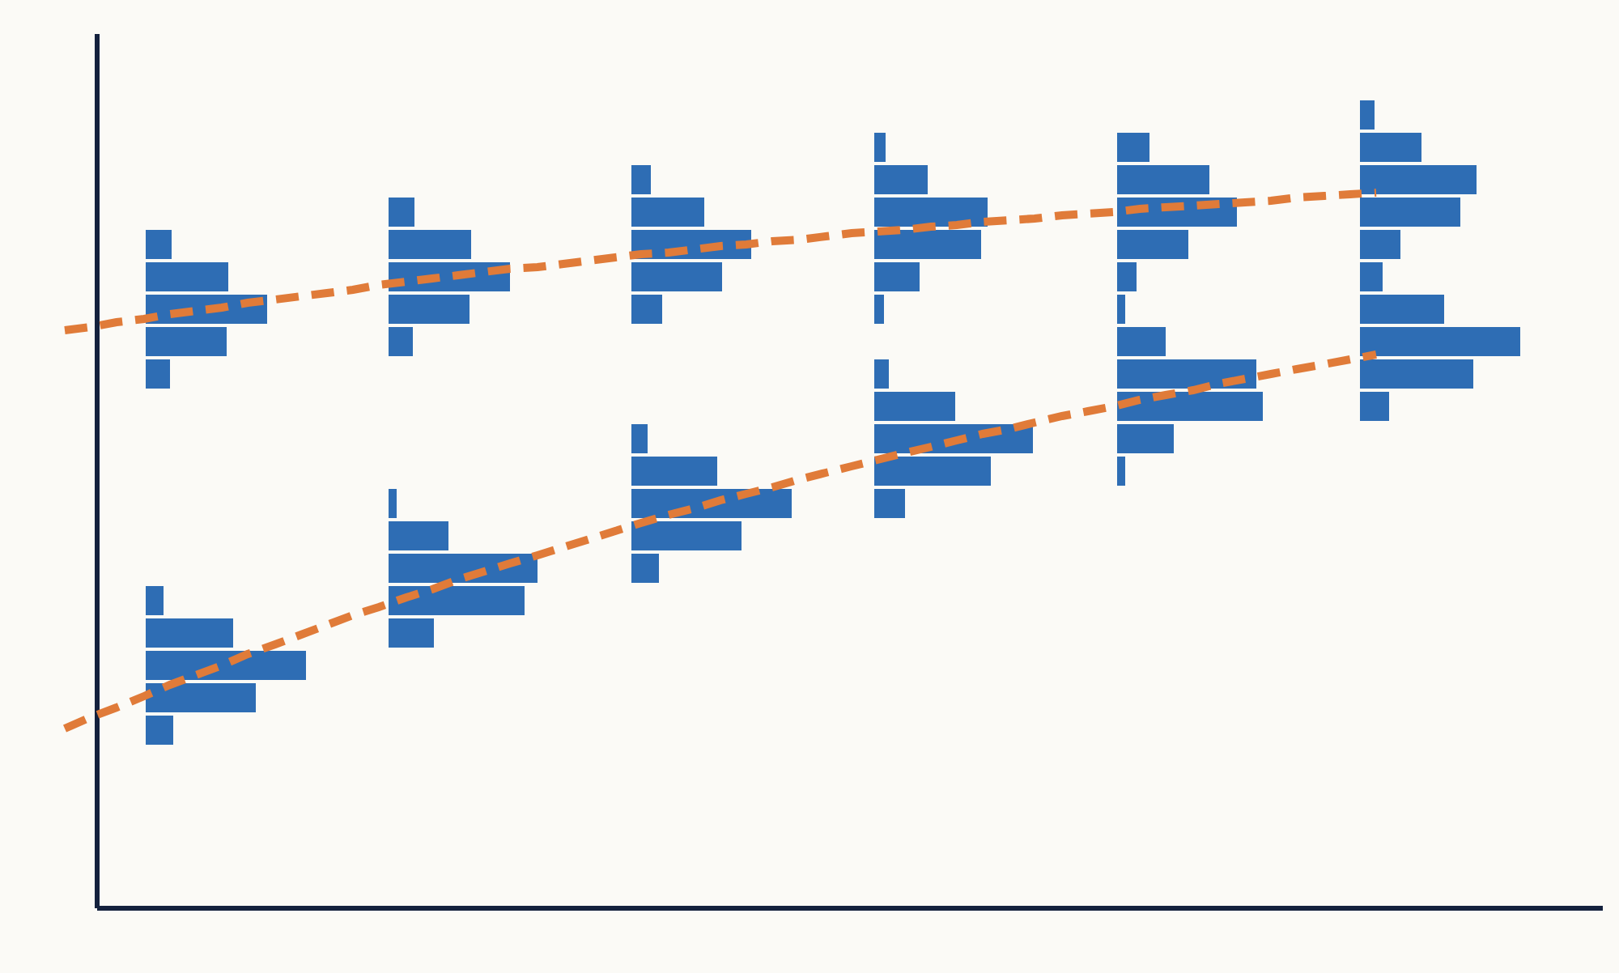
HOW IT WORKS
Peaks in length data are cohorts
Fish born in the same year form one peak in the length distribution
Sampled every month, the peak moves to larger lengths: that is growth
The line linking the peaks is the growth curve
Vertical: length · Horizontal: samples (every 2 months) · Bars: number of fish
Getting Started with ELEFAN | 3
Notes:
The idea behind ELEFAN is very simple.
Fish born in the same year are called a cohort. Their lengths are similar, so together they form one peak in the length distribution.
This figure shows six samples, taken every two months, side by side. The vertical axis is length, and the length of each bar is the number of fish. From left to right, the peaks move up, toward larger lengths. That is growth.
Linking the peaks gives the orange dotted line. This line is the growth curve.
ELEFAN uses a computer to find the growth curve that best links the peaks.

Slide 4
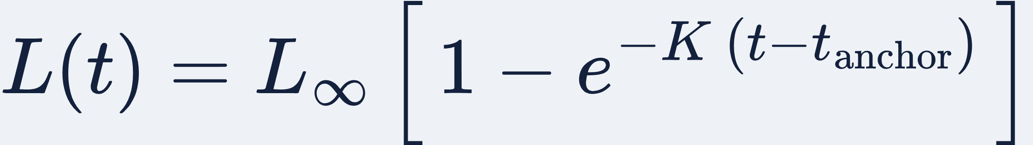
HOW IT WORKS
The von Bertalanffy growth function
Symbol | Meaning | In ELEFAN
L∞ | Asymptotic length | Hard to pin down: few fish in large classes
K | Growth coefficient (/year) | Set by how fast the peaks move
t_anchor | Time when length is zero | Recruitment timing (0.25 = April)
C, ts | Seasonal growth (strength, timing) | Optional
Getting Started with ELEFAN | 4
Notes:
The shape of the line is set by the von Bertalanffy growth function.
We estimate three parameters. L-infinity is the asymptotic length, the size the fish approach but do not exceed. K is the growth coefficient, the speed of growth.
t-anchor replaces t-zero from the textbook. It is the time when length is zero, in other words, the timing of recruitment, as a fraction of the year. Zero point two five means the first of April.
For fish whose growth changes with the seasons, two more parameters, C and t-s, can be added.

Slide 5
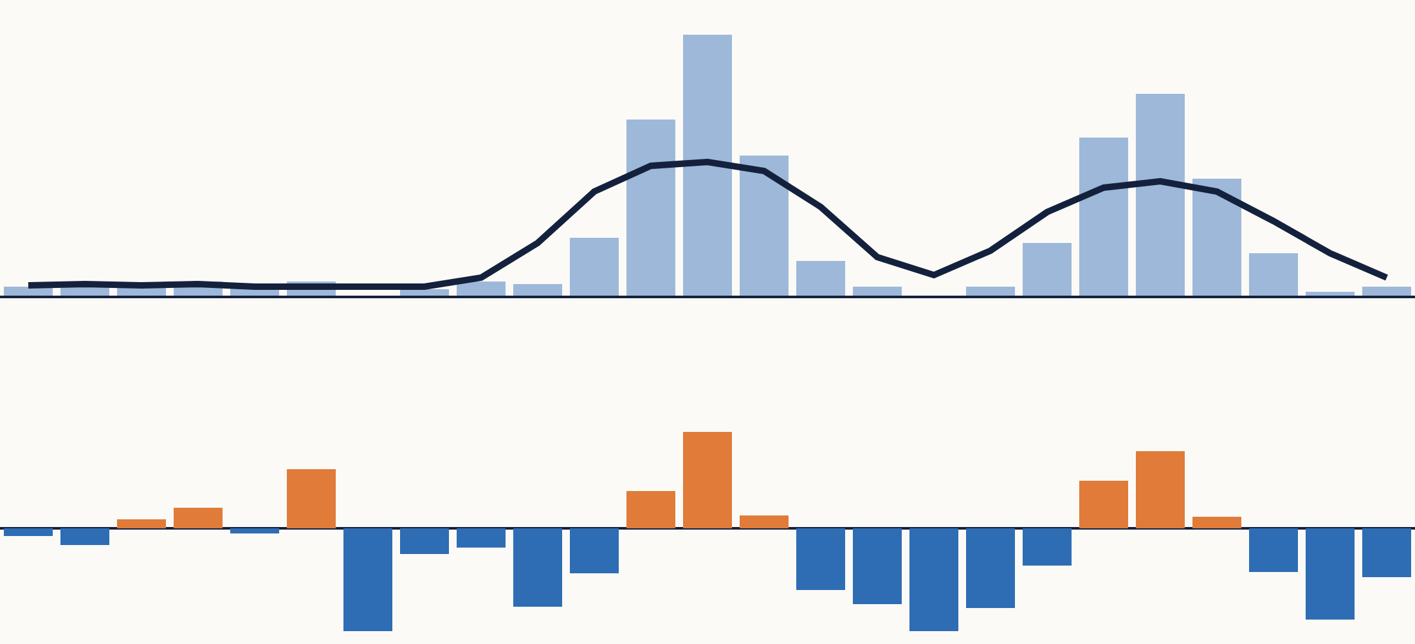
HOW IT WORKS · STEP 1
Split the data into peaks and troughs
Divide each class count by the moving average and subtract 1
Orange = peak (+)
Blue = trough (−)
The small orange bars on the left are chance peaks where counts are low
Top: one month's length data and moving average (MA = 5 classes) · Bottom: restructured values
Getting Started with ELEFAN | 5
Notes:
Now for the three steps. Step one is restructuring.
The top panel shows one month's length frequencies. The black line is a moving average, here over five length classes.
In the bottom panel, each class count is divided by the moving average, and one is subtracted. Classes above the moving average become positive peaks, shown in orange. Classes below become negative troughs, shown in blue.
Look at the small orange bars on the left. Where counts are low, random bumps also become peaks. This is the root of a pitfall we will see later.

Slide 6
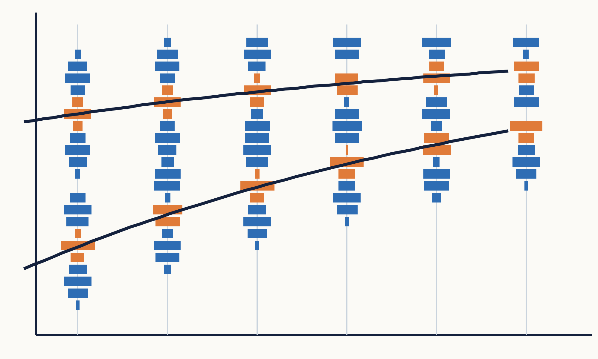
HOW IT WORKS · STEP 2
Draw growth curves and score them
ESP: sum of the peaks (+) and troughs (−) the curves pass through
ASP: sum of all available peaks (the maximum score)
Rn = 10^(ESP / ASP) ÷ 10
The higher Rn, the better the curves follow the peaks
Getting Started with ELEFAN | 6
Notes:
Step two is scoring.
Choose one growth curve and apply it to every year's cohort, and you get several lines like these.
Add up the values where the lines pass. Peaks count as plus, troughs as minus. This sum is called E S P. The sum of all available peaks, the maximum possible score, is called A S P.
Dividing E S P by A S P, and transforming the result, gives the score, R-n. The higher R-n is, the better the curves follow the peaks.

Slide 7
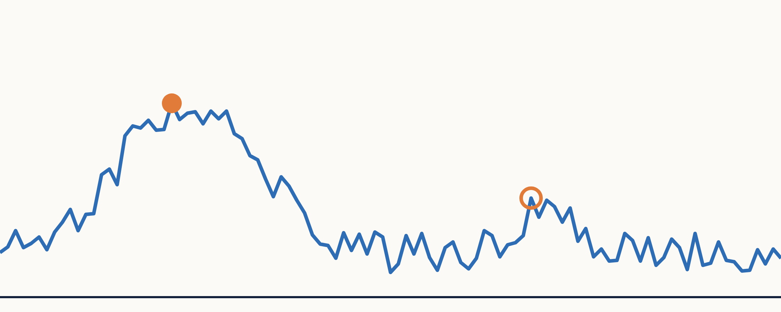
HOW IT WORKS · STEP 3
Search for the curve with the highest score
The score landscape is jagged, full of small peaks
Hill-climbing methods get stuck on a small peak
TropFishR: ELEFAN (grid search), ELEFAN_SA (simulated annealing), ELEFAN_GA (genetic algorithm)
Horizontal: a parameter (e.g. t_anchor) · Vertical: score Rn · ●: maximum · ○: small peak (trap)
Getting Started with ELEFAN | 7
Notes:
Step three is to search for the combination of L-infinity, K and t-anchor with the highest score.
This figure shows how the score changes as one parameter changes. There is one large peak, but the line is jagged, with many small peaks. A simple hill-climbing method gets stuck on a small peak, like the open circle.
So the R package Trop Fish R offers a grid search, as well as methods based on simulated annealing and on a genetic algorithm.

Slide 8
IN PRACTICE
Running it in R with TropFishR
install.packages("TropFishR")
library(TropFishR)
data(synLFQ7) # synthetic data with known parameters
res <- ELEFAN_GA(synLFQ7, MA = 5, seasonalised = TRUE,
low_par = list(Linf = 100, K = 0.05, t_anchor = 0, C = 0, ts = 0),
up_par = list(Linf = 140, K = 0.6, t_anchor = 1, C = 1, ts = 1),
popSize = 60, maxiter = 50, plot = TRUE)
res$par # estimated L∞, K, t_anchor, C, ts
res$Rn_max # the score Rn
MA: moving-average width (classes) · low_par / up_par: search range · plot = TRUE: draw curves on the data
Getting Started with ELEFAN | 8
Notes:
In practice, it takes only a few lines of R.
syn L F Q seven is a synthetic data set with known growth parameters. Because we know the answer, it is good for practice.
The genetic algorithm version of ELEFAN needs the width of the moving average, and the lower and upper limits of the search range. The calculation takes a few minutes.
The last two lines show the estimates and the score. With plotting turned on, you also get a figure with the growth curves drawn over the peaks and troughs.

Slide 9
IN PRACTICE
Testing on data where we know the truth
 | L∞ (cm) | K (/yr) | Φ′ | t_anchor | Score Rn
True values | 123 | 0.20 | 3.48 | 0.25 | 0.21
Estimates | 118.6 | 0.17 | 3.38 | 0.84 | 0.29
K −15%
3.48 → 3.38
An index robust to the L∞–K trade-off. Φ′ fell too: growth itself was underestimated
Growth rate underestimated
The estimates score higher: the score itself does not pick the true values
Getting Started with ELEFAN | 9 | Data: synLFQ7 (TropFishR), ELEFAN_GA (MA = 5), author's calculation
Notes:
Here are the results of running that code.
The true L-infinity is one hundred and twenty-three, and the true K is zero point two. The estimates are one hundred and eighteen point six, and zero point one seven. K came out fifteen percent too small.
L-infinity and K behave like a seesaw. So growth is usually compared using the growth performance index, phi prime: the log of K plus twice the log of L-infinity.
Phi prime is three point four eight for the true values, and three point three eight for the estimates. Because phi prime also fell, the estimate did not just slide along the seesaw. It underestimated growth itself.
And the key point is the score. With the true values, R-n is zero point two one. With the estimates, it is zero point two nine. The computer did not search too little. The ELEFAN score itself prefers a combination that is not the truth.

Slide 10
CAUTION
Four pitfalls
① Settings change the answer
② The L∞–K seesaw
Changing the moving-average width (MA) or the length-class width moves the estimates
“Large L∞, small K” fits about as well as “small L∞, large K”
③ Individual variation blurs peaks
④ Noise still gives an answer
When fish of the same age vary in length, peaks smear and K is easily misestimated
Even data with no growth signal yield a “plausible” K from chance peaks
Getting Started with ELEFAN | 10
Notes:
Next, four pitfalls to watch for.
First, settings change the answer. Changing the width of the moving average, or of the length classes, moves the estimates.
Second, the seesaw between L-infinity and K. A large L-infinity with a small K, and the reverse, can fit about equally well.
Third, fish of the same age still differ in length. When this variation is large, the cohort peaks blur, and K is easily misestimated.
Fourth, even pure noise, data with no growth information at all, will give a plausible K, because ELEFAN picks up chance peaks. Getting an answer is not evidence that the data contain growth information.

Slide 11
THE KEY MESSAGE
ELEFAN gives a hypothesis.
Check it before you use it.
A high score Rn does not mean the answer is right
Notes:
This is the most important message today.
ELEFAN always returns an answer, whatever the data. A high score does not mean the growth estimate is right.
Treat the ELEFAN result as a hypothesis, and check it before you use it.

Slide 12
CAUTION
Tips for using ELEFAN
What to do | Why
Set L∞ from maximum length | Large classes hold little information
Sample hundreds of fish monthly, 1+ years | Peaks need many samples and fish
Vary MA and class width | If settings move the answer, it is weak
Bootstrap the estimates | One value hides uncertainty (fishboot)
Compare with otoliths or tagging | Agreement strengthens the hypothesis
Remember K errors carry into Z | Catch-curve slope is Z / K
Getting Started with ELEFAN | 12
Notes:
So how can we check it? Let's go down the table.
First, fix L-infinity from other information, such as the maximum length. This stops the seesaw, so ELEFAN only needs to estimate K.
Second, sample hundreds of fish every month, for at least a year. Tracking peaks needs both many samples and many fish.
Third, compare the results across different moving-average widths and class widths. If the settings move the answer, the answer is weak.
Fourth, use a bootstrap to get a range of estimates. The R package fishboot can do this.
Fifth, check against other methods, such as otoliths or tagging.
Finally, errors in K carry over into mortality. The slope of a length-converted catch curve is Z over K, so if K is a third of its true value, so is Z. The stock would look healthier than it really is.

Slide 13
SUMMARY
Today's takeaways
1
2
3
ELEFAN finds growth curves from the movement of peaks in length data
It splits data into peaks and troughs and picks the curve with the highest score Rn
The answer is a hypothesis: watch settings, individual variation and noise
Pauly, D. & David, N. (1981) ELEFAN I, a BASIC program for the objective extraction of growth parameters from length-frequency data. Meeresforschung 28: 205–211.
Mildenberger, T.K., Taylor, M.H. & Wolff, M. (2017) TropFishR: an R package for fisheries analysis with length-frequency data. Methods in Ecology and Evolution 8: 1520–1527.
Taylor, M.H. & Mildenberger, T.K. (2017) Extending electronic length frequency analysis in R. Fisheries Management and Ecology 24: 330–338.
Schwamborn, R., Mildenberger, T.K. & Taylor, M.H. (2019) Assessing sources of uncertainty in length-based estimates of body growth with bootstrapped ELEFAN. Ecological Modelling 393: 37–51.
Getting Started with ELEFAN | 13
Notes:
To sum up.
First, ELEFAN finds growth curves from the movement of peaks in length data.
Second, it splits the data into peaks and troughs, and picks the curve that best follows the peaks: the one with the highest score, R-n.
Third, the answer is a hypothesis. Watch out for settings, individual variation and noise, and check it before you use it.
For more detail, see the references on the slide. Thank you. Any questions?

