Slide 1

IOT BASED GREENHOUSE MONITORING AND CONTROL SYSTEM
By –
Avinash Arya (1809259)
Ajeet kr Singh (1809256)
Project Guide:
Mr Chakshu Goel

Slide 2
INTRODUCTION
The Natural ecosystem plays a crucial role in your plants/Yields nurturing and development , If we consider a Greenhouse , The amount of moisture/temperature/humidity inside the greenhouse cannot be adequately understood by farmers in the greenhouse. They just estimate manually the condition in the green building , and they experience it on their own . Experience plays a significant part in their regular activities at the end of the day. The plants would have water if the soil has minimum water content, but if it is too moist, in the greenhouse the roof will be opened during day time. Efficiency in greenhouse plant production must be achieved to achieve effective growth increases, so that high production rates can be achieved at lower cost, higher quality and low environmental burdens. The greenhouse can be controlled by IOT which involves Temperature control , ventilation, immersion of the soil, etc. This System can be managed by concentrating on environmental criterion such as temperature and humidity. A individual can automatically monitor the environmental parameters of the greenhouse . The need for ON/OFF switchgear functions eliminates automation plays an important role in performing things automatically. Automation does not eradicate or suppress human error entirely, but it minimises it at certain stages. It is the need of the world of today for anything to be practical or controlled remotely. Here, assuming that the greenhouse owner will regulate and monitor the greenhouse from anywhere. The owner doesn't have to go over any of them and monitor the circumstances at all times . The owner must remain in one position and constantly track and manage the number of greenhouses at the same time.

Slide 3
NEED FOR THE PROJECT
This Project will Allow You to create suitable micro-environment for your crops/yields
Enhances Irrigation & Fertilization Practices
Control Infection & Avoid Diseases in your yield
Prevent Thefts and Improve Security

Slide 4
REQUIRED PARTS
Temperature Sensor Light Sensor Humidity Sensor Soil Moisture Sensor Microcontroller – Arduino
Wi-Fi Module
IoT server Relays DC Motor
Rain Detection Sensor

Slide 5
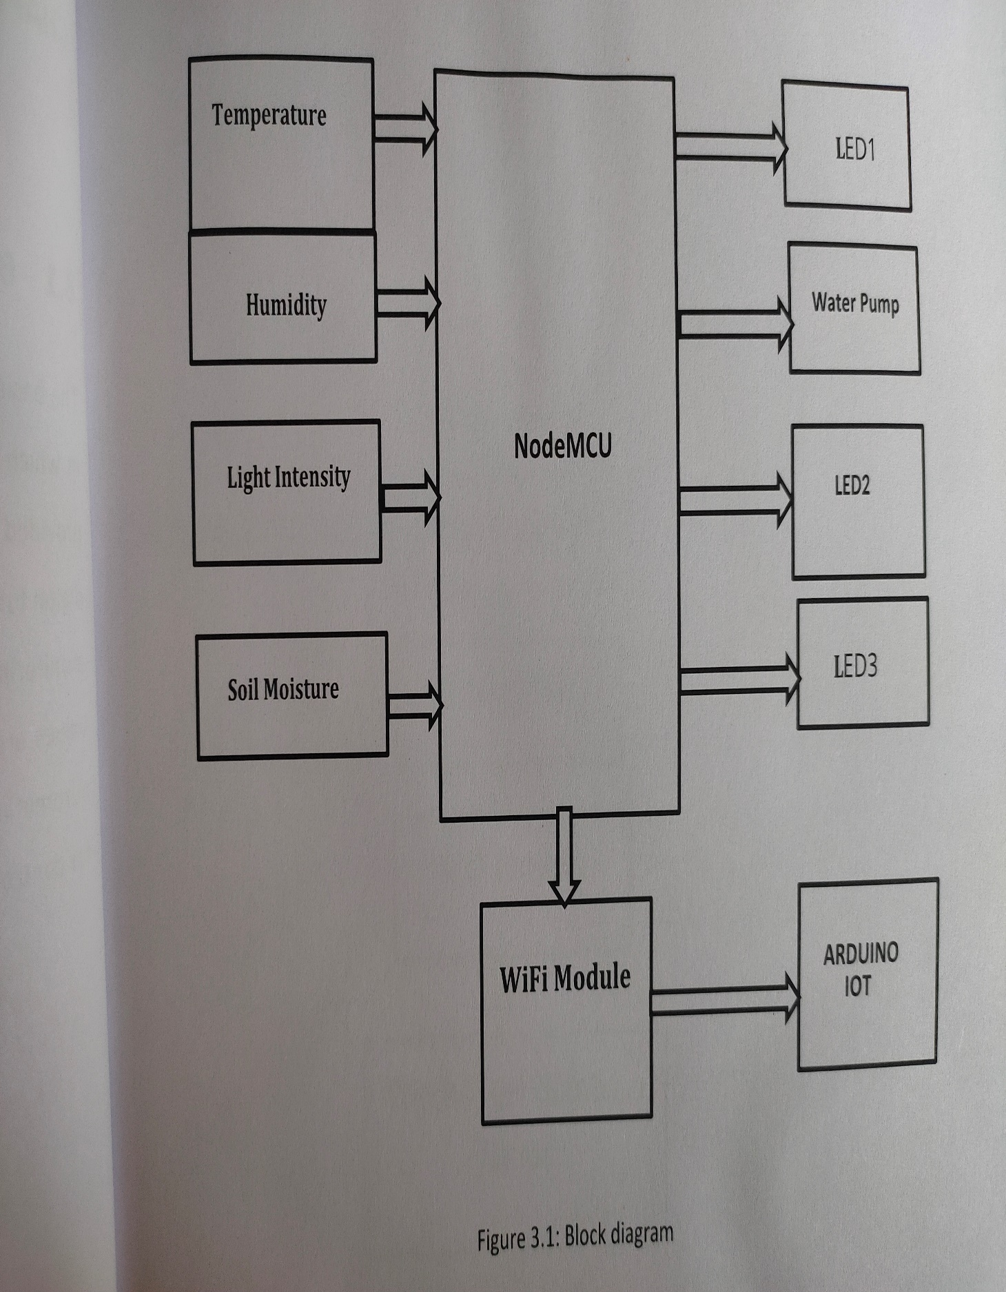
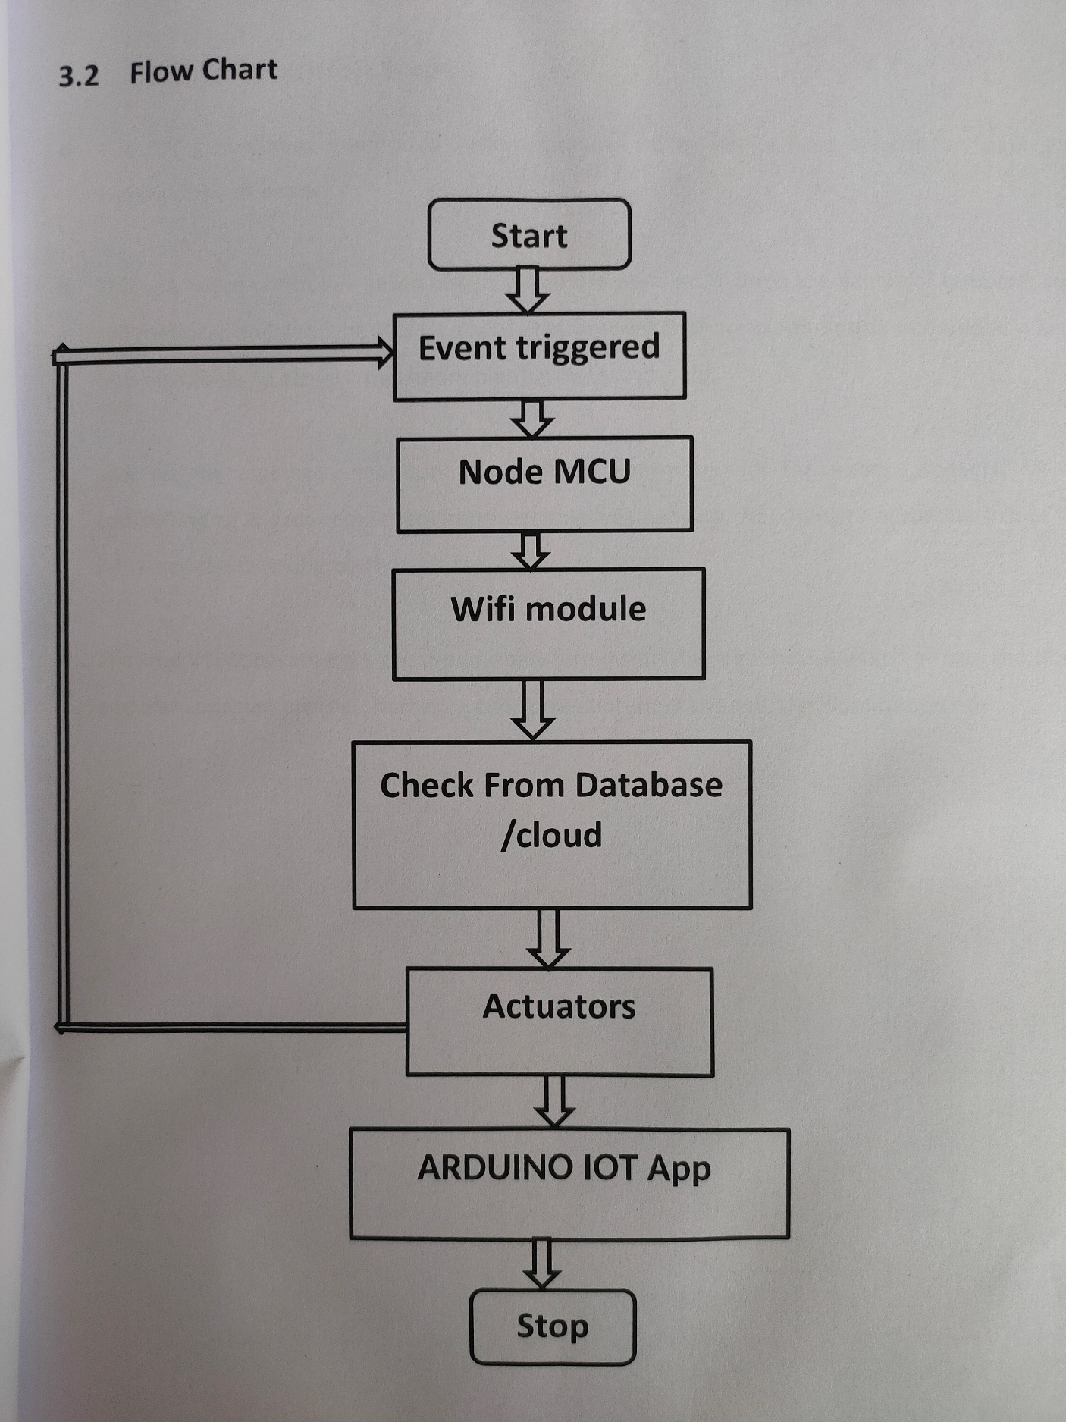
Block Diagram of the project

Slide 6
WORKING
The working of this project primarily revolves around improvement of current agricultural practices by using modern technologies for better yield. This work provides a model of a smart greenhouse, which helps the farmers to carry out the work in a farm automatically without the use of much manual intervention. Greenhouse being a closed structure protects the plants from extreme weather conditions namely: wind, hailstorm, ultraviolet radiations, and insect and pest attacks. The irrigation of agriculture field is carried out using automatic drip irrigation, which operates according to the soil moisture threshold set accordingly so as optimal amount of water is applied to the plants. Based on data from soil moisture sensor , temperature and humidity sensor and LDR sensor we can check for right amount of moisture content , temperature , humidity measures and light required for effective yield of our crops .

Slide 7
Applications
Helps in creating micro-environment for your crops
Will help in growing crops/plants which are not found in that specific terrain/region
Will enable more efficient control of atmosphere inside the green house
Equips farmers with several data to have better understanding about the growth and condition of their yields

Slide 8

Thanks For Watching

