Slide 1
ScheDetour
FMKZ
2013.5.24
Schedy, Schedy, where should I go to next?

Slide 2
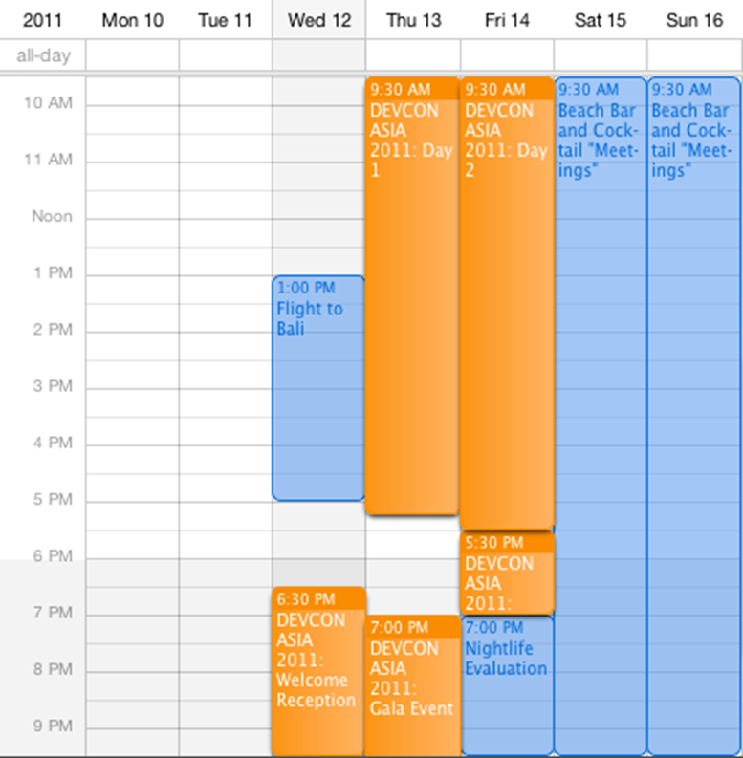
Background & Problem
经常忘记事情？
时间零碎，难以管理？
冤枉路？
谷歌日历太难用？
单一？不直观？不强大？

Slide 3
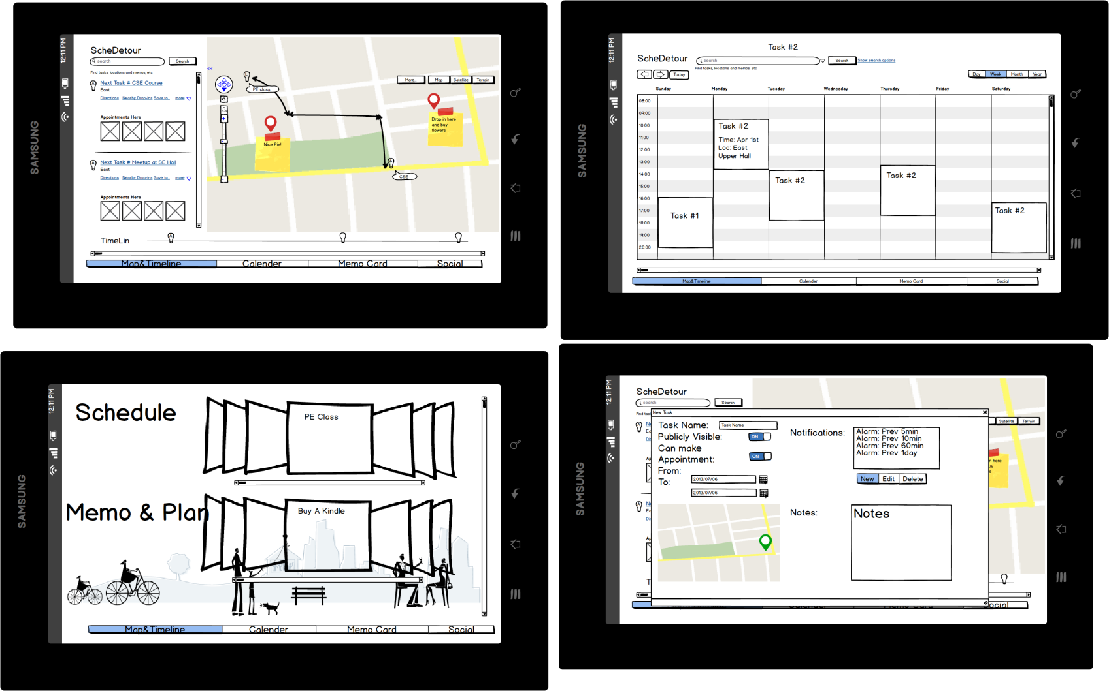
ScheDetour!
地图+时间轴！
GPS+最优路线！
固定计划与兜风结合
  景点介绍
  地标Tips（UGC）
整合备忘录
  购物清单
路线时间统计
  我从SJTU到FDU一般要多久呢？

Slide 4
Features
全新的展示方式！
  事件 ⬄ 地理坐标点
  时间轴 ⬄ 历史与未来
安排的不仅仅是时间！
  时间规划
  路线规划
  预约系统
事件搜索
  按 时间 地点 预约人
单机 联机结合
  单机规划
  联机社交

Slide 5
Technical Notes
客户端
  Android/WP原生应用模块 - 推送、闹钟
  HTML5 界面前端
    位置信息
    图像信息
    触控手势识别
服务端
  数据库
  数据同步
  社交分享

Slide 6
UI Prototype

Slide 7
UI Prototype

Slide 8
UI Prototype

Slide 9
UI Prototype

Slide 10
What's the Value
全新的日程管理体验
  地图记录日程
  时间轴
更简单的日程管理
  自动日程安排
  路线推荐
  周边事件提醒
充分利用触摸手势

Slide 11
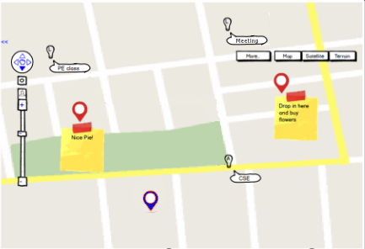
An Example
fixed schedule
  PE class
  CSE
  Meeting
drop-in
  Nice pie
  Buy flowers

Slide 12
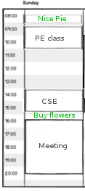
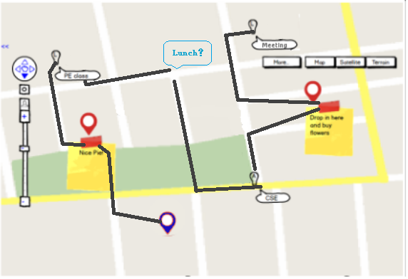

Slide 13
Competitors
Google Calender
  Fixed scheduling only
  No geo-info
(Google) Schemer
  Event/Intention-driven social networking
Foursquare
  Venue/Sites of interests only
Evernote/AK Notepad/...
  Memo only
Yelp
  Local stores/restaurants only
Plurk
  Timeline-d Tweets only

Slide 14
Extensions & Enhancements
2.5-dimension Map (WebGL)
Weather Effect (Canvas)
Mayor System (4sq?)
API for plugin development
Clients on other platforms
  Most parts are in HTML6 and thus very portable
Appointment-based IM (WebRTC)
  "I'm stuck in subway and will be late"
Project-based Scheduling (extended Social)
Meet friends by location!
Plan your trip/hiking/excursion.
NFC-tag memo support

Slide 15
Technical Roadmap
HTML5/CSS/Javascript/NodeJS/MongoDB
Google/Baidu Map API
Parallel JS
WebGL
HTML5 Device APIs
Push Notification
  GCM
  WP Push Notification
Extensions
  WebRTC
  GPS

Slide 16
Why HTML5
Flash becoming deprecated on mobile devices
Portability between platforms
Usability on touch-screen hand-held devices
Devices API
  GPS
  Camera
  Mic
Multi-media, user-friendly presentation
LocalStorage/Offline Content available
Parallel JS – More responsive
Better extensibility (eg, Greasemonkey userscript)

Slide 17
Q&A

Slide 18
MY DAY WITH SCHEDETOUR

Slide 19
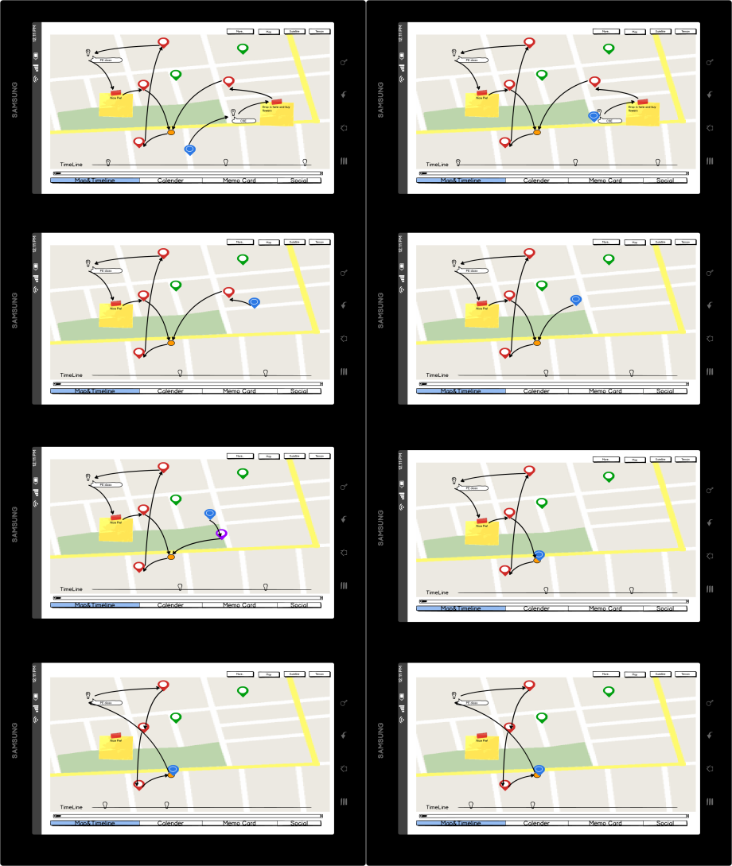
Ready for a happy day!

Slide 20
Got in the classroom.

Slide 23
A new half-off sale!

Slide 24
Back to the dormitory.

Slide 25
Just take a nap…

Slide 26
Oversleep…

Slide 27
A new route!

Slide 28
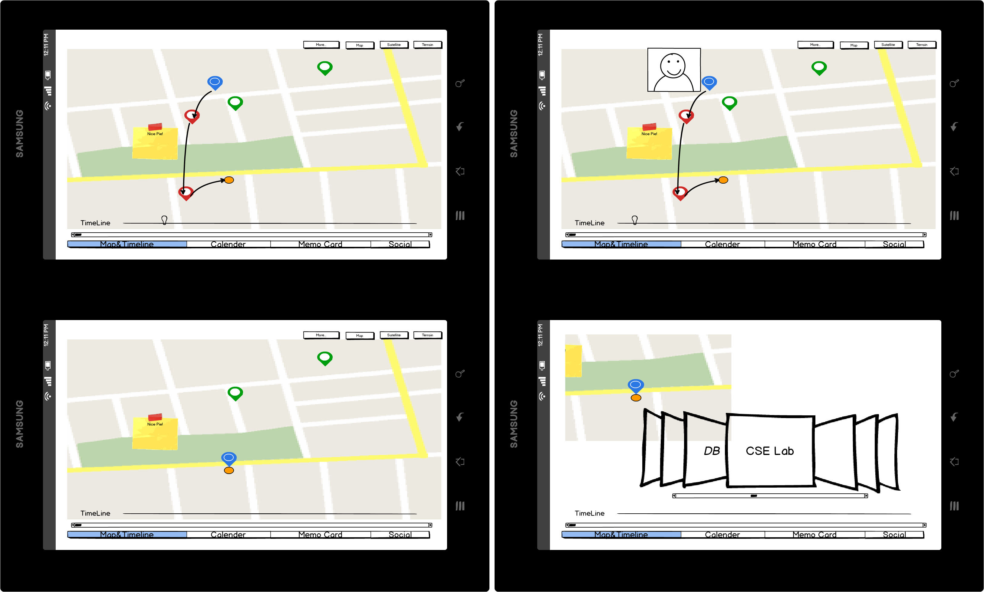

Slide 29
A nice scene…

Slide 30
Enjoy photographing and share.

Slide 31
Still many things to do in the dormitory.

Slide 33
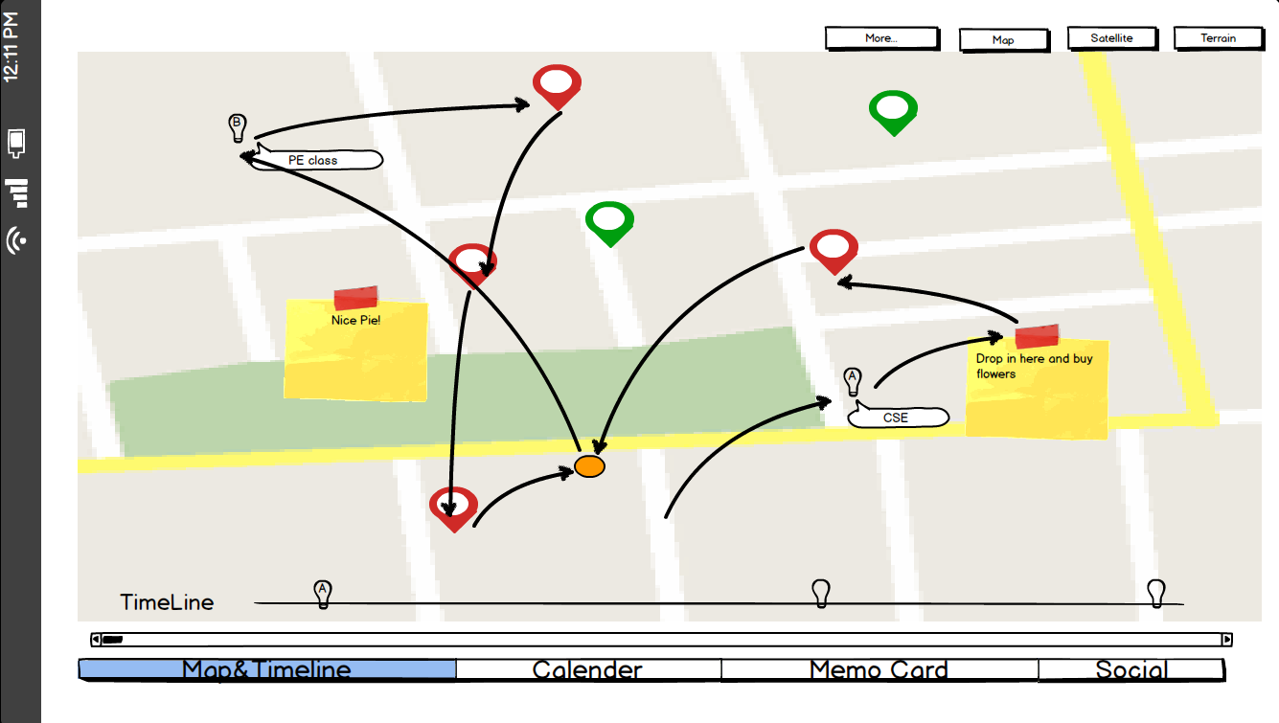
The final route of the day!

Slide 34
THAT’S MY DAY WITH SCHEDETOUR

Slide 35
