Slide 1

ScheduleTour
Schedy, Schedy, where should I go to next?
FEEDADEADF15h
2013.5.27

Slide 2
ScheDetour
FEEDADEADF15h
2013.5.24
Schedy, Schedy, where should I go to next?

Slide 3
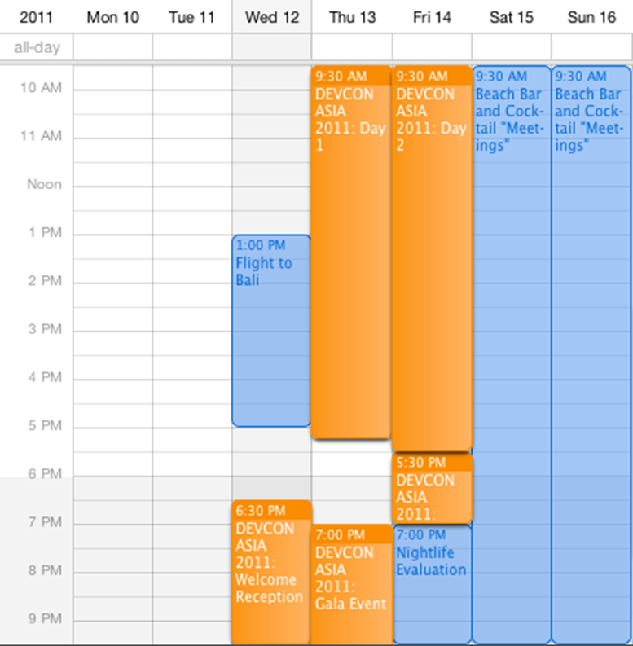
Background & Problem
经常忘记事情？
时间零碎，难以管理？
冤枉路？
谷歌日历太难用？
单一？不直观？不强大？

Slide 4

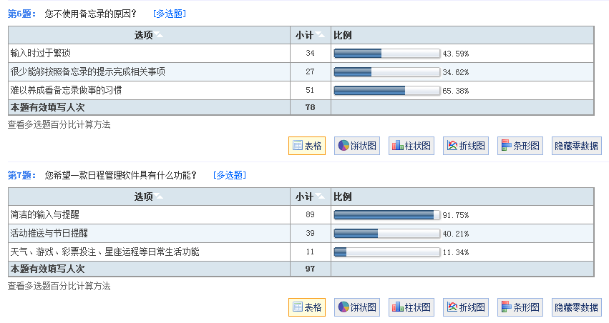

Slide 5
Features
全新的展示方式！
  事件 ⬄ 地理坐标点
  时间轴 ⬄ 历史与未来
安排的不仅仅是时间！
  时间规划
  路线规划
事件搜索

Slide 6
PROTOTYPE

Slide 7
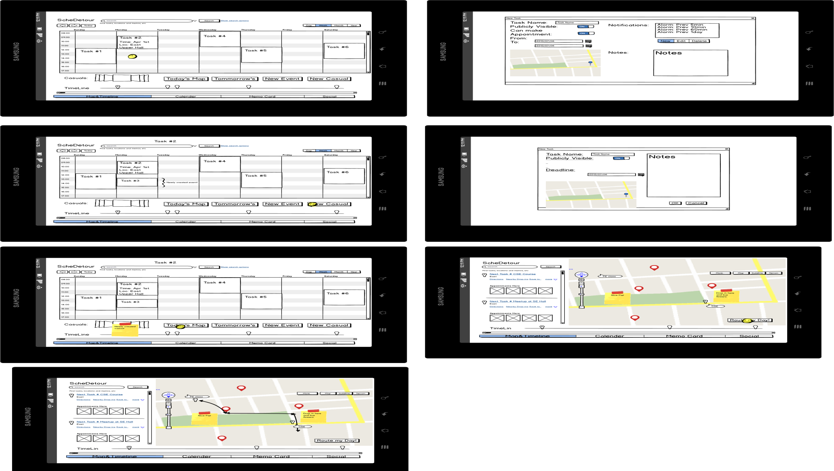

Slide 13
MY DAY WITH SCHEDETOUR

Slide 14
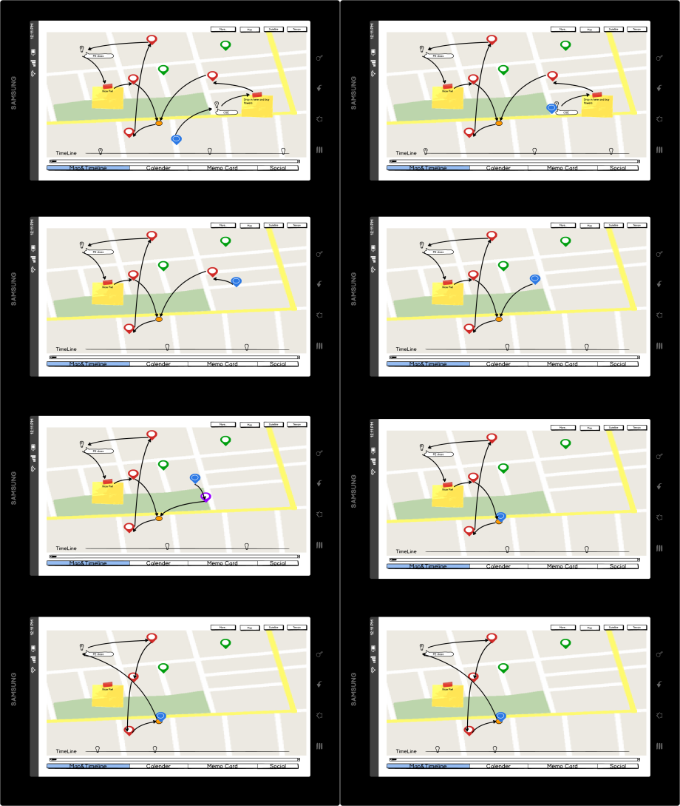
Ready for a happy day!
Notes:
答疑
回寝室
找同学借书
取快递
修车

Slide 15
Got in the classroom.
Notes:
答疑
回寝室
找同学借书
取快递
修车

Slide 16
Notes:
答疑
回寝室
找同学借书
取快递
修车

Slide 17
Notes:
回寝室
找同学借书
取快递
修车

Slide 18
A new half-off sale!
Notes:
大减价
回寝室
找同学借书
取快递
修车

Slide 19
Back to the dormitory.
Notes:
找同学借书
取快递
修车

Slide 20
Just take a nap…

Slide 21
Oversleep…
Notes:
找同学借书
取快递
修车

Slide 22
A new route!
Notes:
取快递
修车
找同学借书

Slide 23
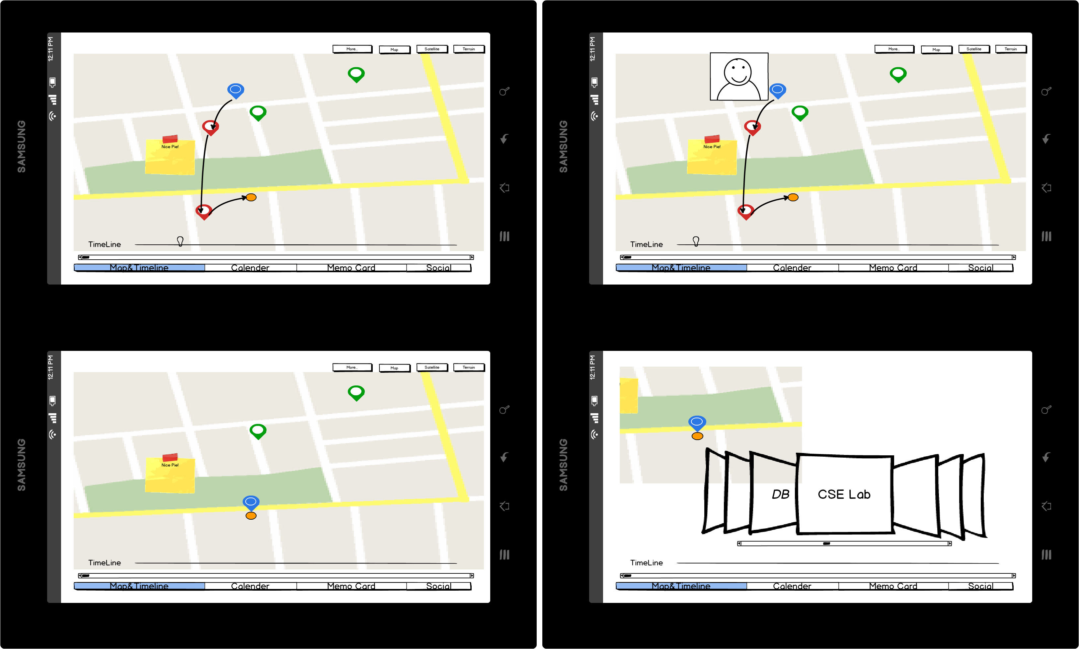
Notes:
取快递
修车
找同学借书

Slide 24
A nice scene…
Notes:
修车
找同学借书

Slide 25
Enjoy photographing and share.

Slide 26
Still many things to do in the dormitory.
Notes:
修车
找同学借书

Slide 28
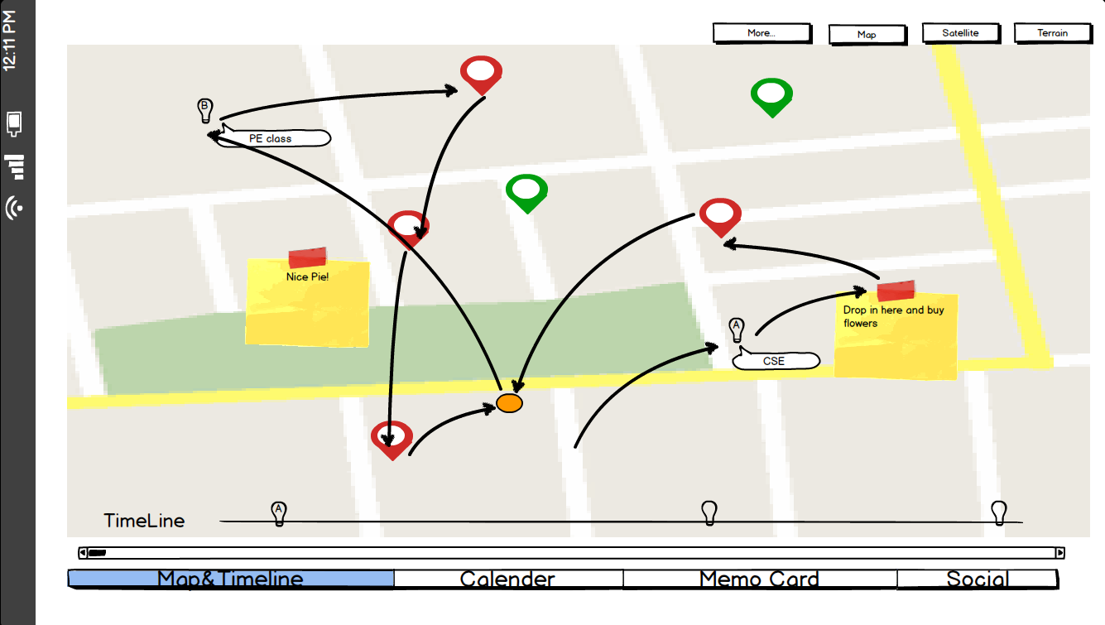
The final route of the day!

Slide 29
THAT’S MY DAY WITH SCHEDETOUR
Easy and Efficient

Slide 30
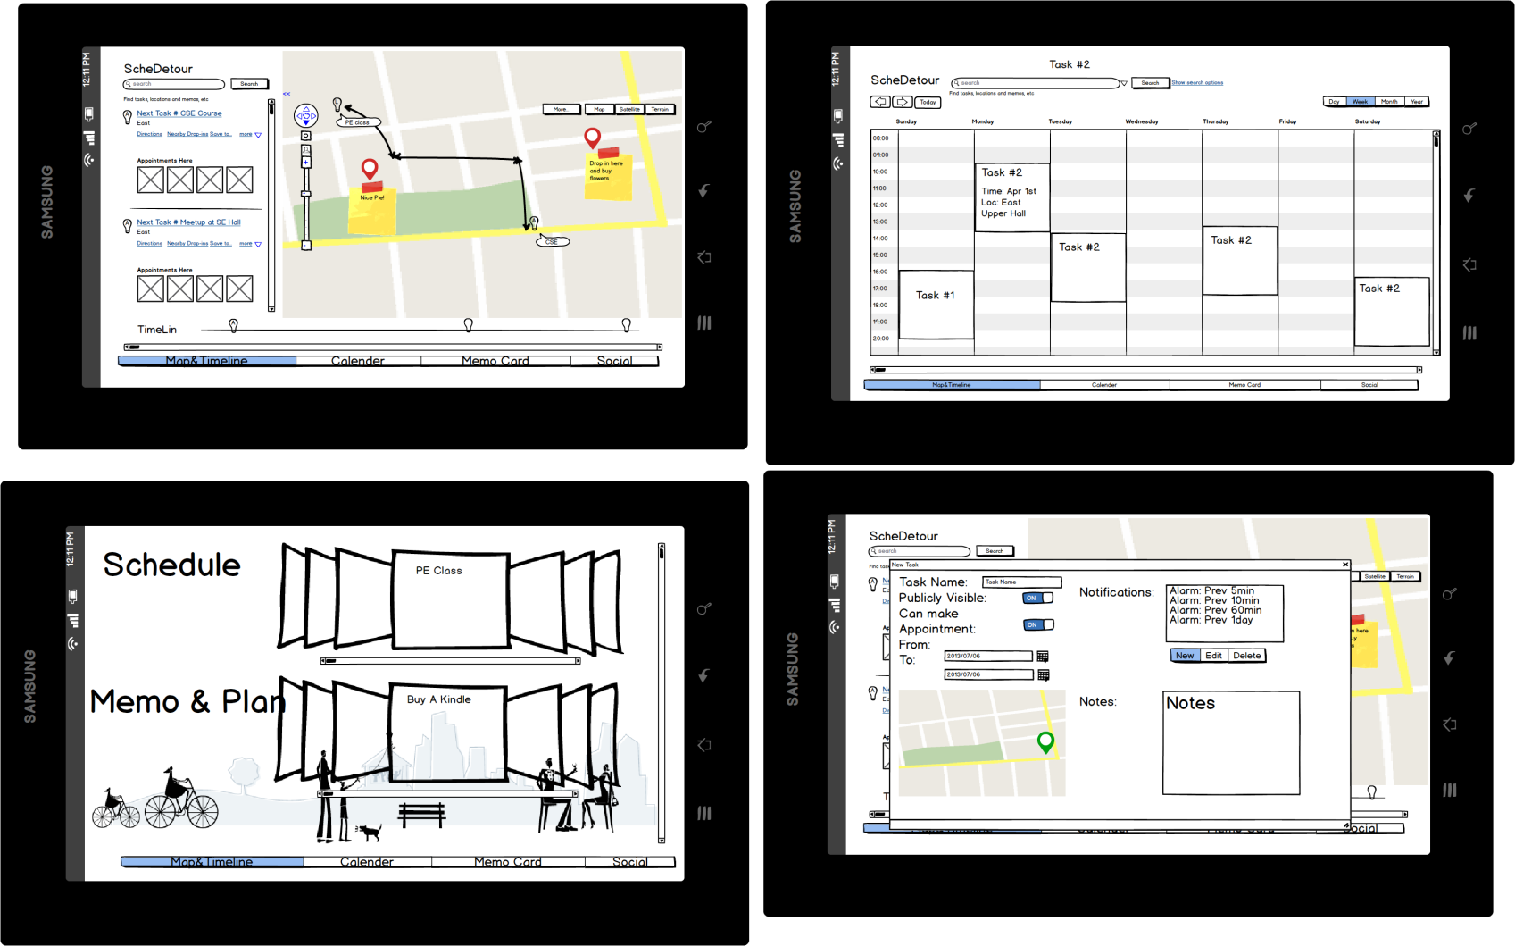
ScheDetour!
地图+时间轴！
GPS+最优路线！
固定计划与兜风结合
  景点介绍
  地标Tips（UGC）
整合备忘录
  购物清单

Slide 31
What's the Value
全新的日程管理体验
  地图记录日程
  时间轴
更简单的日程管理
  自动日程安排
  实时路线推荐
  周边事件提醒

Slide 32
Technical Notes
客户端
  Android/WP原生应用模块 - 推送、闹钟
  HTML5 界面前端
    位置信息
    图像信息
    触控手势识别
服务端
  数据库
  数据同步
  社交分享

Slide 33
Competitors
Google Calender
  Fixed scheduling only
  No geo-info
(Google) Schemer
  Event/Intention-driven social networking
Foursquare
  Venue/Sites of interests only
Evernote/AK Notepad/...
  Memo only
Yelp
  Local stores/restaurants only

Slide 34
Competitors
Google Calender
(Google) Schemer
Foursquare
Evernote/AK Notepad/...
Yelp
Plurk
Notes:
Google Calender
Fixed scheduling only
No geo-info
(Google) Schemer
Event/Intention-driven social networking
Foursquare
Venue/Sites of interests only
Evernote/AK Notepad/...
Memo only
Yelp
Local stores/restaurants only
Plurk
Timeline-d Tweets only

Slide 35
Competitors???
Google Calender
(Google) Schemer
Foursquare
Evernote/AK Notepad/...
Yelp
Plurk
Notes:
Google Calender
Fixed scheduling only
No geo-info
(Google) Schemer
Event/Intention-driven social networking
Foursquare
Venue/Sites of interests only
Evernote/AK Notepad/...
Memo only
Yelp
Local stores/restaurants only
Plurk
Timeline-d Tweets only

Slide 36
Partners!
Google Calender
(Google) Schemer
Foursquare
Evernote/AK Notepad/...
Yelp
Plurk
Notes:
Google Calender
Fixed scheduling only
No geo-info
(Google) Schemer
Event/Intention-driven social networking
Foursquare
Venue/Sites of interests only
Evernote/AK Notepad/...
Memo only
Yelp
Local stores/restaurants only
Plurk
Timeline-d Tweets only

Slide 37
Partners!
Google Calender
(Google) Schemer
Foursquare
Evernote/AK Notepad/...
Yelp
Plurk
Dianping.com
Douban.com
Notes:
Dianping.com
点评“同城活动”和豆瓣同城中有明确基于地理信息的活动。

Slide 38
Extensions & Enhancements
2.5-dimension Map (WebGL)
Weather Effect (Canvas)
API for plugin development
Appointment-based IM (WebRTC)
  "I'm stuck in subway and will be late
NFC-tag memo support

Slide 39
Technical Roadmap
HTML5/CSS/Javascript
Google/Baidu Map API
Parallel JS
WebGL
HTML5 Device APIs
Push Notification
  GCM
  WP Push Notification
Extensions
  WebRTC
  GPS

Slide 40
Why HTML5
Flash becoming deprecated on mobile devices
Portability between platforms
Usability on touch-screen hand-held devices
Devices API
  GPS
  Camera
  Mic
Multi-media, user-friendly presentation
LocalStorage/Offline Content available
Parallel JS – More responsive
Better extensibility (eg, Greasemonkey userscript)

Slide 41
Q&A

Slide 42
Thank you~

Slide 43
THAT’S MY DAY WITH SCHEDETOUR

Slide 46
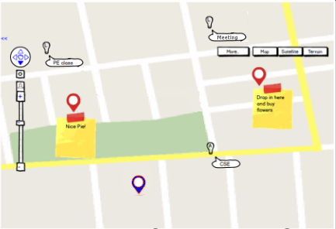
An Example
fixed schedule
  PE class
  CSE
  Meeting
drop-in
  Nice pie
  Buy flowers

Slide 47
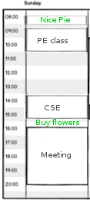
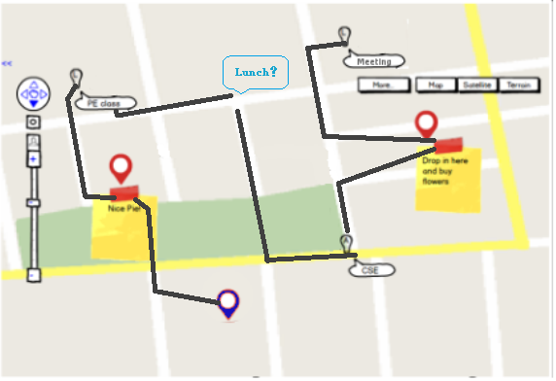

Slide 48
UI Prototype

Slide 49
UI Prototype

Slide 50
UI Prototype

Slide 51
UI Prototype

