Slide 1
 | Harvard University | OSU | UMich | UCLA | UT Dallas | Facebook Group
STUDENT ORG PORTAL |  |  |  |  |  | Groups Discover
Photos
Show events on same site
Existing student organization items on page
Register new org button on portal
Search method | Checkbox category filter | Basic / advance search bar; alphabetic buttons | Search bar; drop down category menu | large search bar; drop down category menu | Search bar; drop down category menu | Search bar; buttons for different categories
Search results presentation | List of names and hyperlinks | Card / list views; name and description | List view; image, name, and description | List view; name, description, contacts | Card view; image, name | List view; image, name, members, join button
Search results features | N/A | Show number of results found | Show number of results found and ‘order by relevance’ | N/A | N/A | Any group / Public Group / Private Group; Any group / My Group

Slide 2
 | Harvard University | OSU | UMich | UCLA | UT Dallas | Facebook Group
STUDENT ORG DESCRIPTION PAGE |  |  |  | Details listed in search results |  | Group Page
Photos
Contacts | Email | Email | Email, social media, online form | Email, phone | Email, social media, online form | Messenger
Members | Number; type of member | Leaders | Officers | Signatories, advisor | Advisor | Number, active users
Purpose
Meeting Time and Location
How to join | Unknown | Unknown | Unknown | Unknown | Click join button to log in to account | Click join button

Slide 3
 | Harvard University | OSU | UMich | UCLA | UT Dallas | Facebook Group
REGISTRATION PROCESS
Description | Long text | Long text | Text and bullet points | Flowchart | Short intro | Short intro
Format | Unknown | Online form | Online form | Online form | Online form | Online form

Slide 4
STUDENT ORG PORTAL | STUDENT ORG DESCRIPTION PAGE | PROPOSAL PROCESS | OTHER
Search Visual clues Category Recommendations Existing organizations Fewer Texts Results Category Image Name Description | Dates and time How to join People Photos Social media Should look consistent across different orgs Should have a good balance between text and images Able to join online | Should be easy to find Digitize Break down process Show progress bar | Event information

Slide 5
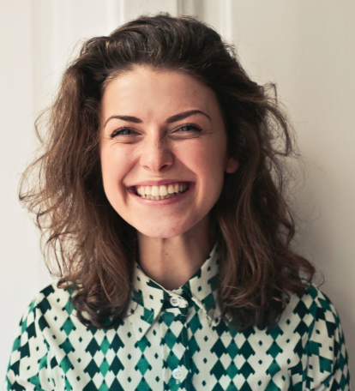
“I have a better idea.”
MOTIVATIONS
Build up resume
Network a lot
Accumulate project experience
Secure an internship position
FRUSTRATIONS
Existing student organizations do not seem fun
Do not know much about other departments’ organizations or events
Forming an organization seems to be a lot of paperwork
Lilian
#Changemaker
Junior year student
Business Management major

Slide 6
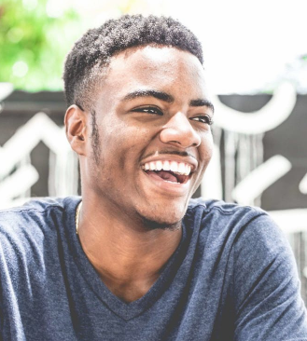
“Make some friends.
Have some fun.
That’s wall I want.”
MOTIVATIONS
Be with friends and make more friends
Have fun
Join sports club
Jay
FRUSTRATIONS
#brotherhood
Too many choices of clubs and organizations
Want to know what organizations his friends join
Freshman
College of Liberal Arts & Sciences

Slide 7

“I don’t want to
commit too much.”
MOTIVATIONS
Academic advising
Job search
Free food
Resume building
FRUSTRATIONS
Min Ha
Can’t be sure to be free same time every week
Doesn’t want to go too far away for an organization meeting or event
Homework and discussions pop up every now and then
#needsomebreak
First year graduate student
Biological Engineering

Slide 8
RESEARCH
DETERMINE
DESIGN
DIRECTIONS
WIREFRAME
+
USER TESTING
HI-FI
MOCKUP
PAGE
Background Research
Personas
Wireframing
Revision
Revision
User Interviews * 5
Design Goals
Usability testing
Usability testing
DAY 1
DAY 2
DAY 3
DAY 4
DAY 5
DAY 6
DAY 7

