Slide 1
A Guide For Developers
May 1, 2018
Phoebe Wu, Chloe Kim
zhuoxuew@andrew.cmu.edu, minkyun3@andrew.cmu.edu
Notes:
Good afternoon Everyone,
We are the team Job Seekers.
My name is Chloe Kim
and my teammate, Phoebe Wu.
We developed our application, ‘A Guide For Developers’.

Slide 2
Product Overview
Problem
Developers want to become more competitive, but how?
Solution
We offer useful information with the visualized data to get developers informed.
Notes:
Our customer is the developers mainly who are looking for a job like us.
The reason why we chose this project is, we knew very well that it is necessary for ourselves.
As job seekers, we want to become more competitive in the job market
but we don’t know where we start, and we don’t know the right way to go.
In addition, since we are busy to prepare technical interviews or coding challenges,
we don’t have enough time to search all the information.
So, we made this application, to help developers become more competitive.
We offer useful information with the visualized data to get them informed.
We used three HackerRank survey data sets for our solution.

Slide 3
Product Features
Feature 1 - Distribution of Developers in Education & Learning Source
Feature 2 - Distribution of Developers in Employment and Role
Feature 3 - Emerging tech skills
Feature 4 - Popular Programming Language
Feature 5 - How does employers measure you?
Notes:
We believe that developers have to know the current position of themselves within the same group first.
Therefore, our application has two features which show the distribution of Developers.
Rest three features show what employers expect to them.
We used two libraries, Numpy and Pandas to extract related data.
and used pyplot library to visualize the data.

Slide 4
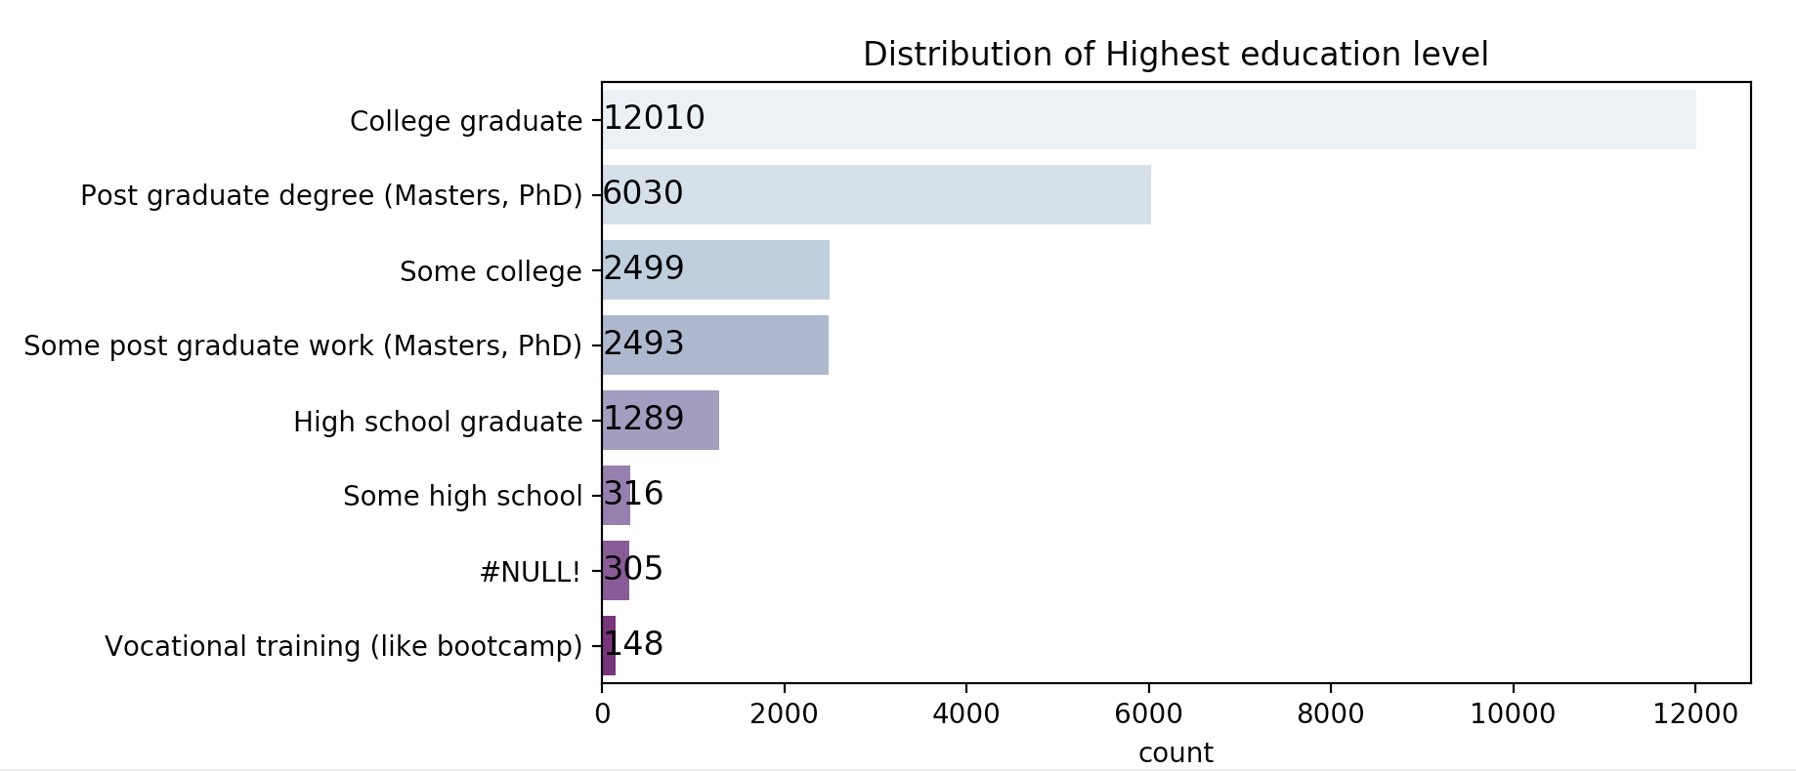
Feature 1
- Distribution of Developers in Education & Learning Source
Notes:
Our application shows the distribution of developers in Education as the first feature.
Our customer can consider to earn a higher degree if he feels his current degree is not enough compared to others.

Slide 5
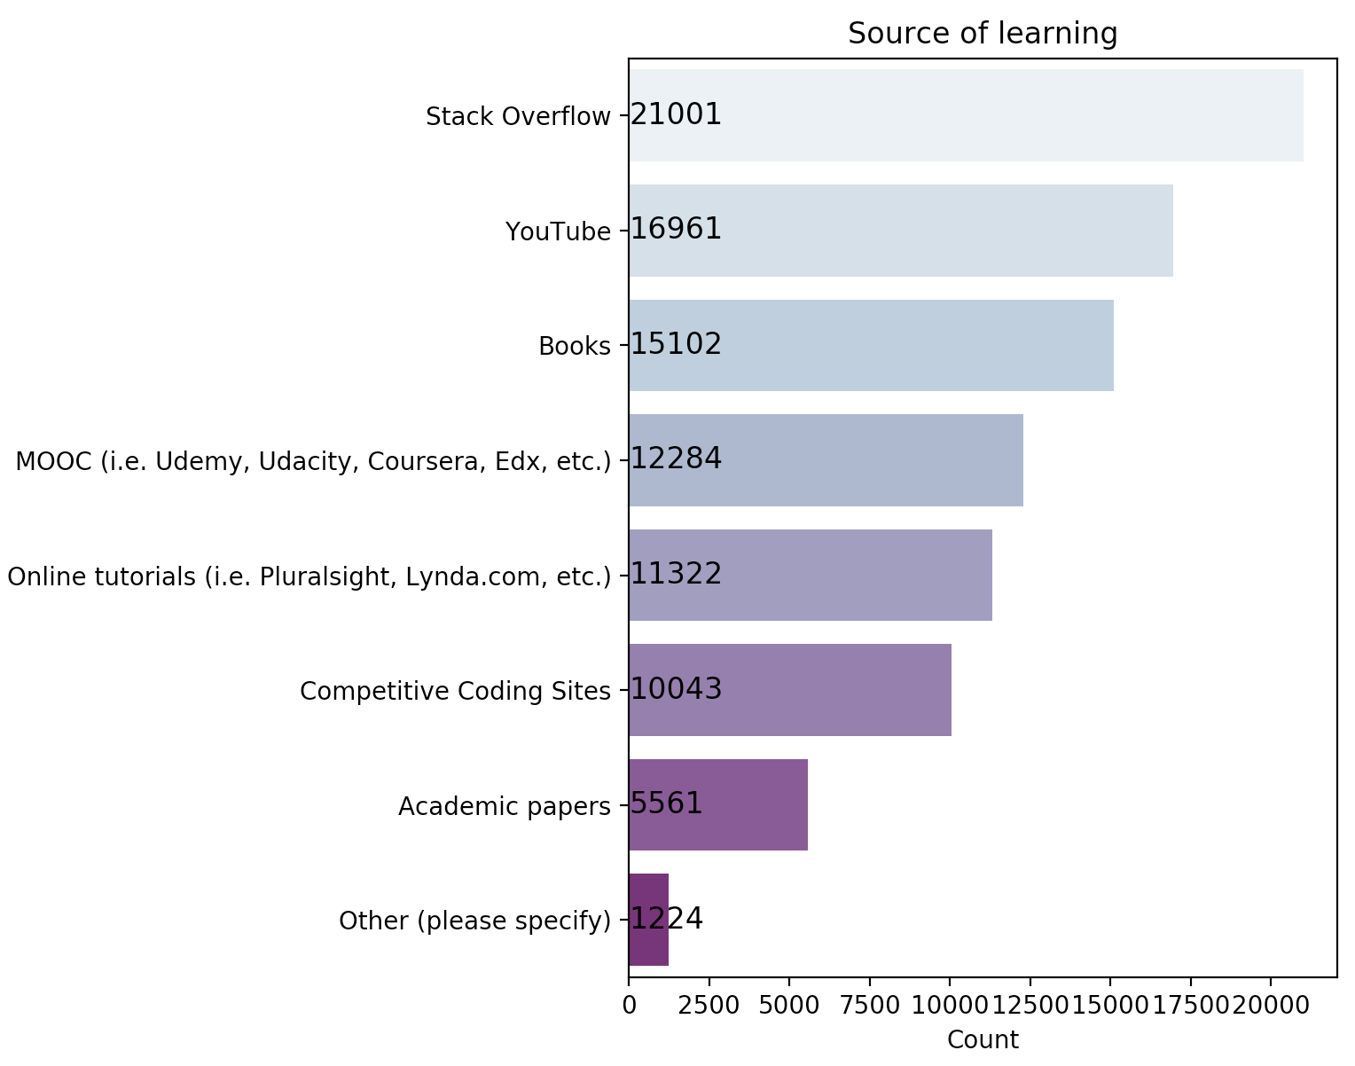
Feature 1
- Distribution of Developers in Education & Learning Source
Notes:
We also shows developers’ popular learning source to help them learn without any budget.

Slide 6
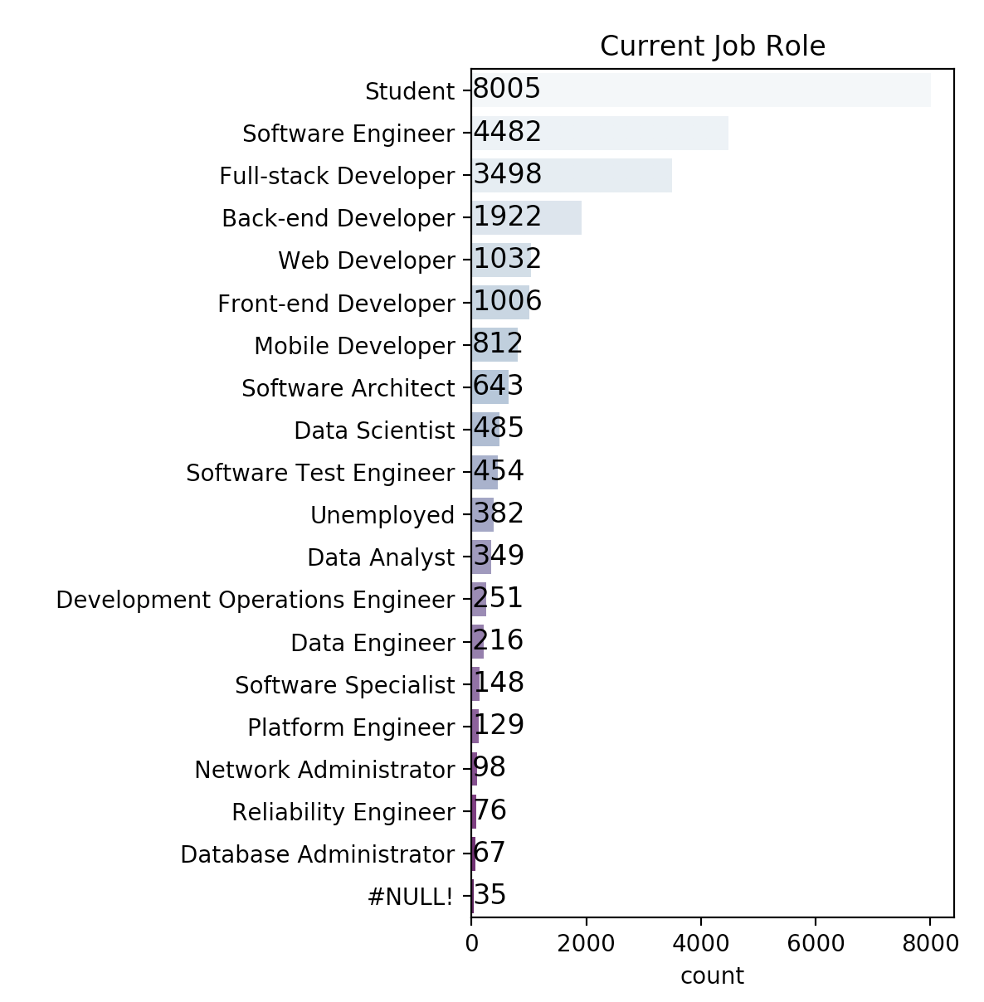
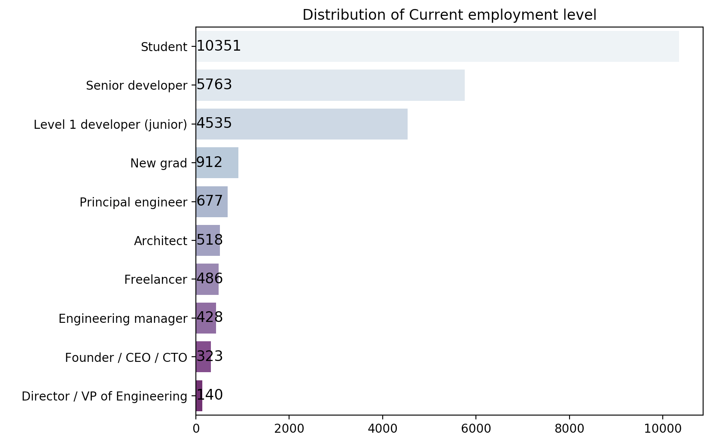
Feature 2
- Distribution of Developers in Employment & Role
Notes:
We shows the distribution of current job and position of developers.
This data will be useful to know what other candidates do and how many positions exist in the market.

Slide 7
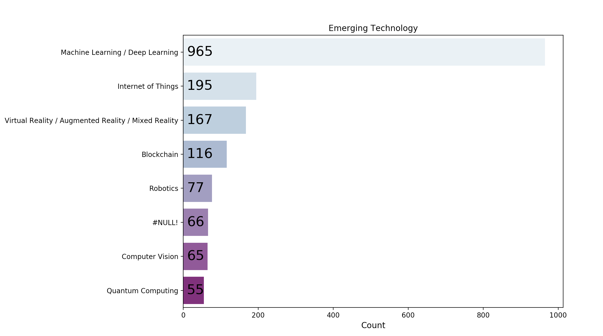
Feature 3 - Emerging tech skills
Display the emerging tech skills of developers.
Datasource comes from survey of developers.
Notes:
The datasource of this feature comes from the developers’ survey.
After grouping and sorting them, it will show the tech skills and how many people work on it.
Users can get to know what is the current trend of tech skills.
According to it, the user could make his own research direction on computer science.
This diagram works as a suggestion table.

Slide 8
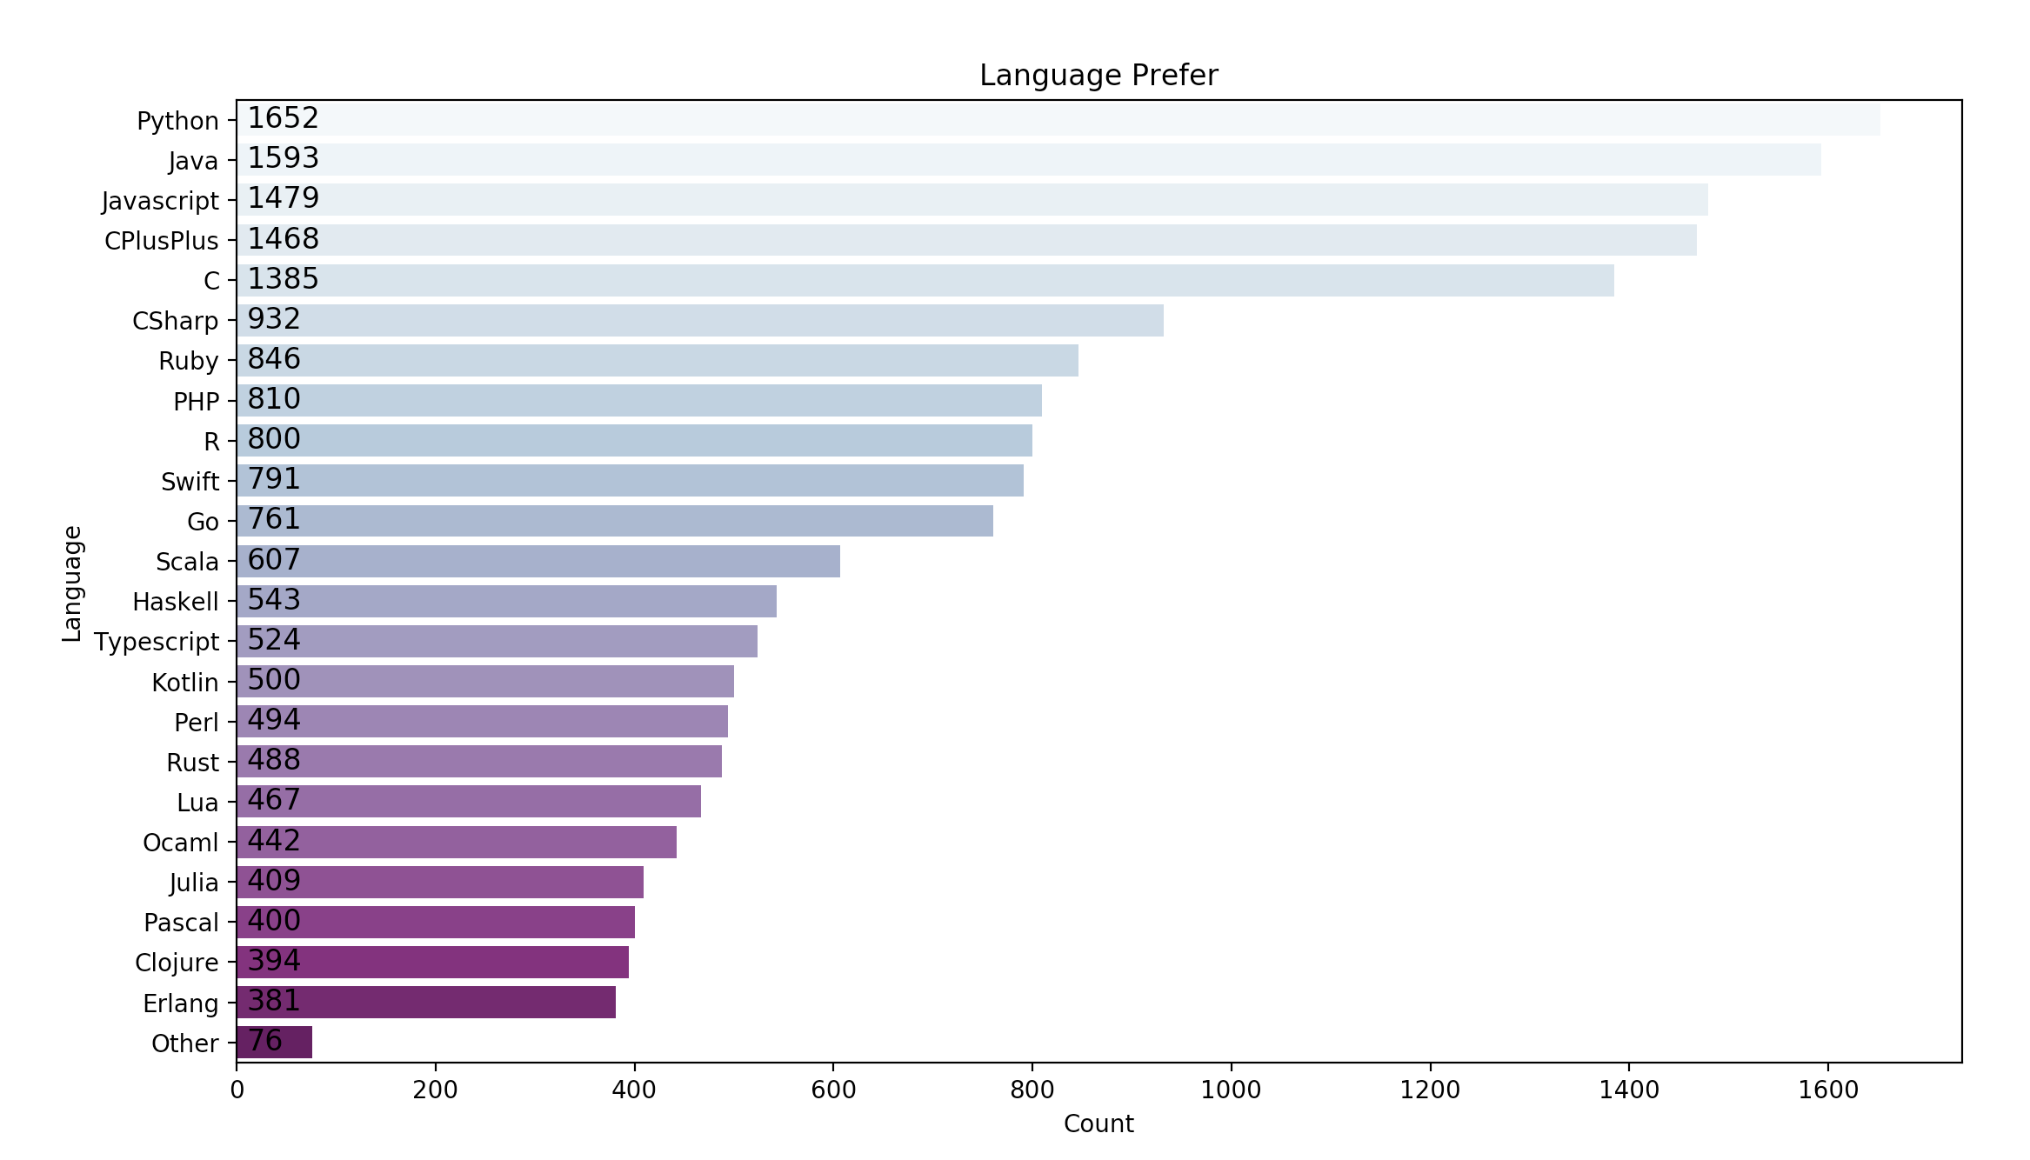
Feature 4 - Popular Programming Language
List most popular programing language of companies’ qualifications.
Datasource comes from the survey of companies.
Notes:
The feature will list popular programming language of companies’ qualifications.
The data comes from hiring managers’ surveys of companies.
For different companies’ software developer position, they have different programming qualifications.
Through summarizing and analyzing them, we could know which language is commonly used and required.
If a user just get in touch with programming, he could check this chart to determine the first programming language to learn.

Slide 9
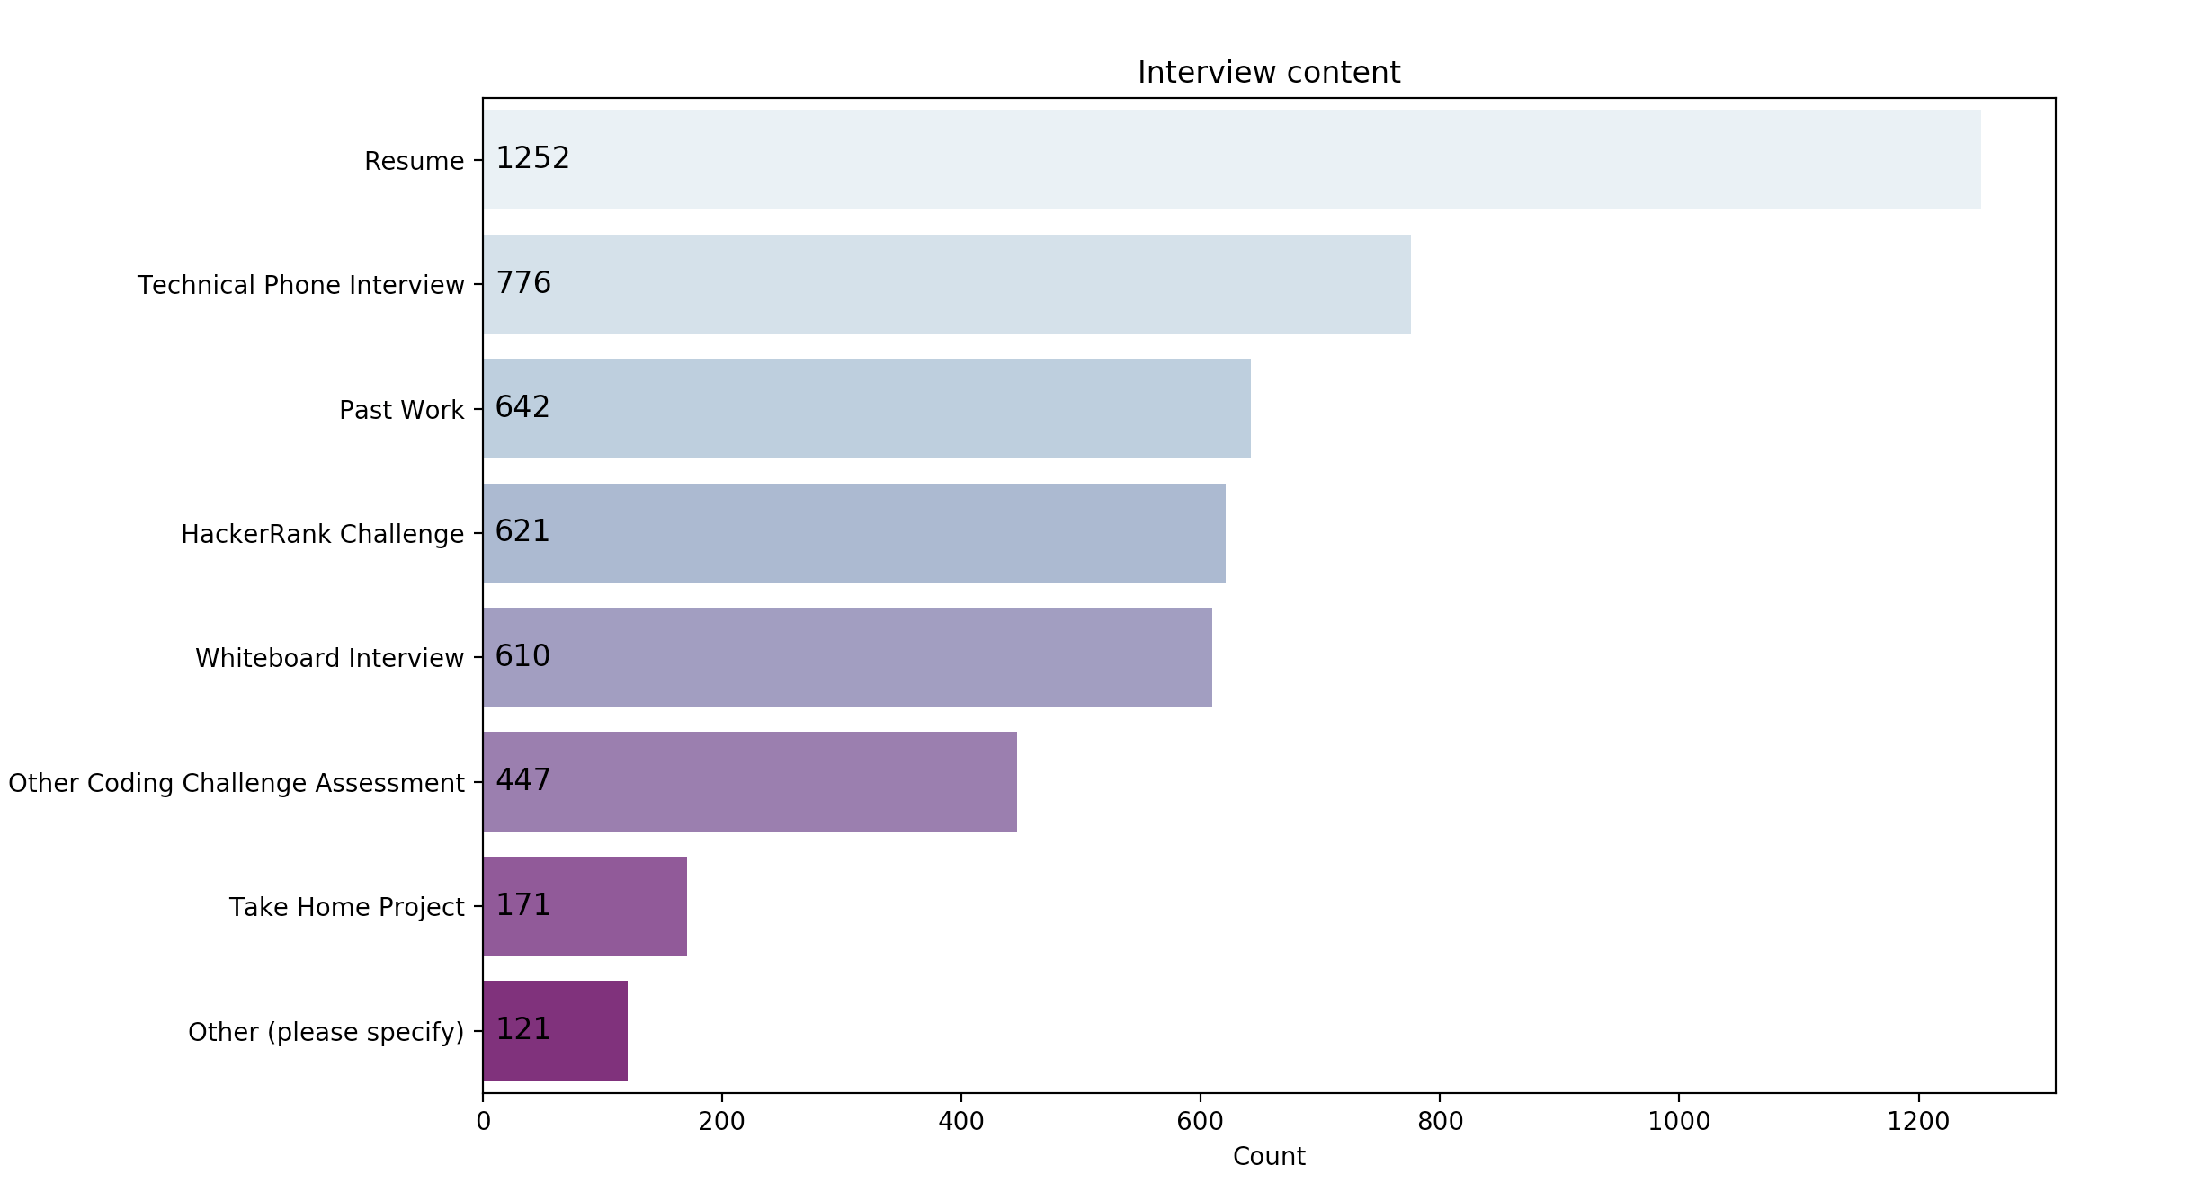
Feature 5 - How does employers measure you?
List common interview forms of company and their measurement.
Based on past developers’ job hunting experience, users can know what is more important in an interview.
Notes:
After we know what we should prepare for a software developer position, let us see how does employers measure us.
This data also comes from hiring managers’ of companies.
This kind of analysis means to help users to figure out what is more important during a job hunting process.
Some people spent a lot of time on practising their programming skills on the whiteboard, because they
think the whiteboard interview determines their result.
However, according to this analysis, we could find out the resume is more important than any others.
This feature is used to help candidate get out of misunderstanding.

Slide 10
Additional Enhancements
In the near future, we will provide an individual solution for our customers.
It will include :
Time the customer should put more (current age - age begins)
Learning Sources
Skill set to be prepared.
Notes:
In the future, we have two parts to improve.
First, we only analyze the Hankrank survey dataset in 2018, which is not enough to provide a comprehensive anaysis.
We will add more dataset into the application.
Second, According to a big dataset, we will add a analysis function for specific users.
We will provide an individual evaluation and solution for the user.
It will include direction the users should put more effort on, and provide some learning advice based on his current statement.
Besides these, we will also provide the learning source for each direction.
All of these are used to help users be well prepared for job interview.

Slide 11
Lessons Learned
Choosing proper dataset is very important.
Hard but valuable to produce meaningful information from the raw data.
Notes:
What I learned in this project is the importance of dataset. Our analysis is based on survey of HankRank’s users.
They have different identity so that they are represet different groups.
Choosing the proper dataset to analyse its feature can build a effective relationship between groups.
The employees can figure out their misunderstand, and employers could effectively make employee know what they are expected.
We also learned that it is hard to produce meaningful information from the raw data.
However, it was so valuable though. We could learn how to read, analyze and make relationships from the raw data.

Slide 12
Deliverables
https://github.com/phoebeWzx/Python-Group-12
https://github.com/phoebeWzx/Python-Group-12/projects

