Slide 1
Principles of Physical Modelling
Modelling the motion of a 2D eccentric disk using lagrangian- Phoebe Malone, Joseph Mace, Oliver Martin, Tanish Madhok

Slide 2
Introduction
Dynamics of Rolling Rigid Bodies: Model vs Experiment
Objective: Evaluate a rolling disc with a radial slot and material variation.
Compare a theoretical model to experimental data
Goal: Test model accuracy in predicting system dynamics
Modelling Approach:
Lagrangian mechanics: Derives equations of motion via kinetic and potential energy.
Assumes no-slip rolling motion (friction present)
Data Validation:
Experimental data via video processing
Direct comparison: Theoretical vs observed dynamics

Slide 3
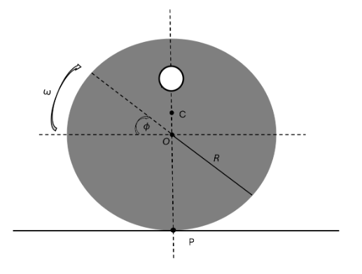
Method
Energy in the system
For a 2D disk rolling on a flat, rough surface with an eccentric center of mass (located at a distance c from its geometric center O), the presence of a circle mass causes this offset. To develop the Lagrangian equation, the velocity Vc is expressed in terms of the angle Ф , using the relation Vc = Vp + Ф* x Rpc, where point P represents the point of instantaneous zero velocity

Slide 4



Method
Energy in the System
Figure 1: Disk visualized with radius R, angle Ф origin O, centre of mass C, and a point of contact at P
Substituting Rpc:
Calculating the cross product gives:

Slide 5

Method
Determining Translational Kinetic energy
The translational kinetic energy of the centre of mass is given by:
Expanding and simplifying results in:

Slide 6
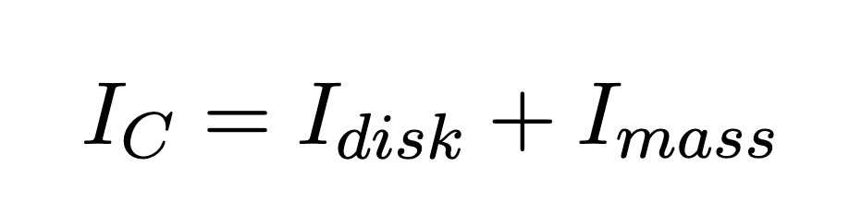


Method
Determining rotational kinetic energy
The first step to calculating the rotational kinetic energy of the center of mass is finding the moment of inertia about C, which is found using:
Where c is the distance from the center of mass to the origin and d is the distance from the center of mass to the center of the circle mass. Therefore,
The rotational kinetic energy is then found using ½ Ic(Ф*^2) where

Slide 7

Method
Total Kinetic Energy
Therefore taking T_rot and T_trans we can express the total kinetic energy as the summation of these parts:
Potential Energy
The potential energy of a centre of mass about an origin is modelled as mgh. In this context height can be written as csin(ϕ) therefore an expression for potential energy is

Slide 8
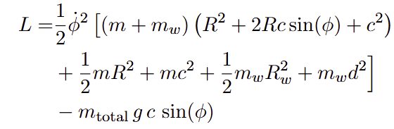
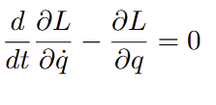
Method
Lagrange Equation
The equation to find L for the lagrange equation is L = T − U . As T and U have already been determined, L can be expressed as
Euler Lagrange equation
The Euler lagrange equation is necessary for finding an equation for the angular acceleration:

Slide 9

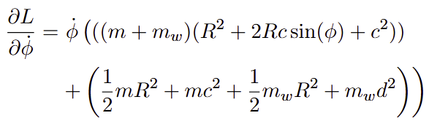

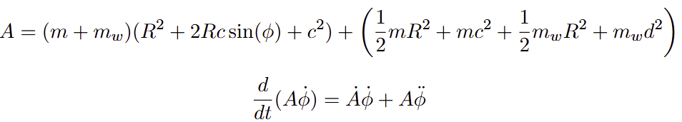
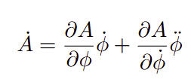
Method
Euler Lagrange equation
continued
Computing
leads to:
After which
is calculated. To do this, the product rule is applied, first, by letting:
Where A* is given by:

Slide 10





Method
Euler Lagrange equation
continued
The partial derivative of A with respect to ϕ is:
Thus,
As A doesn’t depend on ϕ* the right side ’vanishes’ Now, Compute
Substitution is done to get the Euler-Lagrange equation:
This leads to:

Slide 11

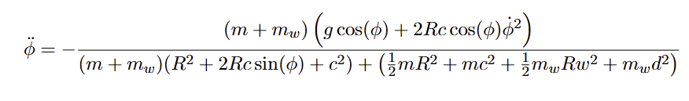
Method
Euler Lagrange equation
continued
The final Form of the Equation of Motion is
Or when fully written out and with the angular acceleration as the focus:
After solving the ODE in MATLAB with realistic variables, figure 2 shows the y-position of the center of mass following an expected path for an eccentric rolling disc. However, the motion repeats indefinitely, so adding an energy loss factor is the next step to improve the model.

Slide 12

Method
Incorporating energy loss
This is achieved by including a dampening term in the Euler-Lagrange equation, acting as constant loss as the disk turns. This term is based on the current velocity at which the disk is turning, therefore, higher speed leads to more energy loss.
Where b is the dampening coefficient

Slide 13
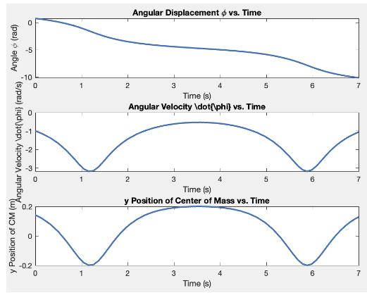
Method
Euler Lagrange Equation (figure)
Figure 2: Results from solving eq23 and plotting the angular velocity, y position and angular displacement over time when R = 1; c = 0.2; g = 9.81; m = 1; mw = 0.1; Rw = 0.1; d = 0.3 and initial angular velocity is set to -1

Slide 14
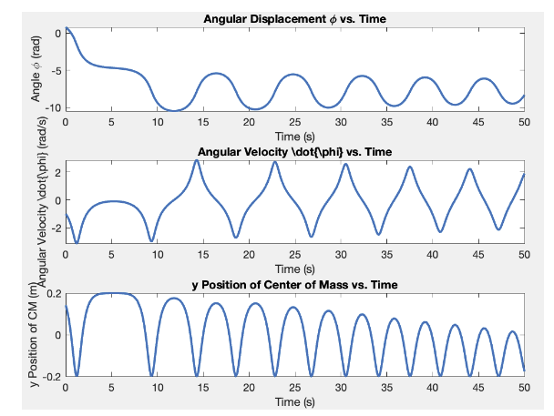
Method
Euler Lagrange Equation
Including this damping term in the model the results in this figure. The disk makes one full turn, then reverses direction every 12 seconds, swinging like a pendulum and gradually losing energy.
Figure 3 : Using the same variables as in Figure 2 with the dampening coefficient b set to 0.04

Slide 15
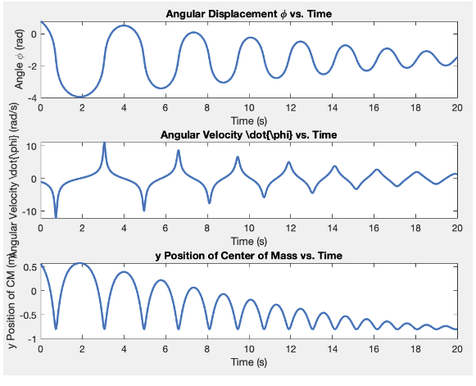
Method
Analysing results
Figure 4: Results from adjusting the position of the center of mass by increasing the added weight, where R = 1; c = 0.8; g = 9.81; m = 1; MW = 1; Rw = 0.1; d = 0.1;
The mass being too heavy means there isn’t enough momentum to push the disk over the sticking point. To test whether this theory is true, the initial angular velocity created by pushing the disk can be increased to see if the momentum carries the center of mass over.

Slide 16
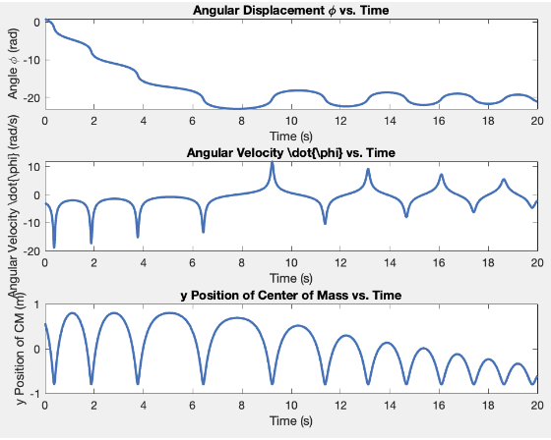
Method
Analyzing results
To test if this is the case, we increased the initial angular velocity, the disc completes multiple full rotations before resuming its oscillating motion, aligning with expected mechanical principles.
Figure 5: Same variables from figure 3, however the initial angular velocity has been increased from -1 to -3.

Slide 17
Taking Readings
Setup
Equipment Calibration:
Configuration: Set up the apparatus as illustrated, ensuring the square is positioned at a specified distance from the center of the disc to maximize potential energy without interfering with the rails. - Calibration: Calibrate all measuring equipment (e.g., cameras, rulers) before the experiment to ensure accurate measurements in both pixels and real dimensions. Document calibration settings (e.g., camera resolution, frame rate).
Controlled Environment:
Indoor Experimentation: Experiment in a controlled indoor environment to minimize external factors like wind or air currents. Ensure consistent lighting for video recording.
Initial Conditions:
Maximize initial potential energy with zero initial kinetic energy for effective energy conversion. Use minimal force, like a gentle side push, to displace the disc without altering initial conditions.

Slide 18
Taking Readings
Setup
Taking Data
Observing Motion
Stability Consideration: The square’s placement at the top of the disc creates an unstable equilibrium, allowing the small force from blowing to initiate movement effectively. – Data Collection: Use a high-speed camera to record the disc’s motion. Secure the camera to prevent any movement during the recording process. Aim to capture a sufficient duration to analyze the motion comprehensively.
Multiple Trials
Trial Protocol: Conduct a minimum of three trials for each setup to enhance reliability. Record any variations in conditions between trials for further analysis.

Slide 19
Taking readings
Data Processing
Colour Recognition
MATLAB Analysis: Process the recorded video using MATLAB. Implement a color recognition algorithm to identify the square’s color and convert video frames into pixel coordinates.
Mean Pixel Calculation
Tracking Position: At each timestep, calculate the mean of the pixel coordinates to track the square’s position over time. Document the method used for calculating the mean.
Scaling to Real Size
Scale Factor Determination: Establish a scale factor by measuring the actual dimensions of the frame and comparing them to the corresponding pixel dimensions. Ensure consistency in measurements

Slide 20
Taking readings
Data Processing
Data Visualization
Graphical Representation: Present the data as a scatter graph, with time on the x-axis and position on the y-axis. Fit a polynomial to the data to analyze the relationship between position and time. Discuss the rationale behind the choice of polynomial degree.
Error Analysis
Identifying Errors: Identify potential sources of error, such as measurement inaccuracies, camera angle distortions, or limitations in color recognition. Develop strategies to mitigate these errors, including conducting multiple recordings and adjusting camera positioning.

Slide 21
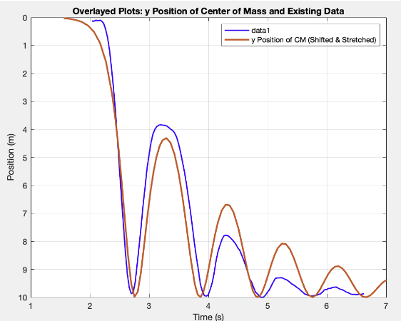
Comparing Final Results
Through experimental data collection of the eccentric disk, results are plotted against the mathematical model, with adjustments made to account for practical conditions such as a reduced circular mass and low initial velocity. Additionally, due to differences in data collection—like origin and start time—the model results are adjusted by flipping and shifting to align with the experimental setup.
Figure 6: Results from the general model and experimental data overlayed where R = 0.07; c =0.03; g = 9.81; m = 0.1; mw = 0.6; Rw = 0.2; d = 0.05;

Slide 22
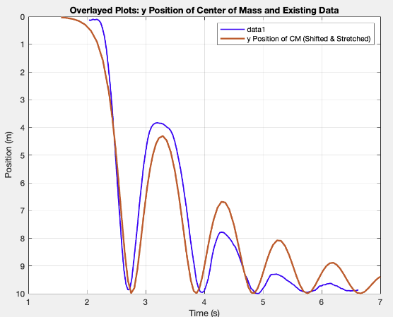
Comparing final results
The most obvious difference between the experimental and modeled data in Figure 6 is in energy loss: the model shows linear decay in oscillations, while the experimental data reveals more complex decay. Modeling energy loss simply as a coefficient times angular velocity is insufficient due to real-world frictional forces, minor slips, and uneven surface contact, all contributing additional complexity.
Figure 6: Results from the general model and experimental data overlayed where R = 0.07; c =0.03; g = 9.81; m = 0.1; mw = 0.6; Rw = 0.2; d = 0.05;

