Slide 1
Flow chart of methodology

Slide 2
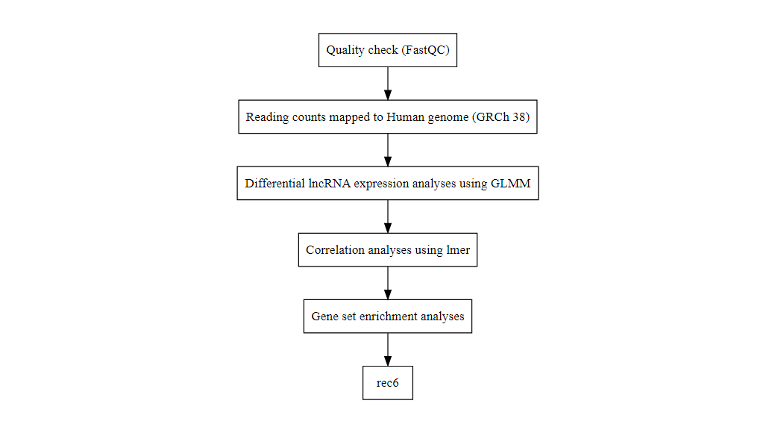
Data analyses steps
Flow diagram sowing steps in analysis

