Slide 1
Flow chart of methodology

Slide 2
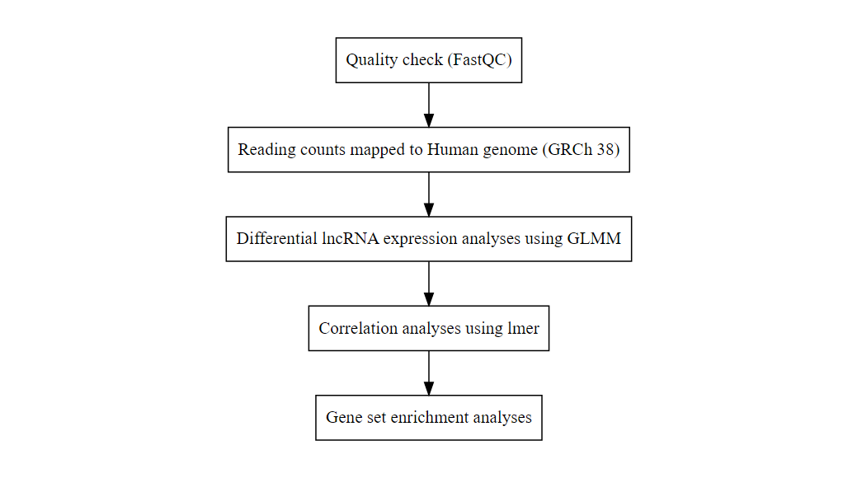
Data analyses steps
Flow diagram sowing data analyses steps

