Slide 1

Empowering Us All
To Watch The Movie We Want
A. Gayahan, P. Wong

Slide 2
“Netflix’s global growth is a big factor in the company’s success.”
“How Netflix Expanded to 190 Countries in 7 Years,” Harvard Business Review, October 12, 2018

Slide 3
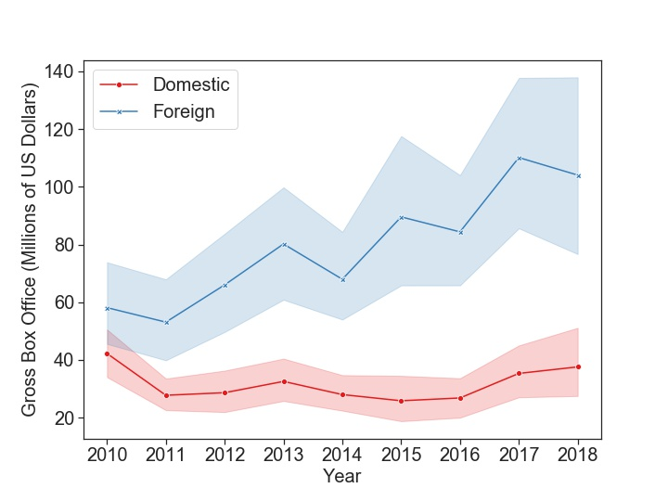
Foreign box office grew, while domestic stagnated...
Domestic vs Foreign Box Office, 2010-2018 (in millions of USD)
dfs
Notes:
This trend tells us a movie portfolio with better global distribution channels is more likely to have better overall box office performance than one that focuses on the domestic market only.
So it’s important to learn more about the films that performed well in foreign box offices.
We study their features by dividing the movies in this period into two groups: those with foreign box office as a share of total box office over 50, labeled as “Global”, and those with share under 50%, which we labeled as “Foreign”, and look at how their performances and attributes are different.

Slide 4
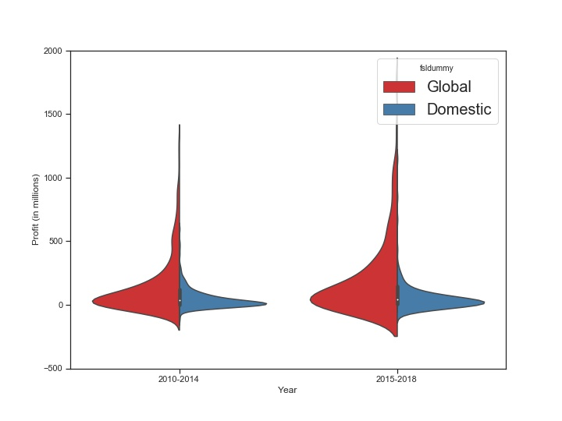
Films with success in global distribution has better upside for profits, especially in recent years
Kernel Density of Profits by Domestic vs Globally Distributed Films, 2010- 2014 vs 2015-2018 (in millions of USD)

Slide 5
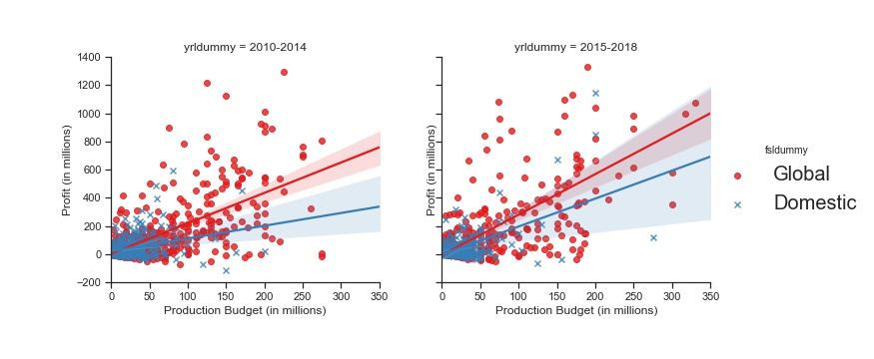
Globally distributed films are more sensitive to production budget: higher production budget often means more profit
Production Budget and Profits, by Domestic vs Globally Distributed Films,
2010- 2014 vs 2015-2018 (in millions of USD)
Notes:
While domestic films’ profit was less sensitive to production budget, it has gotten more so in recent years.

Slide 6
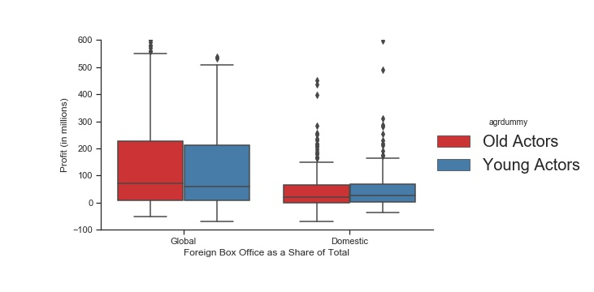
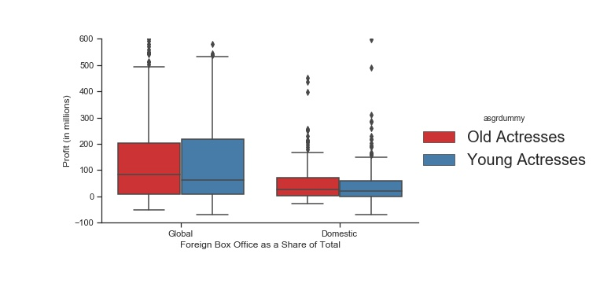
Global films with older actors and actresses tend to be slightly more profitable...
Profit and Average Age of Principle Actors and Actresses,
by Domestic vs Globally Distributed Films (in millions of USD)
Notes:
Left chart: Movies divided into two groups: Average age of principle actors above/below 40. Right chart: average age of principle actresses above/below 35.

Slide 7
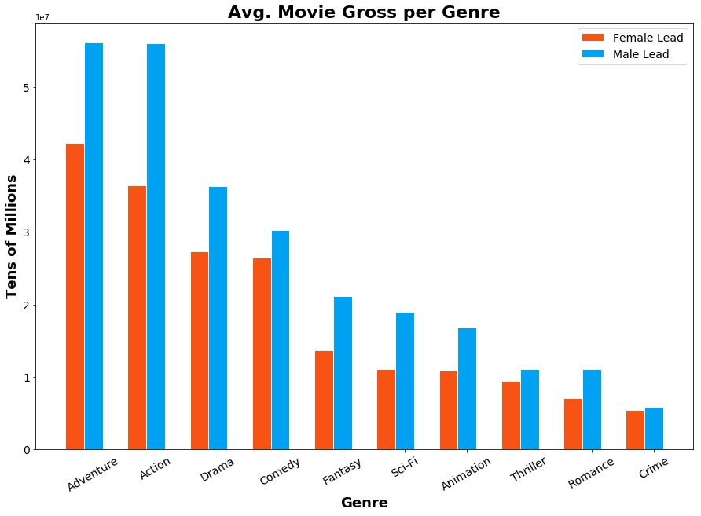
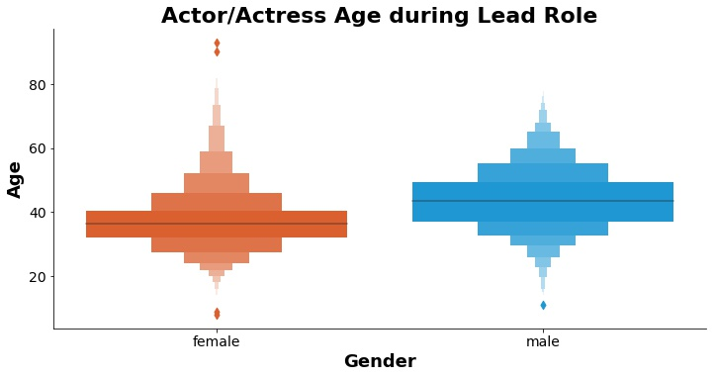
Profitable Genres by Lead Gender

Slide 8
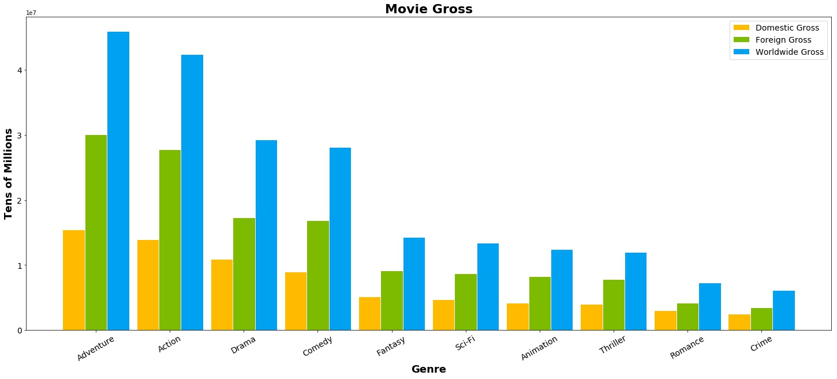
Geographical Market per Genre

Slide 9
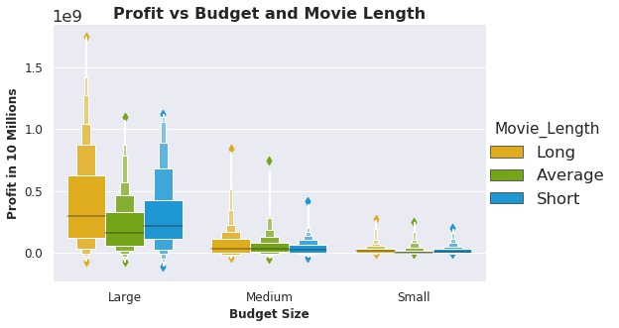
Movie Runtime
Length in Minutes
Short | <96 Min
Average | >96 & <119
Long | >119
Budget in Millions
Small | <12
Medium | >12 & <64
Large | >64

