Slide 1
Advanced Section #4: Methods of Dimensionality Reduction: Principal Component Analysis (PCA)
Marios Mattheakis and Pavlos Protopapas

Slide 2
Outline
Introduction:
Why Dimensionality Reduction?
Linear Algebra (Recap).
Statistics (Recap).
Principal Component Analysis:
Foundation.
Assumptions & Limitations.
Kernel PCA for nonlinear dimensionality reduction.

Slide 3
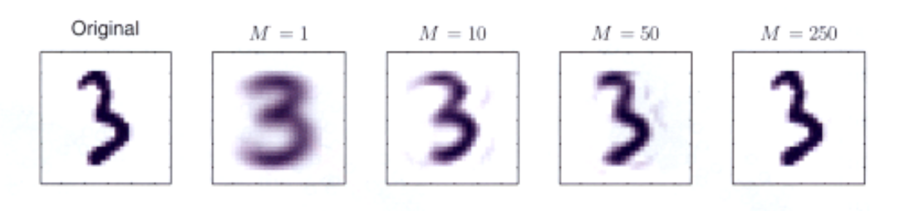

Dimensionality Reduction, why?
A process of reducing the number of predictor variables under consideration.
To find a more meaningful basis to express our data filtering the noise and revealing the hidden structure.
C. Bishop, Pattern Recognition and Machine Learning, Springer (2008).

Slide 4
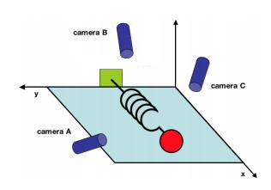
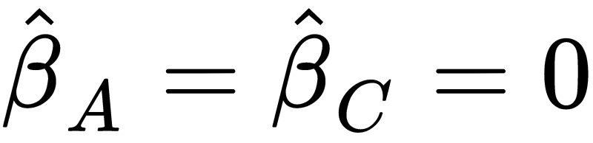
A simple example taken by Physics
Consider an ideal spring-mass system oscillating along x.
Seeking for the pressure Y that spring exerts on the wall.
LASSO regression model:
LASSO variable selection:
J. Shlens, A Tutorial on Principal Component Analysis, (2003).

Slide 5
Principal Component Analysis versus LASSO
LASSO
LASSO simply selects one of the arbitrary directions, scientifically unsatisfactory.
We want to use all the measurements to situate the position of mass.
We want to find a lower-dimensional manifold of predictors on which data lie.
X
X
Principal Component Analysis (PCA): A powerful Statistical tool for analyzing data sets and is formulated in the context of Linear Algebra.
Notes:
We ll see a review on Statistics and LA concepts since you have seen them in previous adv. sections.

Slide 6
Linear Algebra (Recap)

Slide 7





Symmetric matrices
Suppose a design (or data) matrix consists of n observations and p predictors, hence:
Then is a symmetric matrix.
Symmetric:
Using that :
Similar for

Slide 8





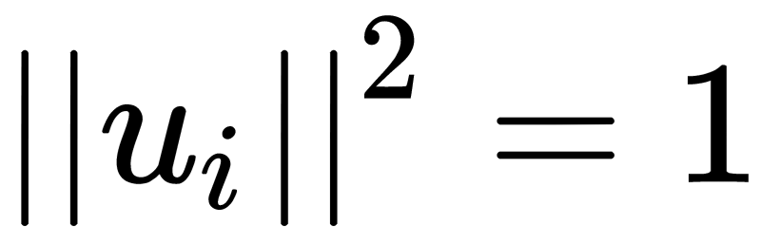
Eigenvalues and Eigenvectors
Suppose a real and symmetric matrix:
Exists a unique set of real eigenvalues: and the associate linearly independent eigenvectors:
such that:
(orthogonal)
(normalized)
Hence, they consist an orthonormal basis.

Slide 9
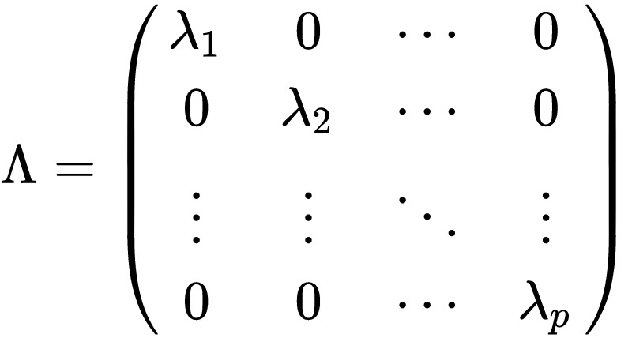
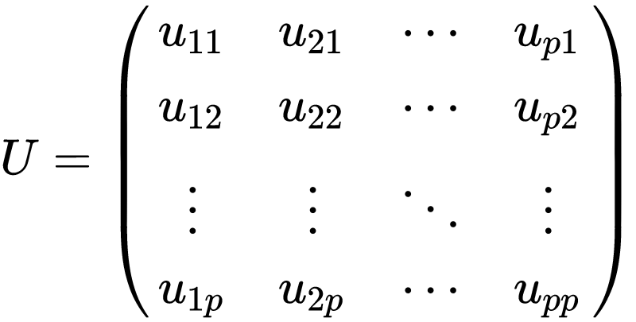

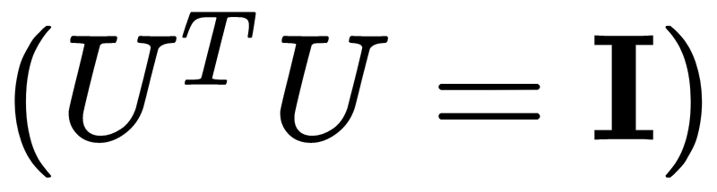

Spectrum and Eigen-decomposition
Spectrum:
Unitary Matrix:
Eigen-decomposition:

Slide 10
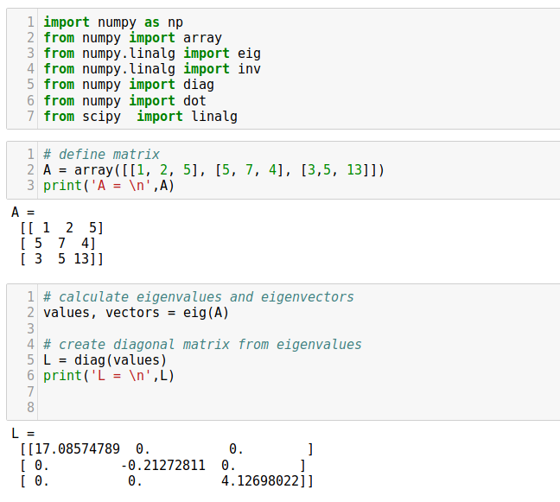
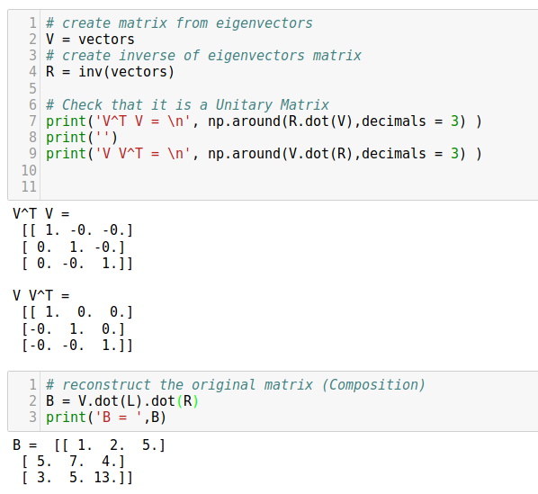
Numerical verification of decomposition property
Notes:
Gram-Schmidt process

Slide 11
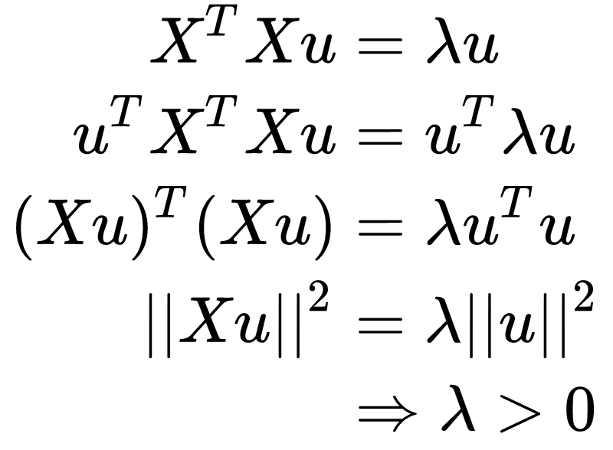
Real & Positive Eigenvalues: Gram Matrix
The eigenvalues of are positive and real numbers:
Similar for
Hence, and are Gram matrices.
Notes:
Group the terms

Slide 12
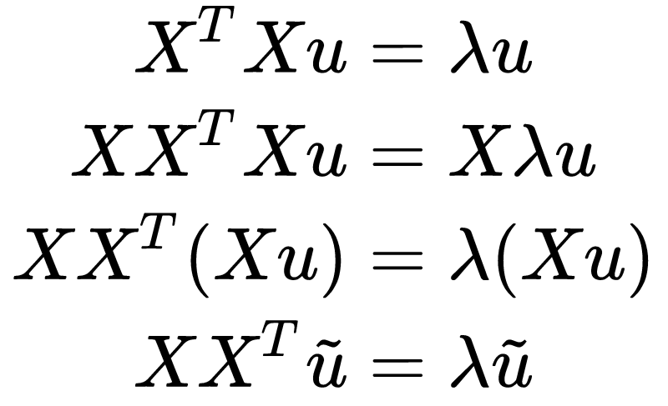

Same eigenvalues
The and share the same eigenvalues:
Same eigenvalues.
Transformed eigenvectors:
Notes:
group the terms
the eigenvalues are unchanged

Slide 13
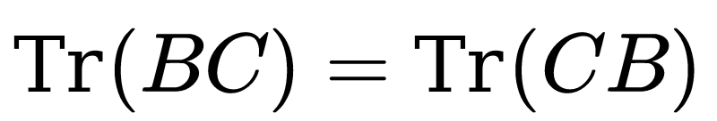
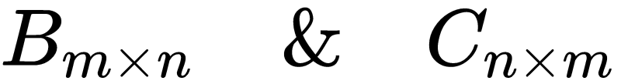
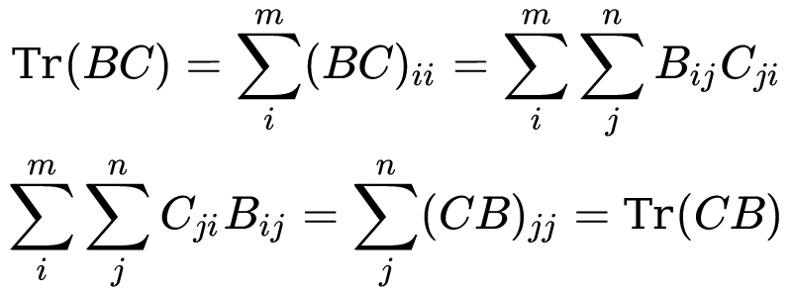
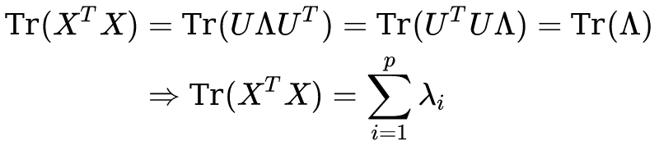

The sum of eigenvalues of is equal to its trace
Cyclic Property of Trace: Suppose the matrices:
The trace of a Gram matrix is the sum of its eigenvalues.

Slide 14
Statistics (Recap)

Slide 15
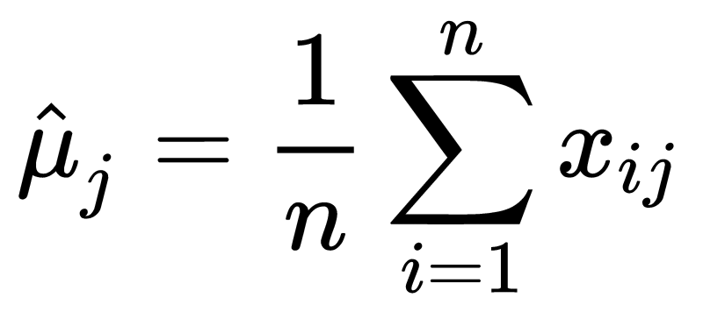

Centered Model Matrix
Suppose the model (data) matrix
We make the predictors centered (each column has zero expectation) by subtracting the sample mean:
Centered Model Matrix:
Notes:
each of the n rows represents a different repetition of the experiment, and each of the p columns gives a particular kind of feature

Slide 16
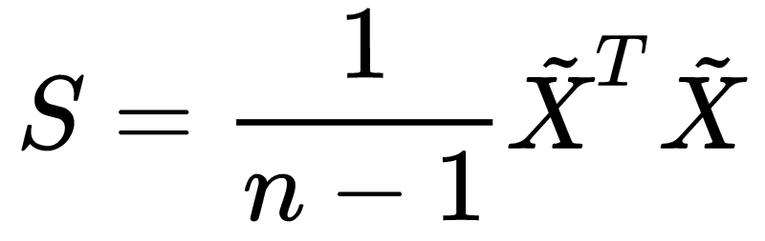
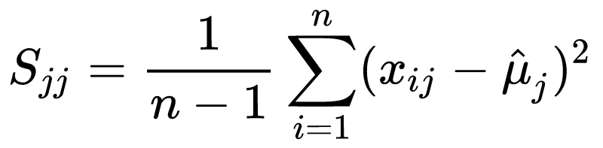
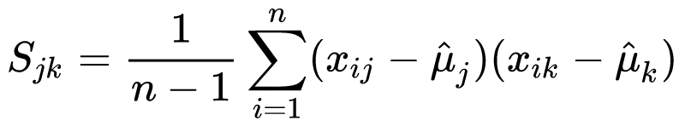
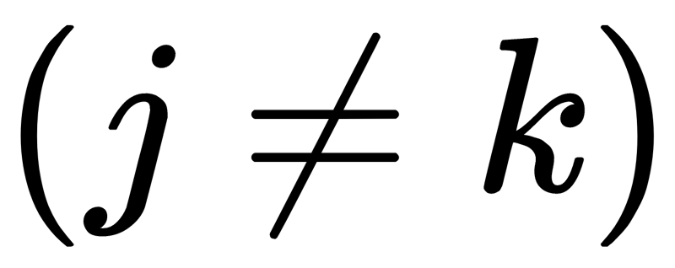
Sample Covariance Matrix
Consider the Covariance matrix:
Inspecting the terms:
The diagonal terms are the sample variances:
The non-diagonal terms are the sample covariances:

Slide 17
Principal Components Analysis (PCA)
Notes:
With the above preliminaries, the actual methodology of PCA is now quite simple. The idea is to remove as much redundancy in our predictors as possible. The redundancy is defined through the correlation between the predictors.

Slide 18
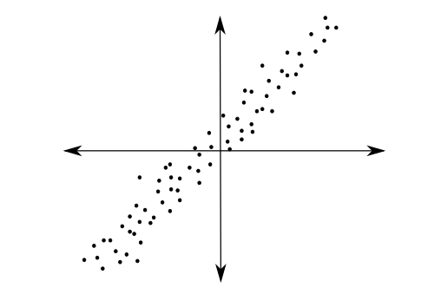
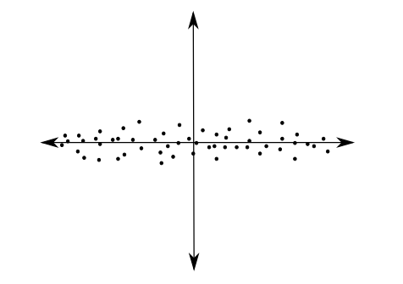
PCA
PCA tries to fit an ellipsoid to the data.
PCA is a linear transformation that transforms data to a new coordinate system.
The data with the greatest variance lie on the first axis (first principal component) and so on.
PCA reduces the dimensions by throwing away the low variance principal components.
J. Jauregui (2012)
Notes:
Using Linear Algebra

Slide 19



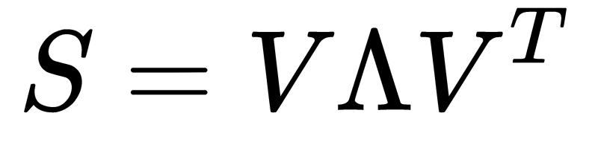

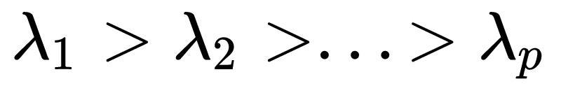

PCA foundation
Since is a Gram matrix, will be a Gram matrix too, hence:
The eigenvalues are sorted in as:
The eigenvector is called the i^{th} principal component of
Notes:
Using Linear Algebra

Slide 20
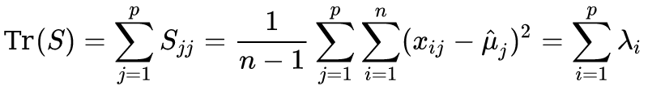
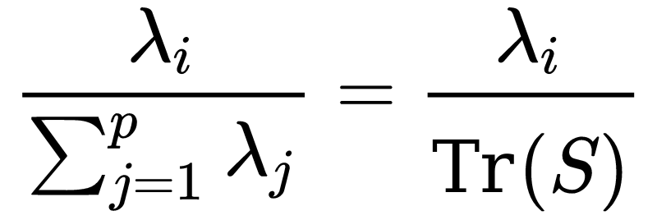

Measure the importance of the principal components
The total sample variance of the predictors:
The fraction of the total sample variance that corresponds to :
so, the indicates the “importance” of the i^{th} principal component.

Slide 21
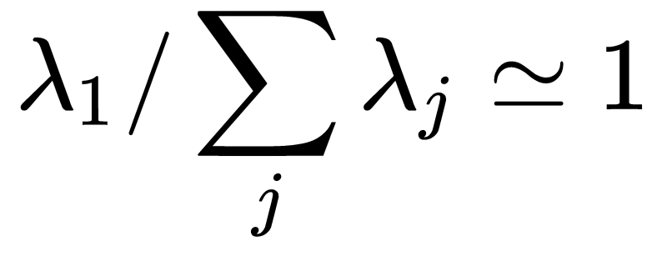
Back to spring-mass example
PCA finds:
revealing the one-degree of freedom.
Hence, PCA indicates that there may be fewer variables that are essentially responsible for the variability of the response.

Slide 22
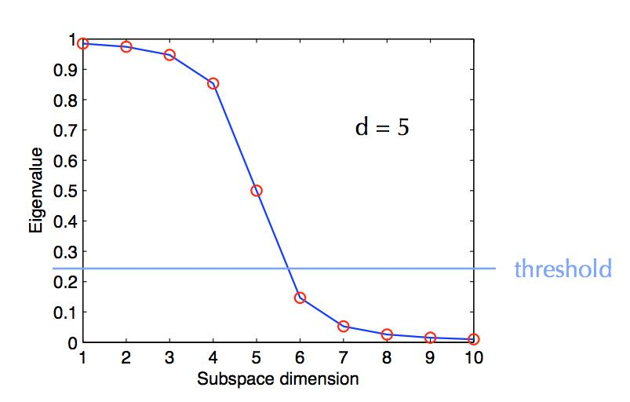
PCA Dimensionality Reduction
The Spectrum represents the dimensionality reduction by PCA.
Notes:
Usually the first eigenvalue are orders of magnitude greater than the others because the data may have fewer degrees of freedom than the number of the predictors.

Slide 23
PCA Dimensionality Reduction
There is no rule in how many eigenvalues to keep, but it is generally clear and left in analyst’s discretion.
C. Bishop, Pattern Recognition and Machine Learning, Springer (2008).
Notes:
Usually the first eigenvalue are orders of magnitude greater than the others because the data may have fewer degrees of freedom than the number of the predictors.
How many eigenvalues to keep is left in teh

Slide 24
Assumptions of PCA
Although PCA is a powerful tool for dimension reduction, it is based on some strong assumptions.
The assumptions are reasonable, but they must be checked in practice before drawing conclusions from PCA.
When PCA assumptions fail, we need to use other Linear or Nonlinear dimension reduction methods.

Slide 25
Mean/Variance are sufficient
In applying PCA, we assume that means and covariance matrix are sufficient for describing the distributions of the predictors.
This is true only if the predictors are drawn by a multivariable Normal distribution, but approximately works for many situations.
When a predictor is heavily deviate from Normal distribution, an appropriate nonlinear transformation may solve this problem.

Slide 26
High Variance indicates importance
The eigenvalue is measures the “importance” of the i^{th} principal component.
It is intuitively reasonable, that lower variability components describe less the data, but it is not always true.

Slide 27
Principal Components are orthogonal
PCA assumes that the intrinsic dimensions are orthogonal allowing us to use linear algebra techniques.
When this assumption fails, we need to assume non-orthogonal components which are non compatible with PCA.

Slide 28
Linear Change of Basis
PCA assumes that data lie on a lower dimensional linear manifold. So, a linear transformation yields an orthonormal basis.
When the data lie on a nonlinear manifold in the predictor space, then linear methods are doomed to fail.

Slide 29



Kernel PCA for Nonlinear Dimensionality Reduction
Applying a nonlinear map Φ (called feature map) on data yields PCA kernel:
Centered nonlinear representation:
Apply PCA to the modified Kernel:

Slide 30
Summary
Dimensionality Reduction Methods
A process of reducing the number of predictor variables under consideration.
To find a more meaningful basis to express our data filtering the noise and revealing the hidden structure.
Principal Component Analysis
A powerful Statistical tool for analyzing data sets and is formulated in the context of Linear Algebra.
Spectral decomposition: We reduce the dimension of predictors by reducing the number of principal components and their eigenvalues.
PCA is based on strong assumptions that we need to check.
Kernel PCA for nonlinear dimensionality reduction.

Slide 31
Advanced Section 4: Dimensionality Reduction, PCA
Thank you
Office hours for Adv. Sec.
Monday 6:00-7:30 pm
Tuesday 6:30-8:00 pm

