Slide 1
Time Series Forecasting
— Japan Tourist Arrivals to Australia
by Lin Xiao
Nov 10, 2025

Slide 2

Motivation
Forecast quarterly international tourist arrivals to Australia from the major market Japan
Tourism arrivals directly impact business operations — forecasting helps companies anticipate and manage demand
Forecasts enable better decisions in:
  Tourism marketing strategy
  Hotel pricing and capacity planning
  Transportation scheduling
  Staffing and resource allocation

Slide 3
Data Source and Characteristics
Data Source:
Data from fpp2 R package, originally published by the Australian Bureau of Statistics data
Time period:
1981 Q1 – 2012 Q3
Frequency:
Quarterly observations
Scope:
International visitor arrivals to Australia from Japan, New Zealand, the UK, and the US
This project Focuses on Japan
Reliability:
ABS data is audited, government-certified, ande widely used in academic forecasting research.
Characteristics:
Strong seasonality and a long-term trend — ideal for time series forecasting

Slide 4
Methodology
Models
  Seasonal Decomposition
  Naïve Model
  Simple Exponential Smoothing
  Holt-Winter
Accuracy Measures
  MAPE - Percentage error, intuitive for business decision-making

Slide 5
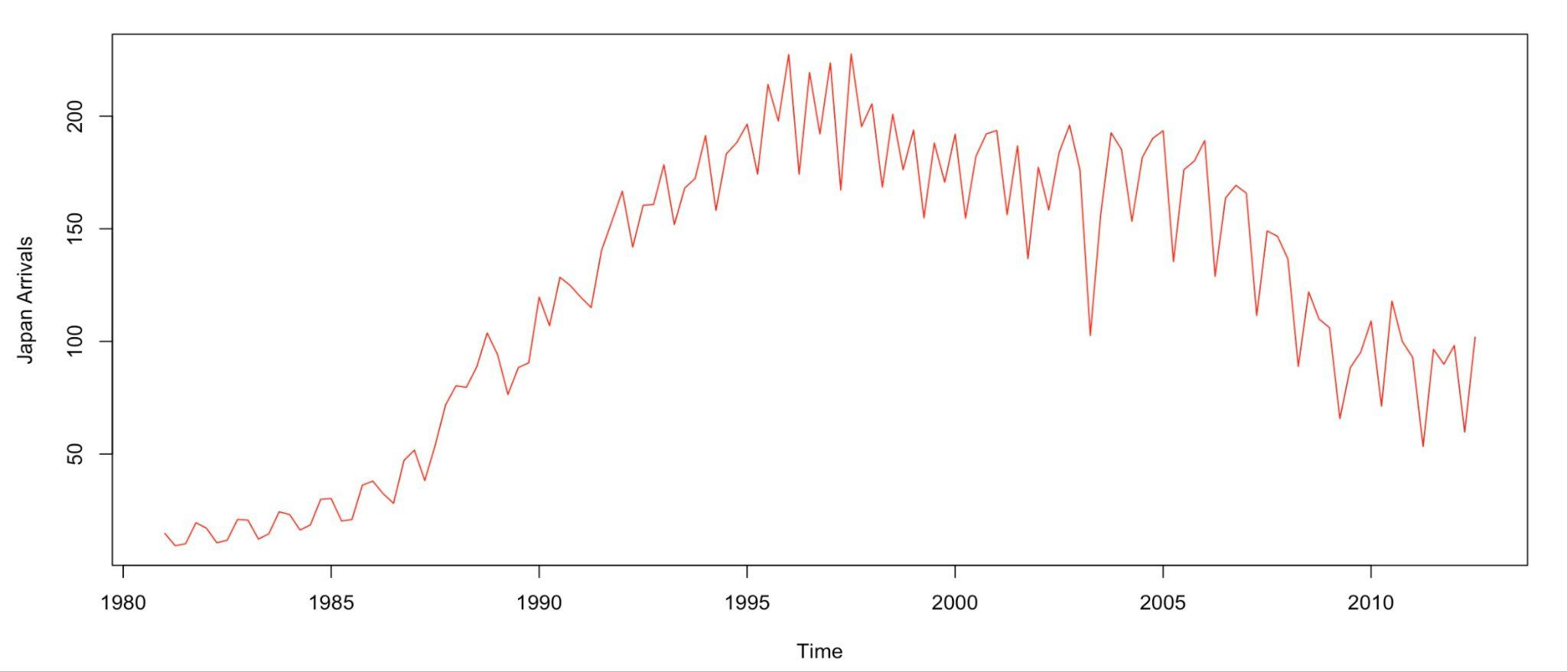
Exploration
Strong annual seasonality
  repeating peak every Q1/Q3
Long-term trend
  growth before 1996
  decline until 2012
Data refinement
  Remove historic data before 1996 - retain more relevant trend period

Slide 6
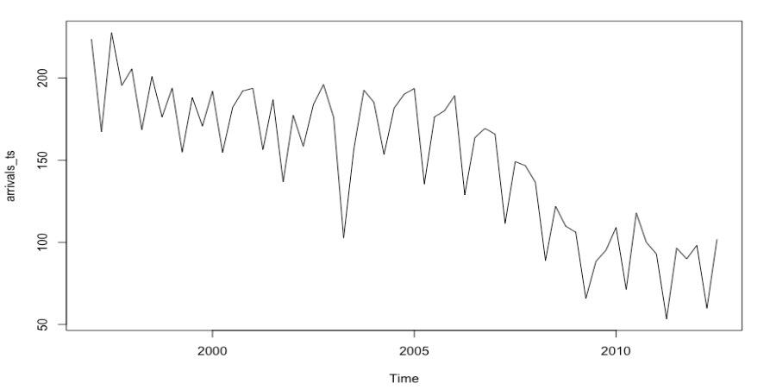
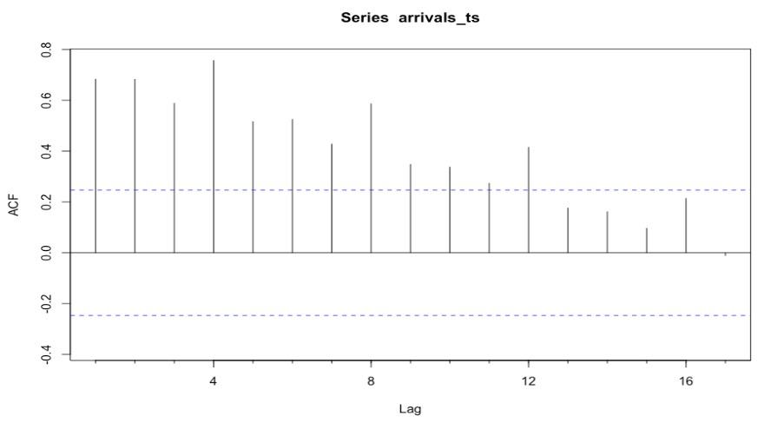
Exploration(Continue)
Time series view:
  Shows clear repeated seasonal structure and downward trend
ACF plot:
  Repeating spikes at lag 4, 8,12, confirms quarterly seasonality
  Decreasing as lag increases, presence of a long-term trend
Insight:
  Data exhibits both trend and seasonality

Slide 7
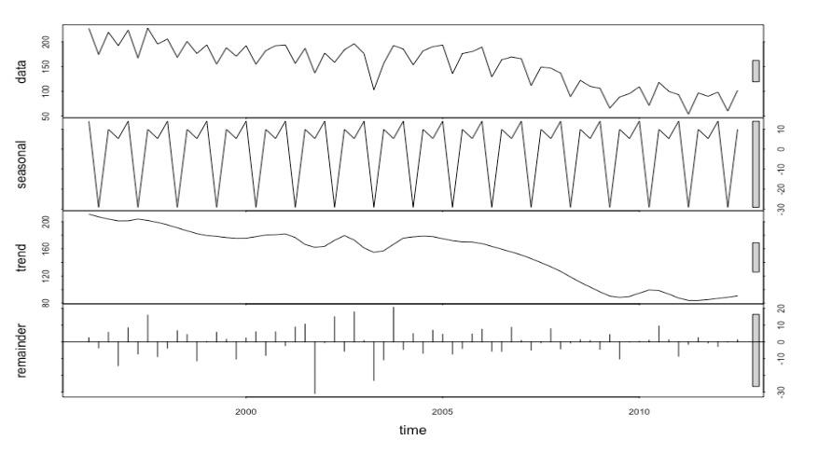
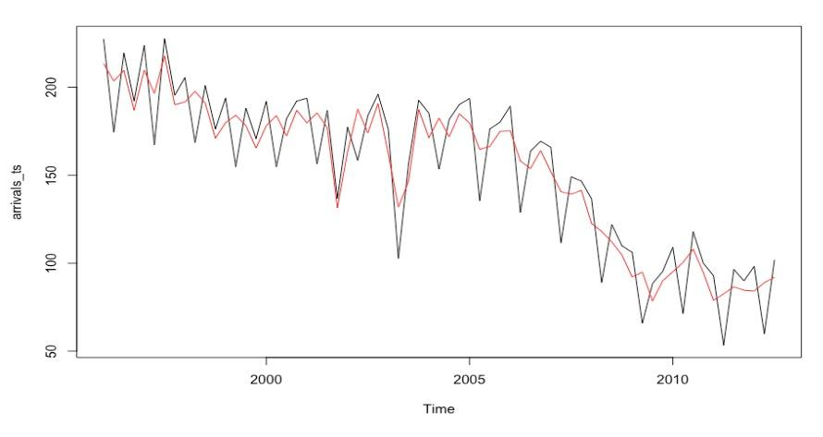
Decomposition
Decomposition
  Additive decomposition
  Seasonal fluctuations
  clear decline trend
  Separate trend from seasonal
Seasonal adjustment
  Smooth fluctuation in original data
  Confirm seasonal fluctuations
  provide cleaner signal

Slide 8
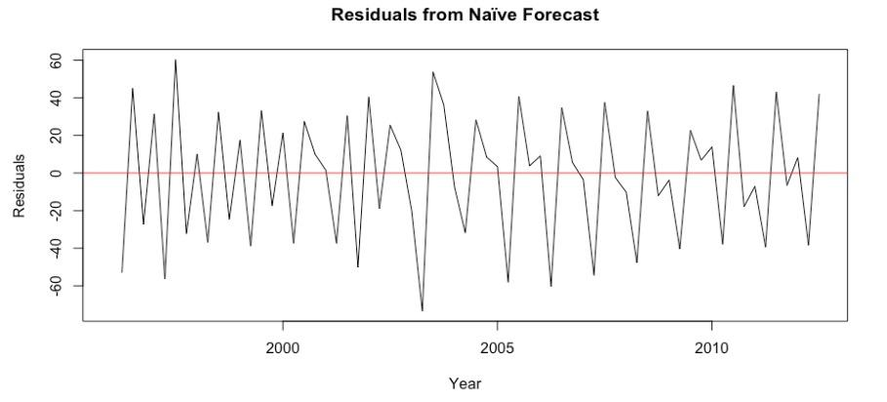
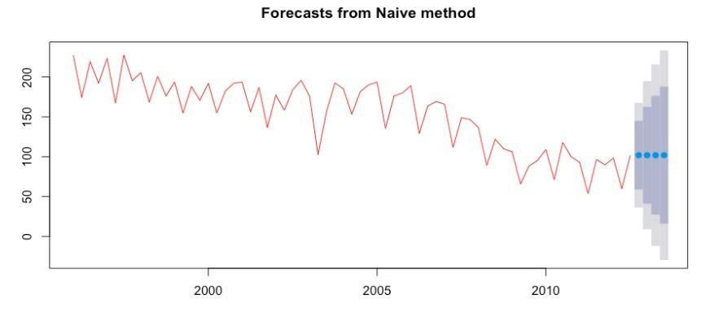
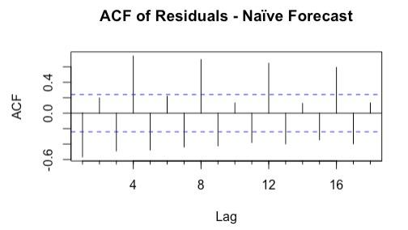
Naive Model
Model Analysis
  Repeating the last quarter’s value
  Mape around 21.7% - poor performance
  Fail to capture trend + seasonality
Residual Analysis
  Large seasonal swings still present
  ACF significant autocorrelation at 4,8,12 lags

Slide 9
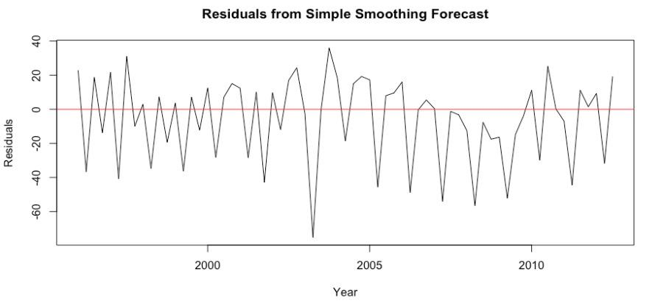
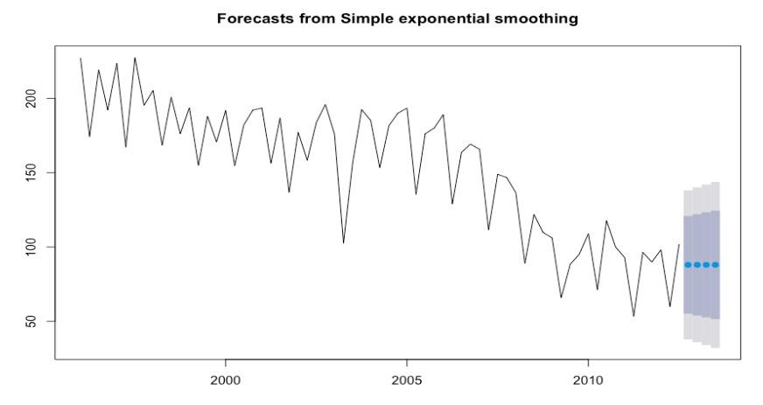
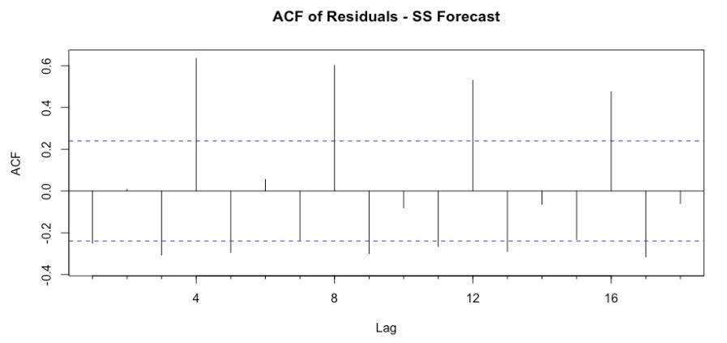
Simple Smoothing
Model Analysis
  Alpha (α) = 0.28 moderate responsiveness
  MAPE = 15.86%
  Forecast produces a flat level (no trend/seasonality)
Residual Analysis
  Seasonal patterns remain
  Centered around zero
  ACF shows significant autocorrelation

Slide 10
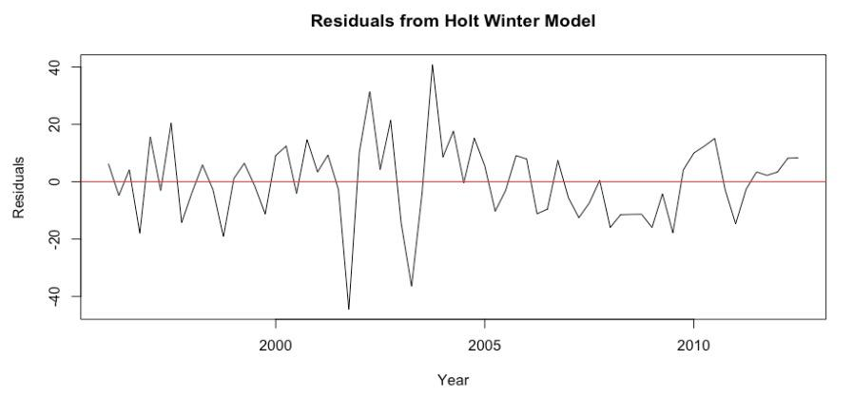
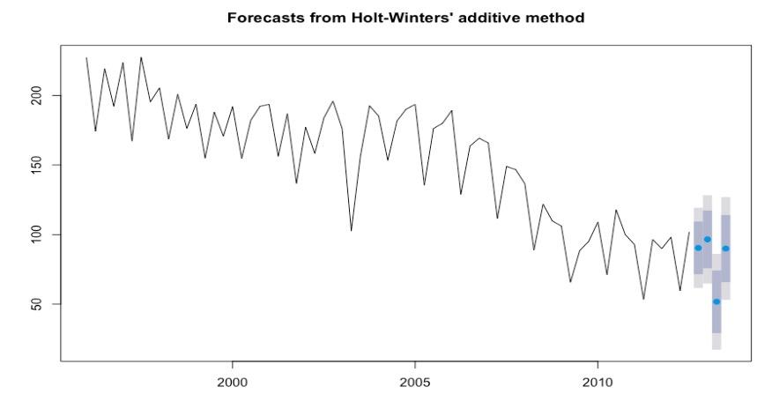
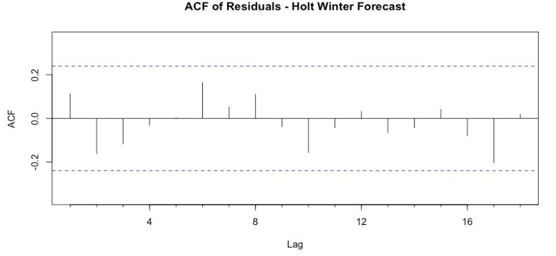
Holt-Winter
Model Analysis
  α = 0.46, β ≈ 0, γ ≈ 0
  MAPE = 7.6%
  Captures level, slight trend and strong seasonality
Residual Analysis
  Centered around zero
  Seasonal pattern largely removed
  ACF shows no significant autocorrelation

Slide 11
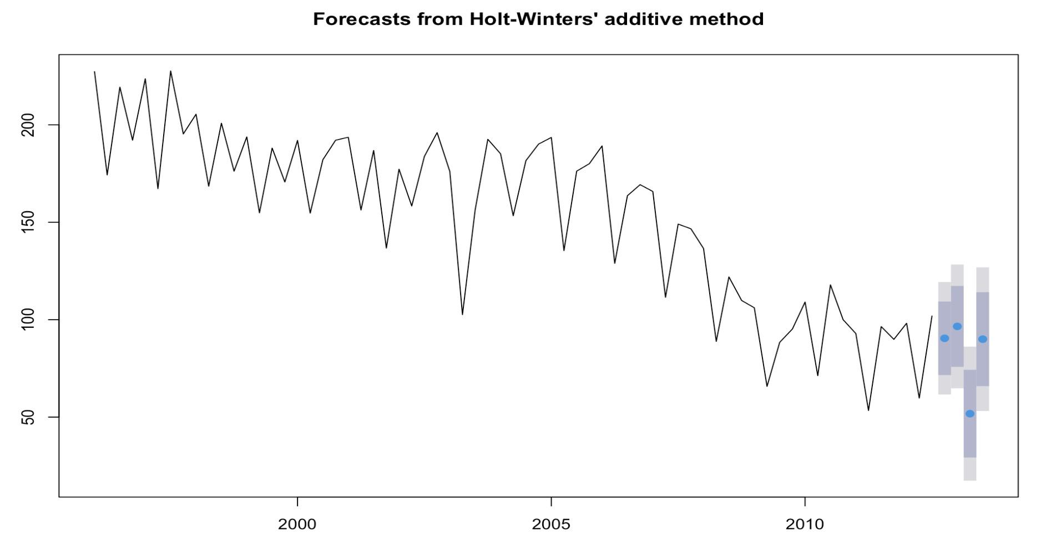
Recommendation
Rank the model by Mape
  Holt-winter 7.640%
  Simple smooth 15.861%
  naive model 21.747%
Final Recommendation - Holt winter
  Balances trend and strong seasonal pattern
  Produce realistic dynamic and stable forecast
  Model assumption satisfied

Slide 12
Forecast and Conclusion
Next Year
  Forecasts remain stable around 90–95 thousand arrivals per quarter.
  Short-term seasonal peaks continue but are weaker than historical highs
Next Two Year
  Arrivals are expected to stay near current levels or decline slightly.
  No strong signs of recovery in the medium term.
Conclusion
  Stabilization after a long-term decline, with seasonality still present but less pronounced.
  Remain flat with moderate seasonal variation, without clear growth momentum in the near future.

Slide 13
Forecast and Conclusion
Extend the dataset
Current data ends in 2012; adding recent years
Incorporate external factors
Tourism arrivals are also influenced by exchange rates, economic conditions, airline capacity, and policy changes.
Including these variables could significantly enhance forecast reliability.
Try advanced forecasting models
Explore ARIMA, ETS variations, or machine-learning-based models for potentially better predictive performance.

Slide 14
Thank you！

