Slide 1
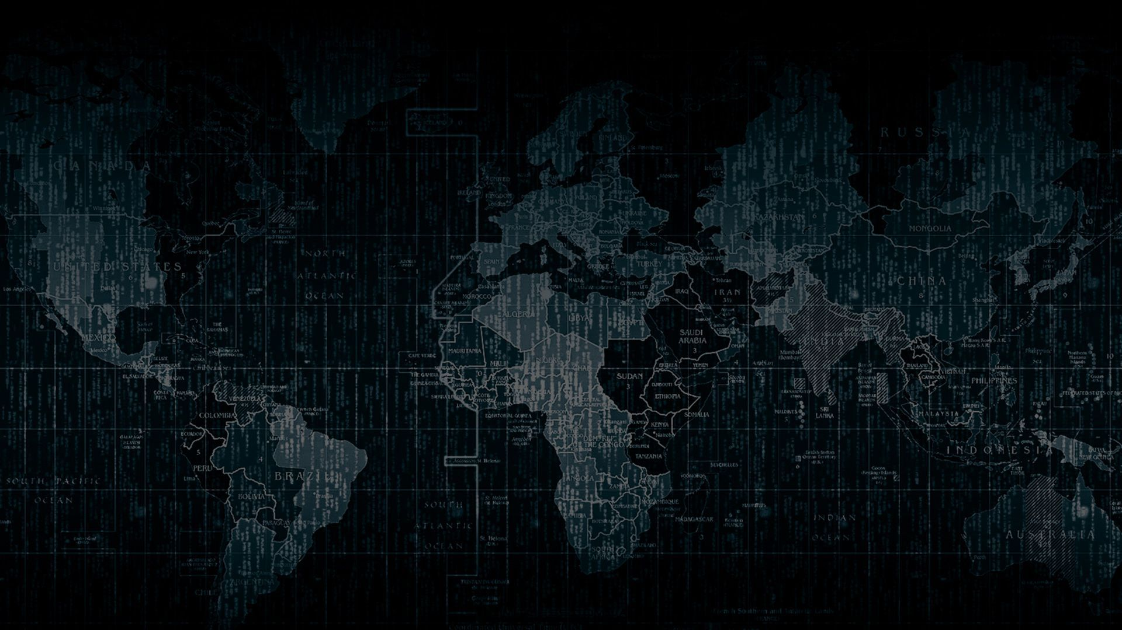
Cybersecurity

Slide 2
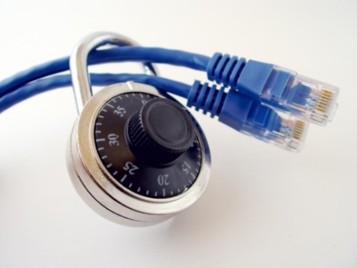
Importance of Cybersecurity
The internet allows an attacker to work from anywhere on the planet.
Risks caused by poor security knowledge and practice:
Identity Theft
Monetary Theft
Legal Ramifications (for yourself and your organization)
Sanctions or termination if policies are not followed
According to the SANS Institute, the top vectors for vulnerabilities available to a cyber criminal are:
Web Browser
IM Clients
Web Applications
Excessive User Rights

Slide 3
Cybersecurity is Safety
Security: We must protect our computers and data in the same way that we secure the doors to our homes.
Safety: We must behave in ways that protect us against risks and threats that come with technology.
Notes:
Security: The way in which we protect access to our computers and information. E.g. Anti-virus software, firewall
Safety: The we behave while using the internet. E.g. Safe email behavior, safe software downloading behavior
Stress the difference and the importance of both together to provide a safe and secure computing environment.

Slide 4
User Awareness
Cyber-Criminals
System Administrators
Some scripts appear useful
to manage networks…
Cracker:
Computer-savvy
programmer creates
attack software
Posts to
Hacker Bulletin Board
SQL Injection
Buffer overflow
Password Crackers
Password Dictionaries
Successful attacks!
Crazyman broke into …
CoolCat penetrated…
Script Kiddies:
Unsophisticated computer users who know how to
execute programs
Downloads
Reports
Posts to
Criminals: Create & sell bots -> generate spam
Sell credit card numbers, etc…
Notes:
Users must be aware of the threats that exist in order to properly detect and prevent them.

Slide 5
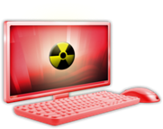

Leading Threats
Viruses
Worms
Trojan Horses / Logic Bombs
Social Engineering
Rootkits
Botnets / Zombies

Slide 6
Viruses
A virus attaches itself to a program, file, or disk.
When the program is executed, the virus activates and replicates itself.
The virus may be benign or malignant but executes its payload at some point (often upon contact).
Viruses can cause computer crashes and loss of data.
In order to recover or prevent virus attacks:
Avoid potentially unreliable websites/emails.
System Restore.
Re-install operating system.
Use and maintain anti-virus software.
Program
A
Extra Code
infects
Program
B
Notes:
Viruses
Computer viruses are software programs that are deliberately designed by online attackers to invade your computer, to interfere with its operation, and to copy, corrupt or delete your data. These malicious software programs are called viruses because they are designed not only to infect and damage one computer, but to spread to other computers all across the Internet.
Computer viruses are often hidden in what appear to be useful or entertaining programs or e-mail attachments, such as computer games, video clips or photos. Many such viruses are spread inadvertently by computer users, who unwittingly pass them along in e-mail to friends and colleagues.

Slide 7
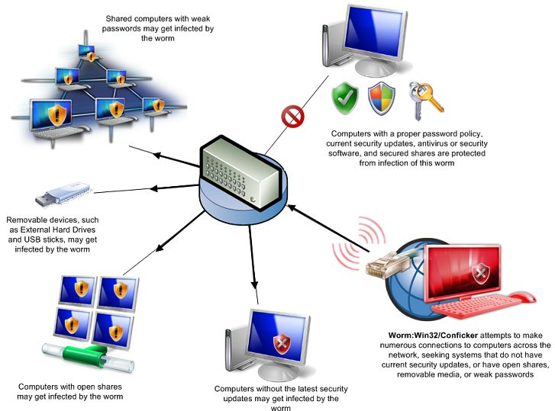
Worms
Independent program that replicates itself and sends copies from computer to computer across network connections.
Upon arrival, the worm may be activated to replicate.
To Joe
To Ann
To Bob
Email List:
Joe@gmail.com
Ann@yahoo.com
Bob@u.edu
Notes:
Worms
Worms are more sophisticated viruses that can replicate automatically and send themselves to other computers by first taking control of certain software programs on your PC, such as email.

Slide 8
Top worst worm and viruses in history
Mydoom (Novarg): 2004 - $38 Bilion
technically a “worm,” spread by mass emailing.
responsible for 25% of all emails sent at time.
$250,000 reward was offered the developer never caught.
Sobig: 2003 - $30 Billion
masqueraded as legitimate computer software attached to emails
disrupted ticketing at Air Canada
WannaCry: 2017 - $4 Billion
WannaCry computer virus is ransomware
virus that takes over your computer (or cloud files) and holds them hostage
It stopped when a 22-year-old security researcher in the U.K. found a way to turn it off
Computers with out-of-date operating systems were hit especially hard
Stuxnet
Notes:
Viruses
Computer viruses are software programs that are deliberately designed by online attackers to invade your computer, to interfere with its operation, and to copy, corrupt or delete your data. These malicious software programs are called viruses because they are designed not only to infect and damage one computer, but to spread to other computers all across the Internet.
Computer viruses are often hidden in what appear to be useful or entertaining programs or e-mail attachments, such as computer games, video clips or photos. Many such viruses are spread inadvertently by computer users, who unwittingly pass them along in e-mail to friends and colleagues.

Slide 9
Logic Bombs and Trojan Horses
Logic Bomb:
Malware logic executes upon certain conditions. The program is often used for otherwise legitimate reasons.
Examples:
Software which malfunctions if maintenance fee is not paid.
Employee triggers a database erase when he is fired.
Trojan Horse:
Masquerades as a benign program while quietly destroying data or damaging your system.
Download a game: It may be fun but contains hidden code that gathers personal information without your knowledge.
Why trojan horse?
The story of the Trojan Horse is well-known. First mentioned in the Odyssey, it describes how Greek soldiers were able to take the city of Troy after a fruitless ten-year siege by hiding in a giant horse supposedly left as an offering to the goddess Athena.
Notes:
Logic Bomb
Malware that destroys data when certain conditions are met. E.g., it may format a hard drive or change data files (possibly by inserting random bits of data) on a particular date or time or if a certain employee record is missing from the employee database.
Example: an employee places a logic bomb inside a system to destroy data when his/her record is removed upon termination.
Trojan Horses
A Trojan horse is a program which seems to be doing one thing, but is actually doing another. A Trojan horse can be used to set up back door in a computer system so that the intruder can gain access later.
The name refers to the horse from the Trojan War, with similar function of deceiving defenders into bringing an intruder inside.

Slide 10
Top trojan horse attacks
Emotet (2018): The King of Malware
first detected in 2014 and primarily targets the banking and health institutions
became famous in 2018 after infecting the Fürstenfeldbruck hospital in Germany forcing them to shut down 450 computers
Storm Worm (2007)
As severe storms swept over Europe in January 2007, thousands of users received a malicious email disguised as a weather bulletin containing updates
spread to as many as 1 million computers in Europe and America.
once infected, it would download a package of executable files on the affected systems.
These files were used to carry out various functions, including stealing sensitive user information, delivering spam emails to spread the malware, and launching Distributed-Denial-of-Service (DDoS) attacks.
Notes:
Logic Bomb
Malware that destroys data when certain conditions are met. E.g., it may format a hard drive or change data files (possibly by inserting random bits of data) on a particular date or time or if a certain employee record is missing from the employee database.
Example: an employee places a logic bomb inside a system to destroy data when his/her record is removed upon termination.
Trojan Horses
A Trojan horse is a program which seems to be doing one thing, but is actually doing another. A Trojan horse can be used to set up back door in a computer system so that the intruder can gain access later.
The name refers to the horse from the Trojan War, with similar function of deceiving defenders into bringing an intruder inside.

Slide 11
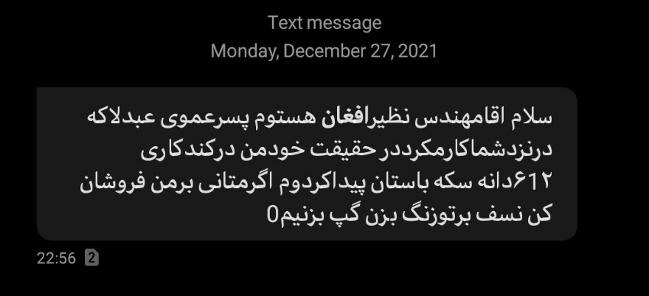

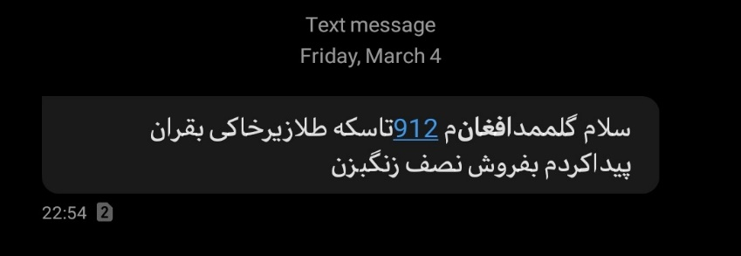
Social Engineering
Social engineering: manipulates people into performing actions or divulging confidential information. Similar to a confidence trick or simple fraud, the term applies to the use of deception to gain information, commit fraud, or access computer systems.
Email:
ABC Bank has
noticed a
problem with
your account…
I have come to repair your machine…
and have some lovely software patches!
Notes:
Social Engineering can occur in-person, over the phone, in emails or fake web pages.
Social Engineering: non-technical or low-technology means - such as lies, impersonation, tricks, bribes, blackmail, and threats - used to attack information systems.
The next two slides discuss two types of Social Engineering: phishing and pharming.

Slide 12
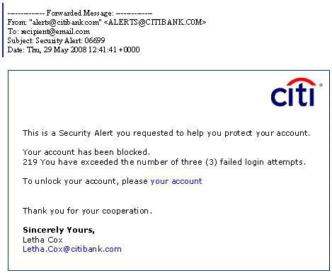
Phishing: Counterfeit Email
Phishing: A seemingly trustworthy entity asks for sensitive information such as SSN, credit card numbers, login IDs or passwords via e-mail.
Notes:
Phishing: A type of Social Engineering. The use of e-mails that appear to originate from a trusted source to trick a user into entering valid credentials at a counterfeit website. Typically the e-mail and the web site looks like they are part of a trusted organization with whom the user is familiar.

Slide 13
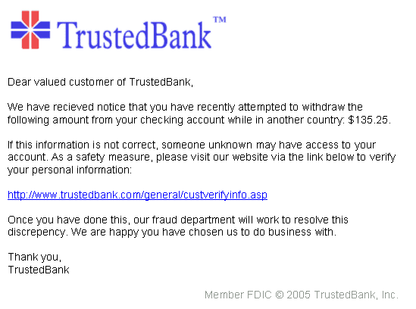
Pharming: Counterfeit Web Pages
Wiping over, but not clicking the link may reveal a different address.
Misspelled
With whom?
Copyright date is old
The link provided in the e-mail leads to a counterfeit webpage which collects important information and submits it to the owner.
The counterfeit web page looks like the real thing
Extracts account information
Notes:
Pharming: Another type of social engineering. A user’s session is redirected to a masquerading website. At the fake website, transactions can be mimicked and information like login credentials can be gathered. With this the attacker can access the real site and conduct transactions using the credentials of a valid user on that website.

Slide 14
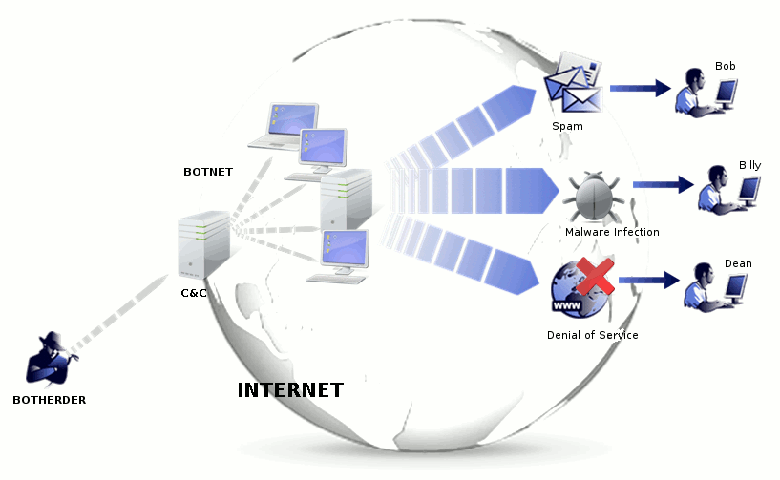
Botnet
A botnet is a number of compromised computers used to create and send spam or viruses or flood a network with messages as a denial of service attack.
The compromised computers are called zombies.
Notes:
When your computer becomes infected, it is likely to become a bot. Because attacks are international, they are hard to locate and eradicate.
Zombie: a compromised computer which may host pornography, illegal music and/or movies
Botnet: a “zombie army,” or collection of compromised computers, zombies, used to send out spam, viruses or distributed denial of service attacks.

Slide 15
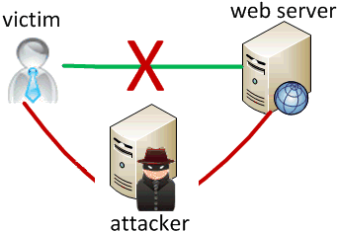
Man In The Middle Attack
An attacker pretends to be your final destination on the network. When a person tries to connect to a specific destination, an attacker can mislead him to a different service and pretend to be that network access point or server.
Notes:
Man in the middle attackers can deploy decoy wireless access points near legitimate ones but pretend to be legitimate. The decoy access point resembles the legitimate one, fooling unwitting users into giving up their credentials.

Slide 16
Rootkit
Upon penetrating a computer, a hacker may install a collection of programs, called a rootkit.
May enable:
Easy access for the hacker (and others)into the enterprise
Keystroke logger
Eliminates evidence of break-in.
Modifies the operating system.
Backdoor entry
Keystroke Logger
Hidden user
Notes:
RootKit: A collection of programs that a hacker uses to mask intrusion and obtain administrator-level access to a computer or computer network.

Slide 17
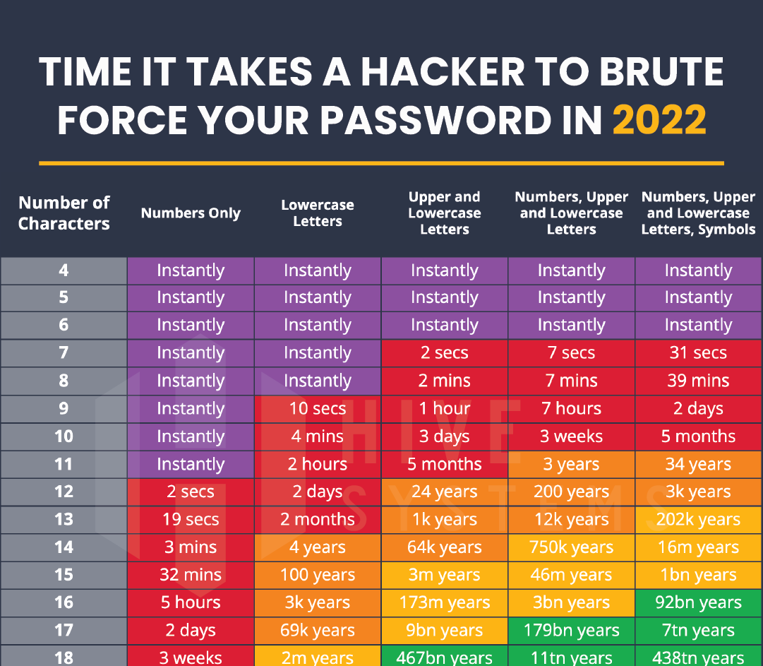
Password Cracking
Notes:
This chart shows the different combinations of passwords and password lengths and how long a dictionary attack or brute force attack would take to guess the password.
Discussion of proper password creation and change techniques will occur later in the User Practices section of the presentation.
At this stage just discuss the attacks and comparisons to password lengths and patterns.
Brute Force Attack: A cryptanalysis technique or other kind of attack method involving an exhaustive procedure that tries all possibilities, one-by-one.
Dictionary Attack: An attack that tries all of the phrases or words in a dictionary, trying to crack a password or key. A dictionary attack uses a predefined list of words compared to a brute force attack that tries all possible combinations.

Slide 18
Identifying Security Compromises
Symptoms:
Antivirus software detects a problem.
Disk space disappears unexpectedly.
Pop-ups suddenly appear, sometimes selling security software.
Files or transactions appear that should not be there.
The computer slows down to a crawl.
Unusual messages, sounds, or displays on your monitor.
Stolen laptop: 1 stolen every 53 seconds; 97% never recovered.
The mouse pointer moves by itself.
The computer spontaneously shuts down or reboots.
Often unrecognized or ignored problems.

Slide 19
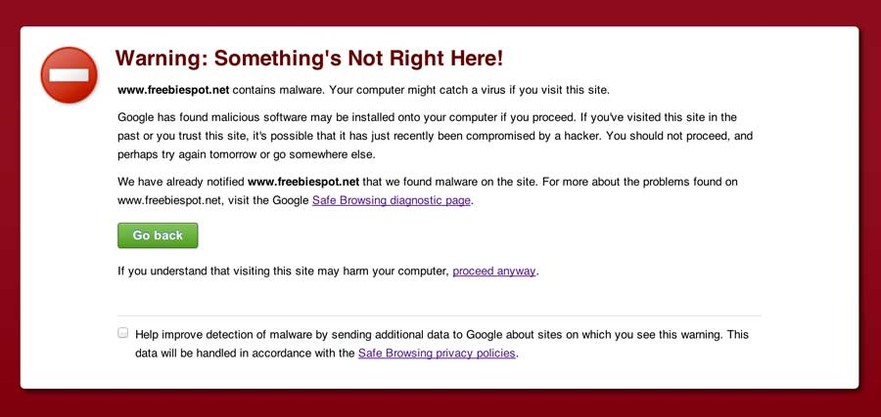
Malware detection
Spyware symptoms:
Changes to your browser homepage/start page.
Ending up on a strange site when conducting a search.
System-based firewall is turned off automatically.
Lots of network activity while not particularly active.
Excessive pop-up windows.
New icons, programs, favorites which you did not add.
Frequent firewall alerts about unknown programs when trying to access the Internet.
Poor system performance.

Slide 20
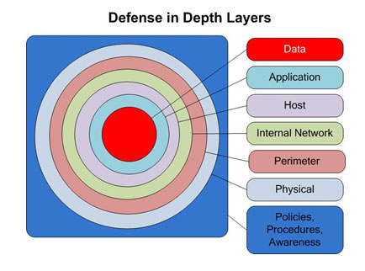
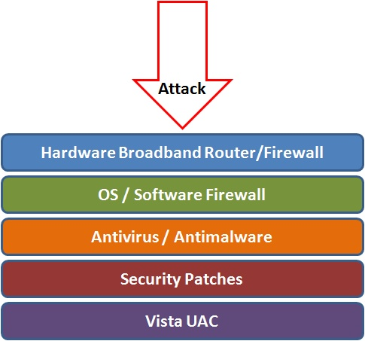
Best Practices to avoid these threats
Defense in depth uses multiple layers of defense to address technical, personnel and operational issues.
User Account Controls

Slide 21
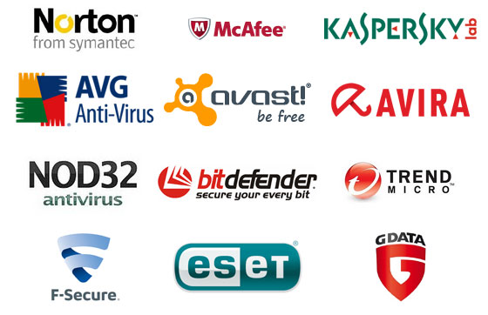
Anti-virus and Anti-spyware Software
Anti-virus software detects certain types of malware and can destroy it before any damage is done.
Install and maintain anti-virus and anti-spyware software.
Be sure to keep anti-virus software updated.
Many free and commercial options exist.
Contact your Technology Support Professional for assistance.

Slide 22
Protect your Operating System
Microsoft regularly issues patches or updates to solve security problems in their software. If these are not applied, it leaves your computer vulnerable to hackers.
The Windows Update feature built into Windows can be set up to automatically download and install updates.
Avoid logging in as administrator
Apple provides regular updates to its operating system and software applications.
Apply Apple updates using the App Store application.

Slide 23
Use Strong Passwords
Make passwords easy to remember but hard to guess
USG standards:
Be at least ten characters in length
Must contain characters from at least two of the following four types of characters:
English upper case (A-Z)
English lower case (a-z)
Numbers (0-9)
Non-alphanumeric special characters ($, !, %, ^, …)
Must not contain the user’s name or part of the user’s name
Must not contain easily accessible or guessable personal information about the user or user’s family, such as birthdays, children’s names, addresses, etc.
Notes:
Make passwords according to organization standards. USG has set a minimum.

Slide 24
Creating Strong Passwords
A familiar quote can be a good start:
Using the organization standard as a guide, choose the first character of each word:
LIASMWTFOS
Now add complexity the standard requires:
L1A$mwTF0S (10 characters, 2 numerals, 1 symbol, mixed English case: password satisfies all 4 types).
Or be more creative!
“LOVE IS A SMOKE MADE WITH THE FUME OF SIGHS”
William Shakespeare

Slide 25

Avoid Social Engineering and Malicious Software
Do not open email attachments unless you are expecting the email with the attachment and you trust the sender.
Do not click on links in emails unless you are absolutely sure of their validity.
Only visit and/or download software from web pages you trust.
Notes:
Email Attachments
Attachments should be opened only from trusted senders.
If you are not expecting an email attachment from the sender, it’s a good idea to call and confirm, before opening the attachment.
Spam email often asks for sensitive information.
Links in emails
Never click on link in email attachment, except only when you are expecting it.
If you are not expecting an email link from the sender, it’s a good idea to call and confirm, before clicking the email link.
If you hover the cursor over an email’s web link description, the link should be displayed on the bottom of the browser. Make sure both of them match.
Trustworthy Web Pages
Software download should be done only from trusted websites like Microsoft for Windows updates and Office application updates.
Avoid downloading and using freeware or shareware, since most of them either don’t come with technical support or full functionality.

Slide 26
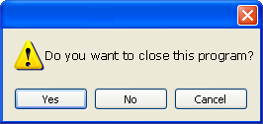
Avoid Stupid Hacker Tricks
Be sure to have a good firewall or pop-up blocker installed.
Pop-up blockers do not always block ALL pop-ups so always close a pop-up window using the ‘X’ in the upper corner.
Never click “yes,” “accept” or even “cancel.”
Infected USB drives are often left unattended by hackers in public places.
Notes:
A pop-up blocker should be installed (many browsers have them as add-ons), but they do not always block all pop-ups
Do not respond to pop ups while working online. For example, a malicious pop up message may say that you have a virus on the system. Close it by clicking on X in the upper right corner. If you click OK, it might install spyware or other malicious code.‘
Infected USB drives are often left unattended by hackers in public places. They intend for unsuspecting people to take the USB home or to the office and unknowingly install the worm or malicious code.

Slide 27

Backup Important Information
No security measure is 100% reliable.
Even the best hardware fails.
What information is important to you?
Is your backup:
Recent?
Off-site & Secure?
Process Documented?
Encrypted?
Tested?
Notes:
Backup should be done (at least)once a week. If possible, store to a removable media.
The removable media should be big enough to hold 52 weeks of backup (e.g., 500GB).
Do a full backup once a month and store it in offsite location. This would be useful in case of a disaster in your office (fire, theft, flood, etc). On the removable media create 12 folders for each month.
Backup data should be tested periodically to ensure reliability.

