Slide 1
BUILDONCANTON · D1
CANTON AGENT MANDATE
Ledger-enforced financial authority for AI agents.
We gave an AI agent money, then tried to make it misbehave.
The model can be compromised. The mandate still holds.
CANTON AGENT MANDATE · AIGENT.FARM
1

Slide 2
01 · THE PROBLEM
AI agents should not get unlimited signing authority.
PROMPT SAFETY
BACKEND RULES
LEDGER AUTHORITY
A model can be jailbroken, prompt-injected or simply wrong.
Application logic can be bypassed or changed.
Put the hard boundary somewhere the model cannot override.
AI decides what it wants to do. Canton decides what it is allowed to do.
CANTON AGENT MANDATE · AIGENT.FARM
2

Slide 3
02 · THE MANDATE
Give the agent exactly enough authority — and no more.
OWNER
AGENT
CAP
Higher Eastcott Farm
AI procurement agent
£500 total
ALLOW-LIST
EXPIRY
REVOCATION
GreenFeed Ltd
30 Sep 2026
Owner-controlled
Enforced in Daml — not in the UI, Python adapter, or model prompt.
CANTON AGENT MANDATE · AIGENT.FARM
3

Slide 4
03 · ATTACK IT
The judge can try to make the agent break the rules.
£240 → GreenFeed
PASS
within cap + allow-list
£900 → GreenFeed
BLOCKED
total spend cap
£100 → Unknown Supplier
BLOCKED
counterparty allow-list
After owner revokes
BLOCKED
mandate no longer exists
12 / 12 Daml scripts green · prohibited actions use submitMustFail
CANTON AGENT MANDATE · AIGENT.FARM
4

Slide 5
04 · HOW IT WORKS
Authority first. Settlement only if permitted.
AI AGENT
DAML MANDATE
ADAPTER
CANTON TOKEN STANDARD
→
→
→
proposes payment
PERMITTED / REJECTED
invoked only if permitted
transfer offer
Current prototype: Daml authorisation + Token Standard settlement are two separate steps.
Atomic coupling is NOT claimed.
CANTON AGENT MANDATE · AIGENT.FARM
5

Slide 6
05 · REAL DEVNET PROOF
The permitted path reached real Cantor8 infrastructure.
START
ACTION
AFTER
LOCKED
10 CC
1 CC
9 CC
1 CC
spendable
Token Standard offer
spendable
in real offer
colin-agent → greenfeed · transferKind: offer · receiver acceptance: PENDING
£240 is the commercial scenario. 1 CC is the technical settlement proof.
No fake hashes. No claim of final receiver settlement.
CANTON AGENT MANDATE · AIGENT.FARM
6

Slide 7
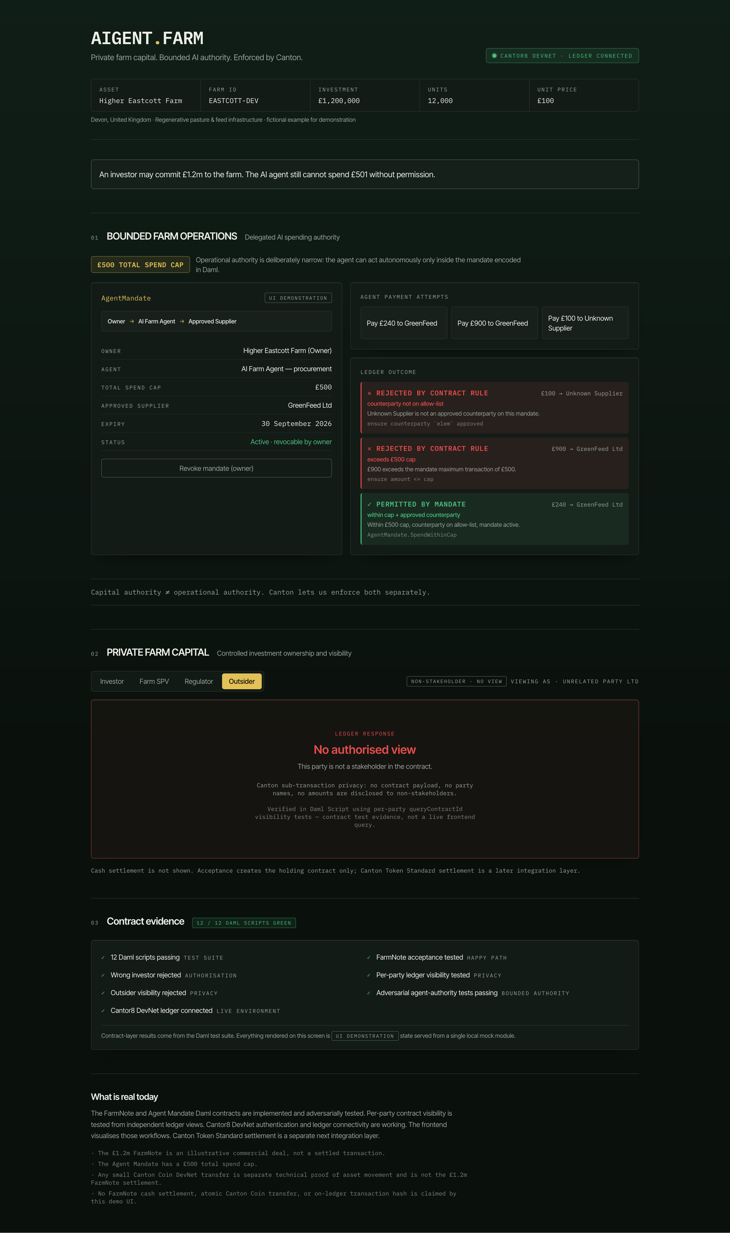
06 · THE DEMO
One screen: mandate, attacks, ledger outcome.
CANTON AGENT MANDATE · AIGENT.FARM
7

Slide 8
07 · PRIVACY EXTENSION
Capital authority ≠ operational authority.
FARM SPV
INVESTOR
REGULATOR
OUTSIDER
issuer / signatory
stakeholder / accept
observer / read-only
no authorised view
An investor may commit £1.2m to the farm. The AI procurement agent still cannot spend £501 without permission.
Privacy is tested per party on the ledger — it isn't CSS.
CANTON AGENT MANDATE · AIGENT.FARM
8

Slide 9
08 · WHAT IS REAL
A deliberately defensible prototype.
PROVEN
NOT CLAIMED
✓ Daml mandate enforcement
— Final GreenFeed acceptance
✓ 12 / 12 adversarial/privacy tests
— Atomic mandate + settlement
✓ Real Cantor8 parties
— Settled £1.2m FarmNote
✓ Real 10 CC funding
— £240 = 1 CC
✓ Real 1 CC transfer offer
✓ Real 10 → 9 spendable transition
✓ Real 1 CC locked
Receiver acceptance remains pending.
CANTON AGENT MANDATE · AIGENT.FARM
9

Slide 10
CANTON AGENT MANDATE
Programmable authority for money and assets.
Give people and AI agents exactly enough authority to move money and assets — and no more.
AI decides what it wants to do. Canton decides what it is allowed to do.
12 / 12 TESTS GREEN
Real DevNet · Real CC · Real transfer offer
CANTON AGENT MANDATE · AIGENT.FARM
10

