Slide 1
Audio Source Separation
EE698R course project
[Conscious?]
(Harsh Kumar , Shorya Kumar)

Slide 2
Introduction

Slide 3
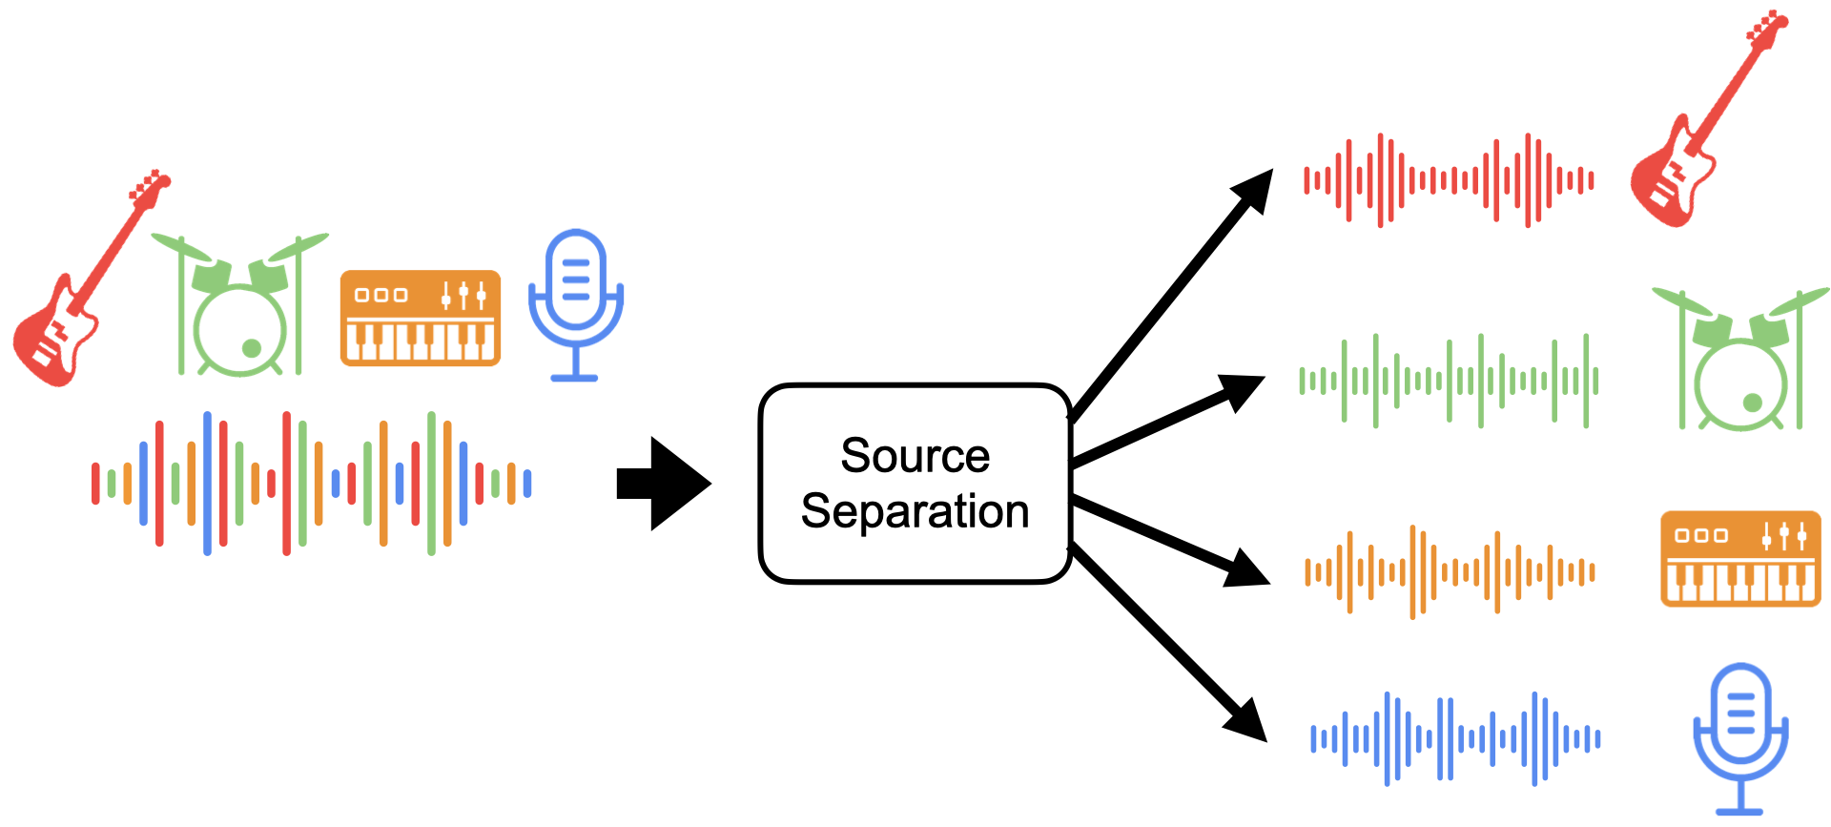
Audio Source Separation

Slide 4
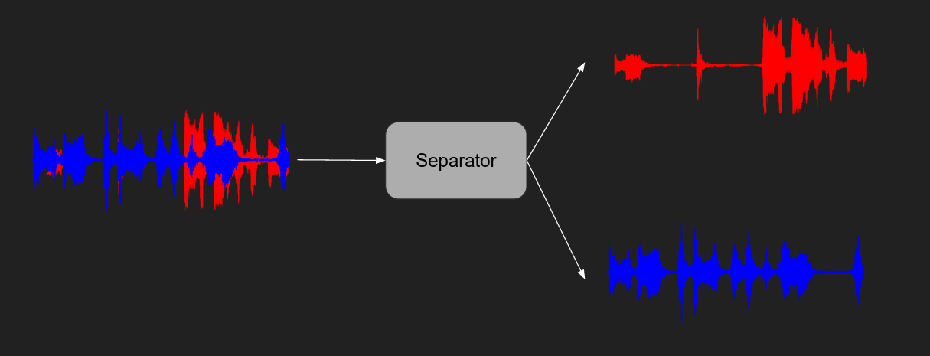
What we are doing
+
Source: https://medium.com/analytics-vidhya/improving-voice-separation-by-incorporating-end-to-end-speech-recognition-c3dd57d80206

Slide 5
Paper Approach

Slide 6
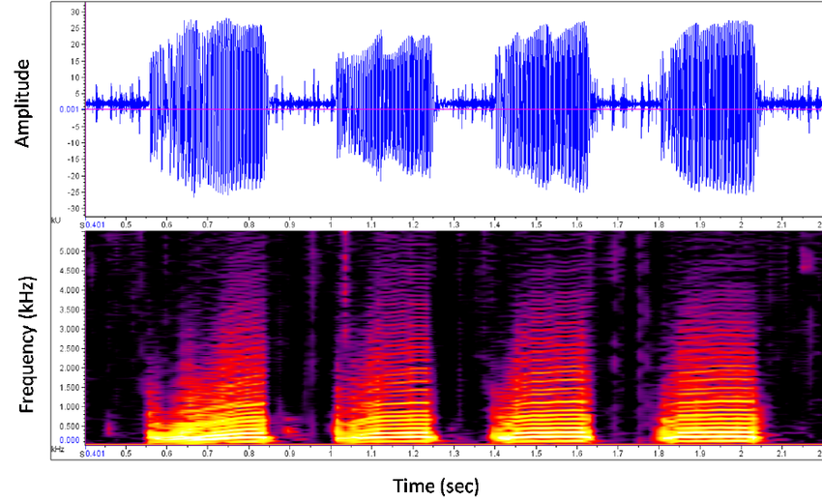
Models for separation usually operate on magnitude spectrum, which ignores phase information.
The STFT output depends on many parameters, such as the size and overlap of audio frames, which can affect the time and frequency resolution. Ideally, these parameters should be optimised with parameters of the separation model to maximise performance for a particular separation task. In practice, however, the transform parameters are fixed to specific values.
Frequency domain v/s Time domain
https://www.researchgate.net/figure/Spectrograms-and-Oscillograms-This-is-an-oscillogram-and-spectrogram-of-the-boatwhistle_fig2_267827408
Source: https://arxiv.org/pdf/1806.03185.pdf [WAVE-U-NET: A MULTI-SCALE NEURAL NETWORK FOR END-TO-END AUDIO SOURCE SEPARATION]

Slide 7
Secondly, the separation model does not estimate the source phase, it is often assumed to be equal to the mixture phase, which is incorrect for overlapping partials. Alternatively, the Griffin-Lim algorithm can be applied to find an approximation to a signal whose magnitudes are equal to estimated ones, but this is slow and often no such signal exists.
Lastly, the mixture phase is ignored in the estimation of sources, which can potentially limit the performance. Thus, it would be desirable for the separation model to learn to estimate the source signals including their phase directly
Frequency domain v/s Time domain
Source: https://arxiv.org/pdf/1806.03185.pdf [WAVE-U-NET: A MULTI-SCALE NEURAL NETWORK FOR END-TO-END AUDIO SOURCE SEPARATION]

Slide 8
Data Preprocessing

Slide 9
MIR-1k dataset
1000 song clips which the music accompaniment and the singing voice are recorded at left and right channels, respectively.
Manual annotations of the dataset include pitch contours in semitone, indices and types for unvoiced frames, lyrics, and vocal/non-vocal segment.
The speech recordings of the lyrics by the same person who sang the songs are also provided in the dataset.

Slide 10
Our Modifications
We used only the undivided 2-channel audio files present in MIR-1K, and created the input and output dataset by merging the channels and separating them respectively.
Hence our model takes a 1-channel audio (Mono) file as input and gives 2 1-channel audio (Mono) files, one for the music accompaniment and one for the vocals.
The audio files had lengths varying from 22 secs to 126 secs.
We clipped all audio files to 1 sec audio files (sampled at 16kHz) due to machine specifications and constraints. Thus we got around 7947 1-sec samples.

Slide 11
Model summary

Slide 12
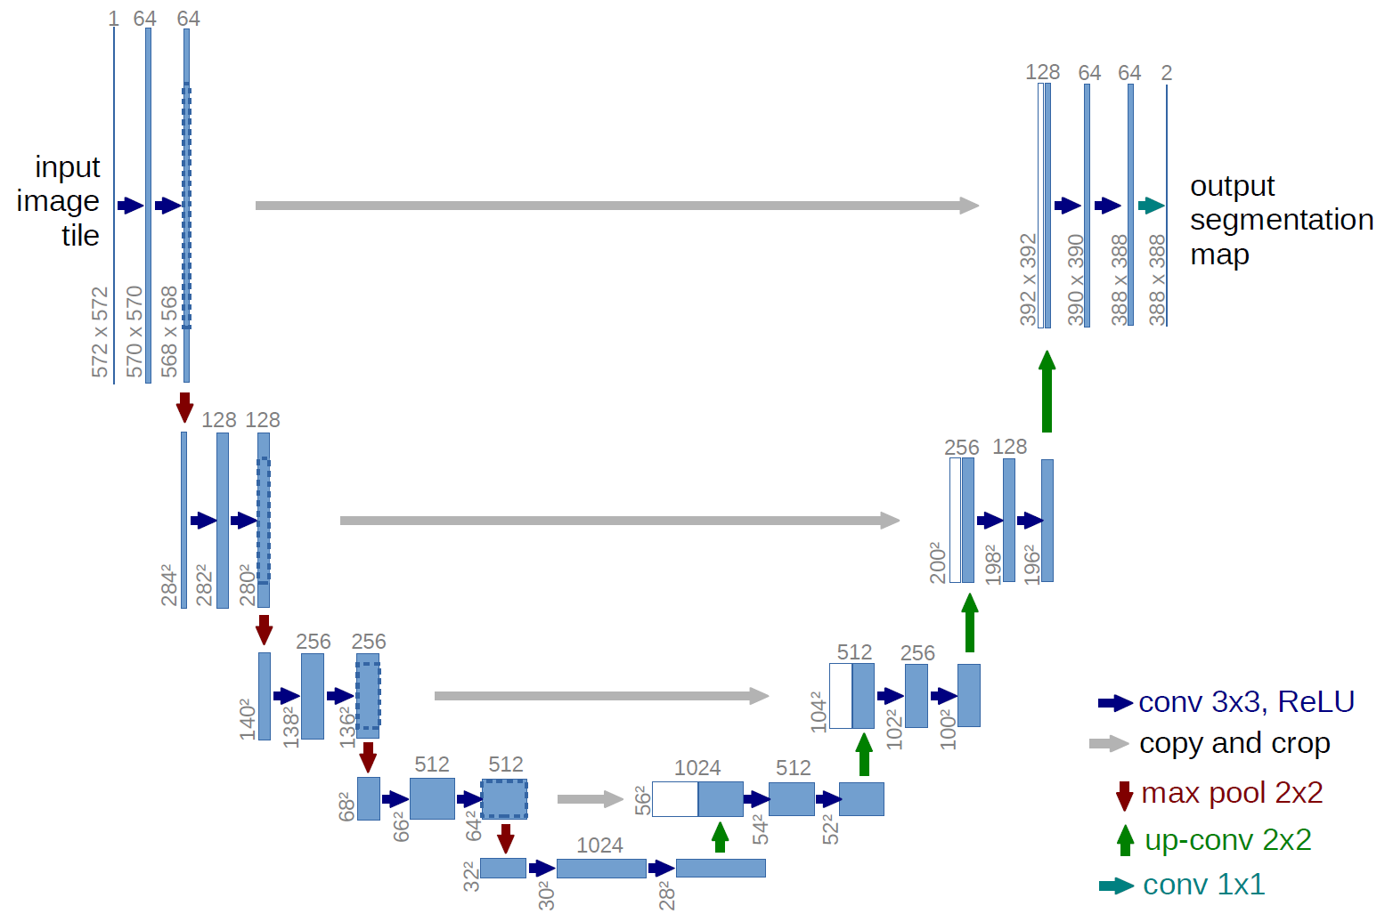
U-Net Model
Source: https://lmb.informatik.uni-freiburg.de/people/ronneber/u-net/

Slide 13
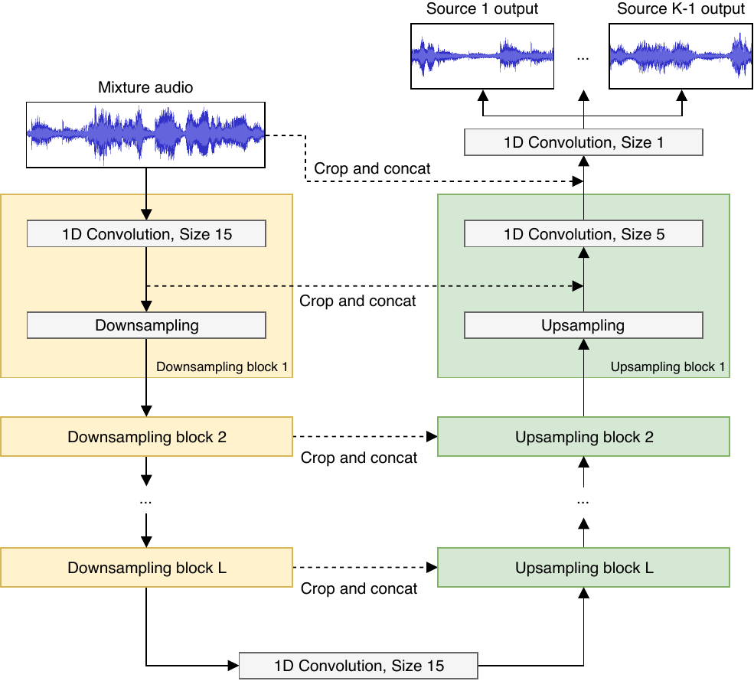
Wave U-Net Model
Source: https://arxiv.org/pdf/1806.03185.pdf [WAVE-U-NET: A MULTI-SCALE NEURAL NETWORK FOR END-TO-END AUDIO SOURCE SEPARATION]

Slide 14
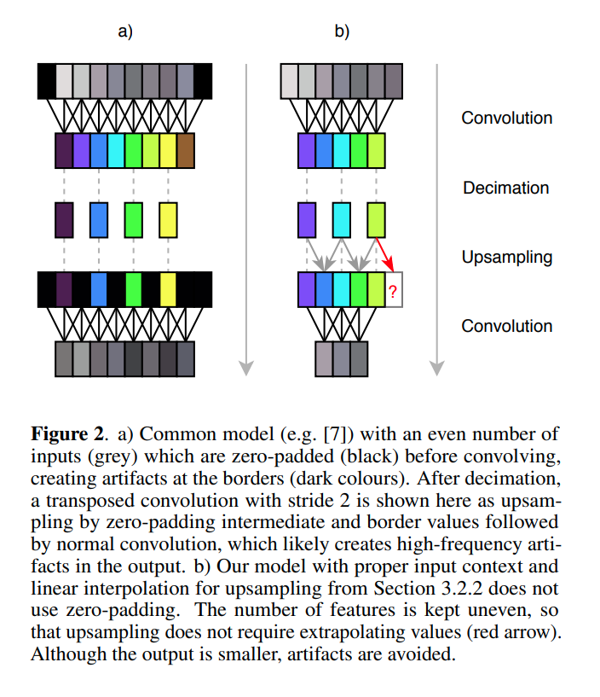
Source: https://arxiv.org/pdf/1806.03185.pdf [WAVE-U-NET: A MULTI-SCALE NEURAL NETWORK FOR END-TO-END AUDIO SOURCE SEPARATION]

Slide 15
Downsampling Block
Convolution This is a general 1D convolutional layer with a fixed kernel size and fixed number of filters for each block individually. We take a stride of 1, hence the output of this layer would be L - k + 1 where L is the initial length of the 1D input to this layer and k is the kernel size. This follows no padding and an activation layer of Leaky-ReLU.
Downsampling Here the resolution of the input, given to this layer, is halved by dropping out every alternate frame/element of the input and hence the output length being half the input length.
Source: https://arxiv.org/pdf/1806.03185.pdf

Slide 16
Upsampling Block
Upsampling Here the resolution of the input is almost doubled by expanding the input into twice its length and filling the gaps with the mean of the values of their neighbours. Note that this is NOT done for the first and last value. So, a L length input becomes a 2L - 1 length output.
Crop and Concat For the i^{th} upsampling block, the output of the convolutional layer of the i^{th} downsampling block is cropped to fit the input of this layer and then concatenated on the input along the channels.
Convolution This is a general 1D convolutional layer similar to the one used in the downsampling block.
Source: https://arxiv.org/pdf/1806.03185.pdf

Slide 17
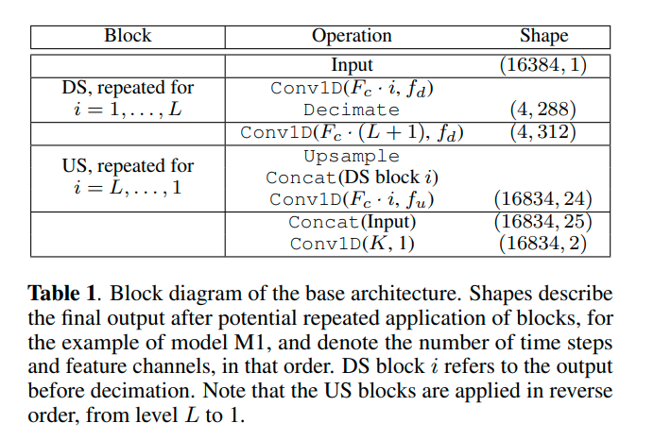
Source: https://arxiv.org/pdf/1806.03185.pdf [WAVE-U-NET: A MULTI-SCALE NEURAL NETWORK FOR END-TO-END AUDIO SOURCE SEPARATION]

Slide 18
Training
Loss Function - Mean Squared Error (MSE)
Optimizer - Adaptive Moment (AdaM) Optimizer With a learning rate of η = 0.001, β₁ = 0.9 and β₂ = 0.999
Batch Size - 16
Input Length - 16000 (as audio is sampled at 16kHz)
No of Layers, L - 11
Extra Filters per layer, F_{c} - 24
Filter Size/Kernel Size - 15 for downsampling block and 5 for upsampling block

Slide 19
Question from last time :
Why not Transposed Convolution

Slide 20
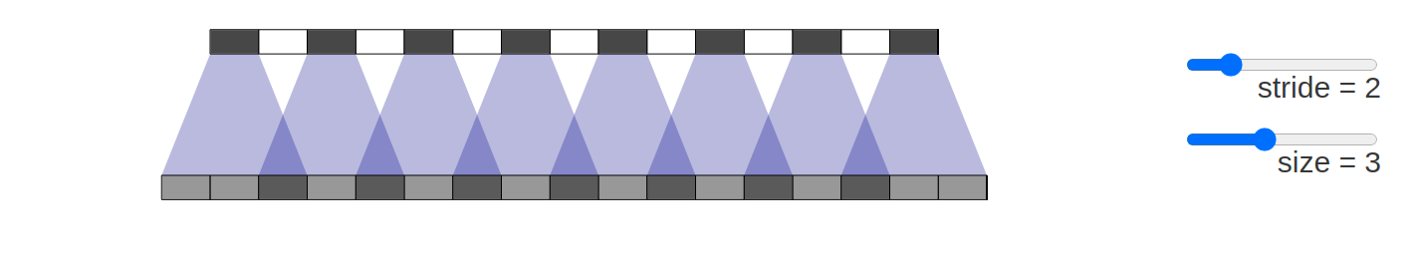
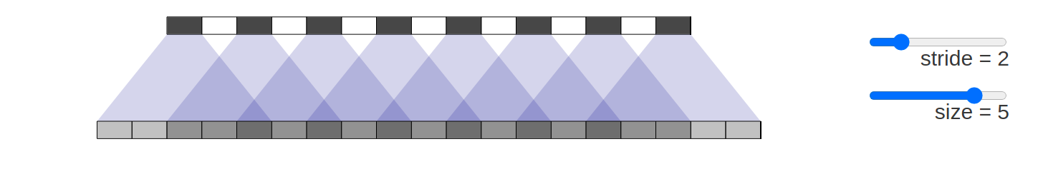
Upsampling artifacts are caused by problematic upsampling layers and due to spectral replicas that emerge while upsampling. Also, depending on the used upsampling layer, such artifacts can either be tonal artifacts (additive high-frequency noise) or filtering artifacts (subtractive, attenuating some bands)
Unfortunately, deconvolution can easily have “uneven overlap,” putting more of the metaphorical paint in some places than others . In particular, deconvolution has uneven overlap when the kernel size (the output window size) is not divisible by the stride (the spacing between points on the top). While the network could, in principle, carefully learn weights to avoid this, in practice neural networks struggle to avoid it completely.
When such convolutions were used as upsampling blocks in the Wave-U-Net model, artifacts were found in the form of high-frequency buzzing noise.
Source: https://distill.pub/2016/deconv-checkerboard/ , https://arxiv.org/pdf/2111.11773.pdf

Slide 21
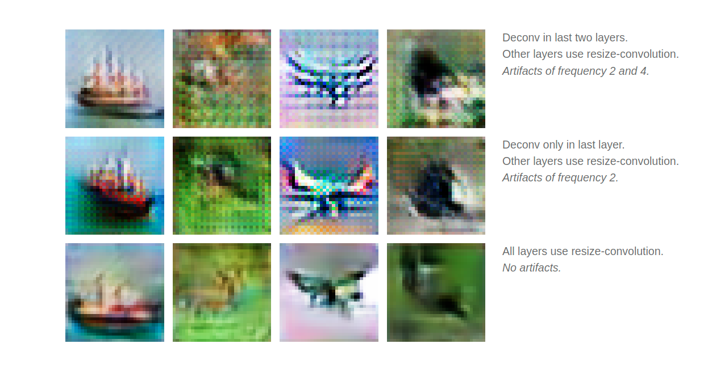
Source: https://distill.pub/2016/deconv-checkerboard/ , https://arxiv.org/pdf/2111.11773.pdf

Slide 22
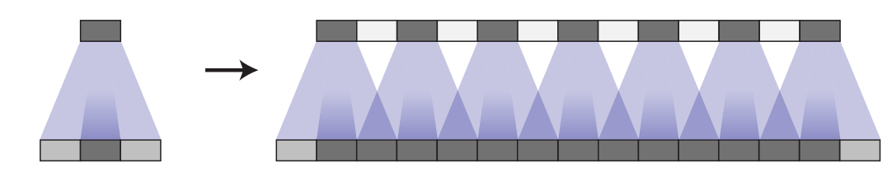
Thinking about things in terms of uneven overlap is — while a useful framing — kind of simplistic. For better or worse, the model learns weights for their deconvolutions. In theory, our models could learn to carefully write to unevenly overlapping positions so that the output is evenly balanced.
In fact, not only do models with uneven overlap not learn to avoid this, but models with even overlap often learn kernels that cause similar artifacts! While it isn’t their default behavior the way it is for uneven overlap, it’s still very easy for even overlap deconvolution to cause artifacts.
Source: https://distill.pub/2016/deconv-checkerboard/ , https://arxiv.org/pdf/2111.11773.pdf

Slide 23
Architectural Improvements

Slide 24
Difference Output Layer
The baseline model outputs one source estimate for each of K sources by independently applying K convolutional filters followed by a tanh nonlinearity to the last feature map.
We consider the mixture signal as the sum of its source signal components:
M ≈ S₁+S₂+...+S_{K}.
Since the baseline model is not constrained in this fashion, it has to learn this rule approximately to avoid highly improbable outputs, which could slow down learning and reduce performance.
Therefore, the authors use a difference output layer to constrain the outputs S_{j} such that only K - 1 source signals are estimated and the last source is then simply computed as
S_{K} ≈ M - (S₁+S₂+...+S_{K}).
Source: https://arxiv.org/pdf/1806.03185.pdf [WAVE-U-NET: A MULTI-SCALE NEURAL NETWORK FOR END-TO-END AUDIO SOURCE SEPARATION]

Slide 25
Learned Upsampling
Linear interpolation for upsampling is simple, parameter-less and encourages feature continuity. However, it may be restricting the network capacity too much.
The authors have proposed the learned upsampling layer. For a given F × n feature map with n time steps, we compute an interpolated feature f_{t+0.5} ∈ R^{F} for pairs of neighbouring features f_{t}, f_{t+1} ∈ R^{F} using parameters w ∈ R^{F} and the sigmoid function σ to constrain each w_{i} ∈ w to the [0, 1] interval:
f_{t+0.5} = σ(w) ⵙ f_{t} + (1 − σ(w)) ⵙ f_{t+1}
The learned interpolation layer can be viewed as a generalisation of simple linear interpolation, since it allows convex combinations of features with weights other than 0.5.
Source: https://arxiv.org/pdf/1806.03185.pdf [WAVE-U-NET: A MULTI-SCALE NEURAL NETWORK FOR END-TO-END AUDIO SOURCE SEPARATION]

Slide 26
Evaluation

Slide 27
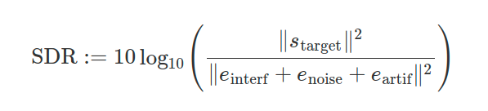
SDR (Signal-to-Distortion Ratio)
The signal-to-distortion (SDR) metric is commonly used to evaluate source separation performance . An audio track is usually partitioned into non-overlapping audio segments multiple seconds in length, and segment-wise metrics are then averaged over each audio track or the whole dataset to evaluate model performance.
The SDR computation is problematic when the true source is silent or near-silent. In case of silence, the SDR is log(0), i.e. undefined , which happens often for vocal tracks.
Source: https://arxiv.org/pdf/1806.03185.pdf [WAVE-U-NET: A MULTI-SCALE NEURAL NETWORK FOR END-TO-END AUDIO SOURCE SEPARATION]

Slide 28
MAD (Mean Absolute Deviation)
Since the collection of segment-wise vocal SDR values across the dataset is not normally distributed , the mean and standard deviation are not sufficient . As a workaround, authors take the median over segments, as it is robust against outliers , using the median absolute deviation (MAD) as a rank-based equivalent to the standard deviation (SD).
We also note that increasing the duration of segments beyond one second alleviates this issue by removing many, but not all outliers. This is more memory-intensive and presumably still punishes errors during silent sections most.
Source: https://arxiv.org/pdf/1806.03185.pdf [WAVE-U-NET: A MULTI-SCALE NEURAL NETWORK FOR END-TO-END AUDIO SOURCE SEPARATION]

Slide 29
Limitations

Slide 30
Inconsistencies in Boundaries
Lost Temporal Context
Since the model’s input and output are of equal length and the total output is created by concatenating predictions for non-overlapping consecutive audio segments, inconsistencies and discontinuities emerge at the borders.
The loudness might abruptly decreases at the end of a 4s, and a beginning vocal melisma is suddenly cut off at 2s seconds, leaving only quiet noise, before the vocals reappear at 4s.
A vocal melisma with only the vowel “a” can sound similar to a non-vocal instrument and presumably was mistaken for one because no further temporal context was available.
This model is less capable of performing separation wherever information from a temporal context is required. Larger input and output sizes somewhat alleviate the issue.
Source: https://arxiv.org/pdf/1806.03185.pdf [WAVE-U-NET: A MULTI-SCALE NEURAL NETWORK FOR END-TO-END AUDIO SOURCE SEPARATION]

Slide 31
Team

Slide 32


Harsh Kumar
(harshku@iik.ac.in)
Shorya Kumar
(shoryak@iik.ac.in)

Slide 33
Q/A

Slide 34
Where is the paper published
What did you do in the project exactly
How every function works in training
Importance of audio source separation
Maths add kardena slides me
Vanishing gradients problem in WaveUNet

Slide 35
Thank You!!!

