Slide 1
FAKE NEWS DETECTION Using NLP
Presentation by-
Jyoti Nigam (158)

Slide 2
Contents
Algorithms
Implementation
Methodology
Introduction
Results
QnA

Slide 3

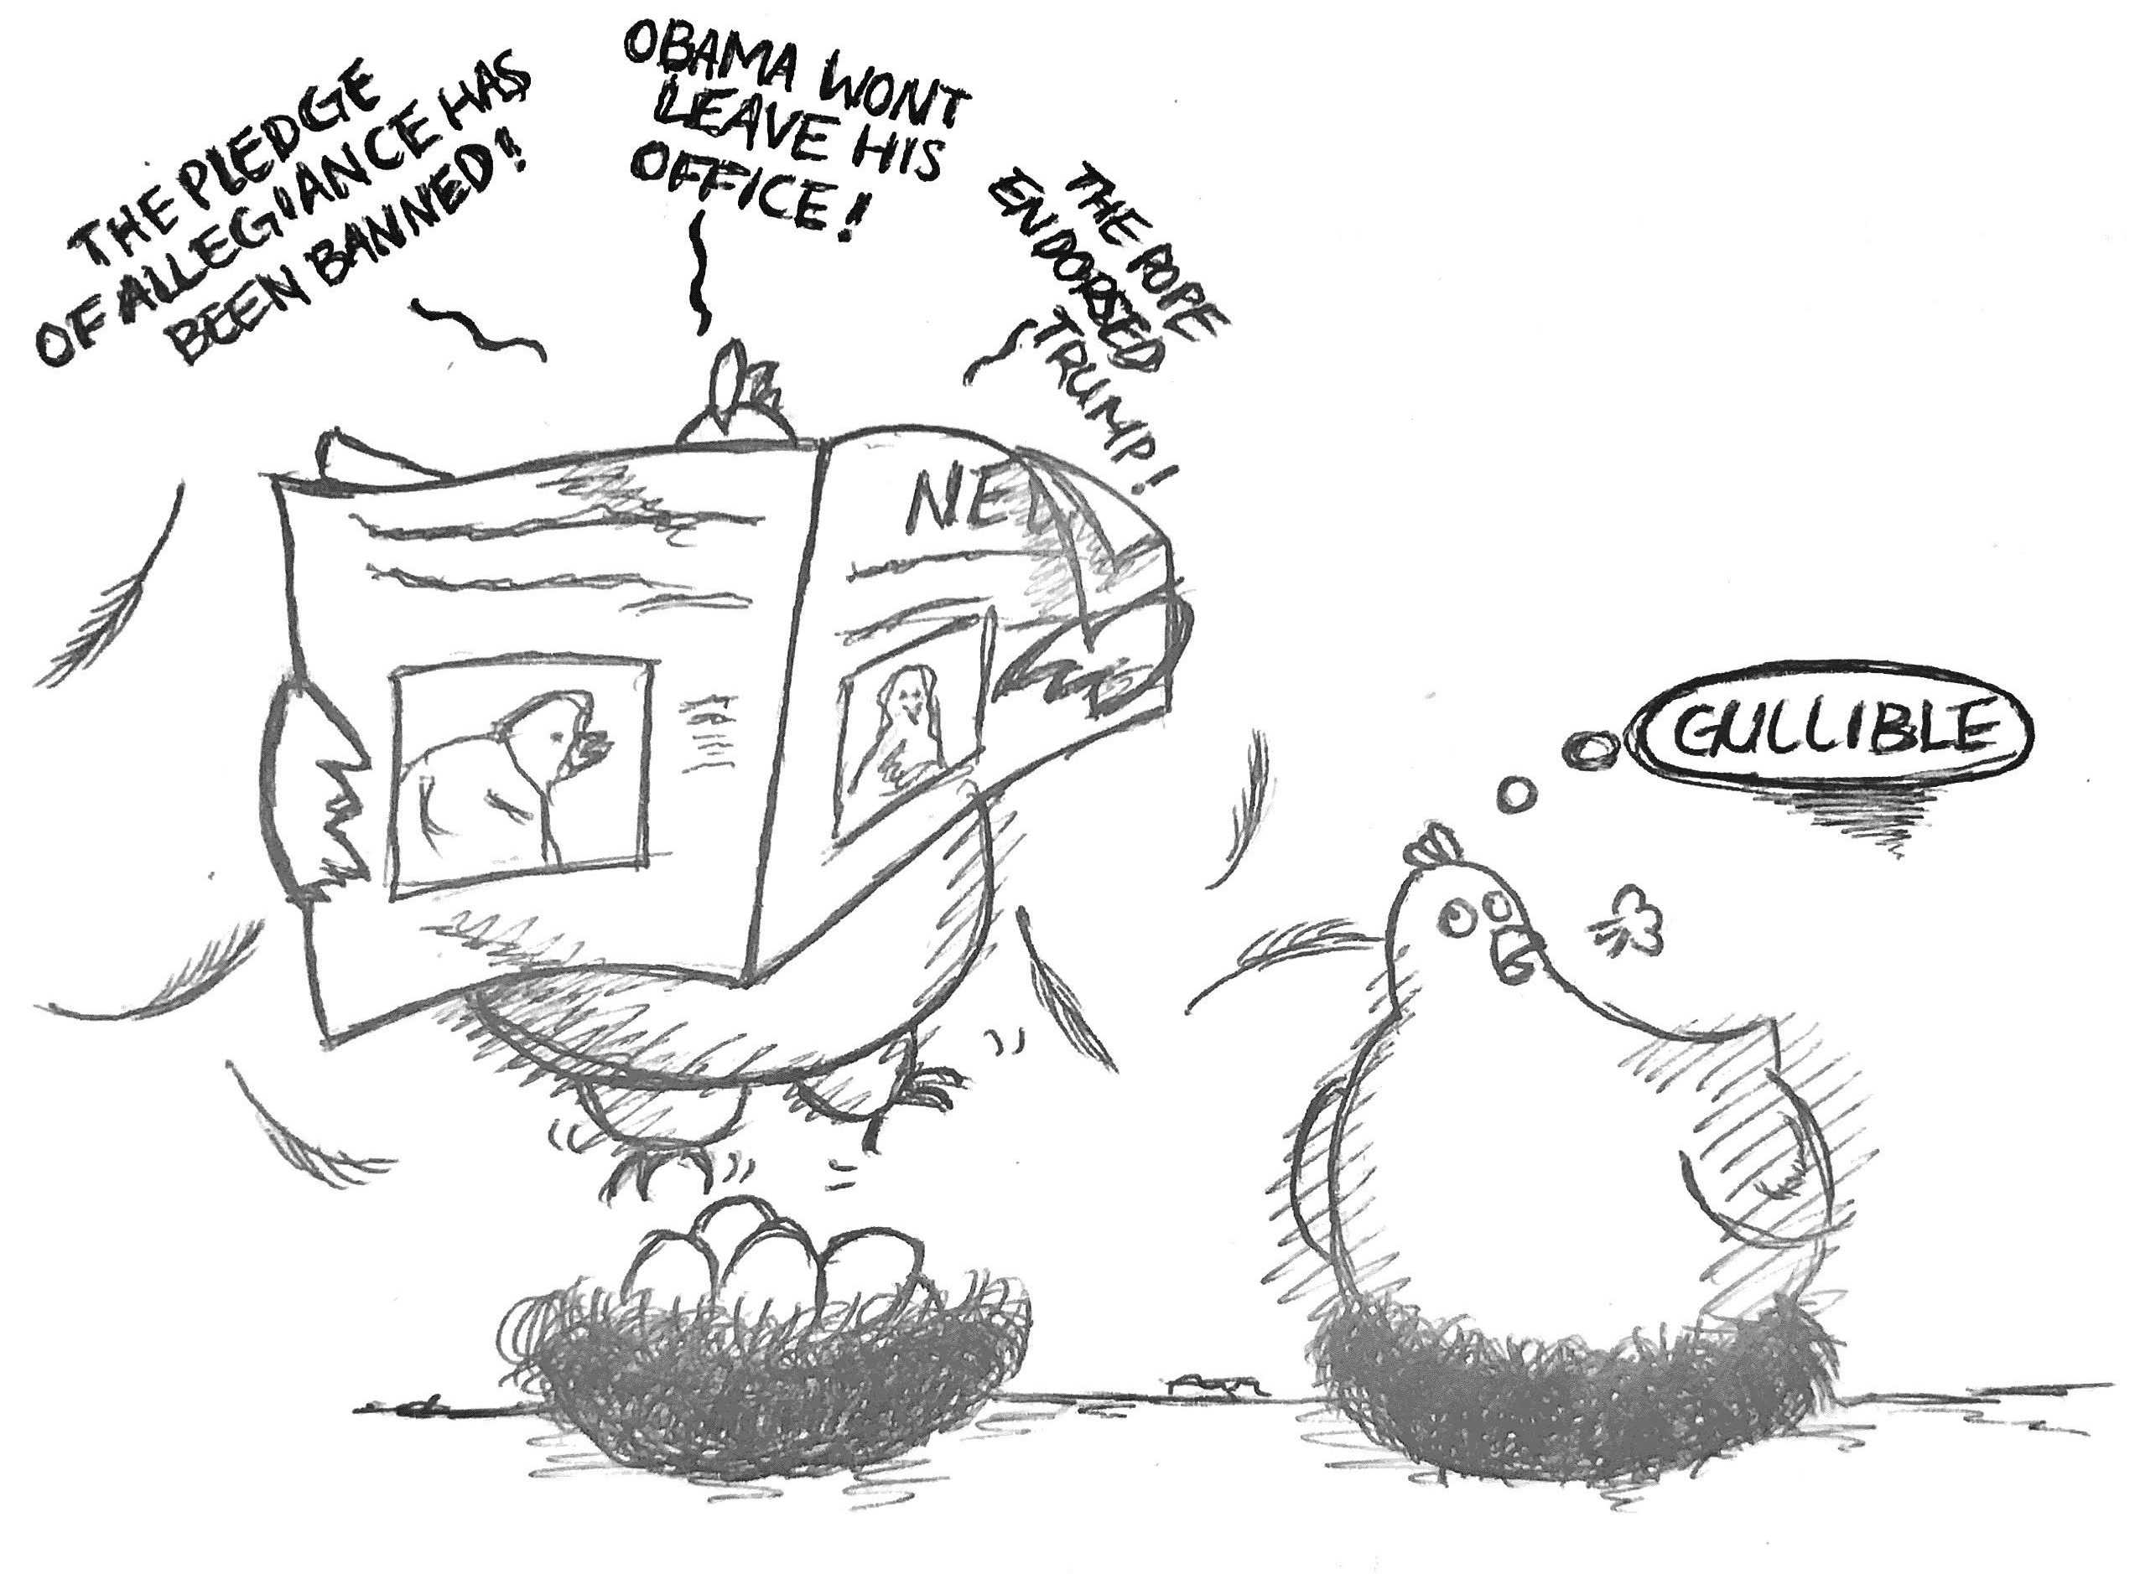
FAKE NEWS
Fake news's simple meaning is to incorporate information that leads people to the wrong path. Nowadays fake news spreading like water and people share this information without verifying it. This is often done to further or impose certain ideas and is often achieved with political agendas.

Slide 4
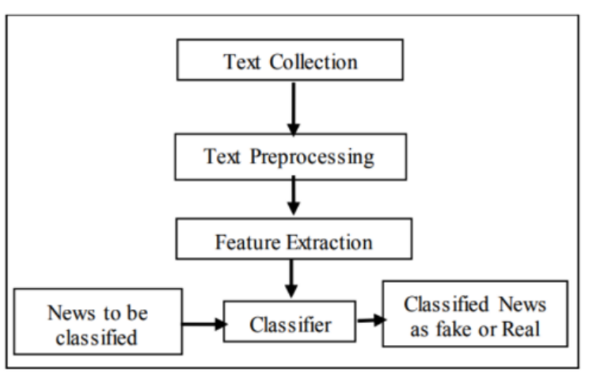
METHODOLOGY
DATASET- I have used the ISOT dataset which can be downloaded from -
https://www.uvic.ca/ecs/ece/isot/datasets/index.php
LANGUAGE USED
PYTHON

Slide 5
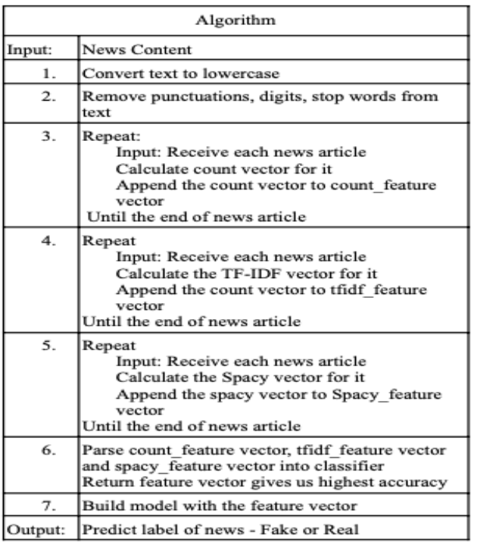
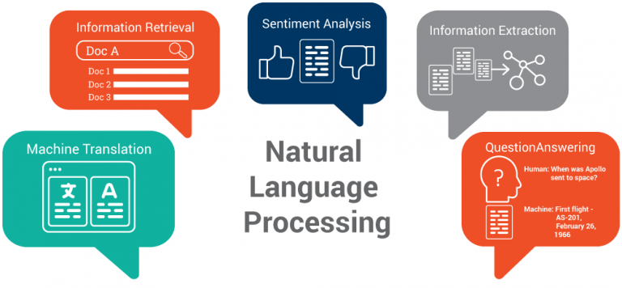
ALGORITHMS

Slide 6
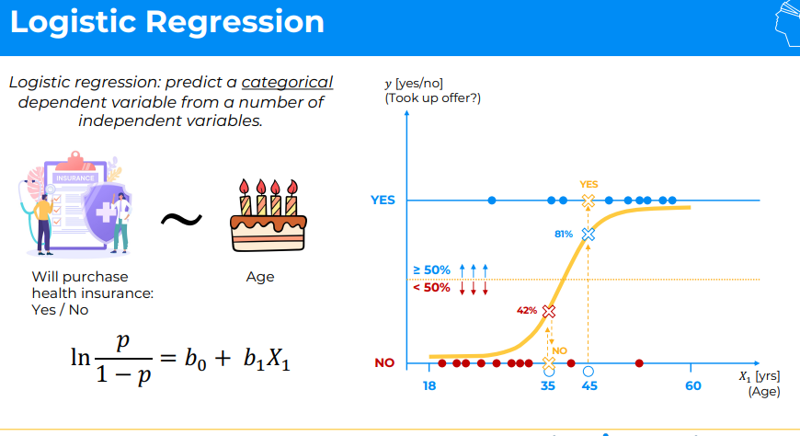
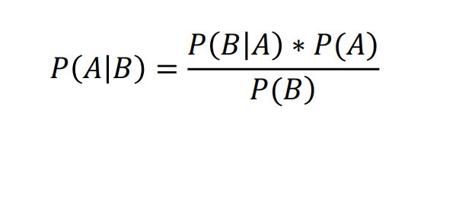
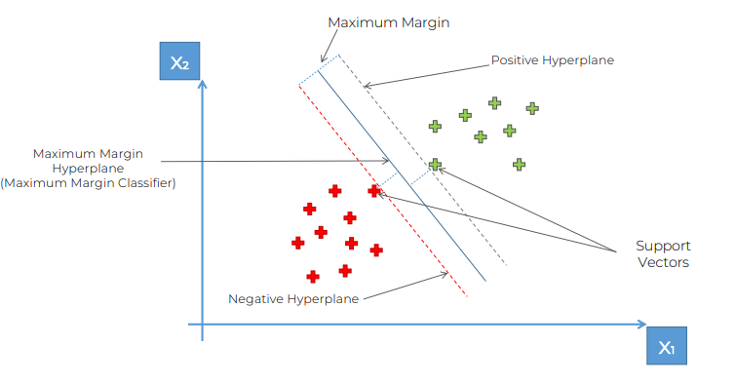
ALGORITHMS

Slide 7
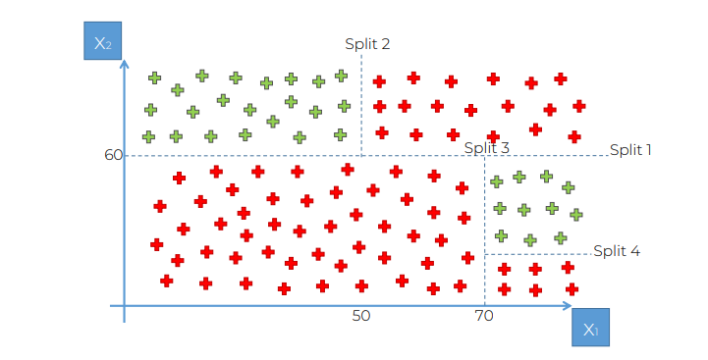
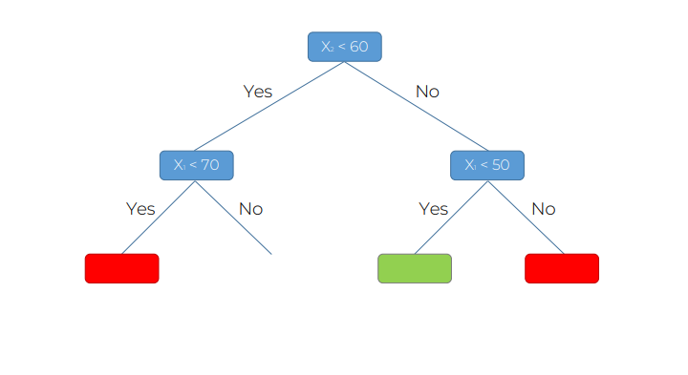
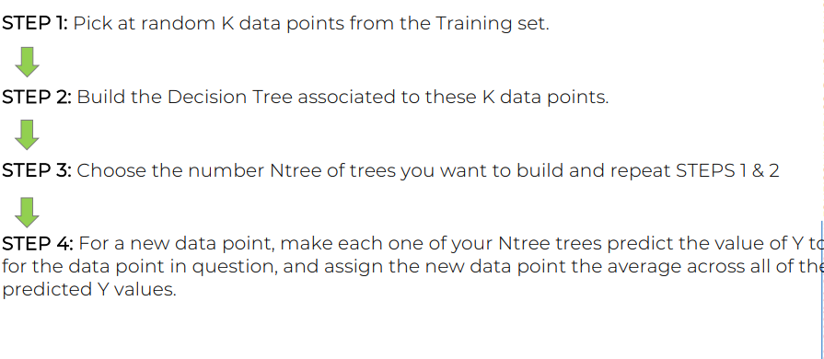

Slide 8

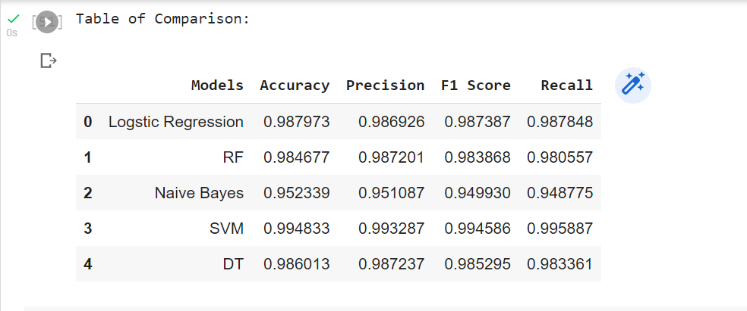
IMPLEMENTATION
https://colab.research.google.com/drive/1QWda9aPuMBGttFVg2_Ms9_RtEOER4bud?usp=sharing

Slide 9
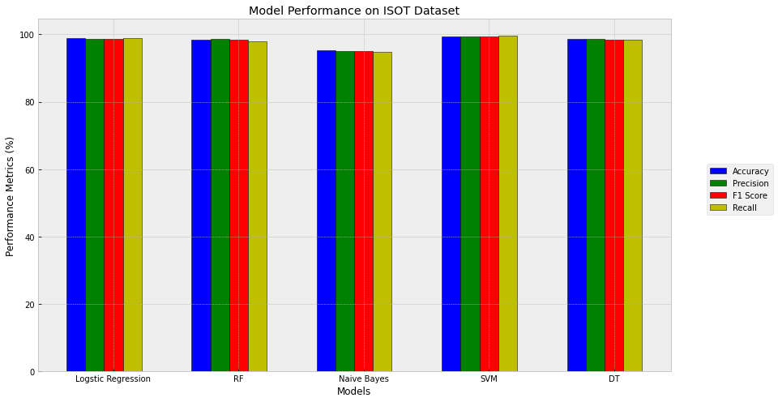
RESULTS

Slide 10
Q/A Up for your questions. THANKYOU

