Slide 1
promise object
promise object
promise object
Call
back
Call
back
Call
back

Slide 2
promise object
Call
back
Call
back
Call
back

Slide 3
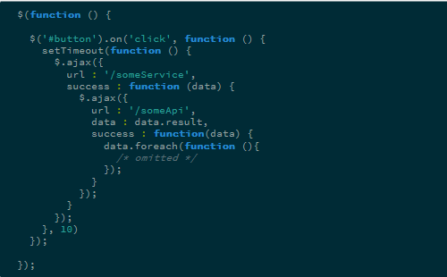
1
2
3
4
5

